Slide 1
>> IN THE NAME OF ALLAH, THE MOST GRACIOUS, THE MOST MERCIFUL <<
FRAGILITY ANALYSIS BASED ON ACCELERATION, STRUCTURAL DUCTILITY DAMAGE INDEX, ENERGY DISSIPATION CAPACITY INDEX, EQULIVALENT VISCOUS DAMPING RATIO WITH NONLINEAR DYNAMIC ANALYSIS OF A MULTI-DEGREE-OF-FREEDOM (MDOF) SYSTEM UTILIZING 50 GROUND MOTIONS IN OPENSEES
WRITTEN BY SALAR DELAVAR GHASHGHAEI (QASHQAI)

Slide 2


Slide 3
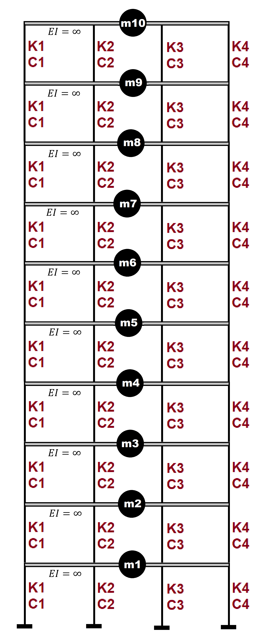

Slide 4
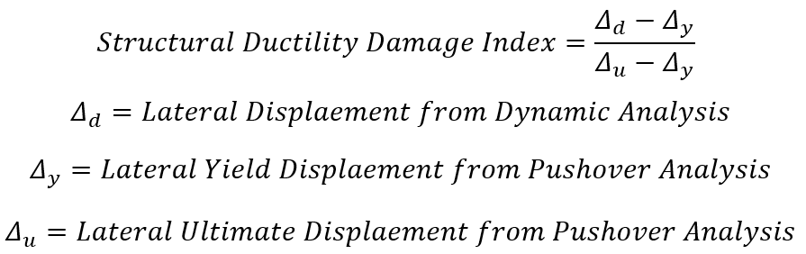

Slide 5
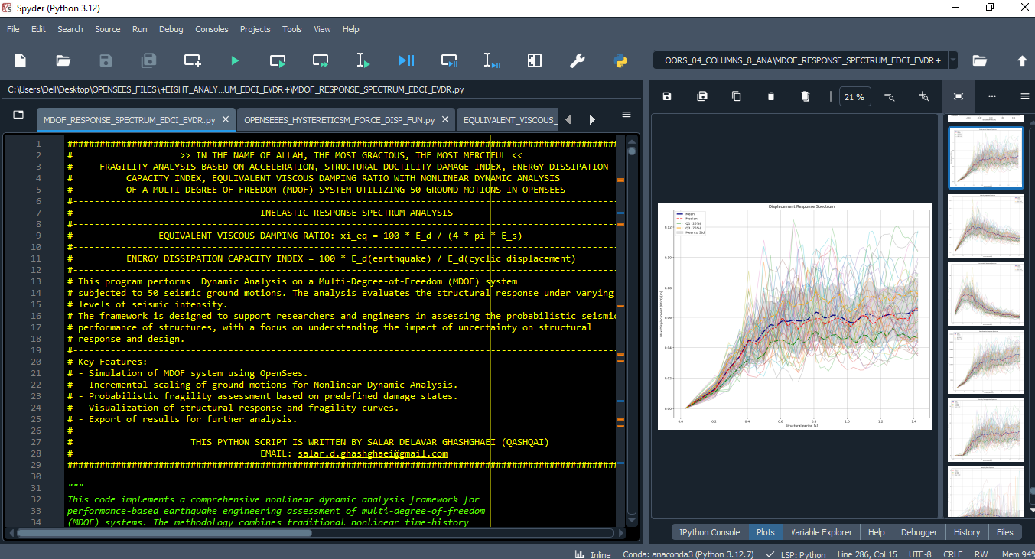

Slide 6
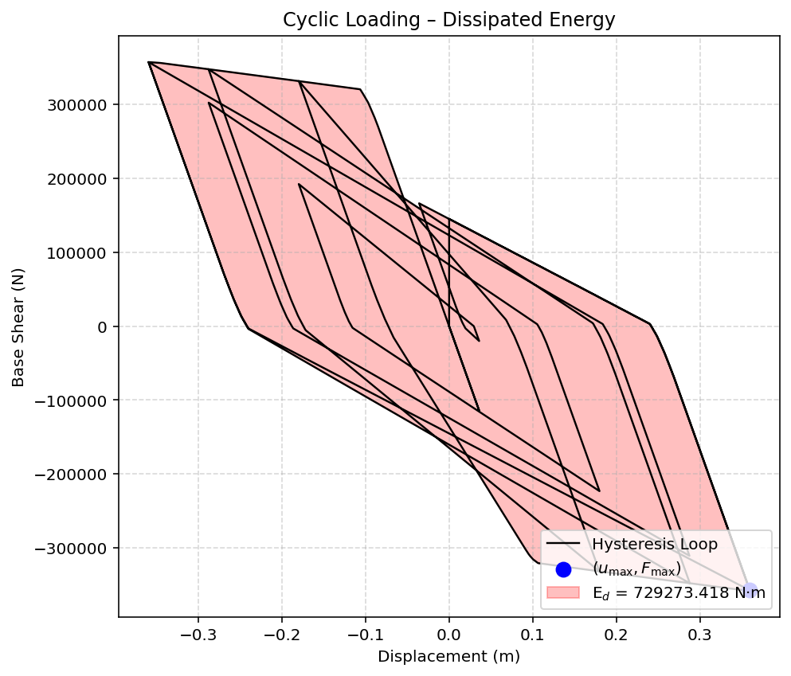

Slide 7
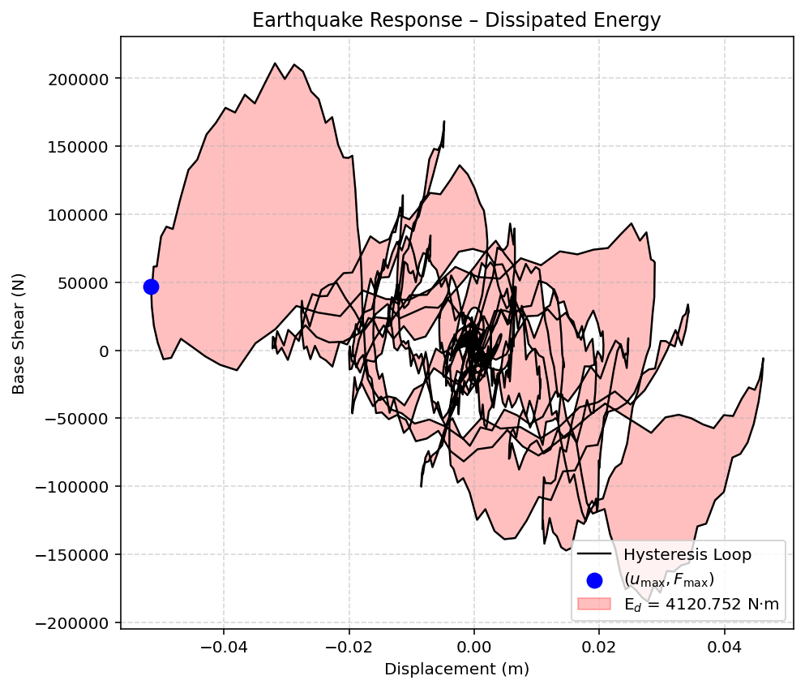

Slide 8
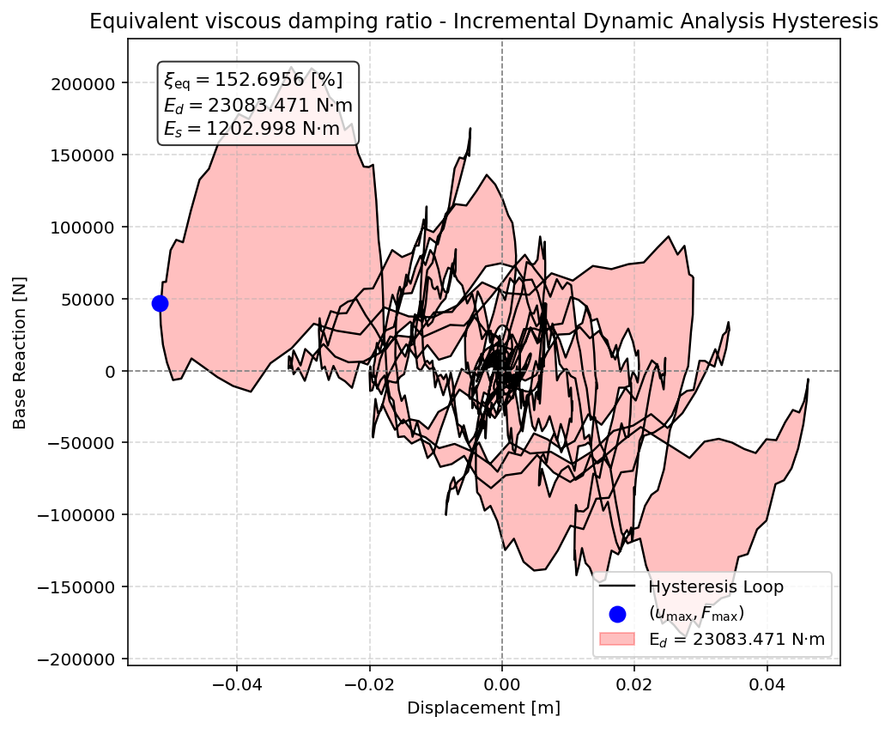

Slide 9
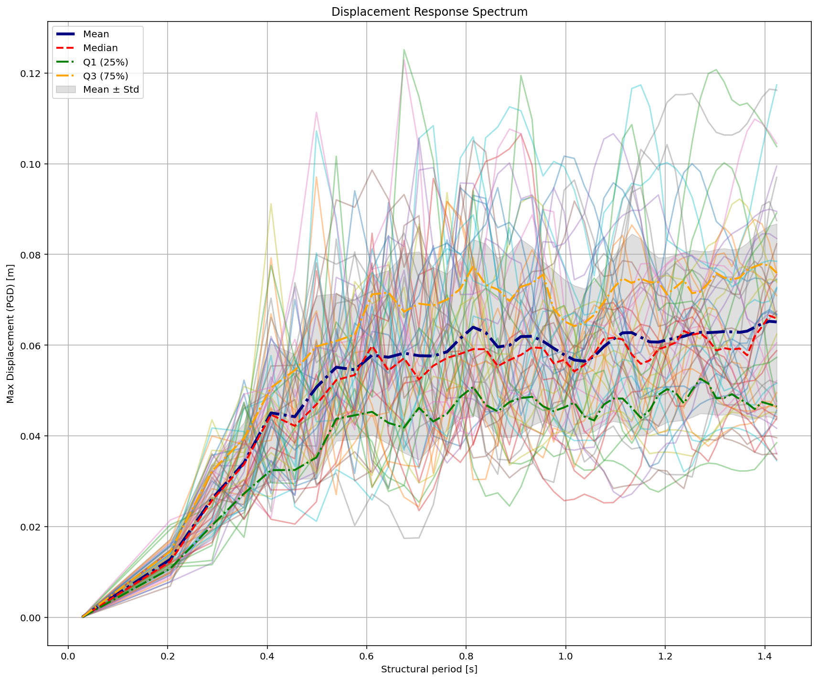

Slide 10
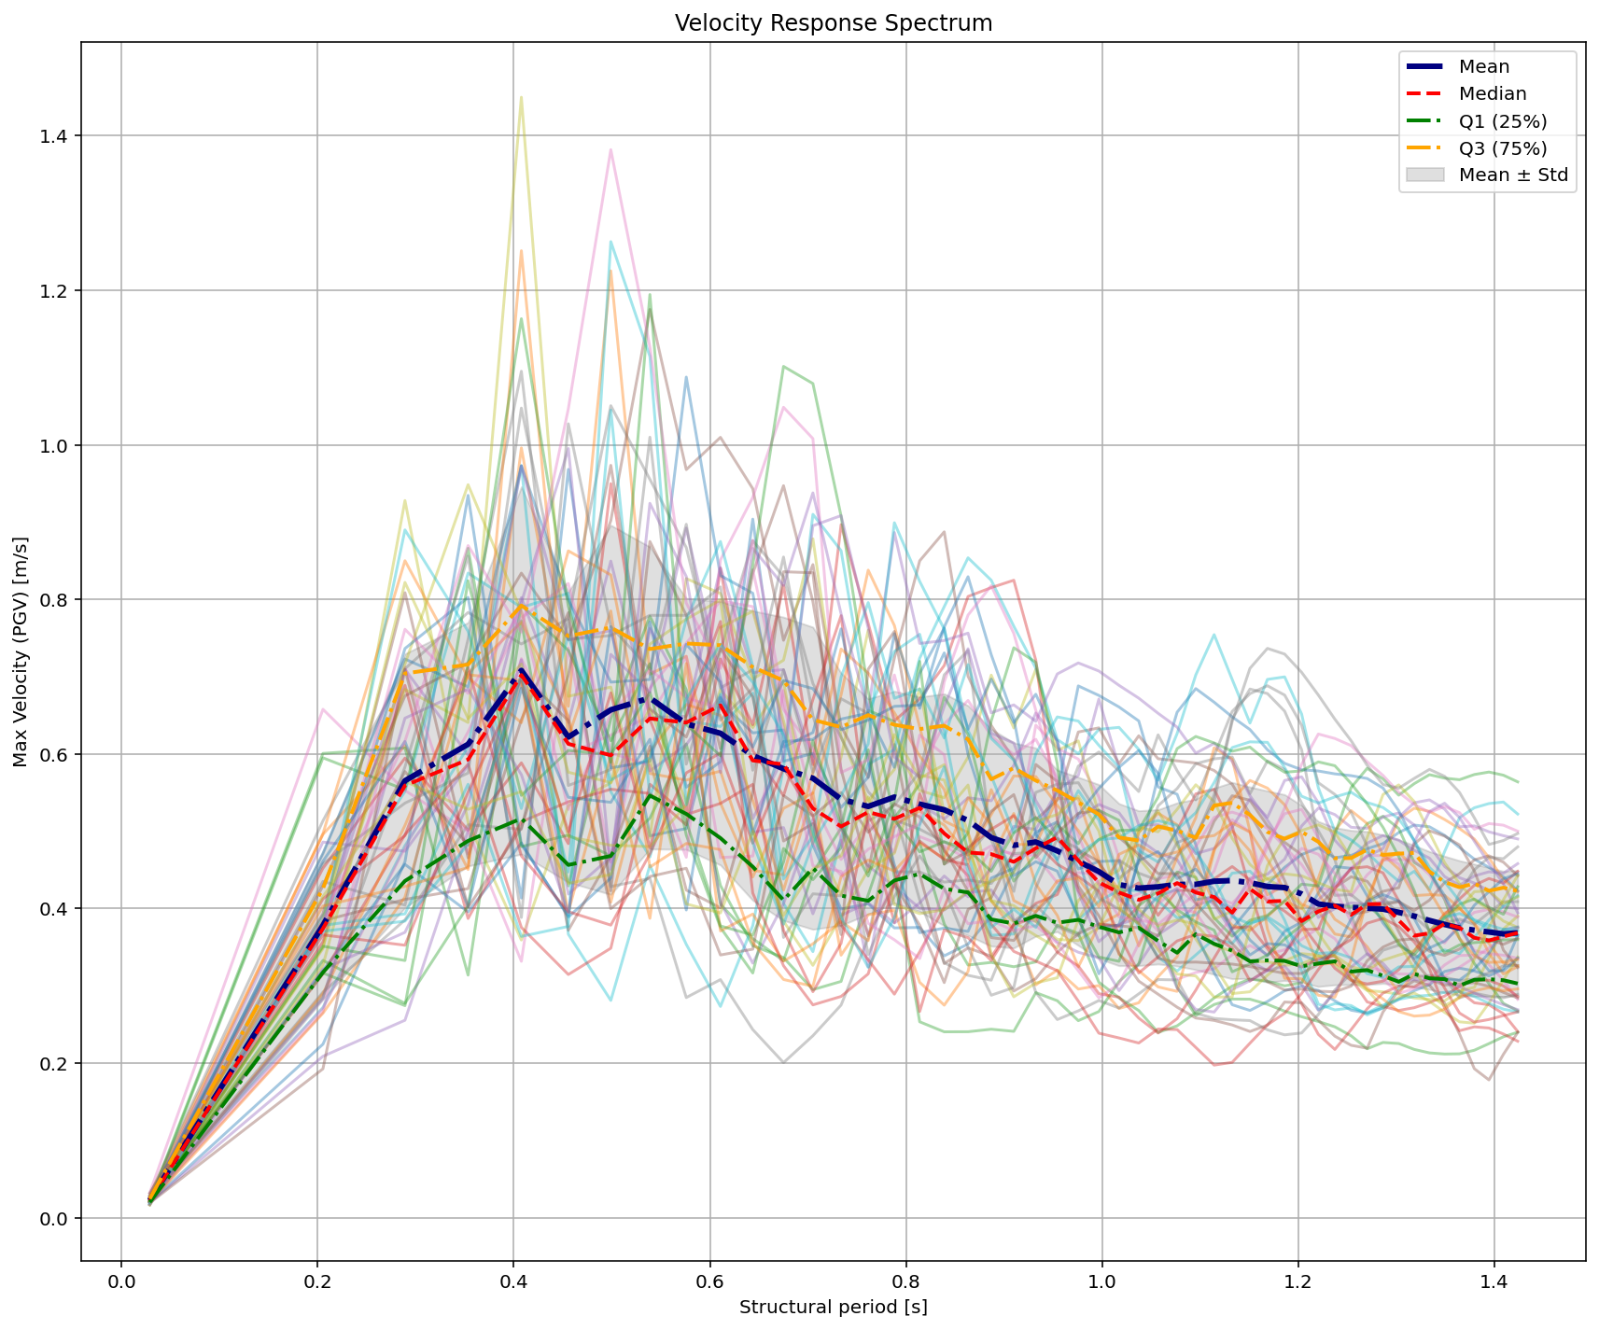

Slide 11
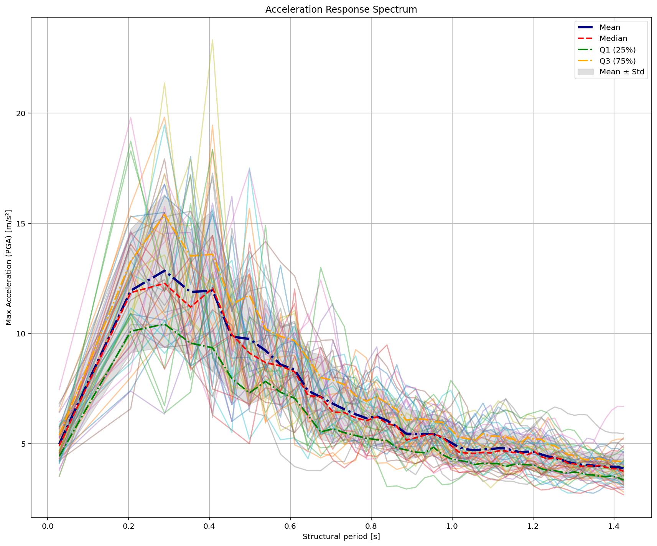

Slide 12
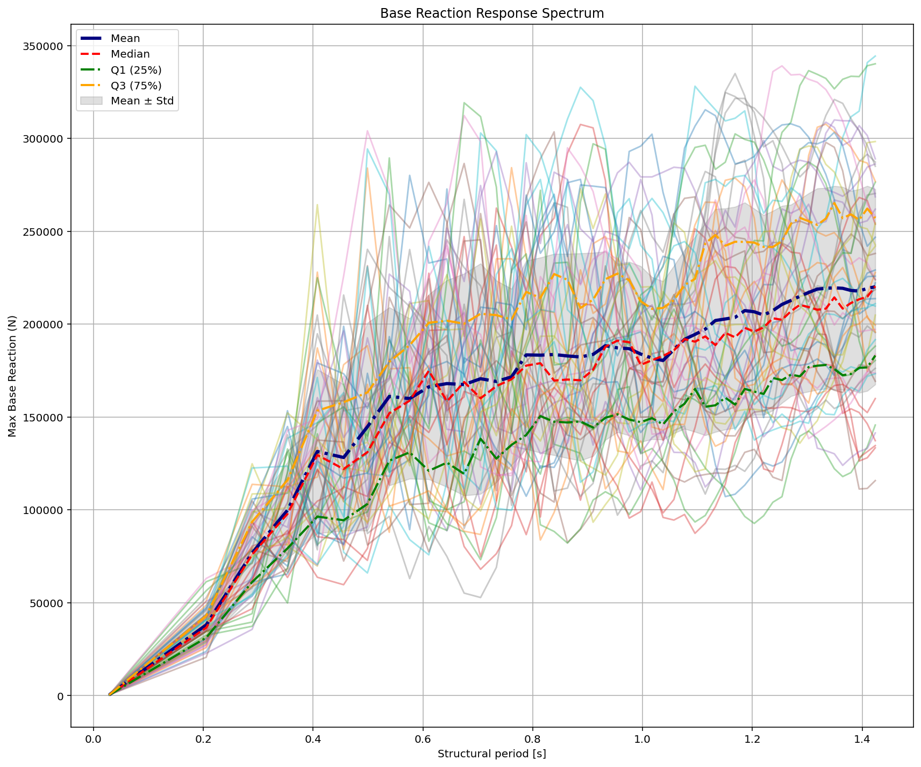

Slide 13
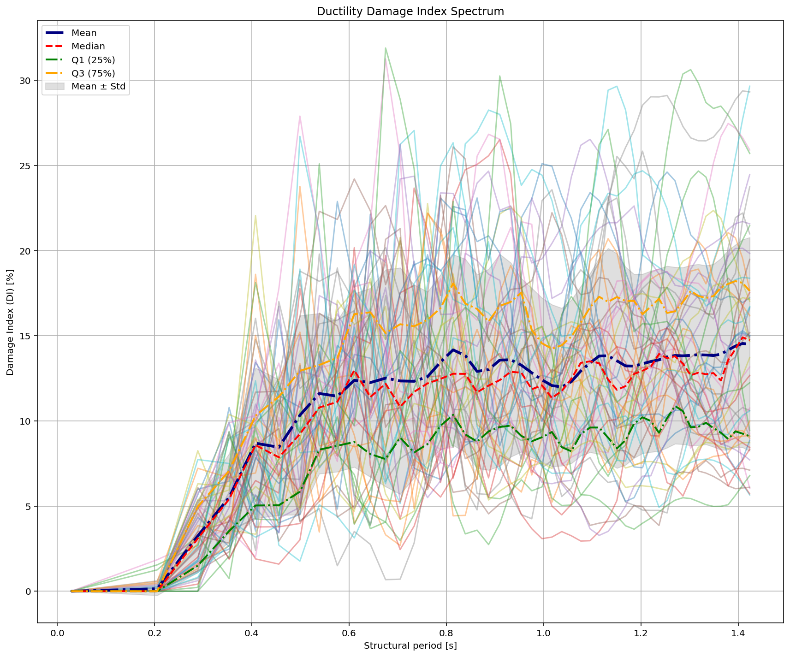
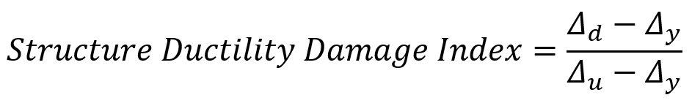

Slide 14
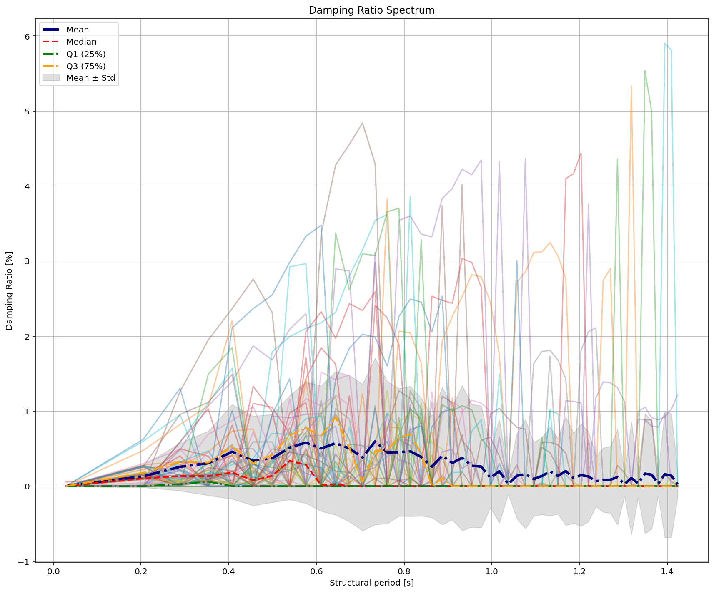

Slide 15
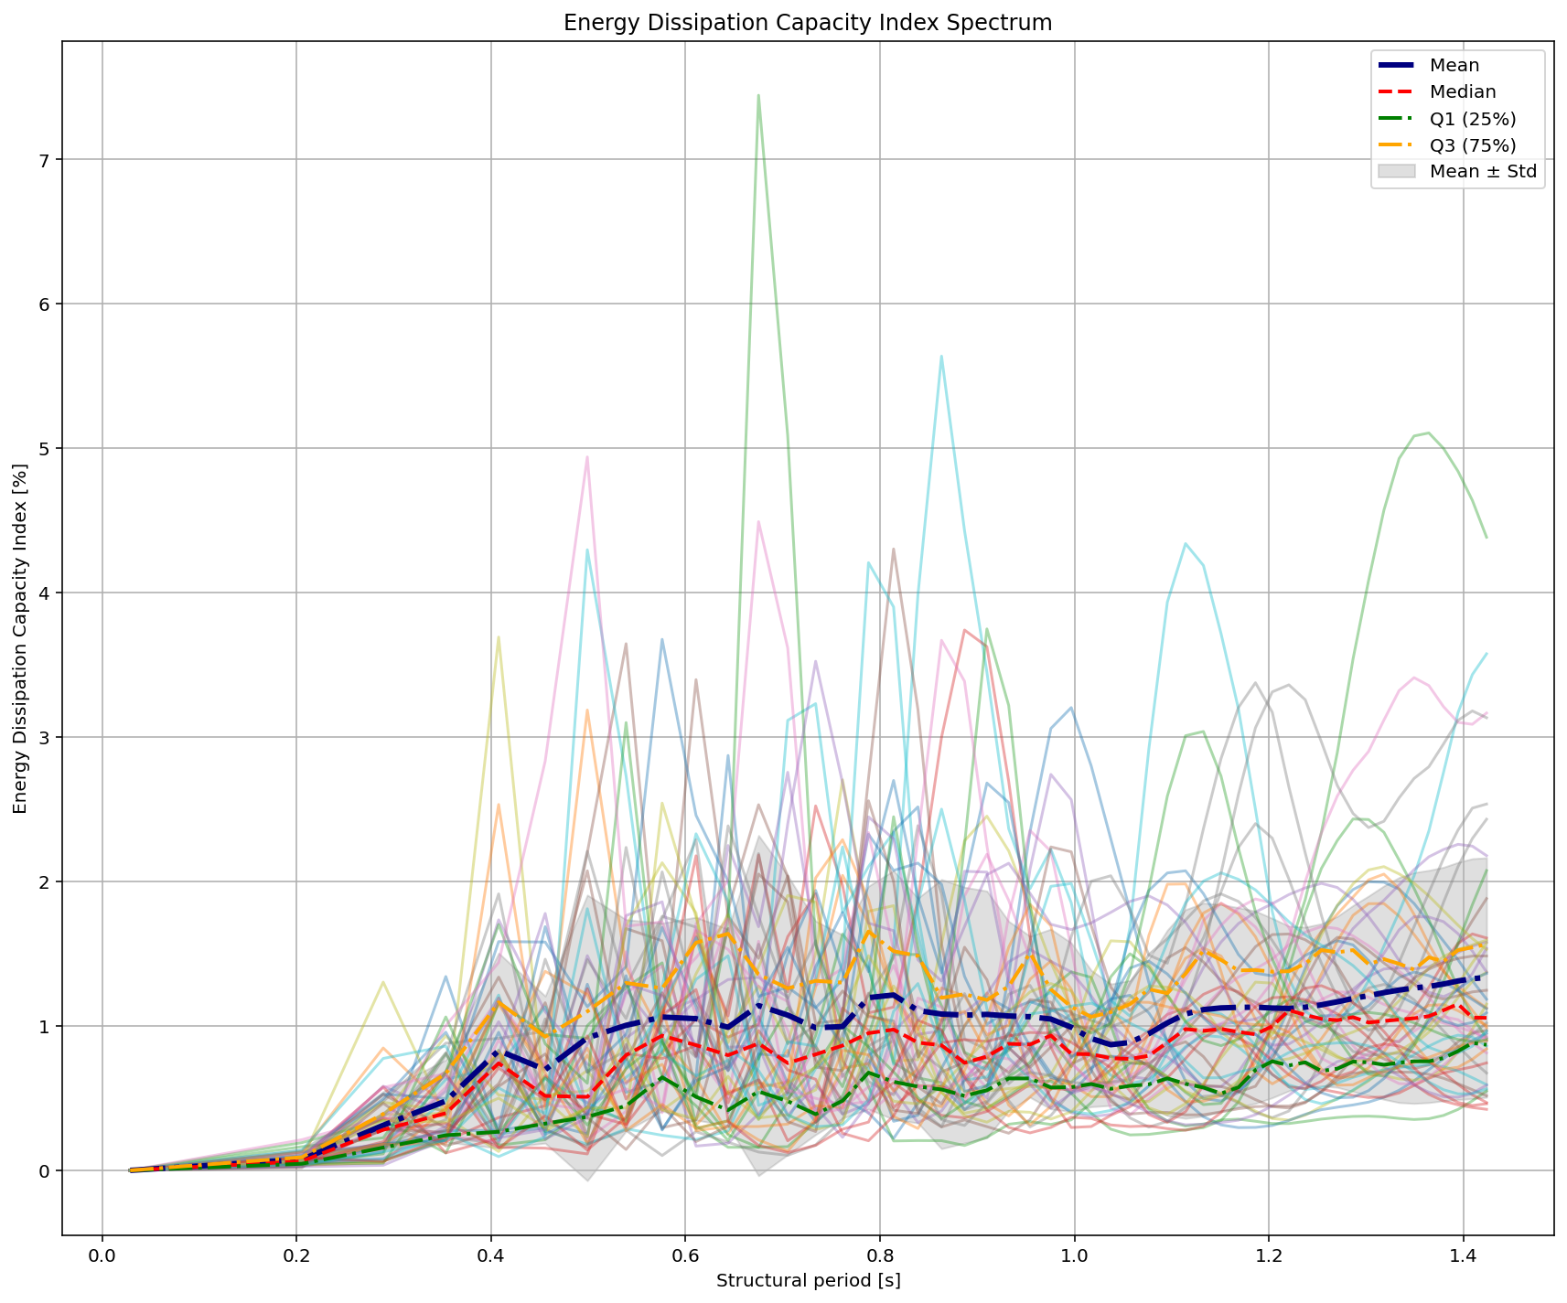

Slide 16
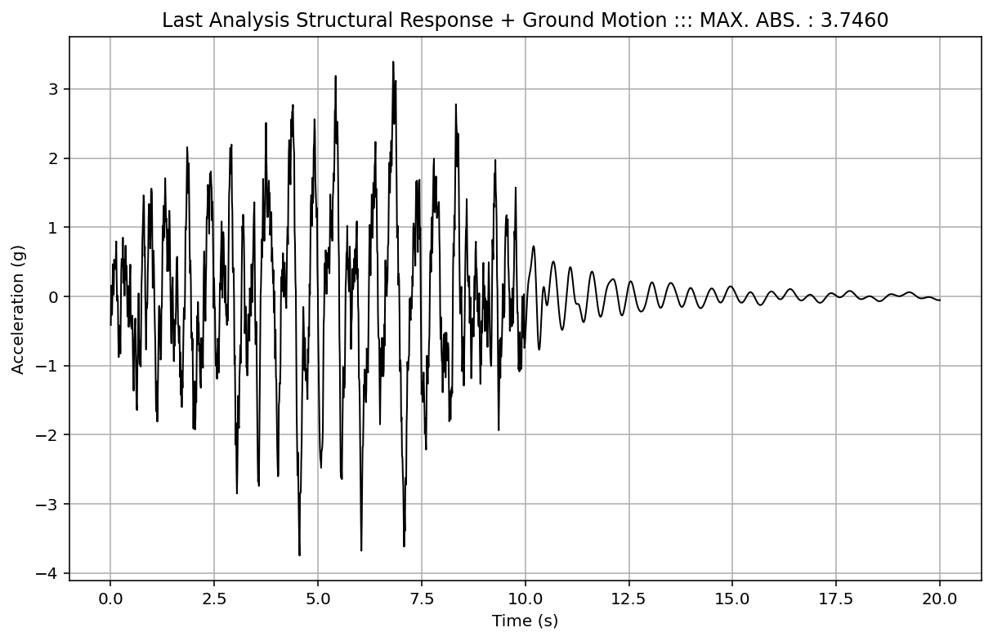

Slide 17
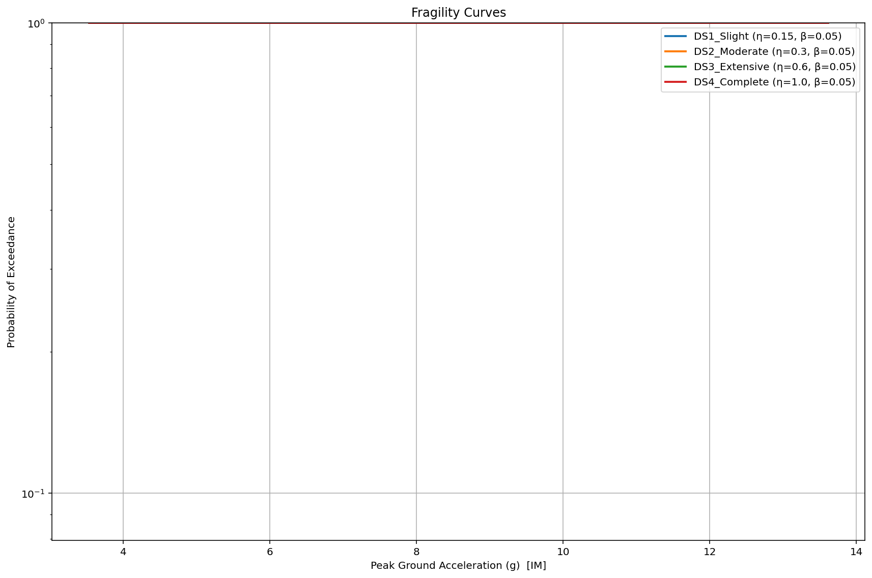

Slide 18
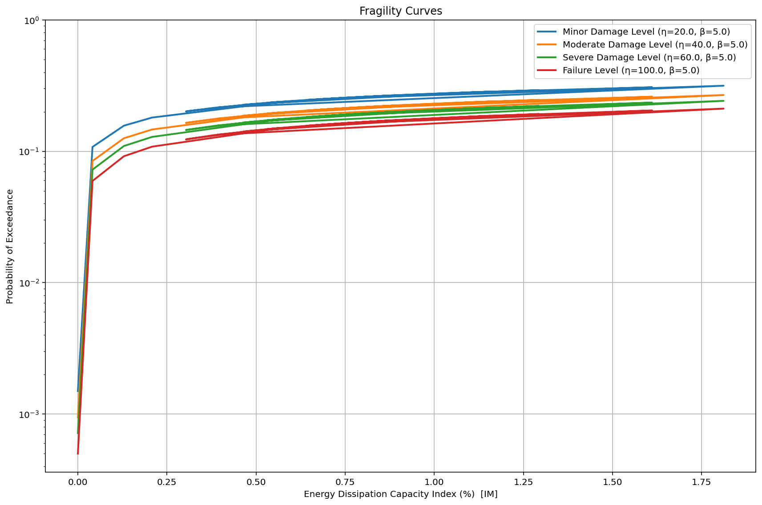

Slide 19
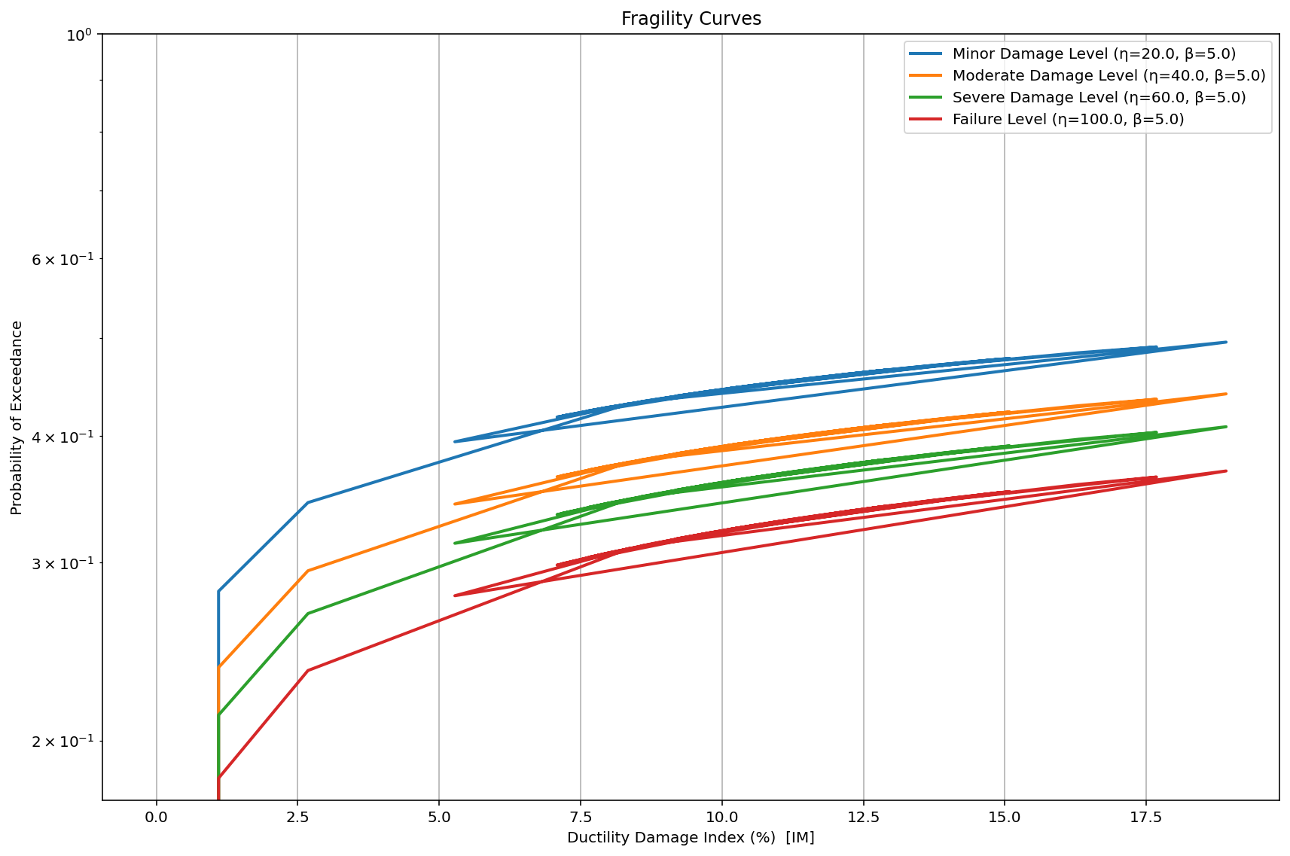

Slide 20
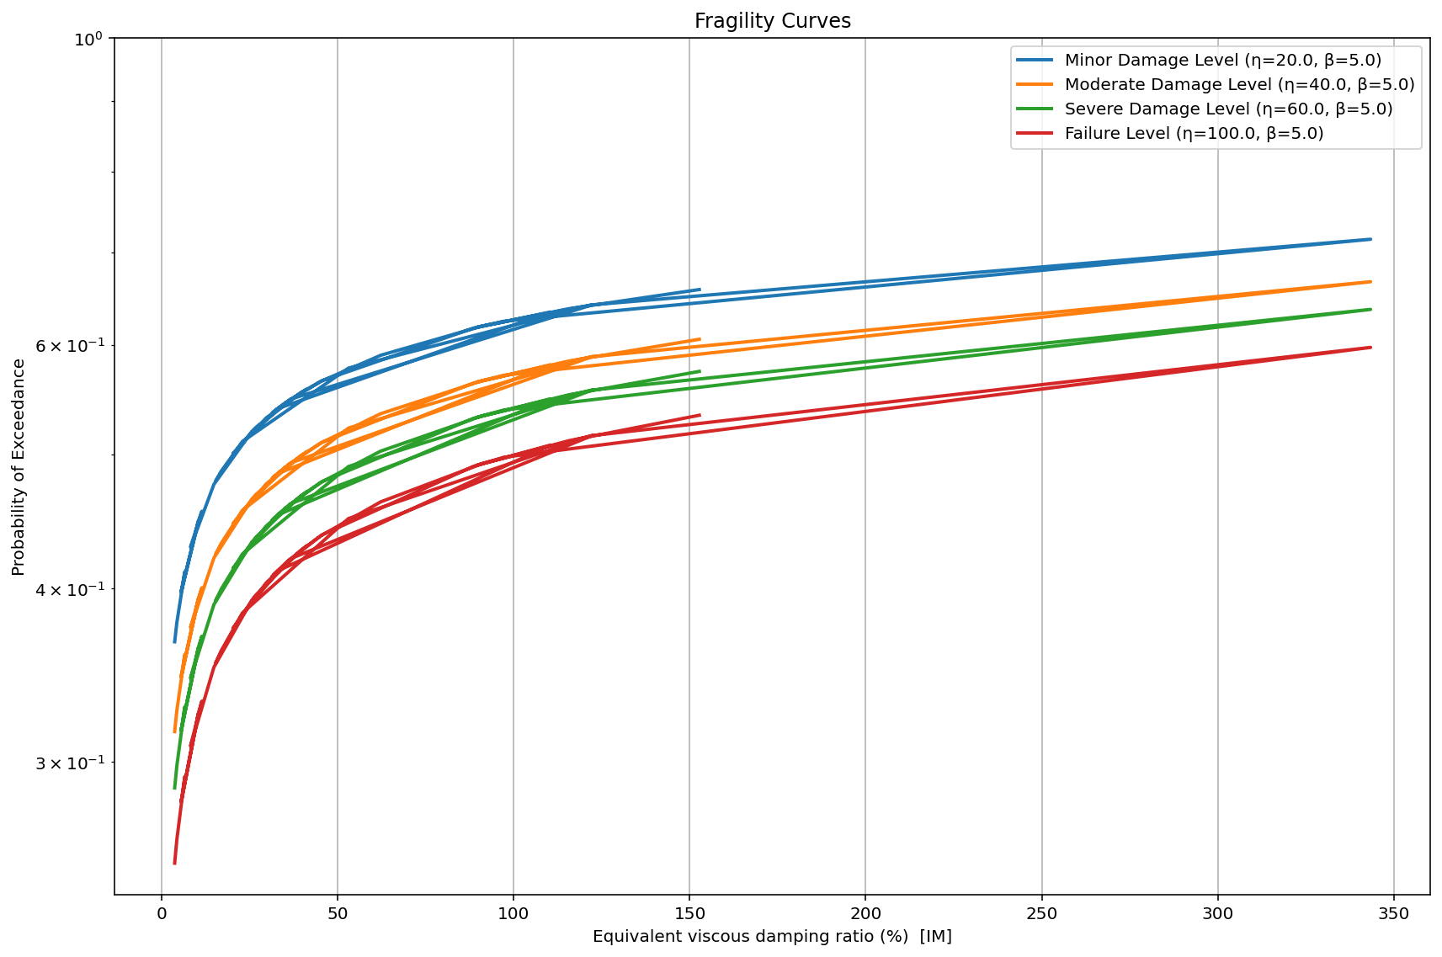
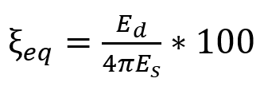

Slide 21
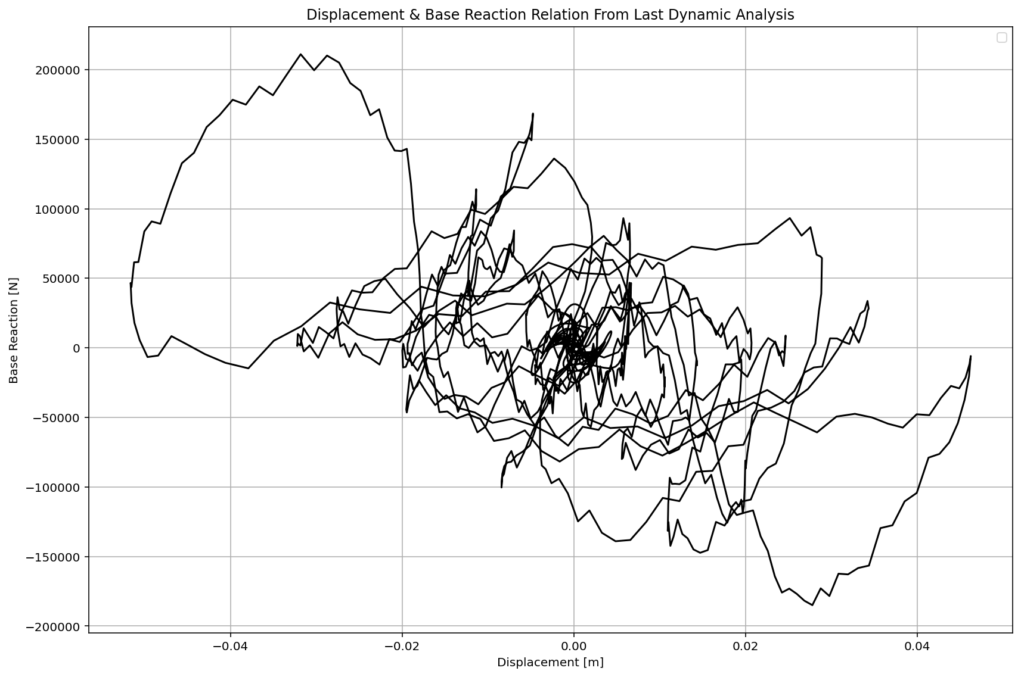

Slide 22
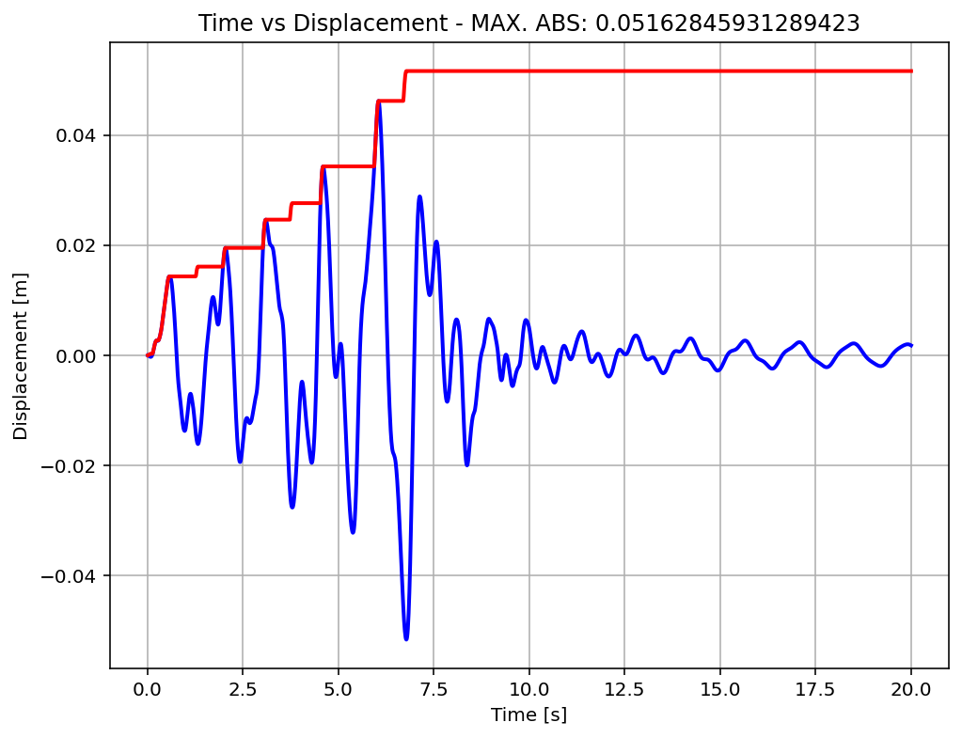

Slide 23
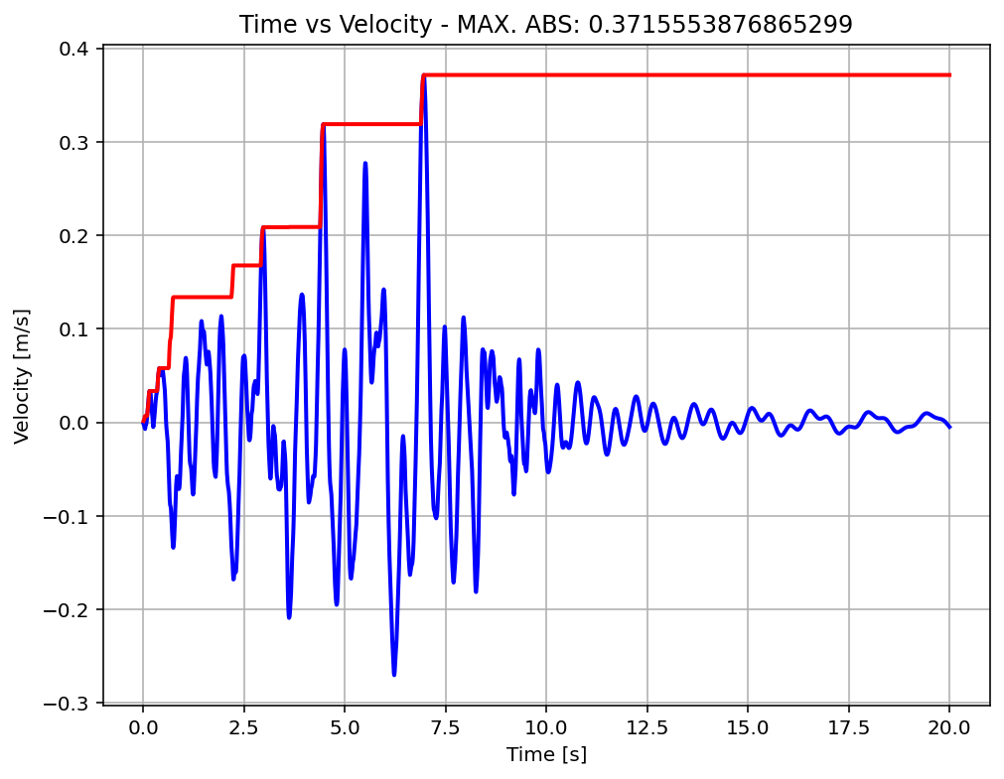

Slide 24
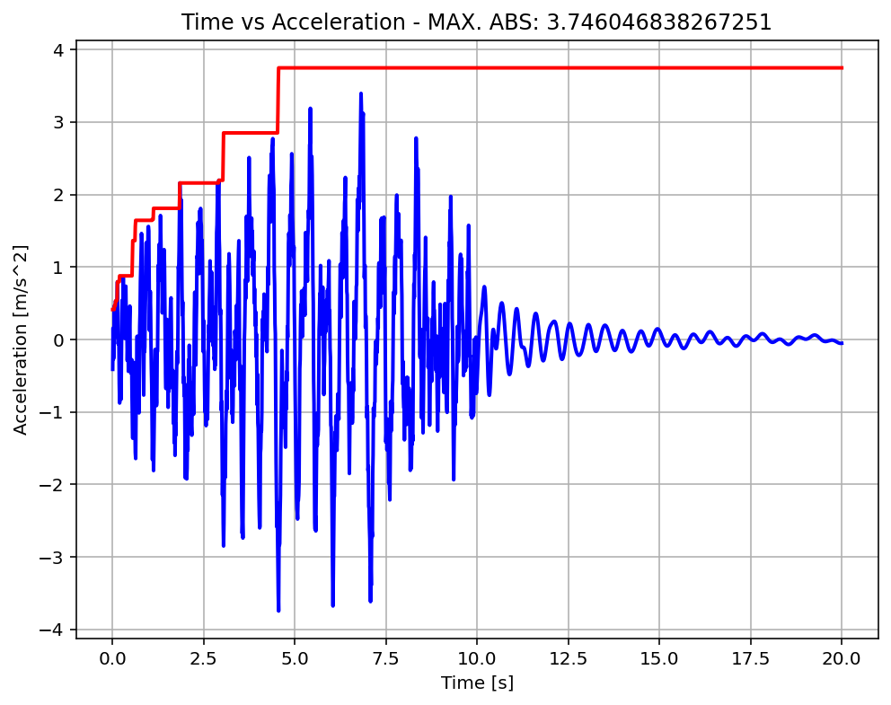

Slide 25
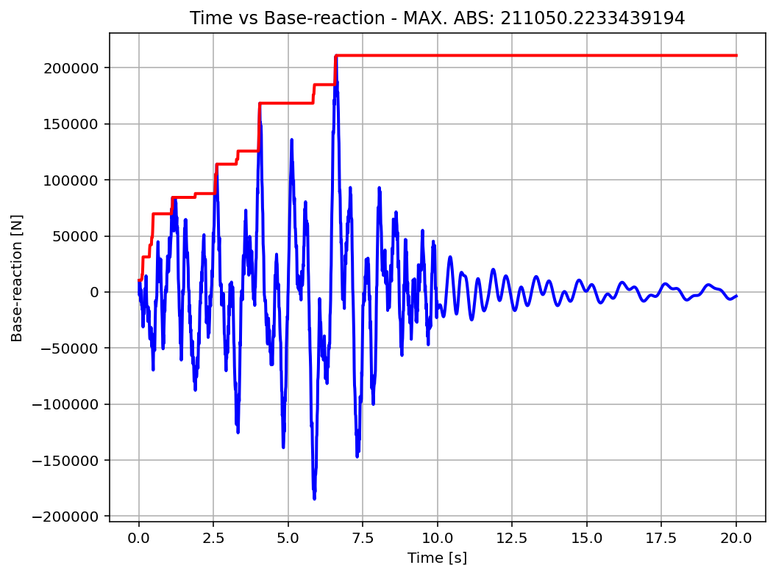

Slide 26
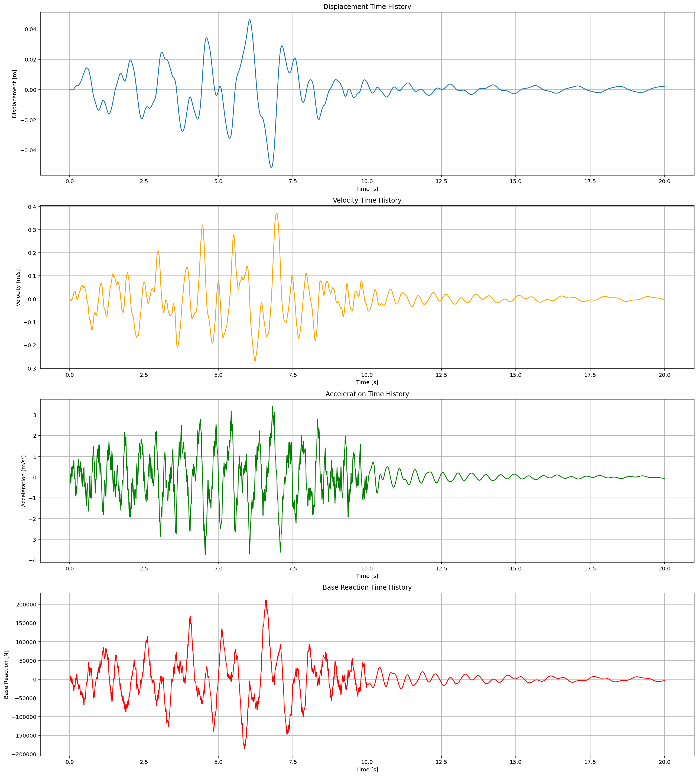

Slide 27
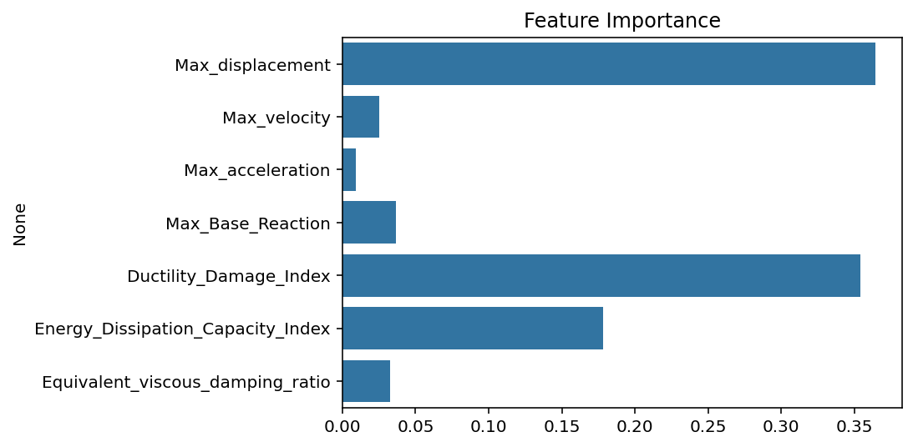

Slide 28
