Slide 1
>> IN THE NAME OF ALLAH, THE MOST GRACIOUS, THE MOST MERCIFUL <<
PARAMETRIC NONLINEAR SEISMIC DEMAND SPECTRA OF A SINGLE-DEGREE-OF-FREEDOM (SDOF) SYSTEMS WITH VARIABLE DUCTILITY CAPACITY IN OPENSEES
WRITTEN BY SALAR DELAVAR GHASHGHAEI (QASHQAI)

Slide 2
This OpenSees script performs a nonlinear SDOF ductility response-spectrum analysis that characterizes an oscillator’s hysteretic behavior, energy dissipation, and damage under earthquake excitation. It defines mass, stiffness, yield strength, ultimate displacement, and damping; applies a cyclic displacement protocol to establish baseline energy dissipation; then runs nonlinear time-history analyses with Newmark integration over a parametric sweep of periods. For each period, it extracts peak displacement, velocity, acceleration, and base reaction, and computes the Ductility Damage Index, Energy Dissipation Capacity Index, and Equivalent Viscous Damping Ratio. Finally, it statistically processes and plots displacement, velocity, acceleration, base-reaction, DDI, EDCI, and EVDR spectra, generates fragility information, and exports results for
performance-based earthquake engineering and parametric studies.
Since the structure was assumed to be inelastic and the response spectra were then plotted for the energy dissipation capacity index and the ductility damage index, this shows the natural period beyond which an increase in the structure’s period leads to a higher probability of damage, and as the ductility ratio of the structure increases, the level of damage decreases.

Slide 3
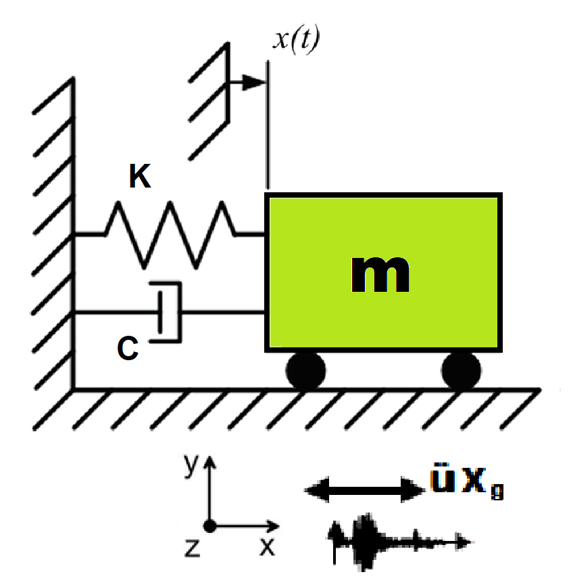
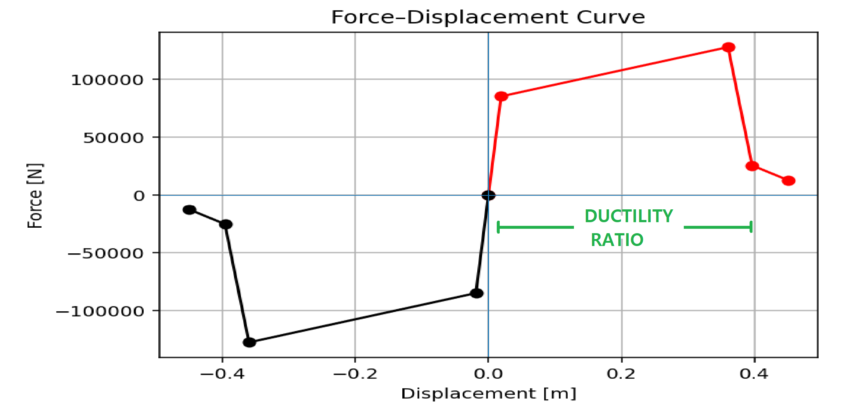

Slide 4
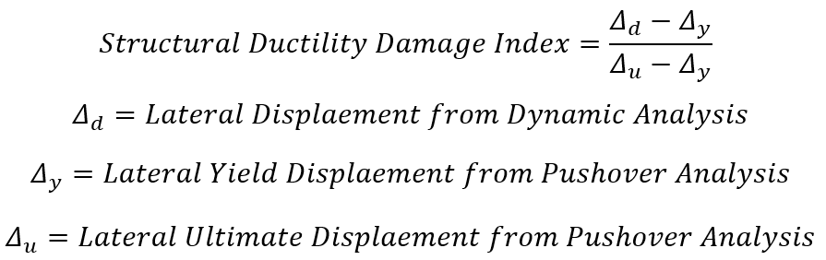

Slide 5
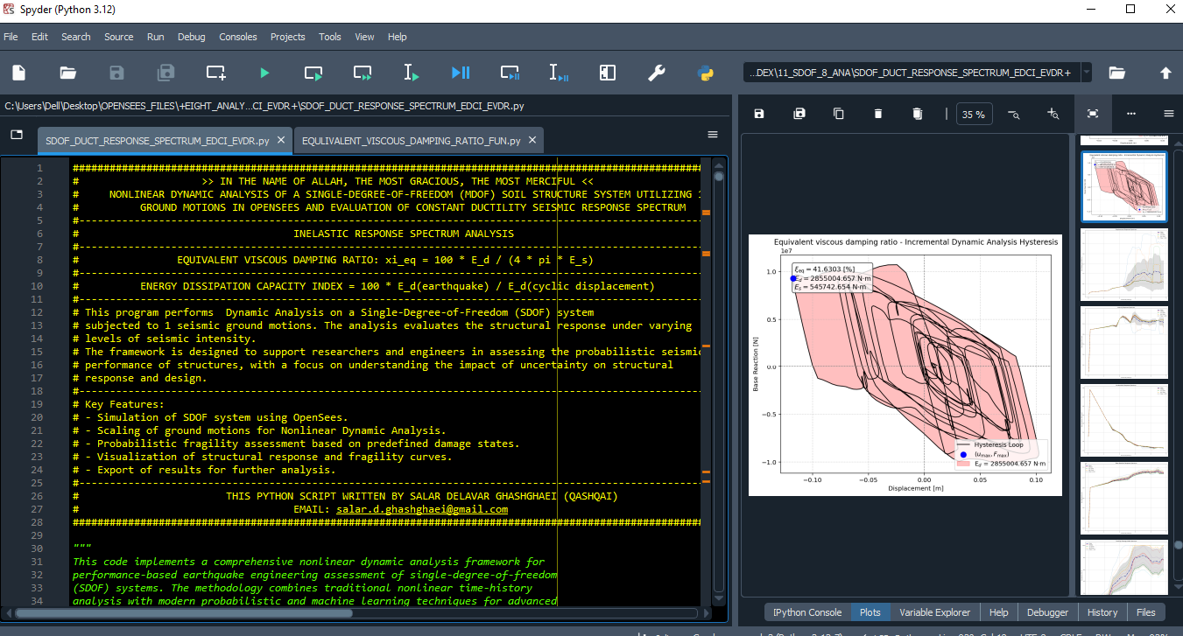

Slide 6
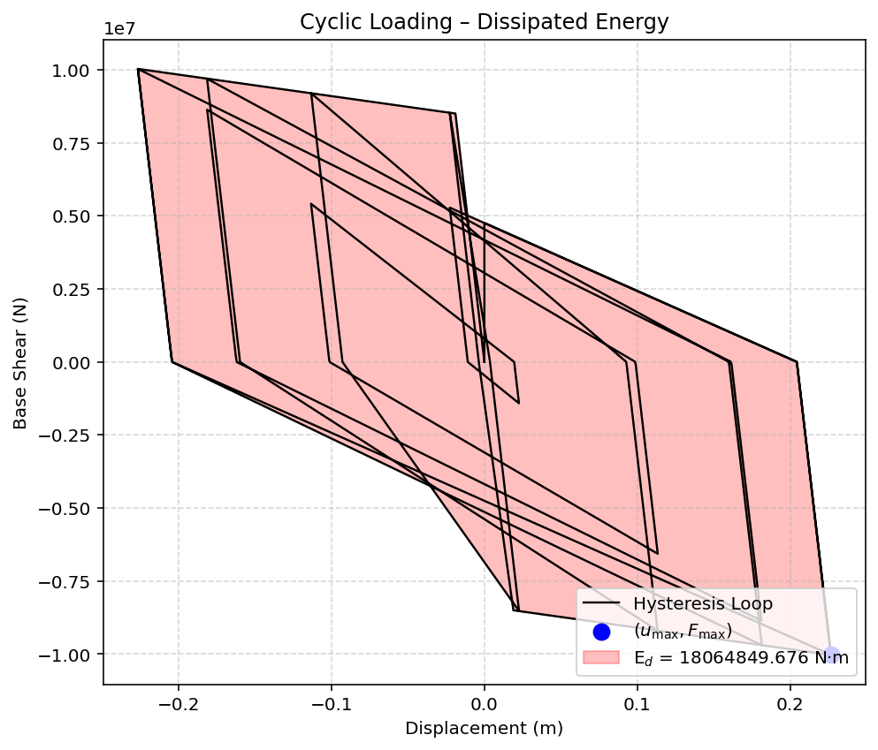

Slide 7
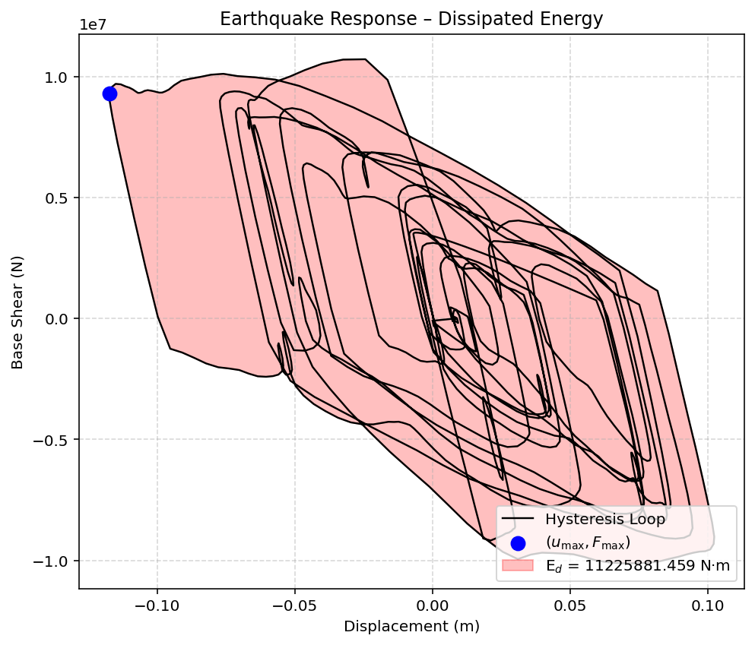

Slide 8
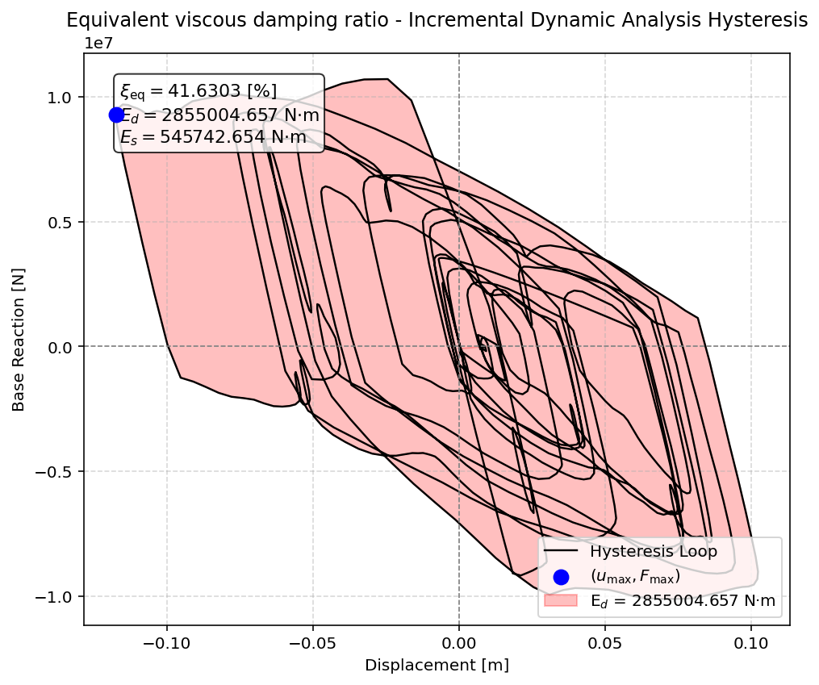

Slide 9
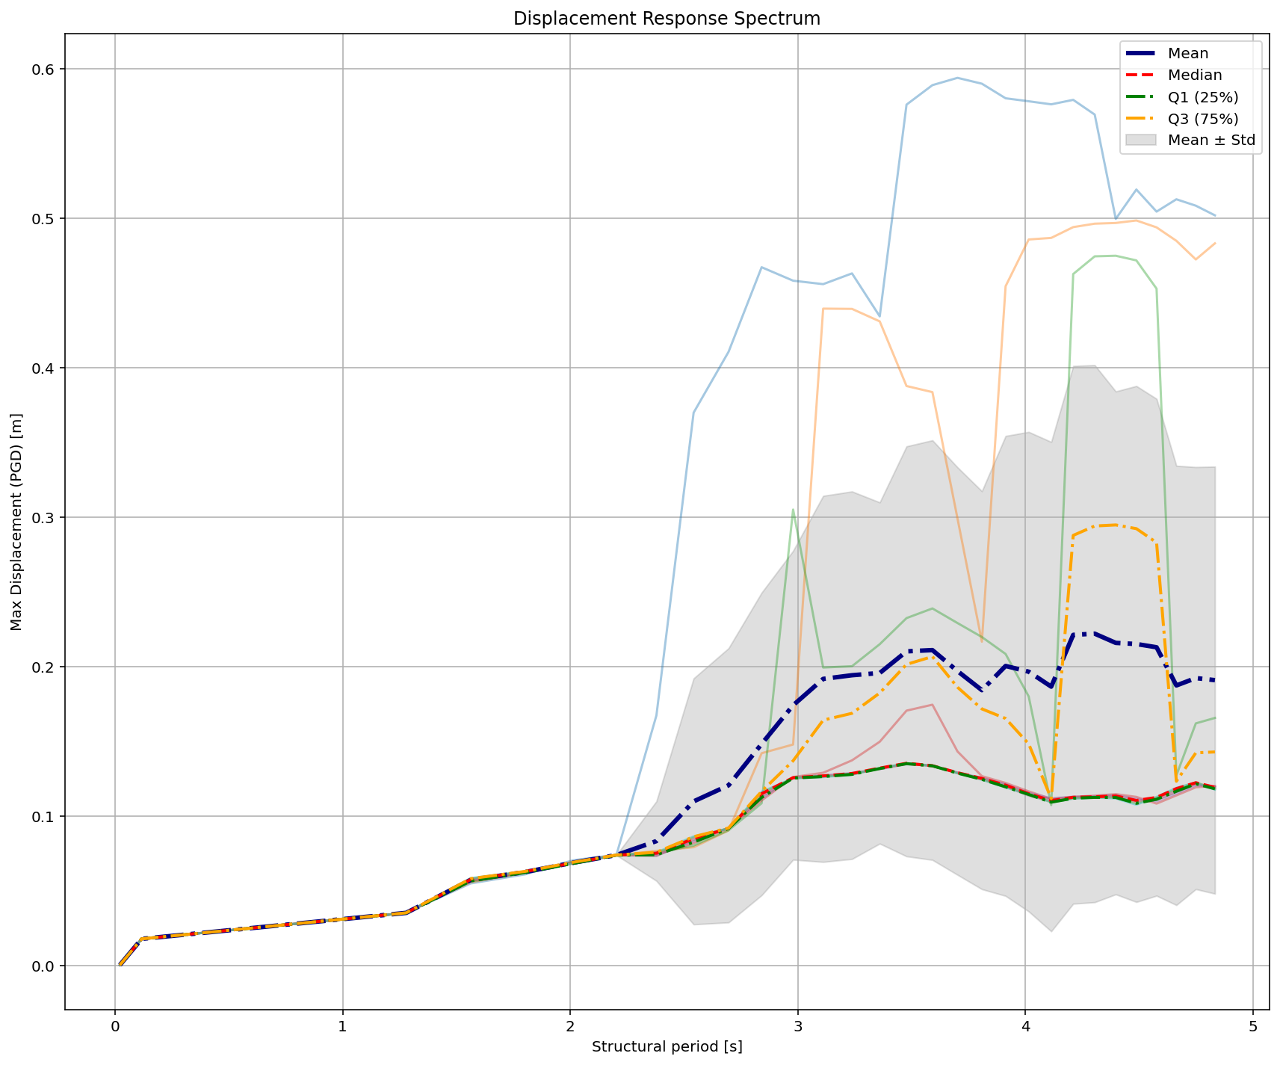

Slide 10
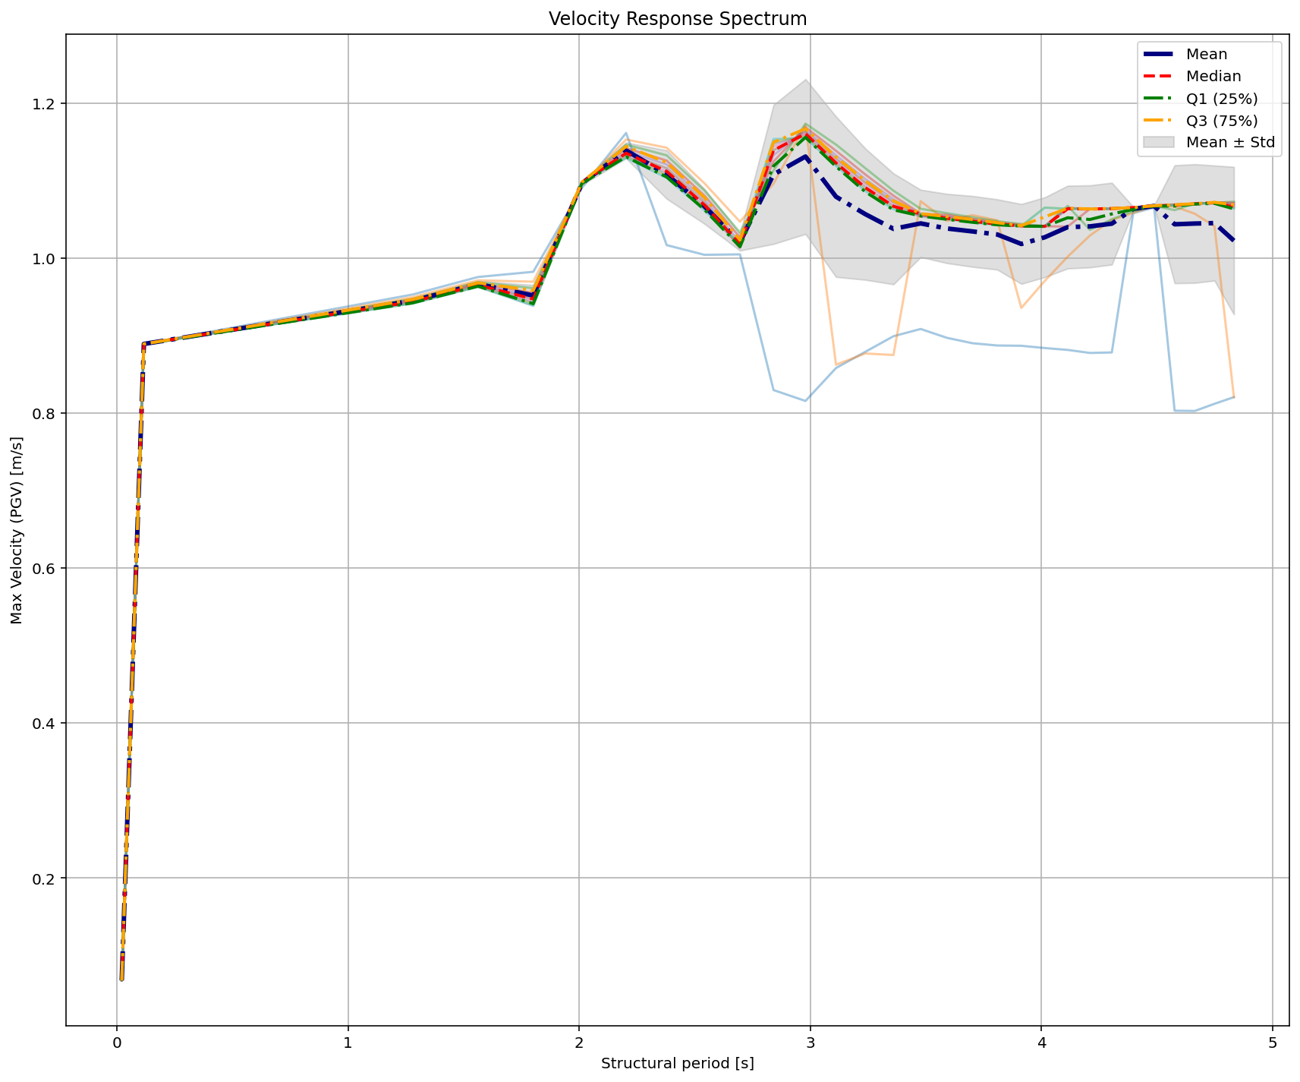

Slide 11
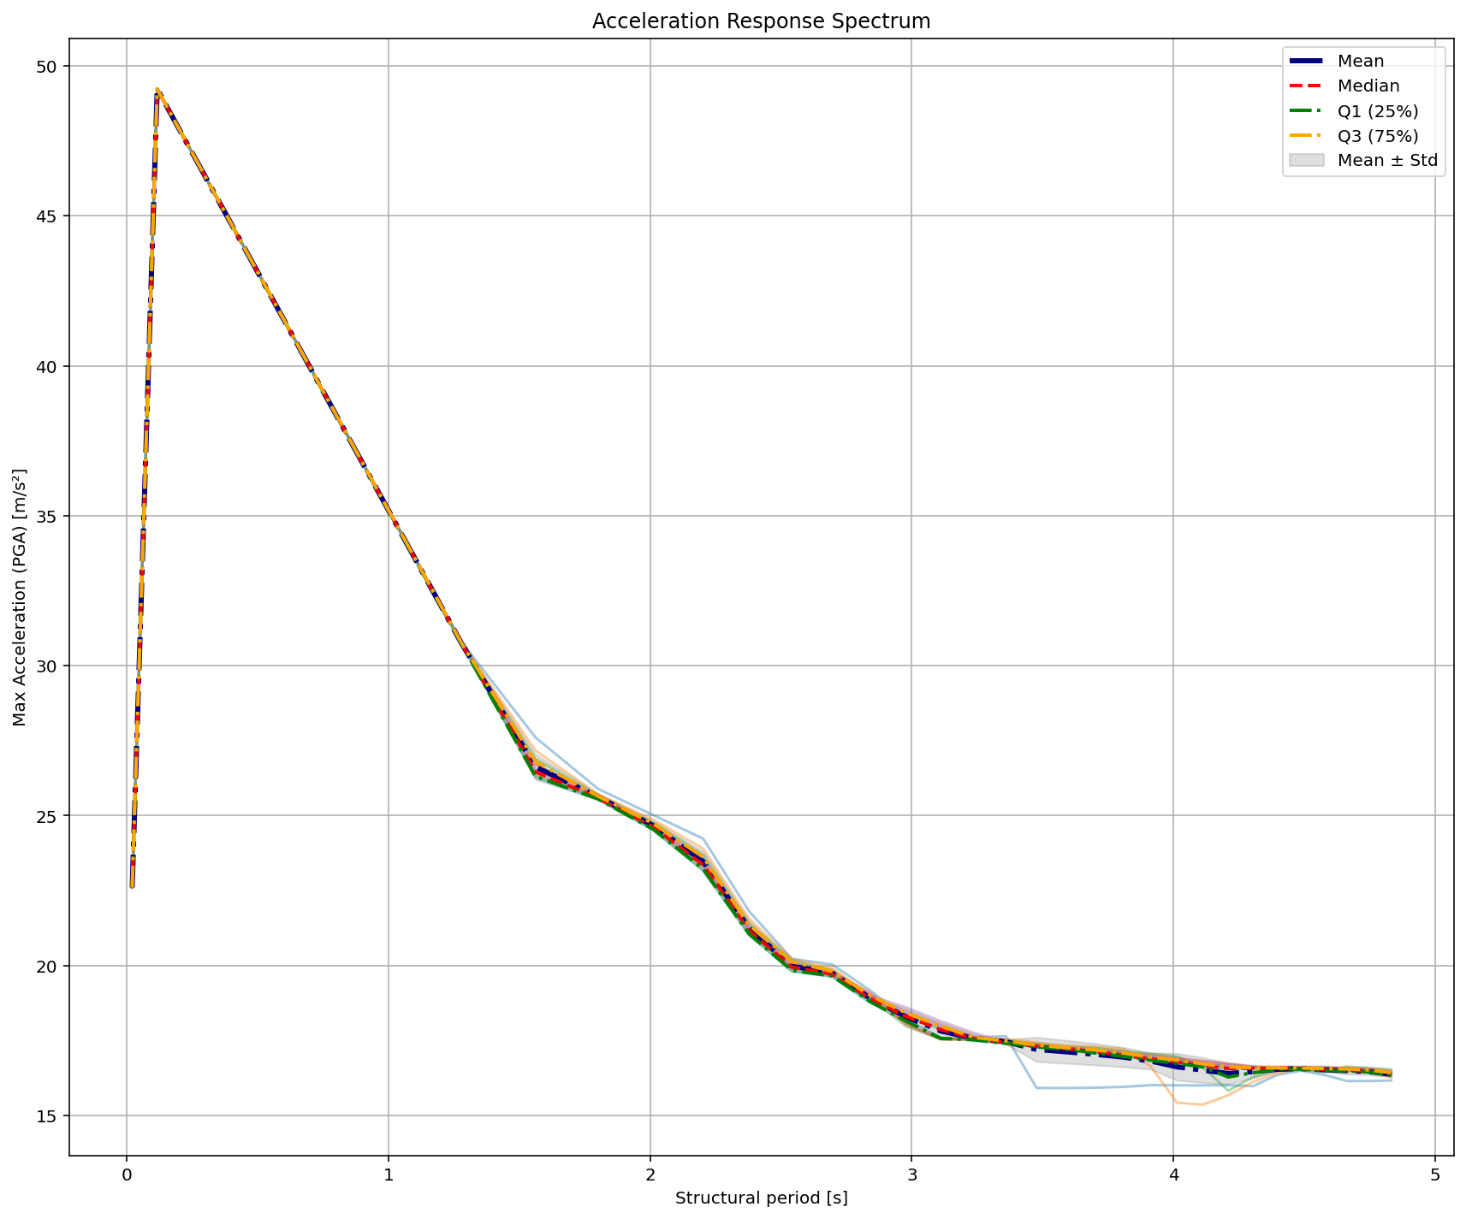

Slide 12
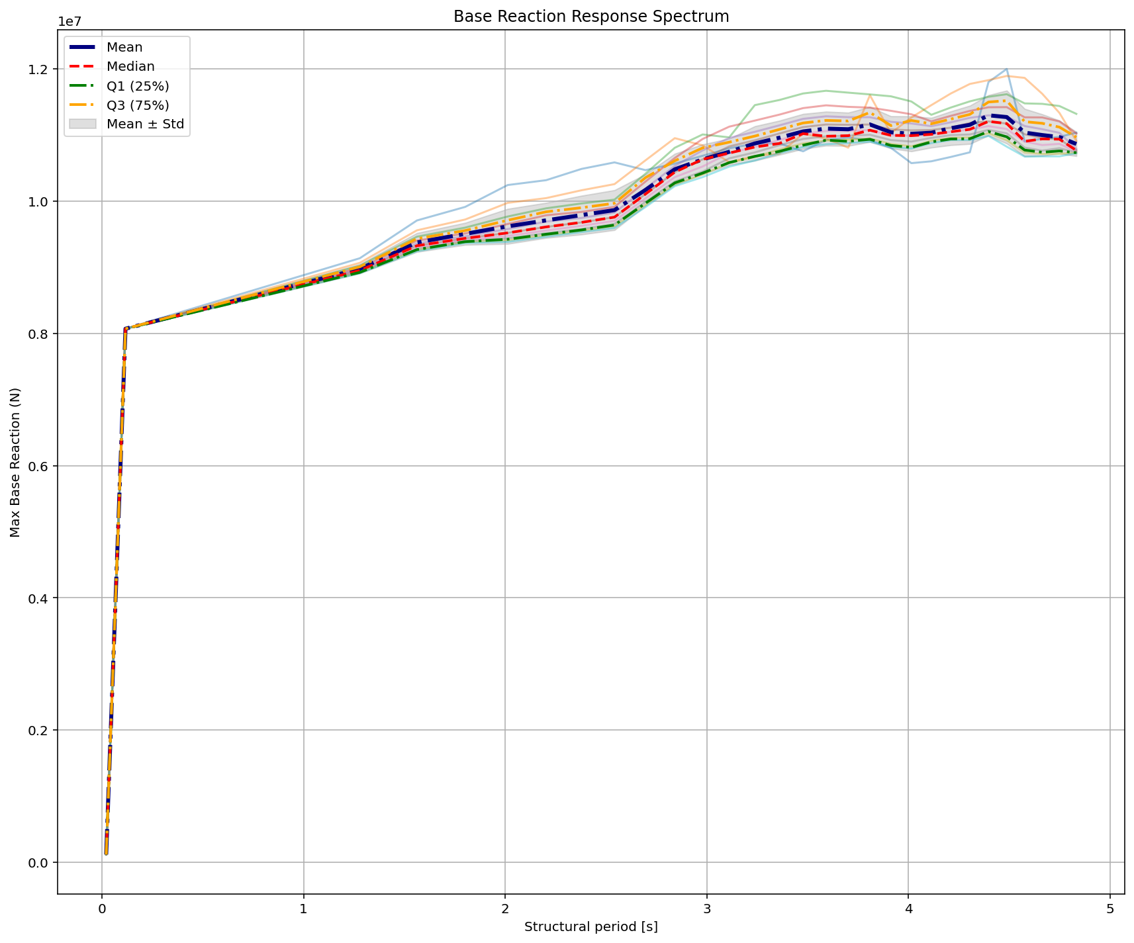

Slide 13
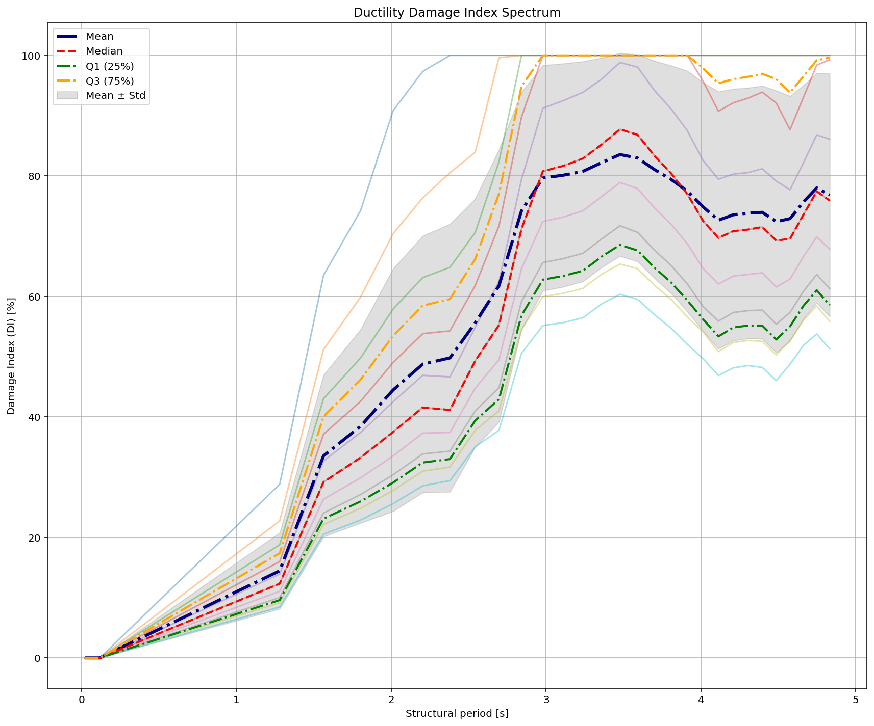
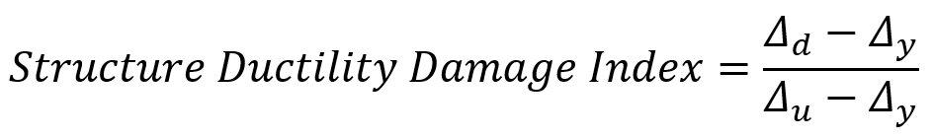

Slide 14
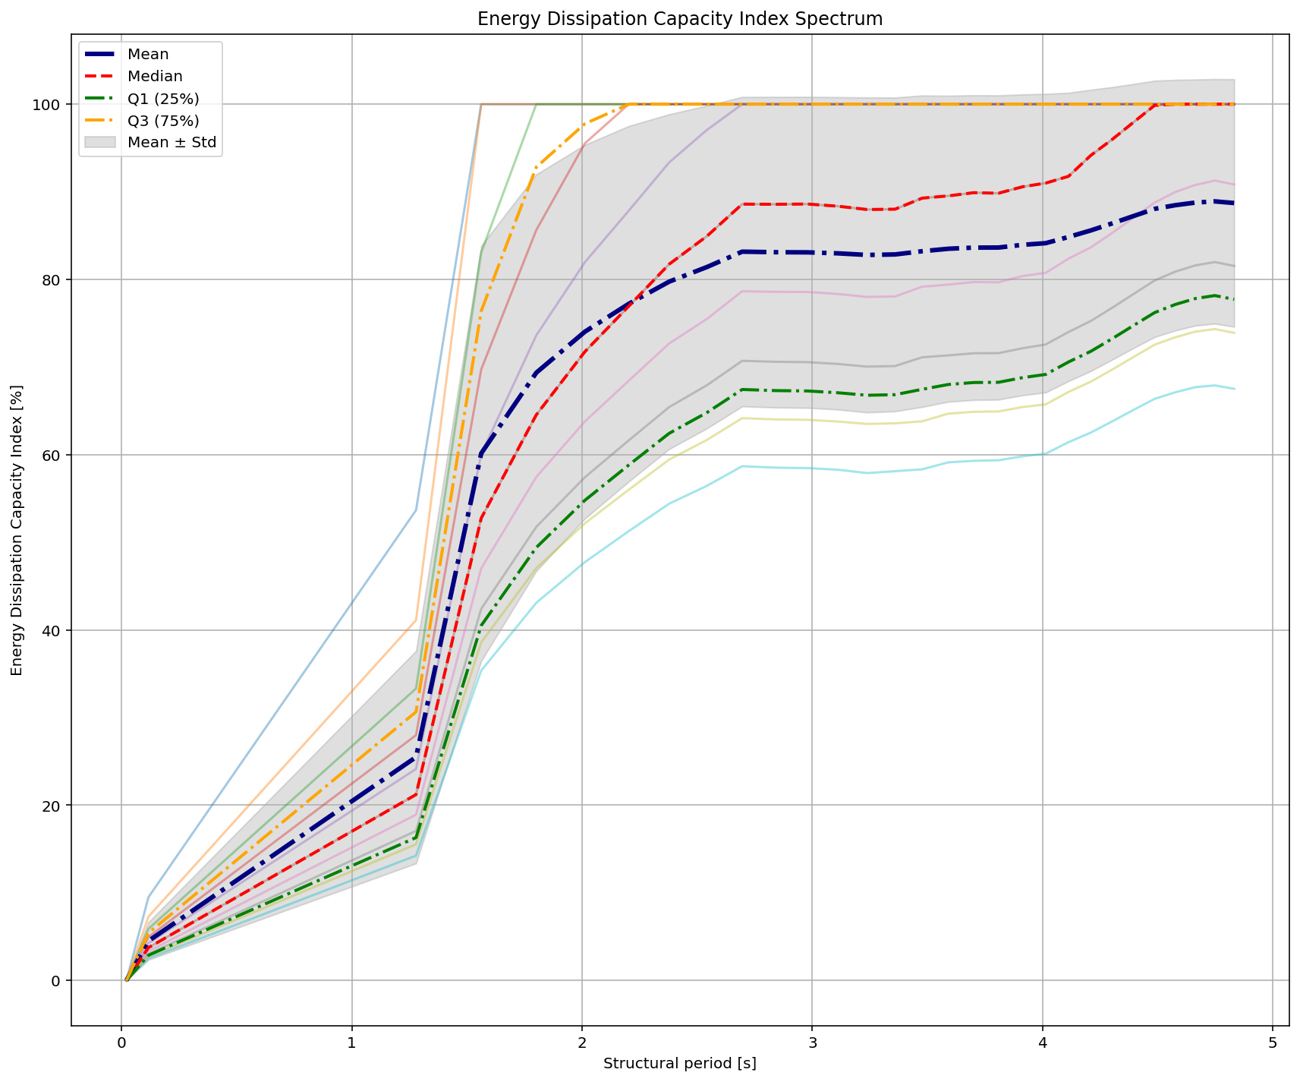

Slide 15
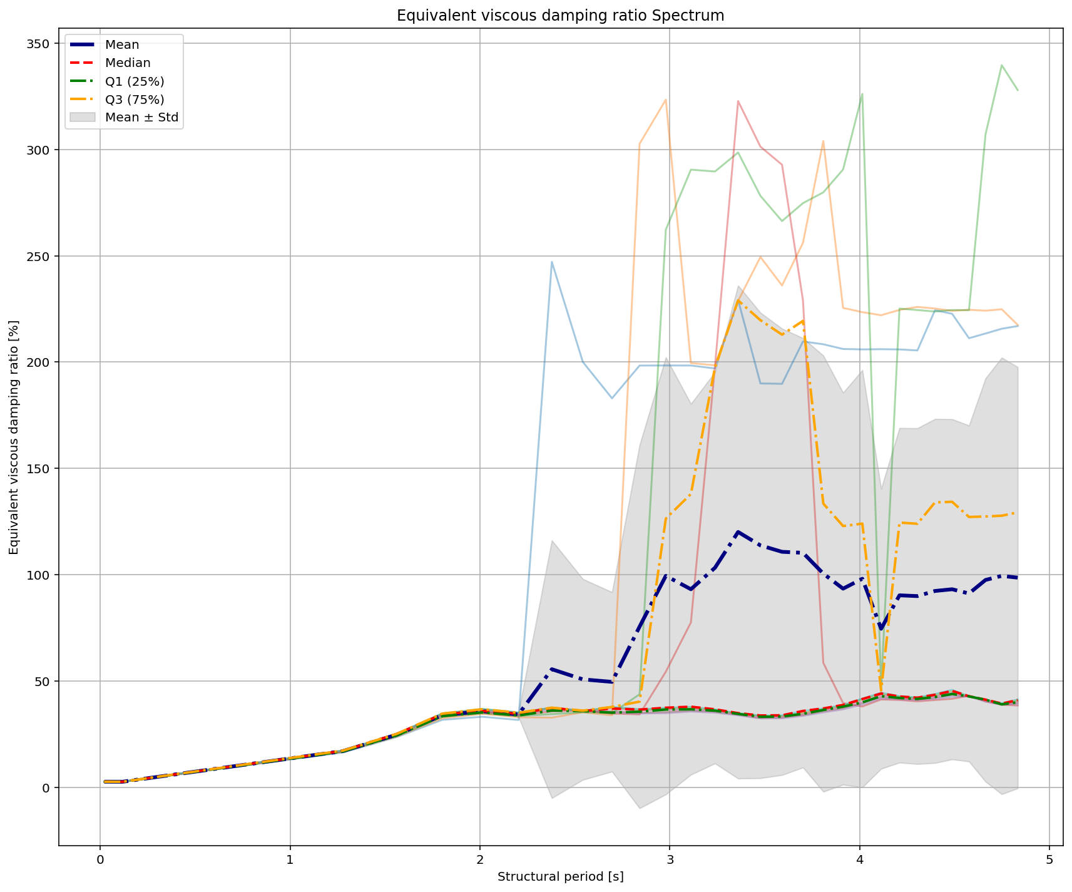
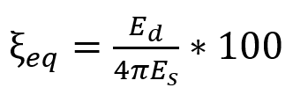

Slide 16
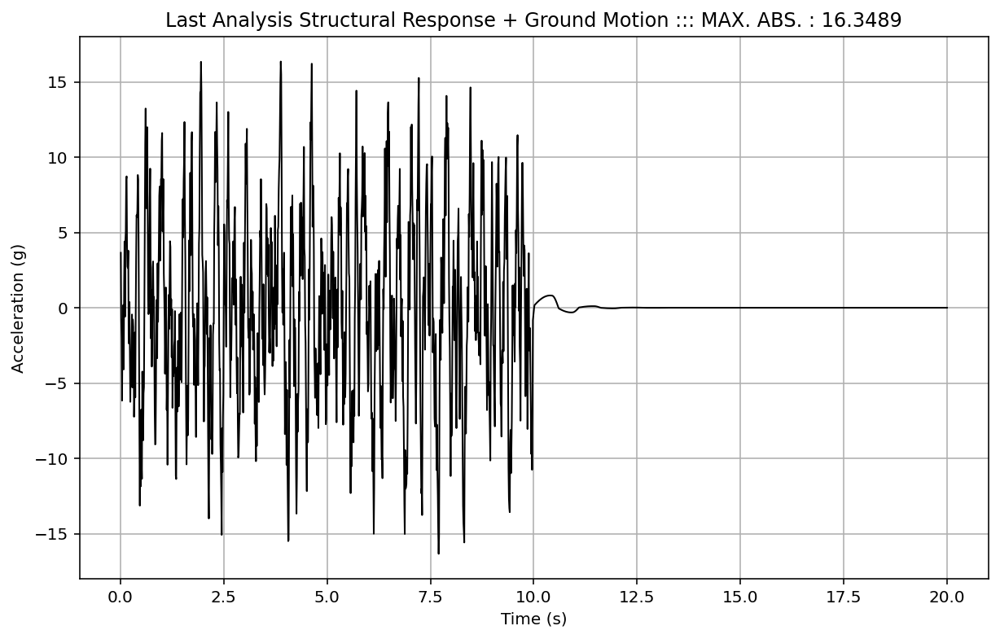

Slide 17
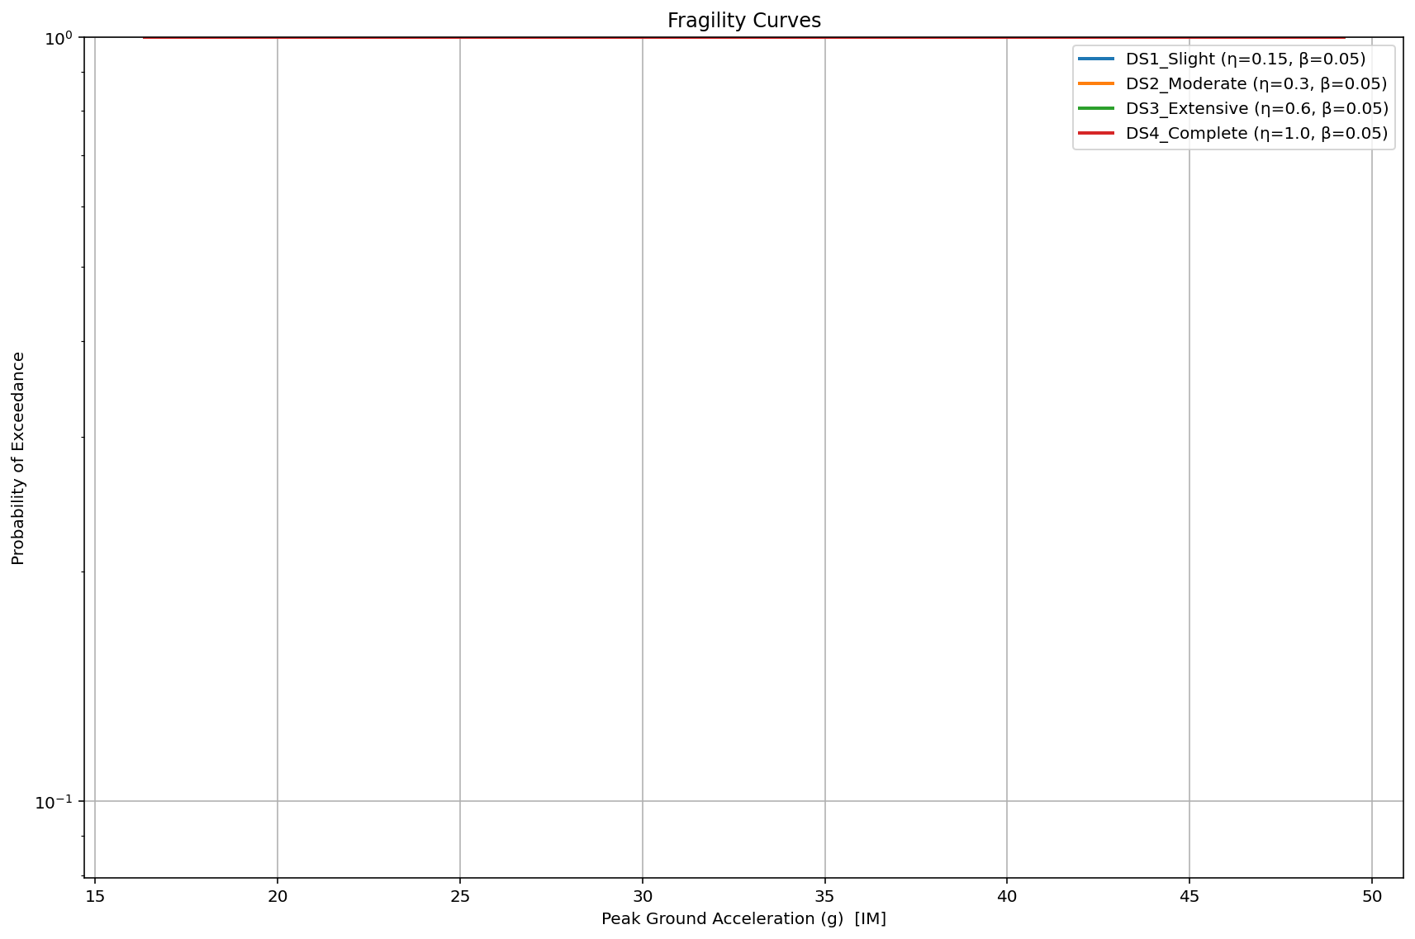

Slide 18
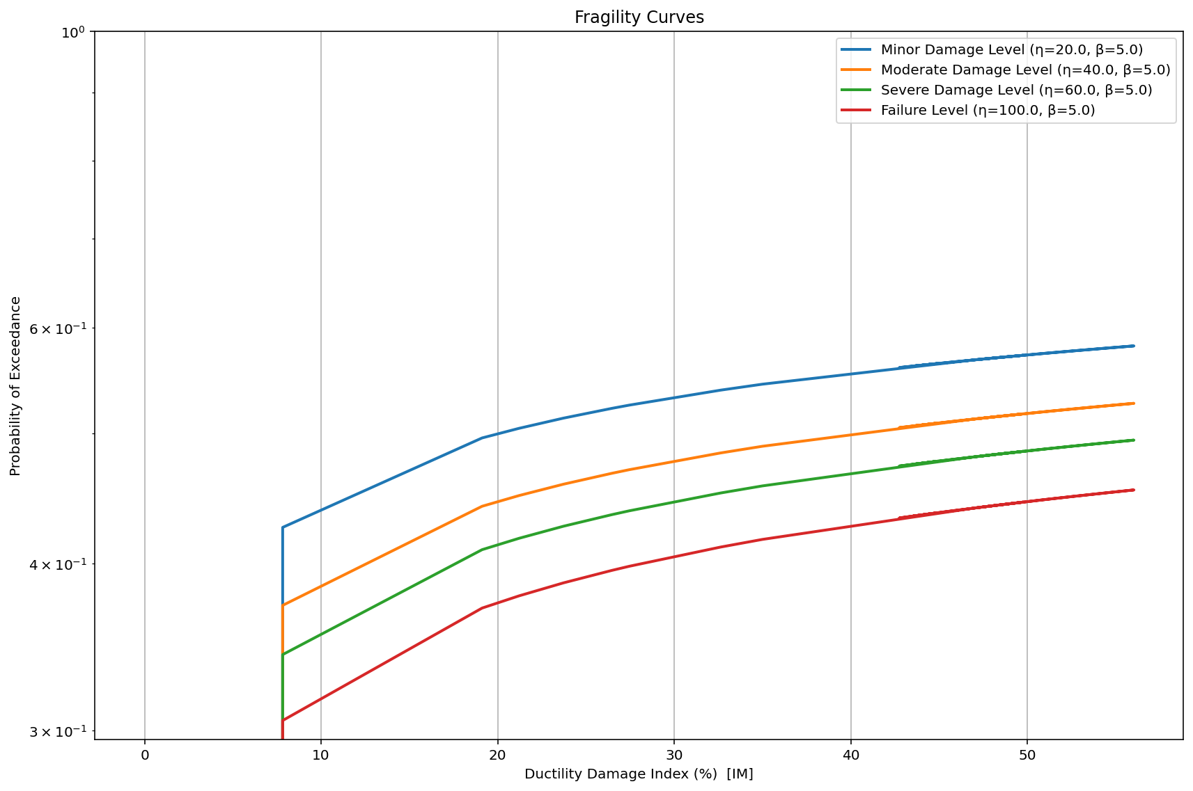

Slide 19
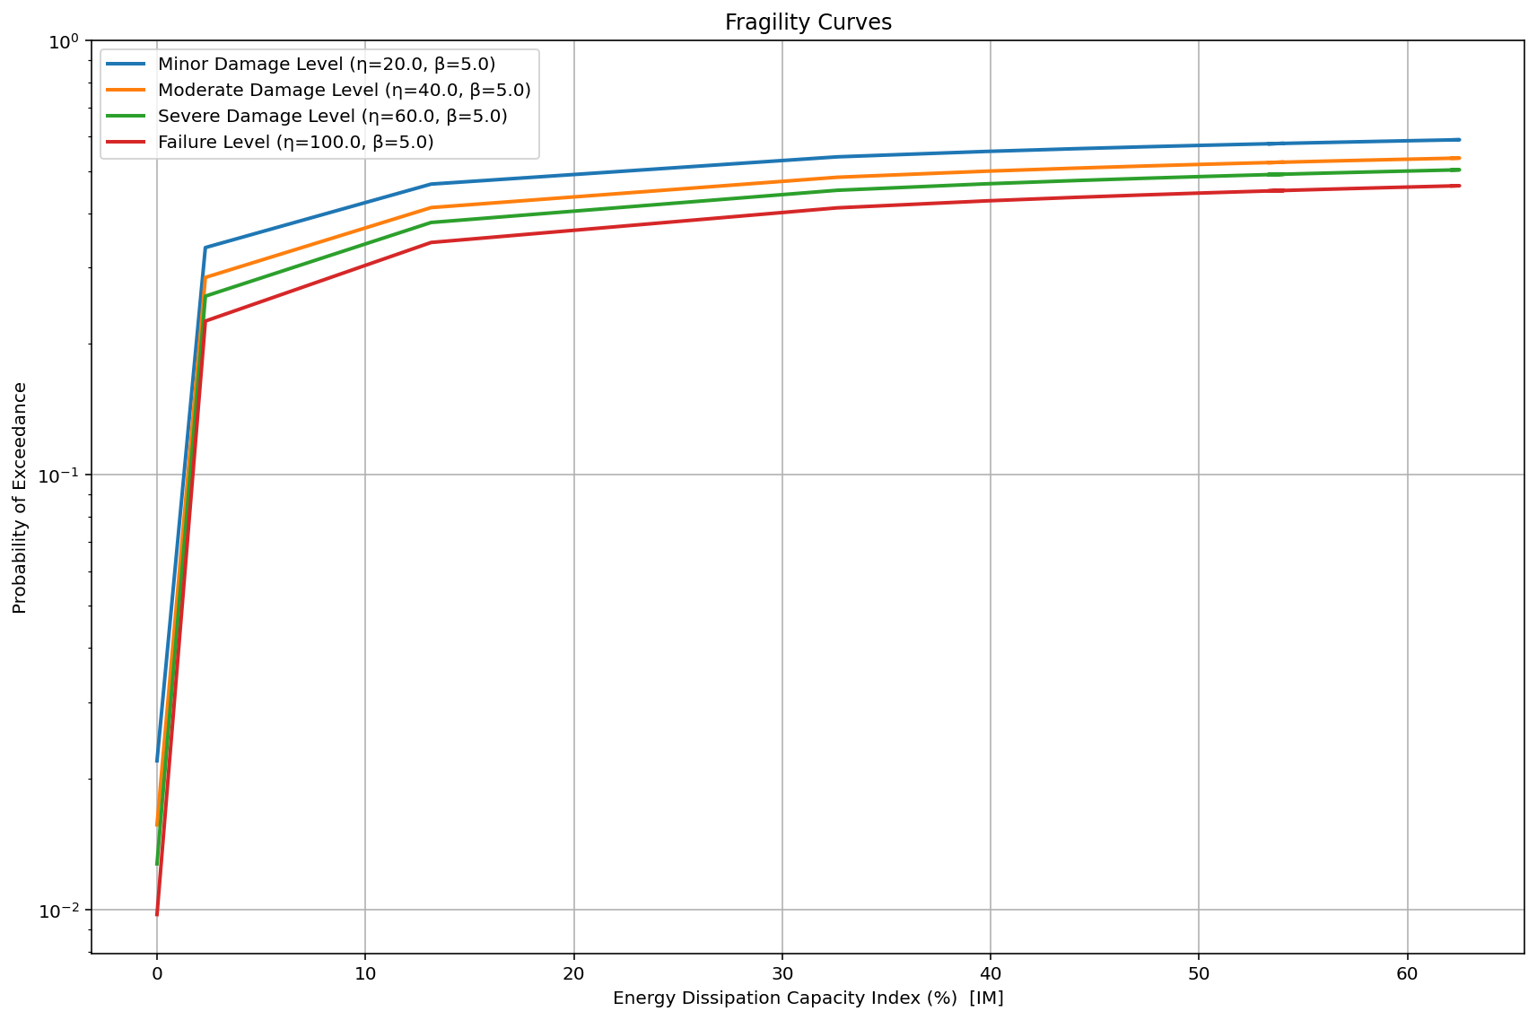

Slide 20
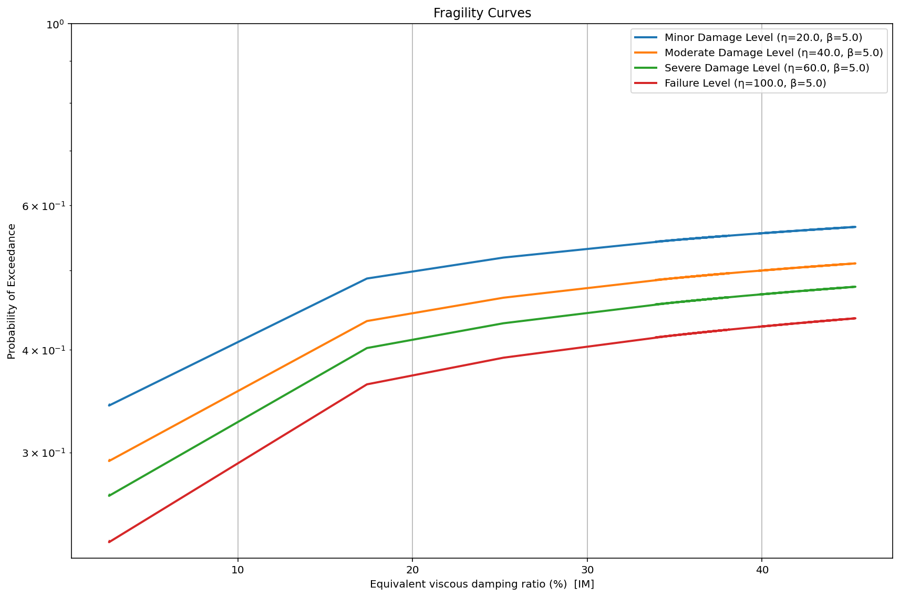

Slide 21
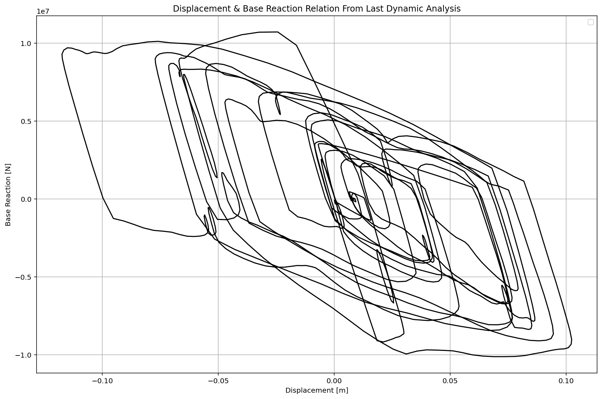

Slide 22
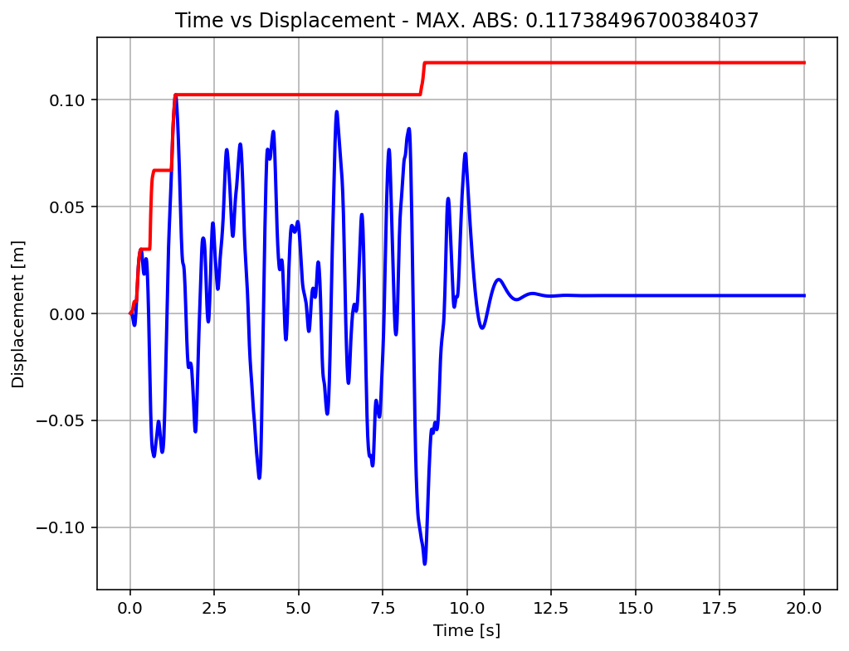

Slide 23
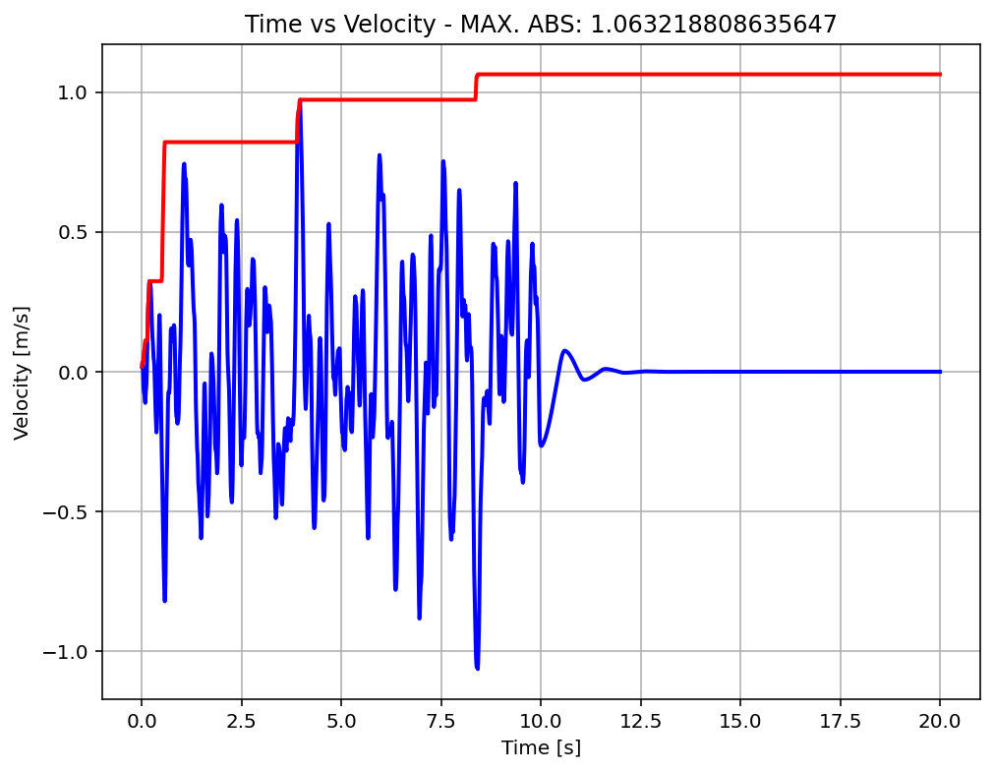

Slide 24
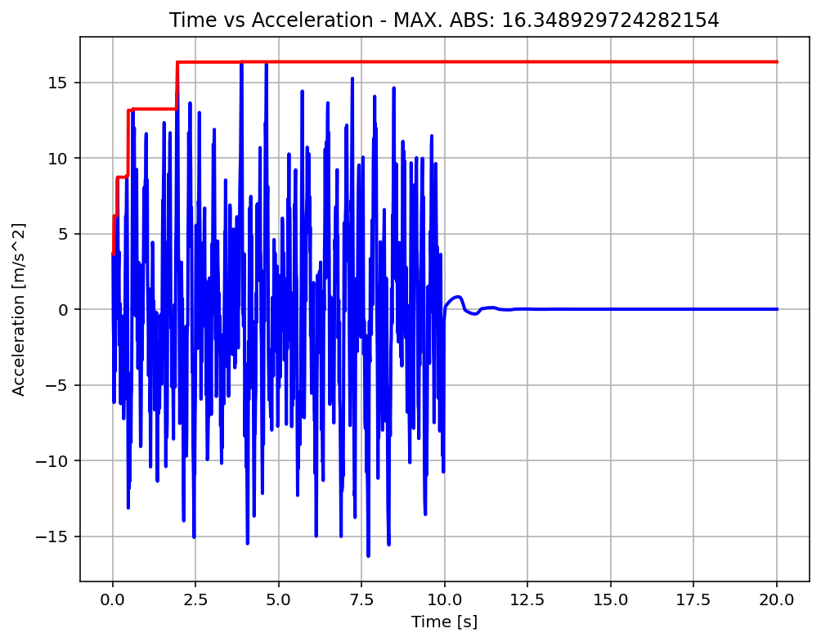

Slide 25
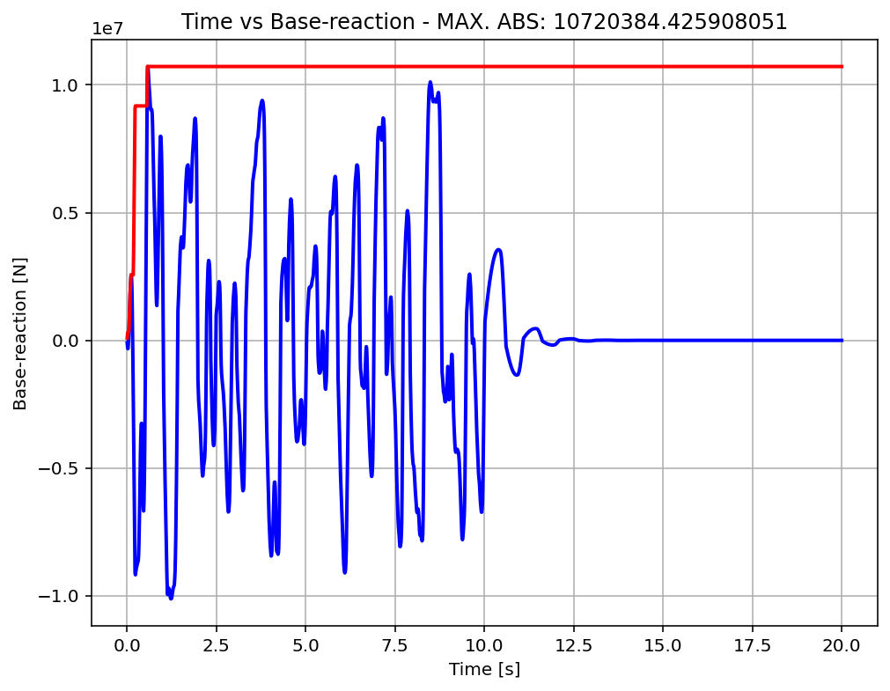

Slide 26
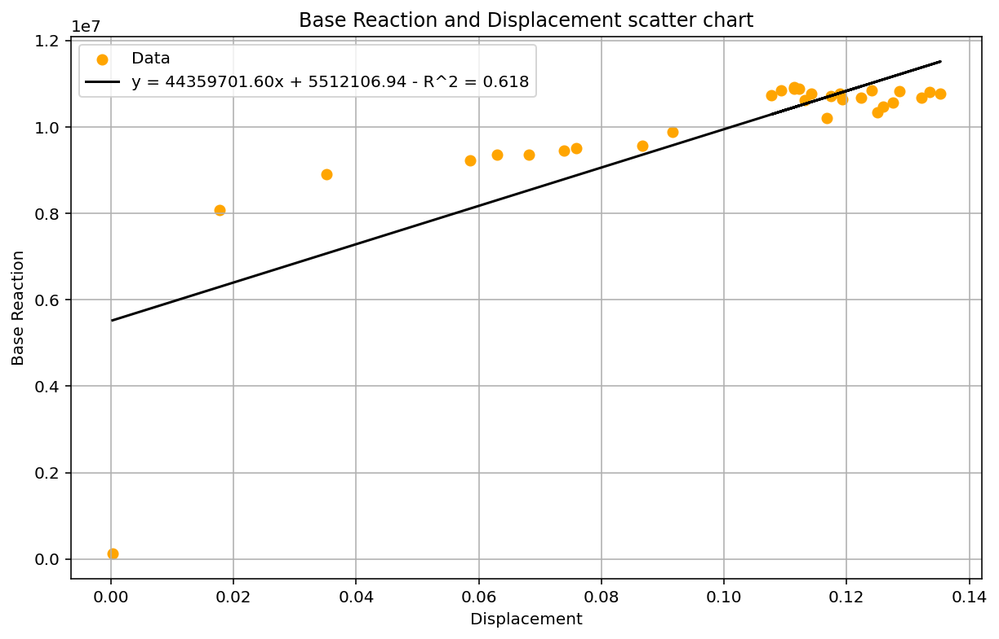

Slide 27
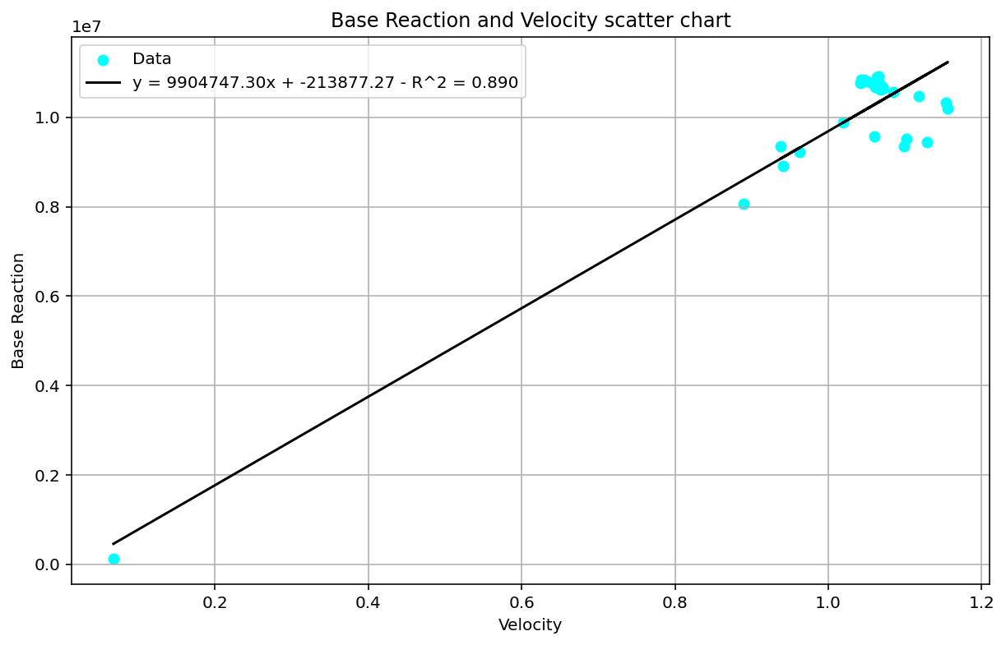

Slide 28
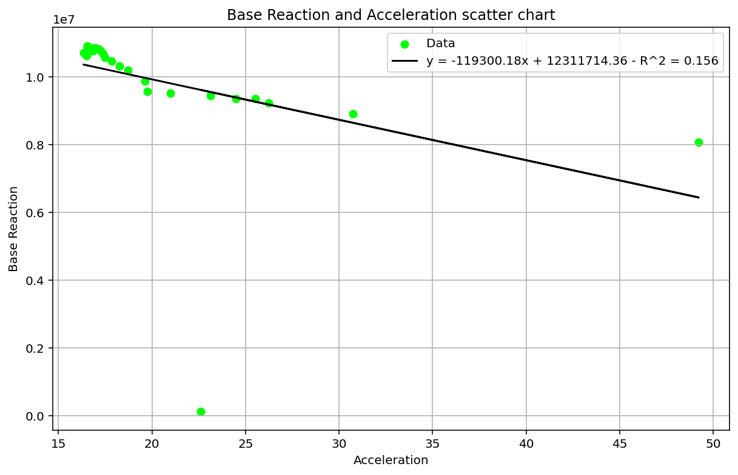

Slide 29
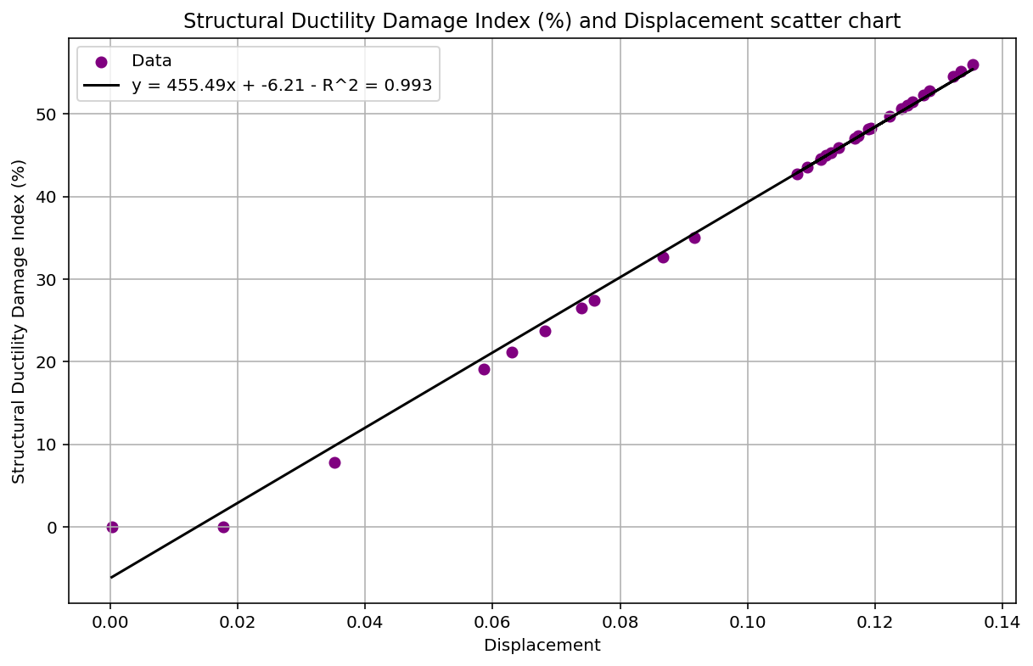

Slide 30
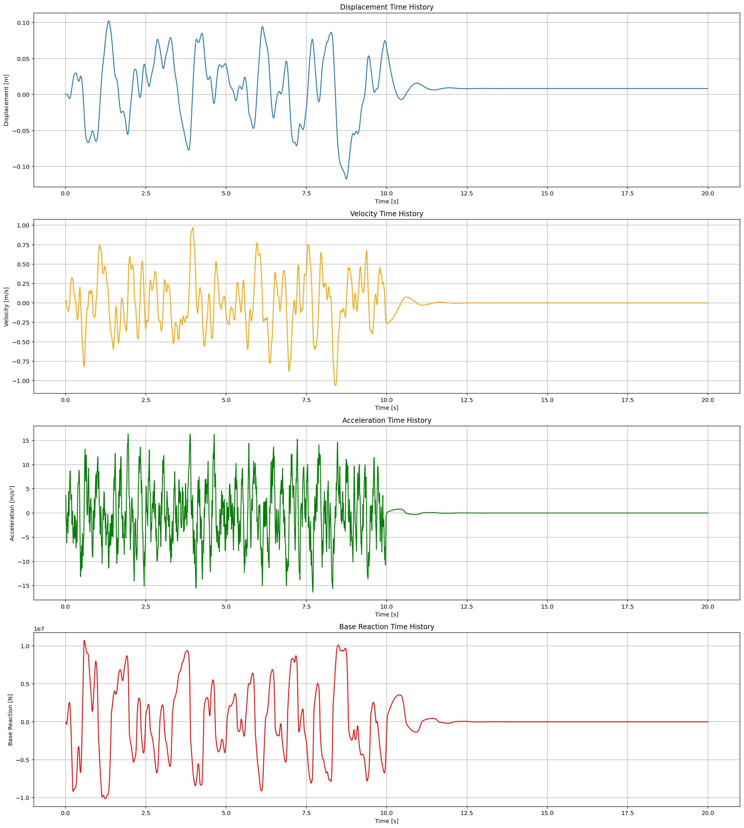

Slide 31
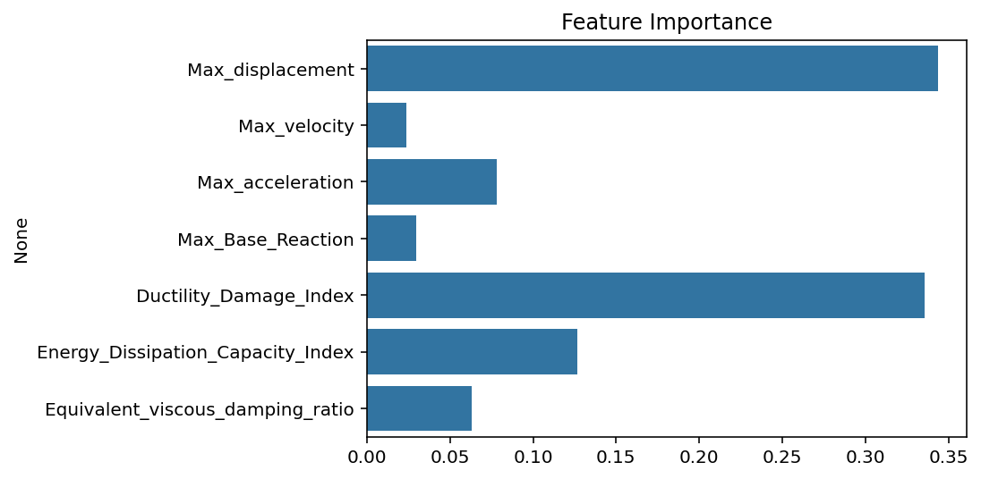

Slide 32
