Slide 1
IN THE NAME OF ALLAH, THE MOST GRACIOUS, THE MOST MERCIFUL
CONSTRAINED OPTIMIZATION OF REINFORCED CONCRETE COLUMN DESIGN USING NONLINEAR PUSHOVER ANALYSIS IN OPENSEES
WRITTEN BY SALAR DELAVAR GHASHGHAEI (QASHQAI)

Slide 2
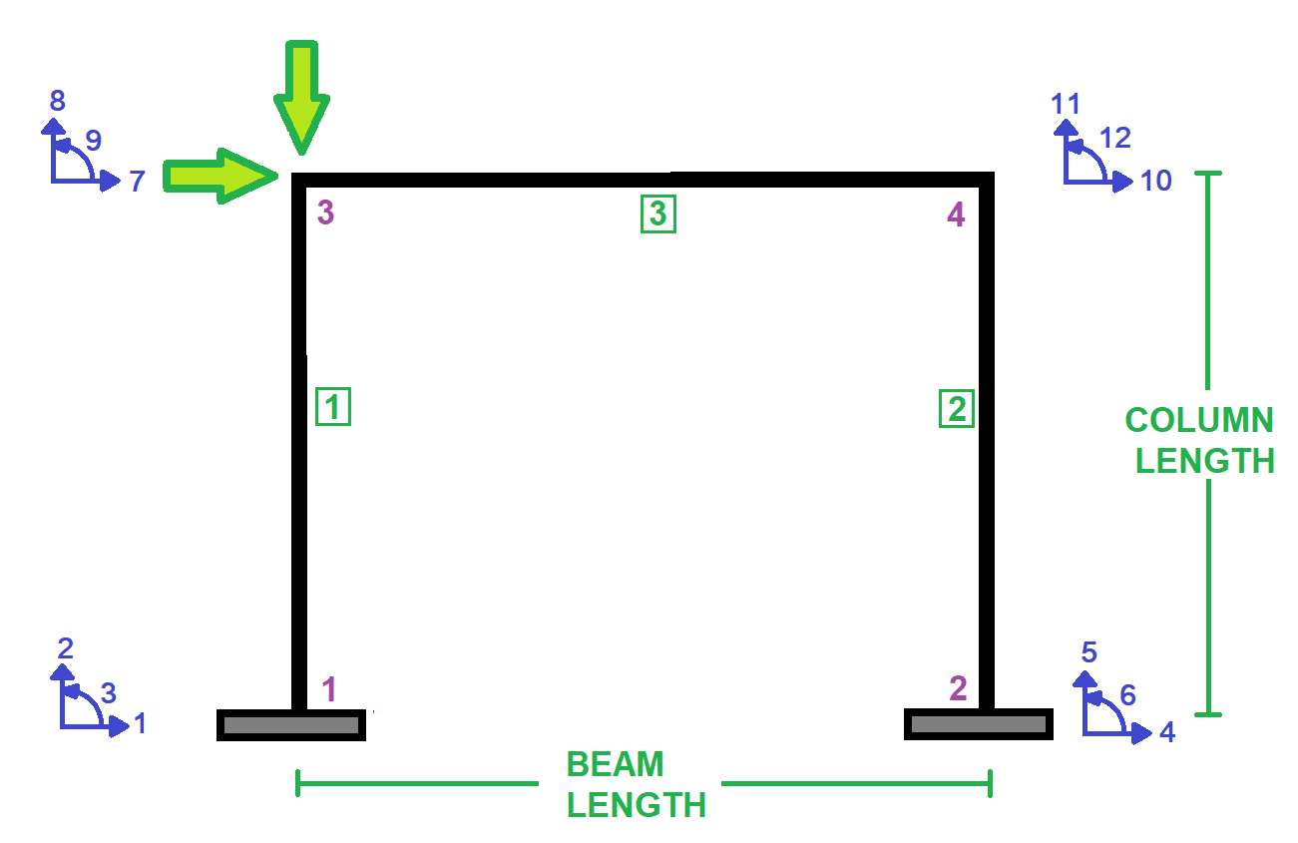

Slide 3
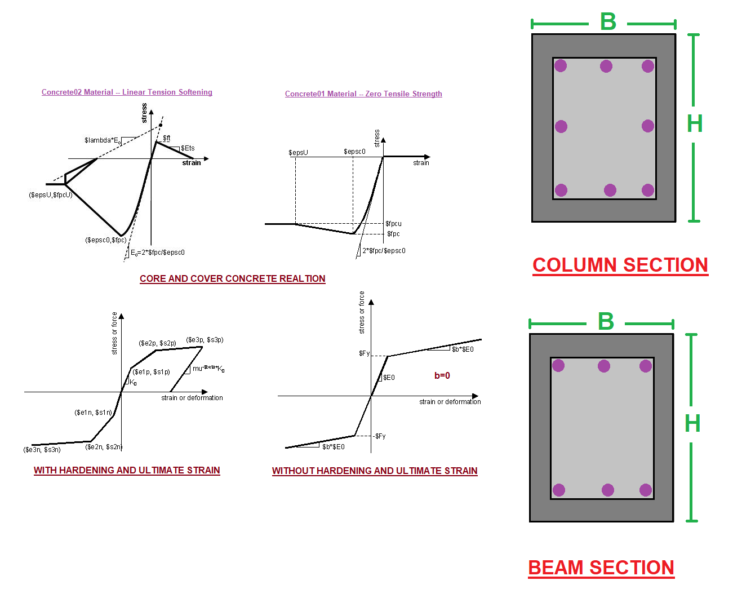

Slide 4
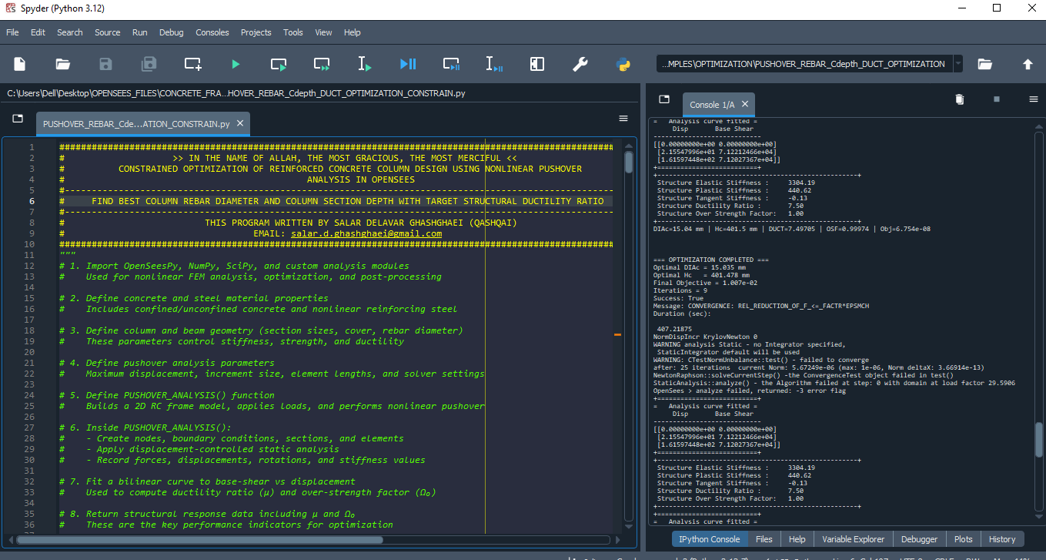

Slide 5
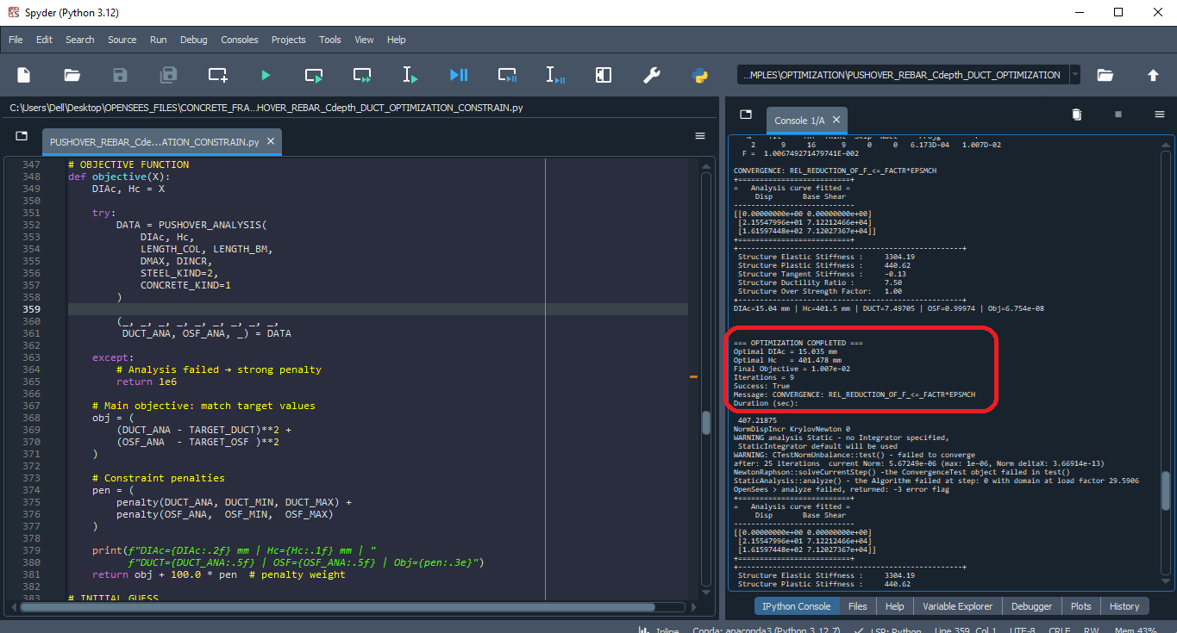

Slide 6
NONLINEAR STATIC ANALYSIS
(PUSHOVER)

Slide 7
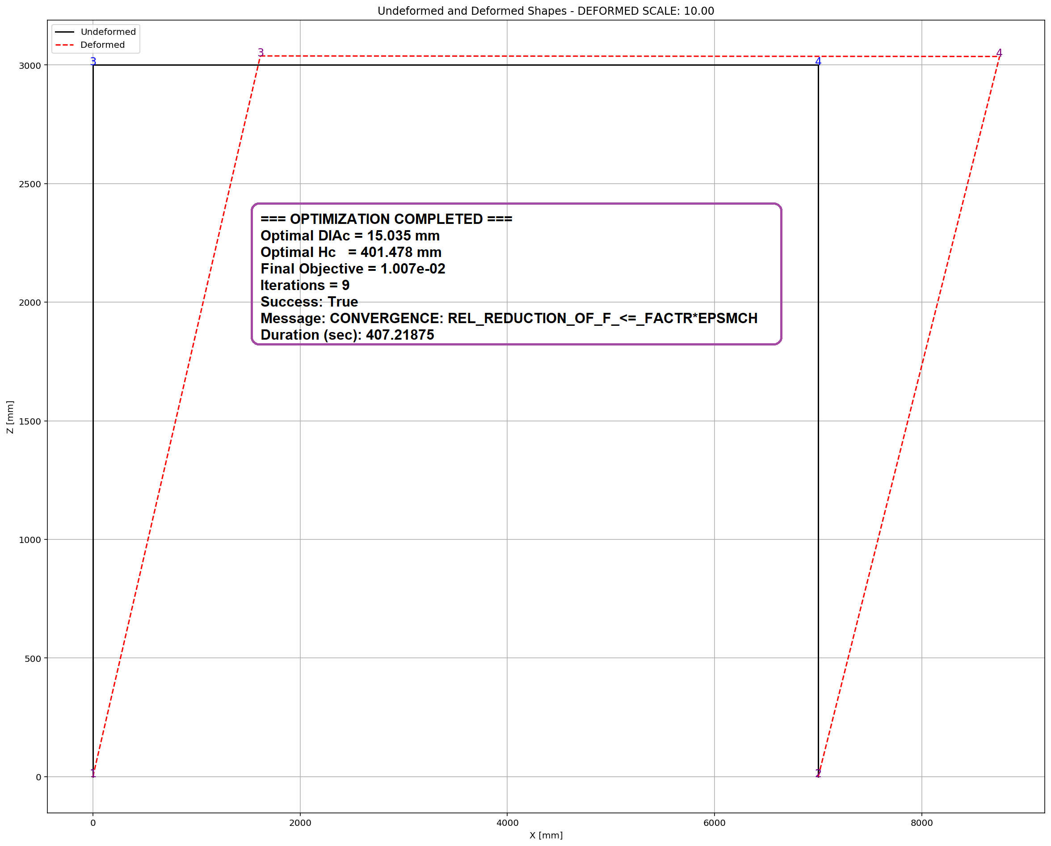

Slide 8
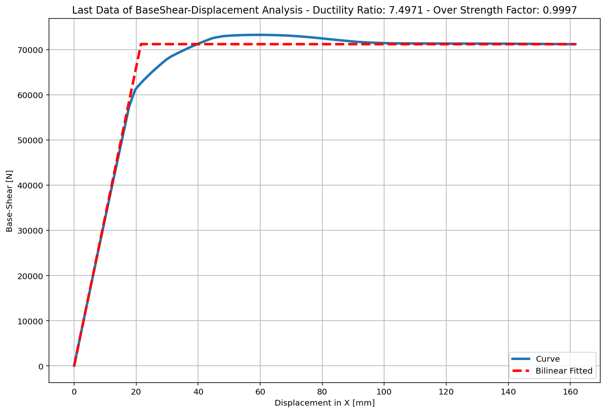
+==========================+
= Analysis curve fitted =
Disp Base Shear
----------------------------
[[0.00000000e+00 0.00000000e+00]
[2.15547996e+01 7.12212466e+04]
[1.61597448e+02 7.12027367e+04]]
+==========================+
+----------------------------------------------------+
Structure Elastic Stiffness : 3304.19
Structure Plastic Stiffness : 440.62
Structure Tangent Stiffness : -0.13
Structure Ductility Ratio : 7.50
Structure Over Strength Factor: 1.00
+----------------------------------------------------+
Over Strength Coefficient (Ω0): 0.9997
Displacement Ductility Ratio (μ):7.4971
Ductility Coefficient (Rμ): 7.4971
Structural Behavior Coefficient (R): 7.4951

