Slide 1
>> IN THE NAME OF ALLAH, THE MOST GRACIOUS, THE MOST MERCIFUL <<
SENSITIVITY ANALYSIS OF CONCRETE FRAME BY CHANGING COLUMN REBAR DIAMETER AND COLUMN SECTION DEPTH USING OPENSEES FOR STRUCTURAL BEHAVIOR COEFFICIENT CALCULATION.
BY SALAR DELAVAR GHASHGHAEI (QASHQAI)

Slide 2
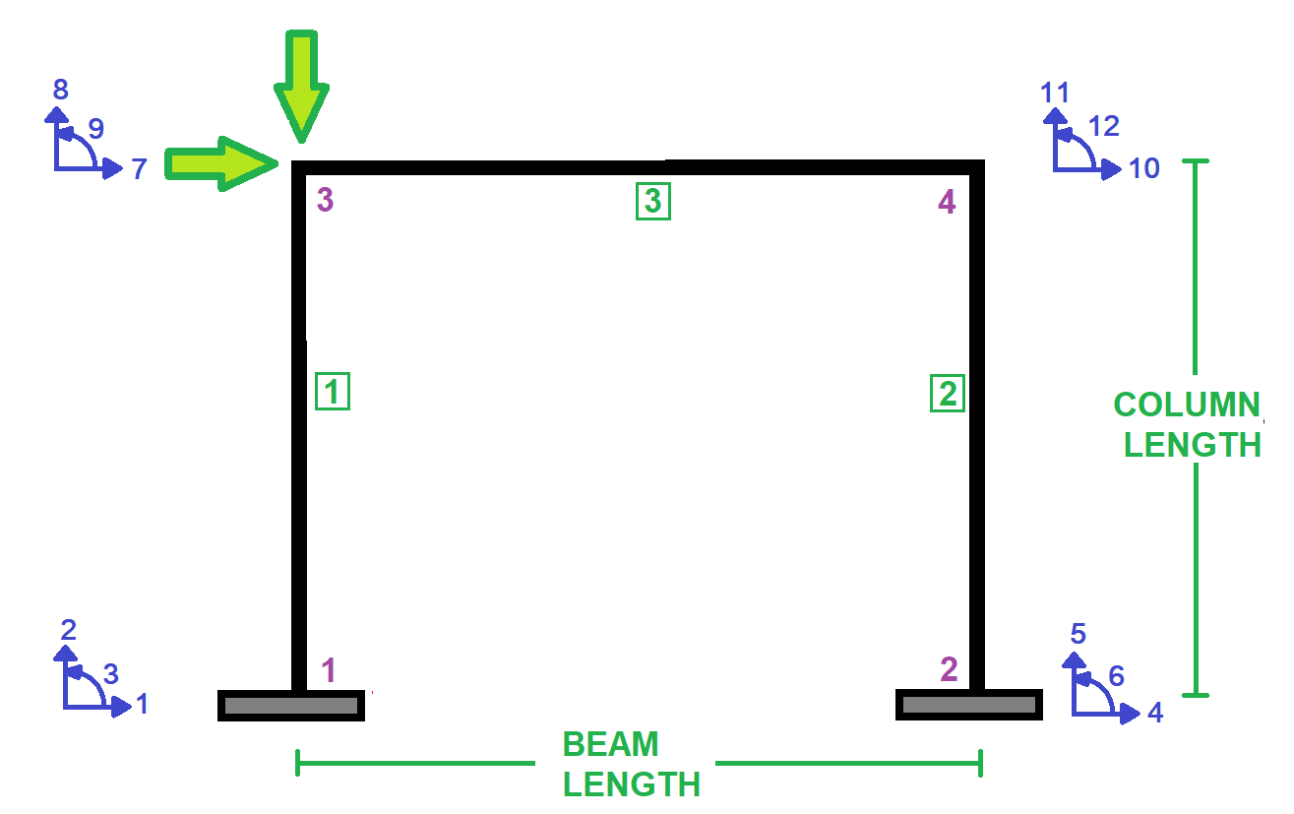

Slide 3
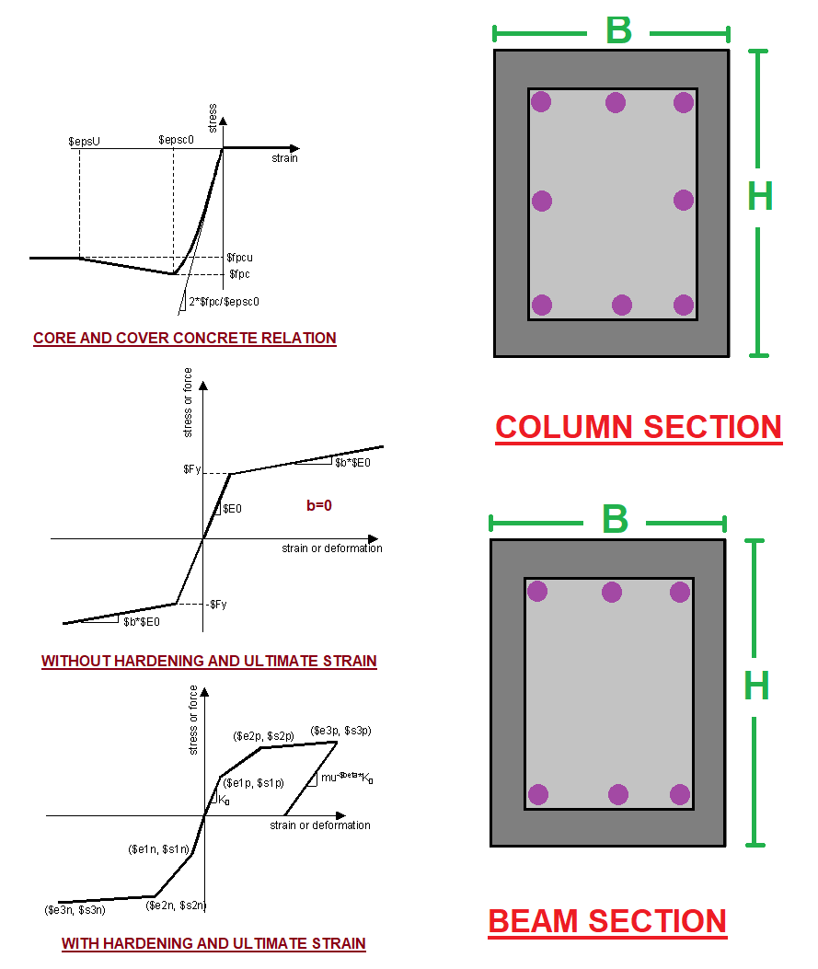

Slide 4
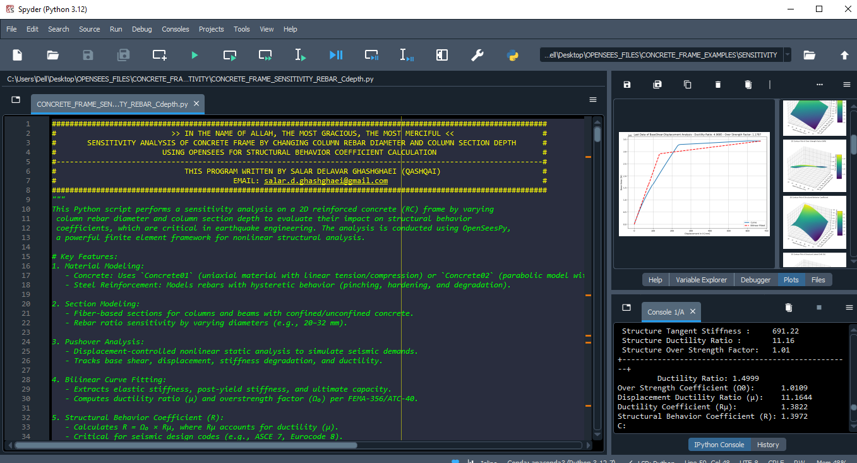

Slide 5
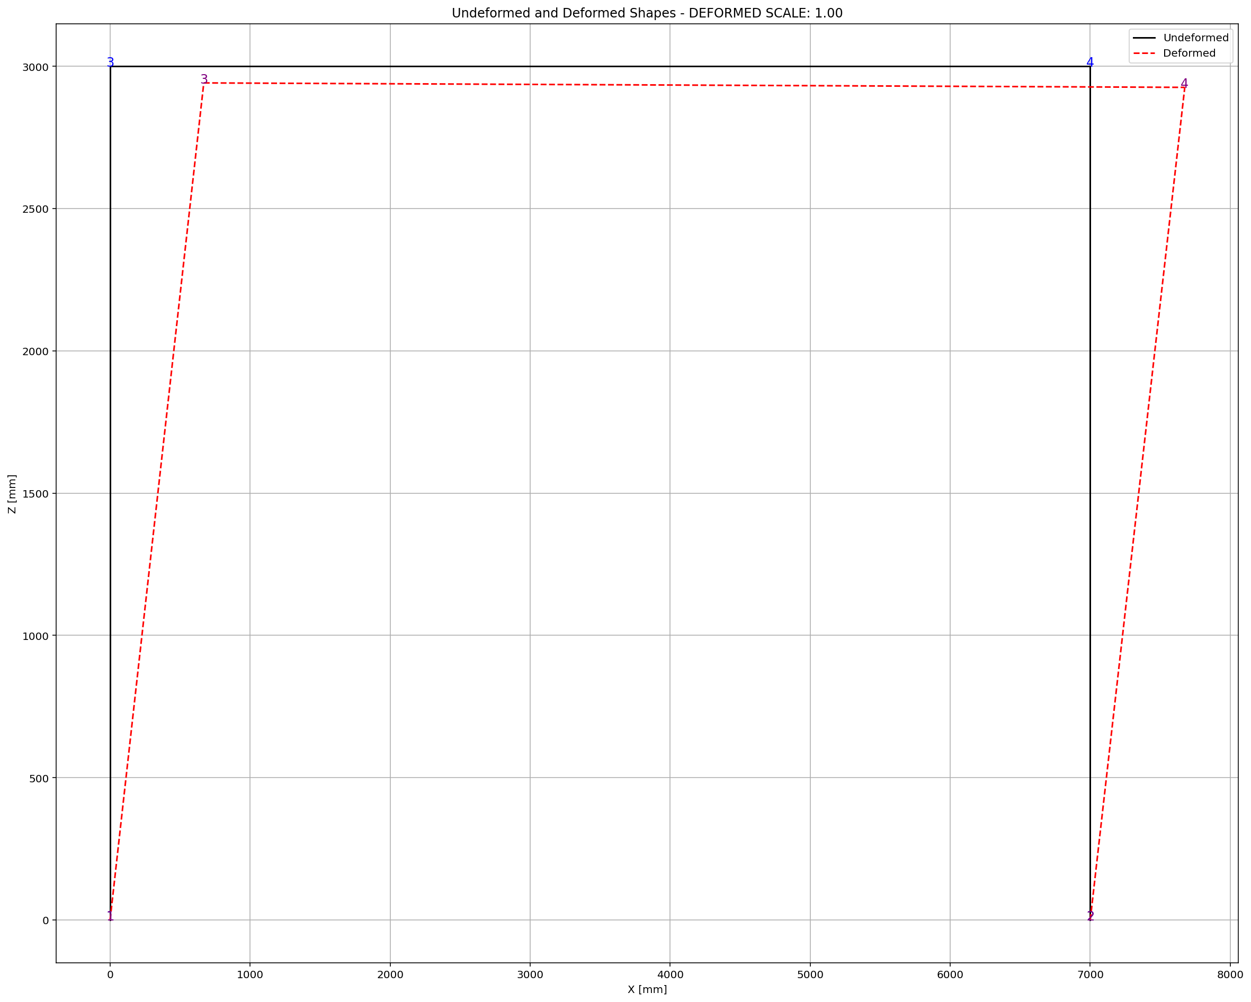

Slide 6
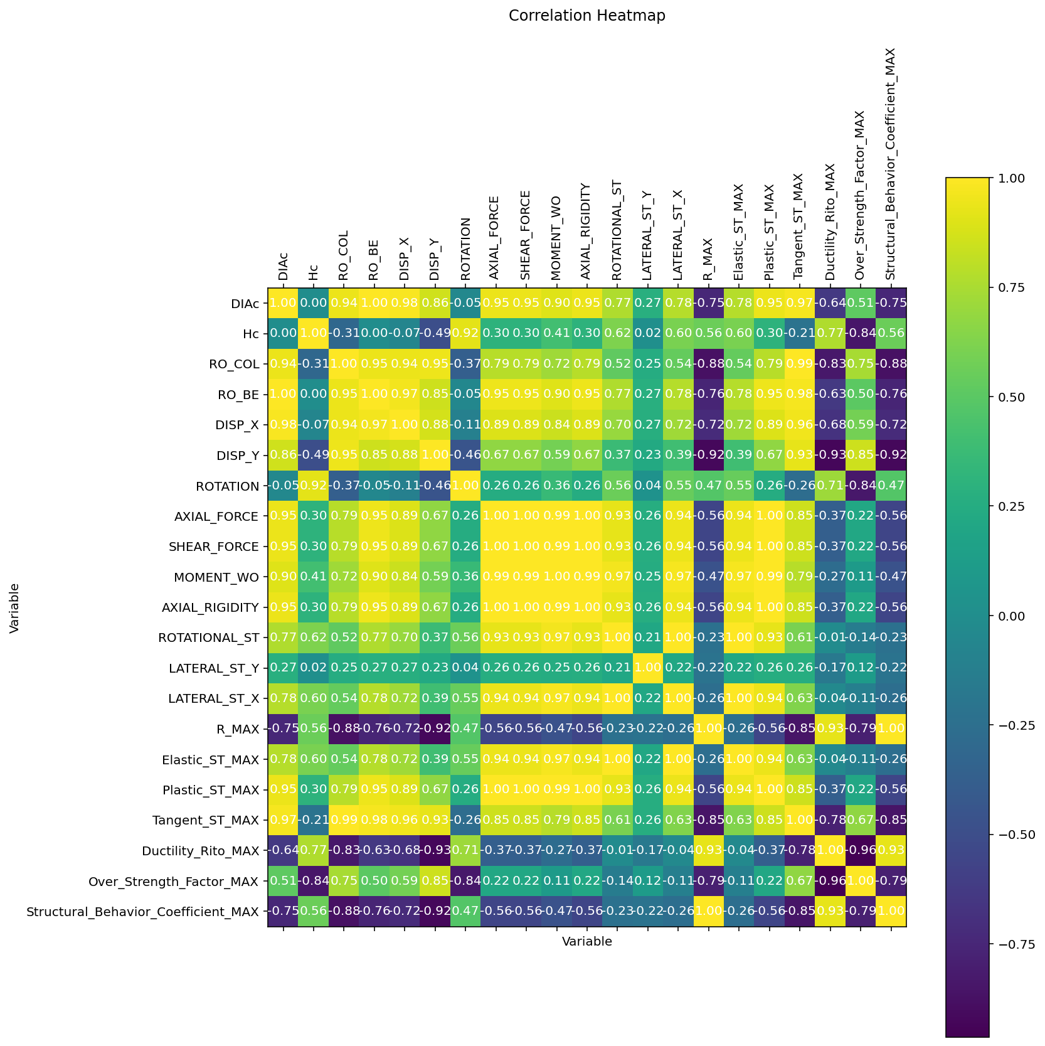

Slide 7
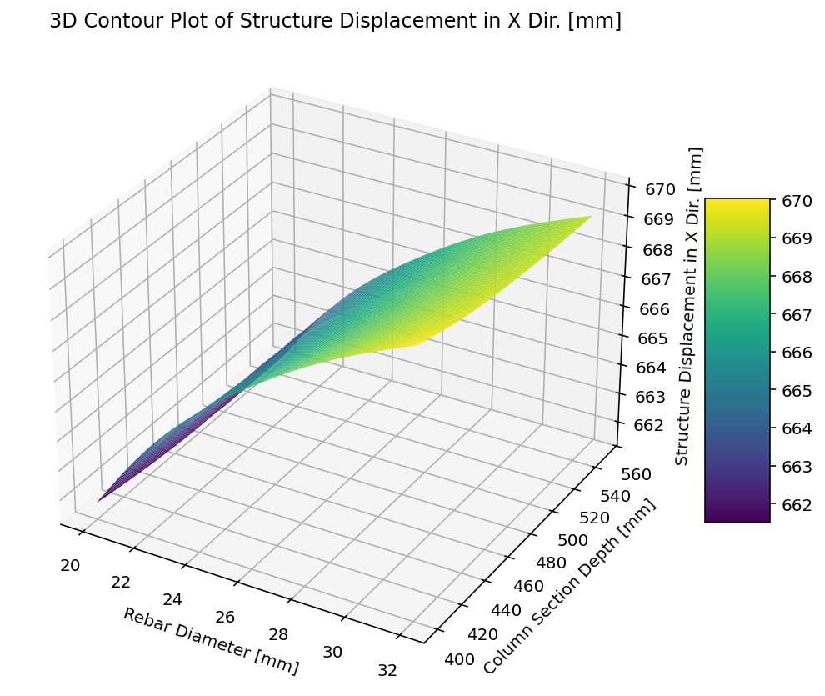

Slide 8
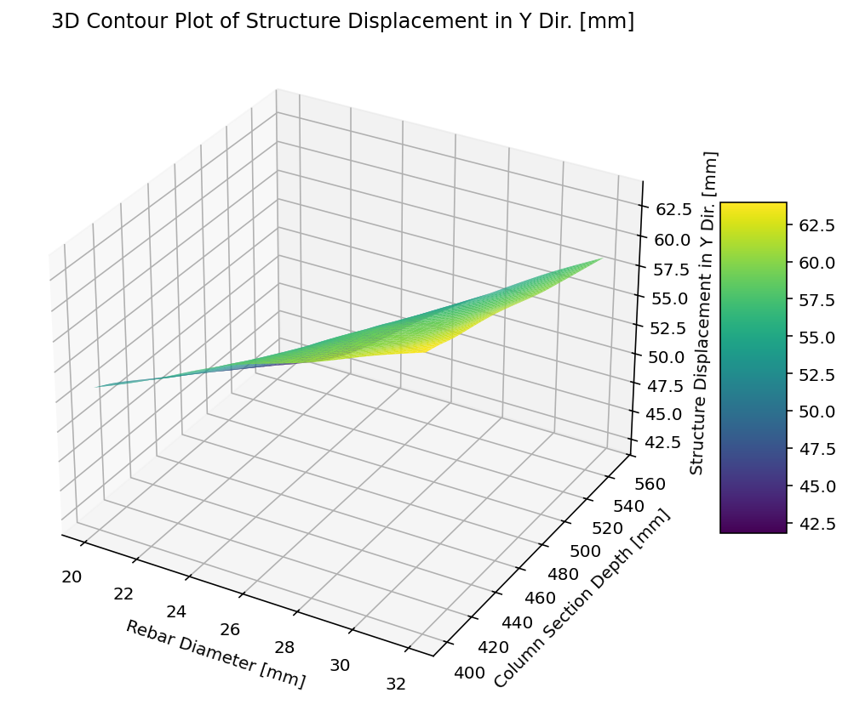

Slide 9
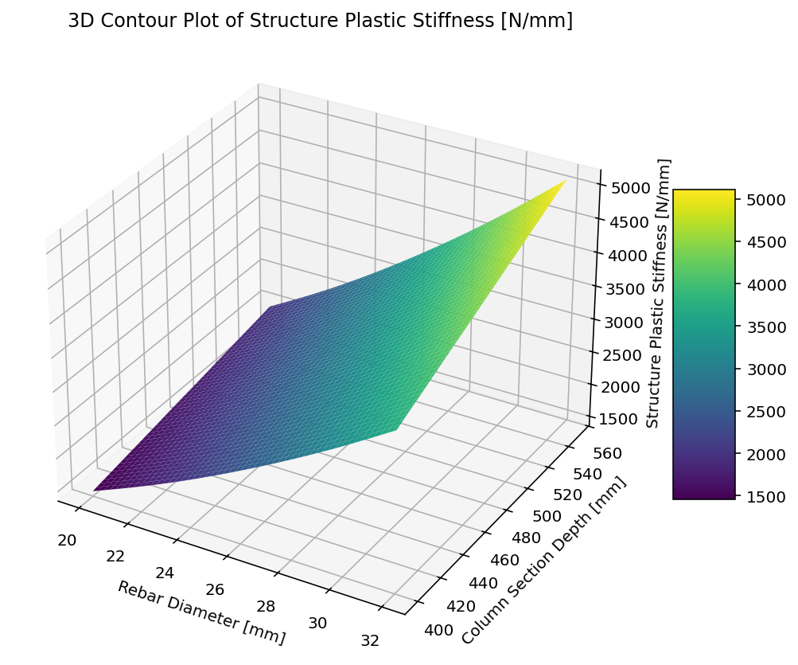

Slide 10
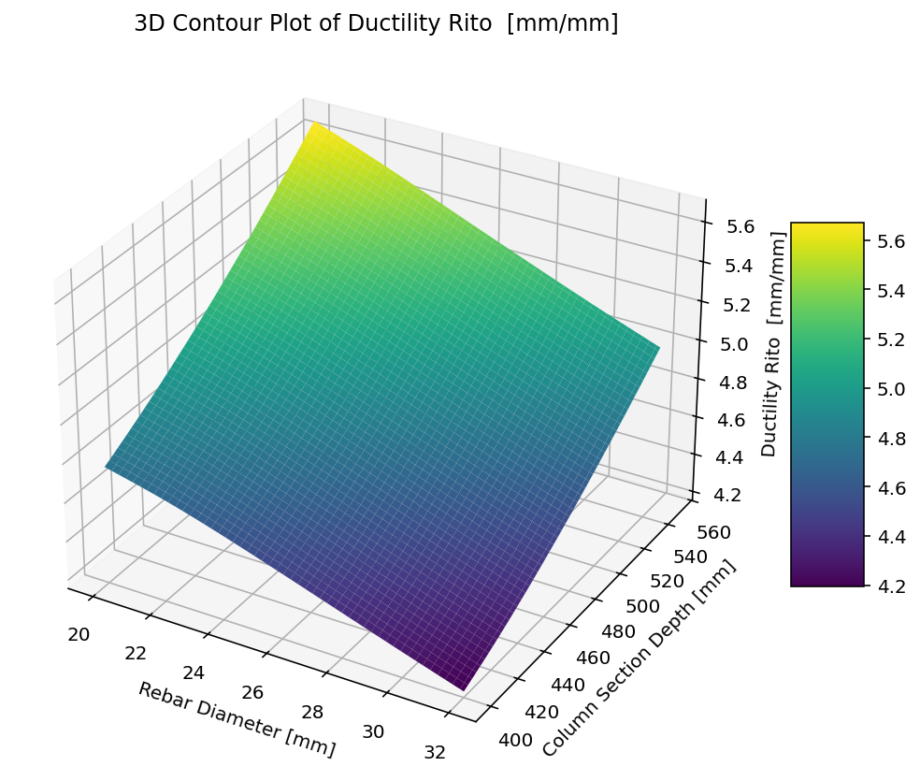

Slide 11
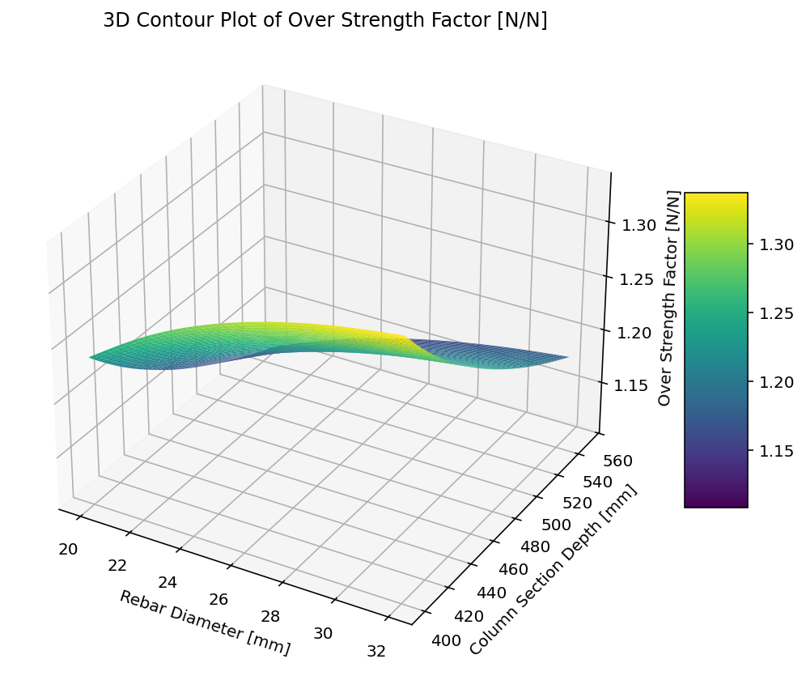

Slide 12
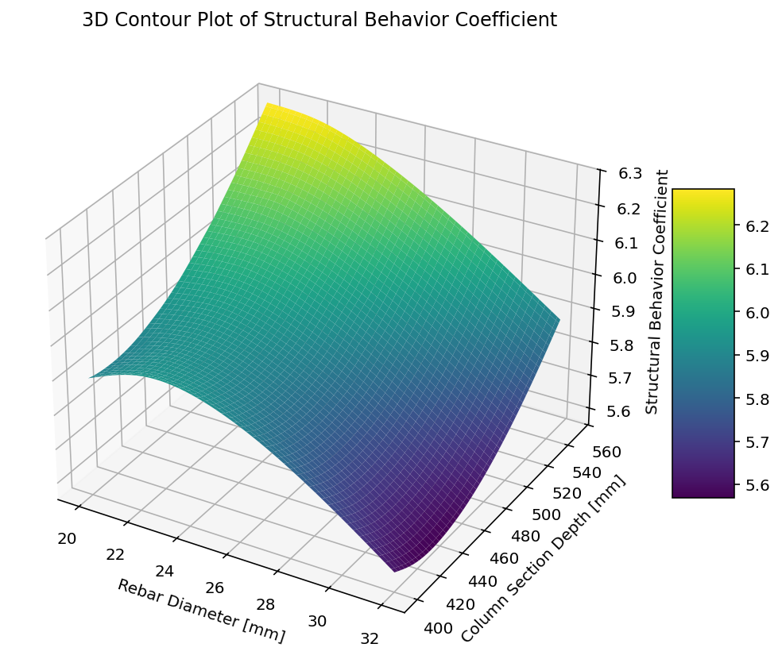

Slide 13
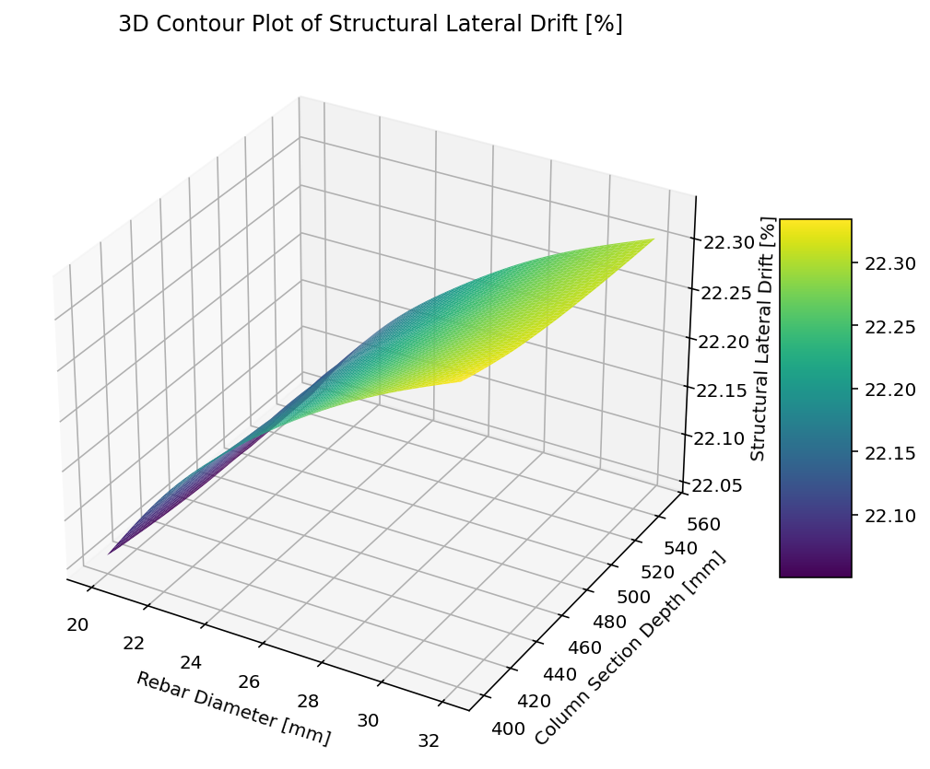

Slide 14
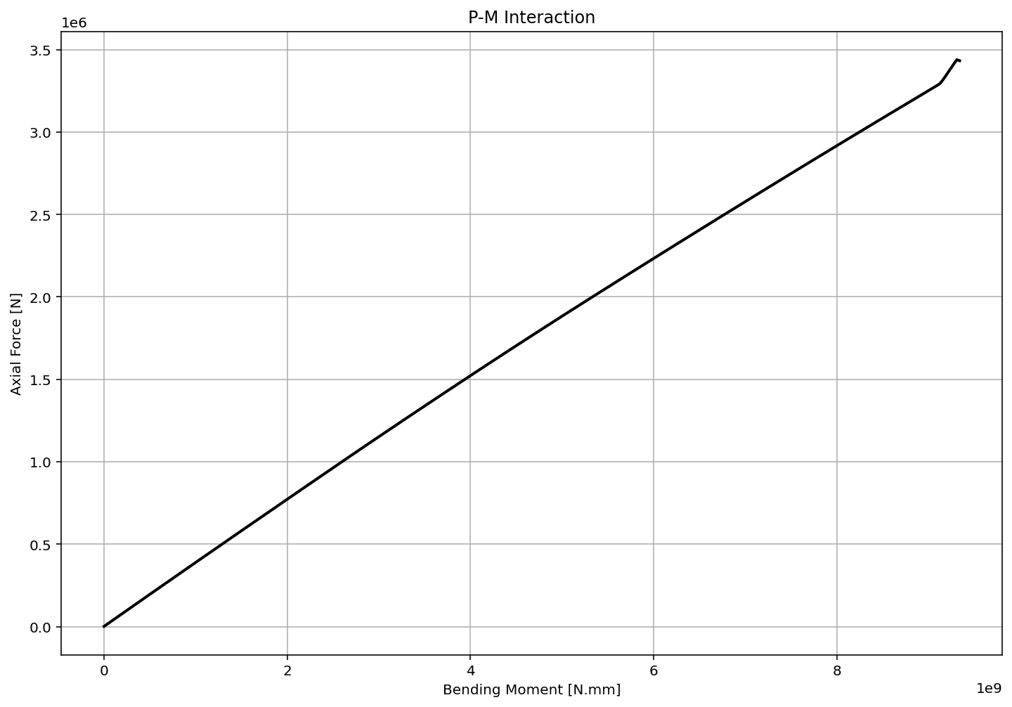

Slide 15
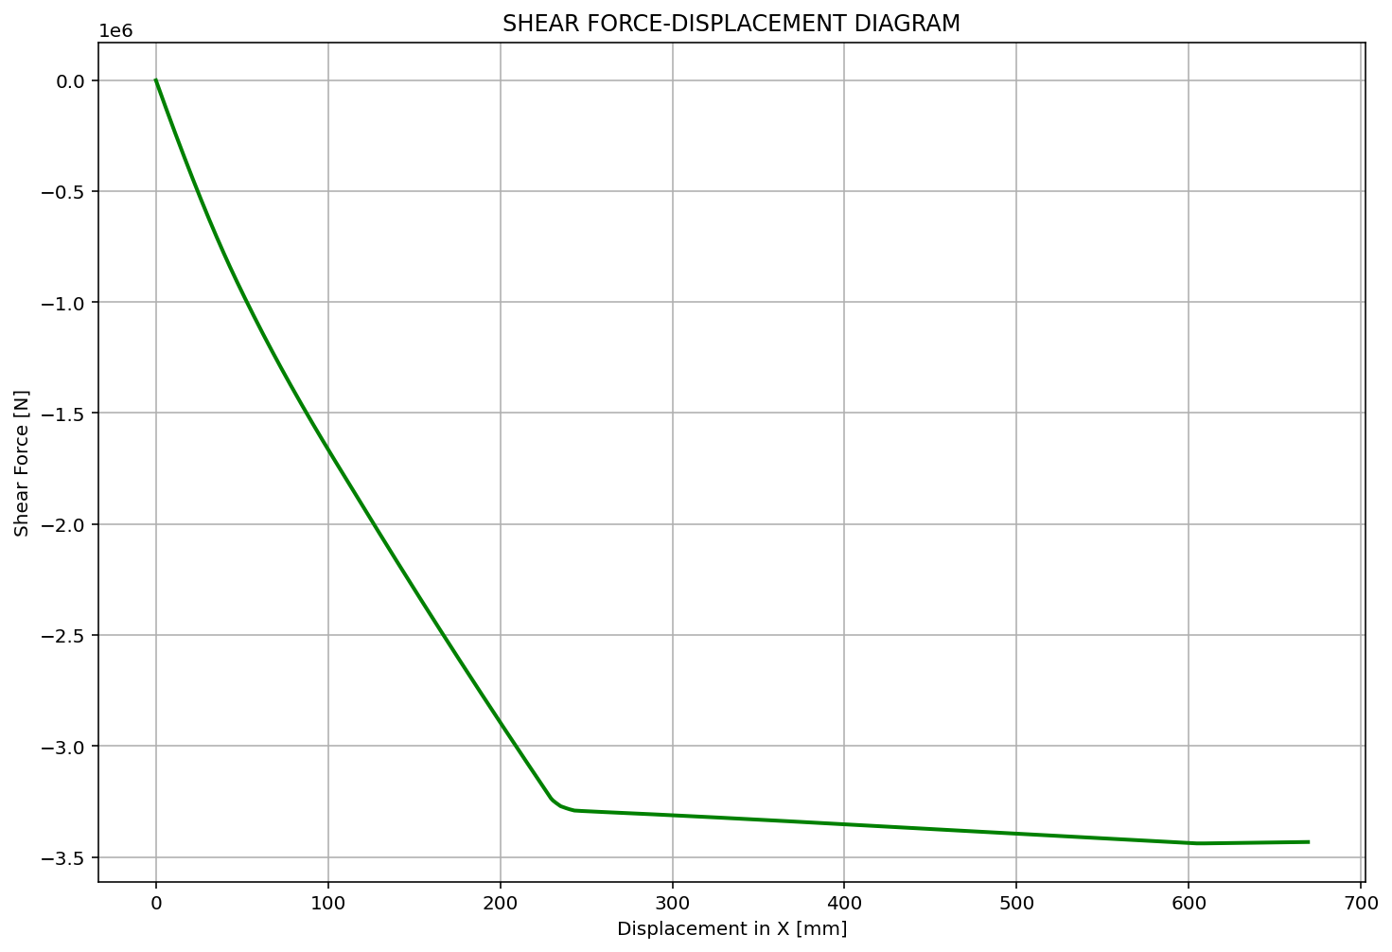

Slide 16
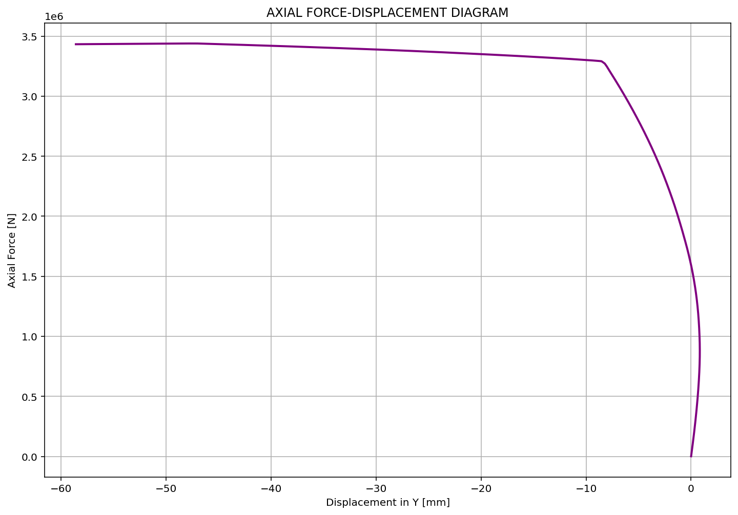

Slide 17
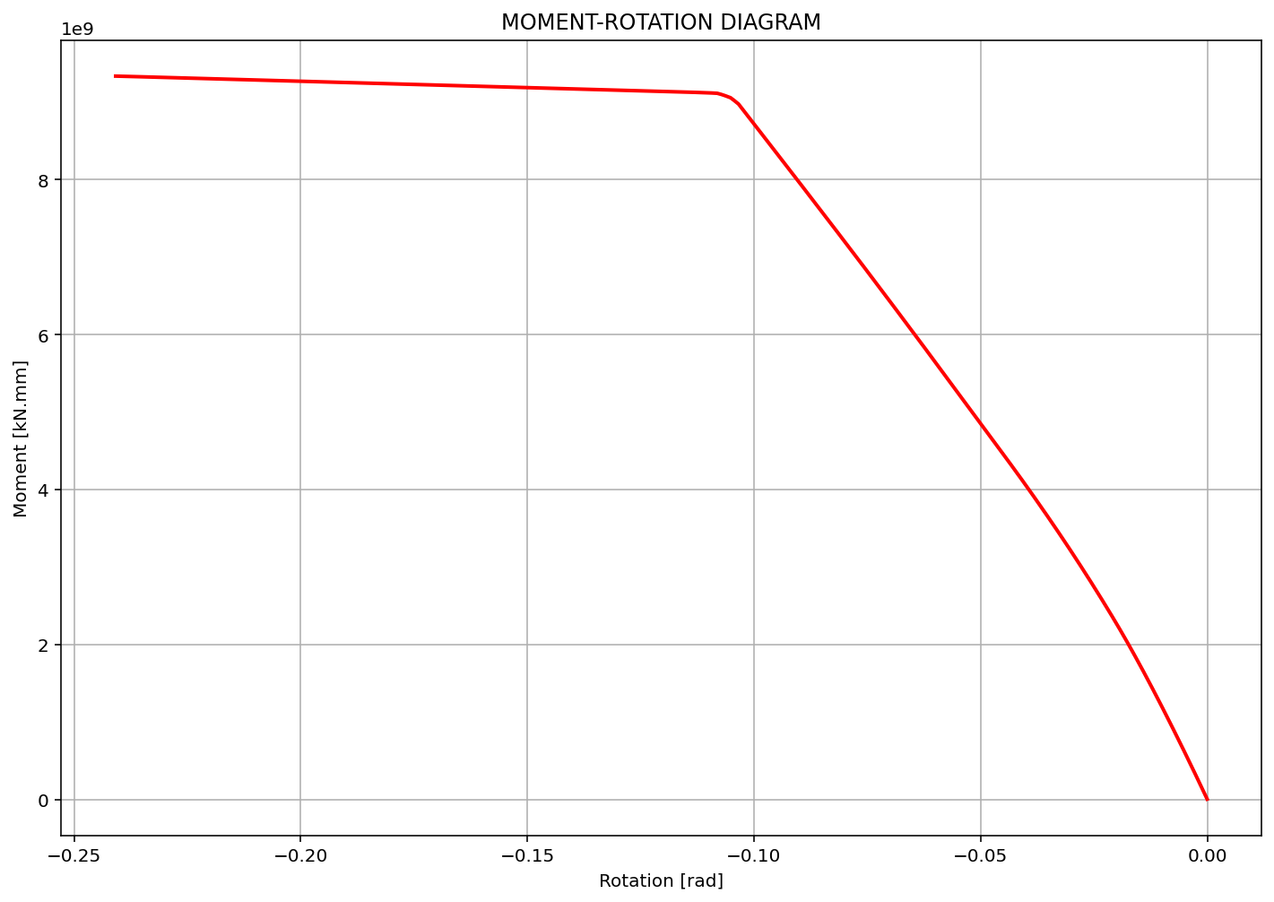

Slide 18
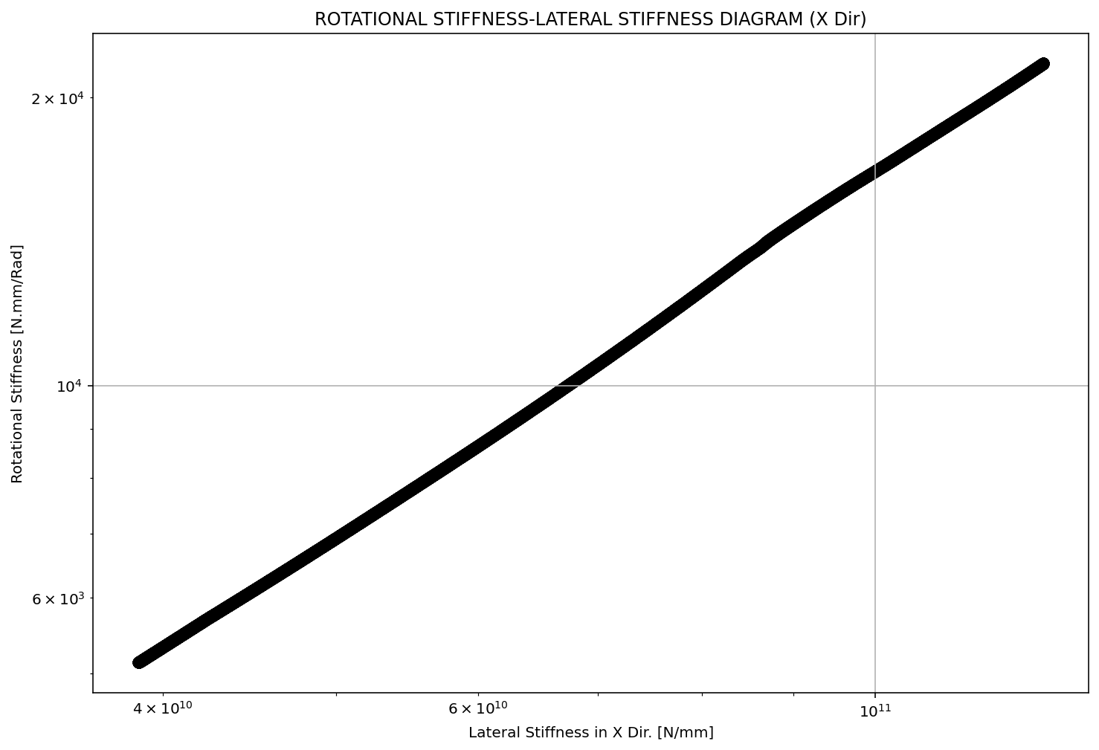

Slide 19
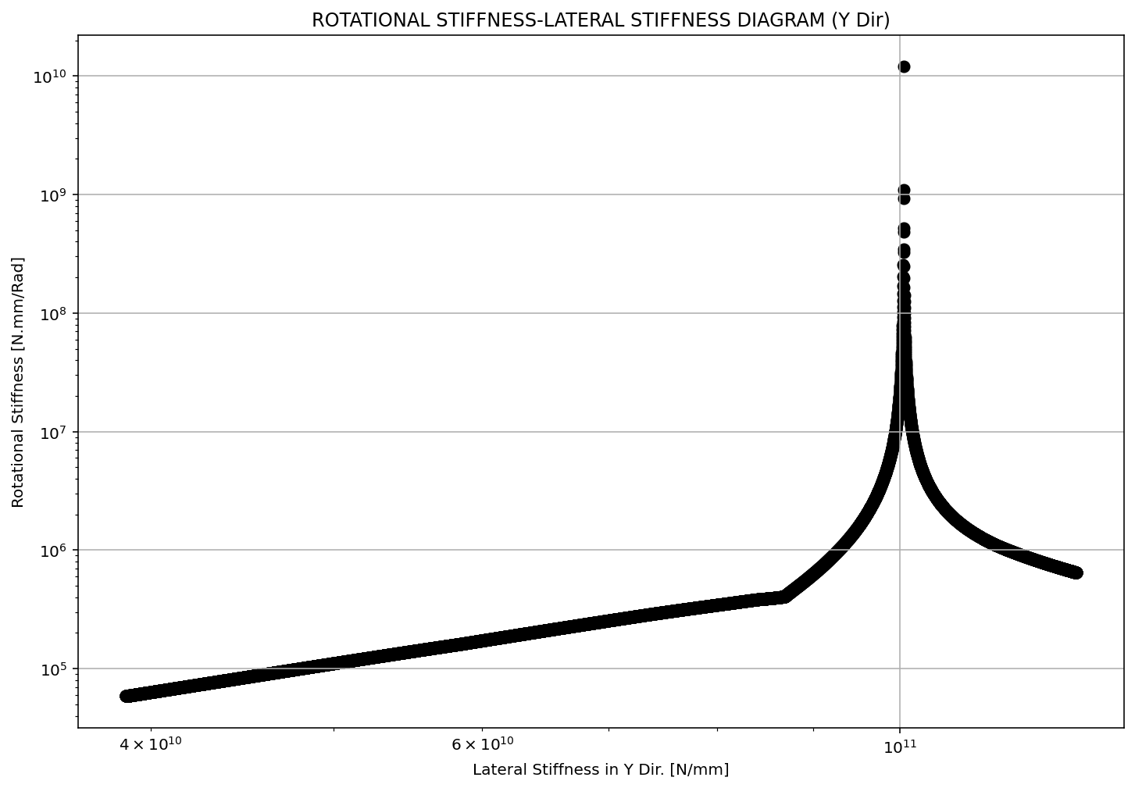

Slide 20
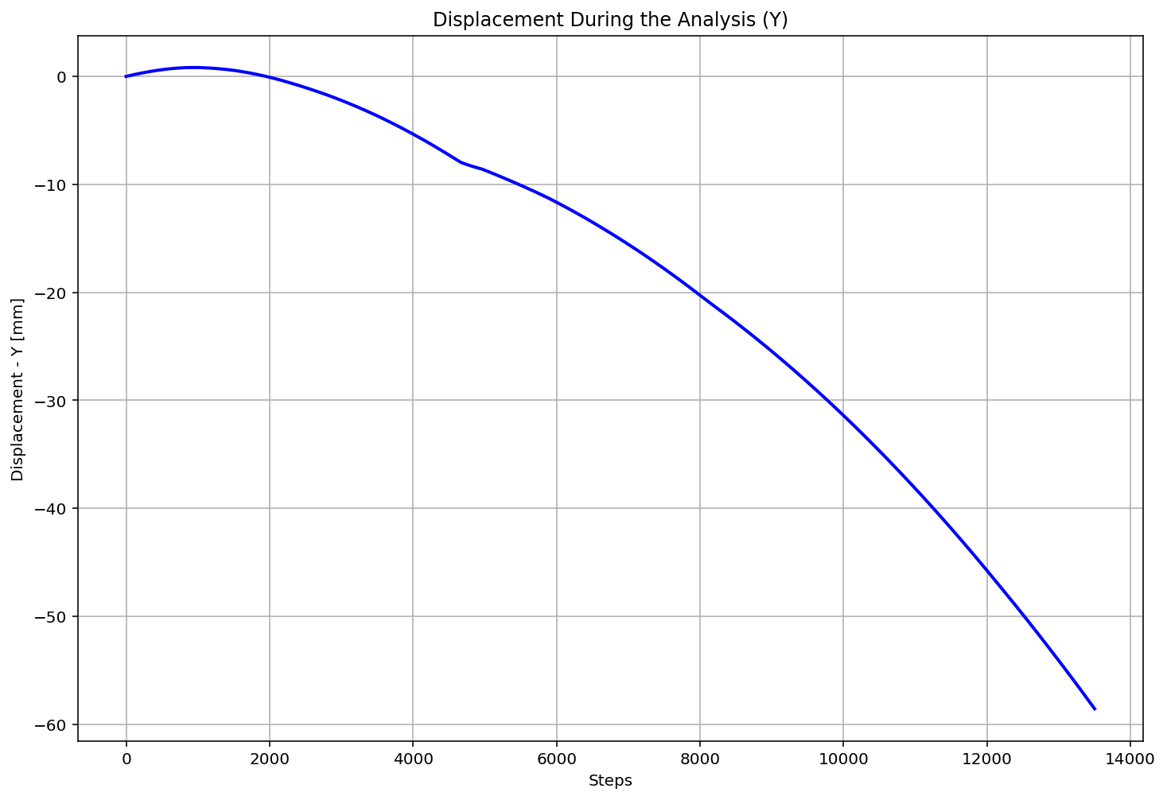

Slide 21
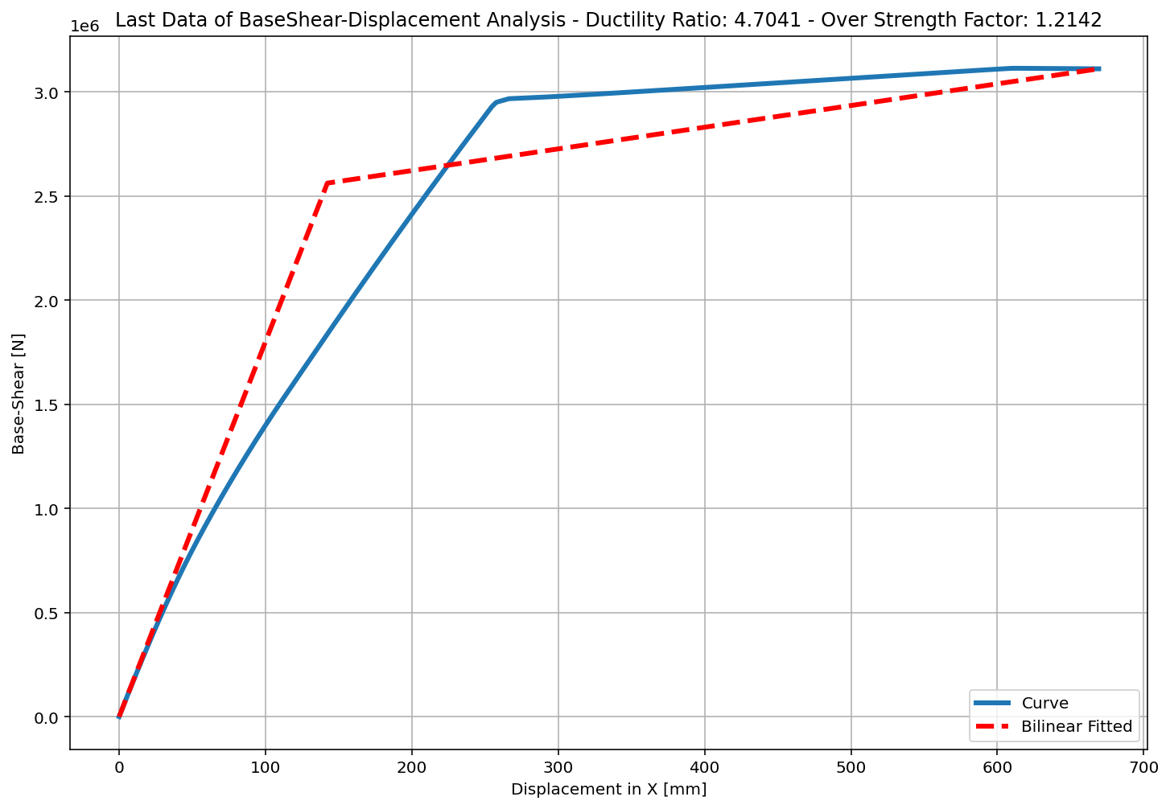
+==========================+
= Analysis curve fitted =
Disp Base Shear
----------------------------
[[0.00000000e+00 0.00000000e+00]
[1.34140749e+02 2.91233600e+06]
[6.69156174e+02 3.43278876e+06]]
+==========================+
+----------------------------------------------------+
Structure Elastic Stiffness : 21711.05
Structure Plastic Stiffness : 5130.03
Structure Tangent Stiffness : 972.78
Structure Ductility Ratio : 4.99
Structure Over Strength Factor: 1.18
+----------------------------------------------------+
Over Strength Coefficient (Ω0): 1.1787
Displacement Ductility Ratio (μ): 4.9885
Ductility Coefficient (Rμ): 4.9885
Structural Behavior Coefficient (R): 5.8799

Slide 22
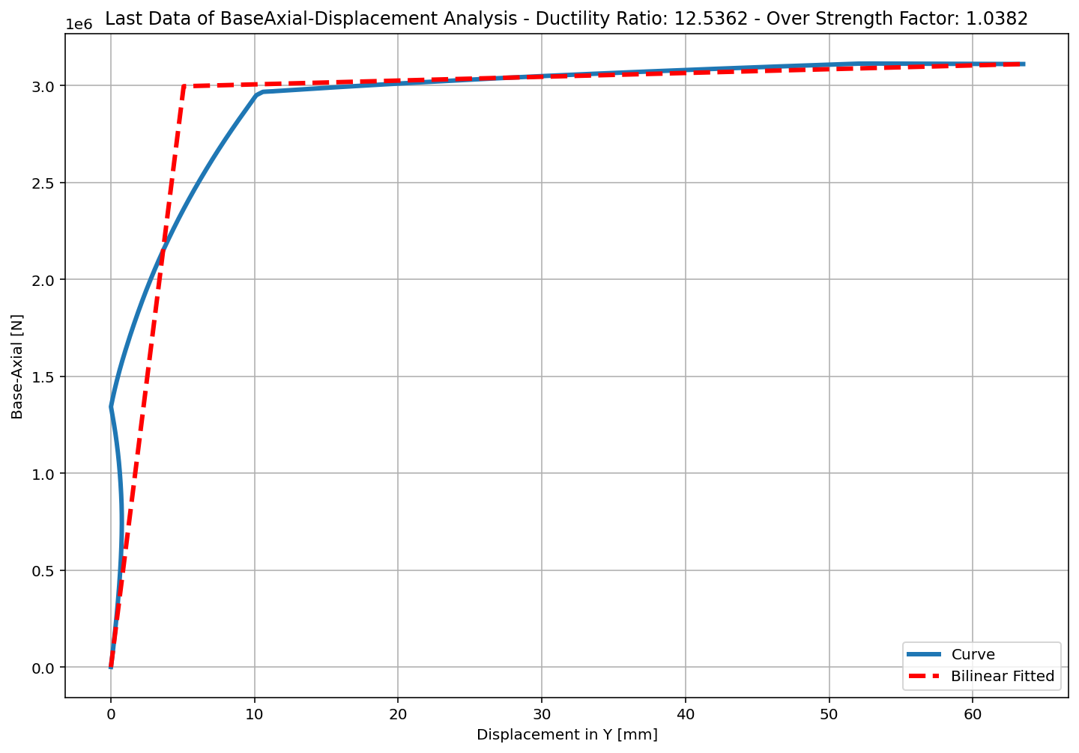
+==========================+
= Analysis curve fitted =
Disp Base Shear
----------------------------
[[0.00000000e+00 0.00000000e+00]
[5.24665998e+00 3.39592666e+06]
[5.85759771e+01 3.43278876e+06]]
+==========================+
+----------------------------------------------------+
Structure Elastic Stiffness : 647254.95
Structure Plastic Stiffness : 58604.04
Structure Tangent Stiffness : 691.22
Structure Ductility Ratio : 11.16
Structure Over Strength Factor: 1.01
+----------------------------------------------------+
Ductility Ratio: 1.4999
Over Strength Coefficient (Ω0): 1.0109
Displacement Ductility Ratio (μ): 11.1644
Ductility Coefficient (Rμ): 1.3822
Structural Behavior Coefficient (R): 1.3972

