Slide 1
IN THE NAME OF ALLAH
DYNAMIC TIME HISTORY ANALYSIS
EXTERNAL OBJECT CONTACT EFFECTS WITH SOIL-STRUCTURE INTERACTIONS VIA THE SPRING METHOD
WRITTEN BY SALAR DELAVAR GHASHGHAEI (QASHQAI)

Slide 2
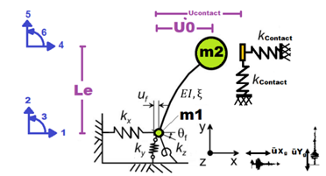

Slide 3
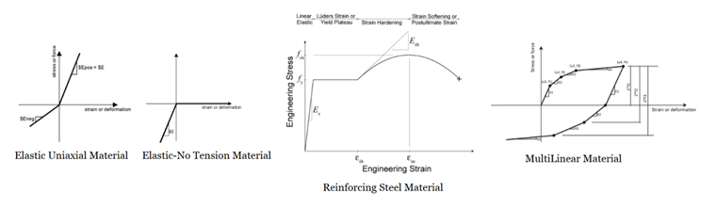

Slide 4
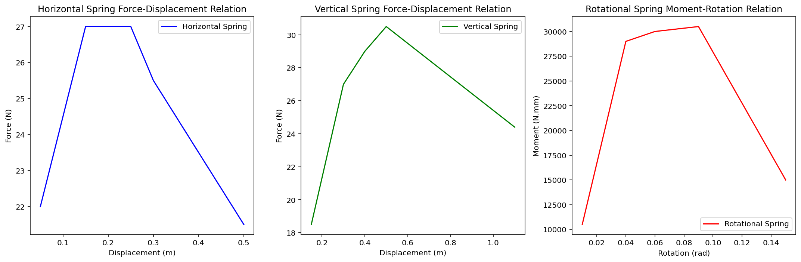

Slide 5
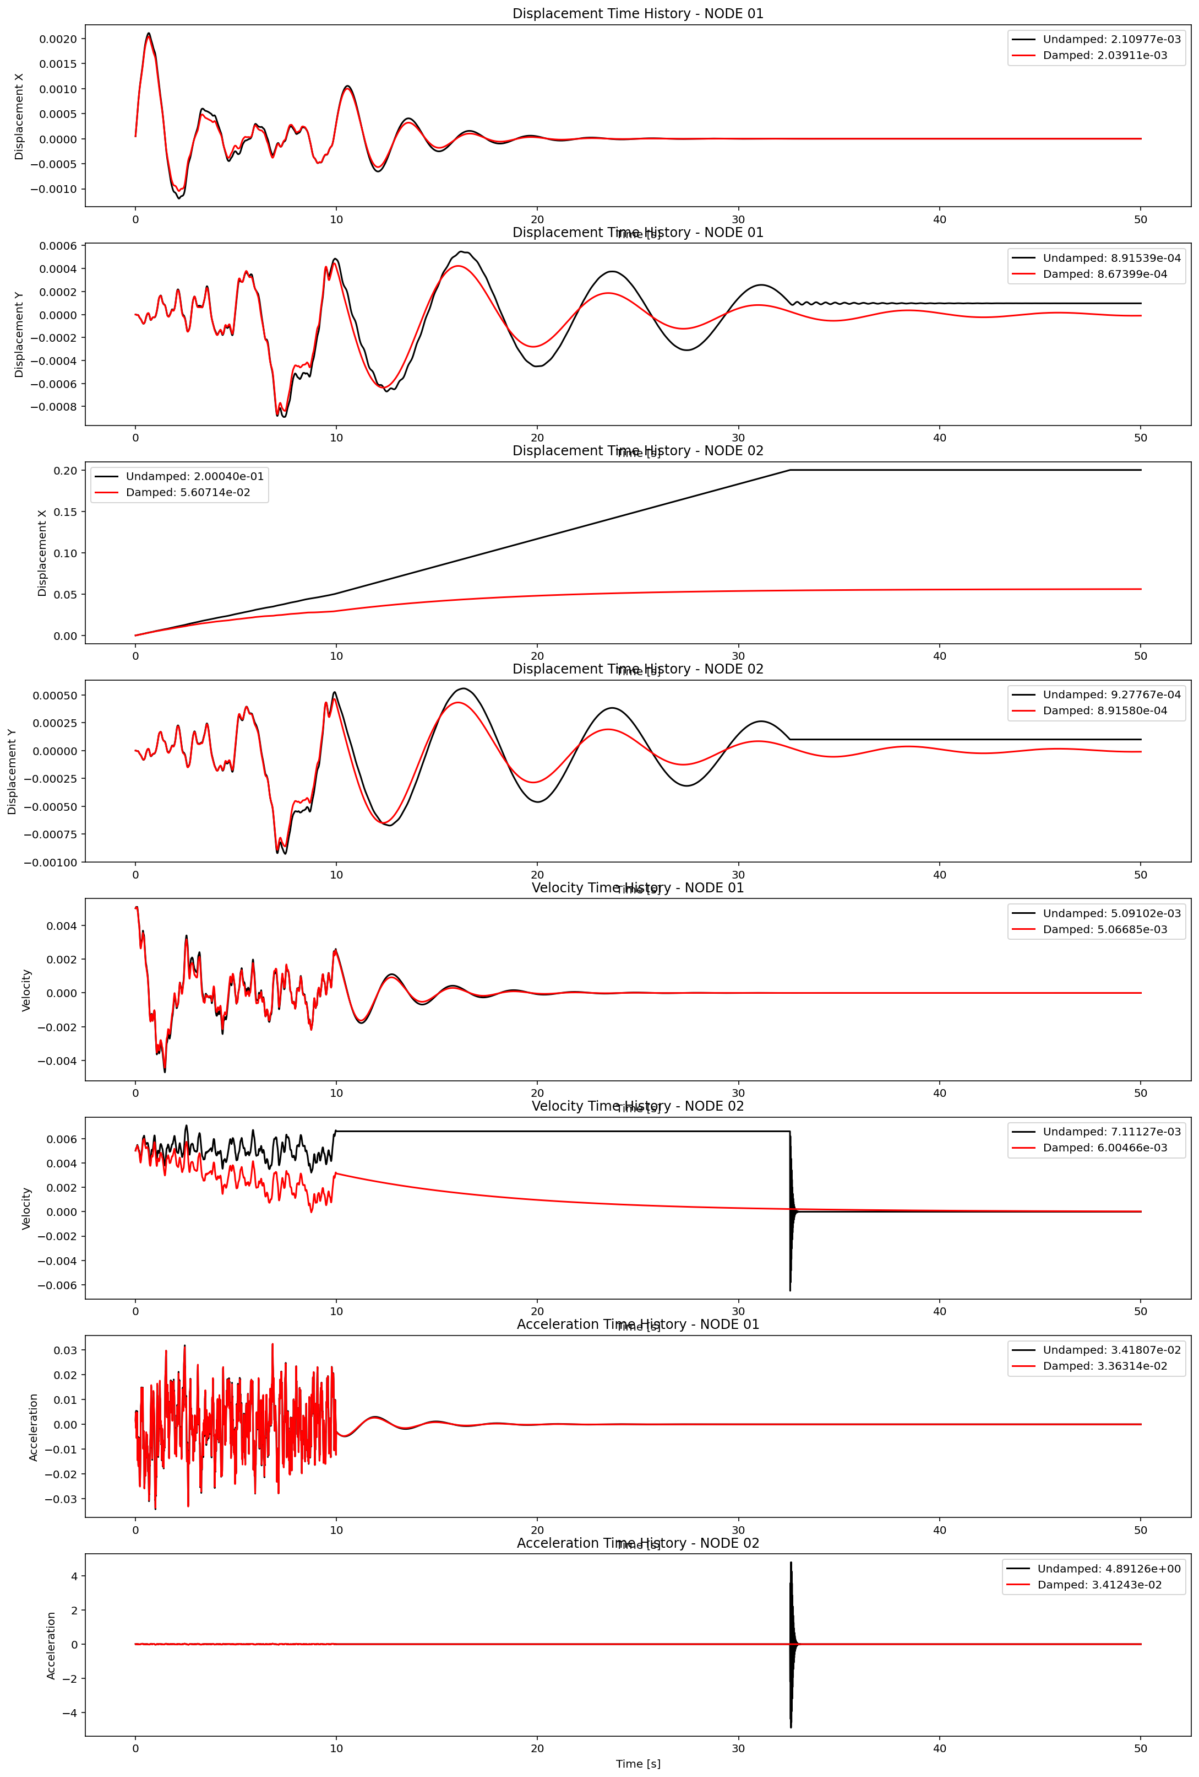

Slide 6
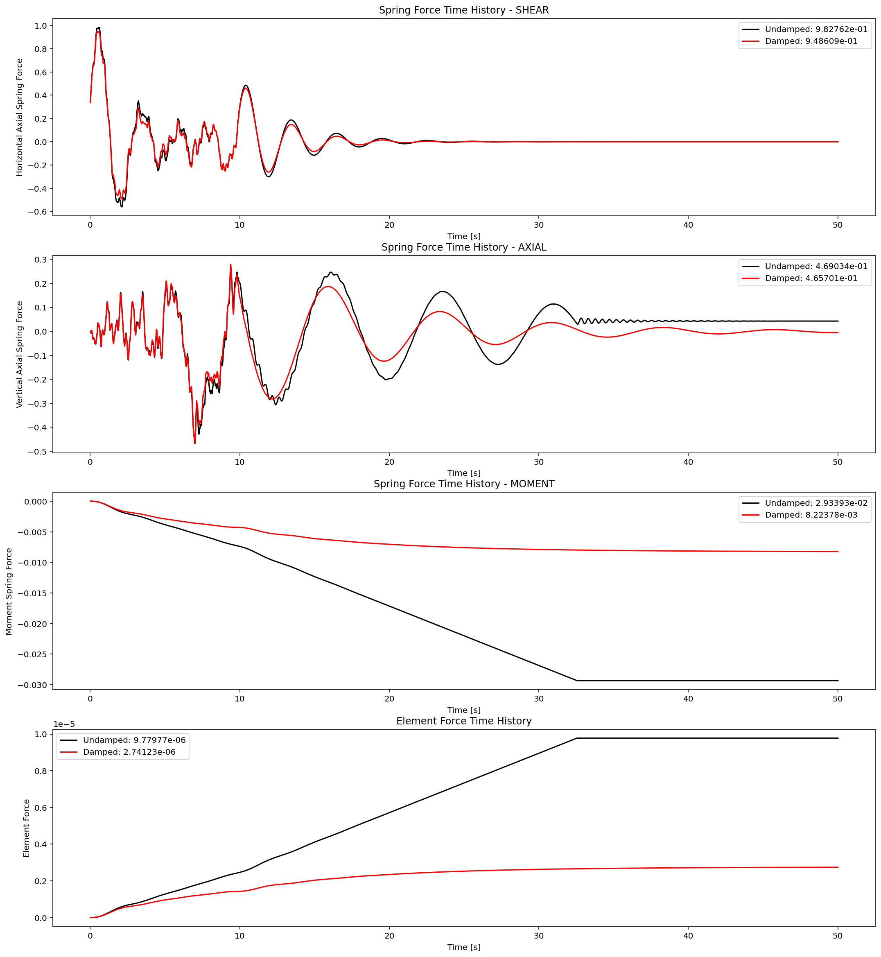

Slide 7
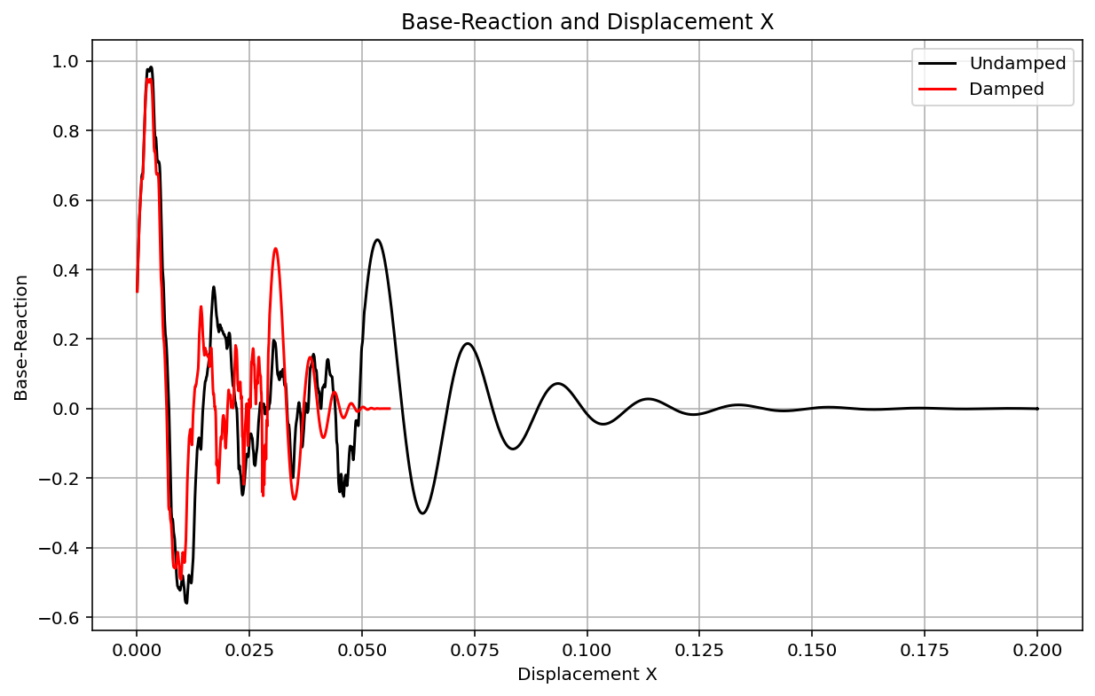

Slide 8
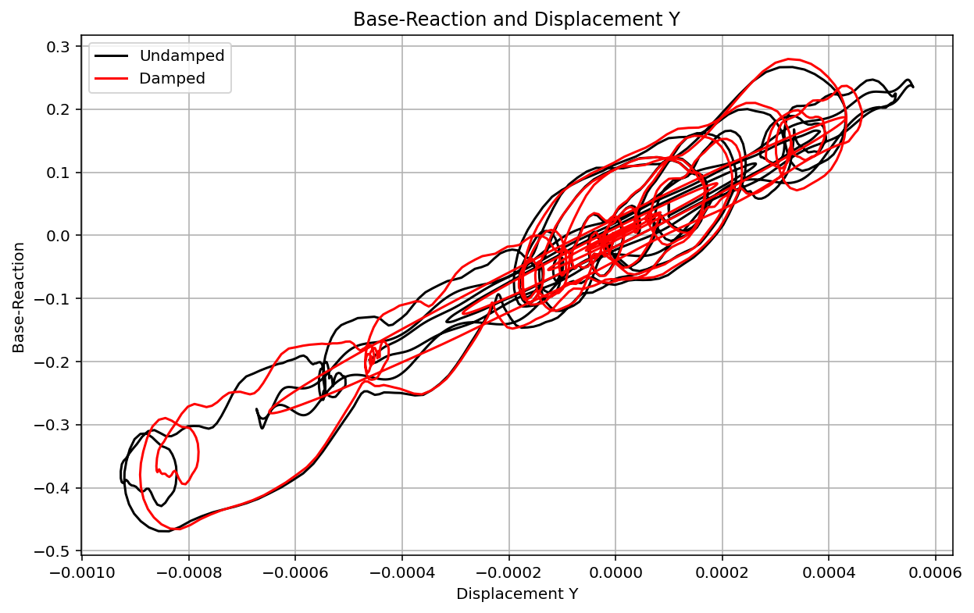

Slide 9
