Slide 1
>> IN THE NAME OF ALLAH, THE MOST GRACIOUS, THE MOST MERCIFUL <<
DETERMINATION OF OPTIMUM STRUCTURAL YIELD STRENGTH FROM ENERGY DISSIPATION CAPACITY INDEX USING FINITE‑DIFFERENCE NEWTON ITERATION AND OPENSEES
THIS PROGRAM WRITTEN BY SALAR DELAVAR GHASHGHAEI (QASHQAI)

Slide 2
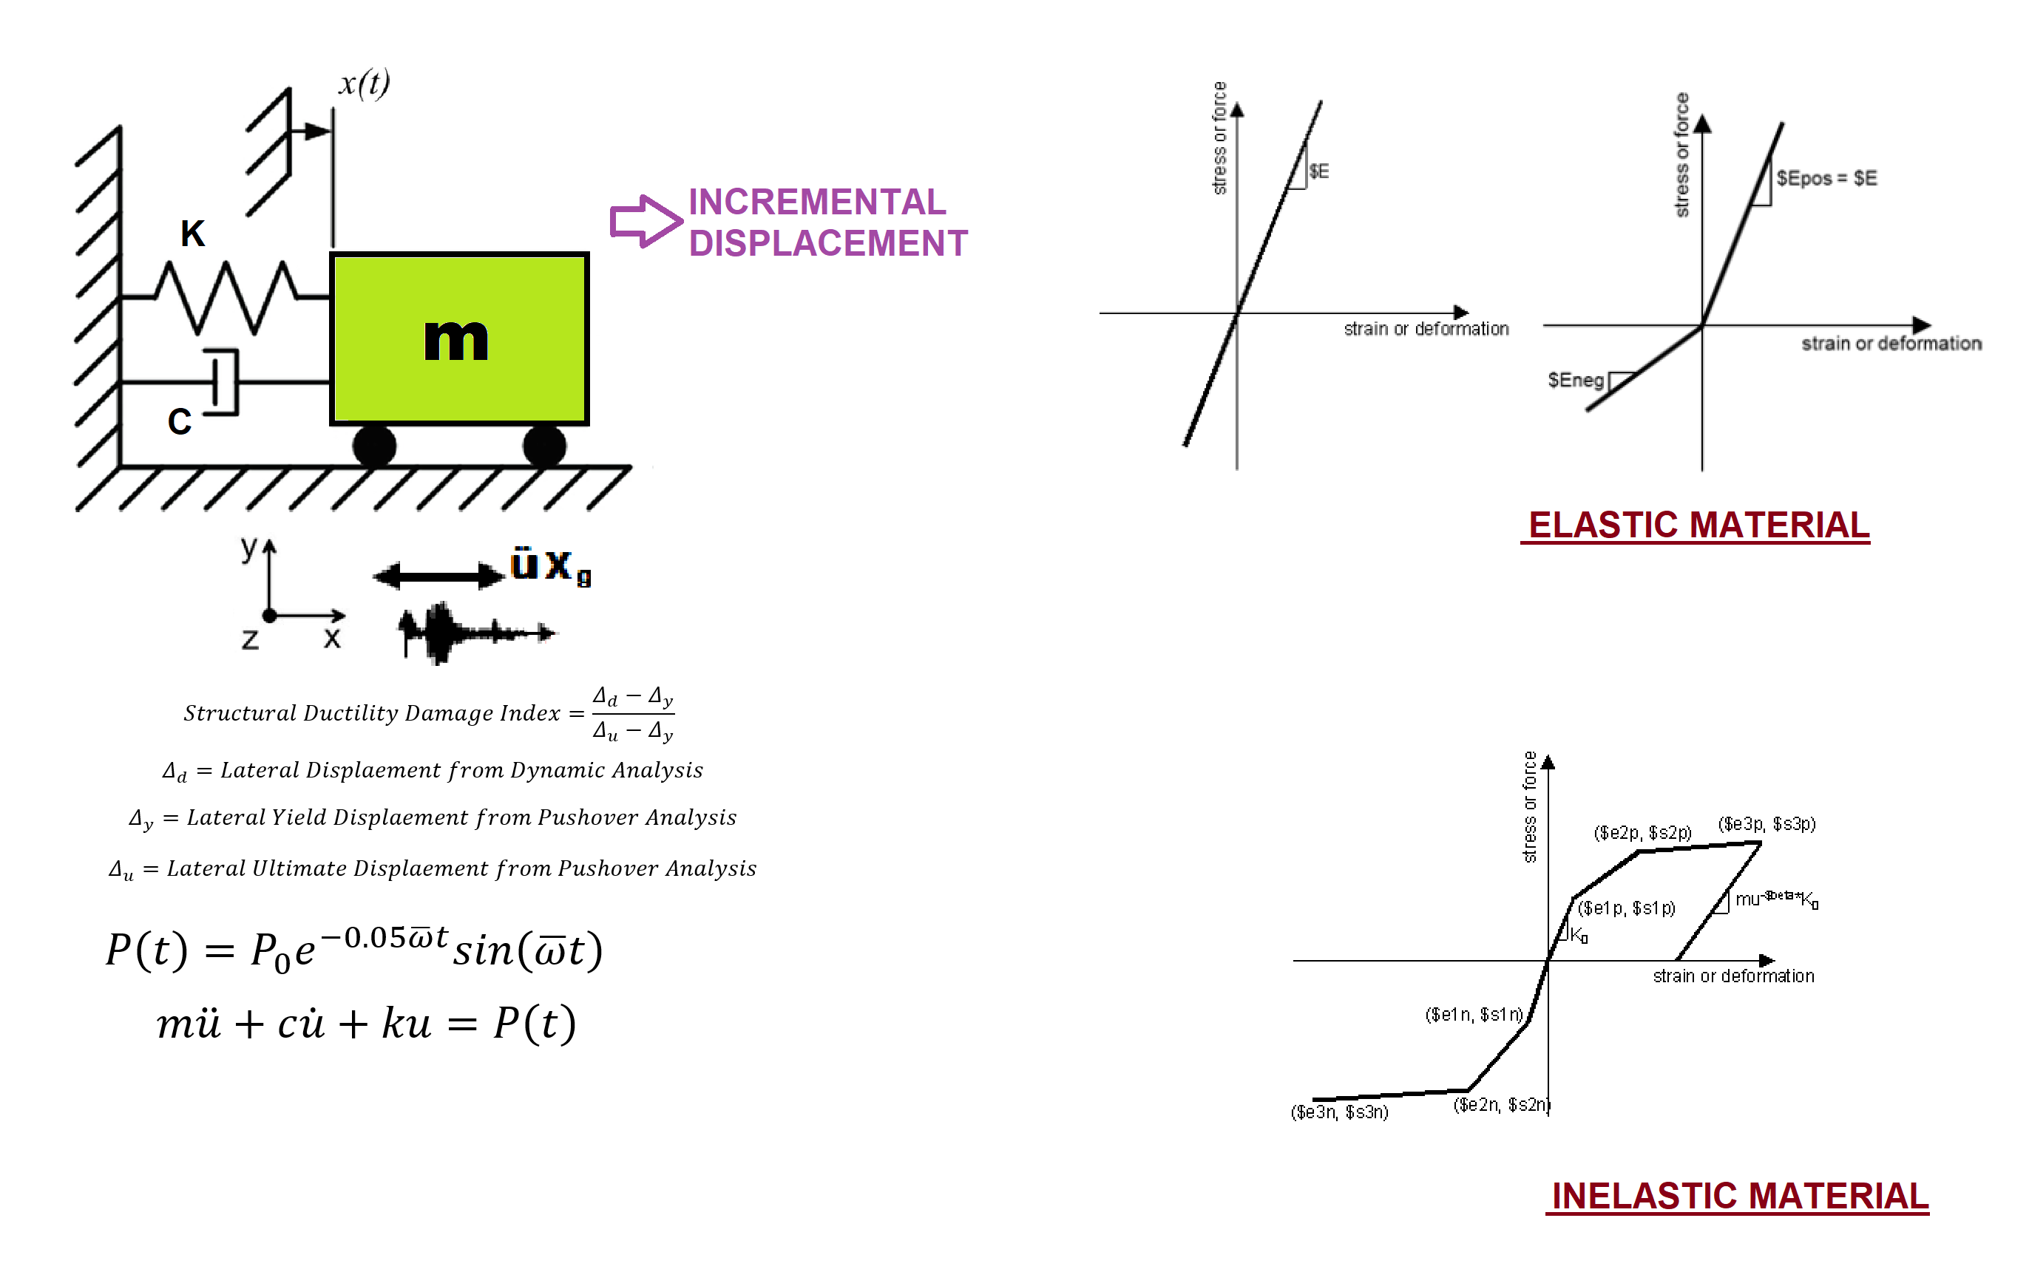

Slide 3
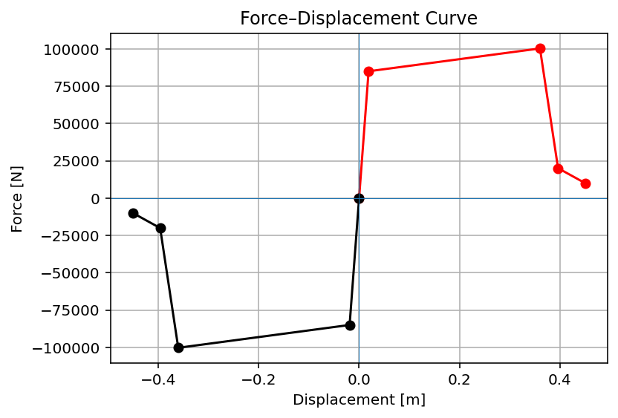

Slide 4
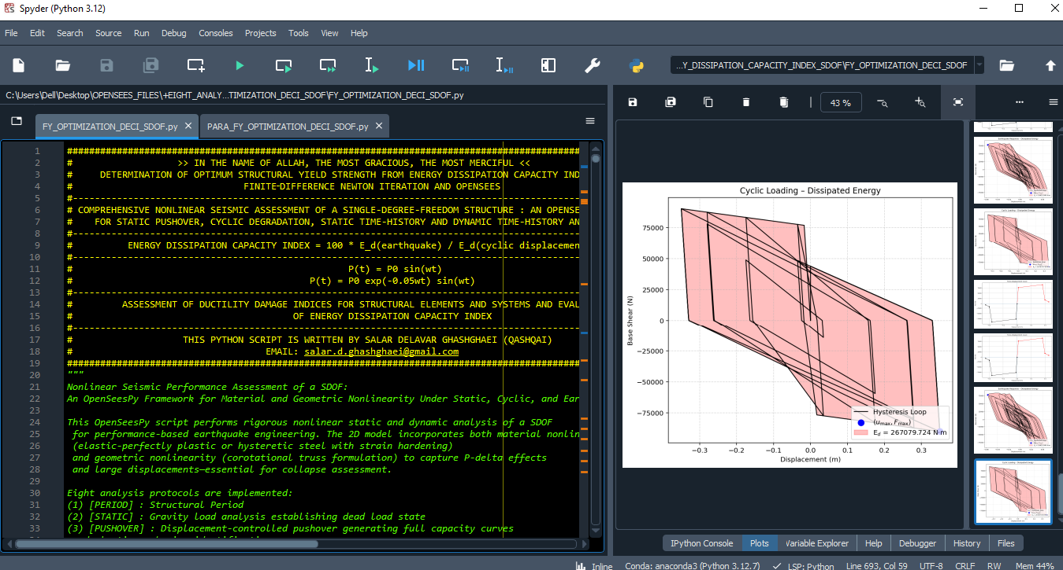

Slide 5
OPTIMIZATION PROBLEM FOR ENERGY DISSIPATION CAPACITY INDEX (EDCI)

Slide 6
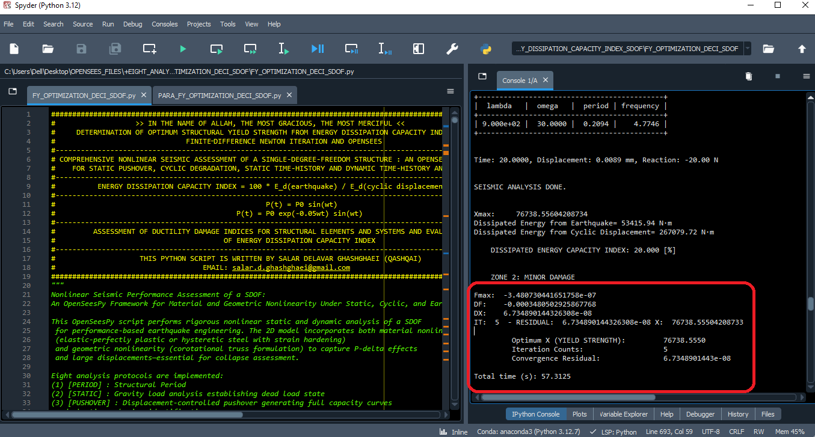

Slide 7
Dissipated Energy from Earthquake= 53415.94 N·m
Dissipated Energy from Cyclic Displacement= 267079.72 N·m
DISSIPATED ENERGY CAPACITY INDEX: 20.000 [%]
ZONE 2: MINOR DAMAGE
Fmax: -3.480730441651758e-07
DF: -0.0003480502925867768
DX: 6.734890144326308e-08
IT: 5 - RESIDUAL: 6.734890144326308e-08 X: 76738.55504208733
Optimum X (YIELD STRENGTH): 76738.5550
Iteration Counts: 5
Convergence Residual: 6.7348901443e-08
Total time (s): 57.3125

Slide 8
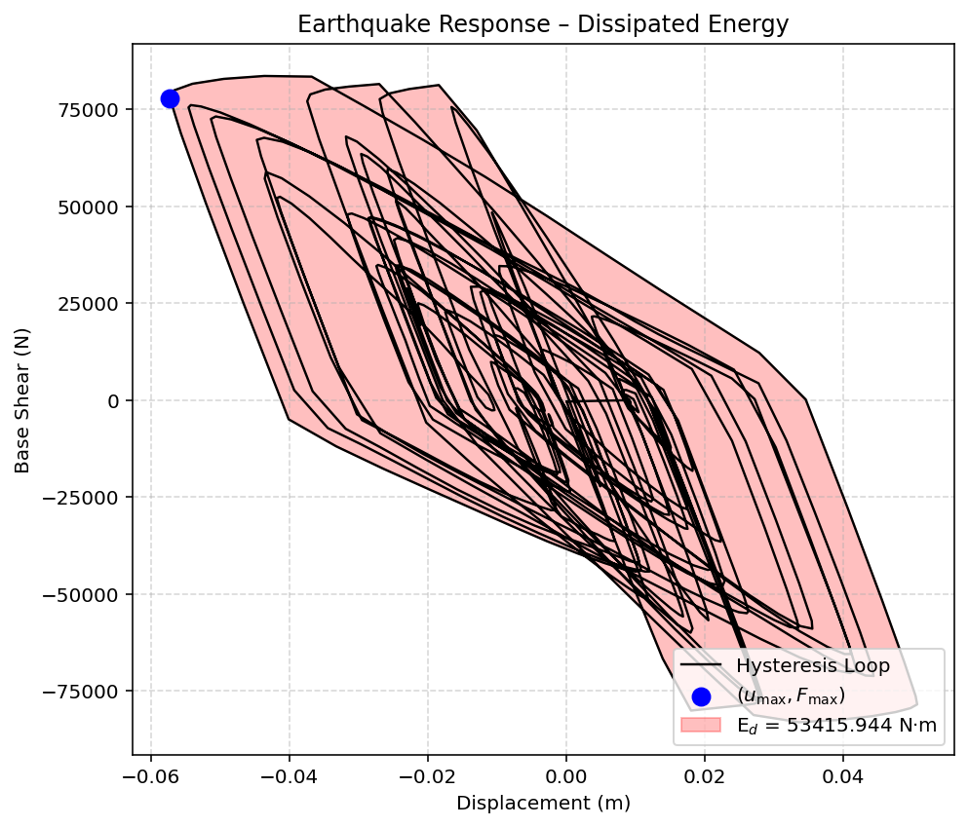

Slide 9
