Slide 1
IN THE NAME OF ALLAH, THE MOST GRACIOUS, THE MOST MERCIFUL
THERMAL ANALYSIS OF CONCRETE FRAME USING OPENSEES. EVALUATION OF THE STRUCTURAL PERIOD DURING THERMAL LOAD APPLIED TO ALL ELEMENTS
WRITTEN BY SALAR DELAVAR GHASHGHAEI (QASHQAI)

Slide 2
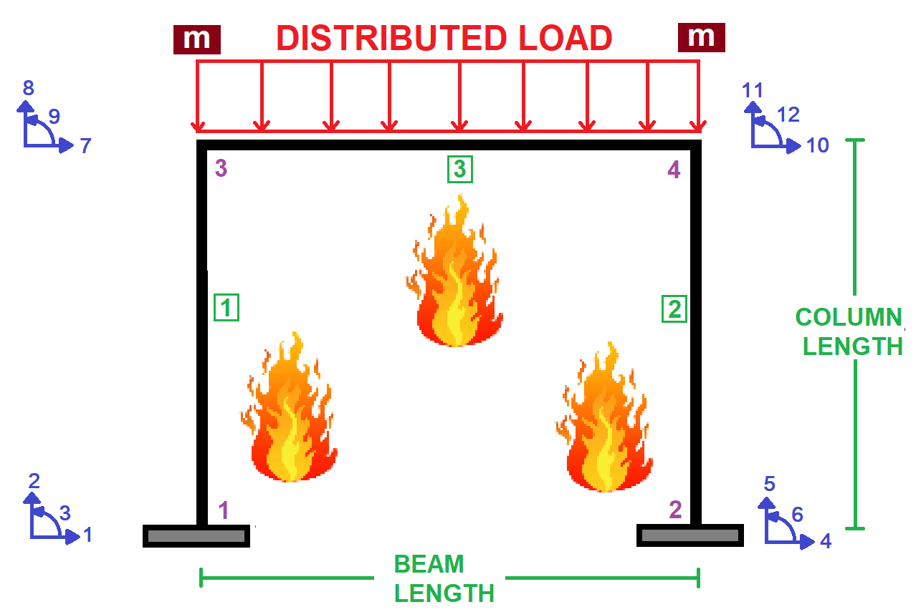

Slide 3
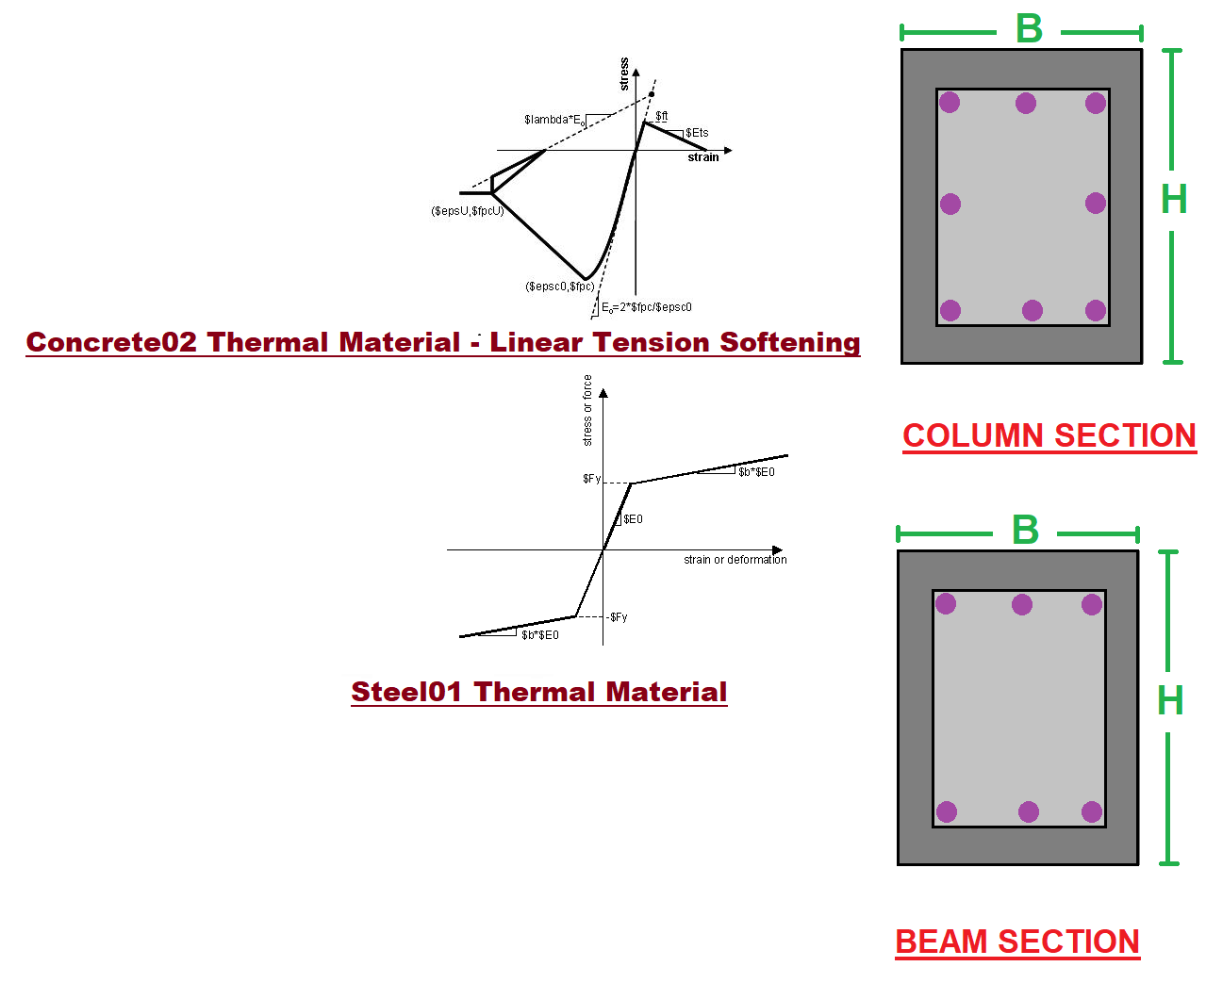

Slide 4
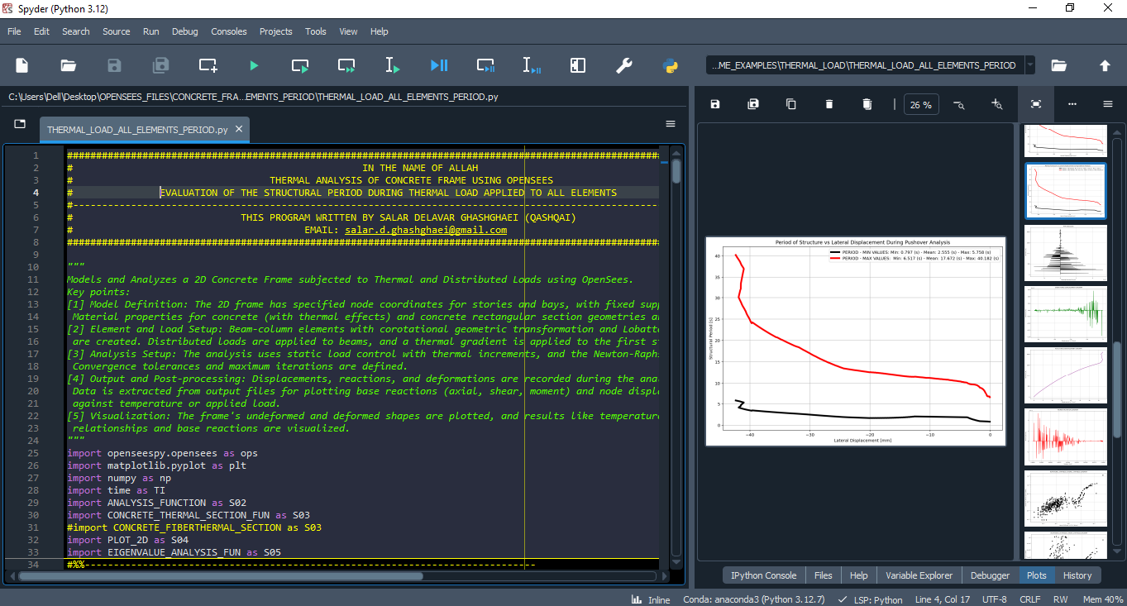

Slide 5
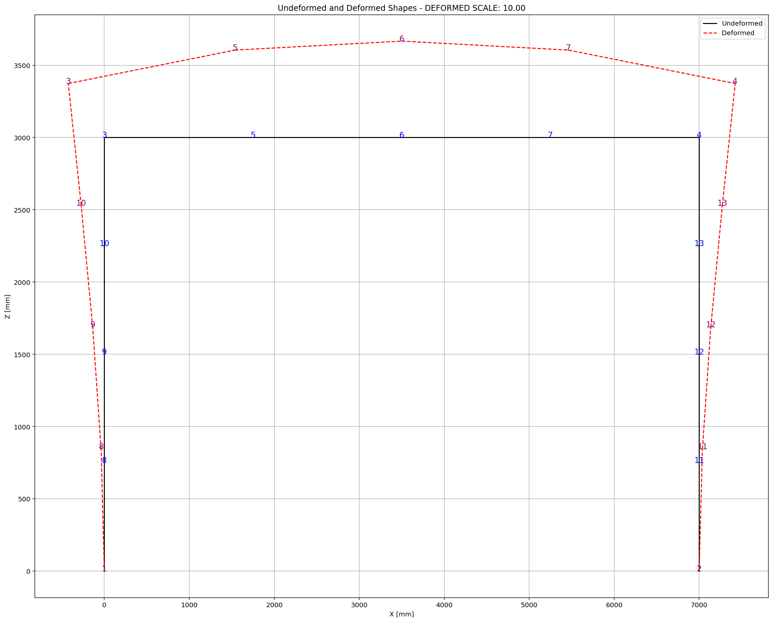

Slide 6
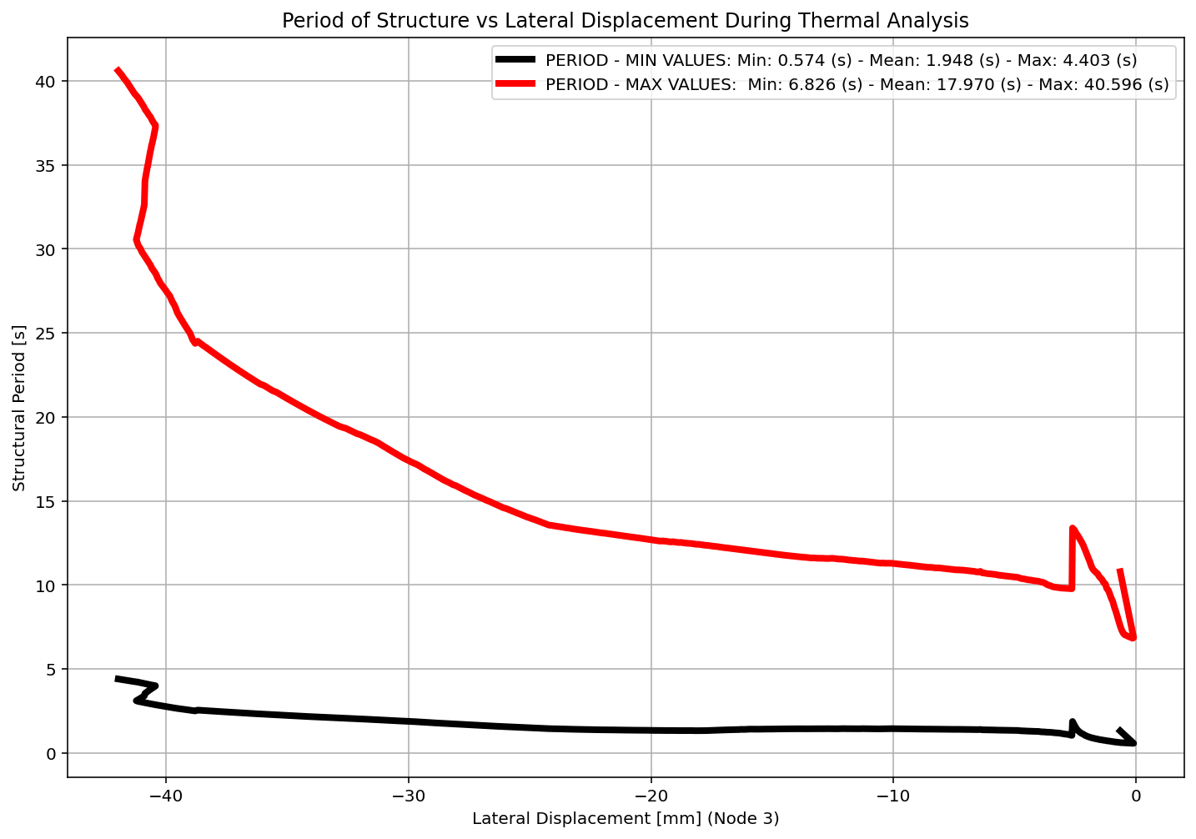

Slide 7
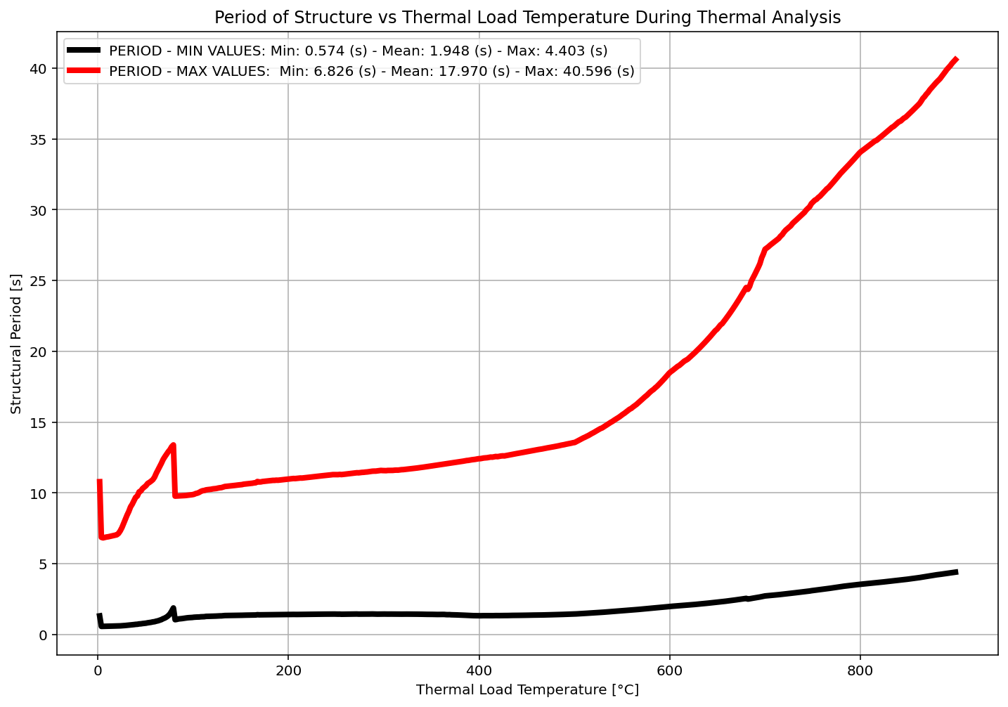

Slide 8
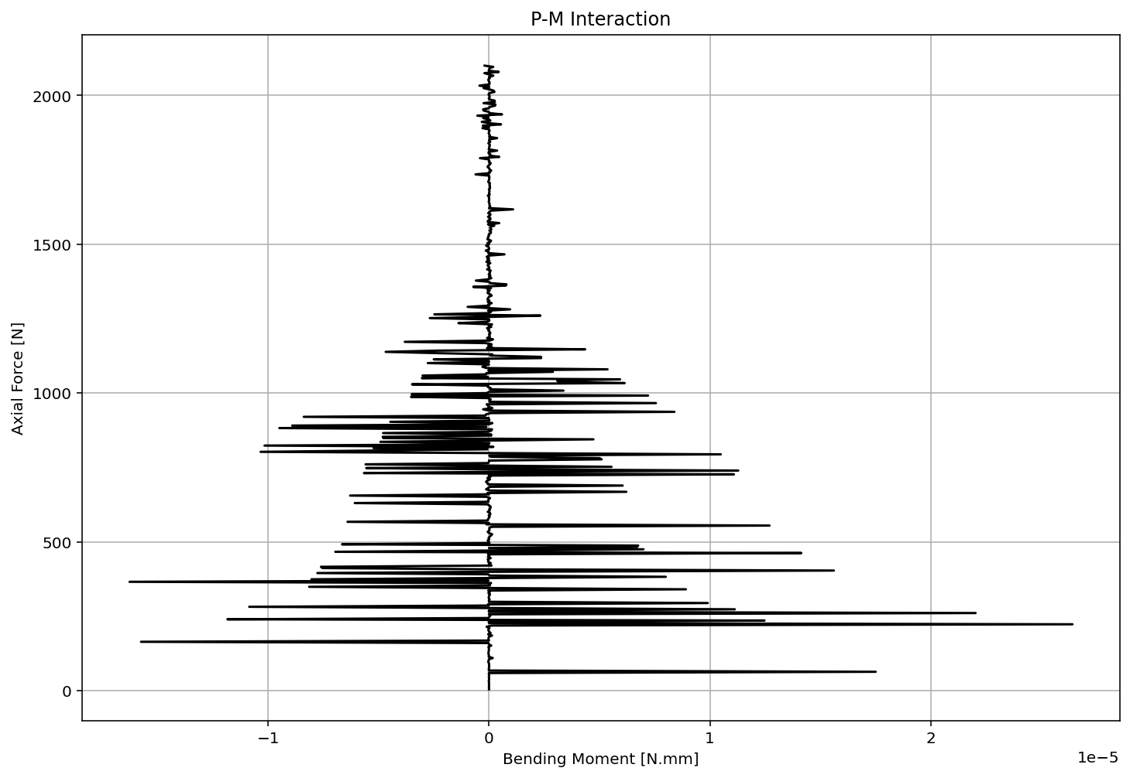

Slide 9
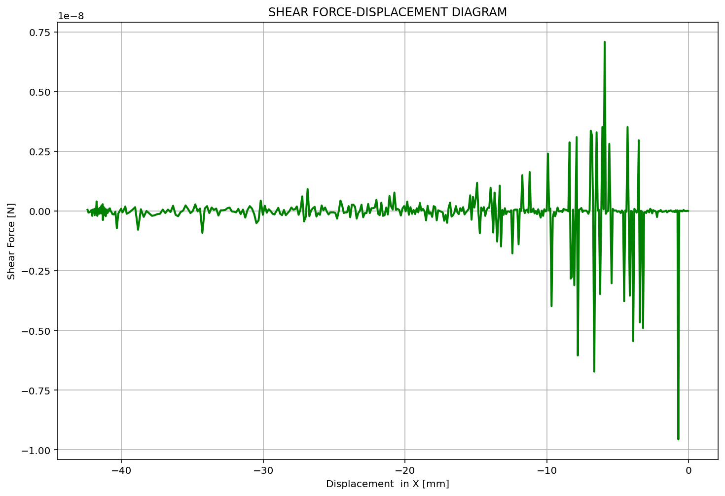

Slide 10
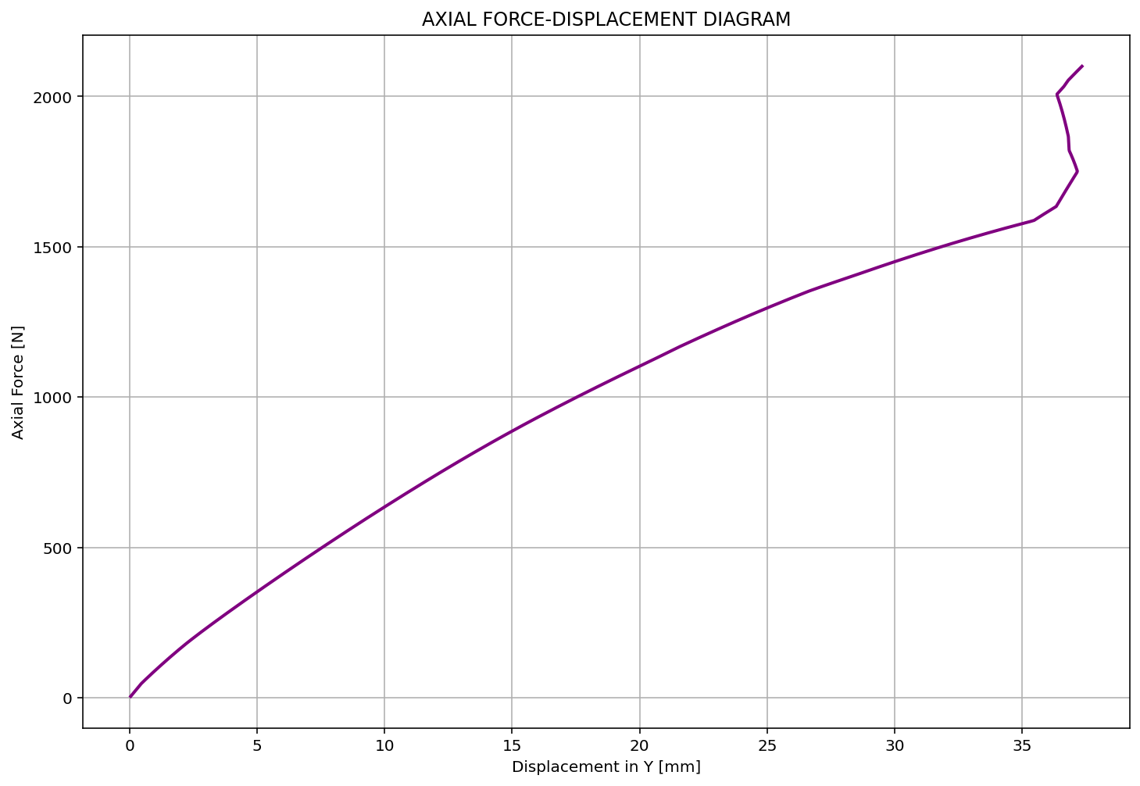

Slide 11
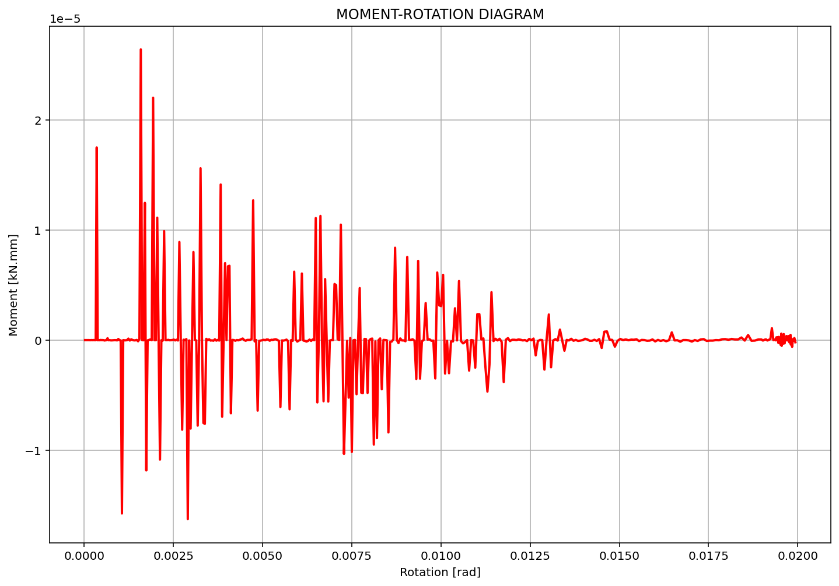

Slide 12
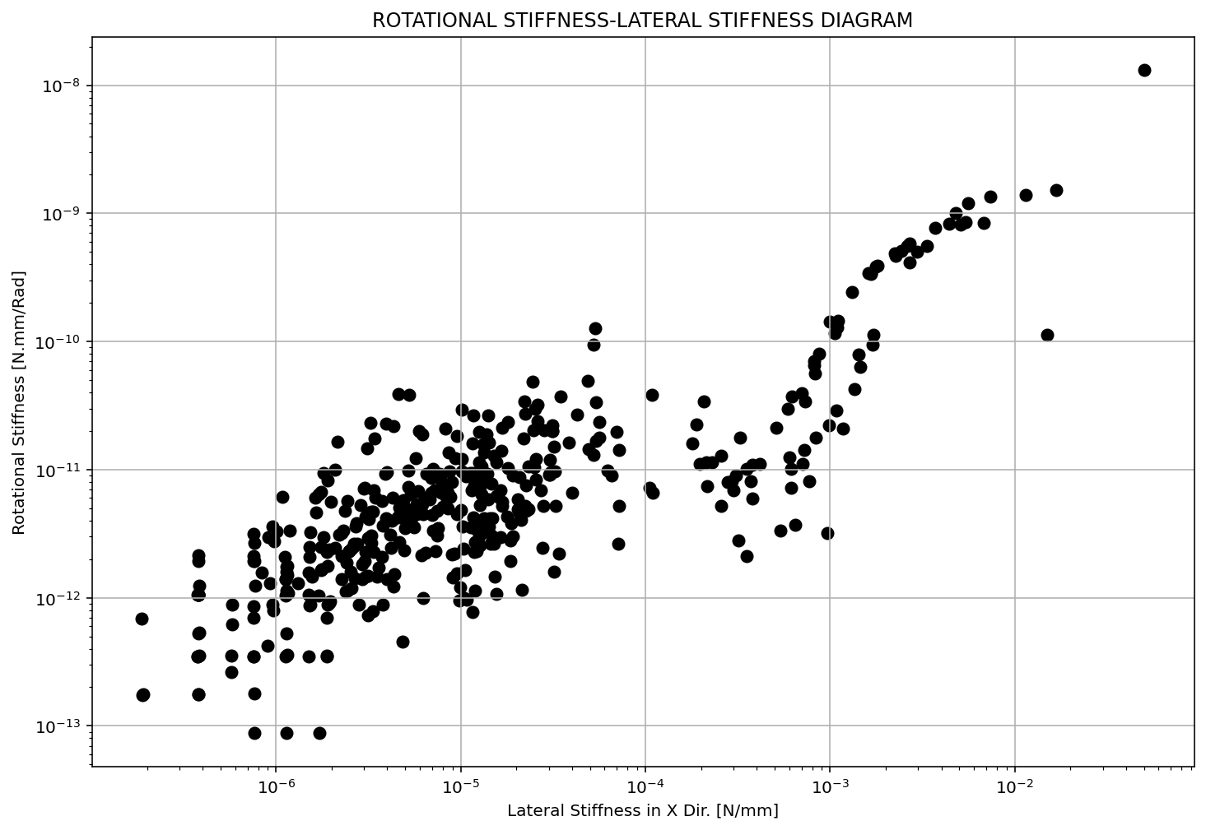

Slide 13
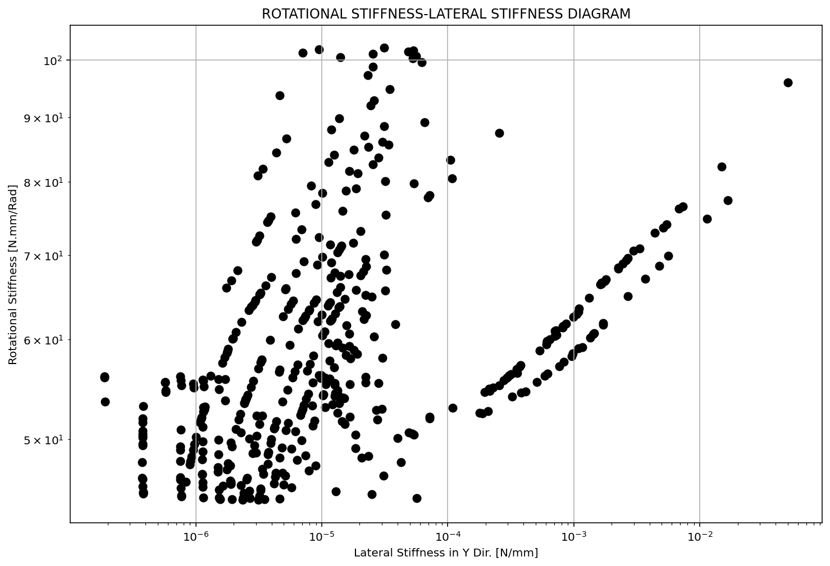

Slide 14
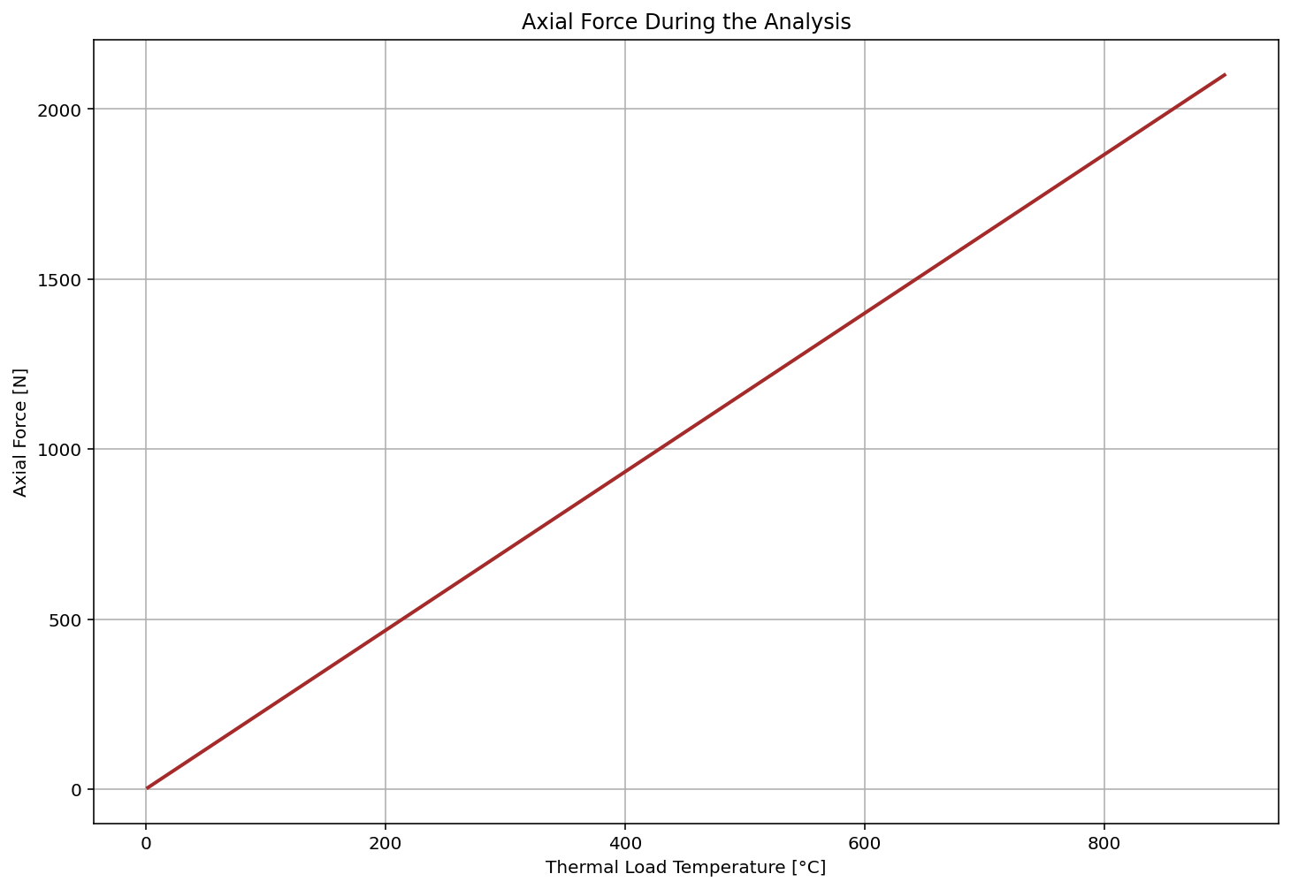

Slide 15
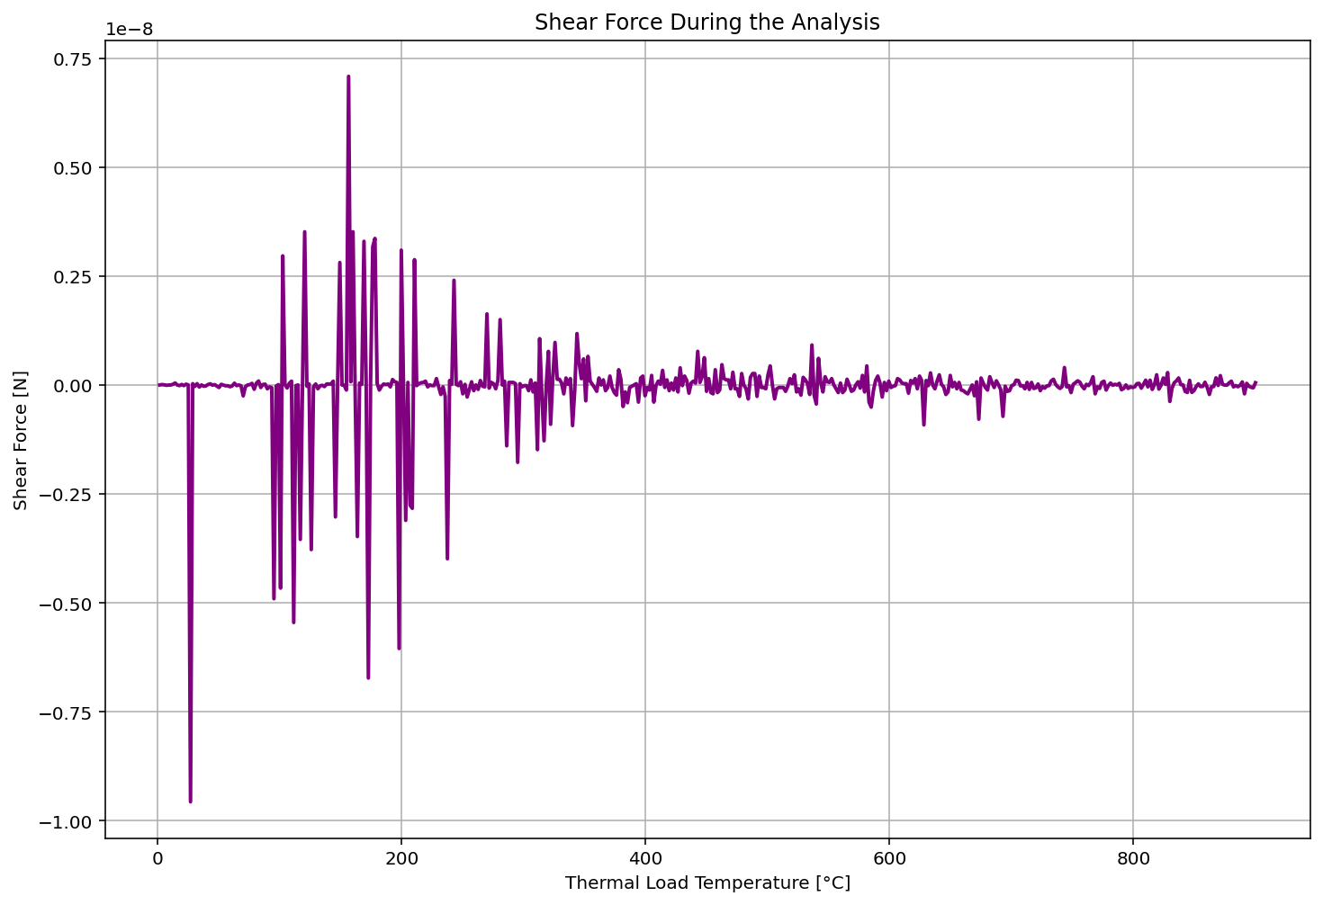

Slide 16
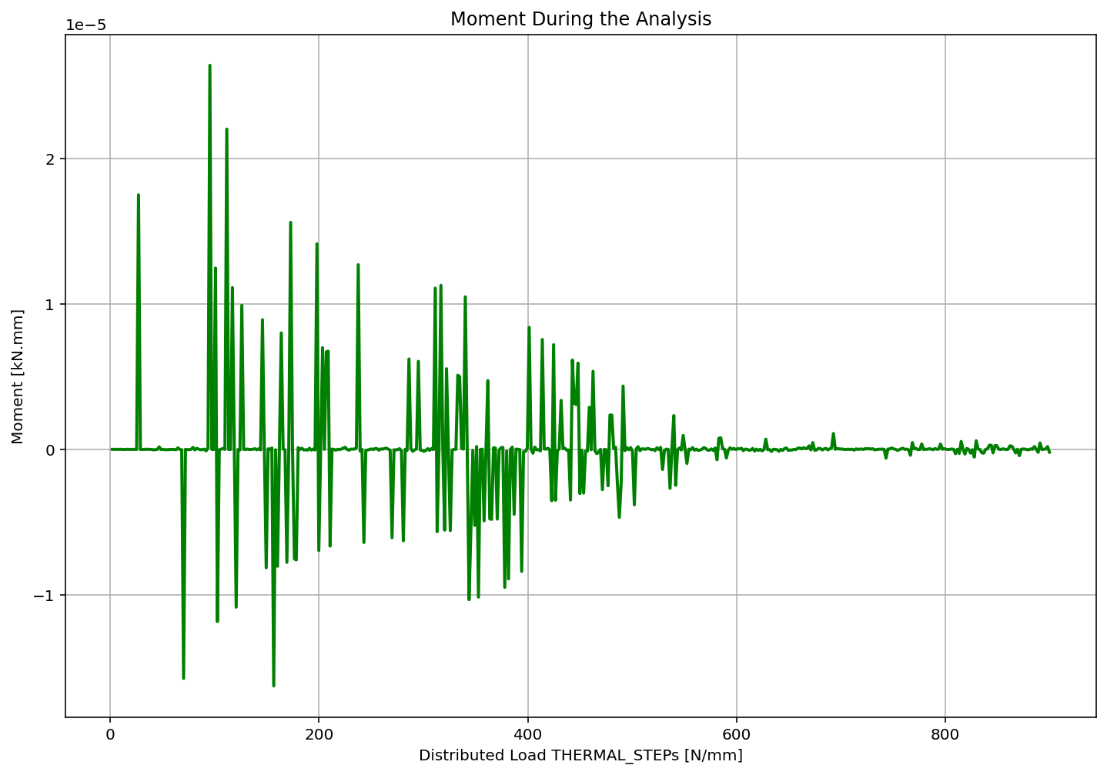

Slide 17
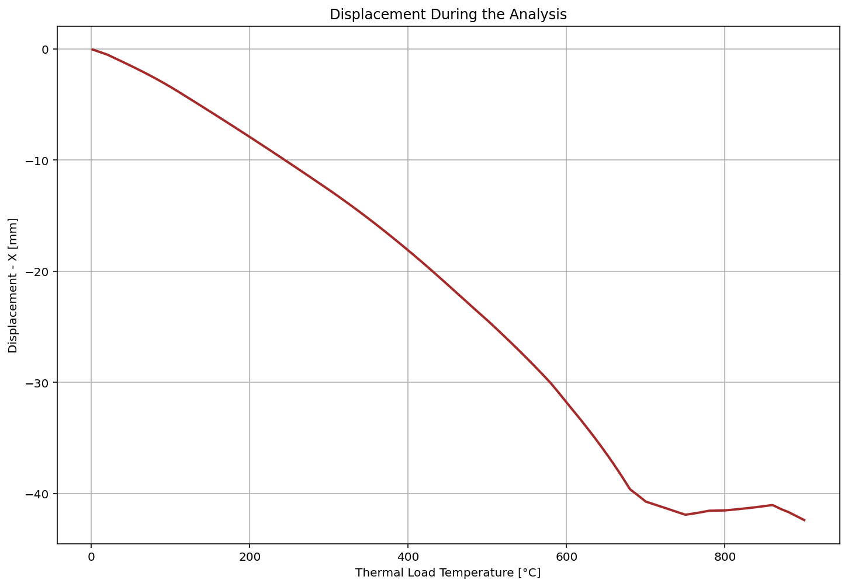

Slide 18
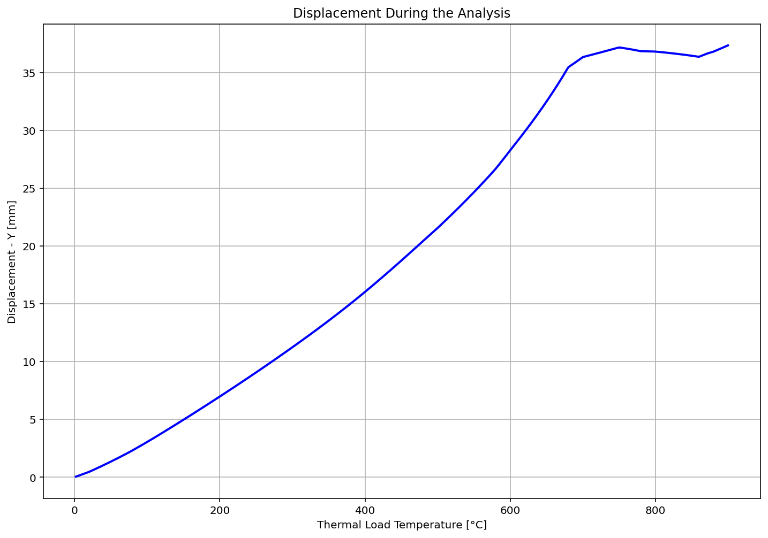

Slide 19
