Slide 1
IN THE NAME OF ALLAH, THE MOST GRACIOUS, THE MOST MERCIFUL
ASSESSMENTS OF THE STRUCTURAL DUCTILITY DAMAGE INDEX WITH DIFFERENT CONFINEMENT ENHANCEMENT RATIO OF CONCRETE FRAME USING OPENSEES
WRITTEN BY SALAR DELAVAR GHASHGHAEI (QASHQAI)

Slide 2
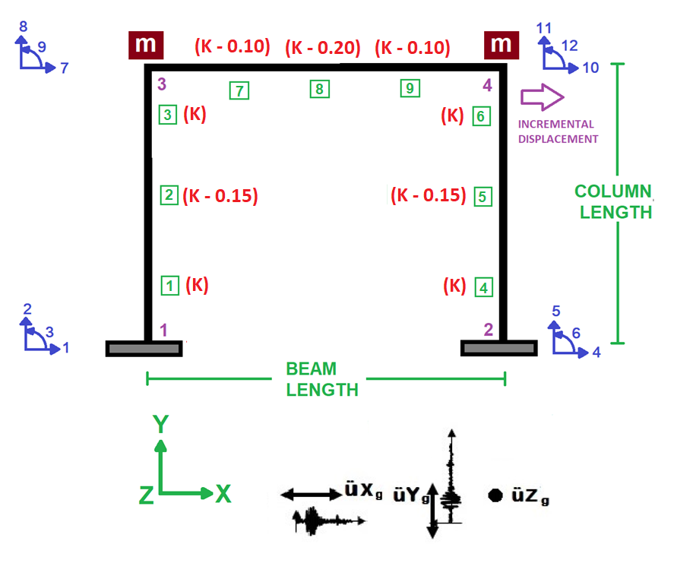

Slide 3
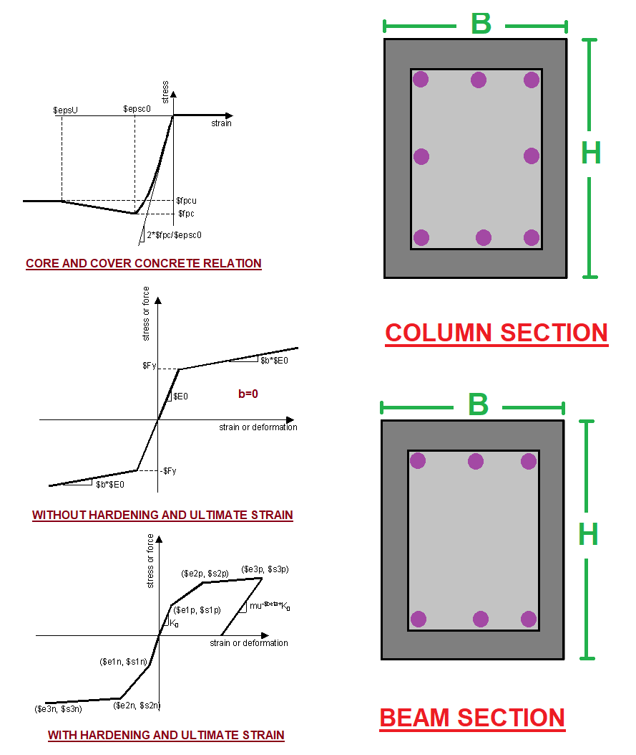

Slide 4
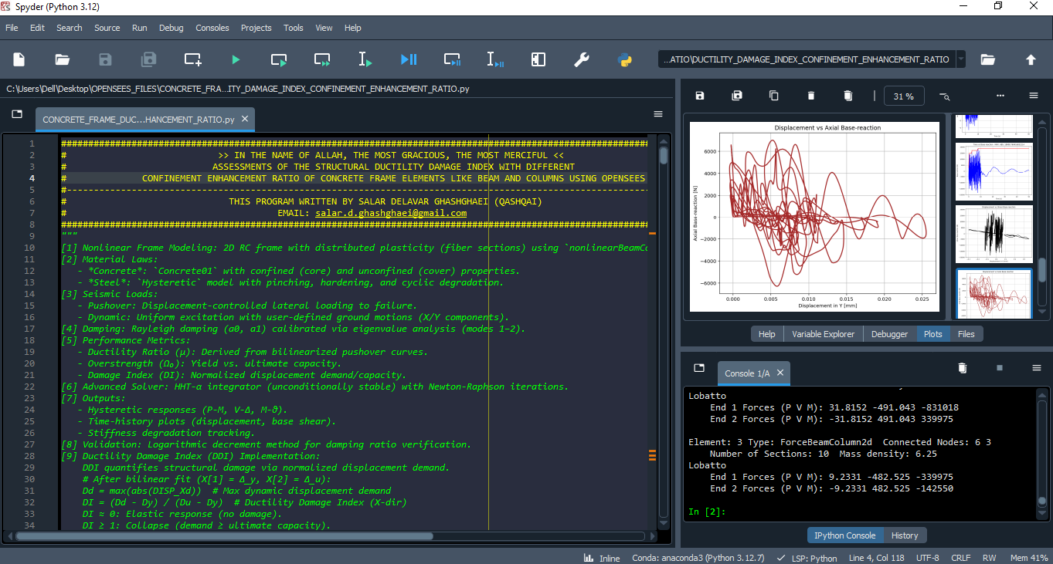

Slide 5
NONLINEAR STATIC ANALYSIS
(PUSHOVER)

Slide 6
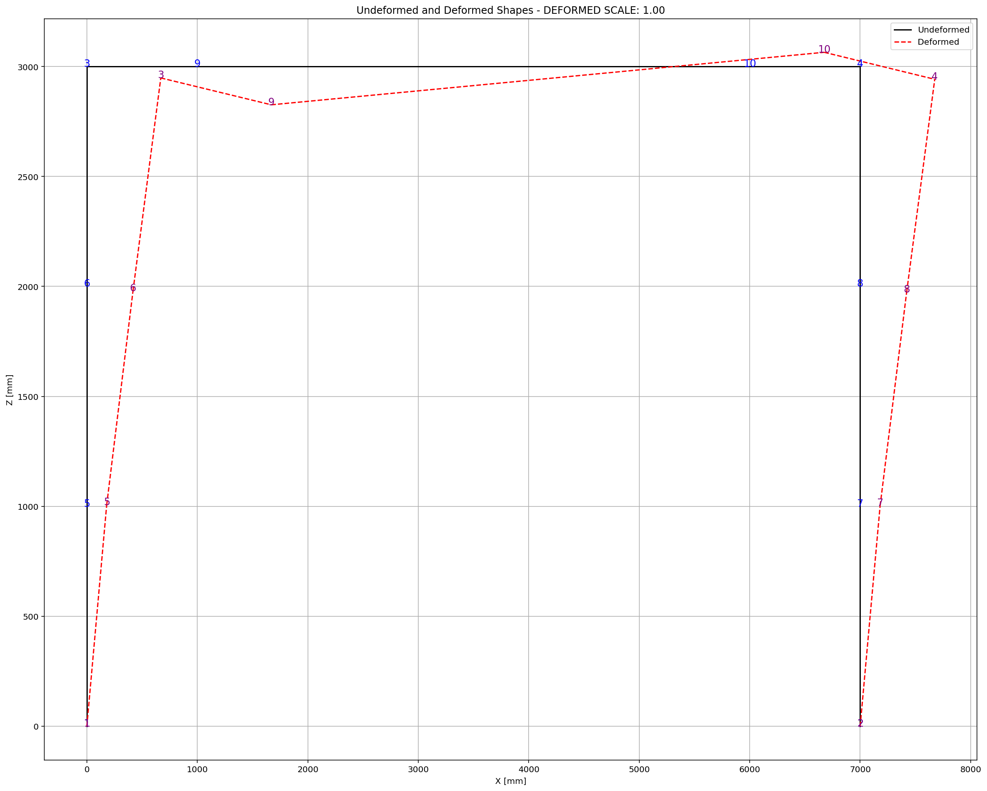

Slide 7
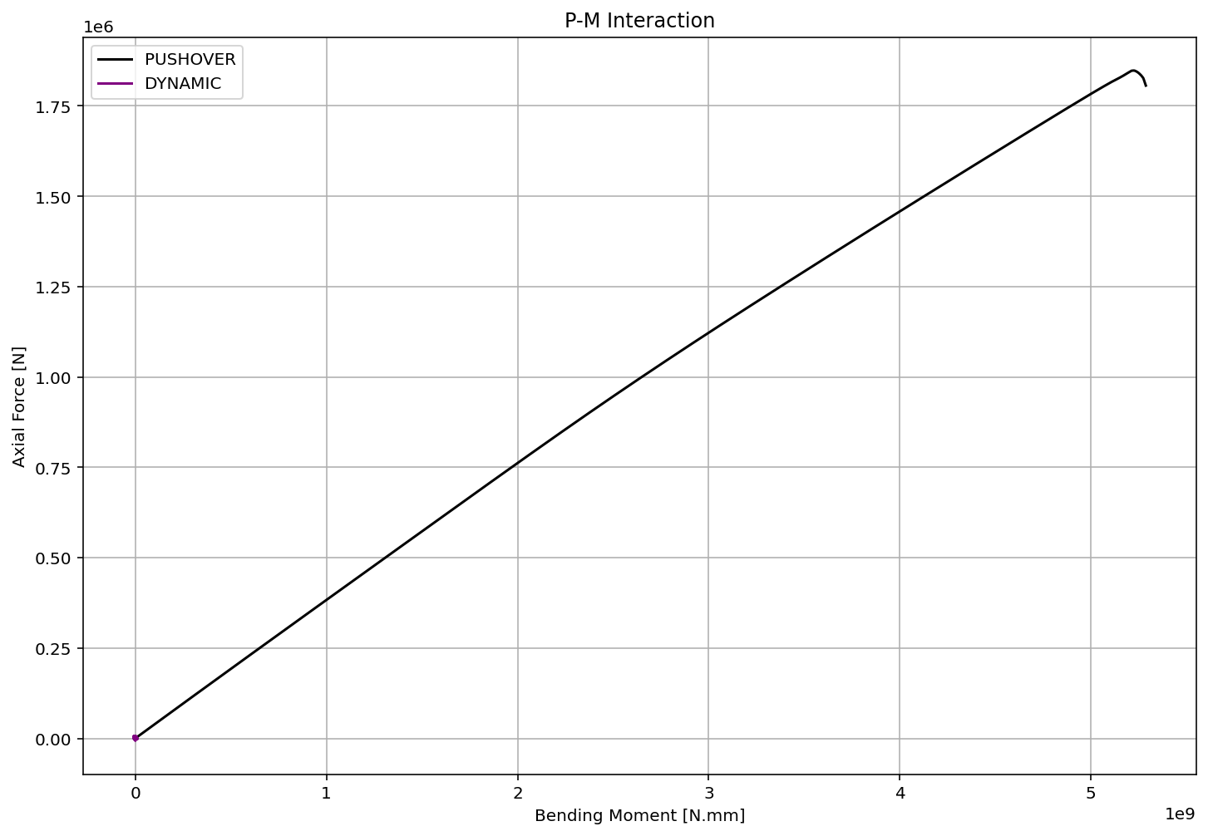

Slide 8
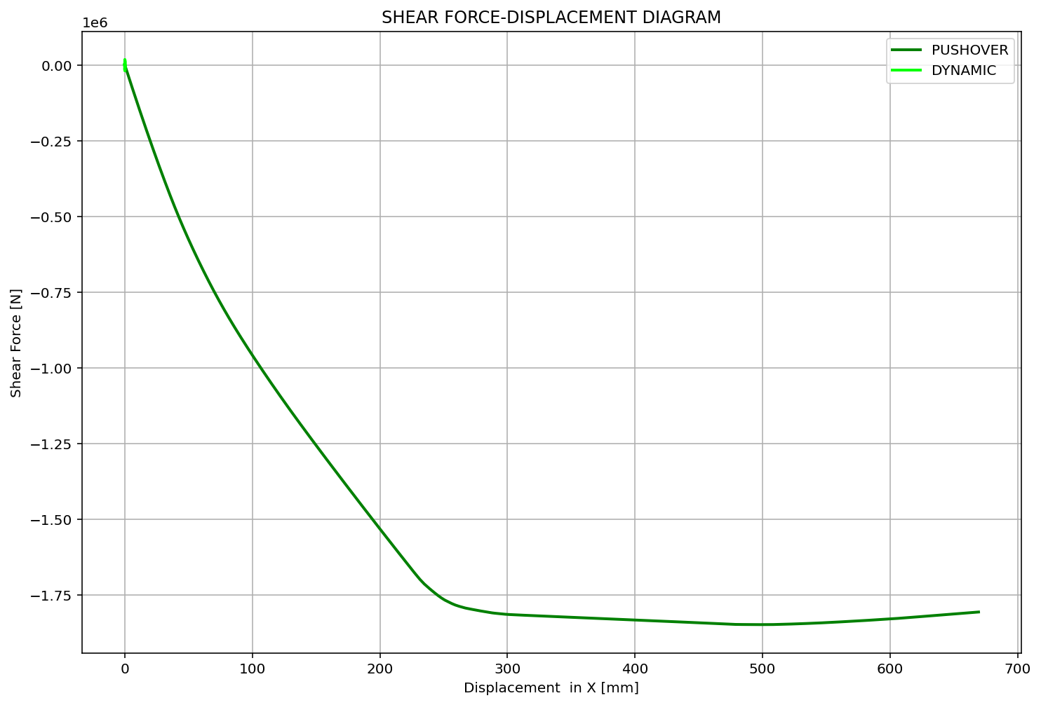

Slide 9
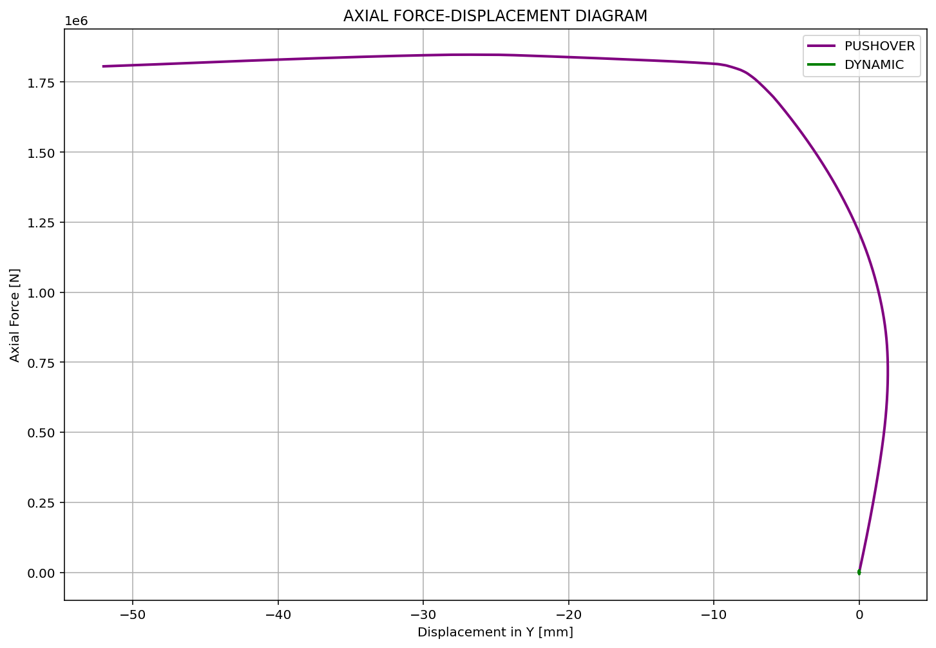

Slide 10
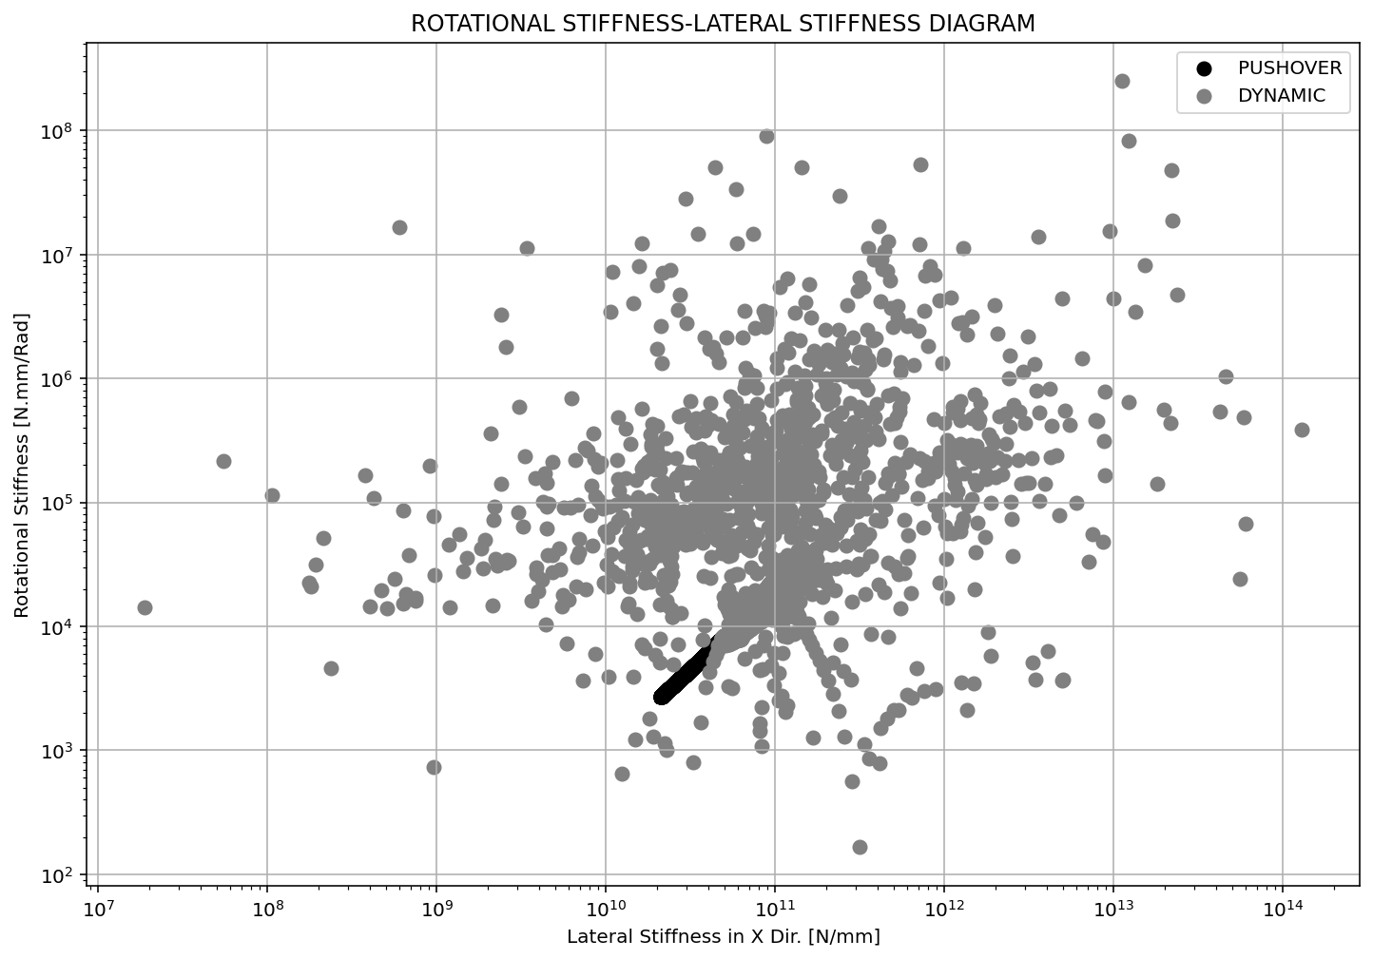

Slide 11
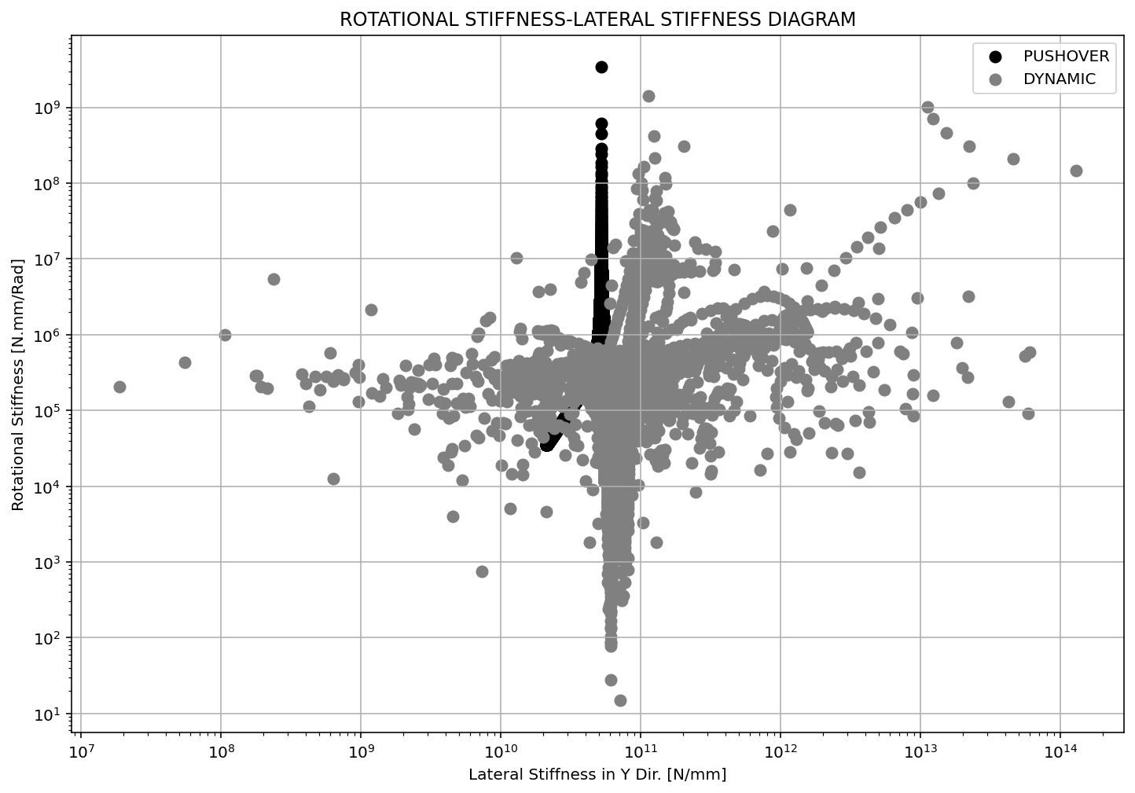

Slide 12
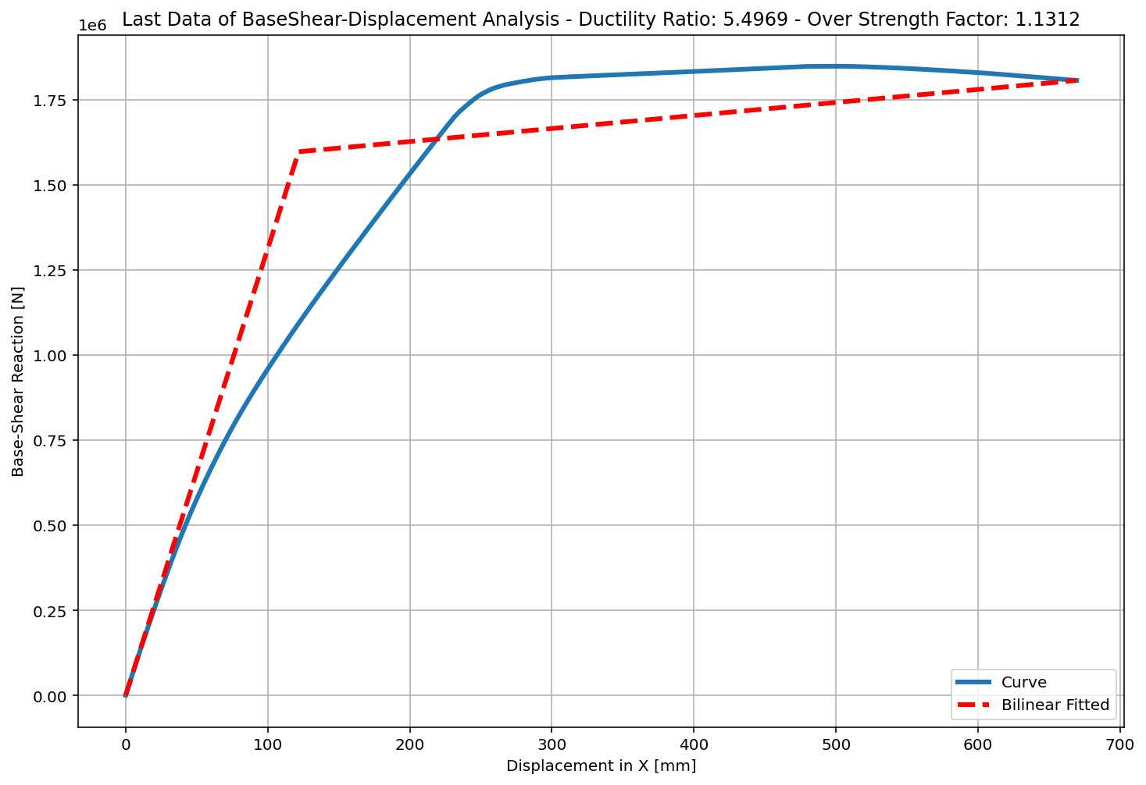
+==========================+
= Analysis curve fitted =
Disp Base Shear
----------------------------
[[0.00000000e+00 0.00000000e+00]
[1.21772102e+02 1.59682013e+06]
[6.69373716e+02 1.80637355e+06]]
+==========================+
+----------------------------------------------------+
Structure Elastic Stiffness : 13113.19
Structure Plastic Stiffness : 2698.60
Structure Tangent Stiffness : 382.67
Structure Ductility Ratio : 5.50
Structure Over Strength Factor: 1.13
+----------------------------------------------------+
Over Strength Coefficient (Ω0): 1.1312
Displacement Ductility Ratio (μ): 5.4969
Ductility Coefficient (Rμ): 5.4969
Structural Behavior Coefficient (R): 6.2183
Structural Ductility Damage Index in X Direction: -0.2217

Slide 13
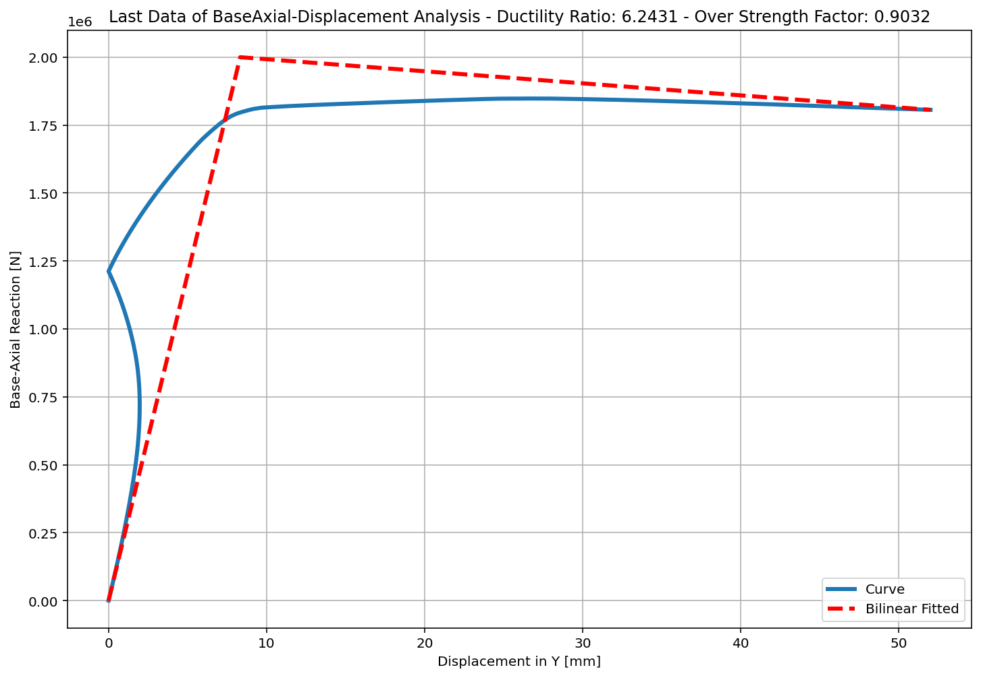
+==========================+
= Analysis curve fitted =
Disp Base Shear
----------------------------
[[0.00000000e+00 0.00000000e+00]
[8.33194946e+00 2.00005546e+06]
[5.20171457e+01 1.80637355e+06]]
+==========================+
+----------------------------------------------------+
Structure Elastic Stiffness : 240046.52
Structure Plastic Stiffness : 34726.50
Structure Tangent Stiffness : -4433.58
Structure Ductility Ratio : 6.24
Structure Over Strength Factor: 0.90
+----------------------------------------------------+
Over Strength Coefficient (Ω0): 0.9032
Displacement Ductility Ratio (μ): 6.2431
Ductility Coefficient (Rμ): 6.2431
Structural Behavior Coefficient (R): 5.6385
Structural Ductility Damage Index in Y Direction: -0.1901

Slide 14
NONLINEAR DYNAMIC ANALYSIS

Slide 15
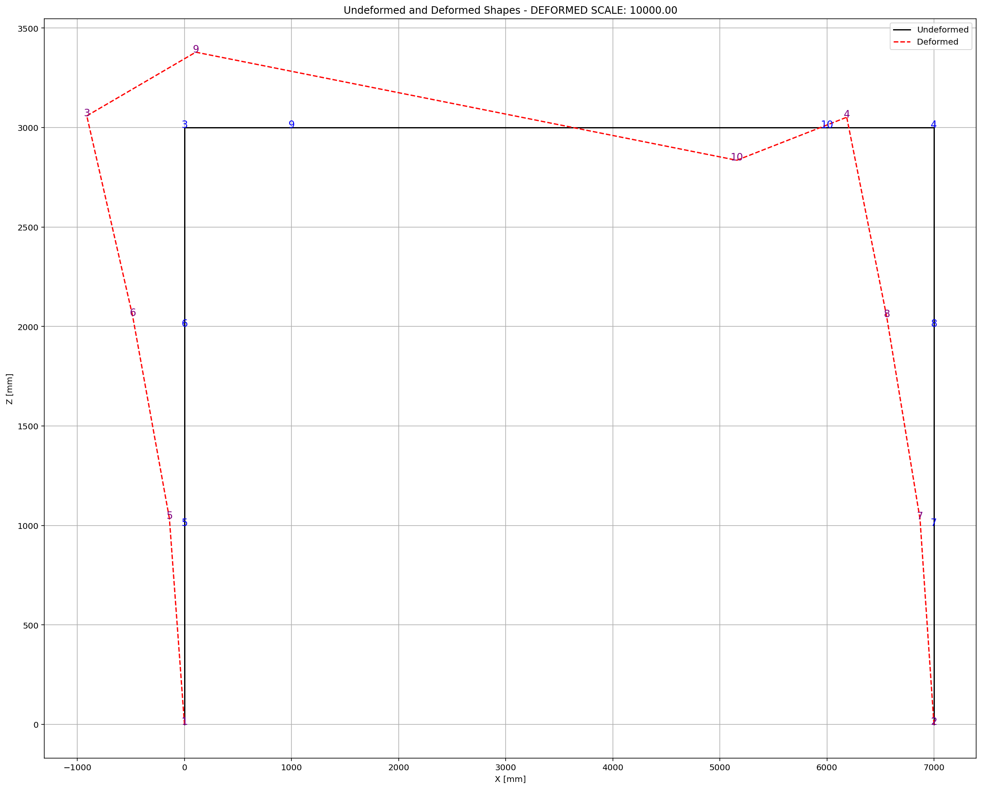

Slide 16
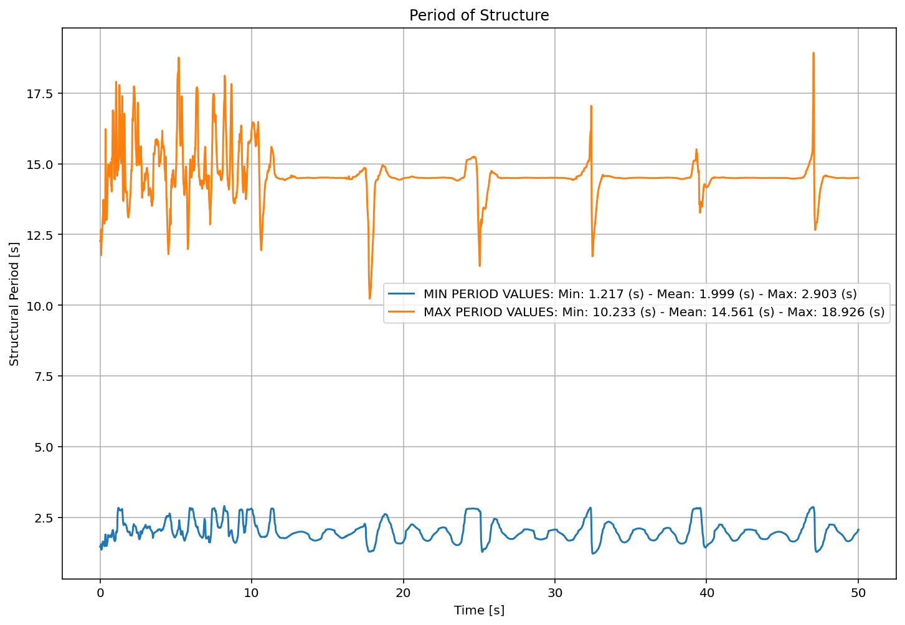

Slide 17
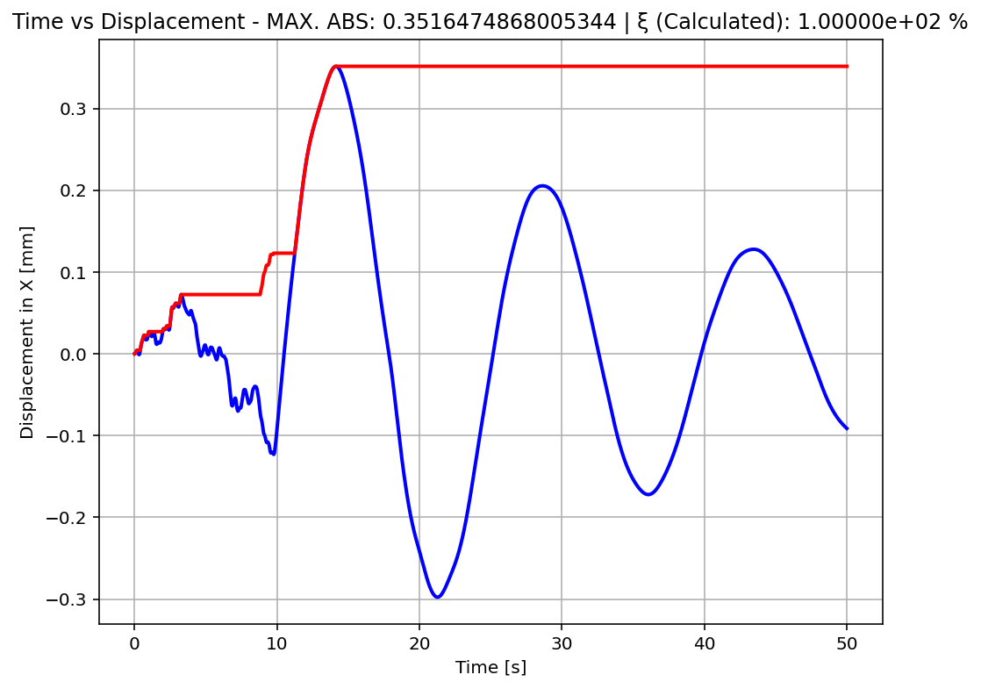

Slide 18
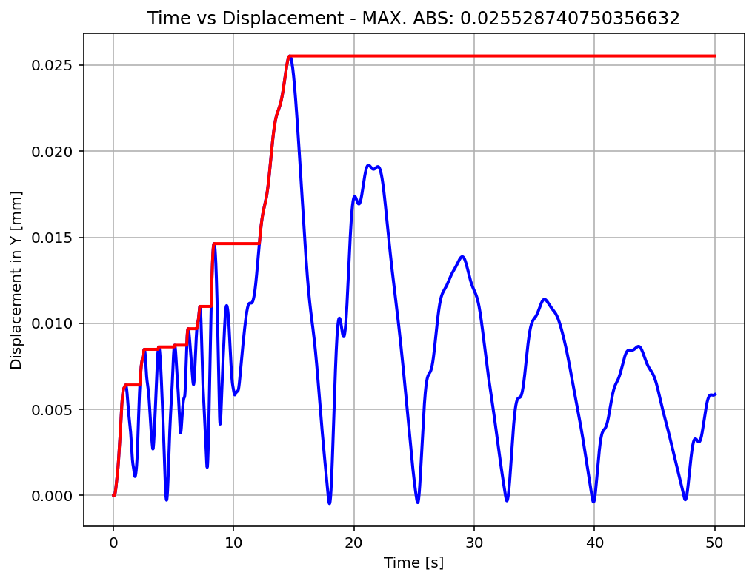

Slide 19
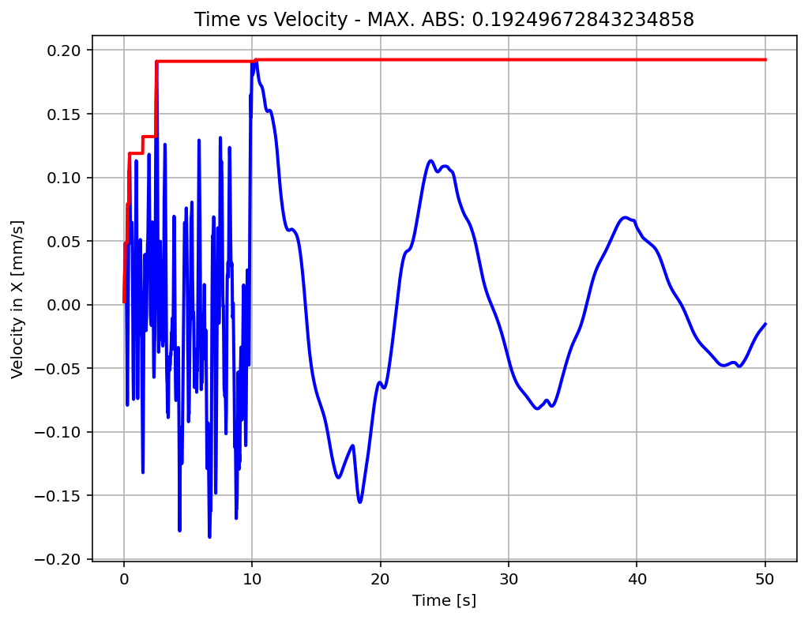

Slide 20
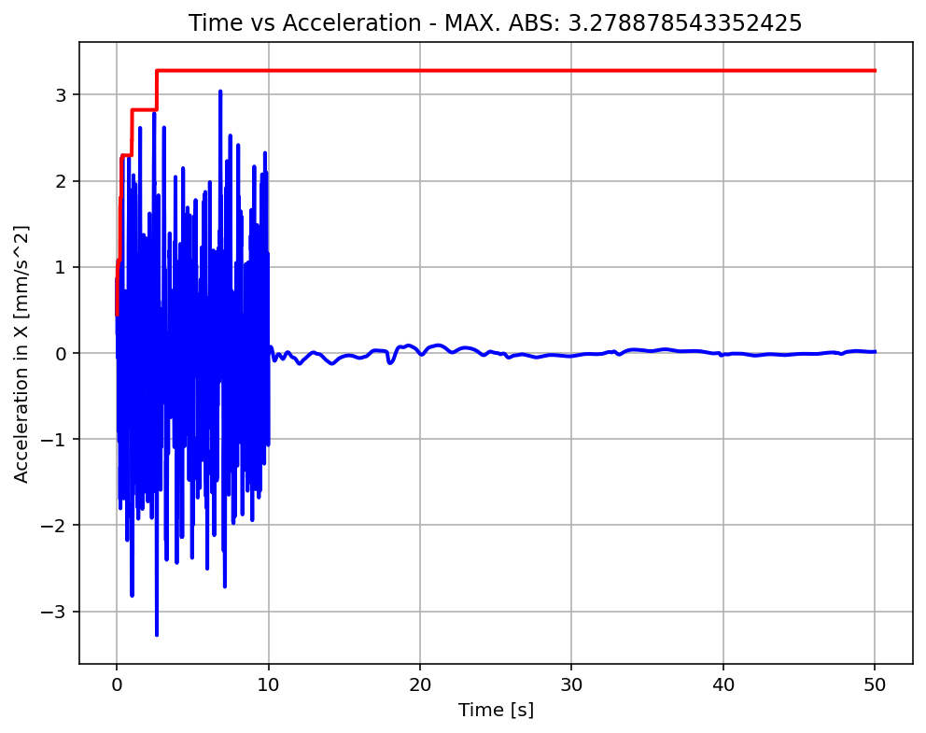

Slide 21
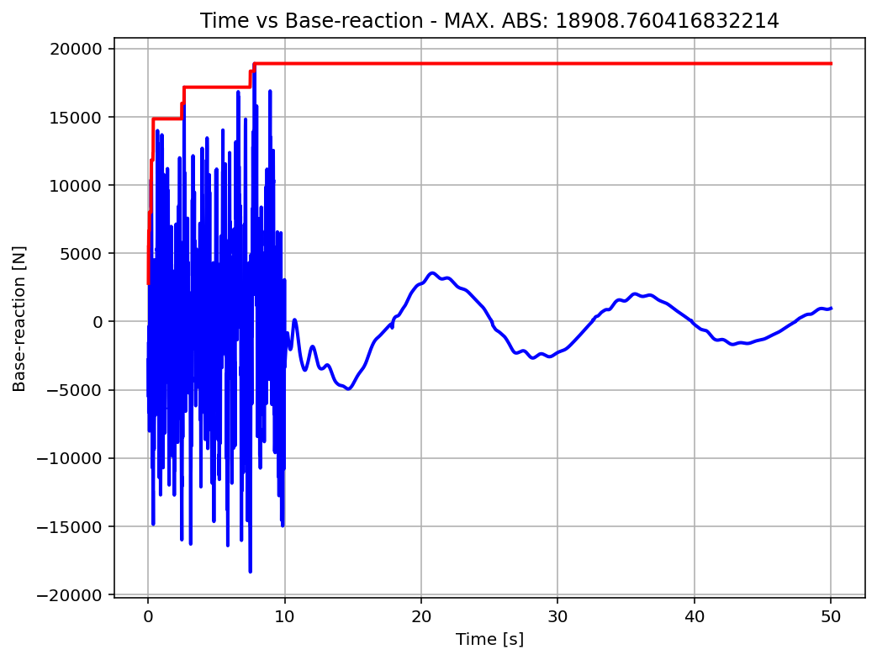

Slide 22
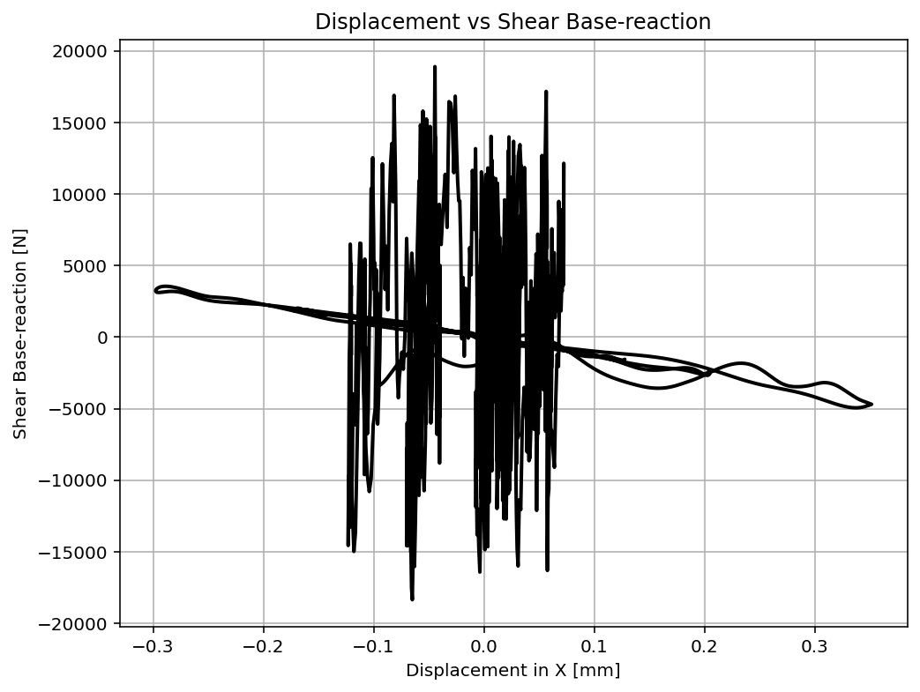

Slide 23
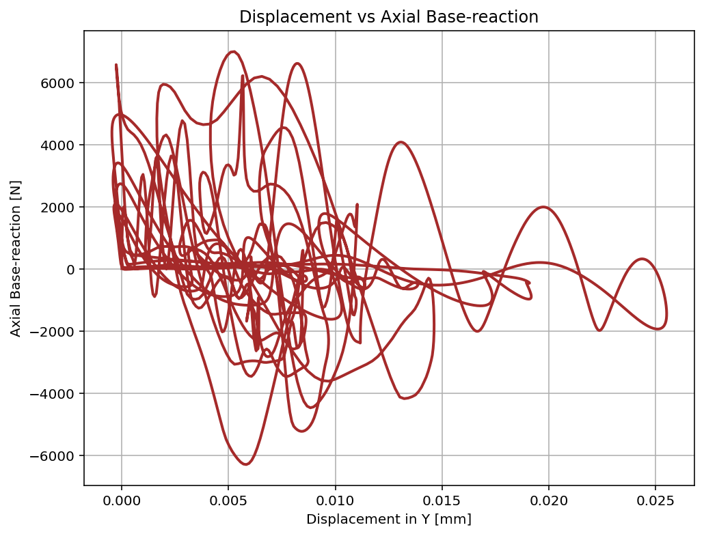

Slide 24
