Slide 1
>> IN THE NAME OF ALLAH, THE MOST GRACIOUS, THE MOST MERCIFUL <<
MOMENT-CURVATURE ANALYSIS OF CONFINED CONCRETE SECTION IN UNCERTAINITY CONDITIONS MONTE-CARLO METHOD
WRITTEN BY SALAR DELAVAR GHASHGHAEI (QASHQAI)

Slide 2
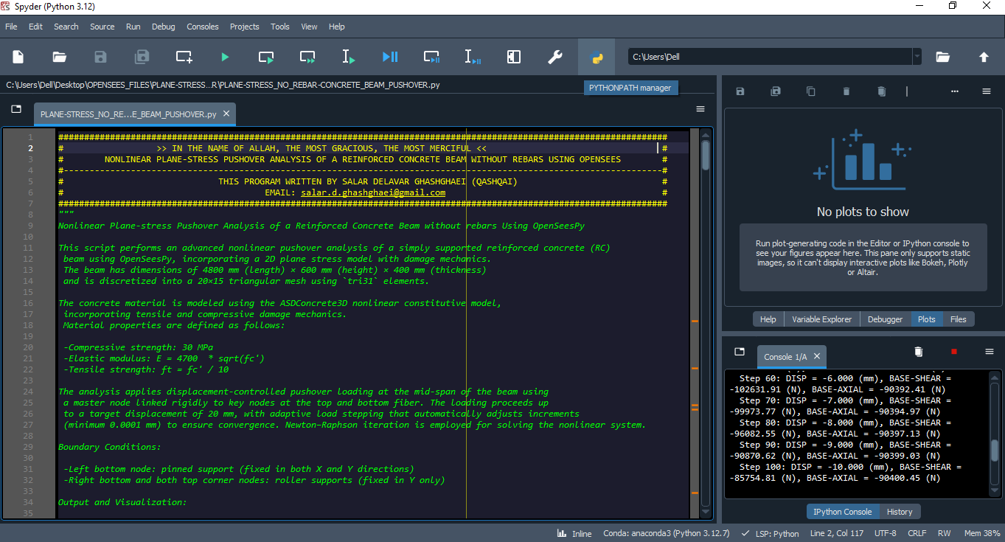

Slide 3
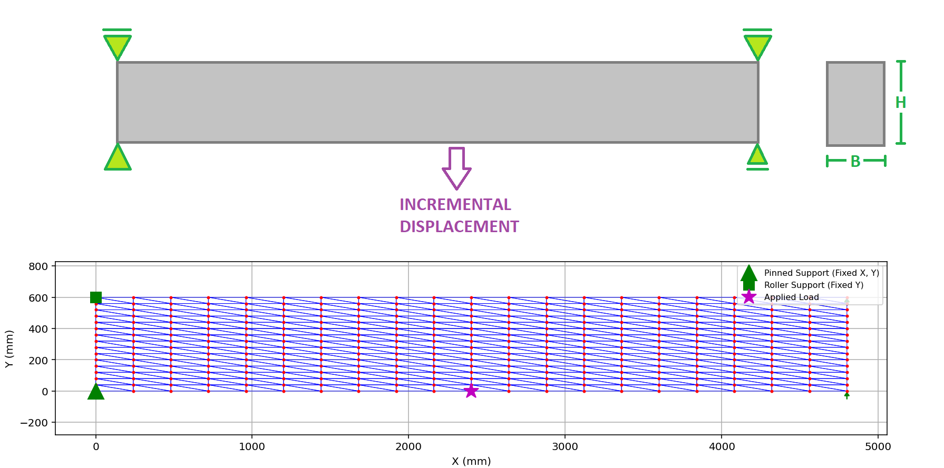

Slide 4
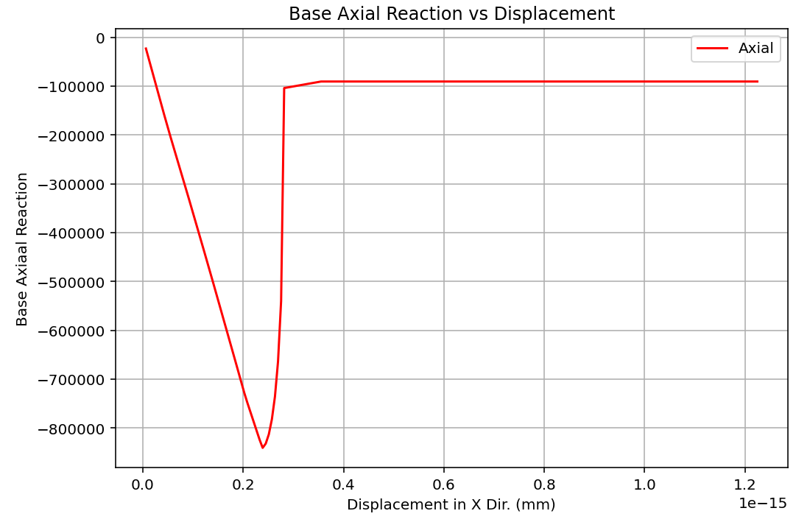

Slide 5
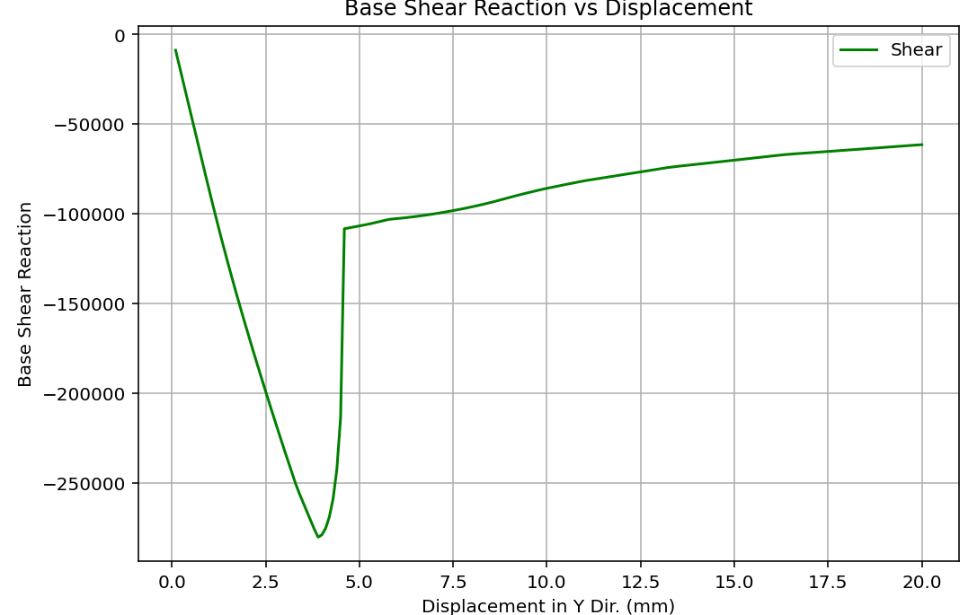

Slide 6
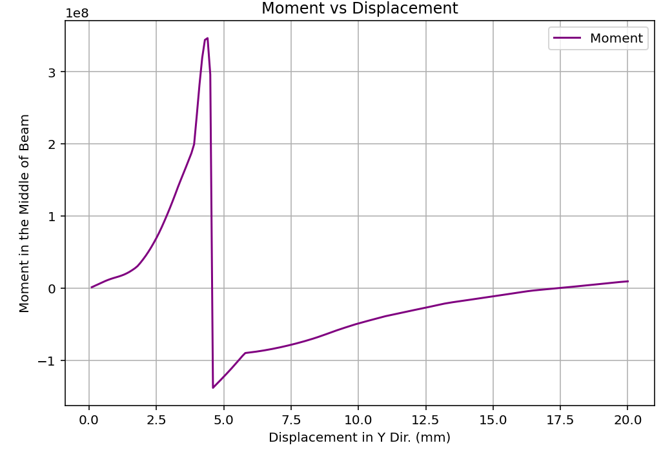

Slide 7
