Slide 1
IN THE NAME OF ALLAH
SOIL-FOUNDATION-STRUCTURE INTERACTION USING OPENSEES
SOIL SIMULATED WITH SIMPLE SPRINGS AND THE SOIL SPRINGS VALUES IS NOT EXACT.
WRITTEN BY SALAR DELAVAR GHASHGHAEI (QASHQAI)

Slide 2
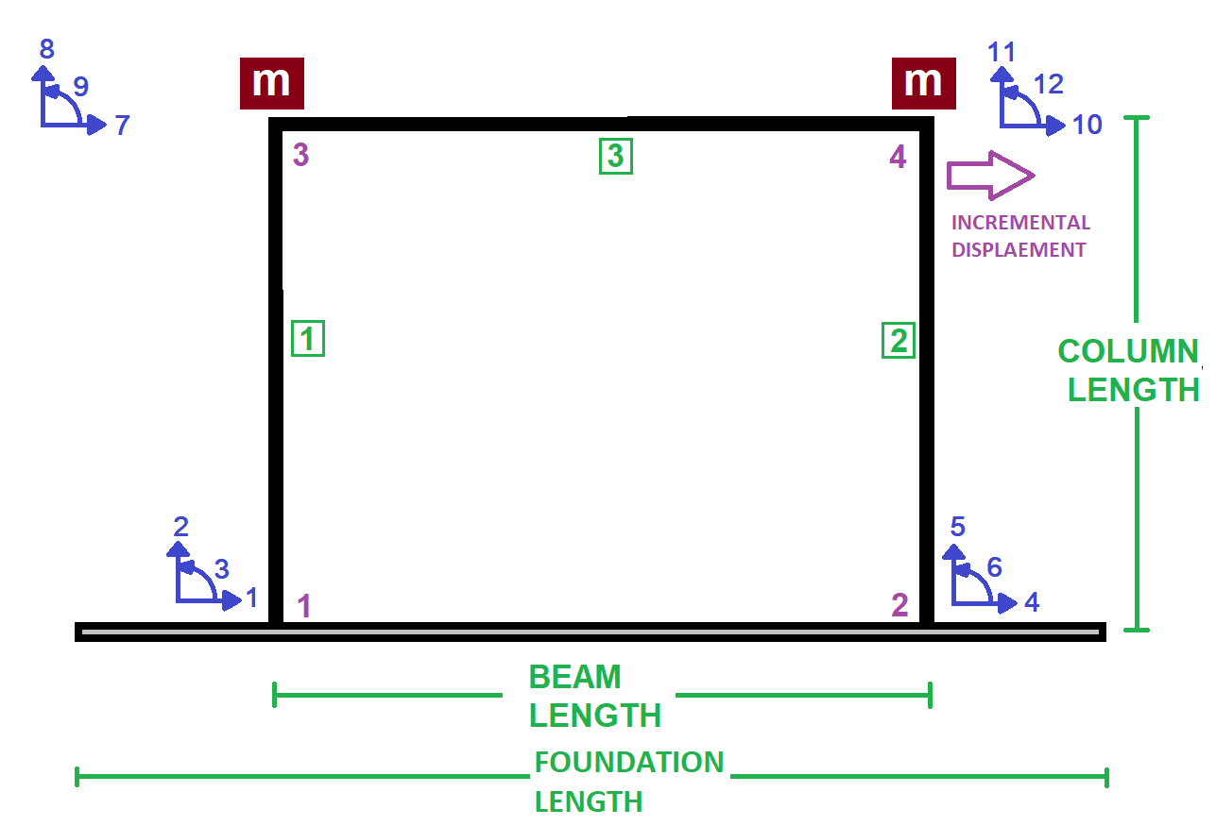

Slide 3
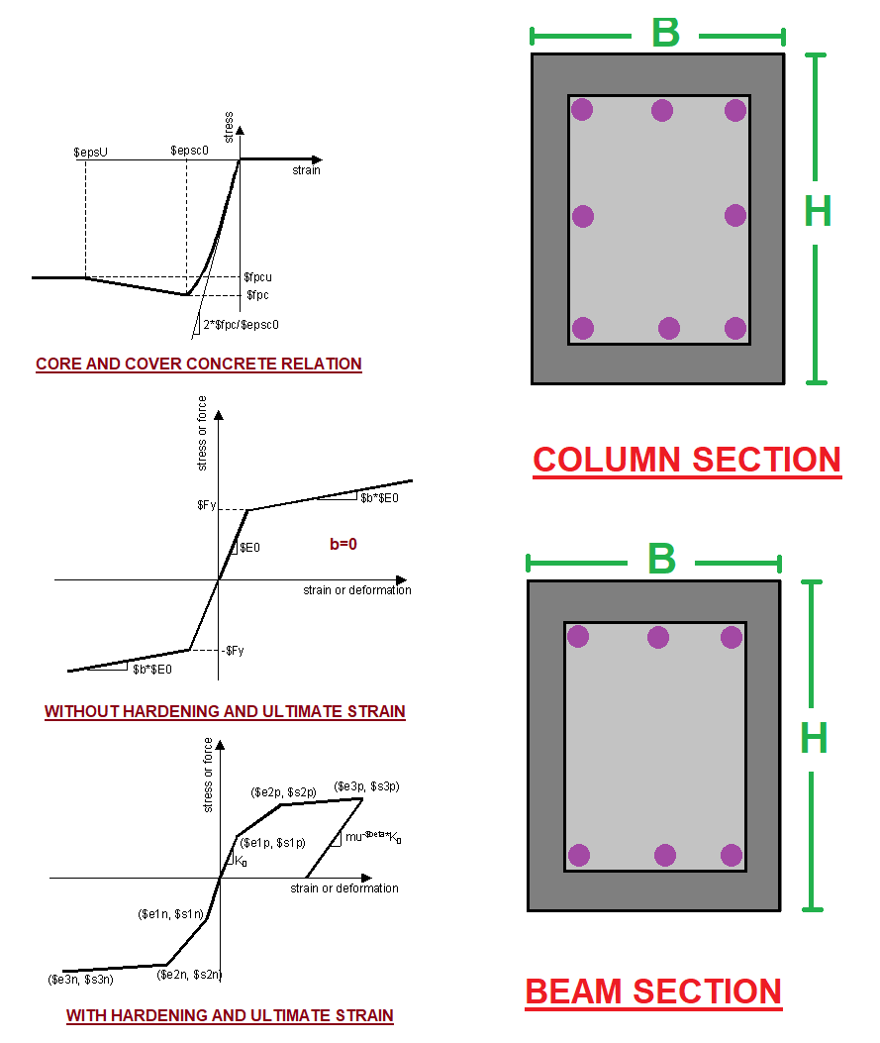

Slide 4
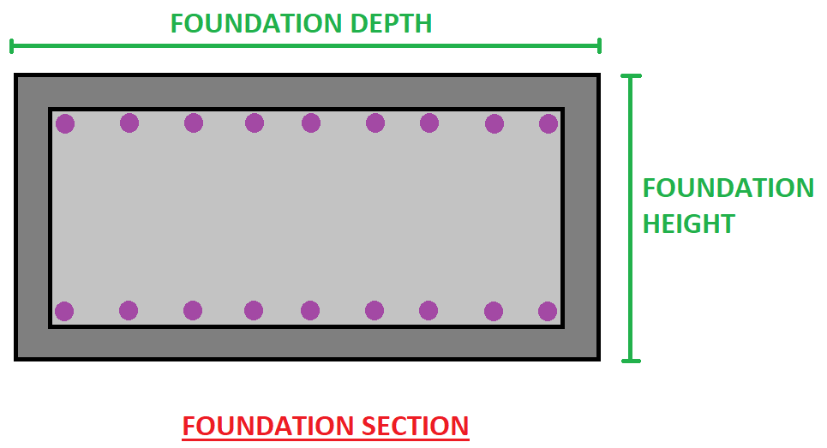

Slide 5
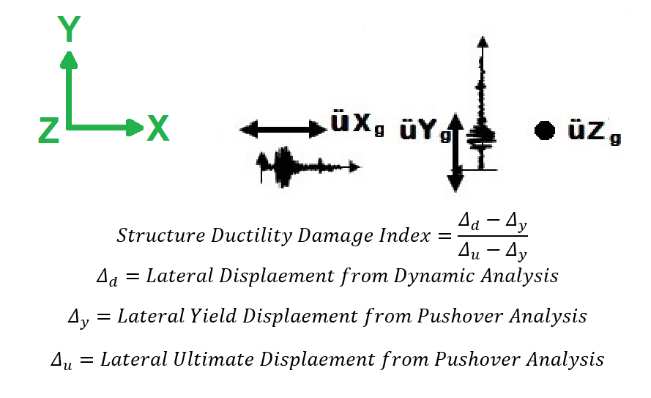

Slide 6
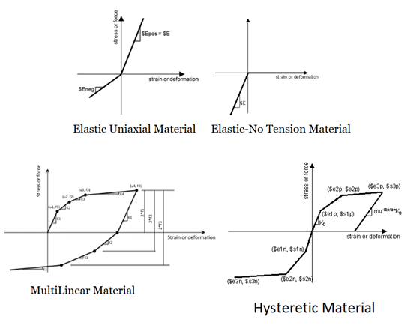

Slide 7
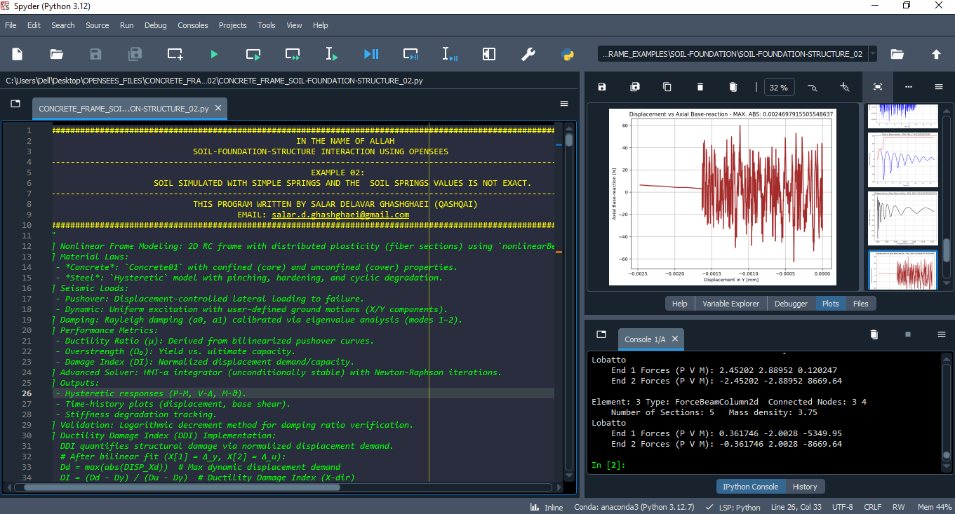

Slide 8
NONLINEAR STATIC ANALYSIS
(PUSHOVER)

Slide 9
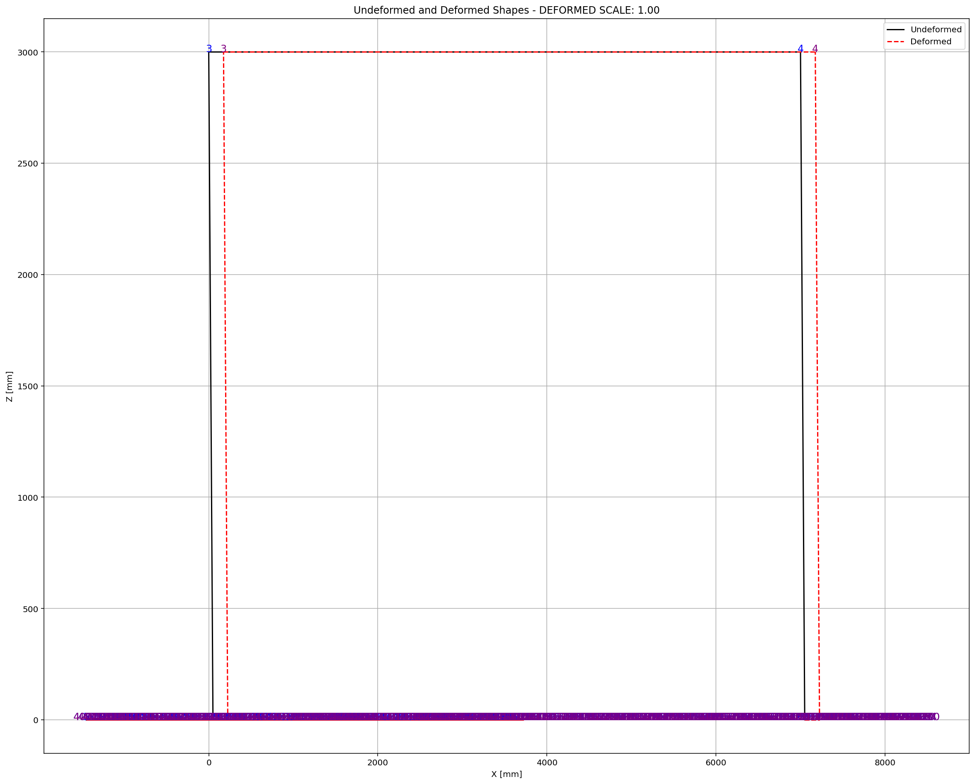

Slide 10
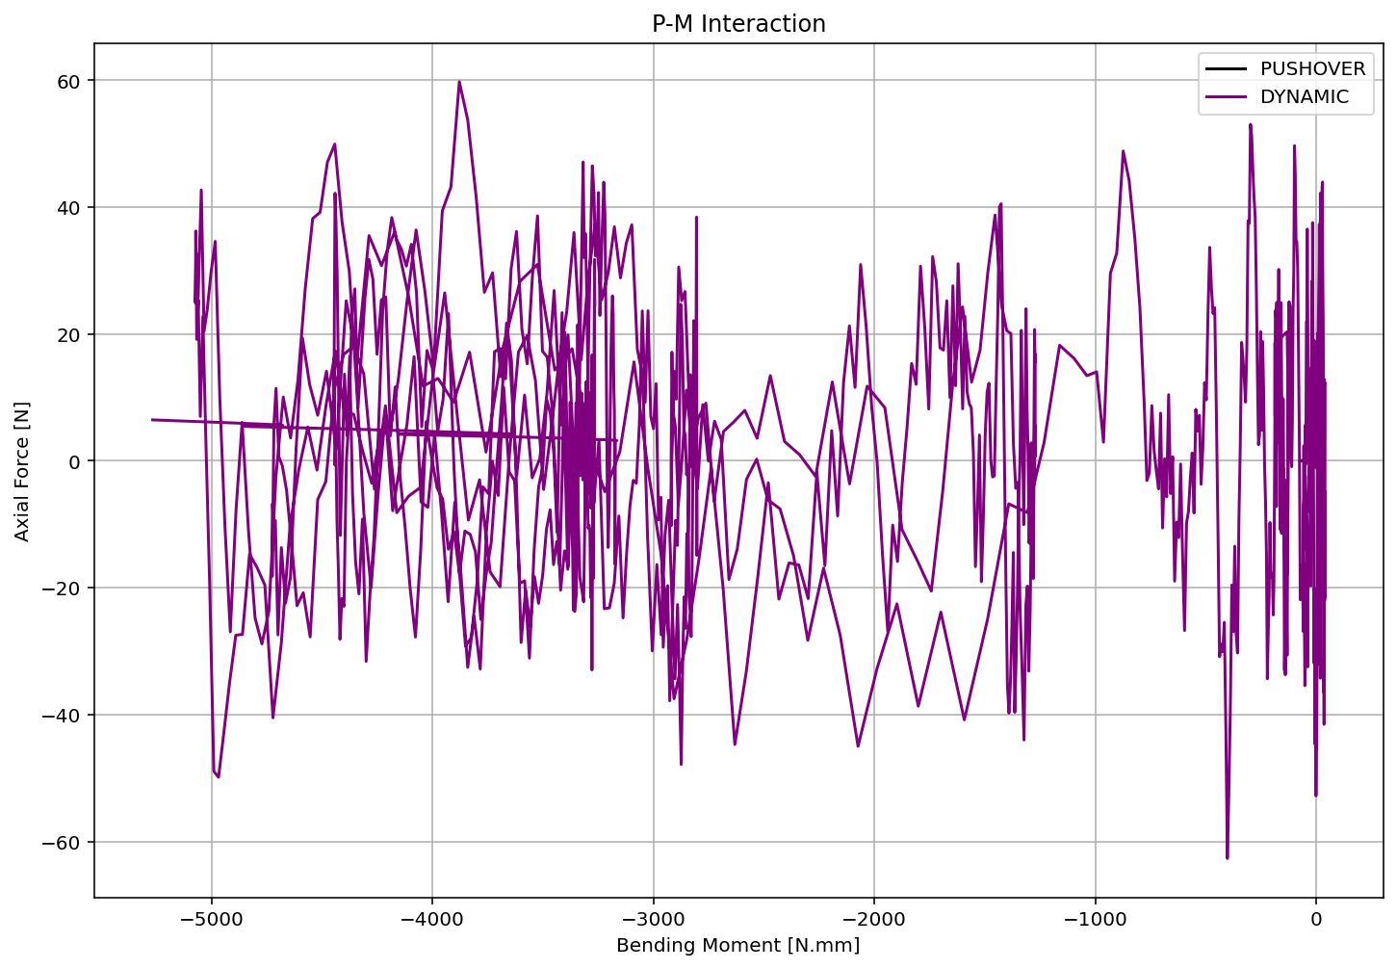

Slide 11
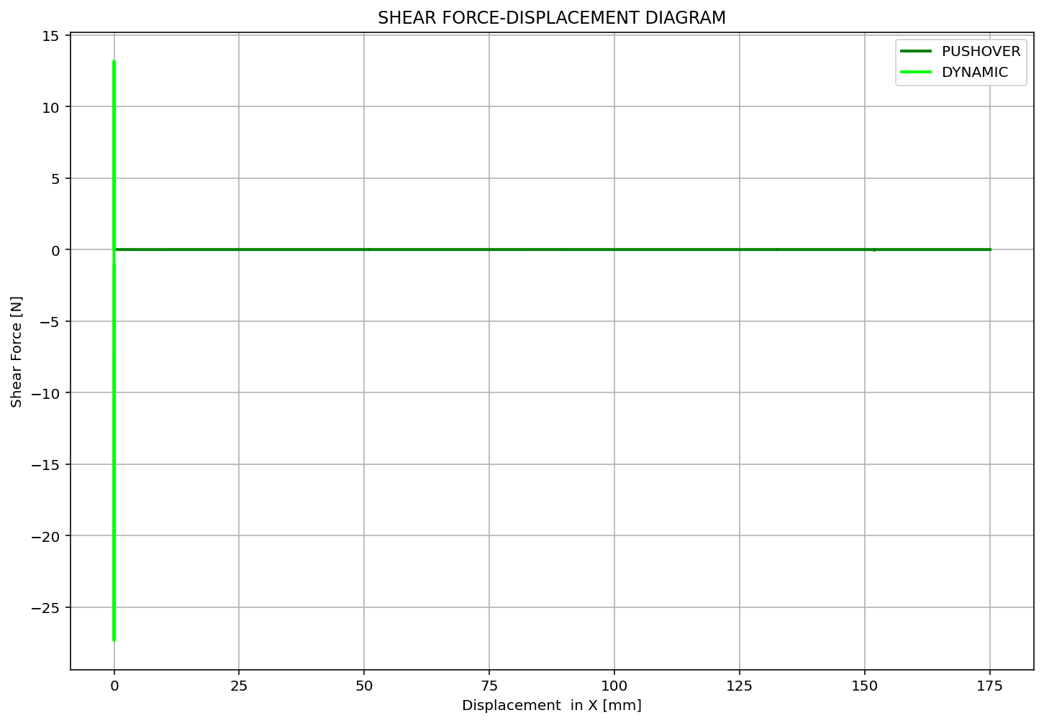

Slide 12
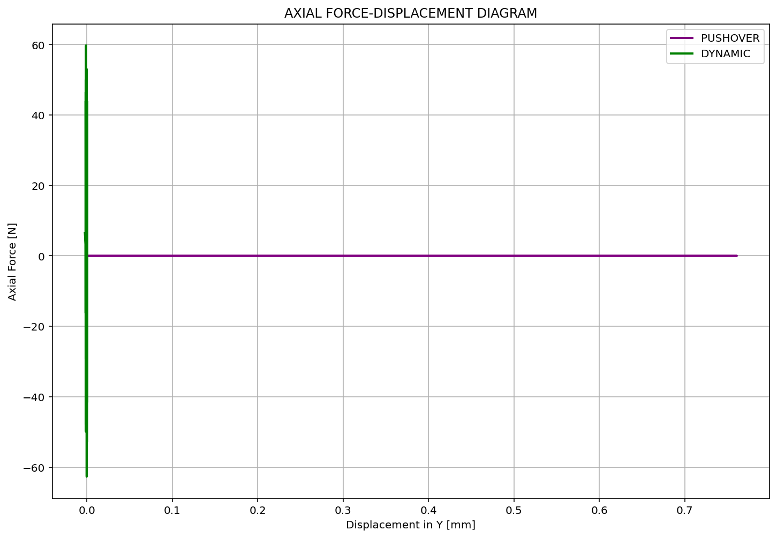

Slide 13
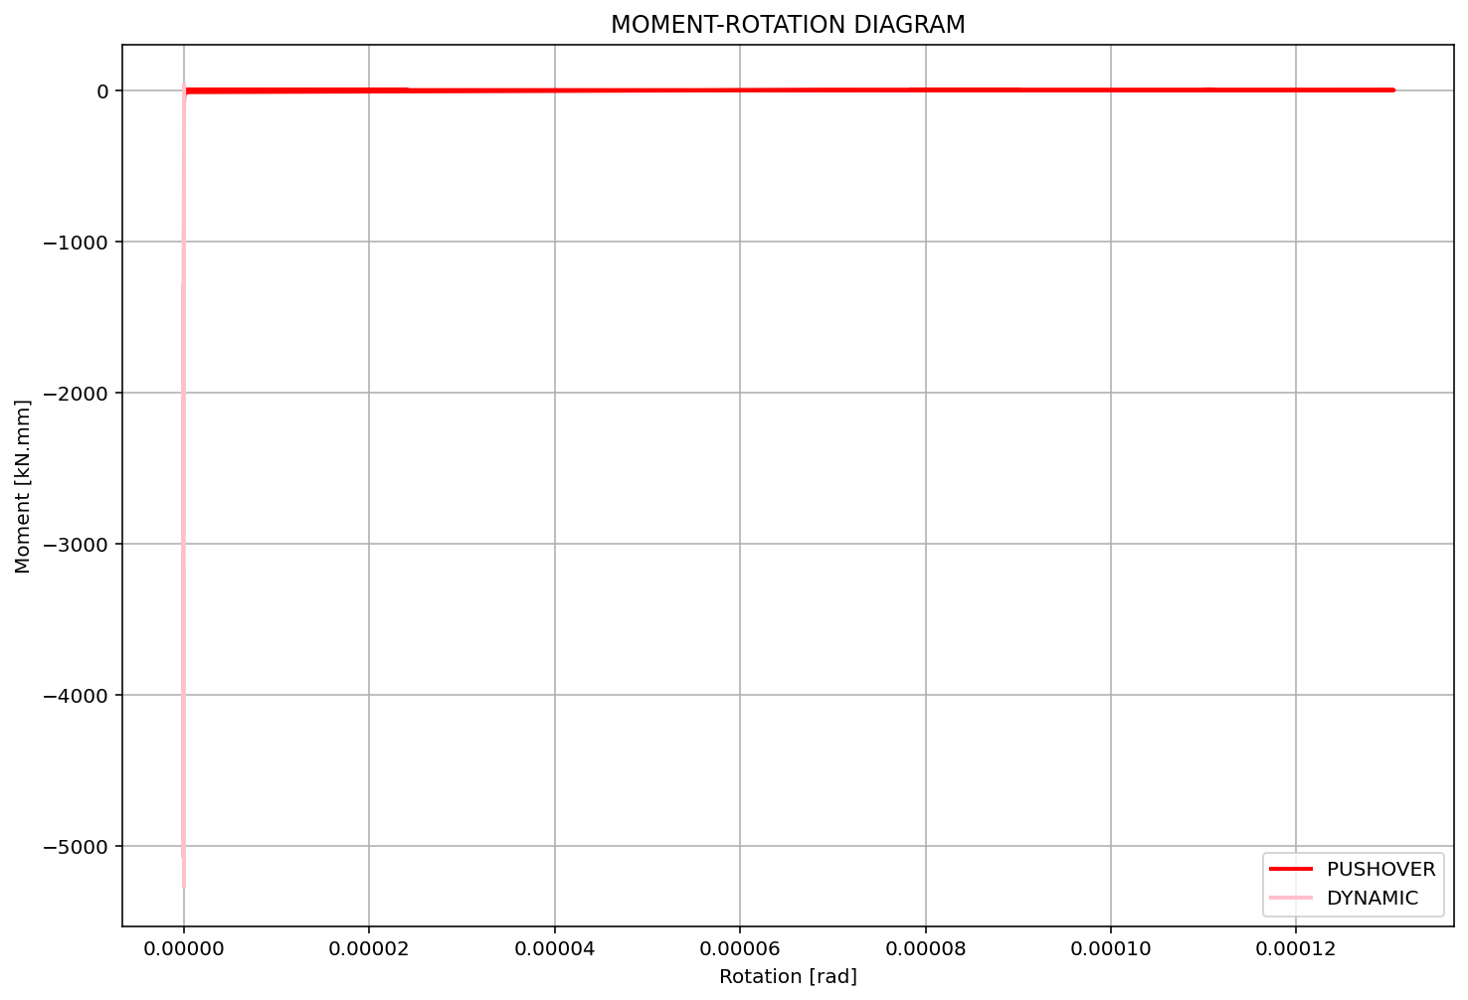

Slide 14
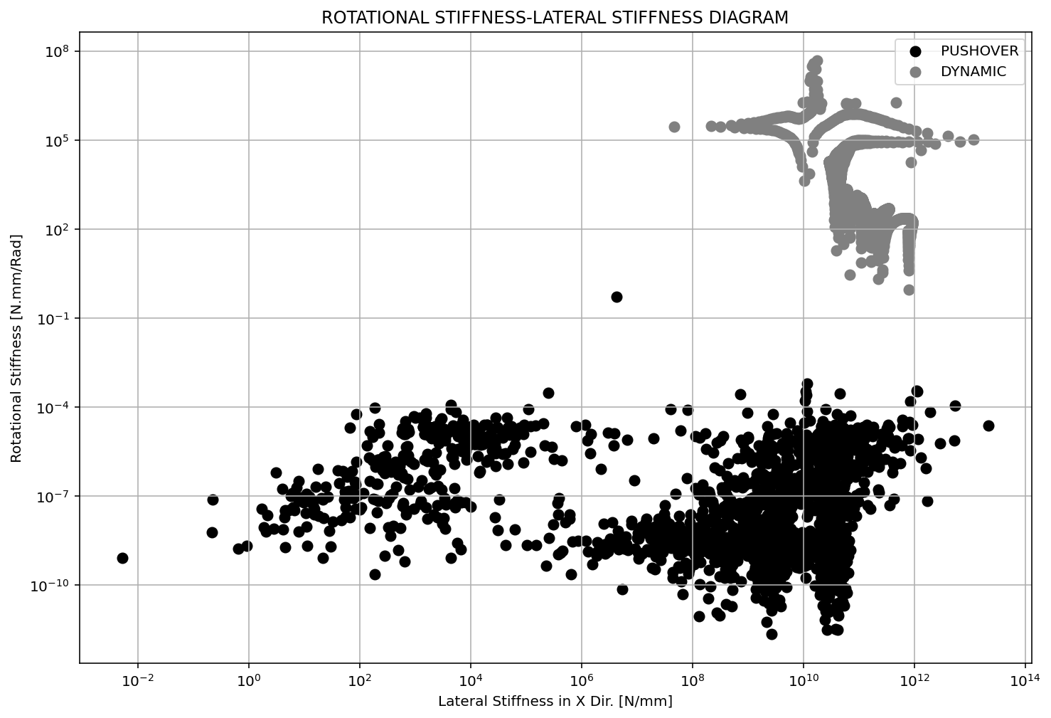

Slide 15
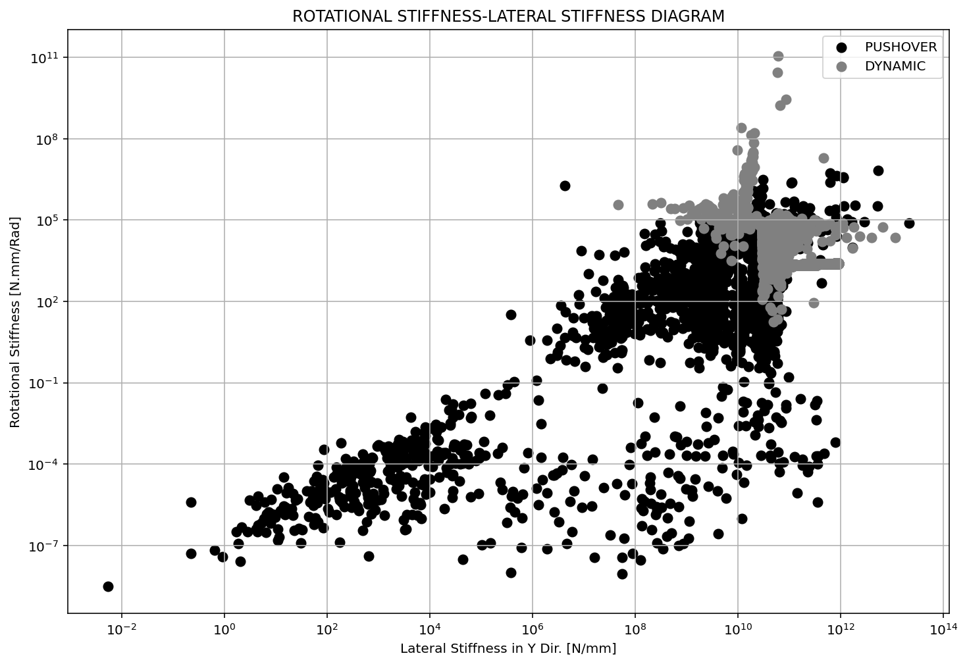

Slide 16
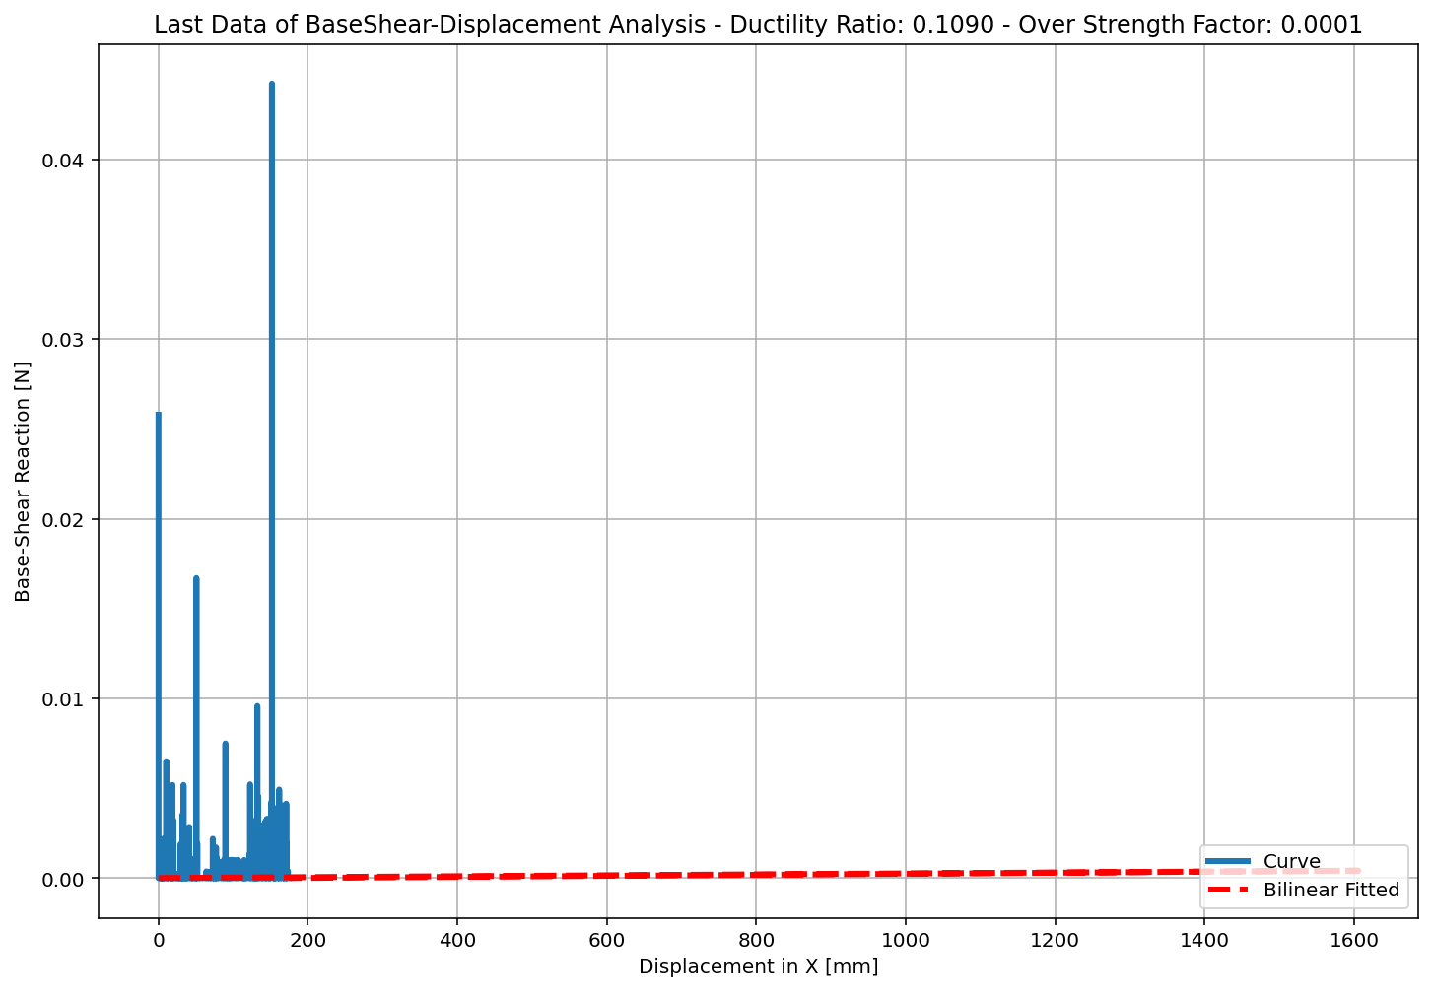

Slide 17
NONLINEAR DYNAMIC ANALYSIS

Slide 18
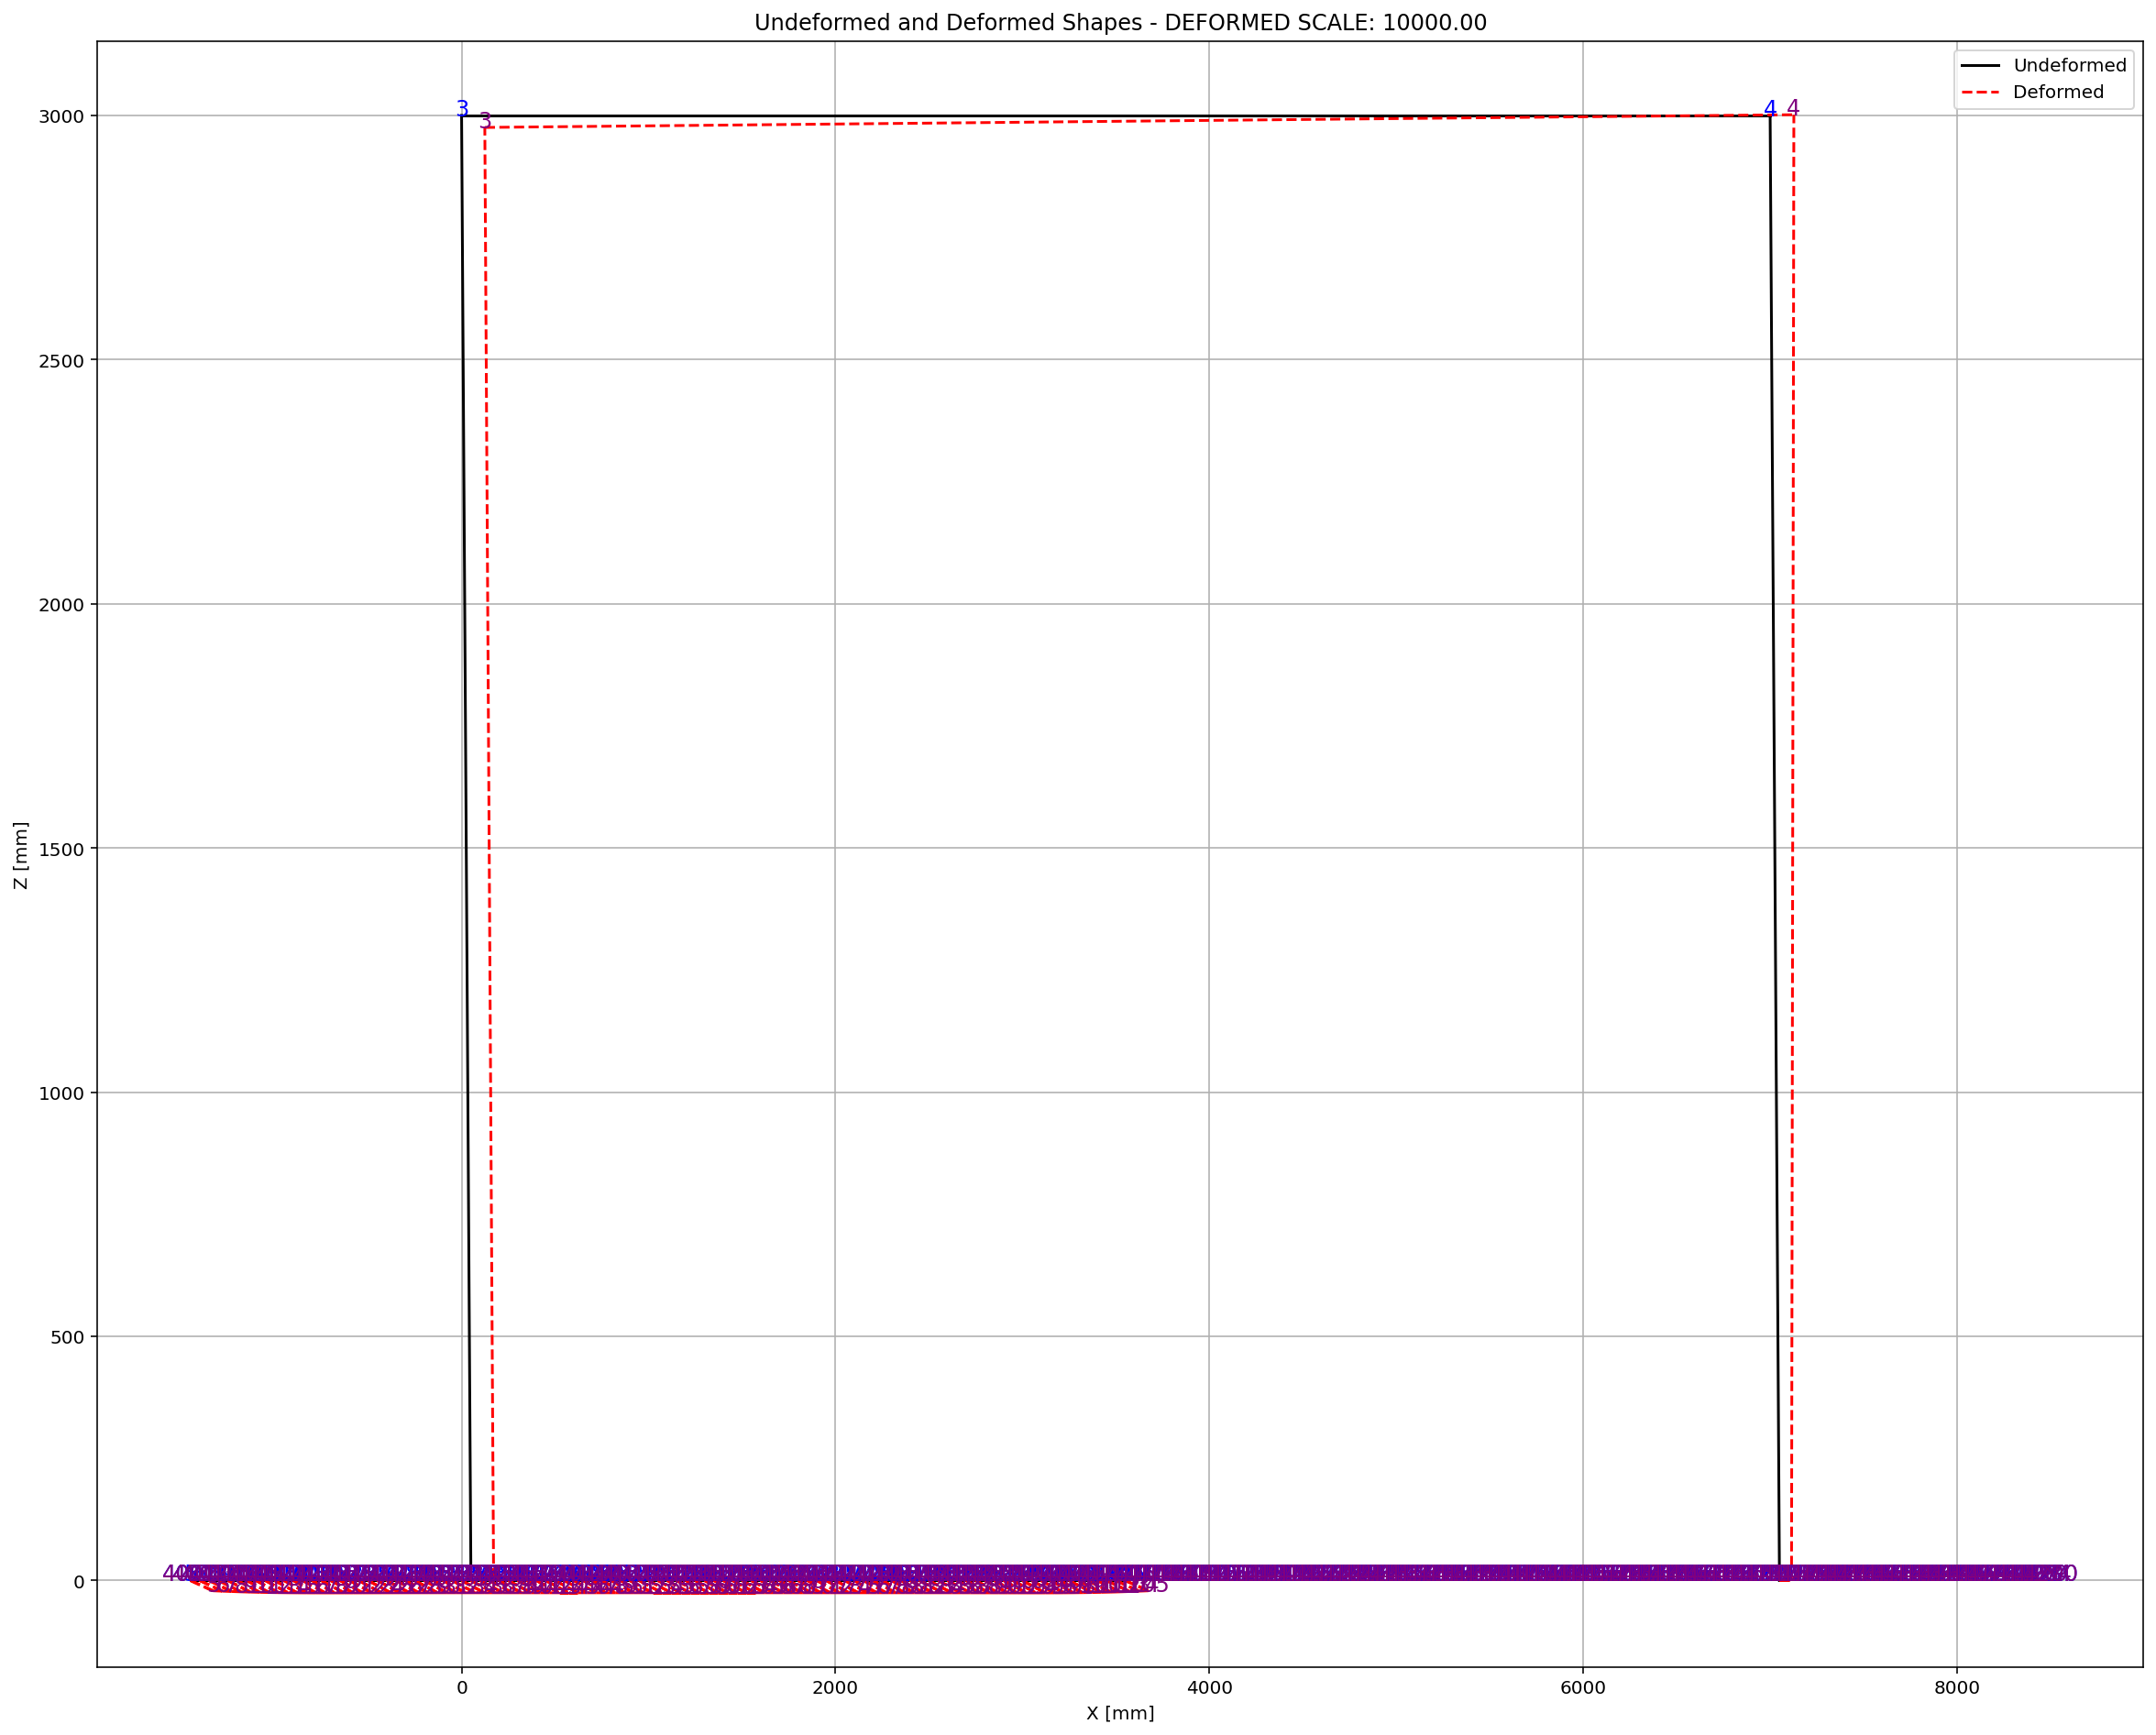

Slide 19
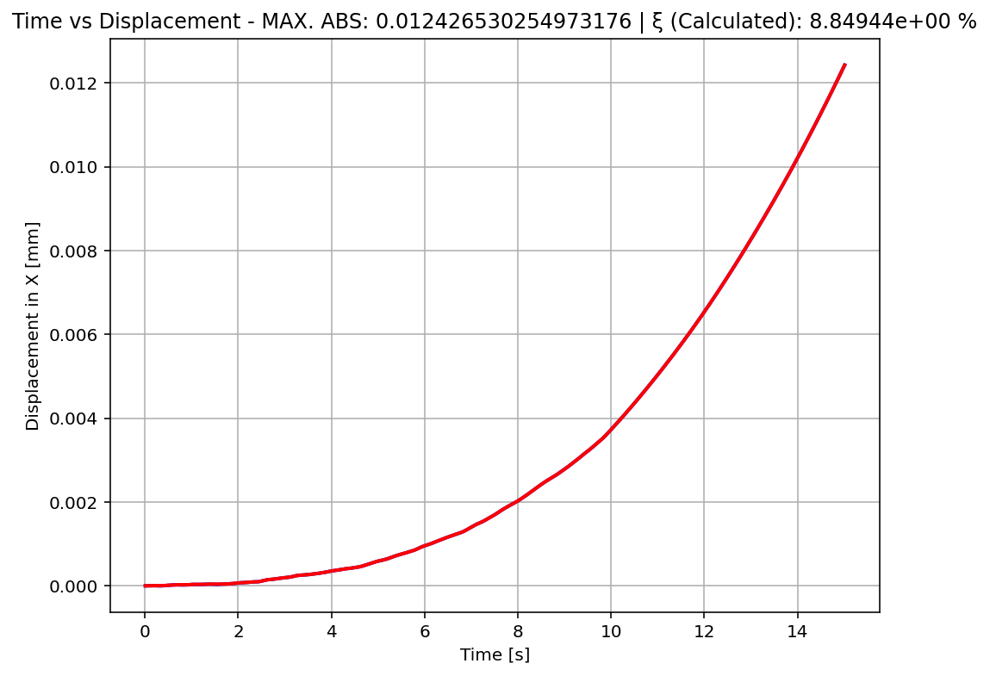

Slide 20
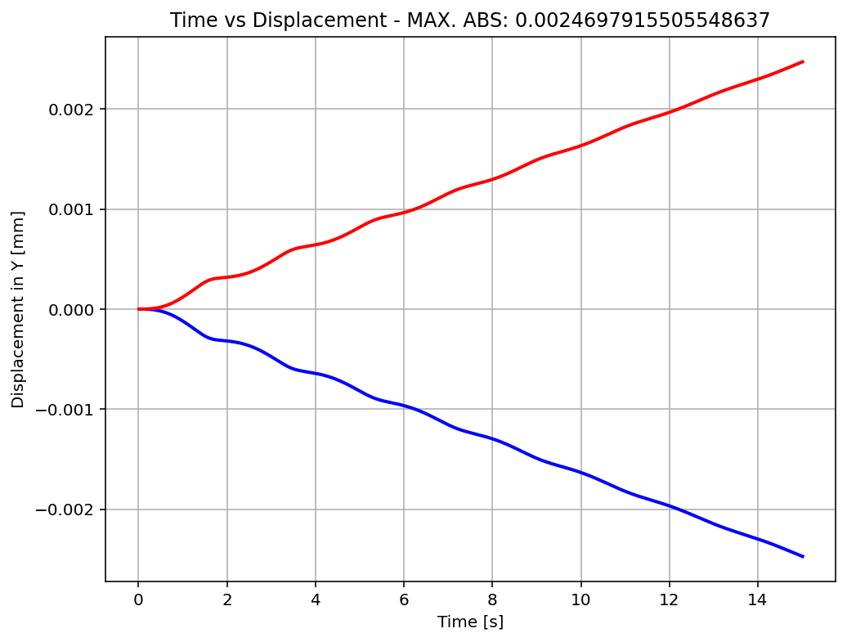

Slide 21
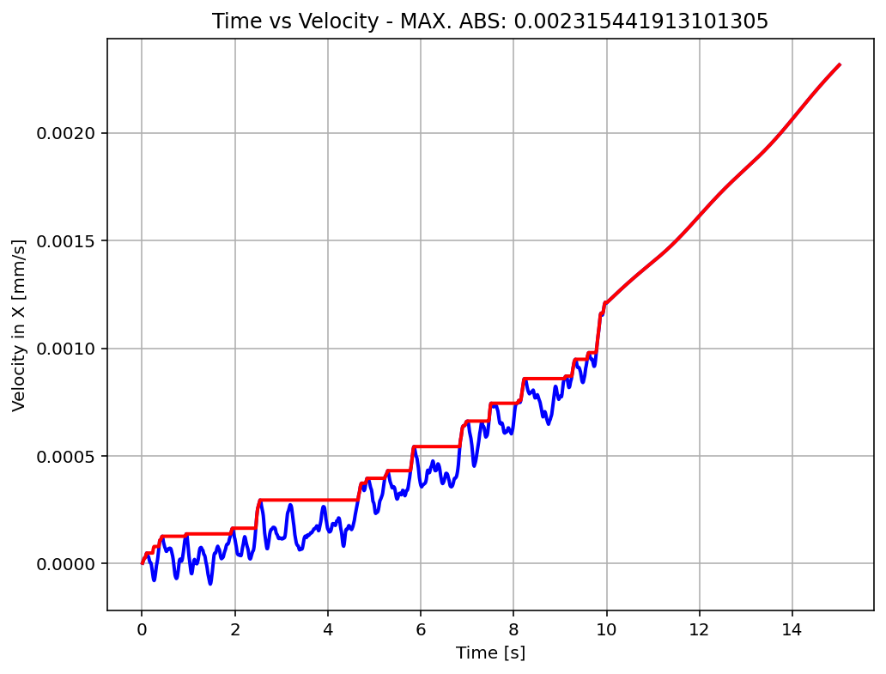

Slide 22
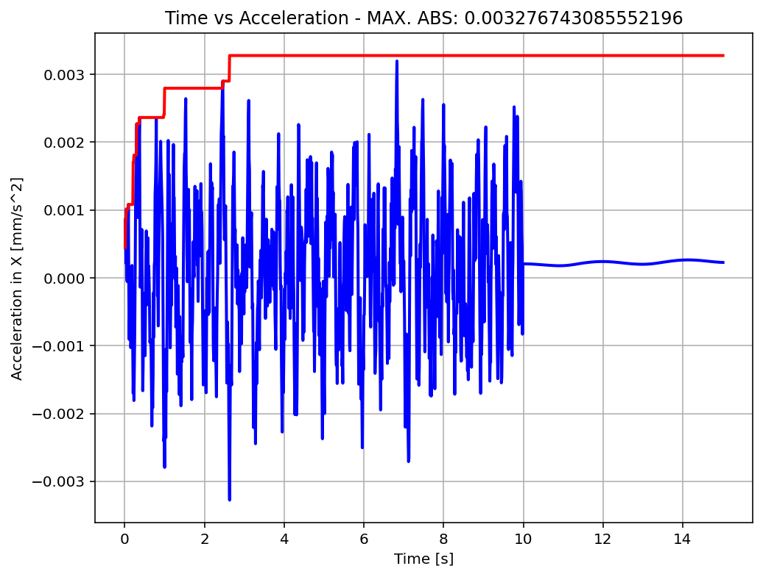

Slide 23
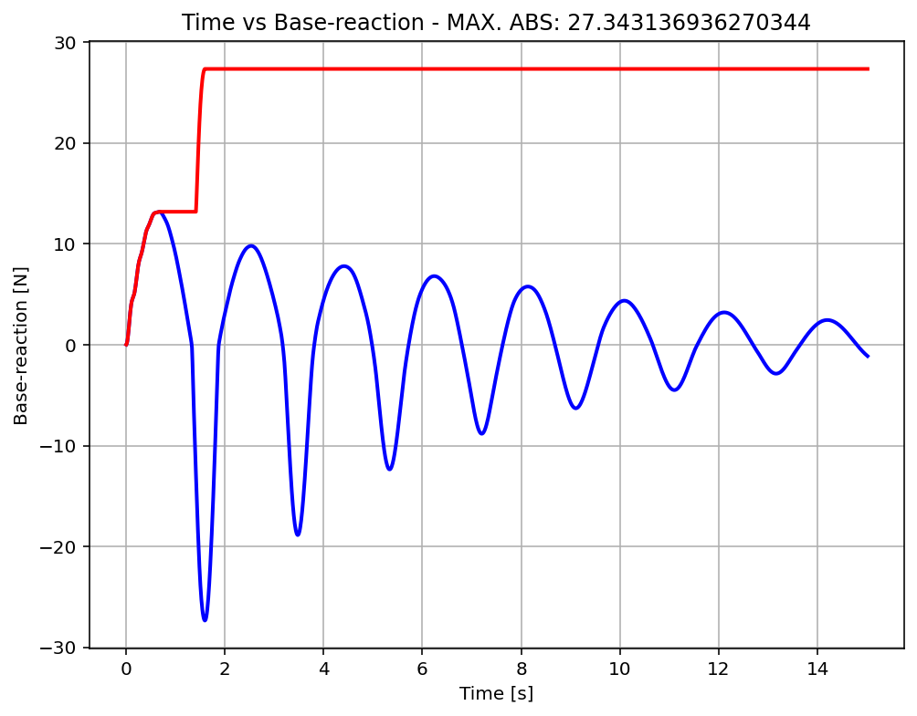

Slide 24
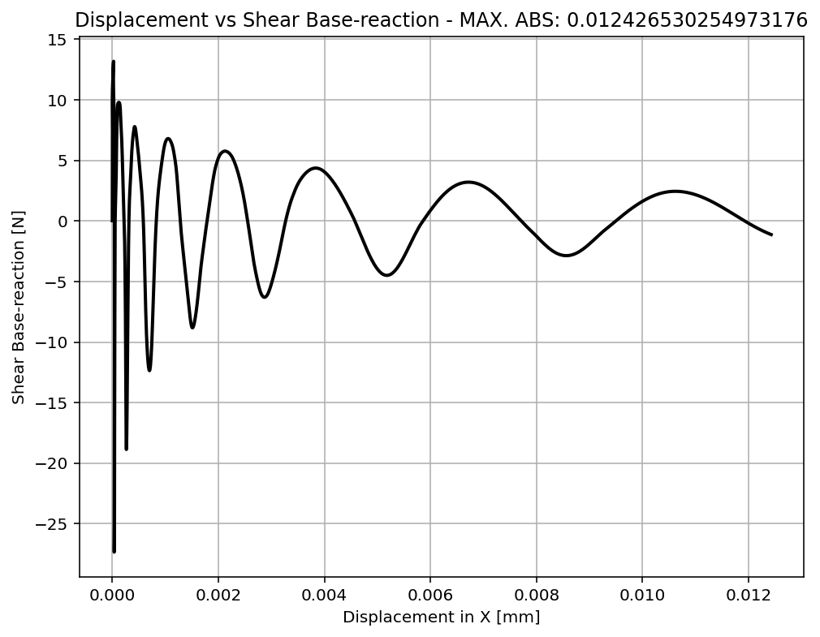

Slide 25
