Slide 1
>> IN THE NAME OF ALLAH, THE MOST GRACIOUS, THE MOST MERCIFUL <<
DYNAMIC ANALYSIS AND PERFORMANCE ASSESSMENT OF INELASTIC SDOF SYSTEMS USING RESPONSE SPECTRUM METHODS IN OPENSEES
WRITTEN BY SALAR DELAVAR GHASHGHAEI (QASHQAI)

Slide 2
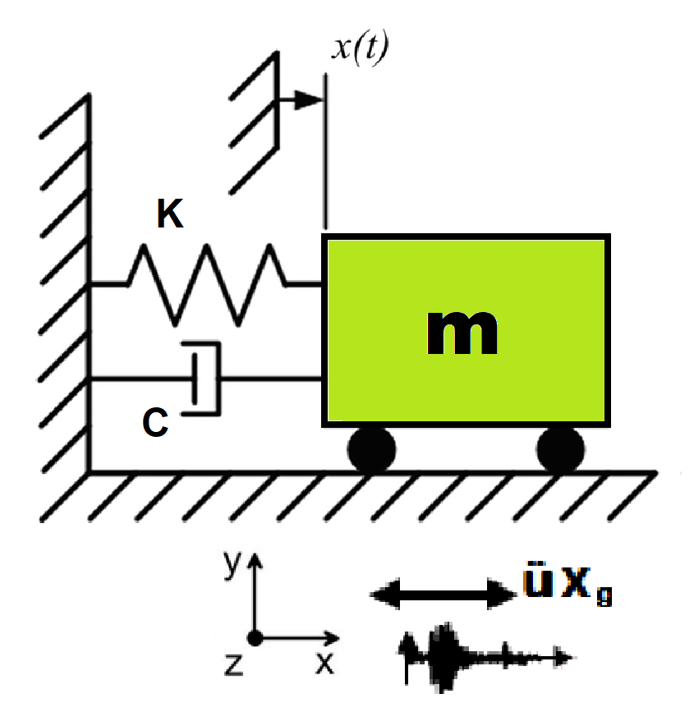
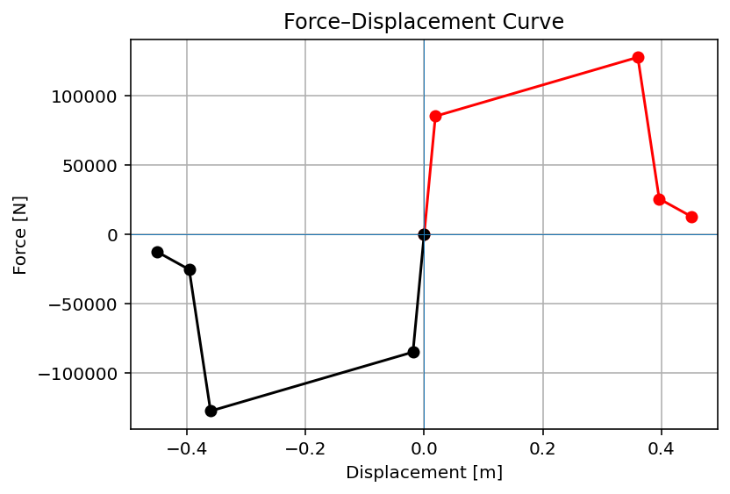

Slide 3
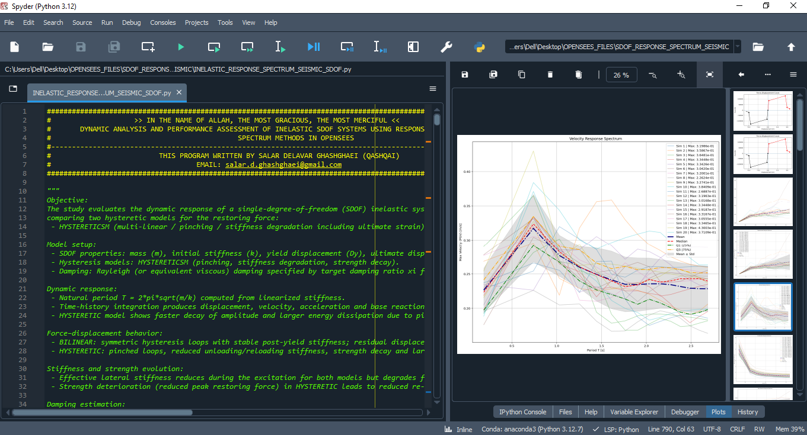

Slide 4
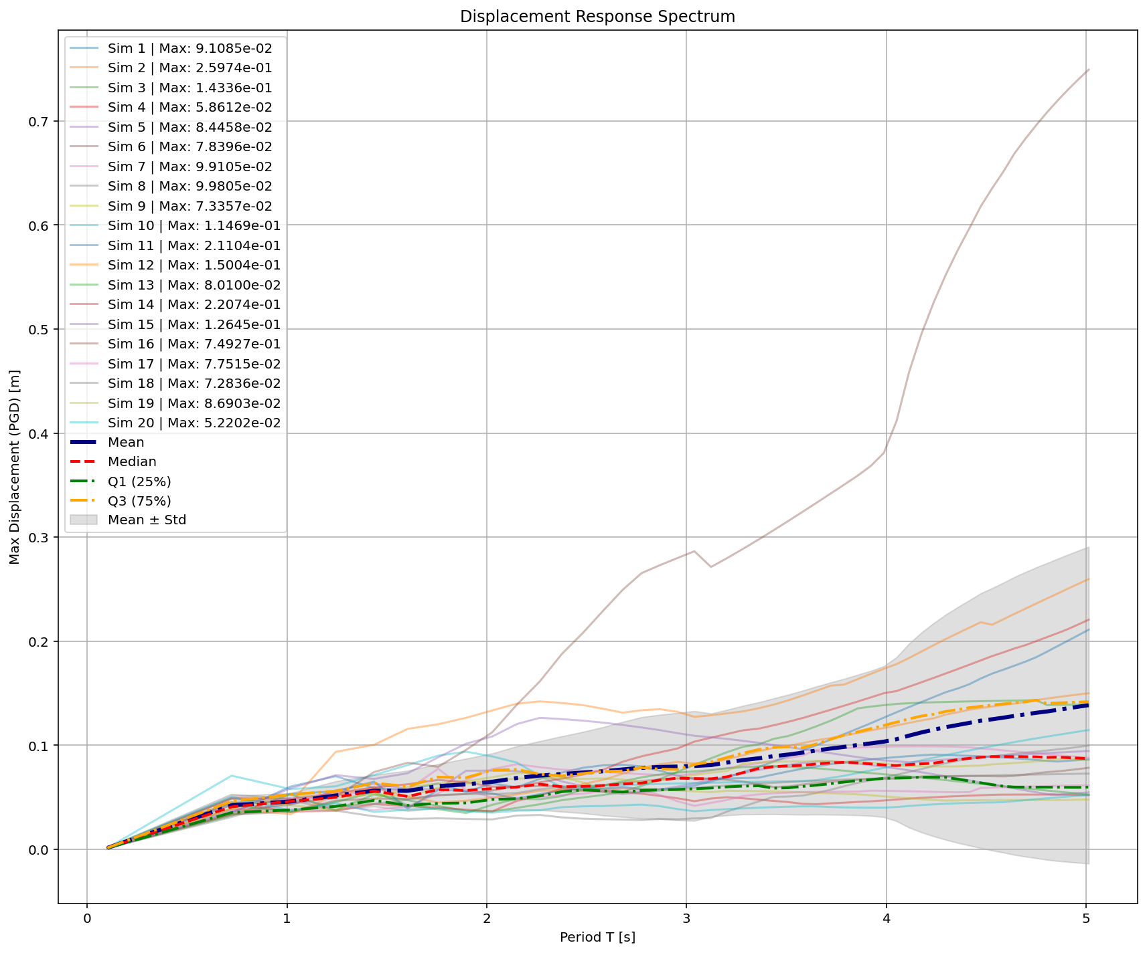

Slide 5
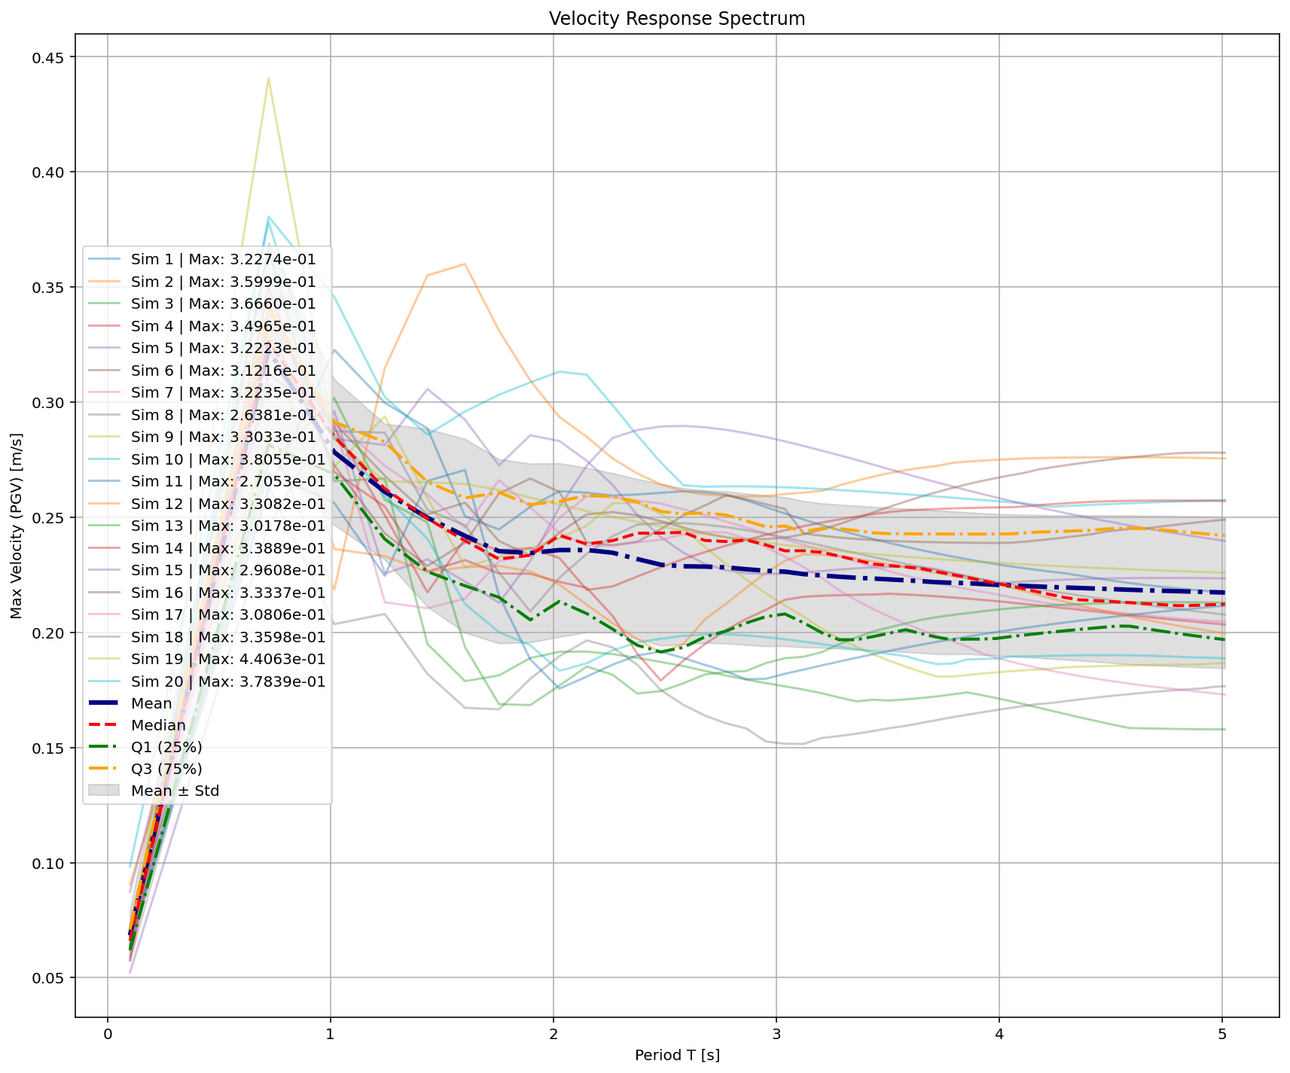

Slide 6
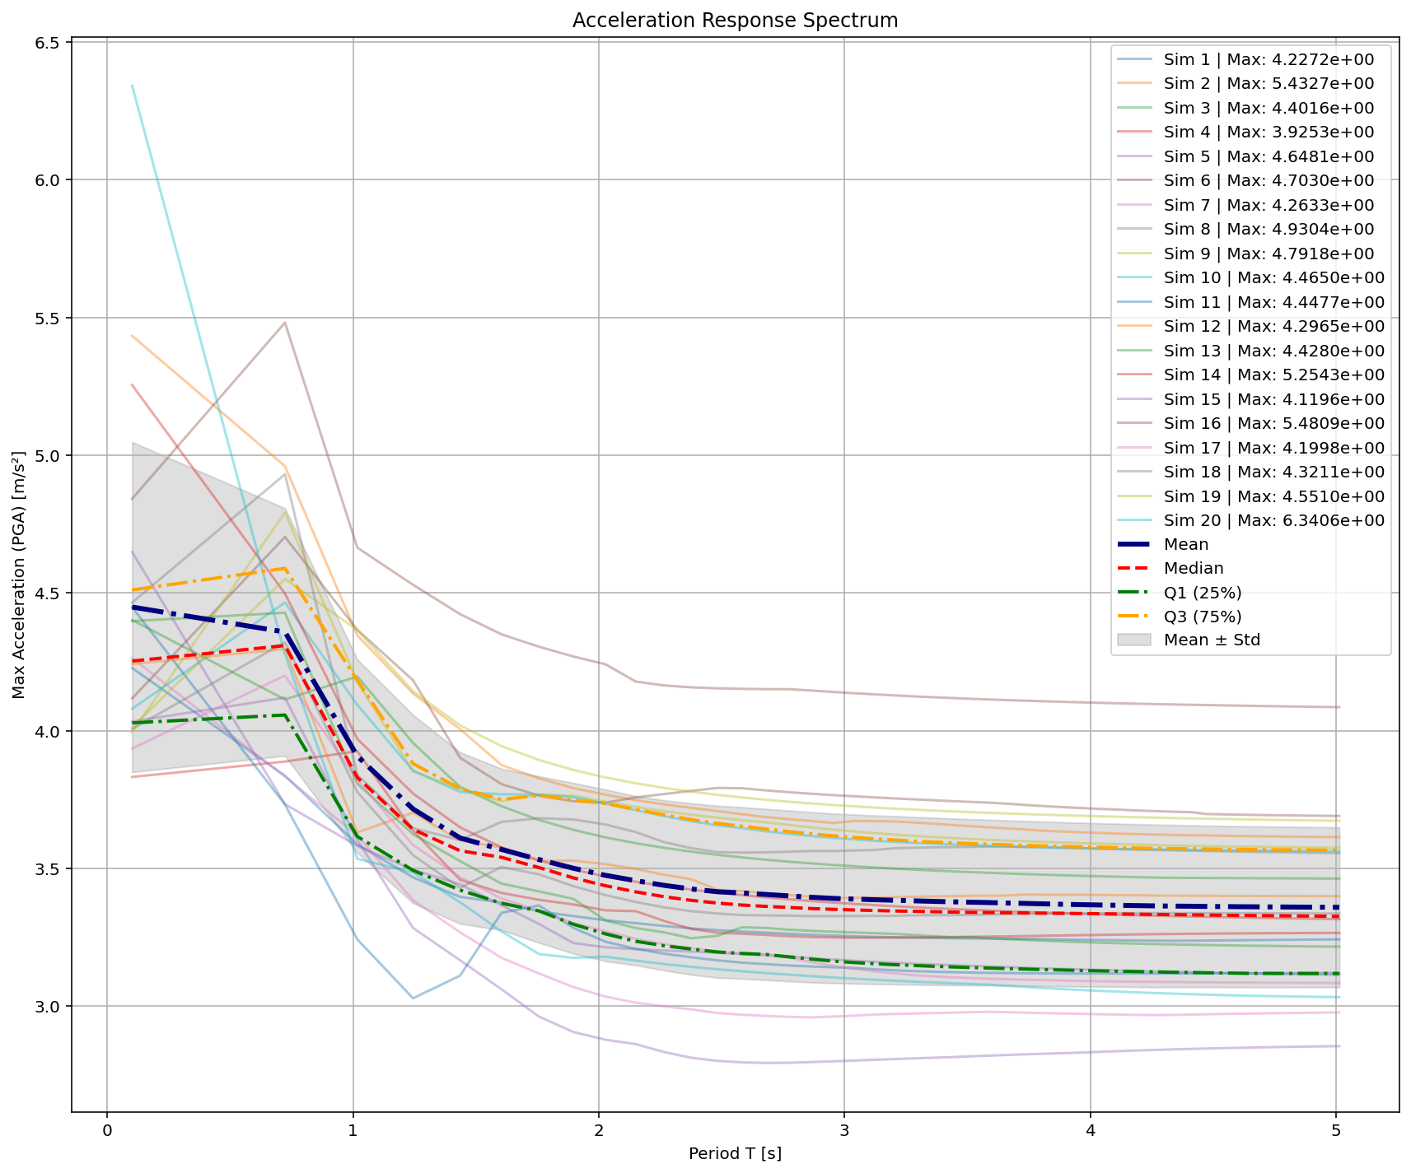

Slide 7
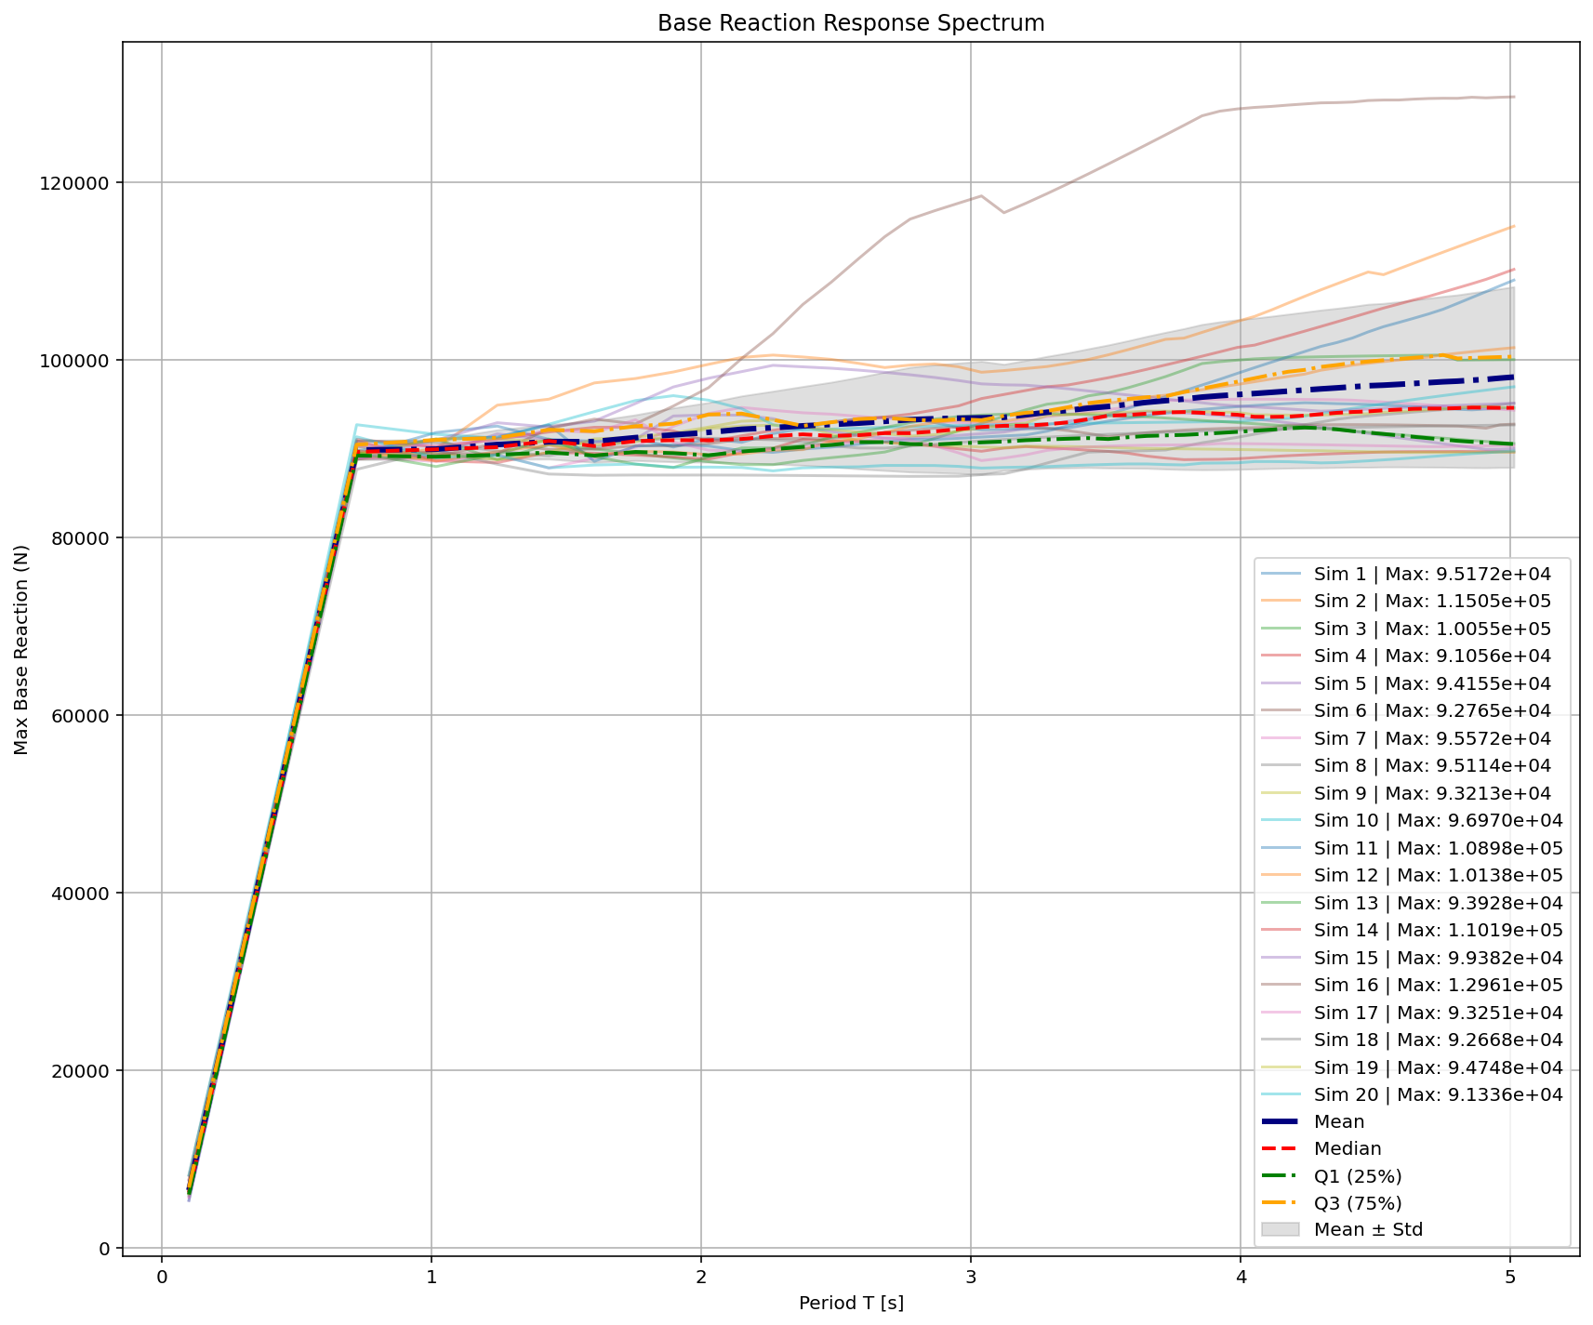

Slide 8
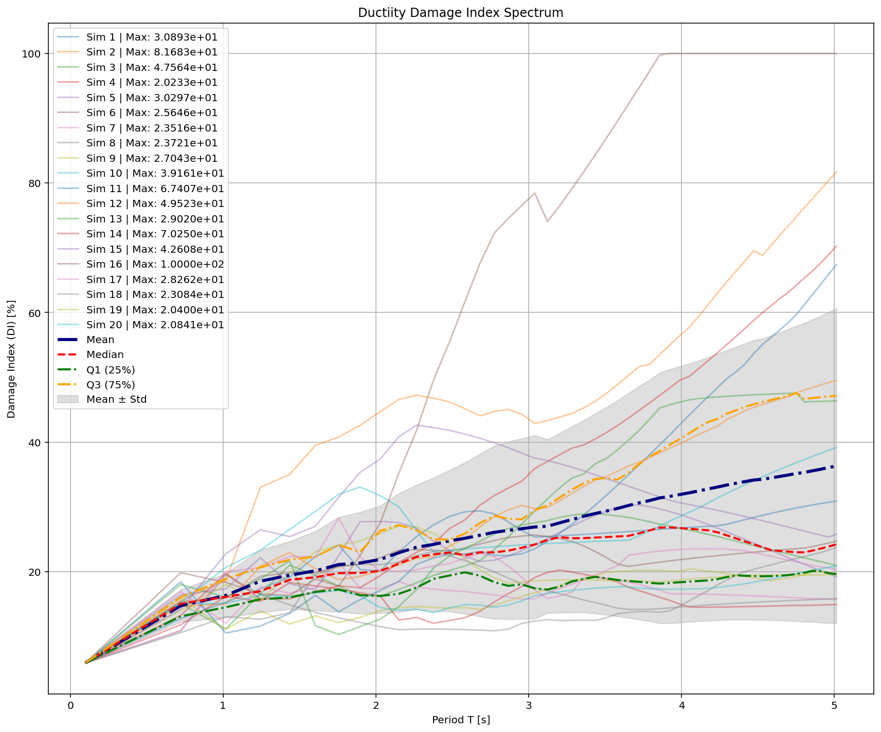

Slide 9
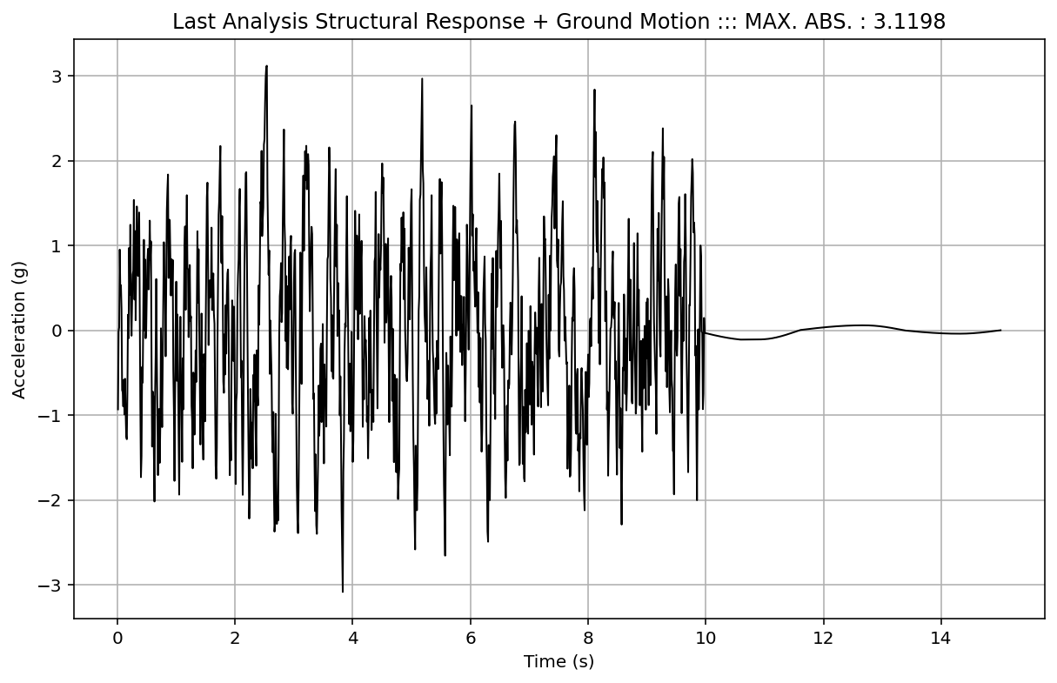

Slide 10
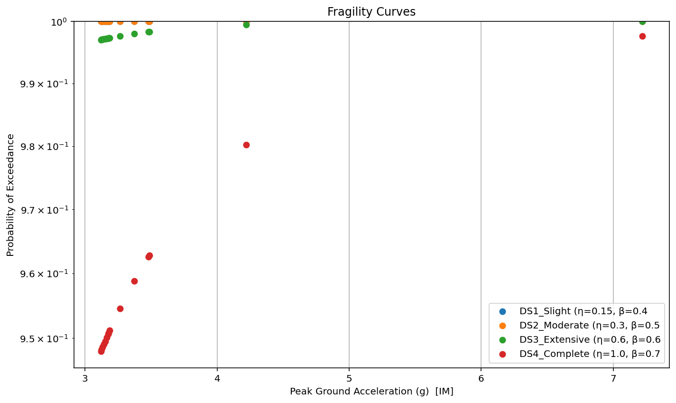

Slide 12
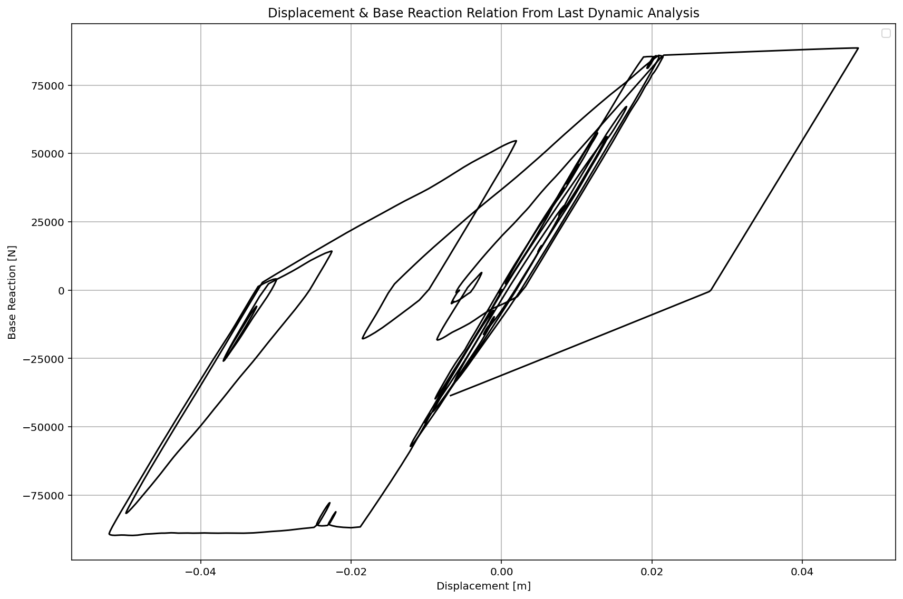

Slide 13
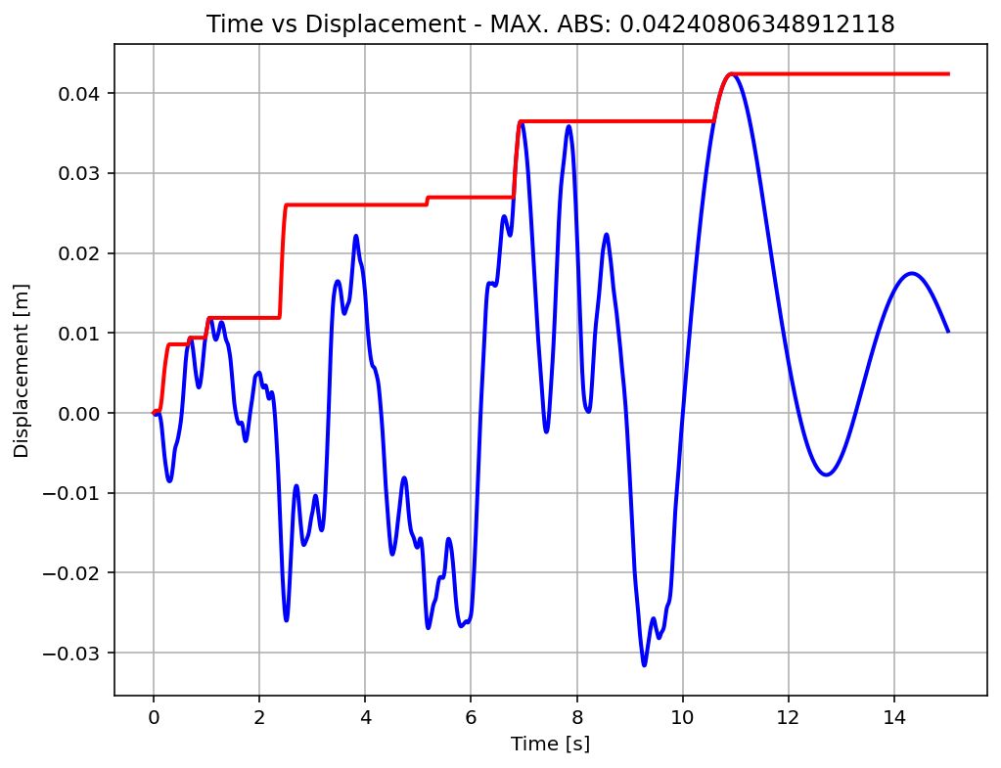

Slide 14
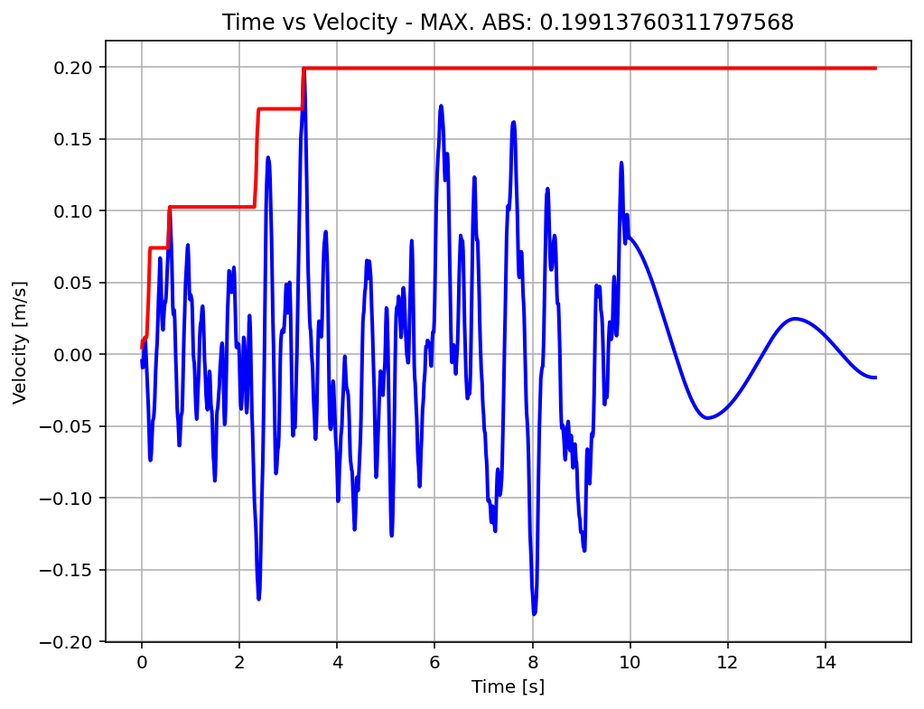

Slide 15
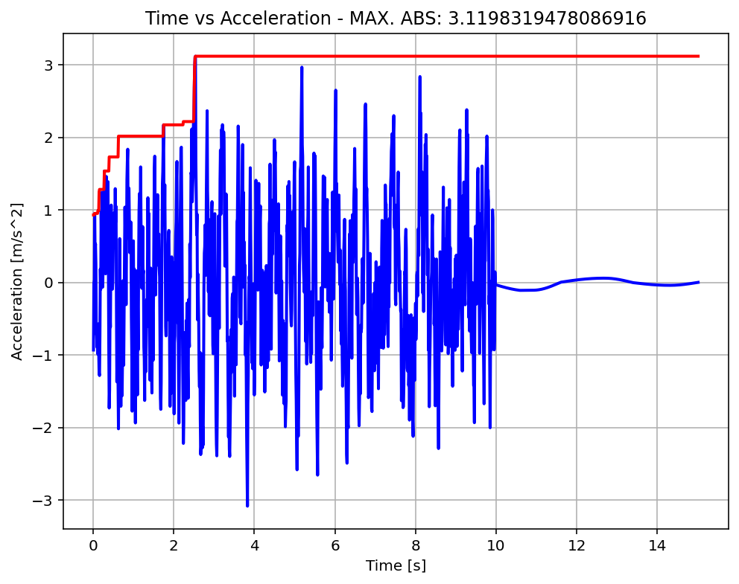

Slide 16
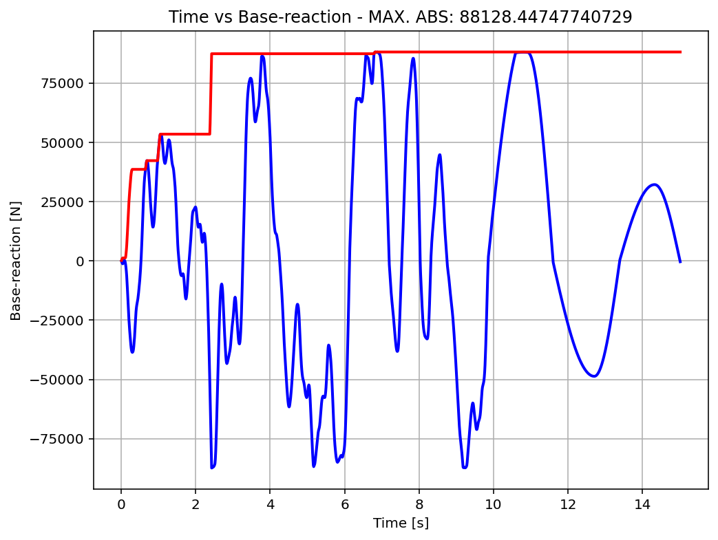

Slide 17
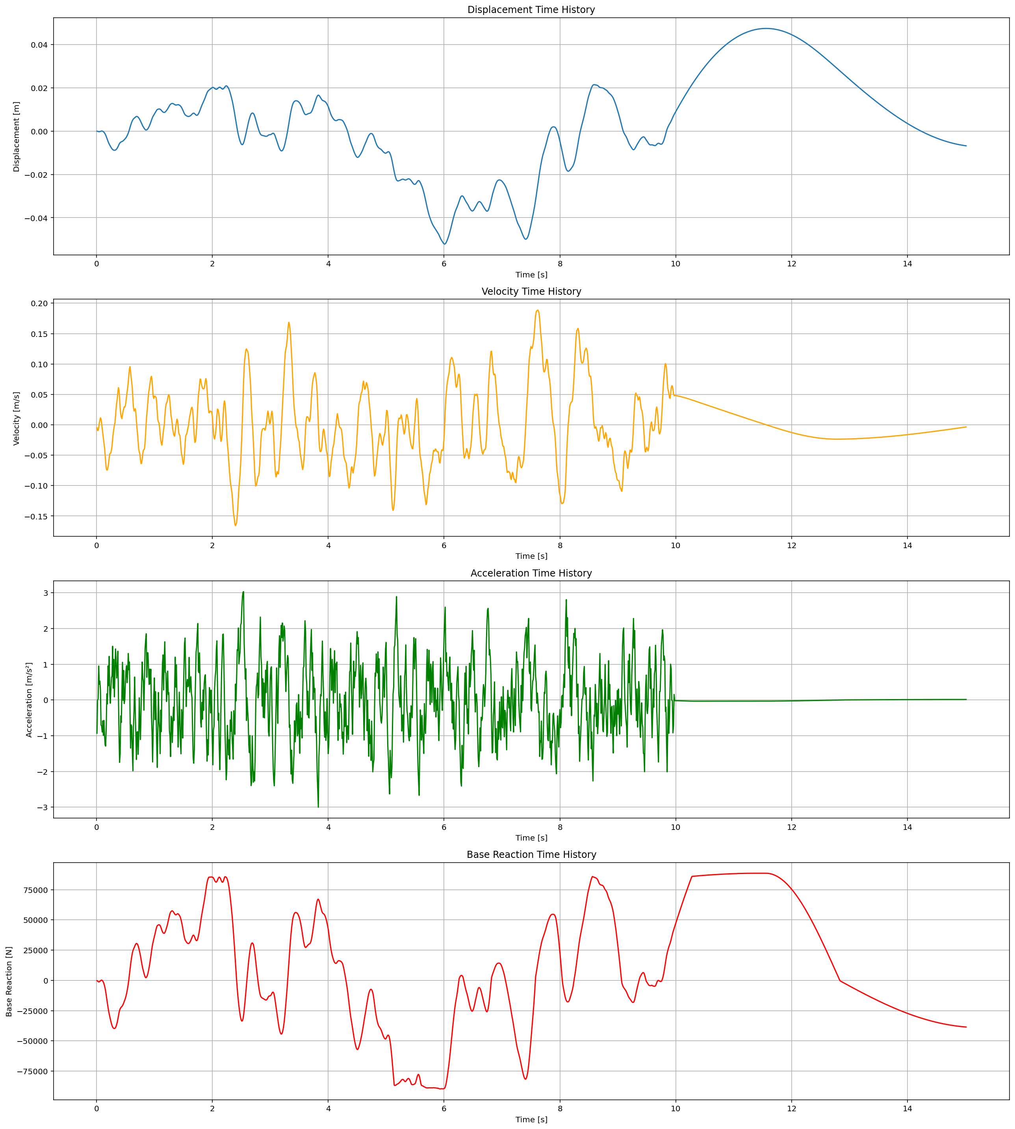

Slide 18
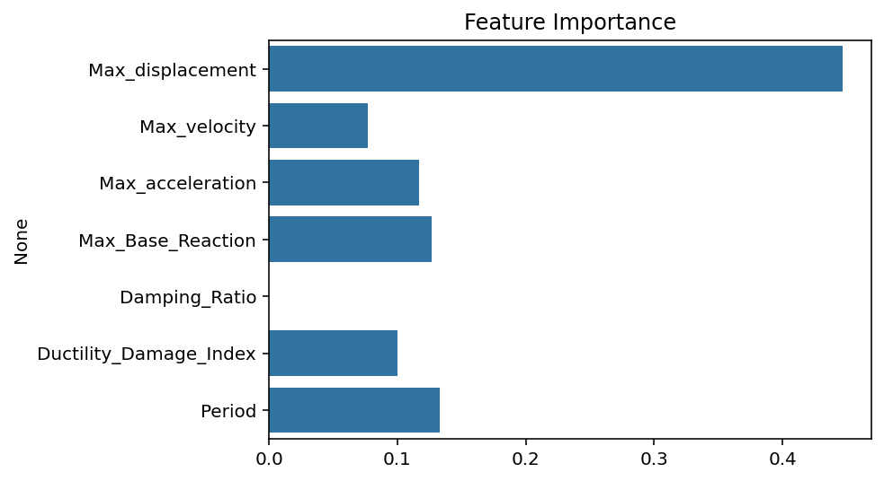

Slide 19
