Slide 1
>> IN THE NAME OF ALLAH, THE MOST GRACIOUS, THE MOST MERCIFUL <<
INVESTIGATION OF MULTI-MODE POST-BUCKLING PHENOMENA IN SEMI-RIGID STEEL COLUMNS USING OPENSEES CONSIDERING THE GEOMETRIC AND MATERIAL PROPERTIES NONLINEARITY
WRITTEN BY SALAR DELAVAR GHASHGHAEI (QASHQAI)

Slide 2
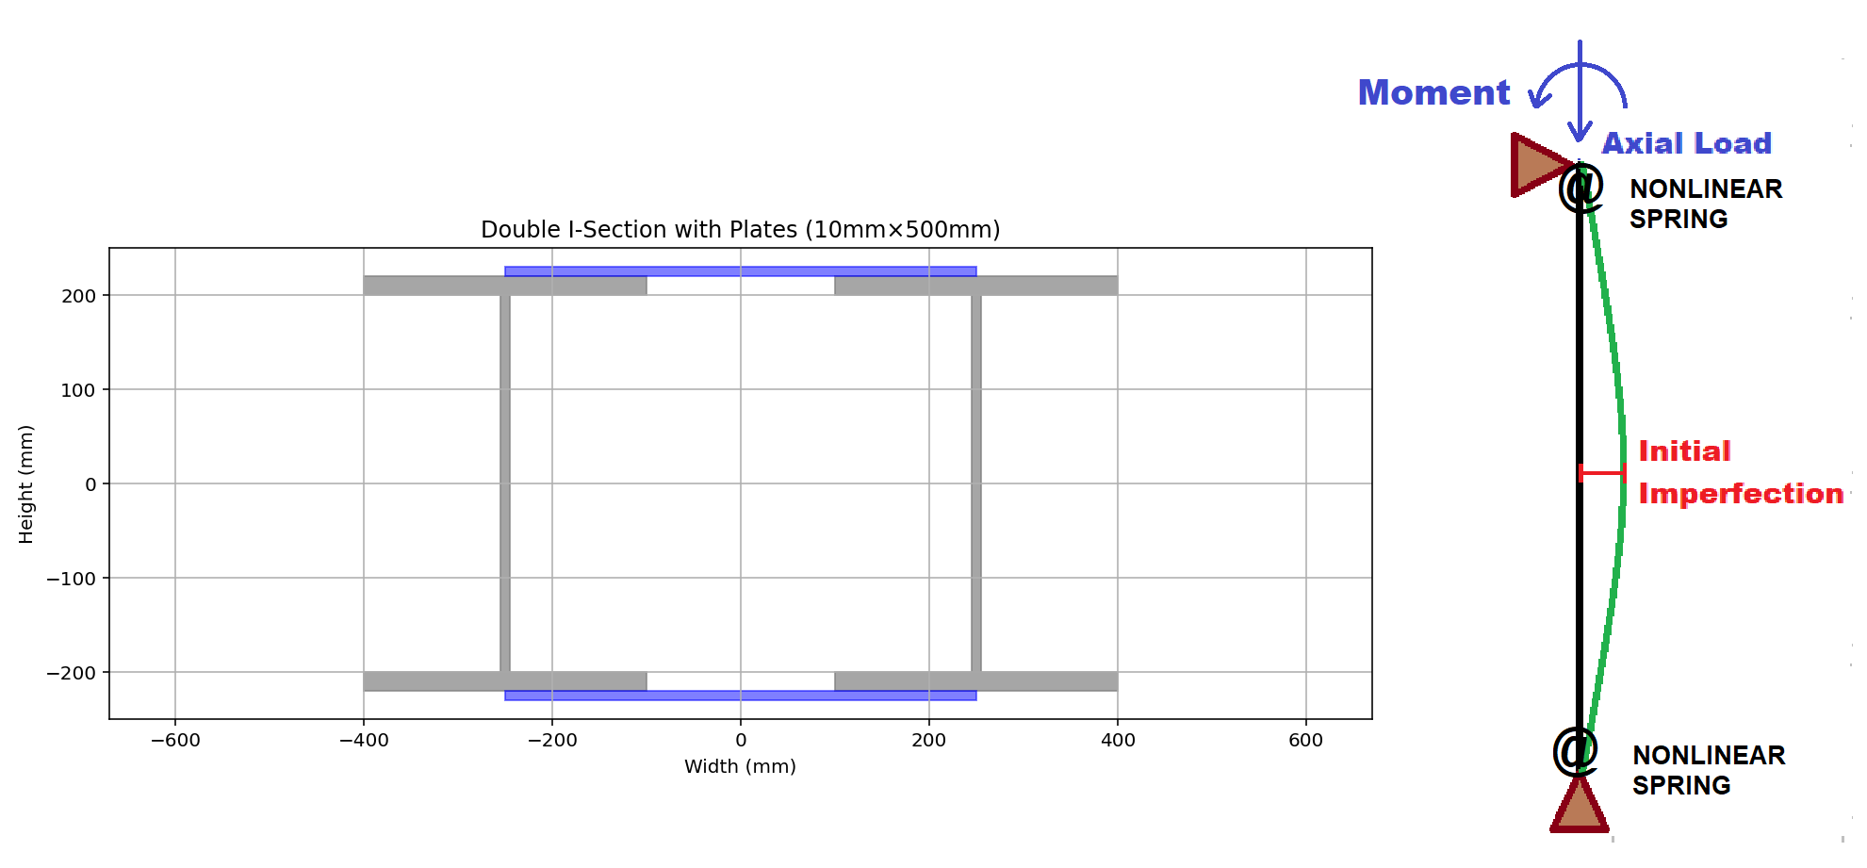
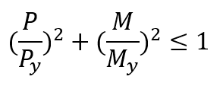

Slide 3
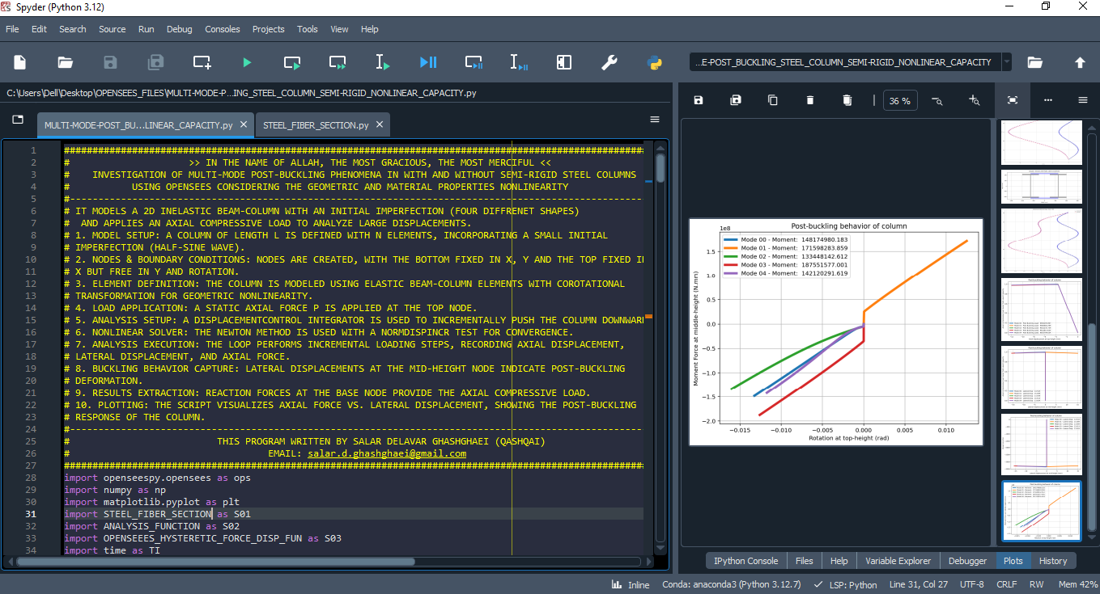

Slide 4
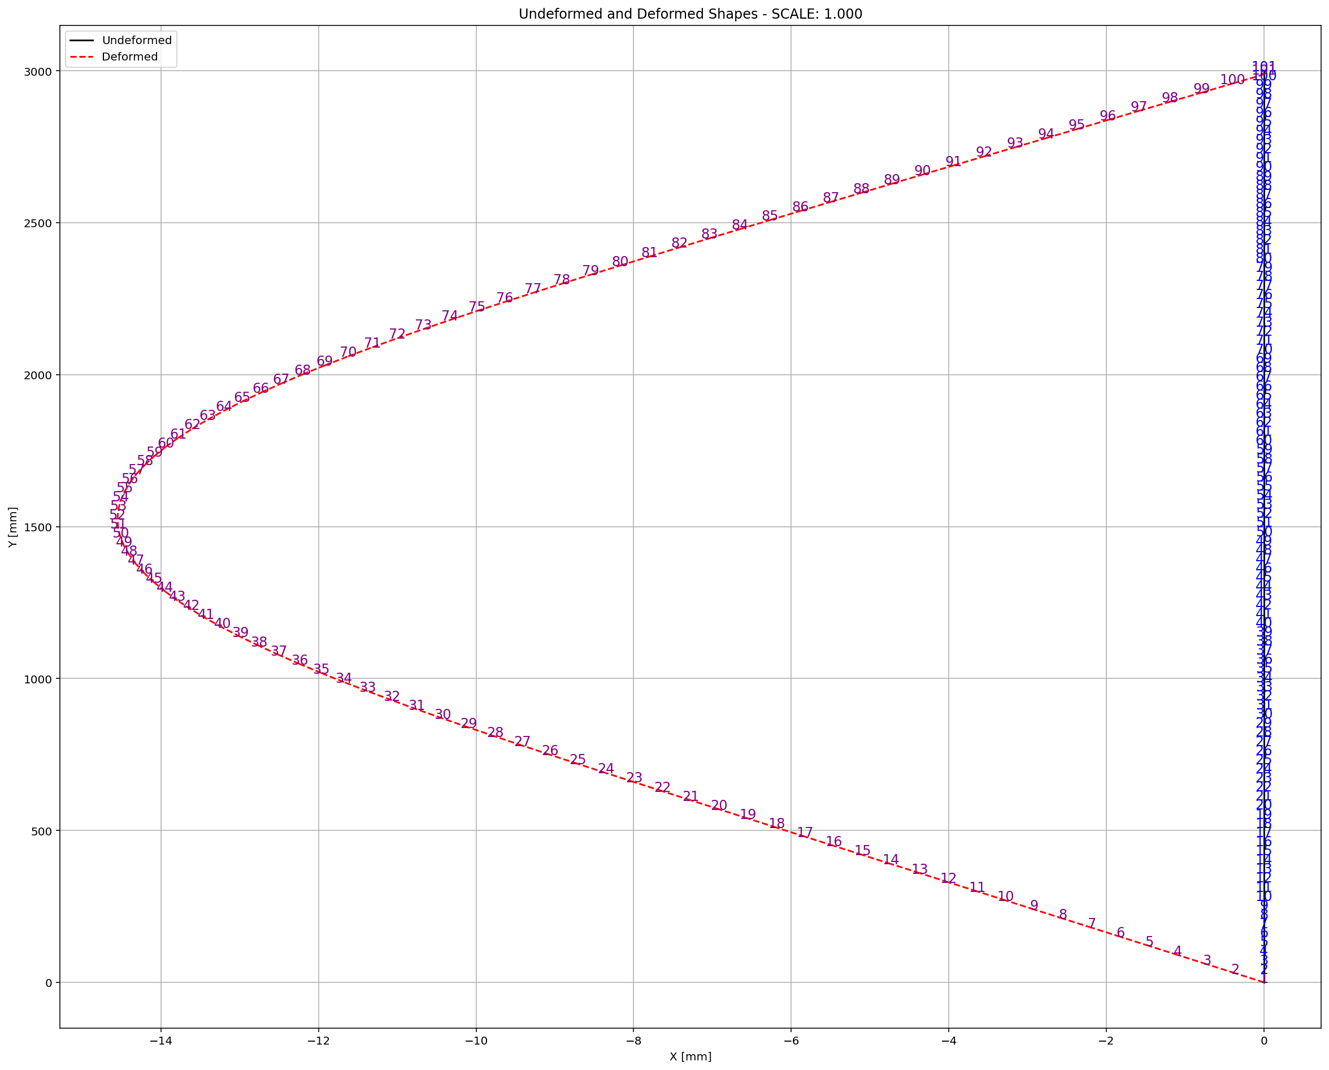

Slide 5
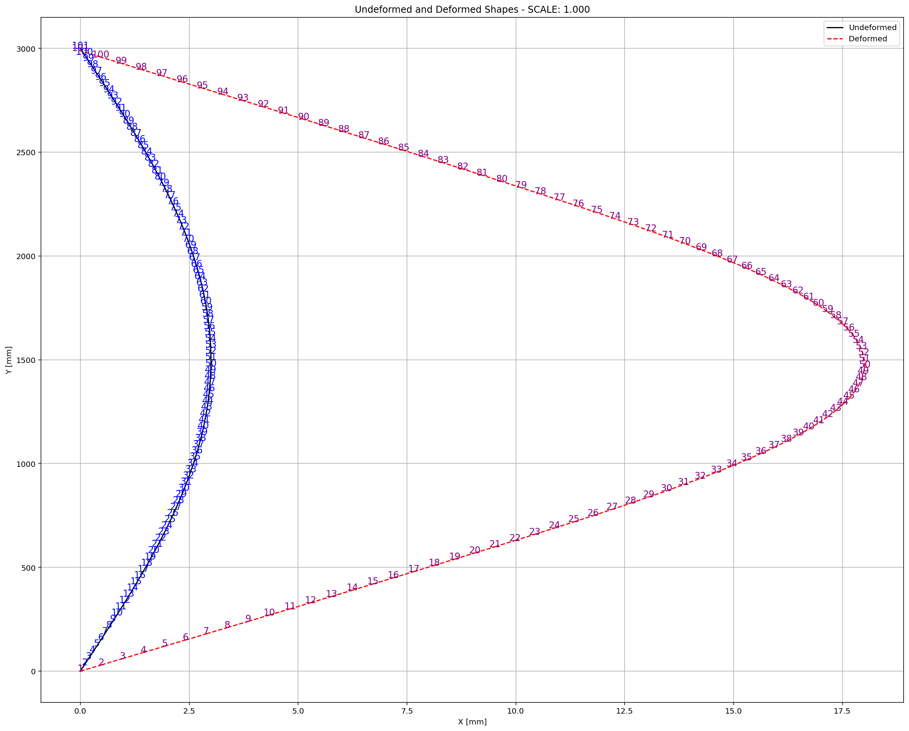

Slide 6
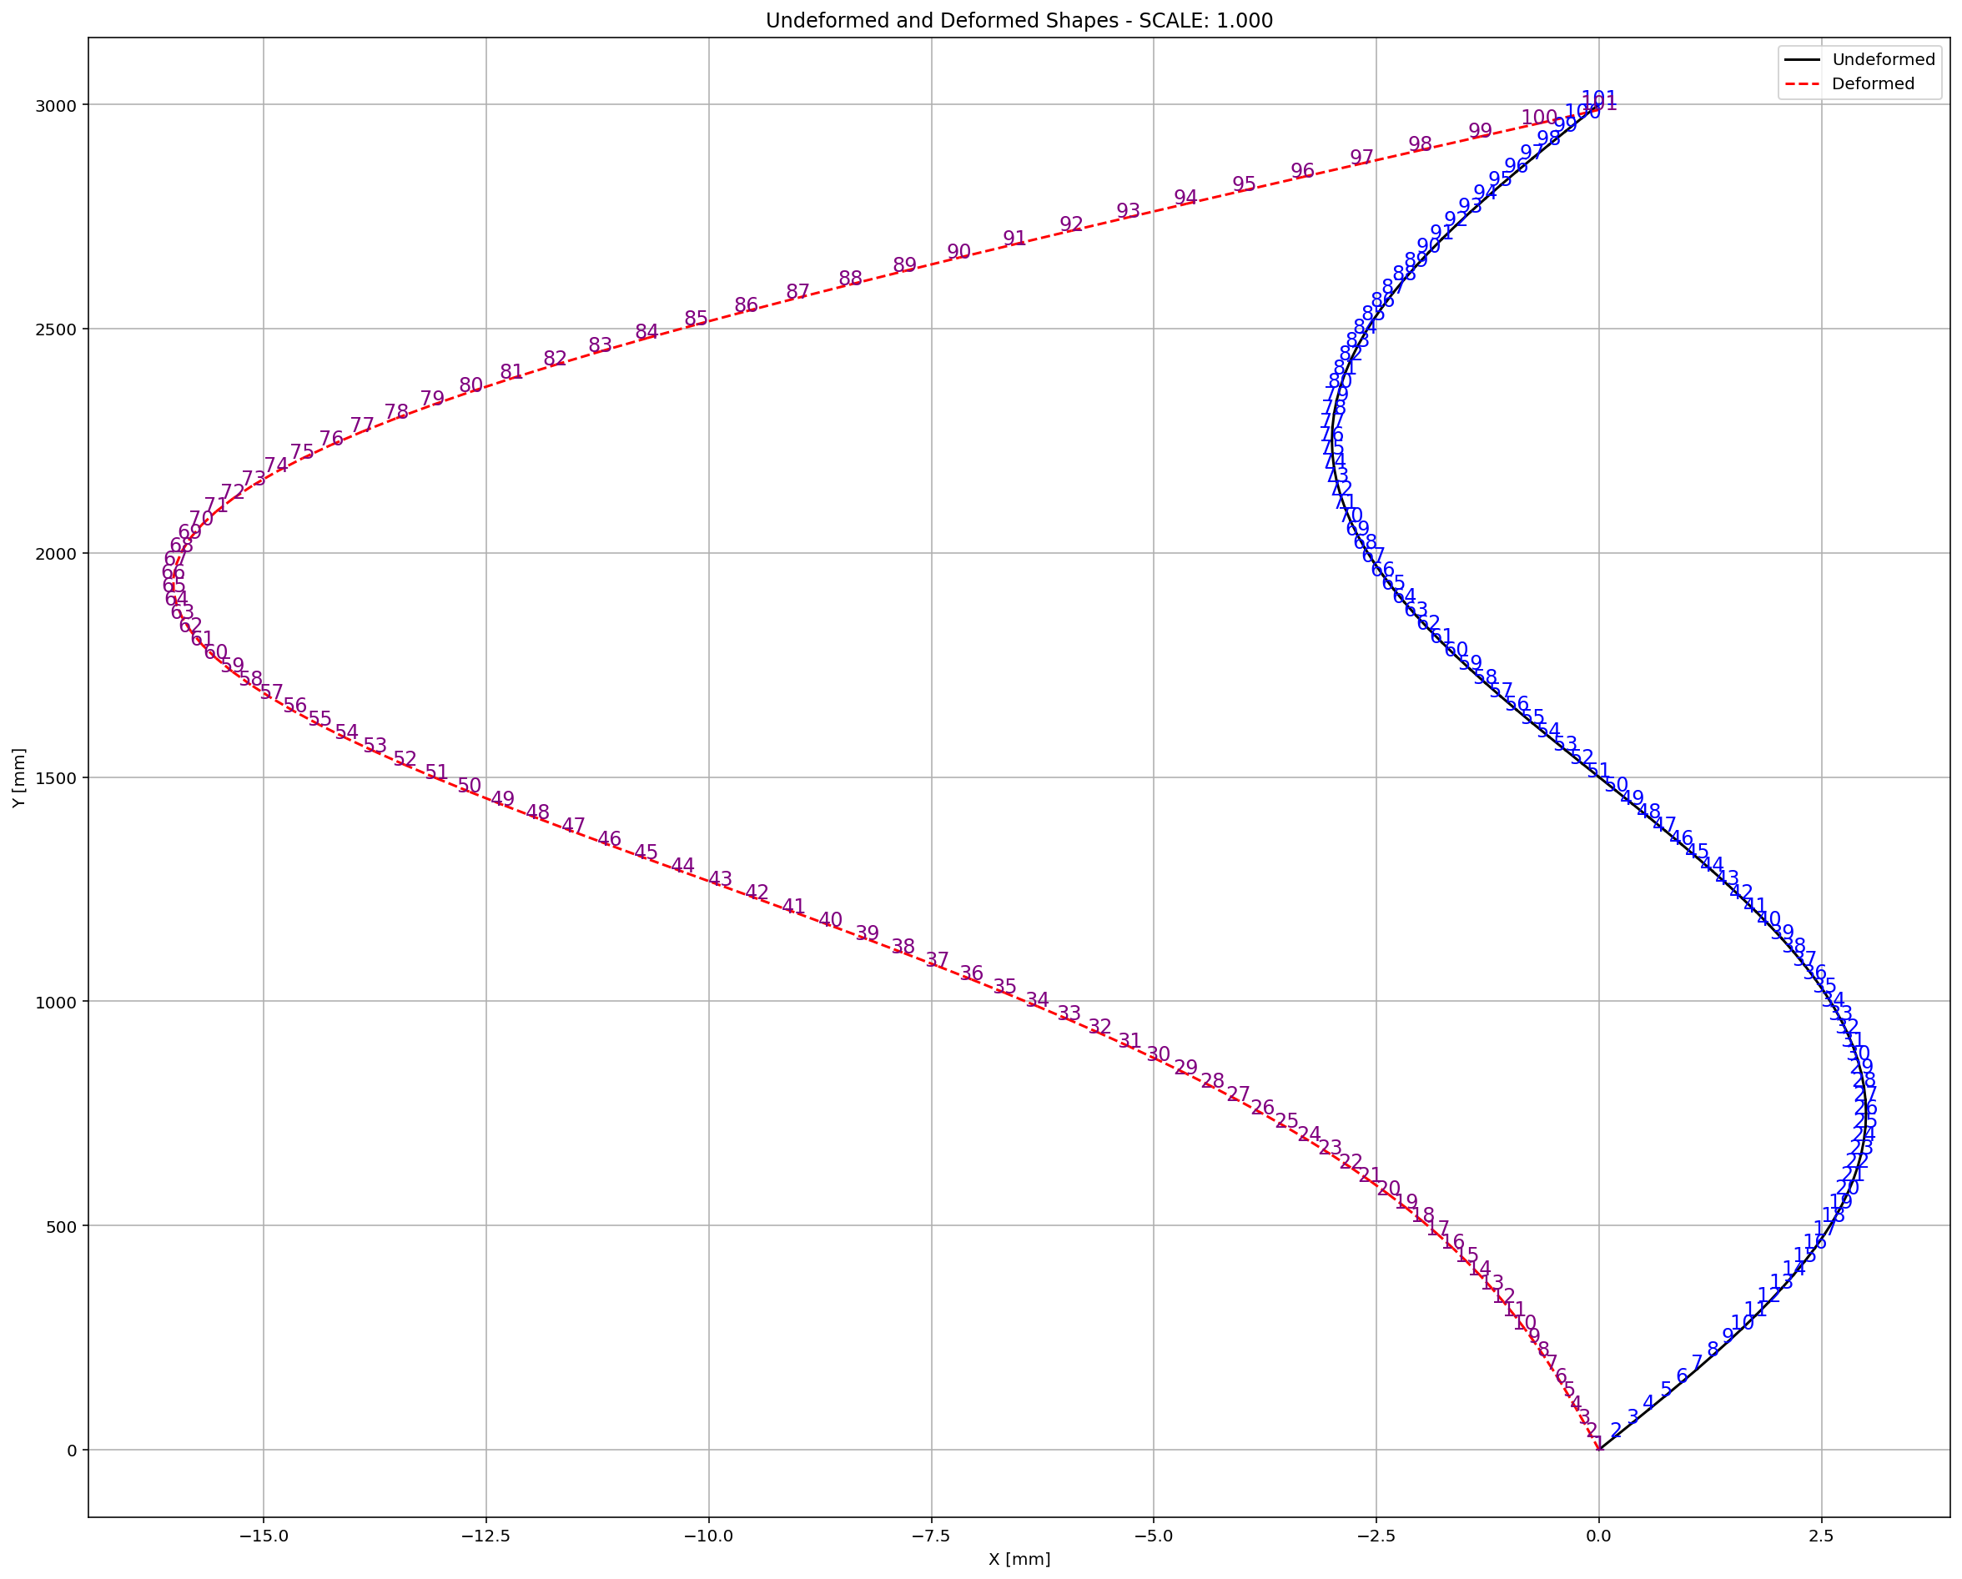

Slide 7
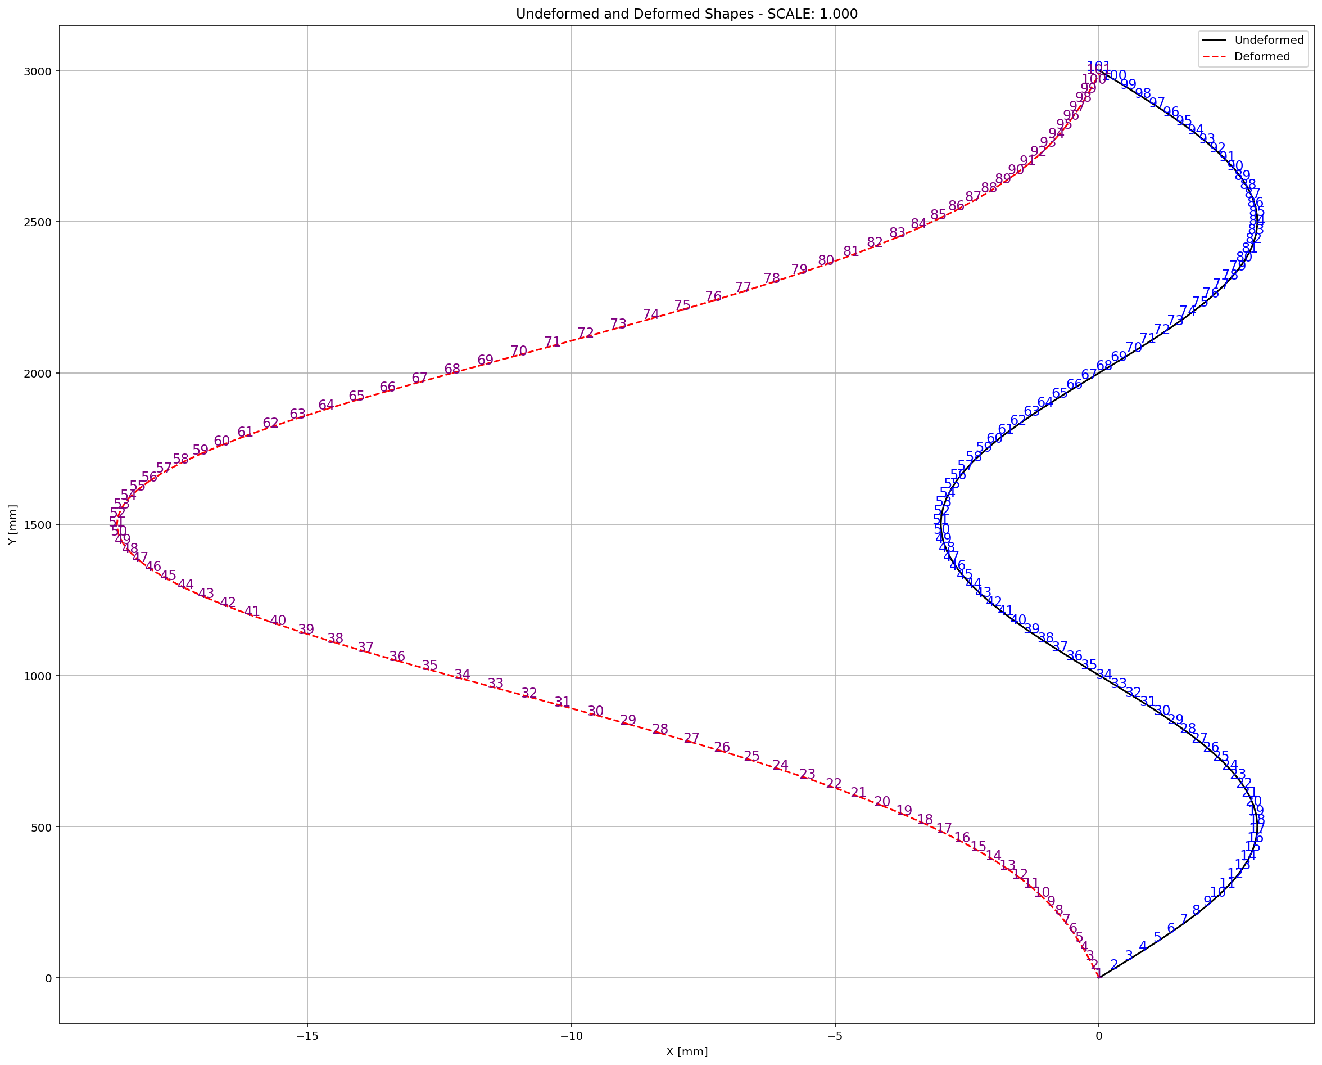

Slide 8
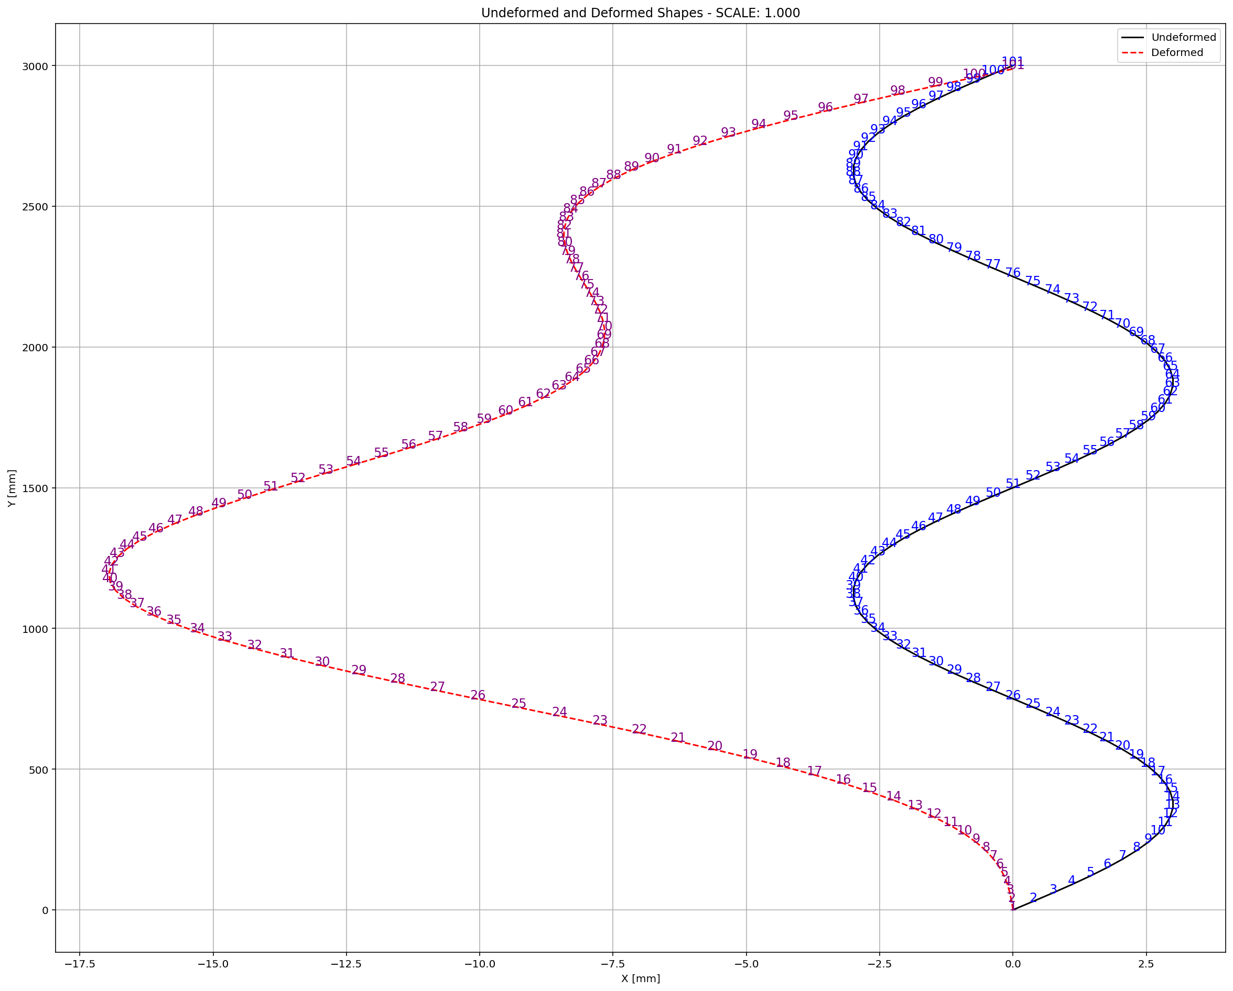

Slide 9
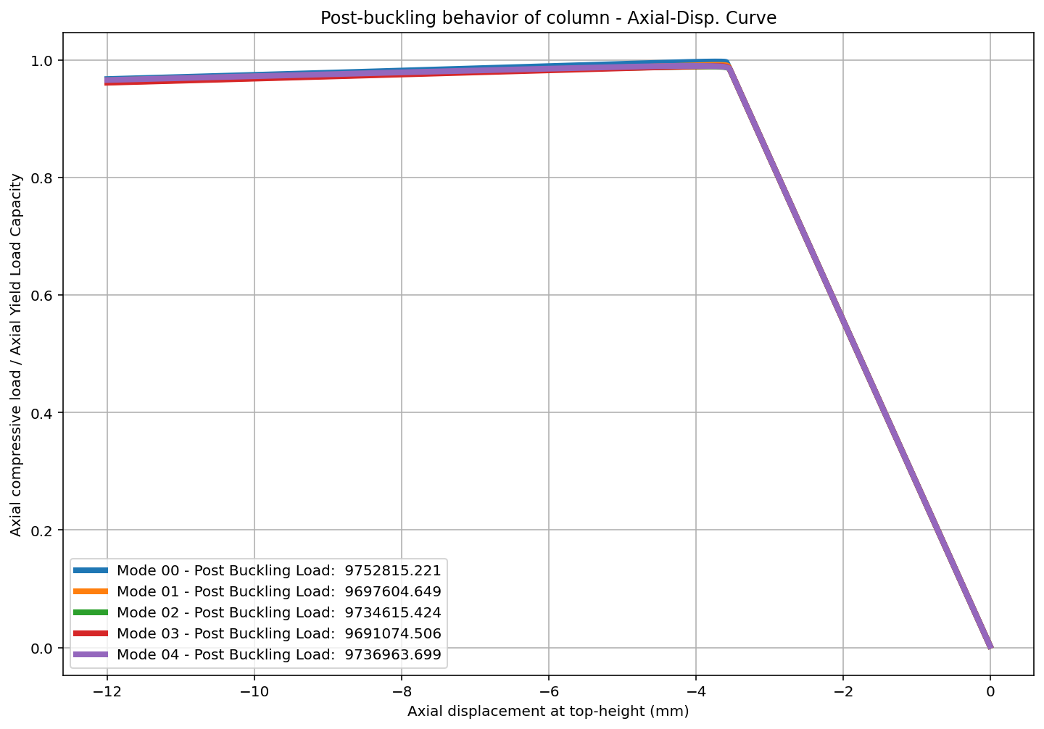

Slide 10
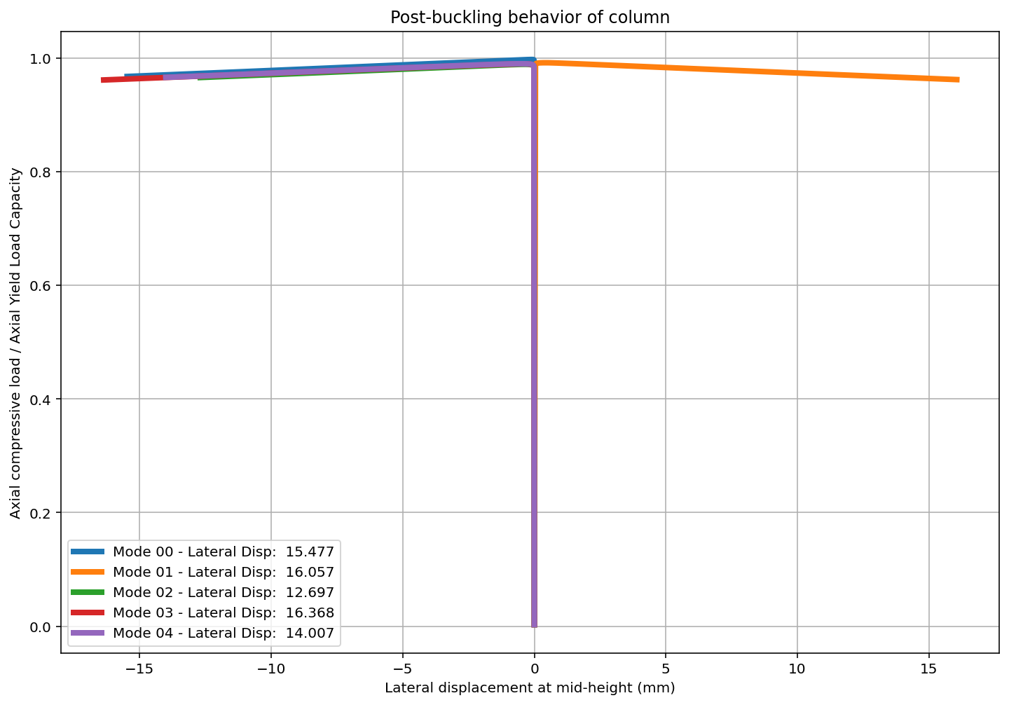

Slide 11
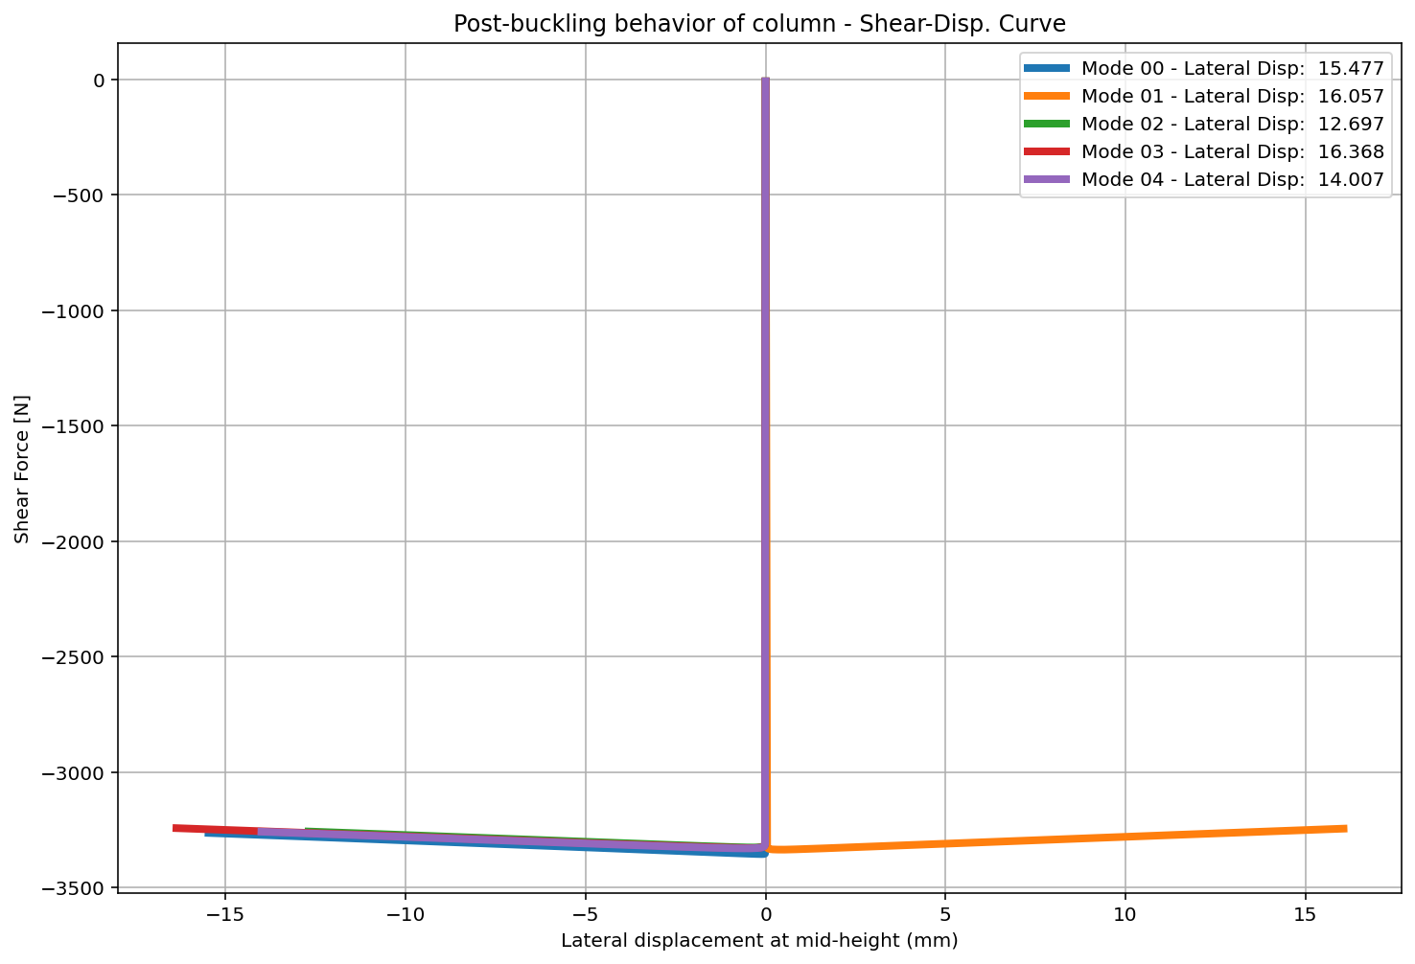

Slide 12
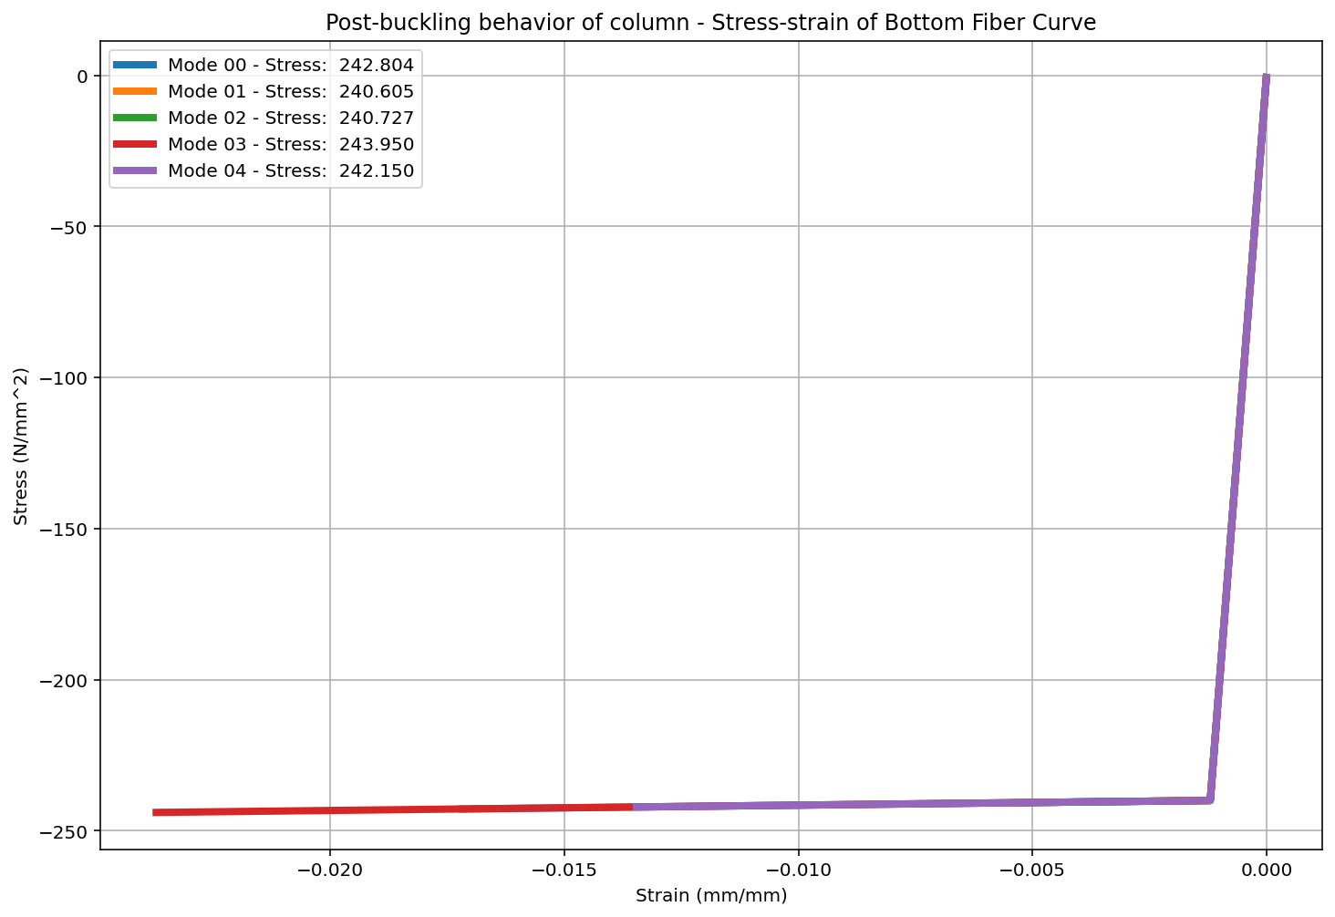

Slide 13
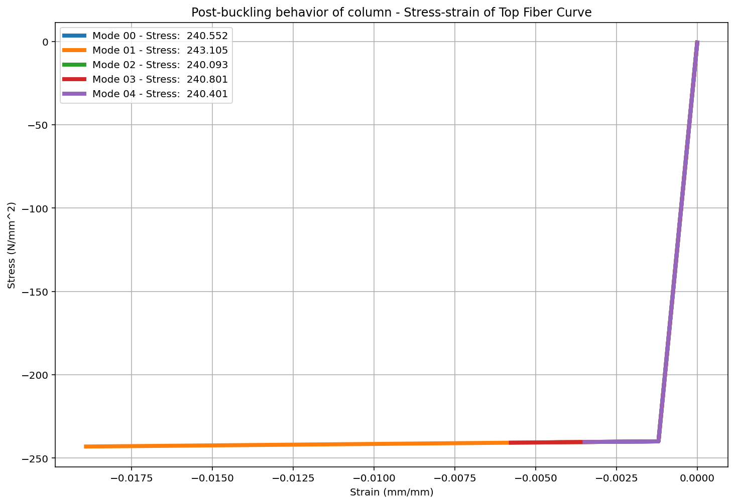

Slide 14
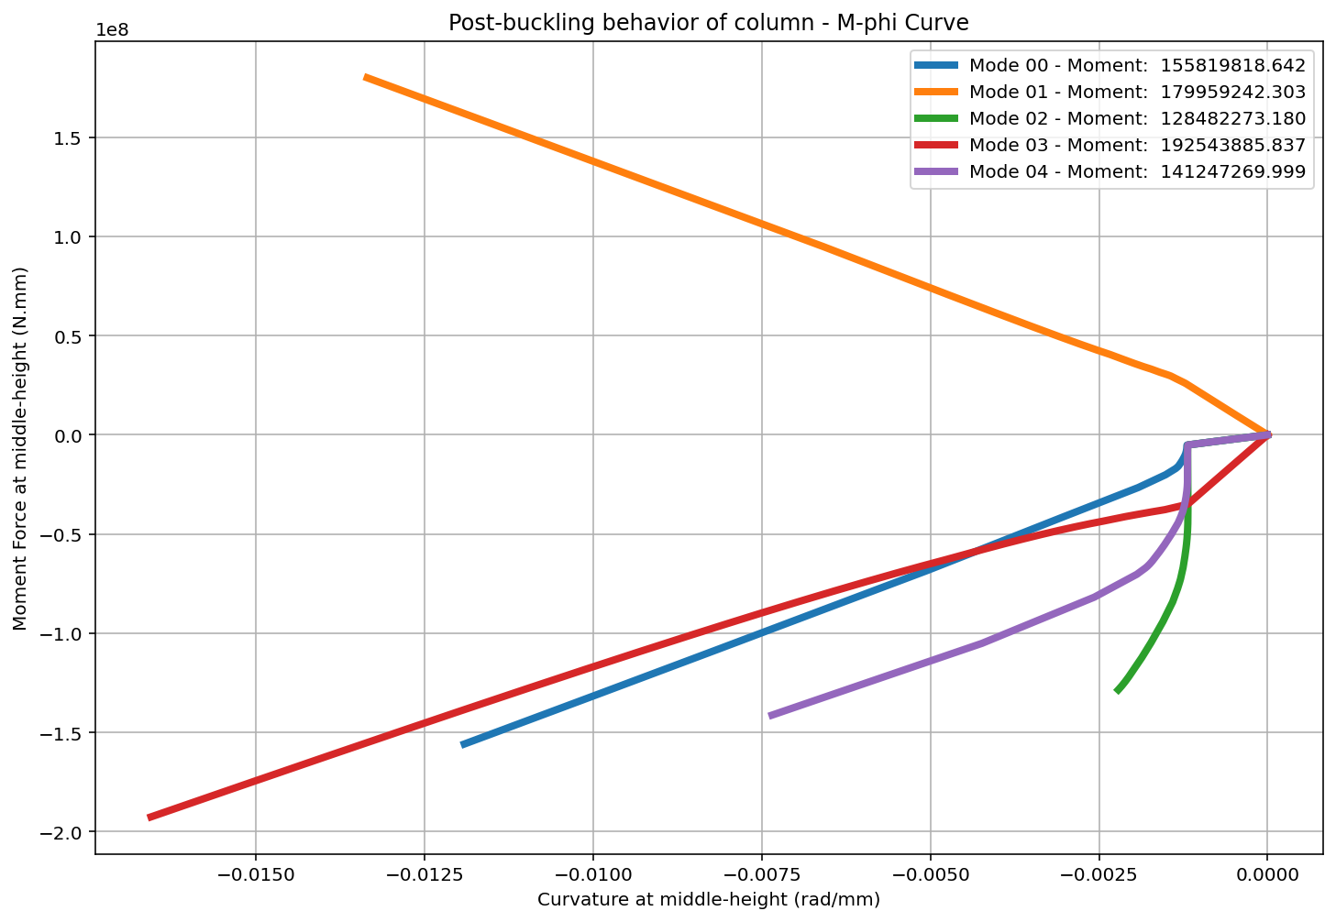

Slide 15
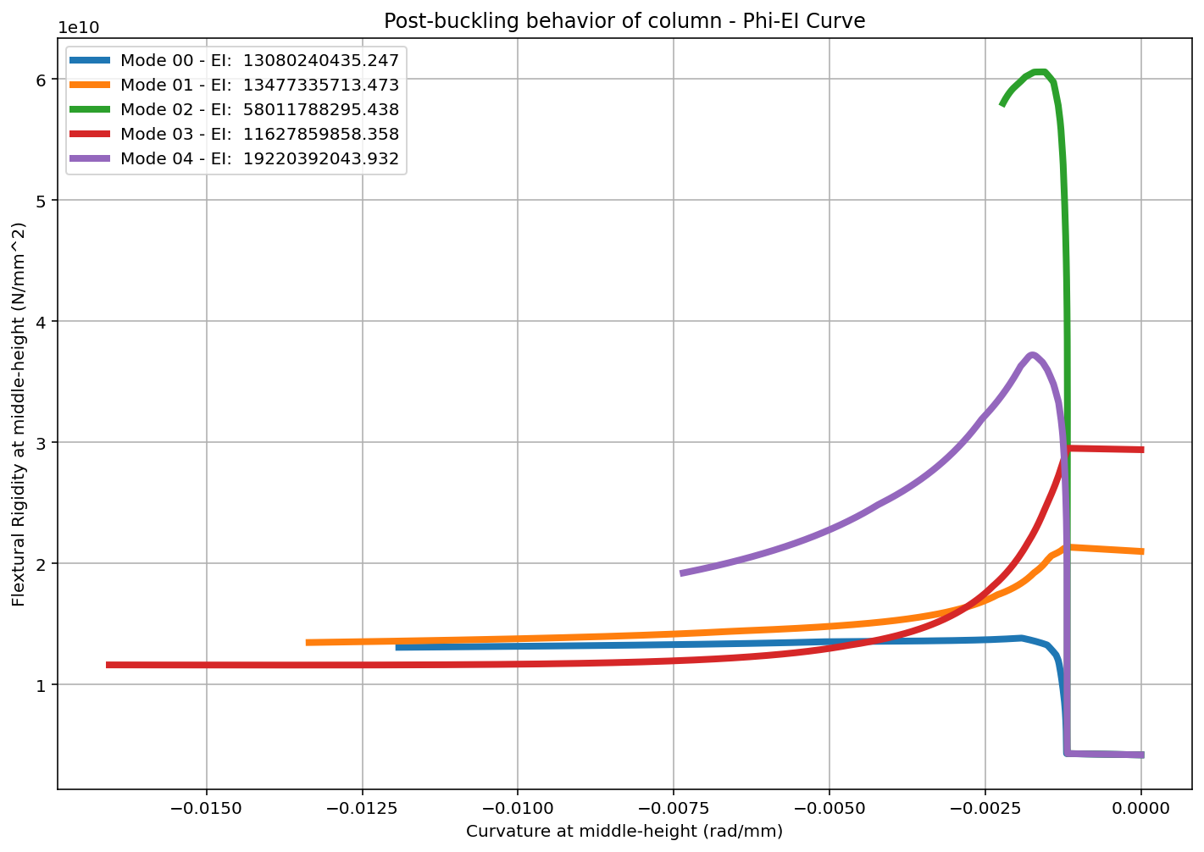

Slide 16
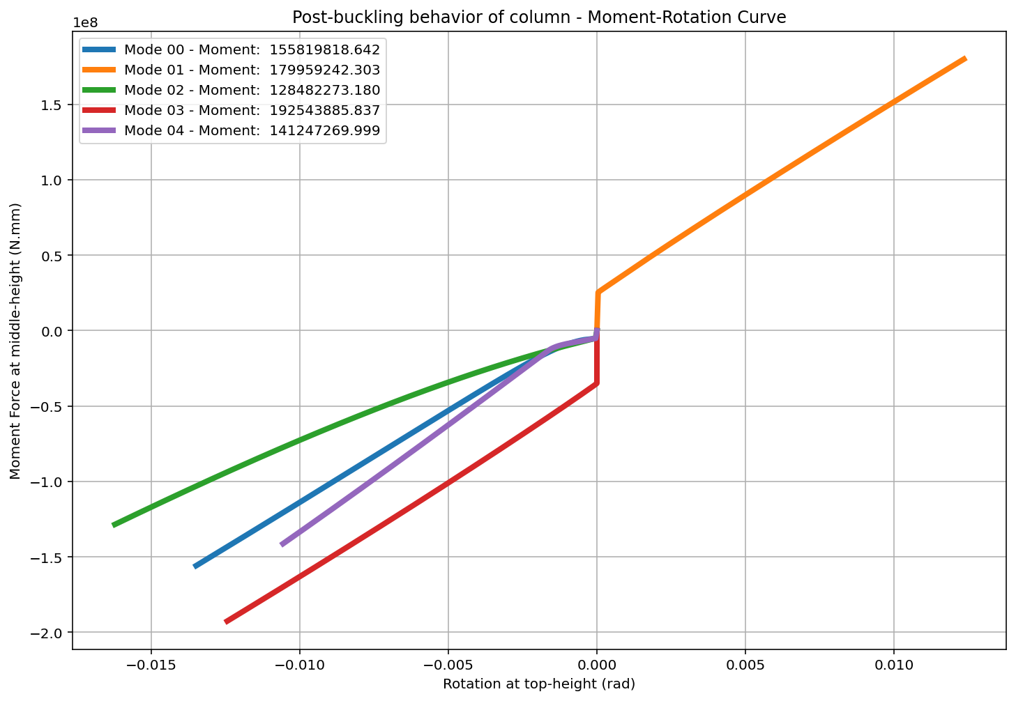

Slide 17
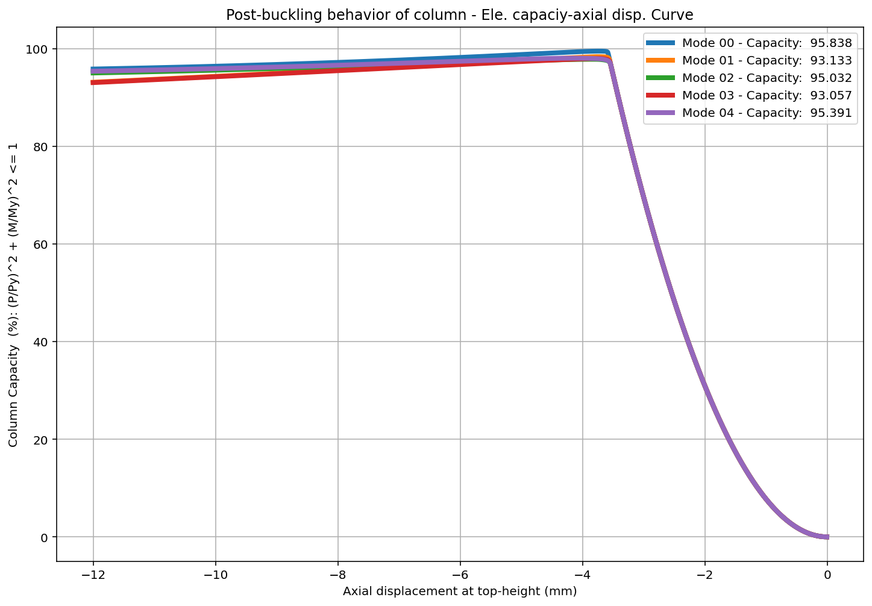

Slide 18
