Slide 1
IN THE NAME OF ALLAH
SOIL-FOUNDATION-STRUCTURE INTERACTION USING OPENSEES
SOIL-FOUNDATION INTERACTIONS SIMULATED WITH SIMPLE SPRINGS.
SOIL SPRINGS VALUES ARE NOT EXACT.
WRITTEN BY SALAR DELAVAR GHASHGHAEI (QASHQAI)

Slide 2
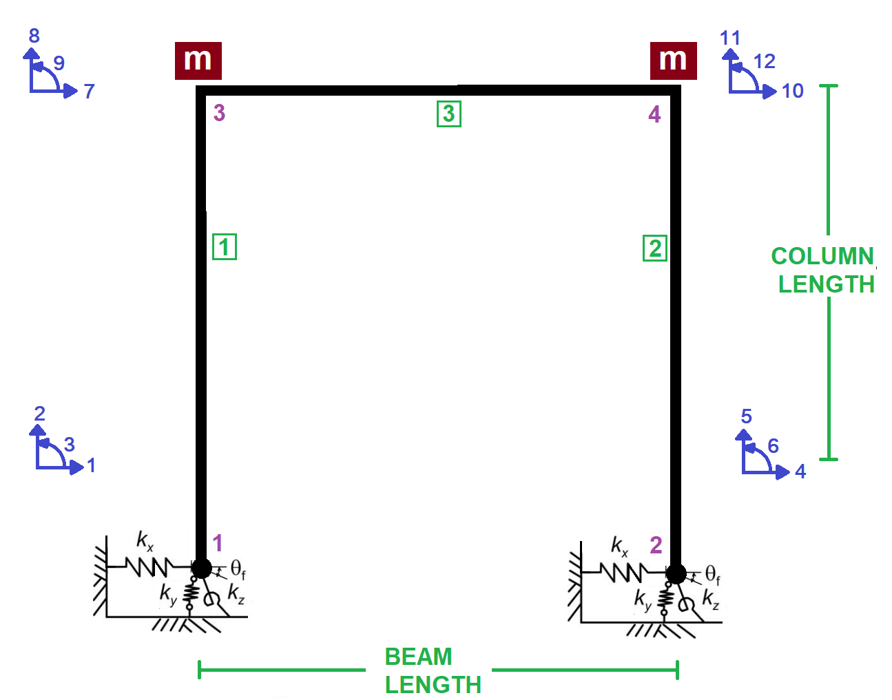

Slide 3
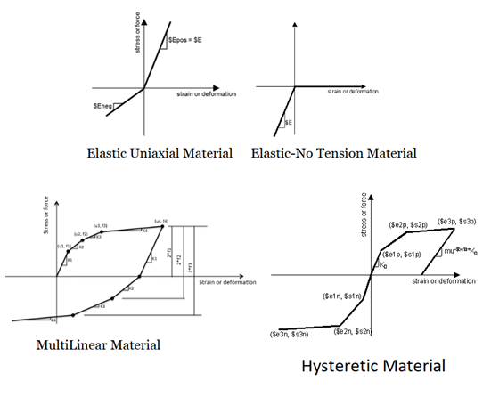

Slide 4
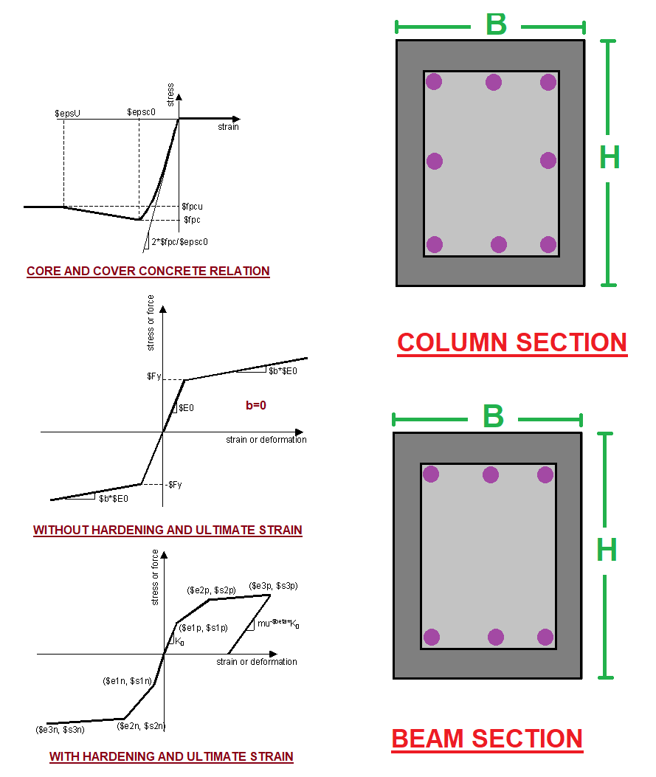

Slide 5
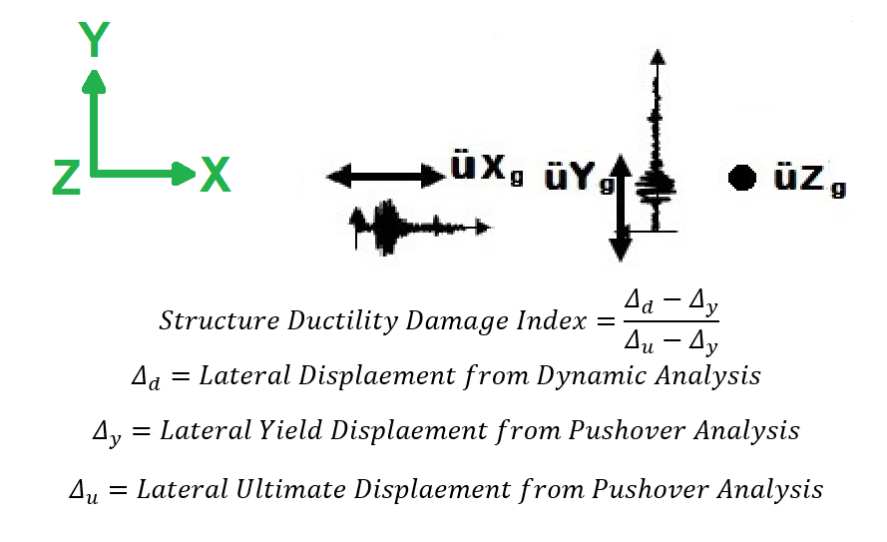

Slide 6
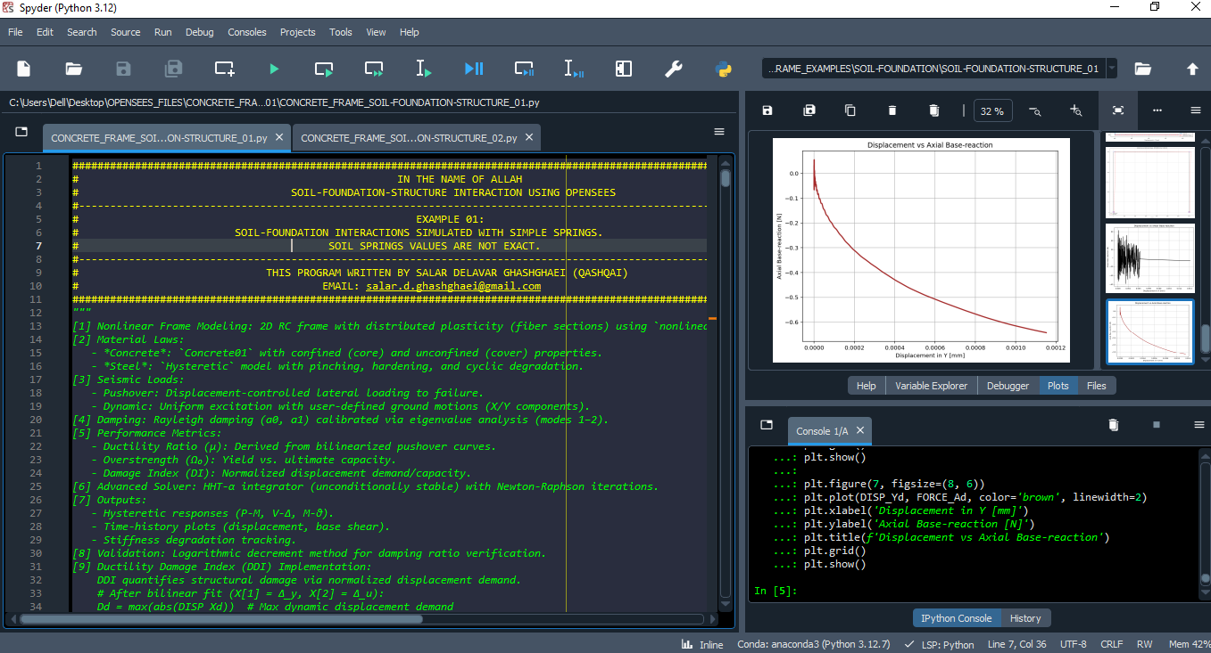

Slide 7
NONLINEAR STATIC ANALYSIS
(PUSHOVER)

Slide 8
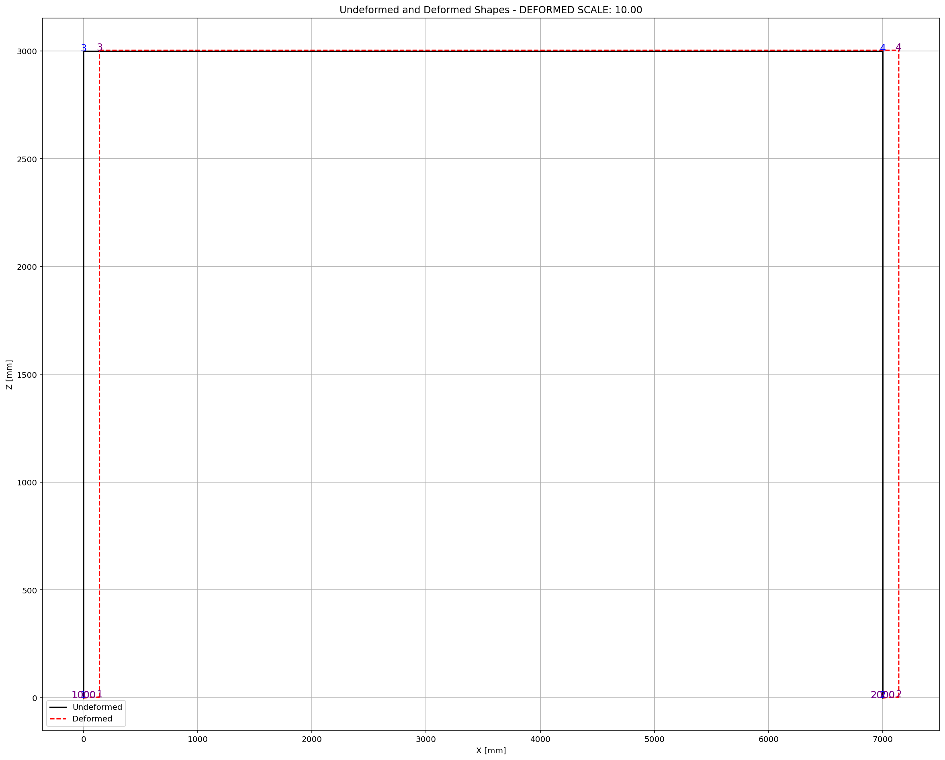

Slide 9
NONLINEAR DYNAMIC ANALYSIS

Slide 10
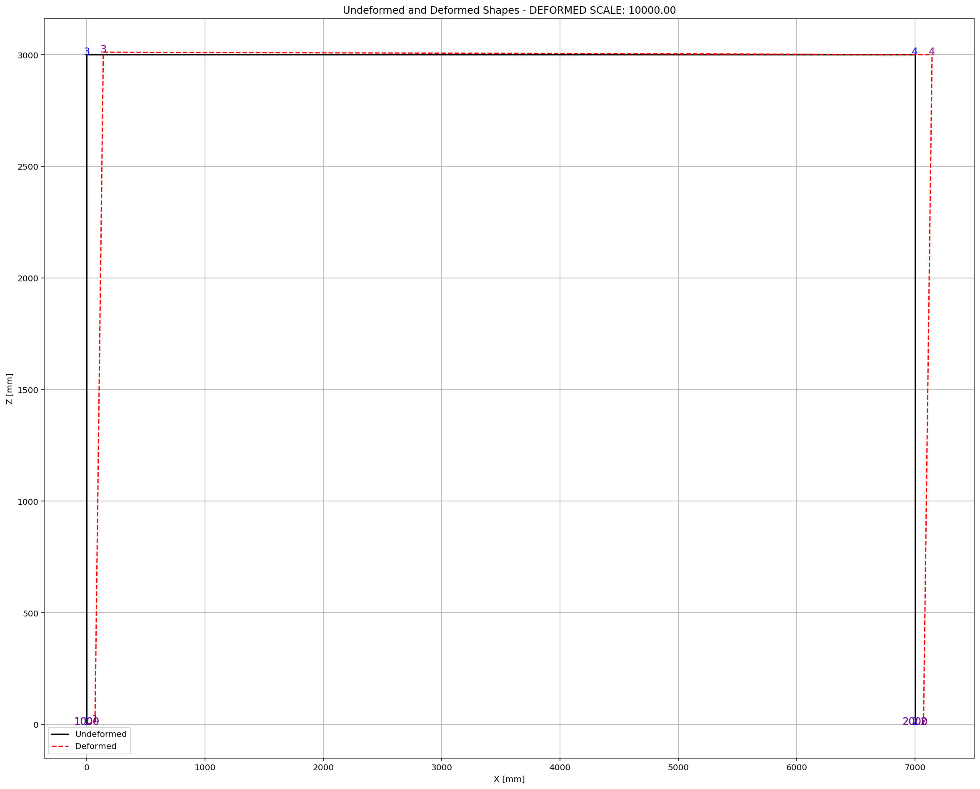

Slide 11
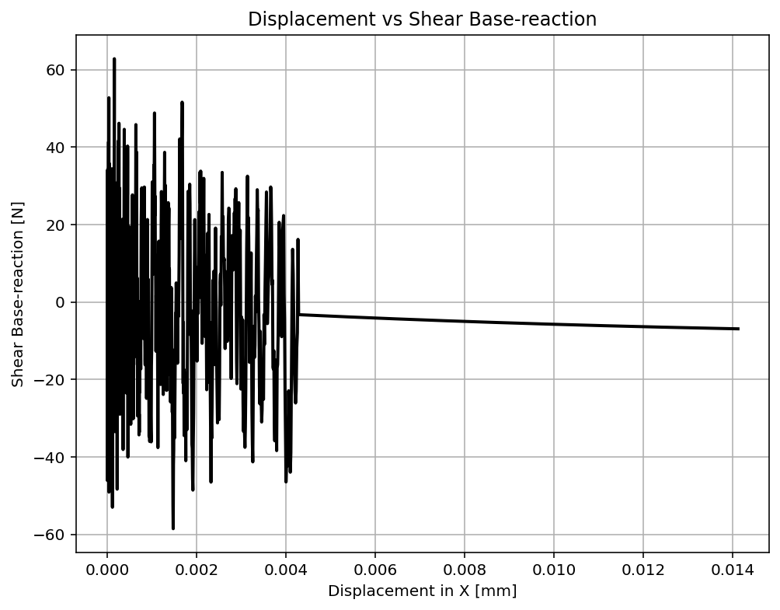

Slide 12
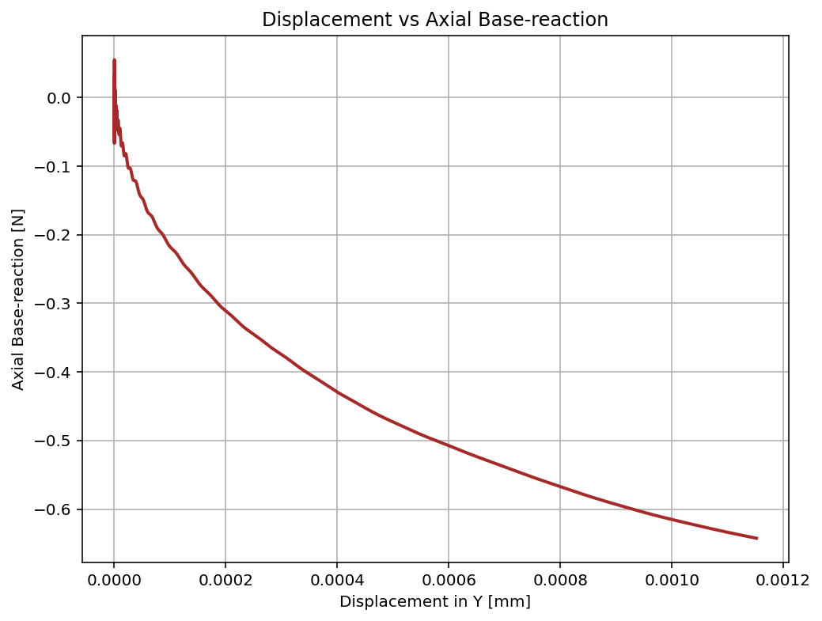

Slide 13
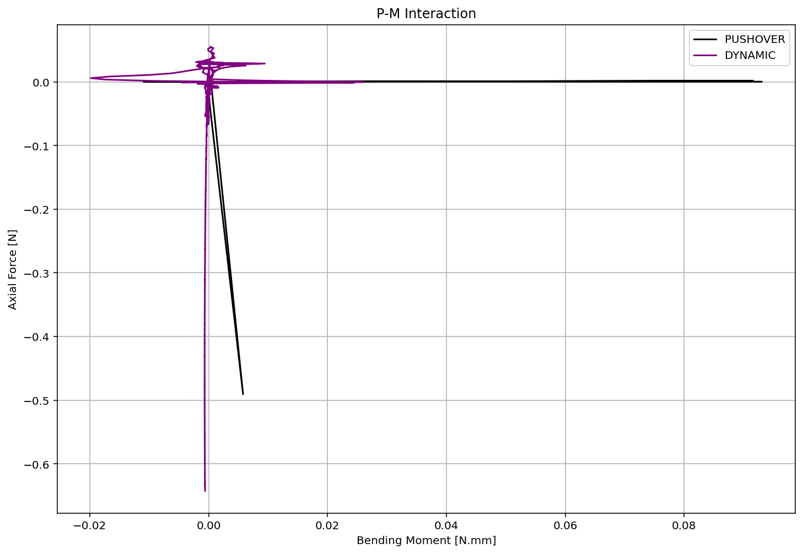

Slide 14
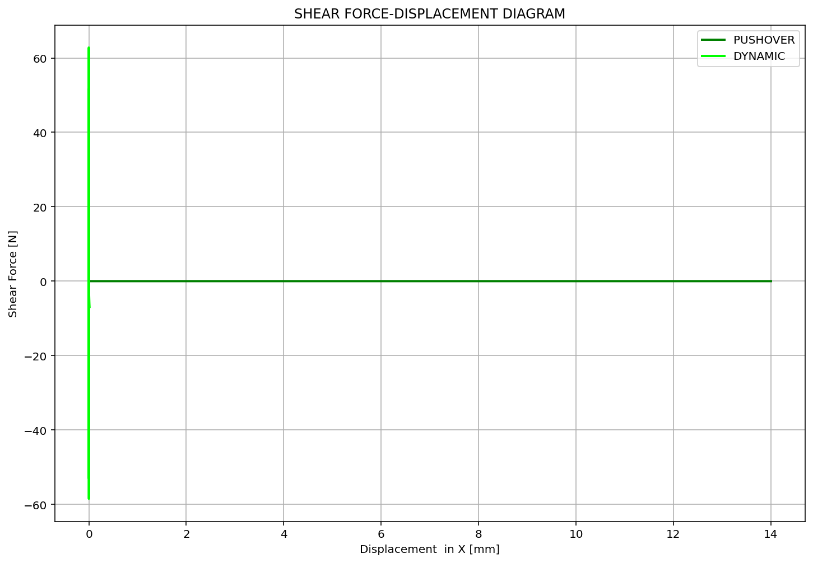

Slide 15
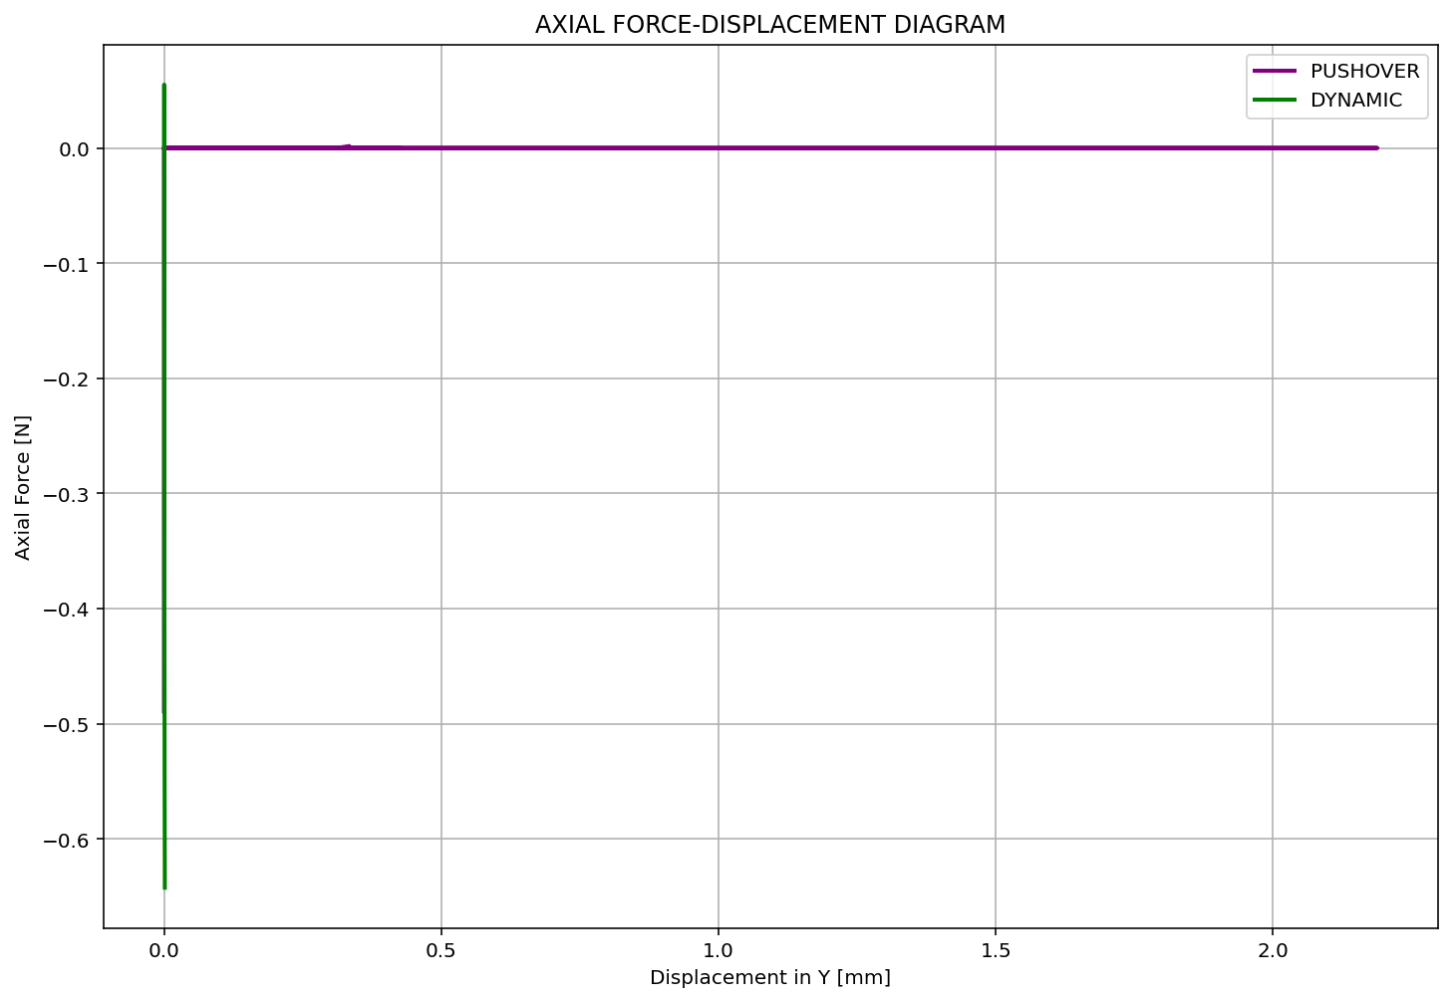

Slide 16
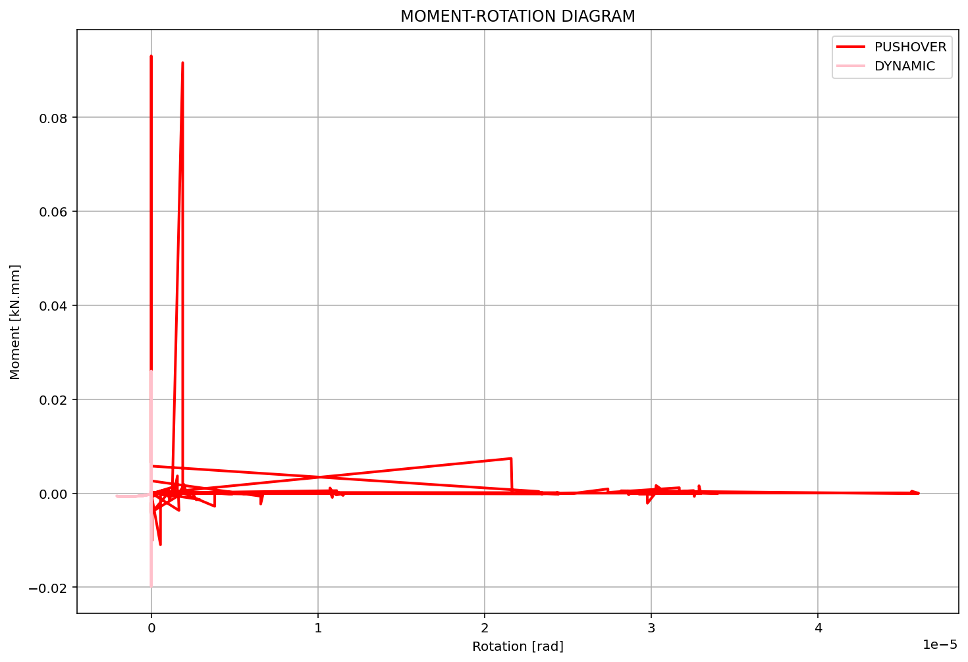

Slide 17
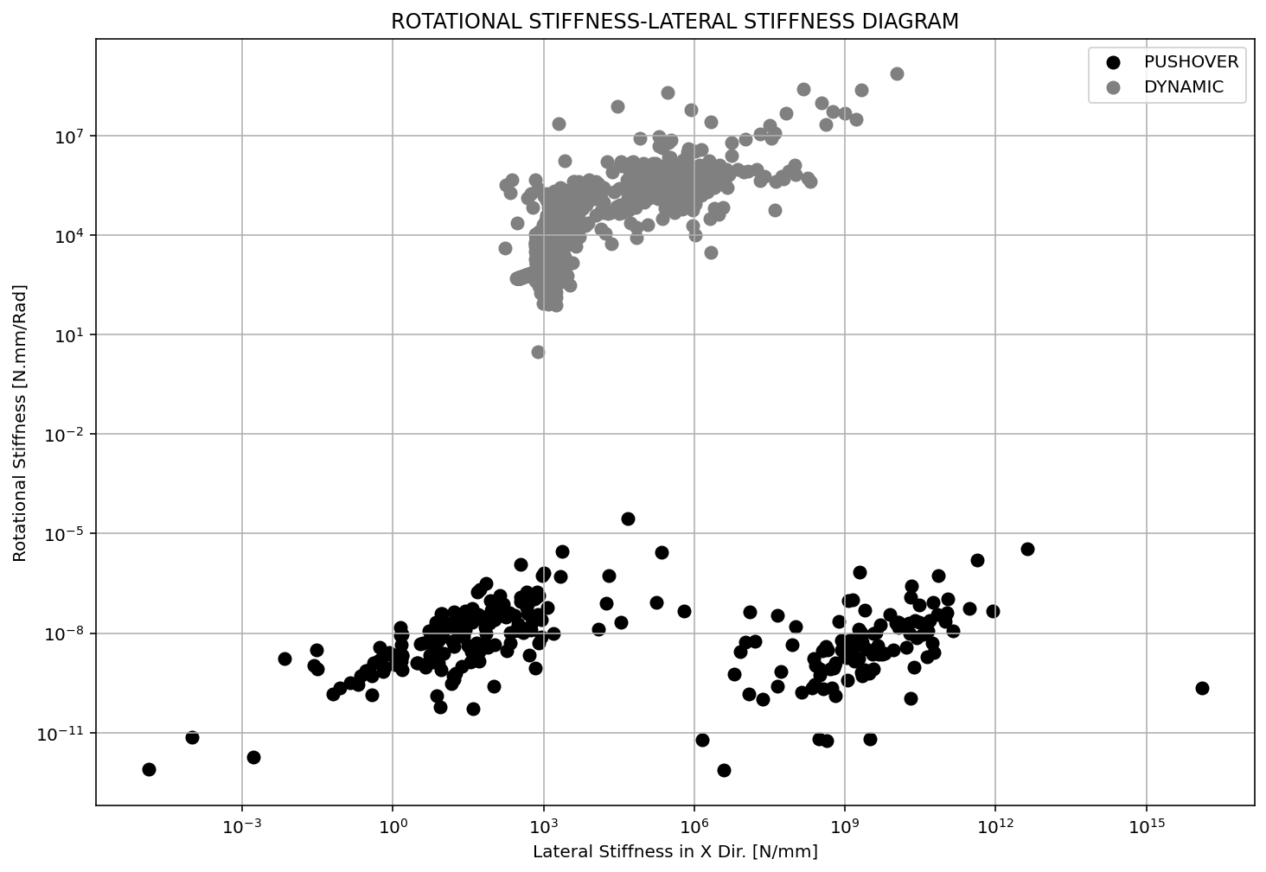

Slide 18
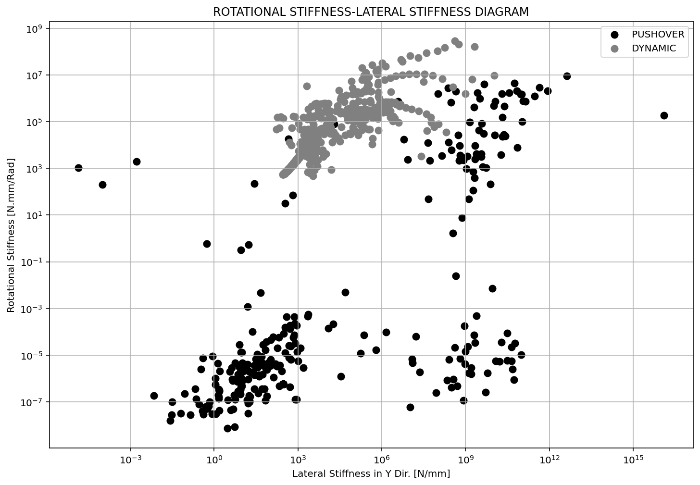

Slide 19
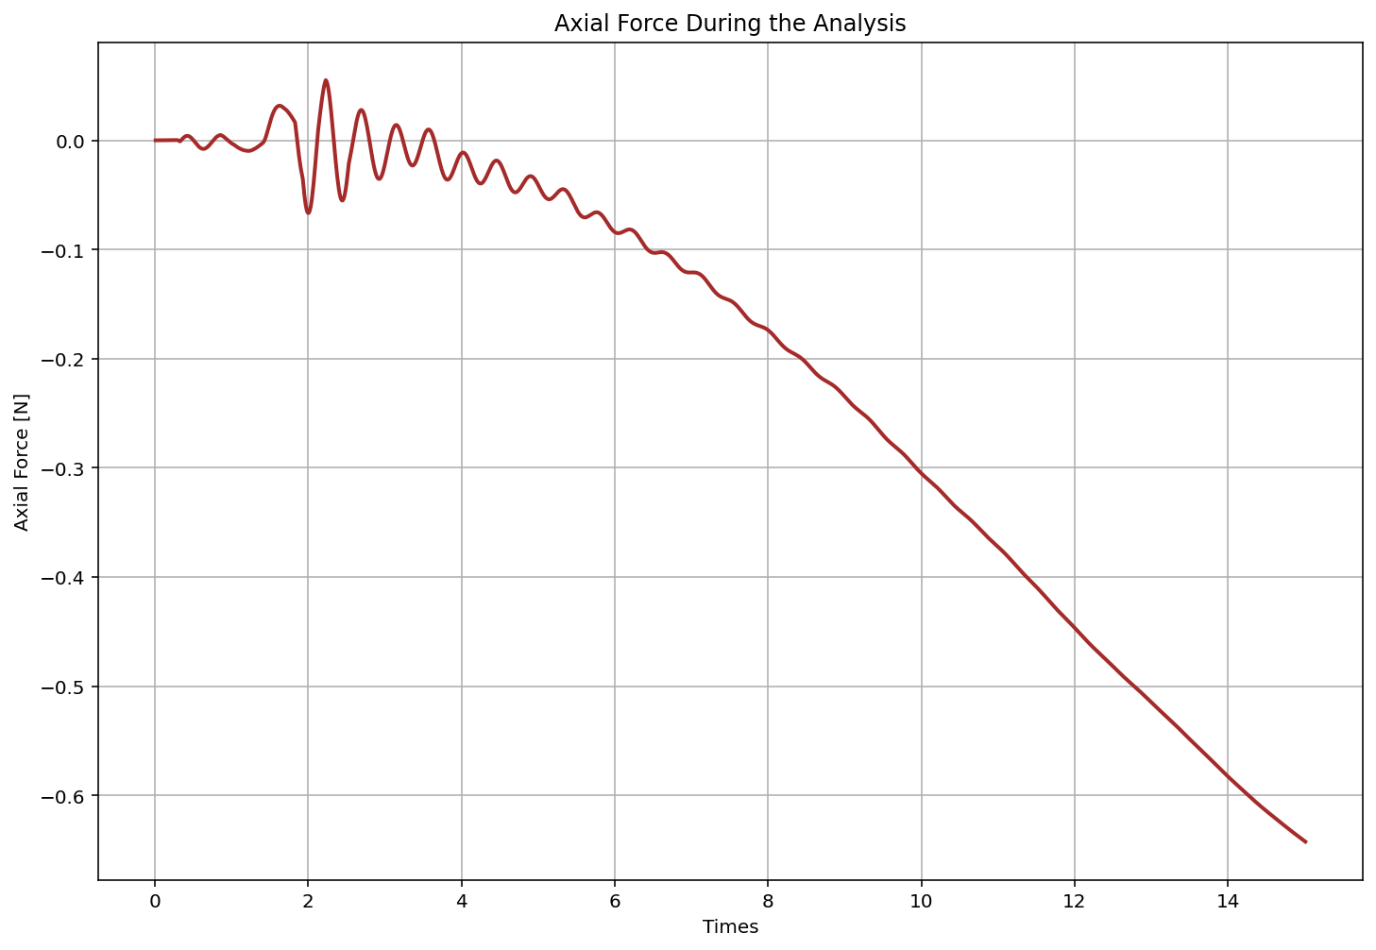

Slide 20
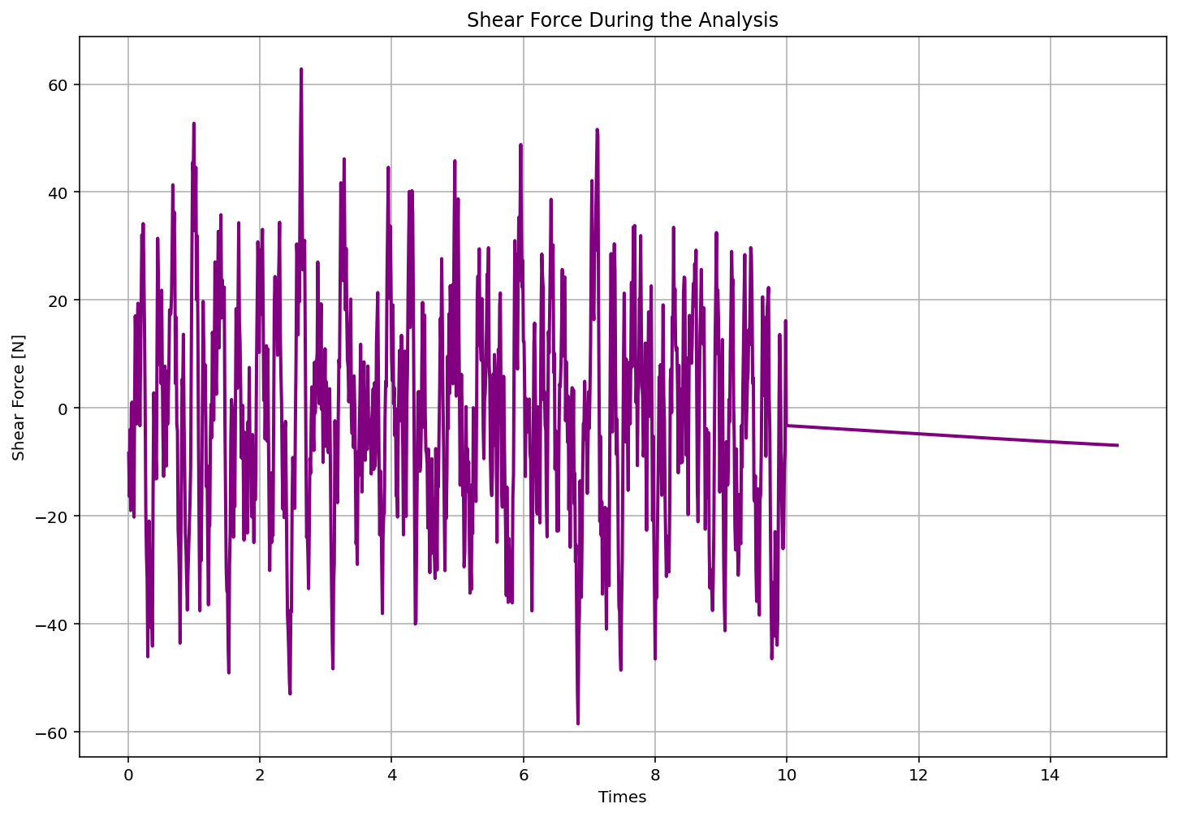

Slide 21
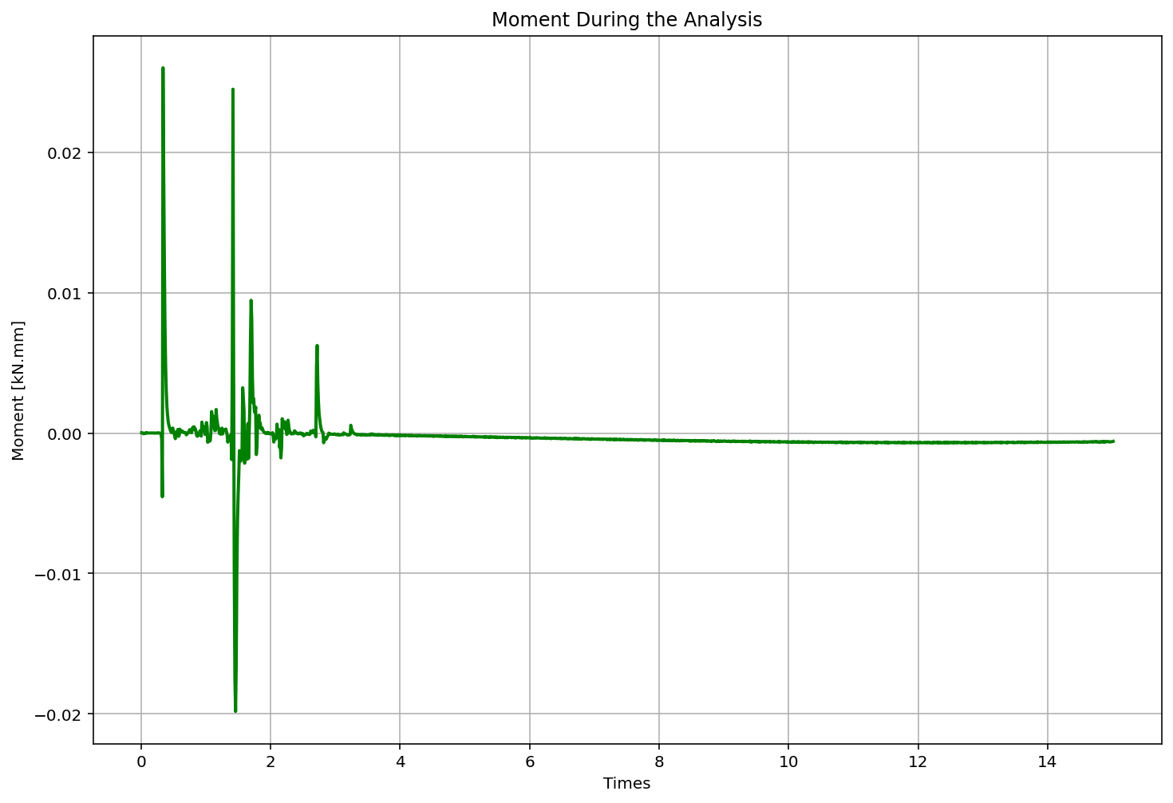

Slide 22
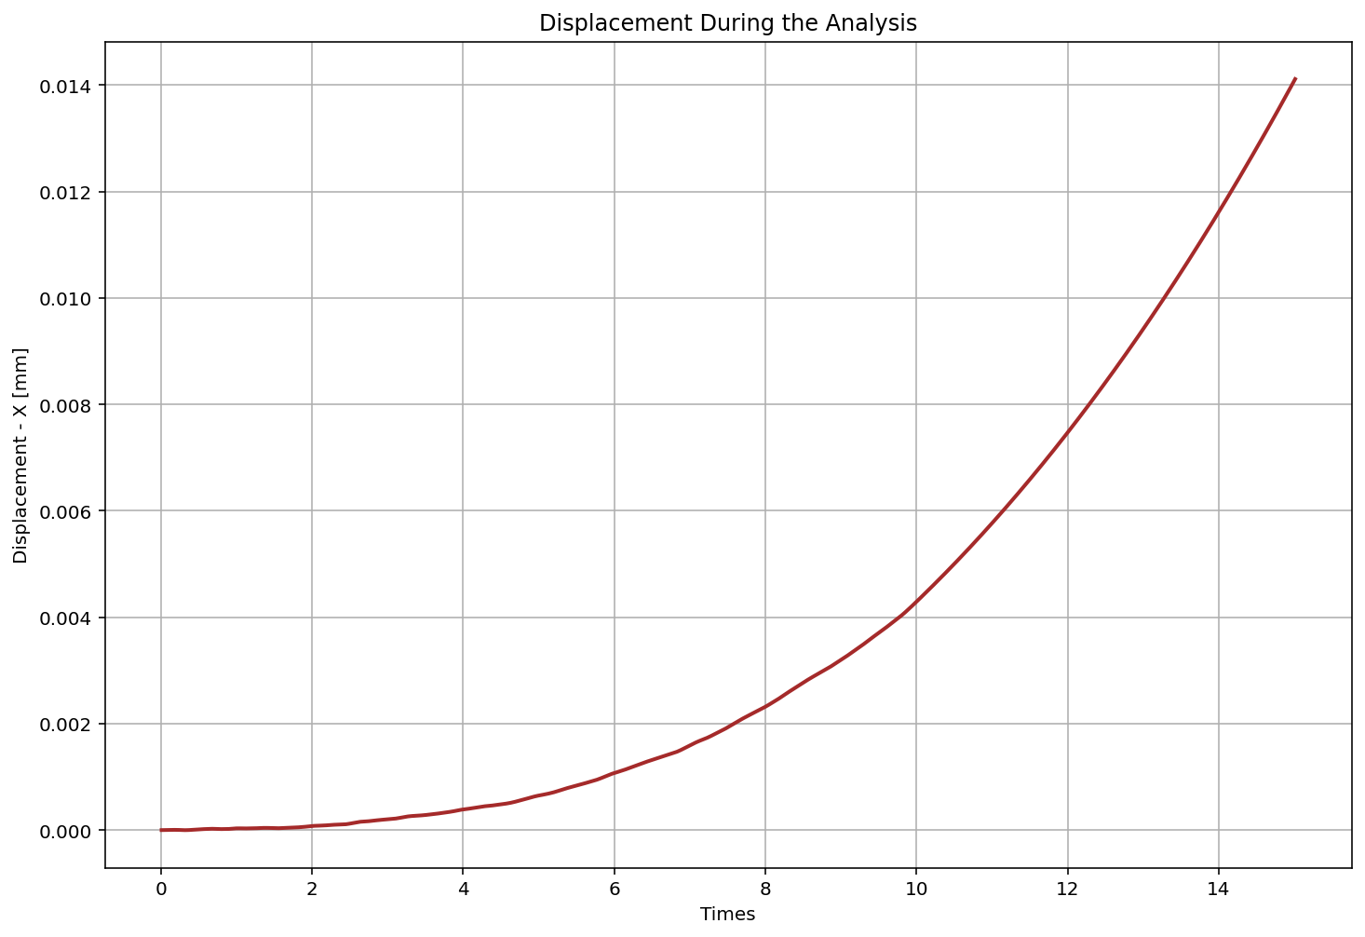

Slide 23
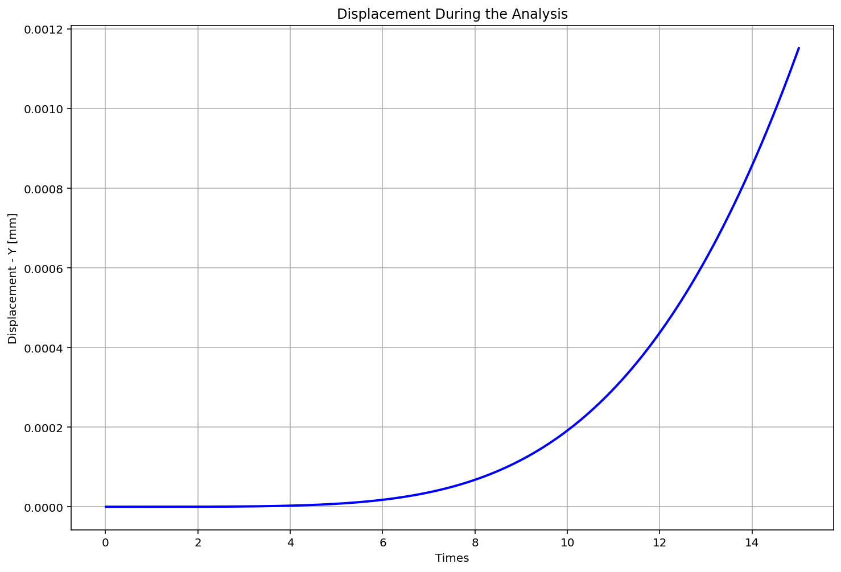

Slide 24
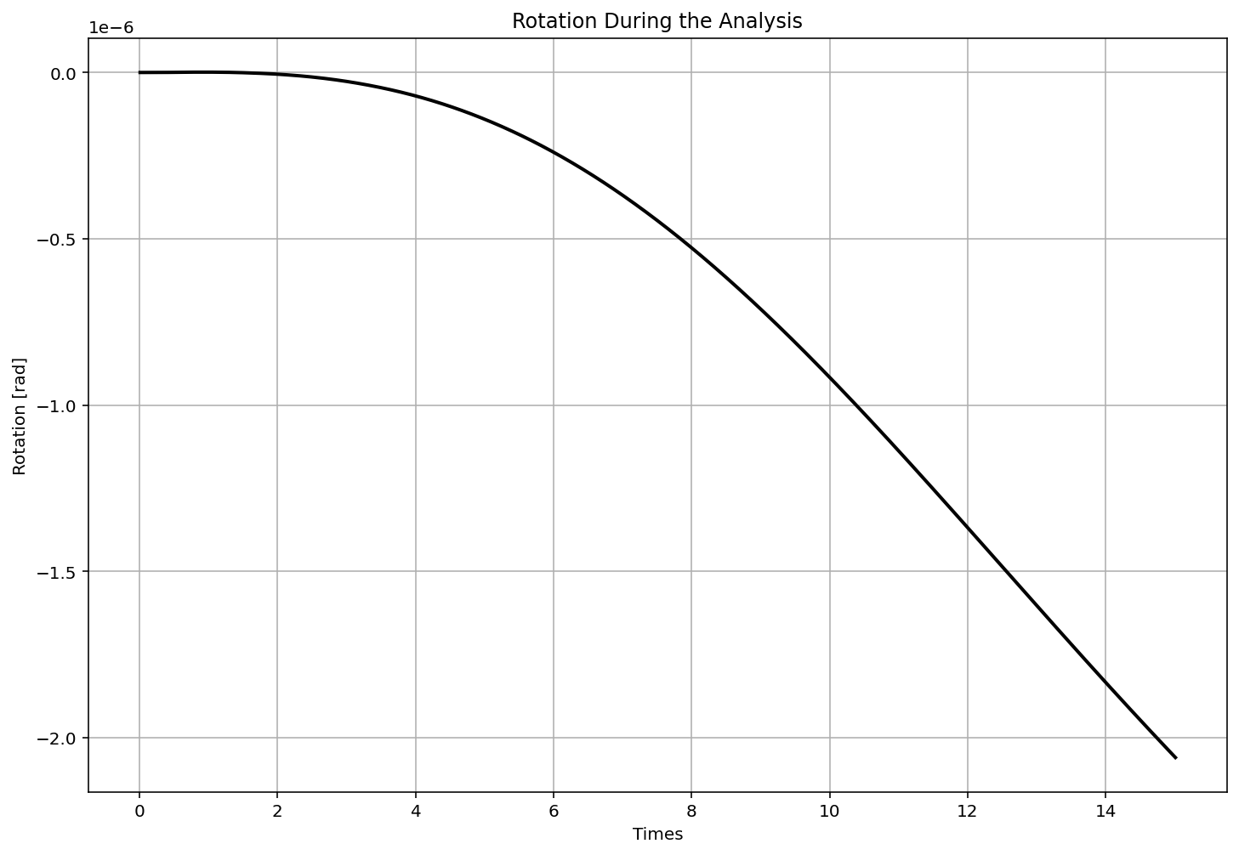

Slide 25
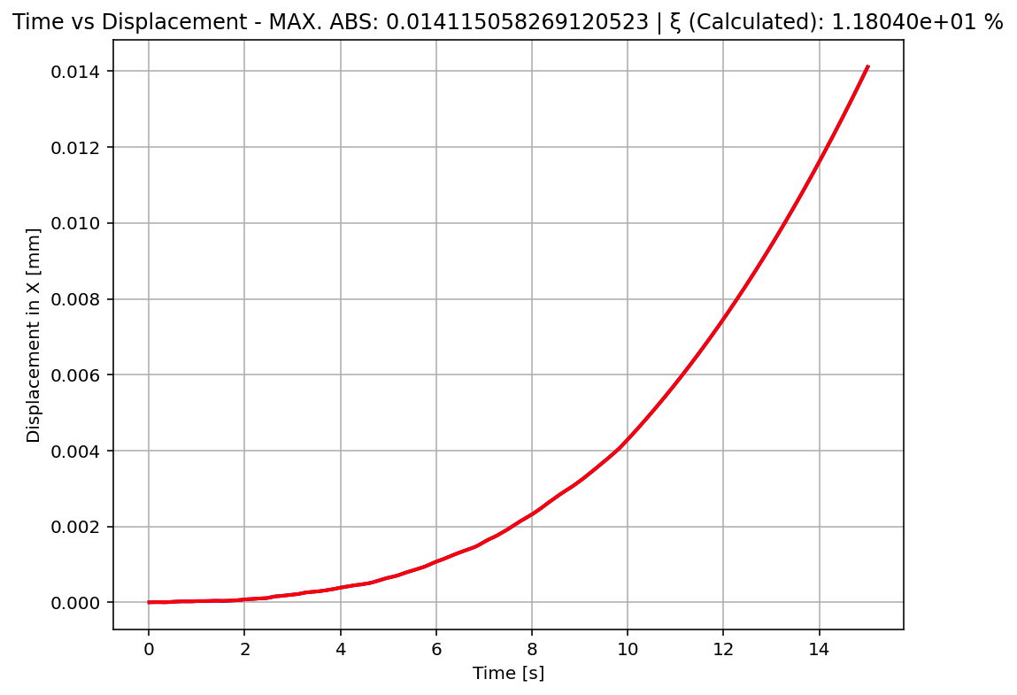

Slide 26
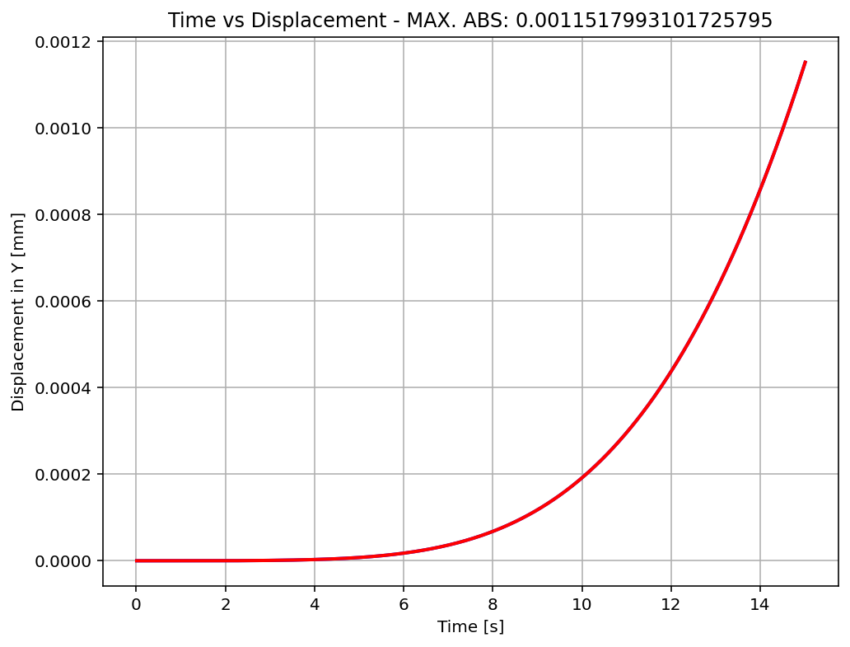

Slide 27
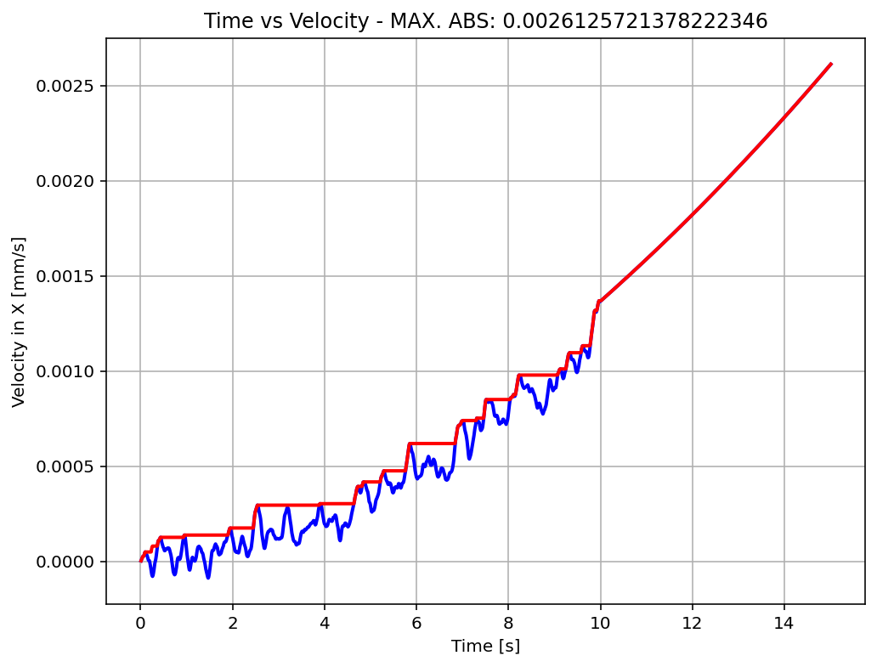

Slide 28
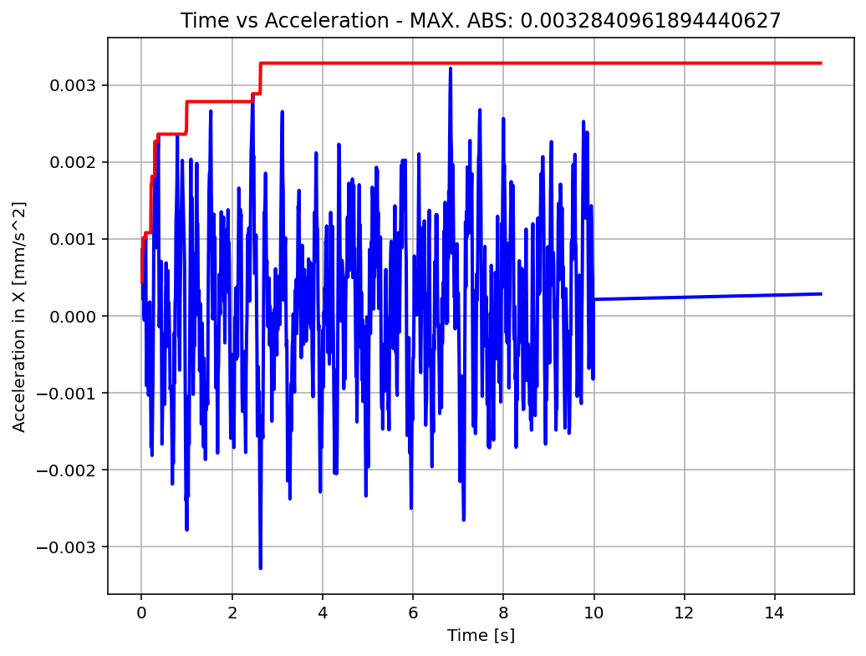

Slide 29
