Slide 1
IN THE NAME OF ALLAH, THE MOST GRACIOUS, THE MOST MERCIFUL
STRUCTURAL DUCTILITY RATIO OPTIMIZATION WITH PUSHOVER ANALYSIS OF CONCRETE FRAME SECTION. EVALUATING STRAIN HARDENING AND ULTIMATE STRAIN CRITERIA USING OPENSEES. FIND BEST COLUMN REBAR DIAMETER WITH DEFINED STRUCTURAL DUCTILITY RATIO. OPTIMIZATION ALGORITHM: NEWTON-RAPHSON METHOD
WRITTEN BY SALAR DELAVAR GHASHGHAEI (QASHQAI)

Slide 2
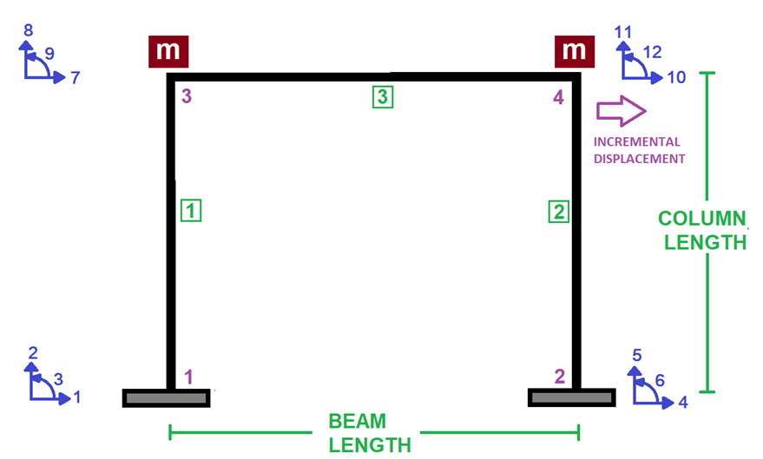

Slide 3
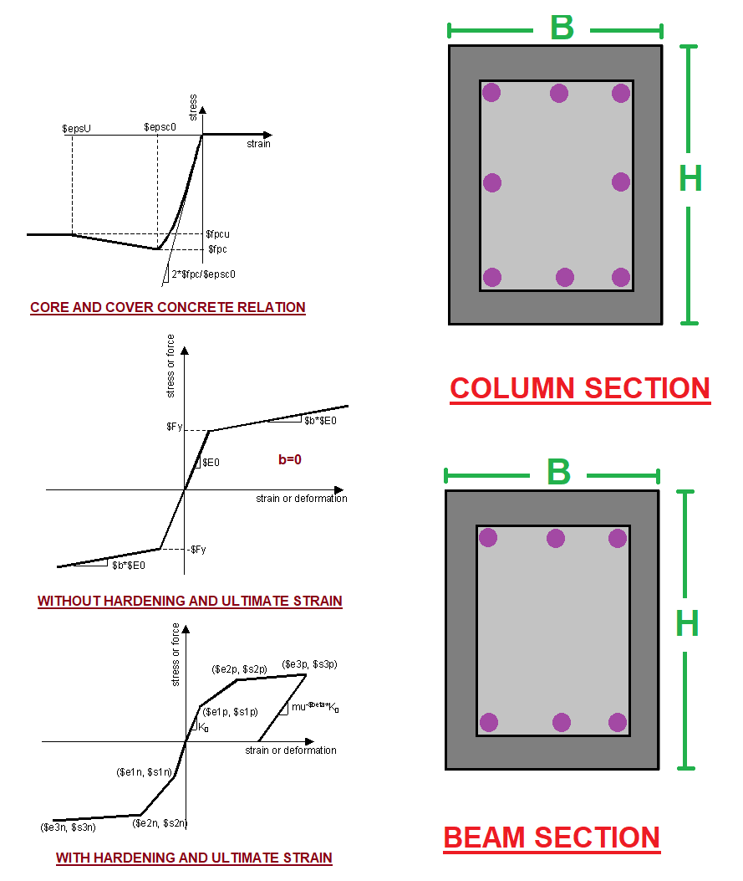

Slide 4
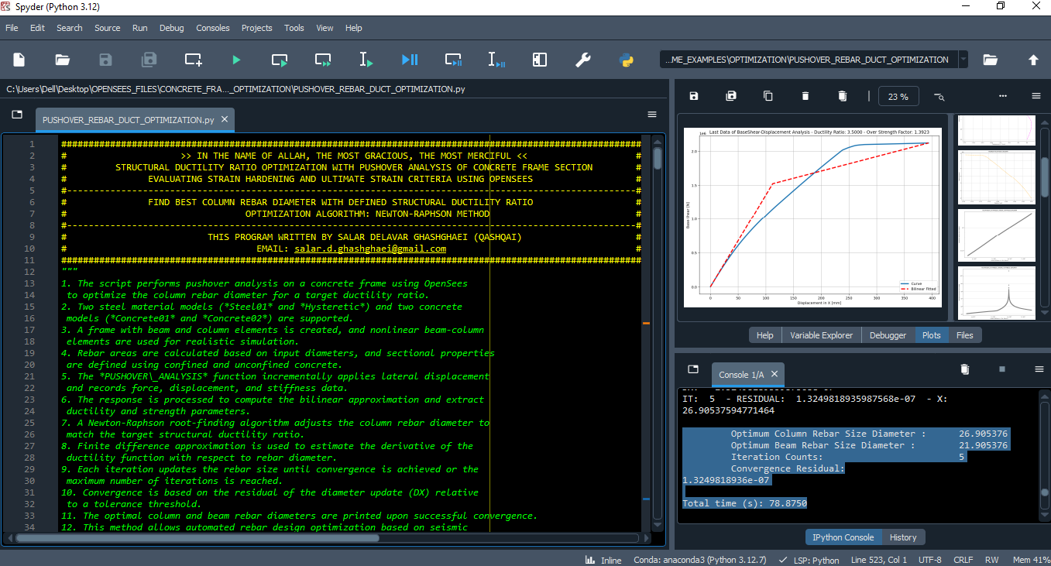

Slide 5
NONLINEAR STATIC ANALYSIS
(PUSHOVER)

Slide 6
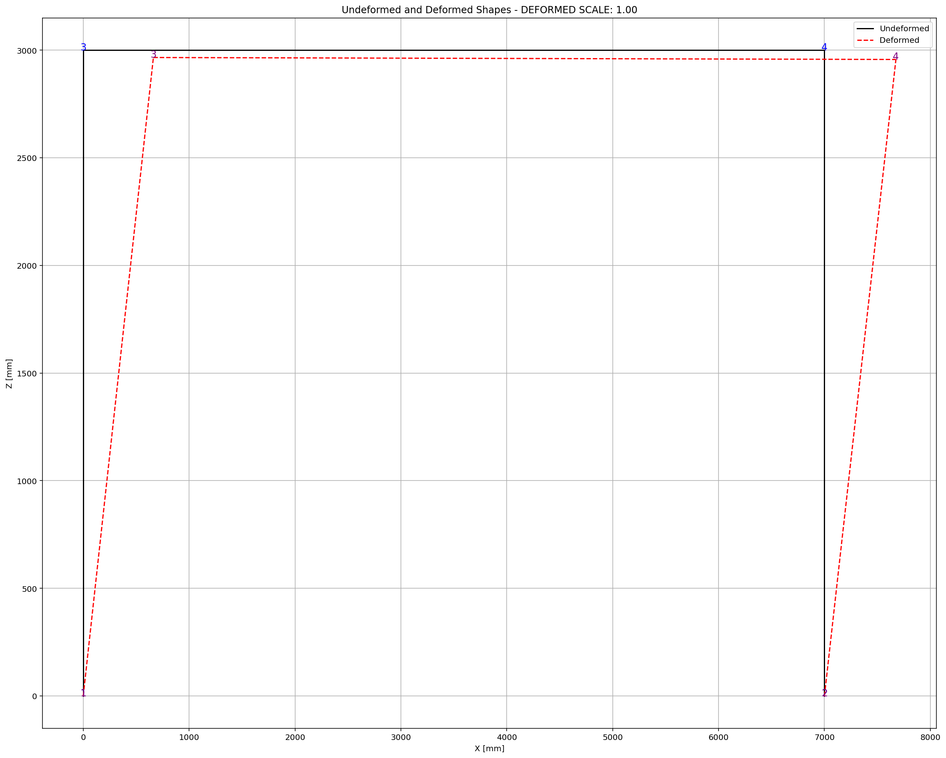
Optimum Column Rebar Size Diameter : 26.905376
Optimum Beam Rebar Size Diameter : 21.905376
Iteration Counts: 5
Convergence Residual: 1.3249818936e-07
Total time (s): 78.8750

Slide 7
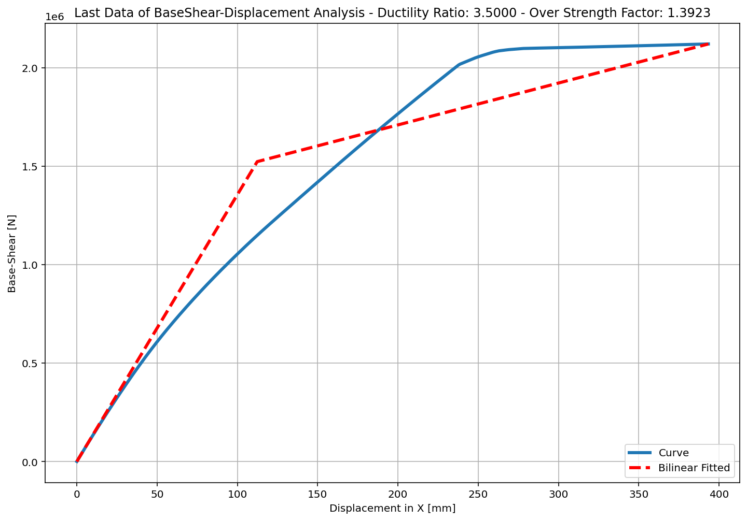
+==========================+
= Analysis curve fitted =
Disp Base Shear
----------------------------
[[0.00000000e+00 0.00000000e+00]
[1.12374568e+02 1.52276631e+06]
[3.93308797e+02 2.12010320e+06]]
+==========================+
+----------------------------------------------------+
Structure Elastic Stiffness : 13550.81
Structure Plastic Stiffness : 5390.43
Structure Tangent Stiffness : 2126.25
Structure Ductility Ratio : 3.50
Structure Over Strength Factor: 1.39
+----------------------------------------------------+
Over Strength Coefficient (Ω0): 1.3923
Displacement Ductility Ratio (μ):3.5000
Ductility Coefficient (Rμ): 3.5000
Structural Behavior Coefficient (R): 4.8729

Slide 8
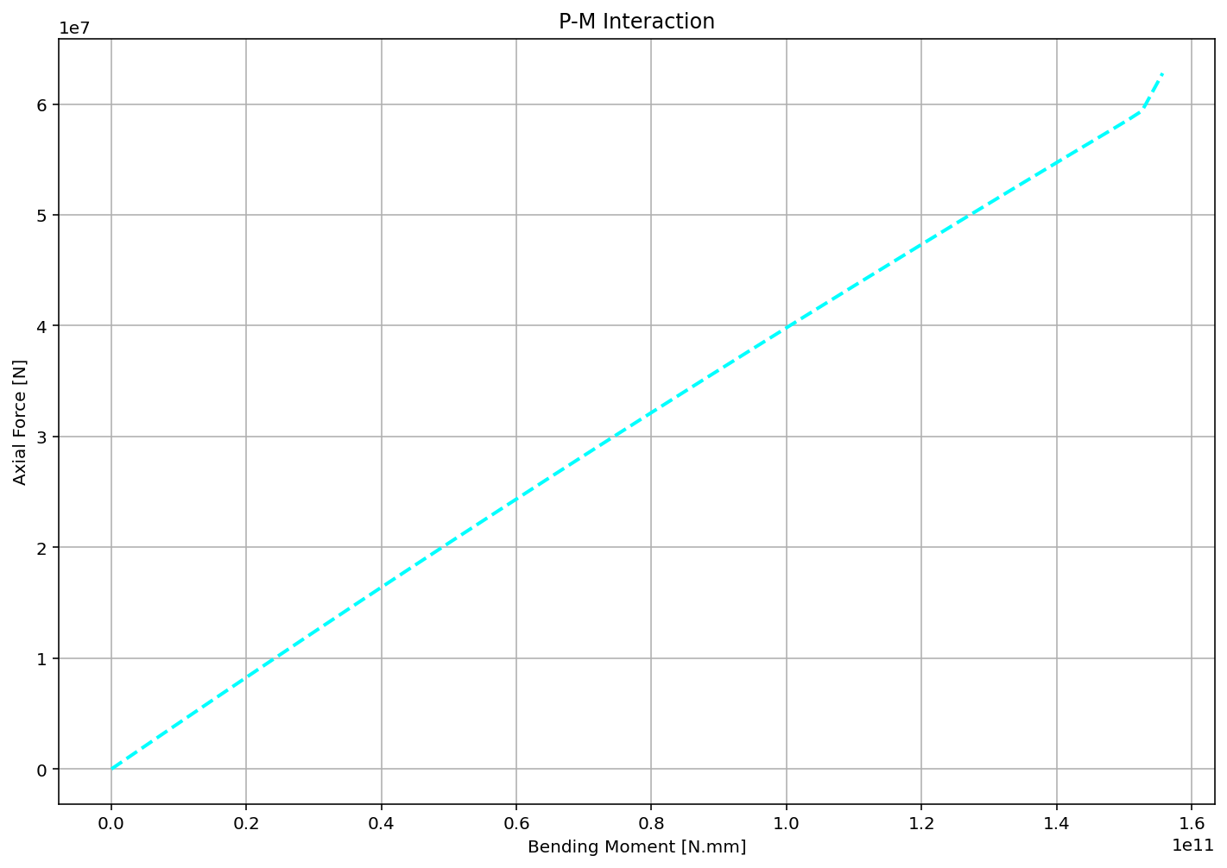

Slide 9
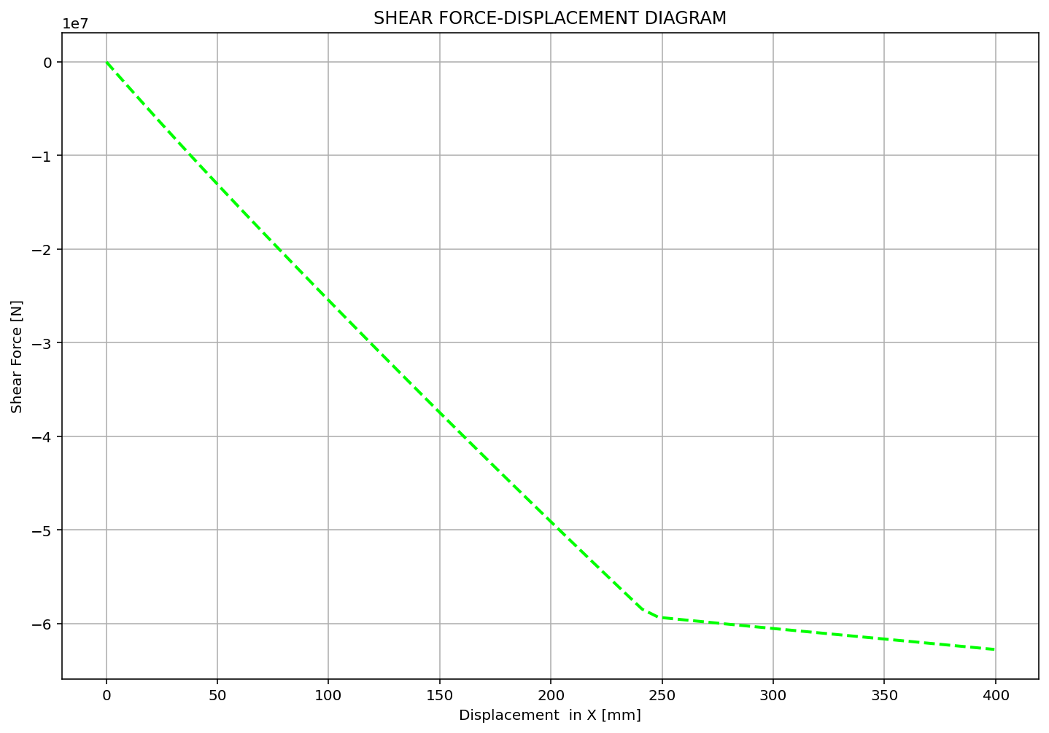

Slide 10
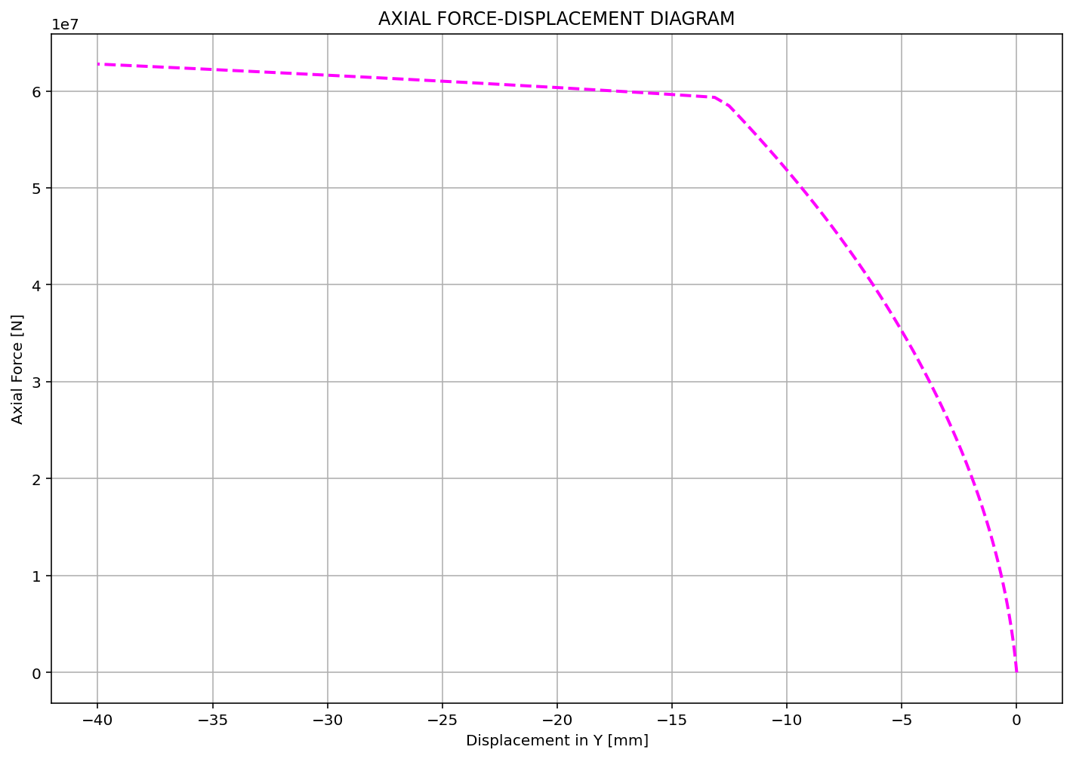

Slide 11
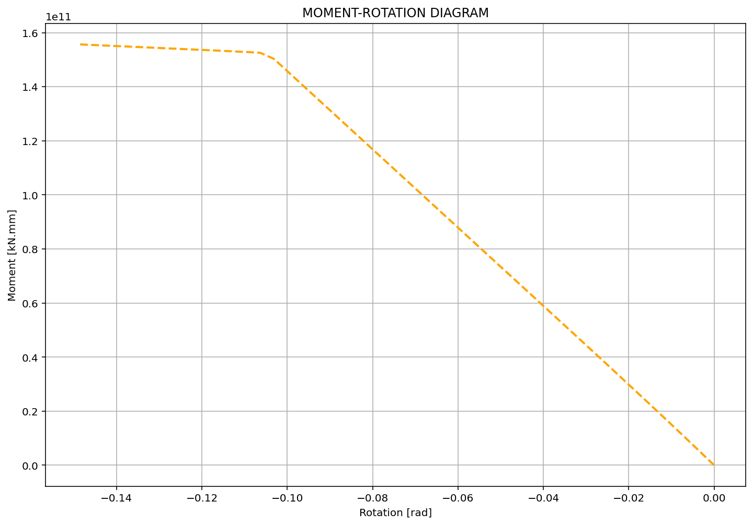

Slide 12
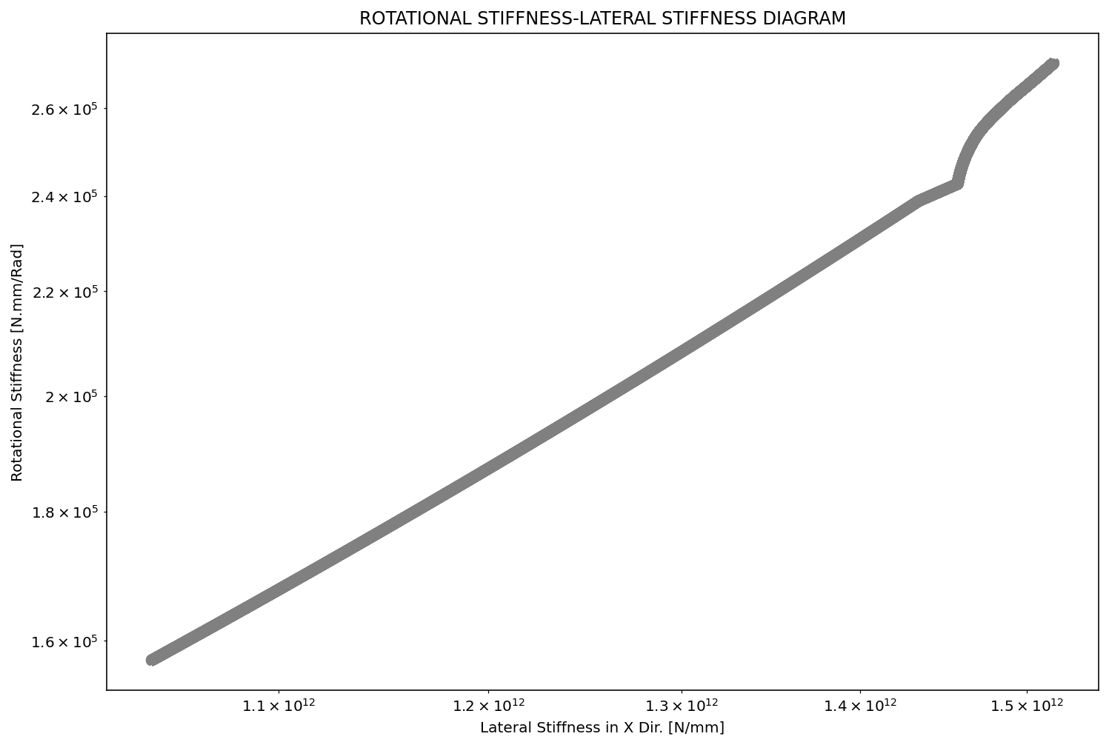

Slide 13
