Slide 1
>> IN THE NAME OF ALLAH, THE MOST GRACIOUS, THE MOST MERCIFUL <<
COMPREHENSIVE NONLINEAR SEISMIC ASSESSMENT OF A COMPOSITE SECTION FRAME: AN OPENSEES FRAMEWORK FOR STATIC PUSHOVER, CYCLIC DEGRADATION, STATIC TIME-HISTORY AND DYNAMIC TIME-HISTORY ANALYSIS
THIS PROGRAM IS WRITTEN BY SALAR DELAVAR GHASHGHAEI (QASHQAI)

Slide 2
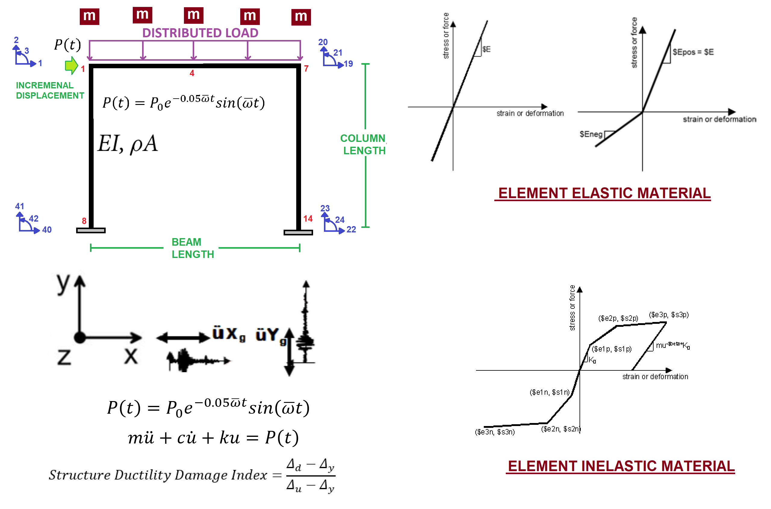

Slide 3
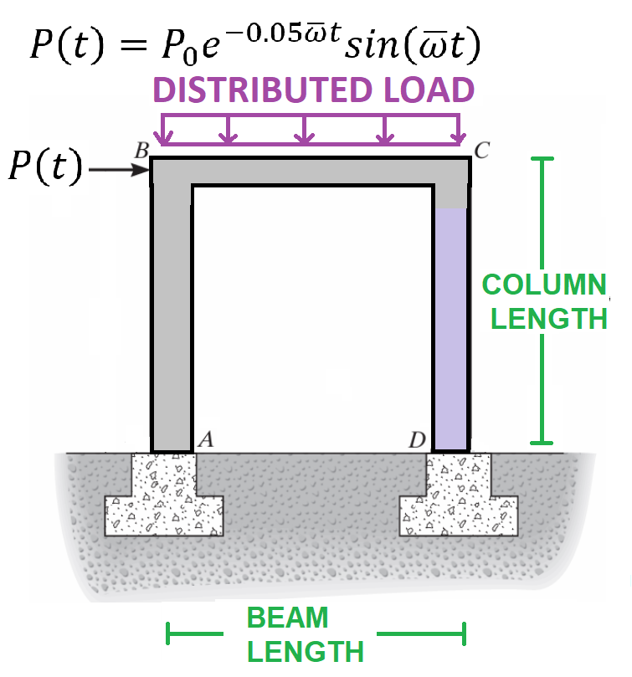

Slide 4
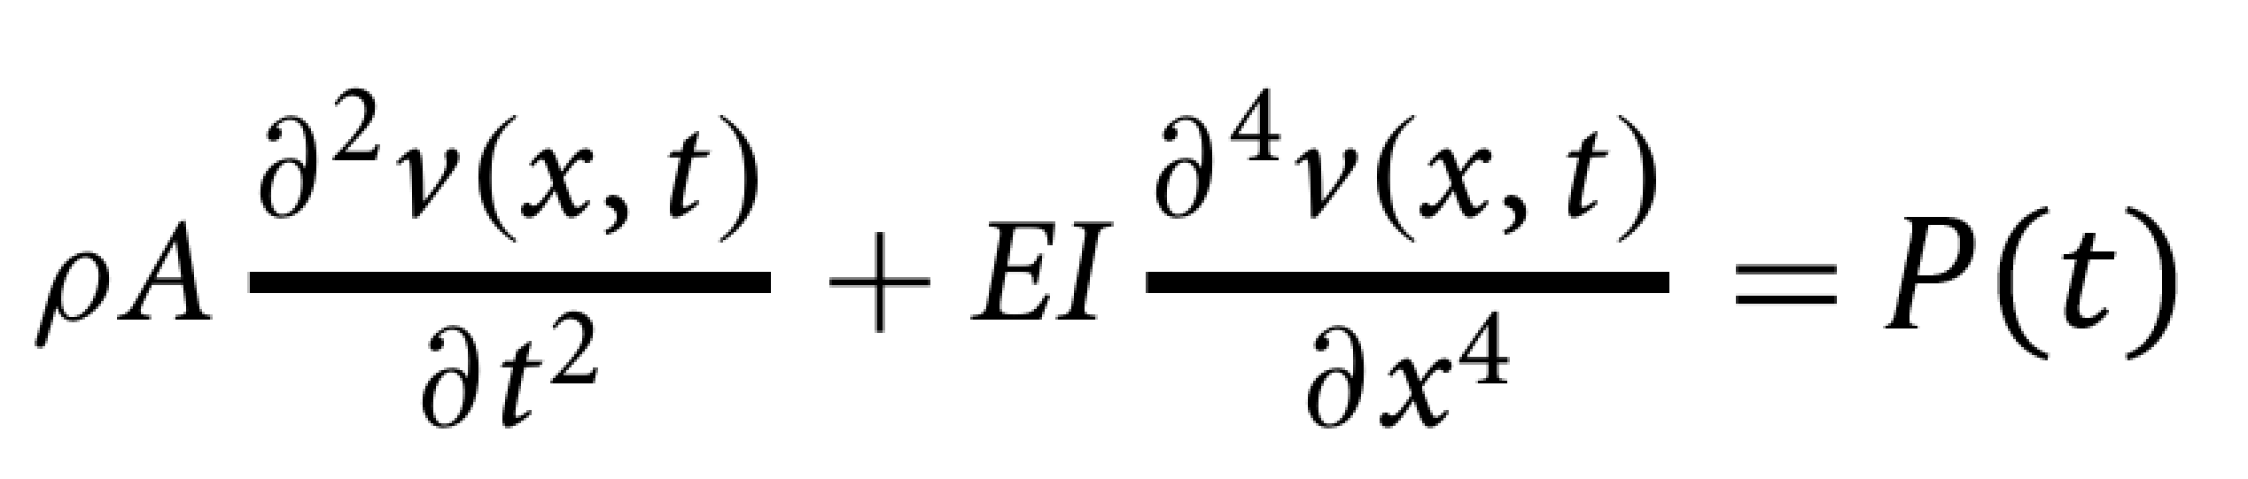

Slide 5
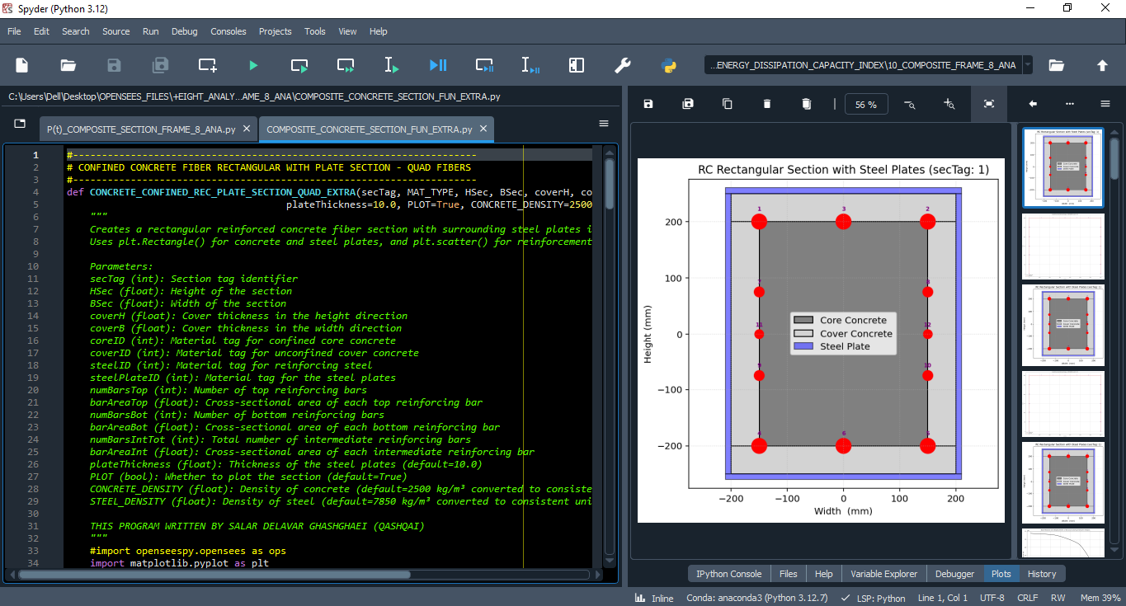

Slide 6
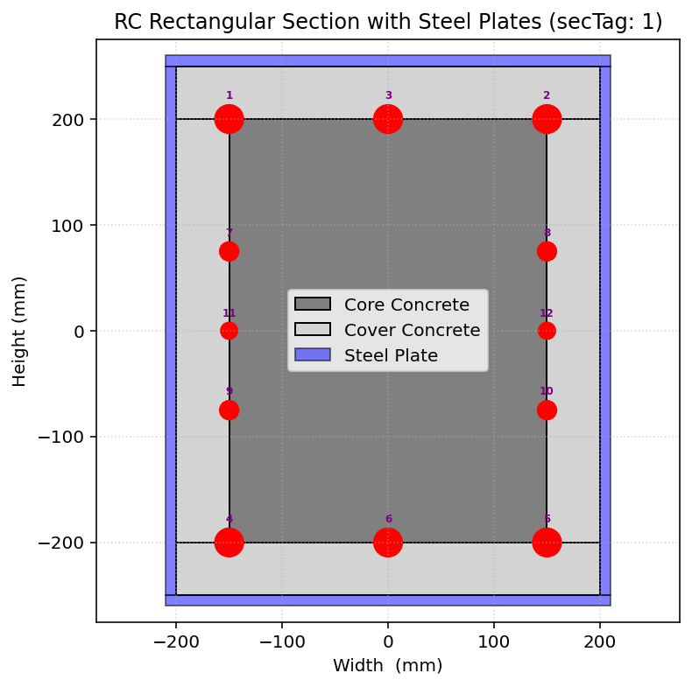
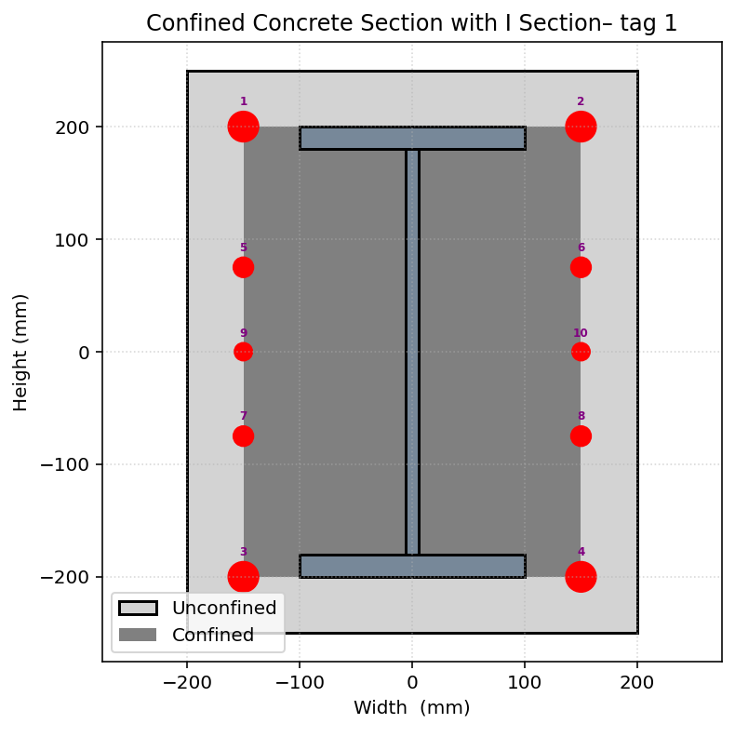
COMPOSITE_CONCRETE_SECTION_FUN_EXTRA
COMPOSITE_REC_I_SECTION_FUN

Slide 7
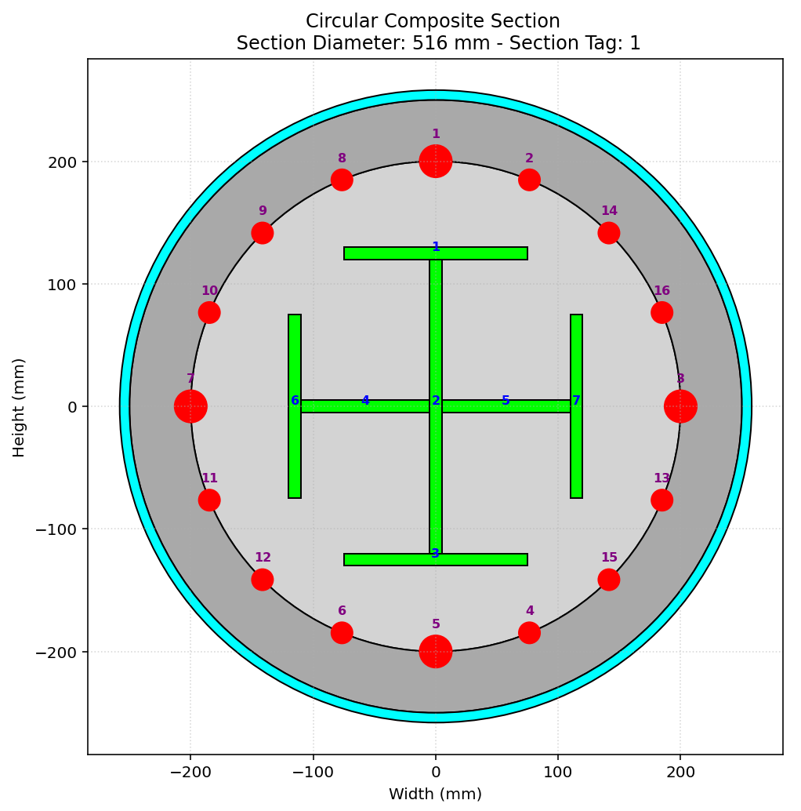
COMPOSITE_CIRCULAR_CONFINED_CONCRETE_SECTION_FUN_EXTRA

Slide 8
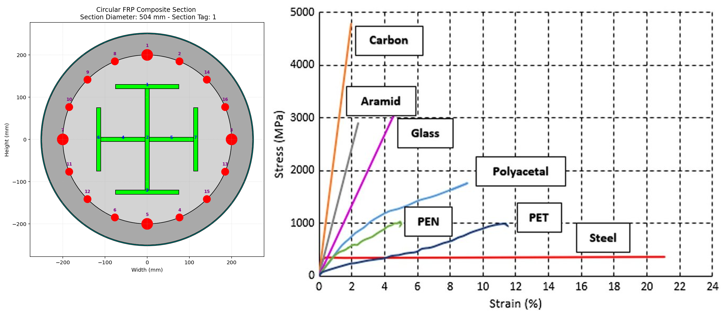
COMPOSITE_FRP_CIRCULAR_CONFINED_CONCRETE_SECTION_FUN_EXTRA

Slide 9
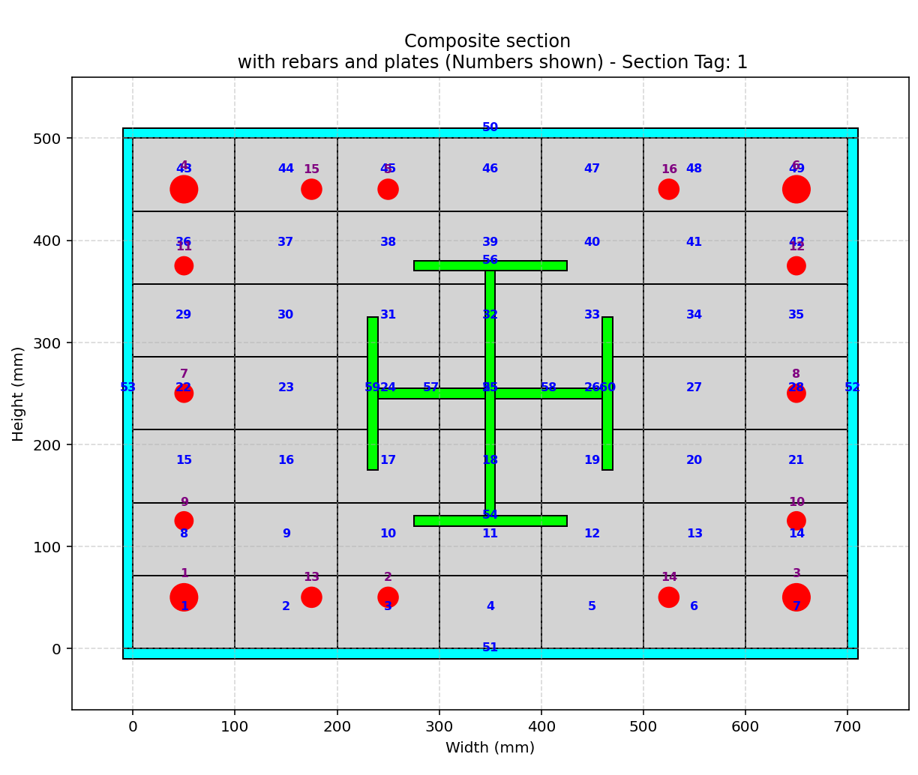
COMPOSITE_SECTION_DIFF_WIDTH_HEIGHT_FUN_EXTRA_TWO

Slide 10
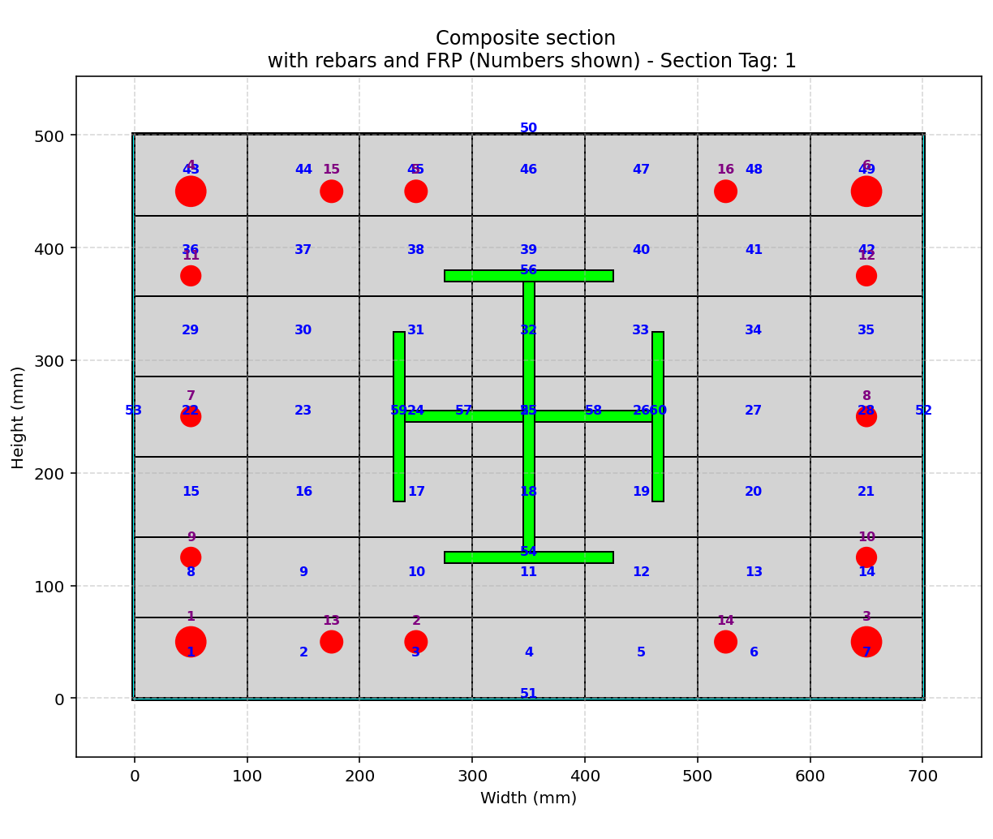
COMPOSITE_FRP_SECTION_DIFF_WIDTH_HEIGHT_FUN_EXTRA

Slide 11
STATIC ANALYSIS

Slide 12
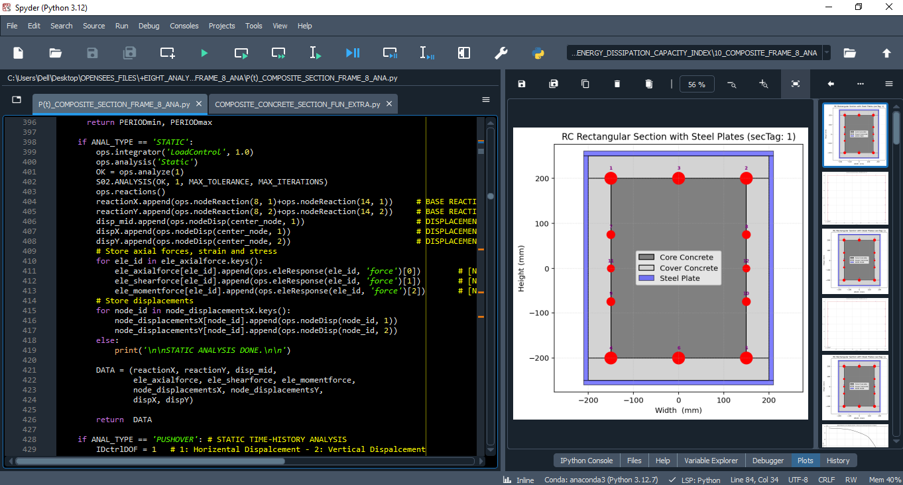

Slide 13
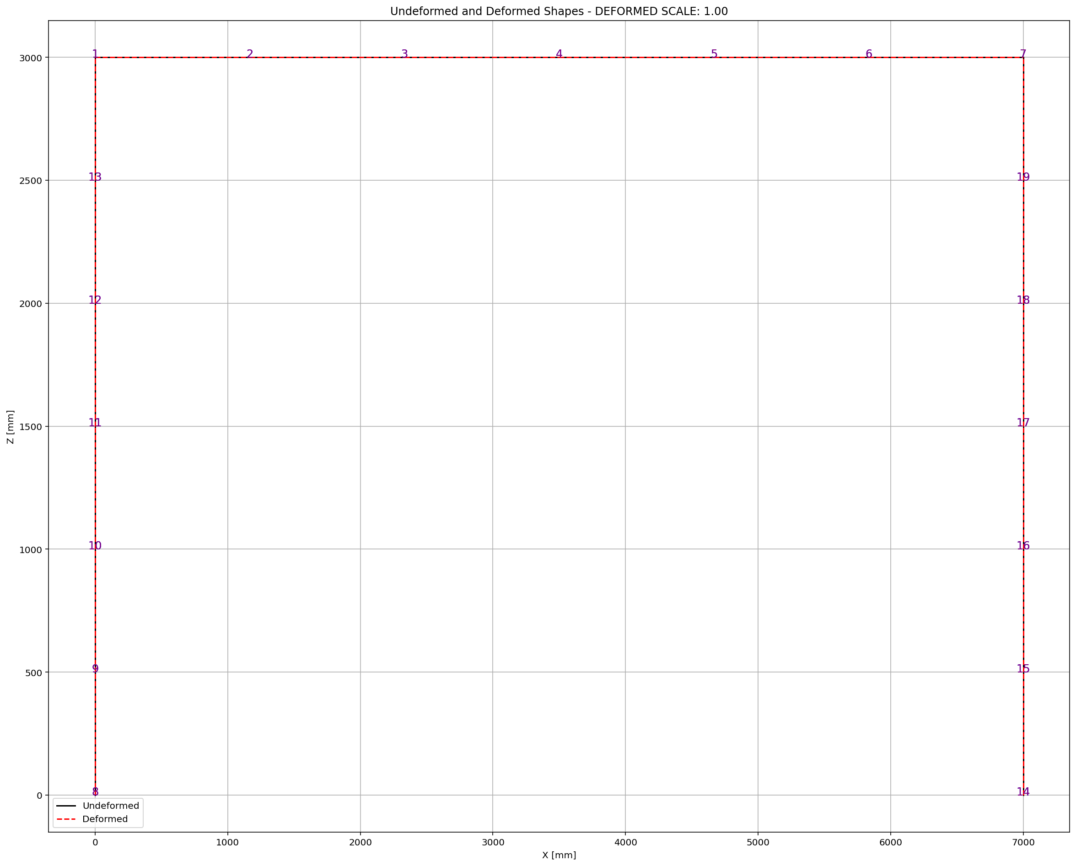

Slide 14
PUSHOVER ANALYSIS

Slide 15
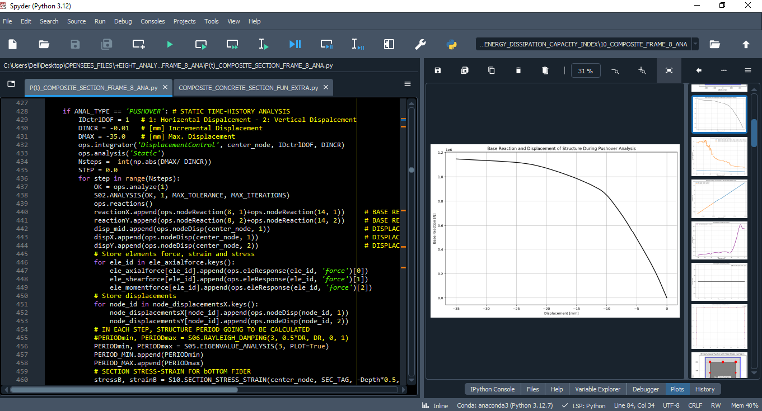

Slide 16
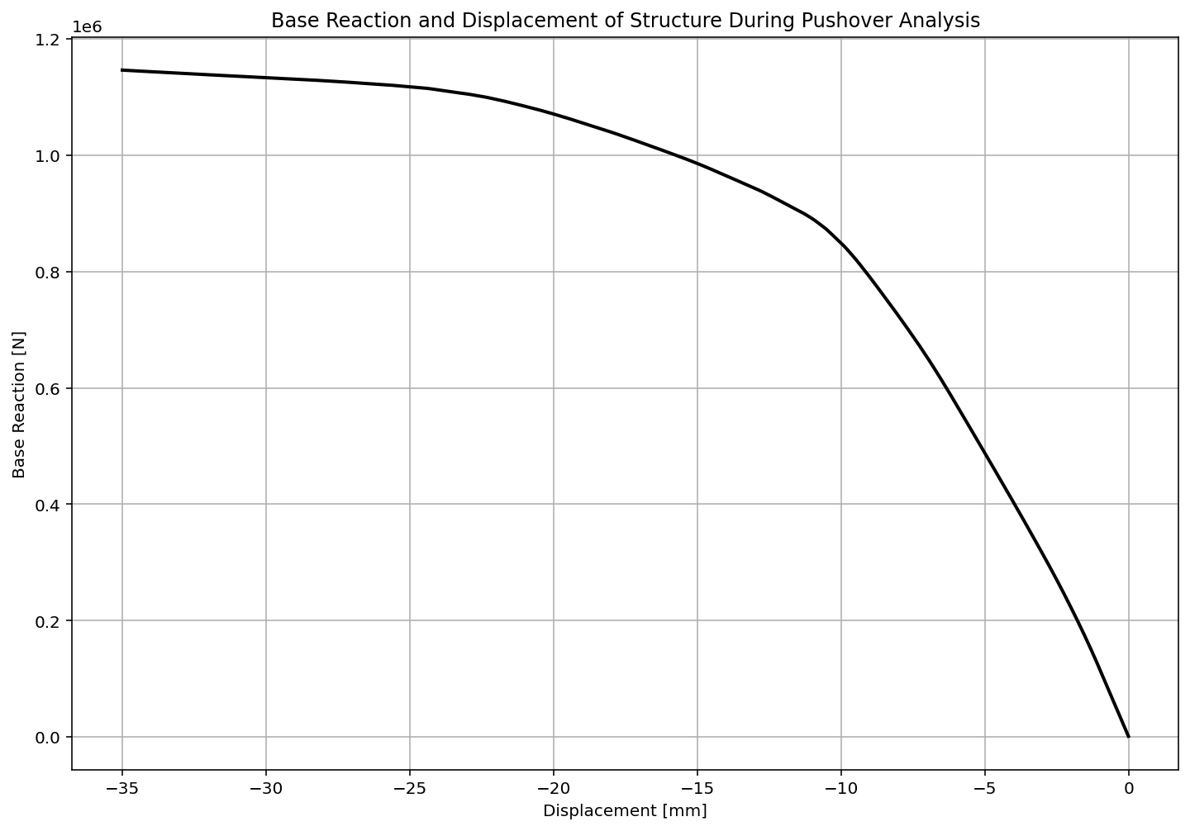

Slide 17
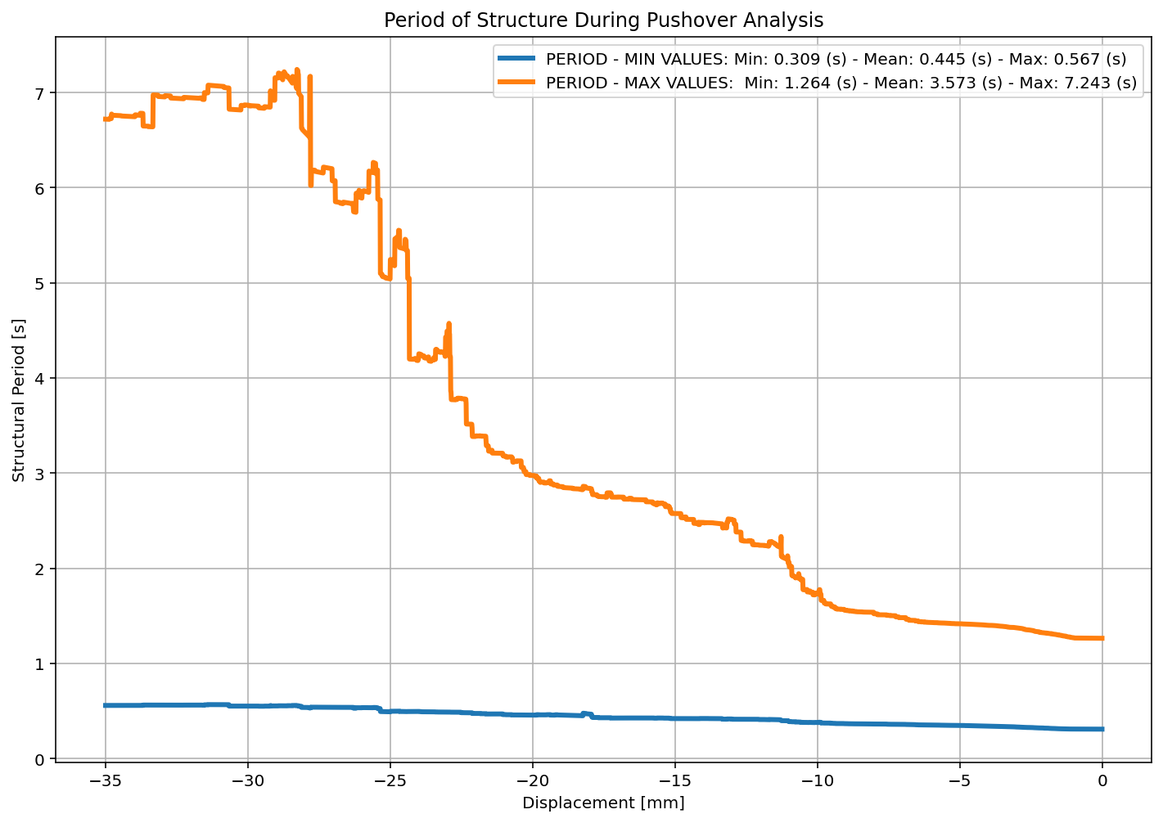

Slide 18
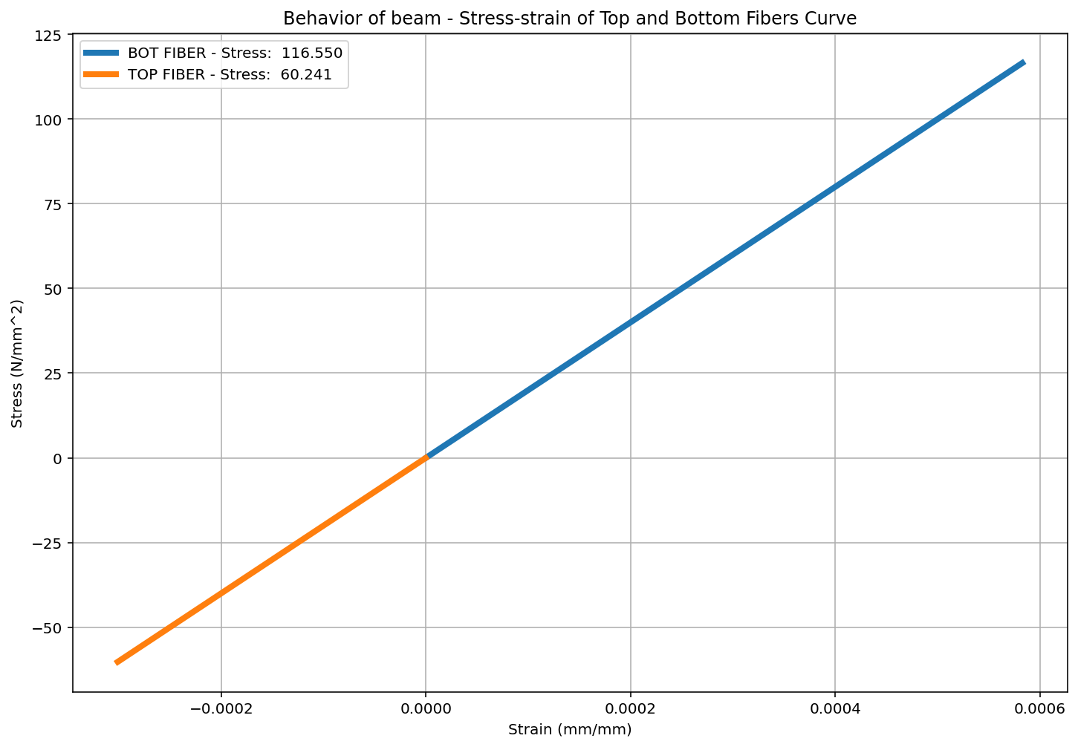

Slide 19
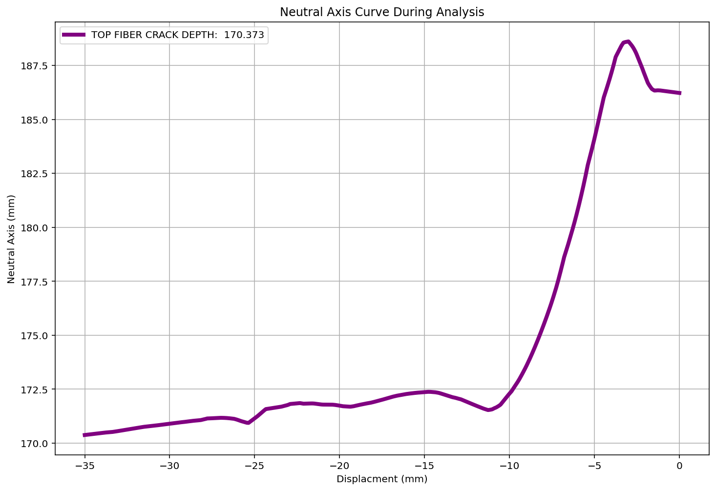

Slide 20
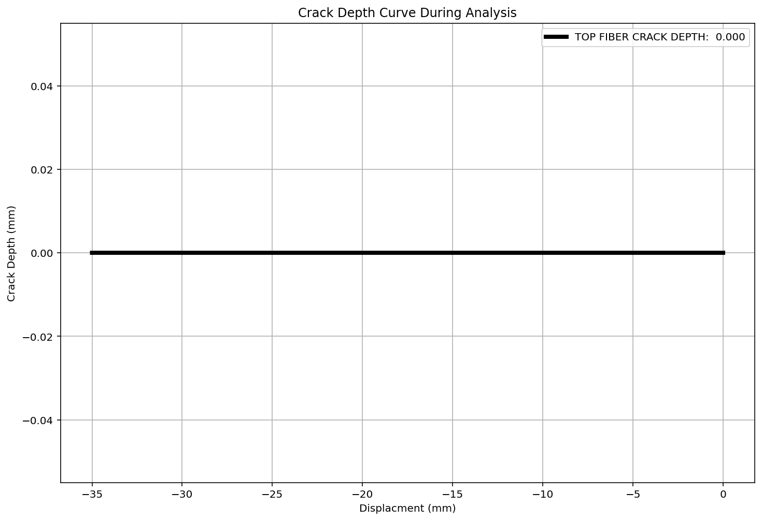

Slide 21
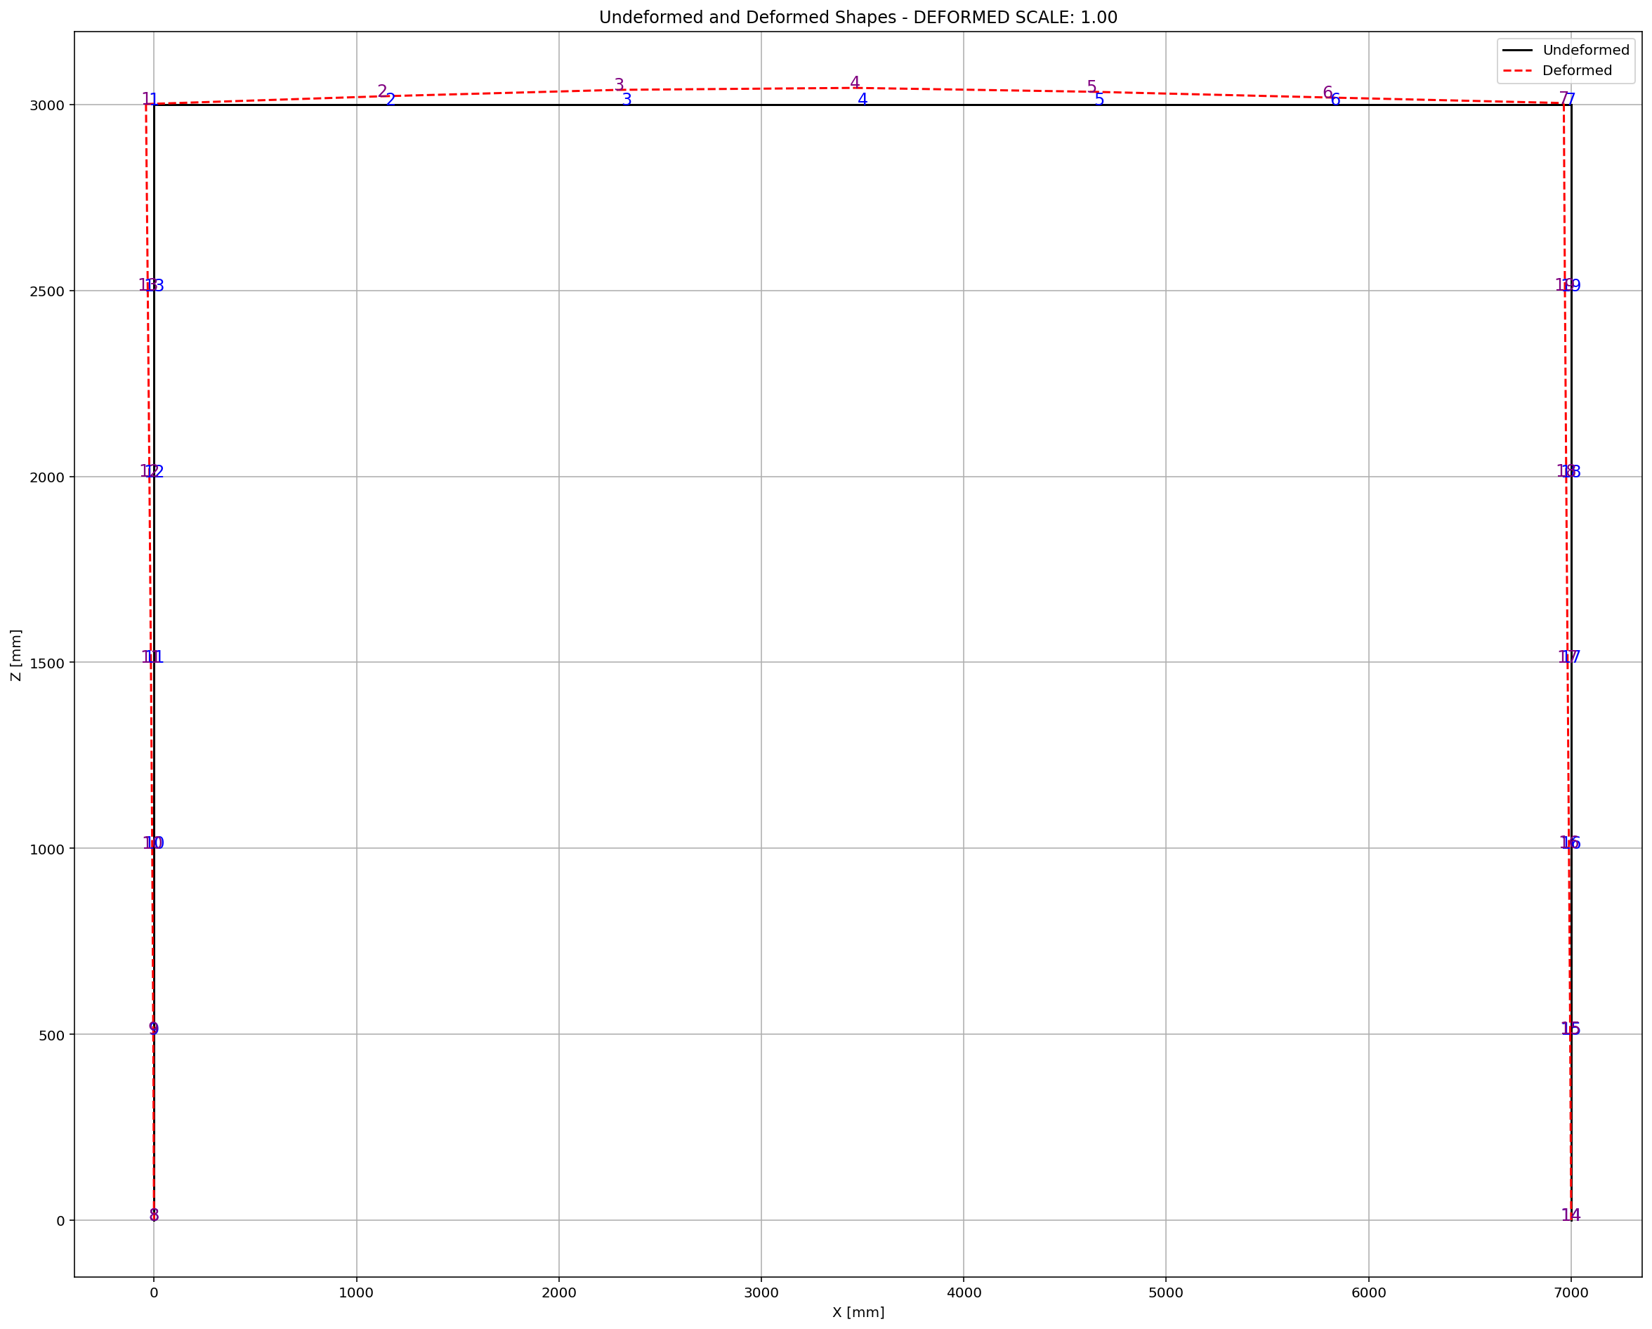

Slide 22
CYCLIC DISPLACEMENT ANALYSIS

Slide 23
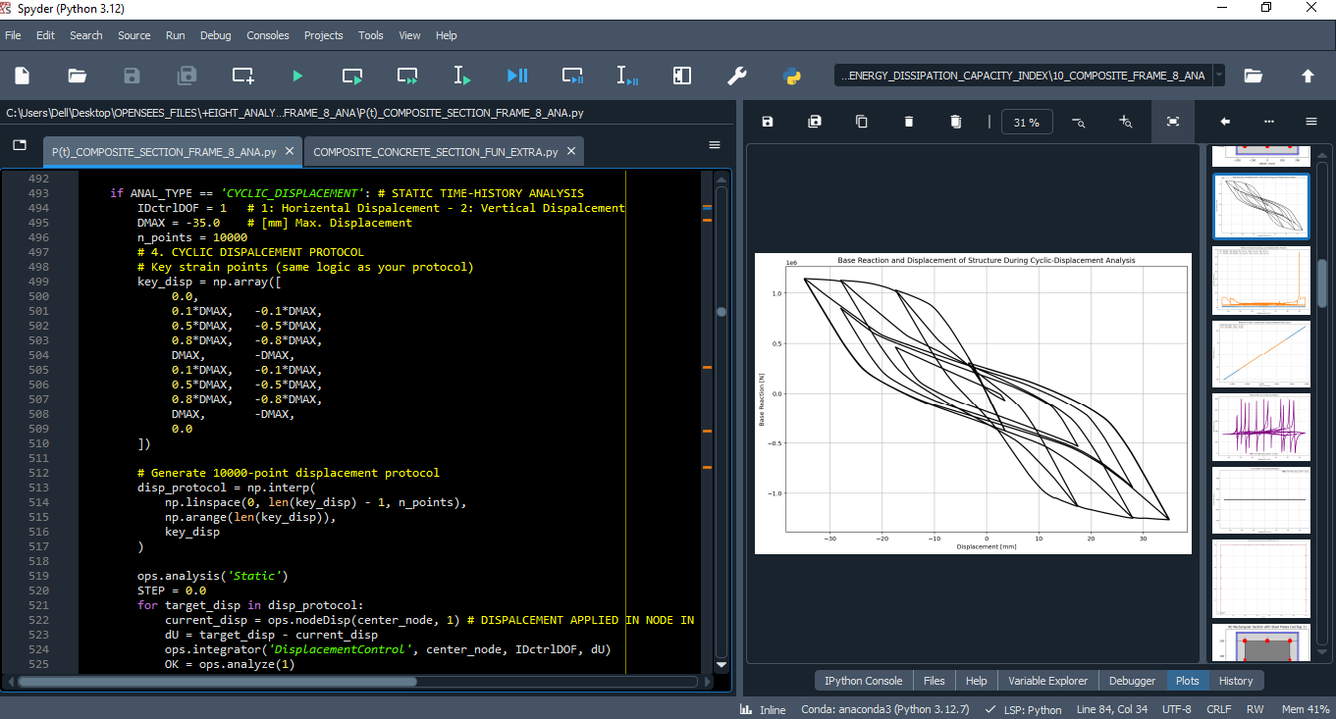

Slide 24
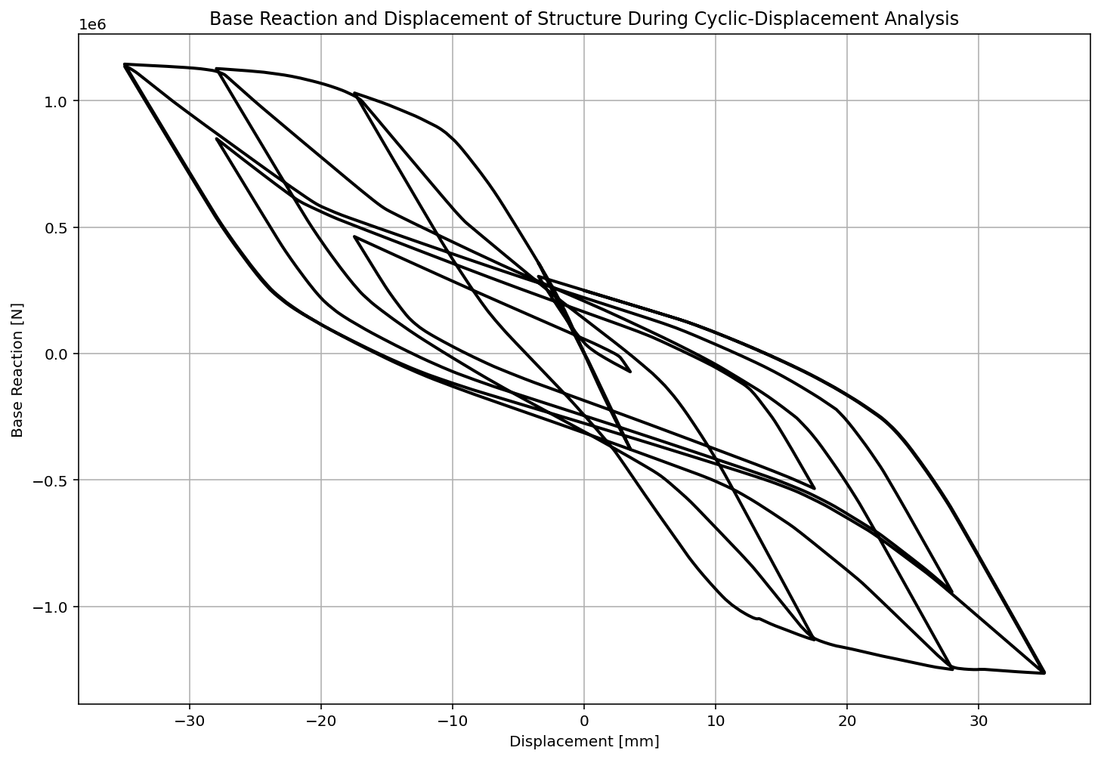

Slide 25
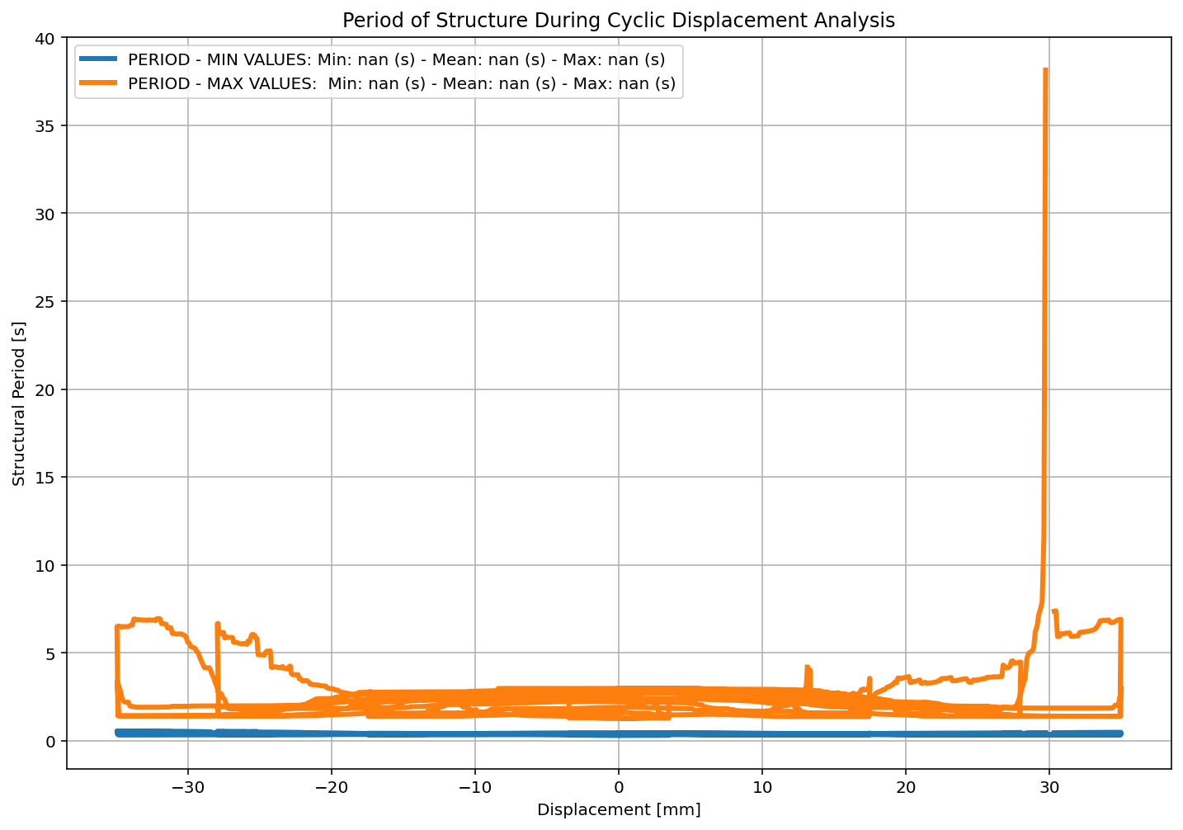

Slide 26
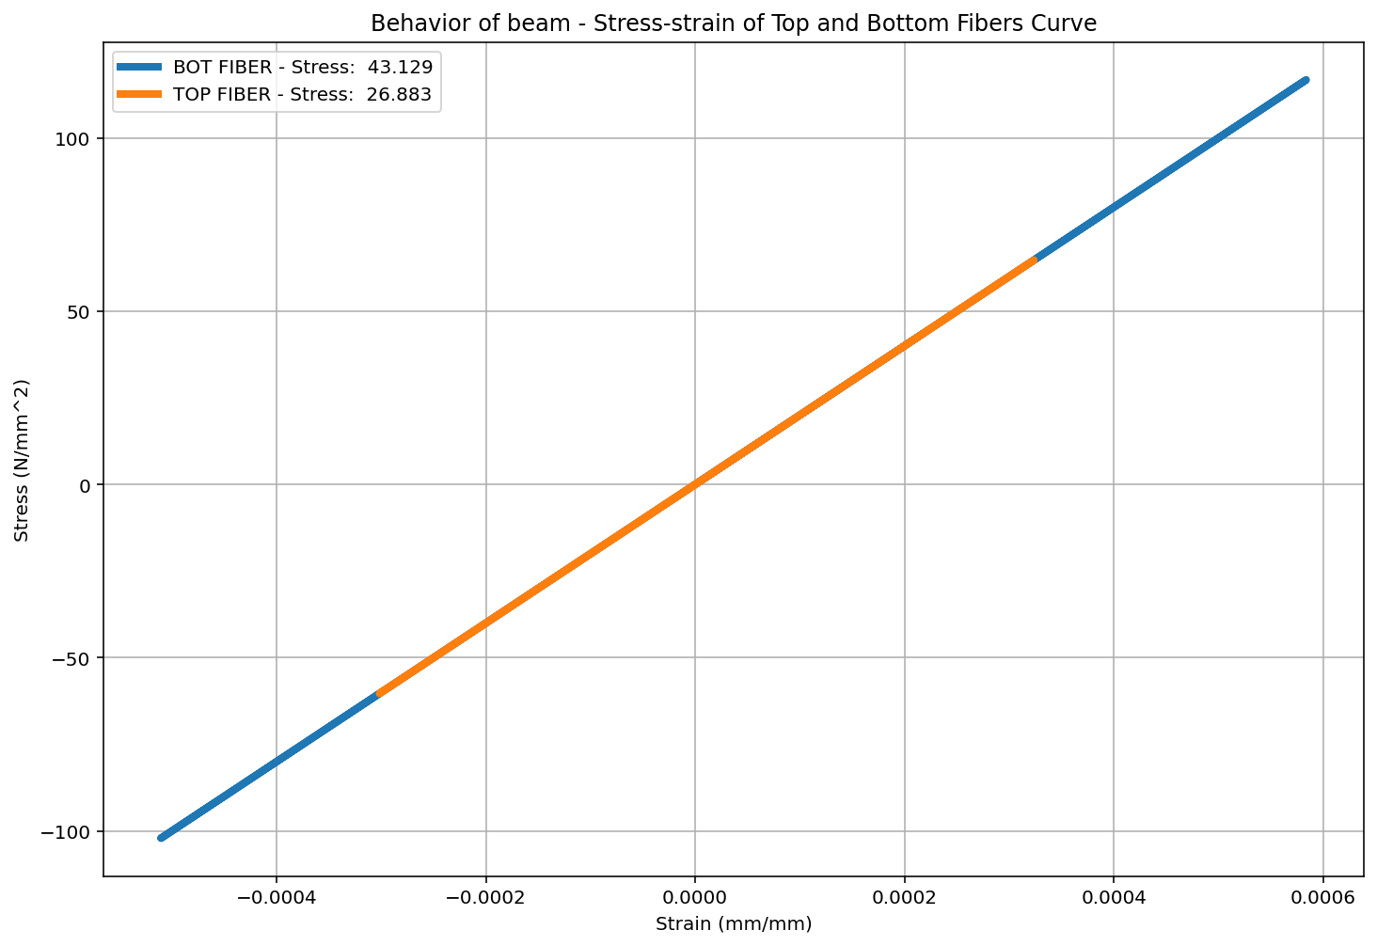

Slide 27
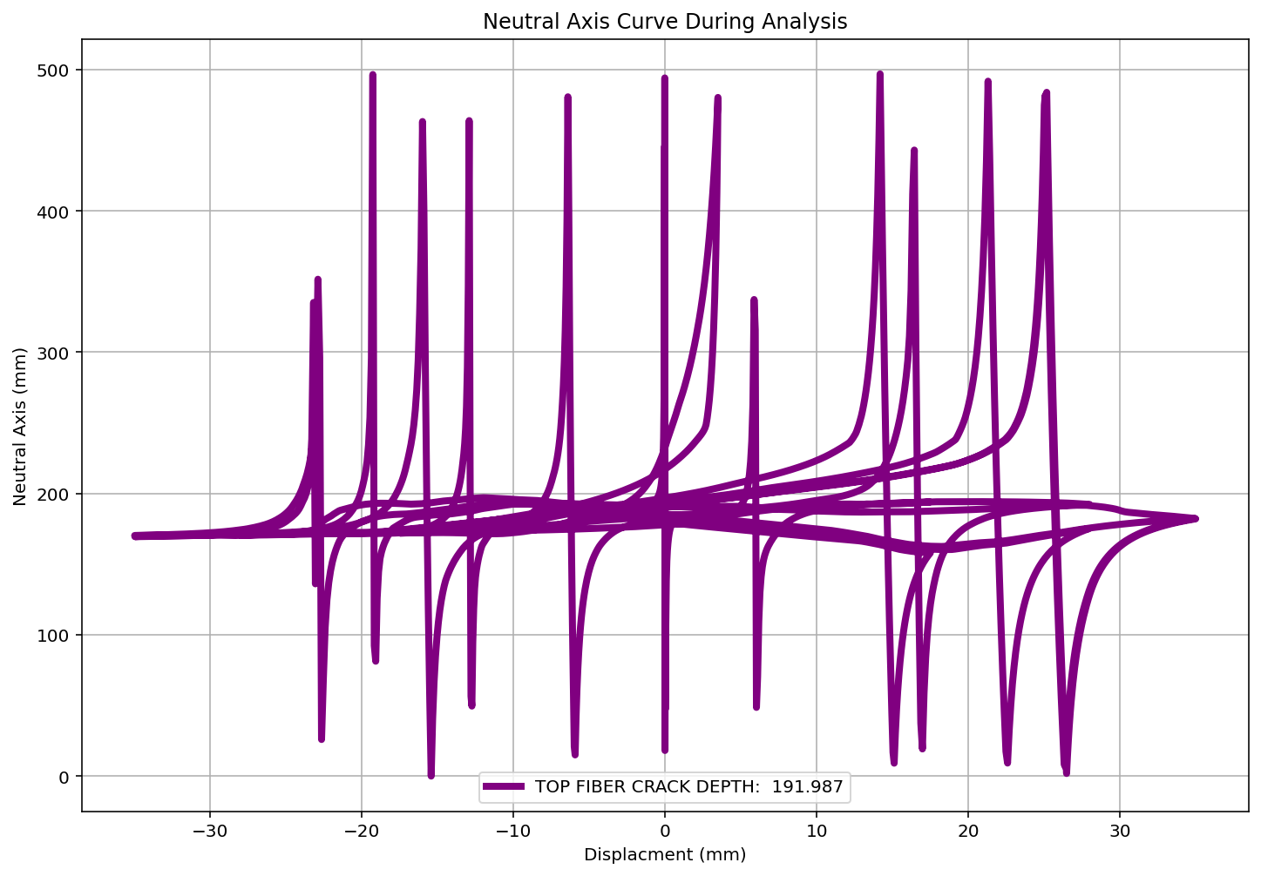

Slide 28
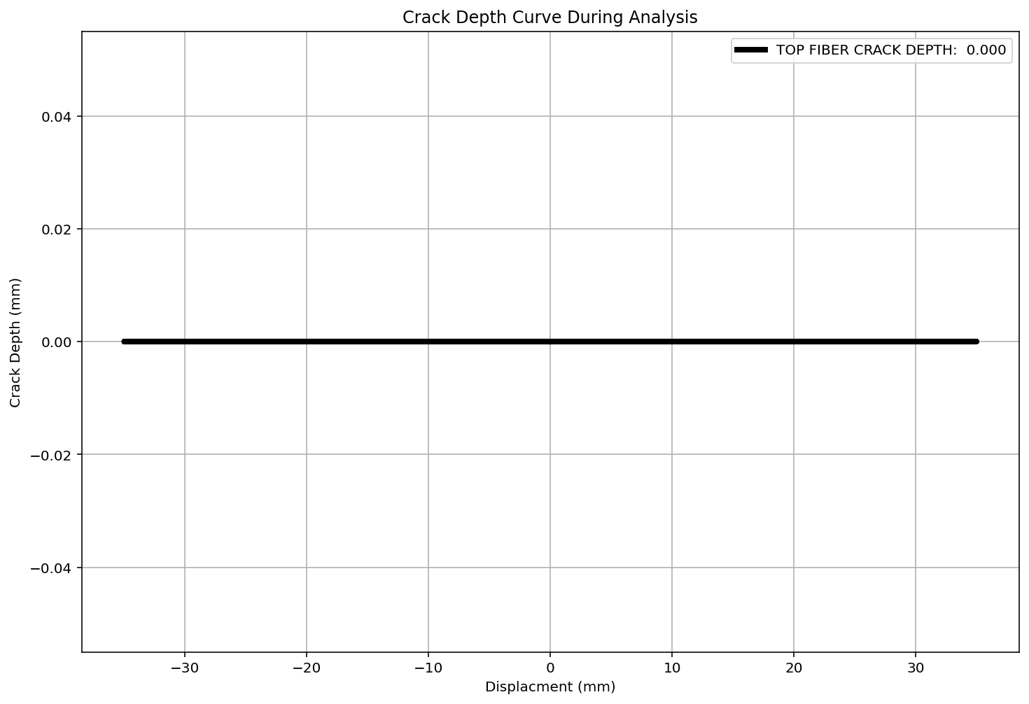

Slide 29
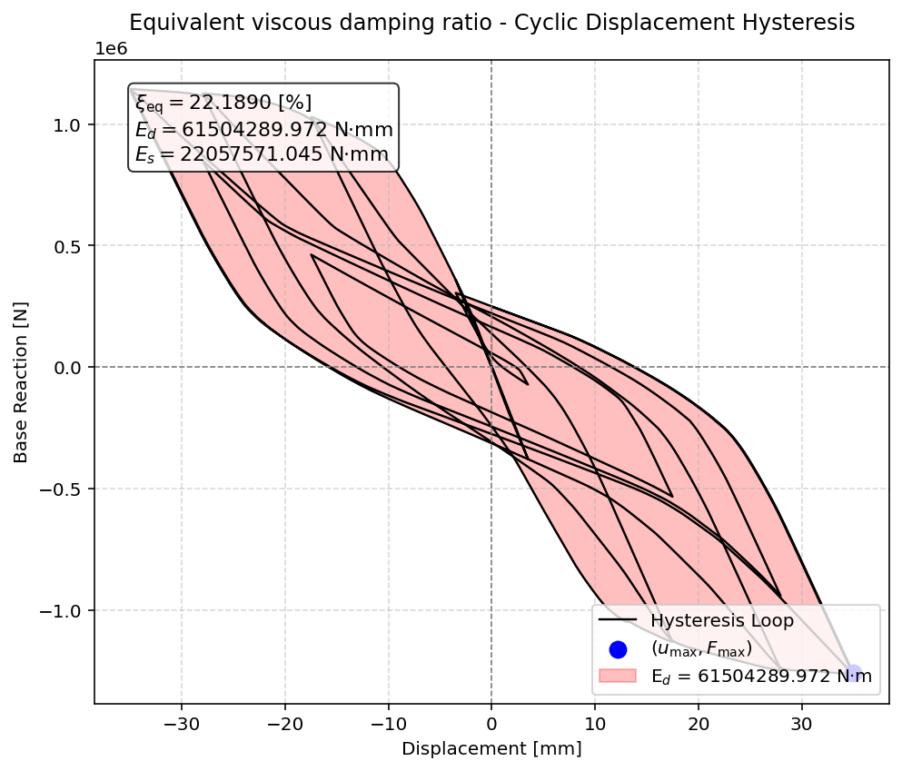

Slide 30
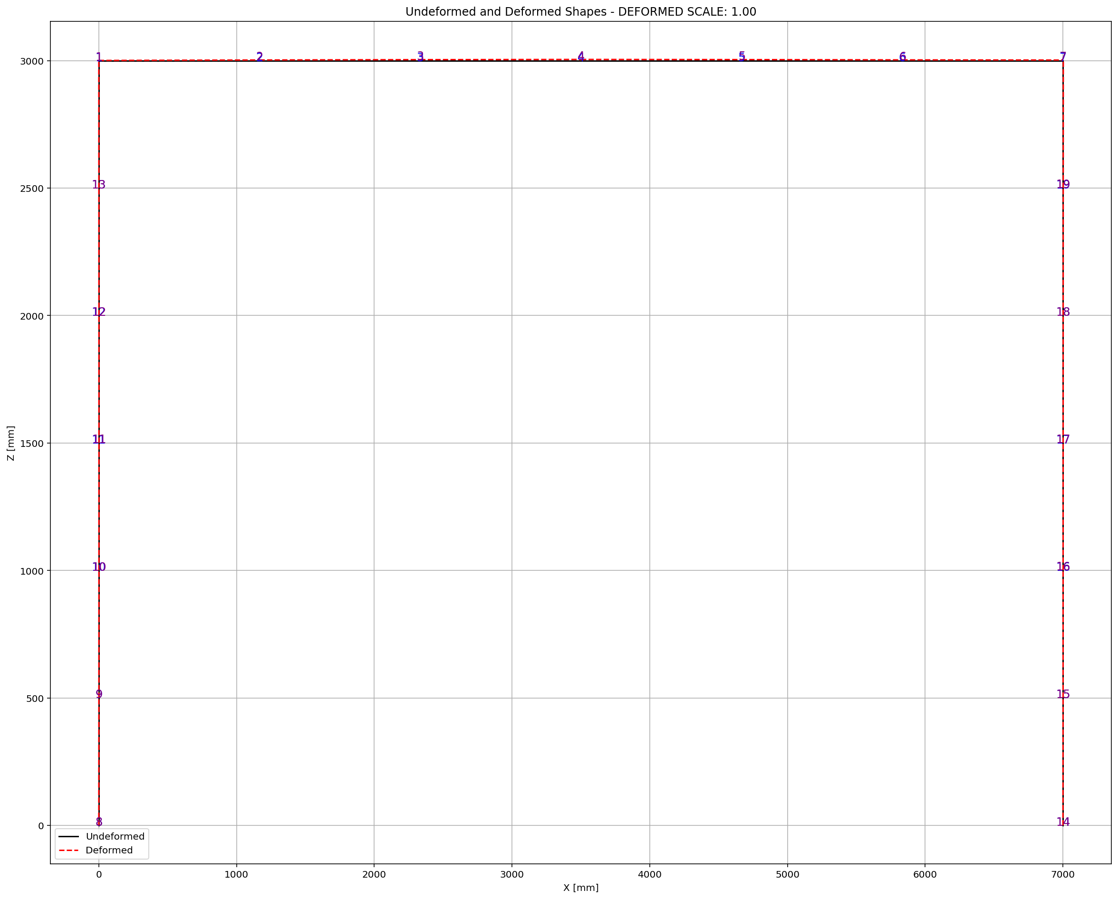

Slide 31
STATIC TIME-HISTORY WITH EXTERNAL TIME-DEPENDENT LOADING ANALYSIS

Slide 32
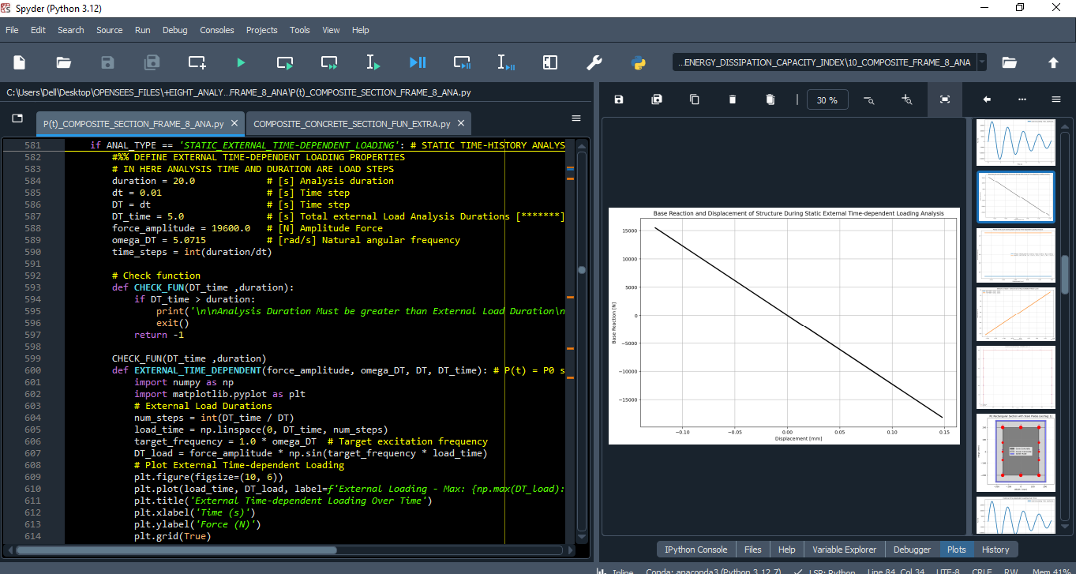

Slide 33
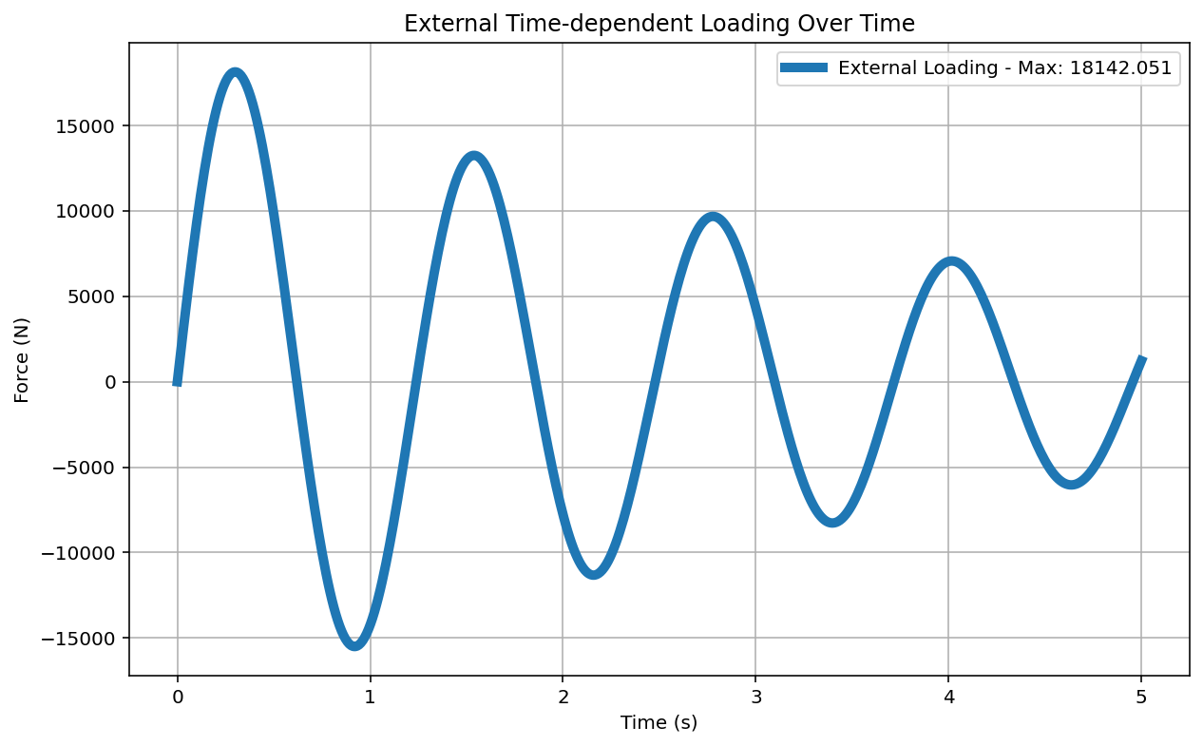

Slide 34
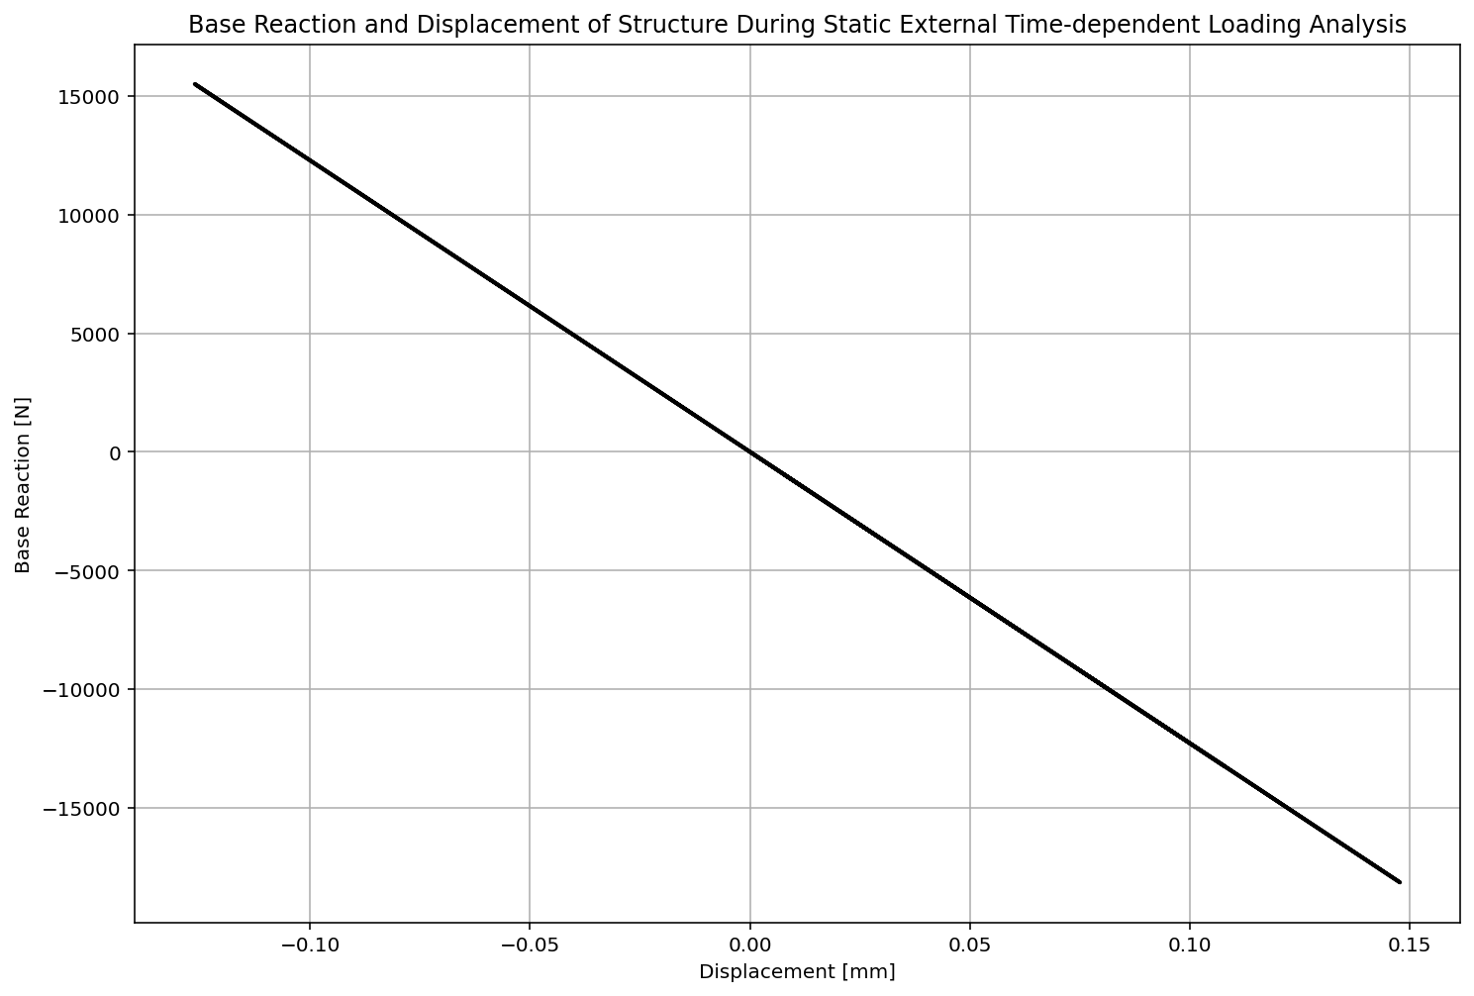

Slide 35
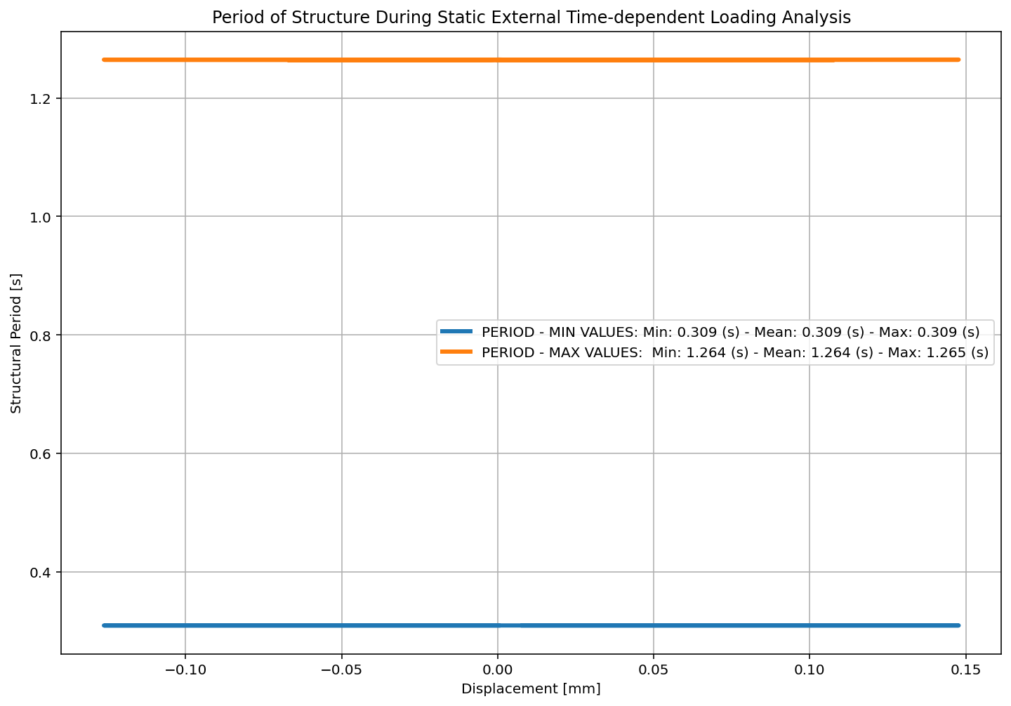

Slide 36
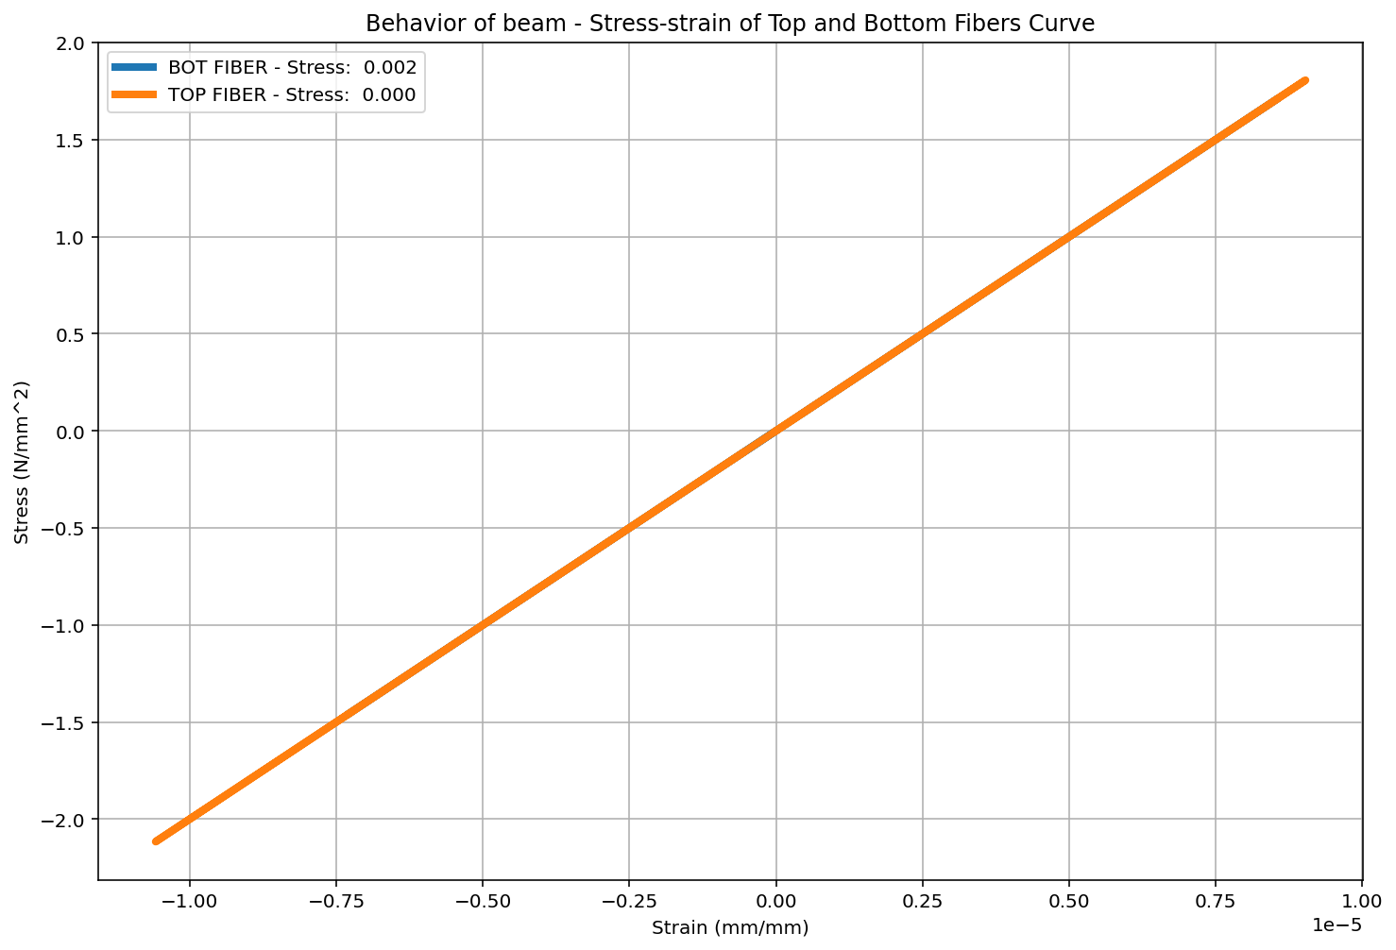

Slide 38
DYNAMIC TIME-HISTORY WITH EXTERNAL TIME-DEPENDENT LOADING ANALYSIS

Slide 39
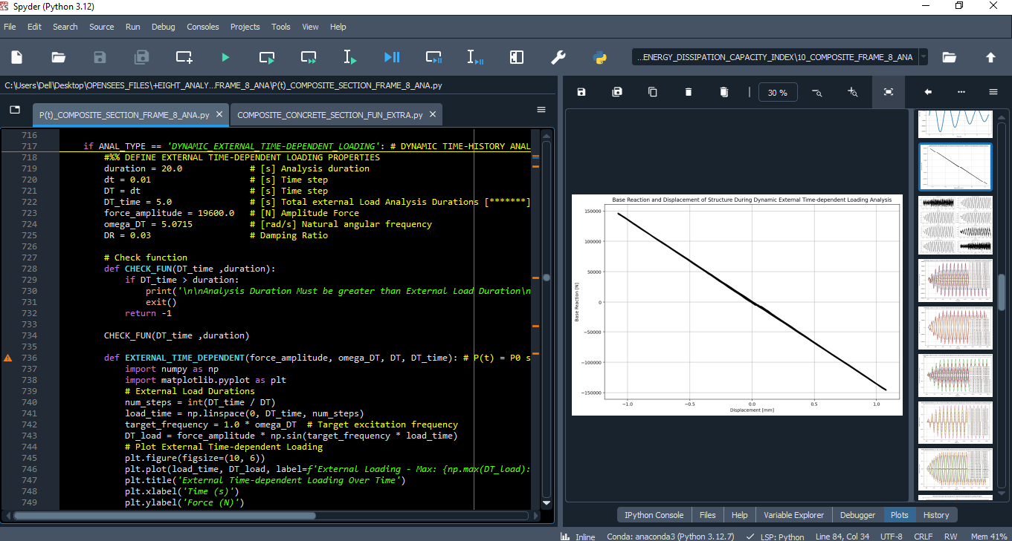

Slide 41
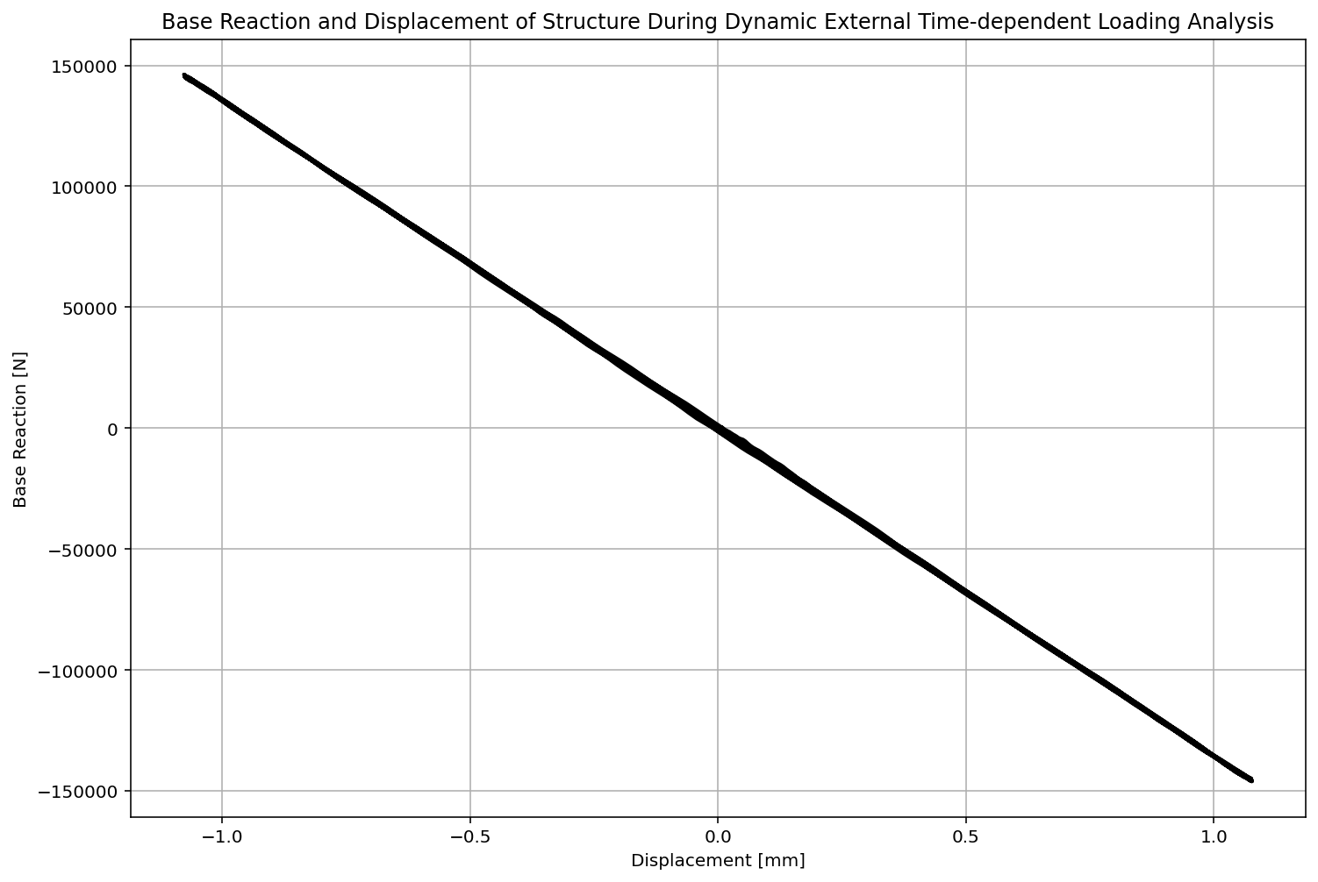

Slide 42
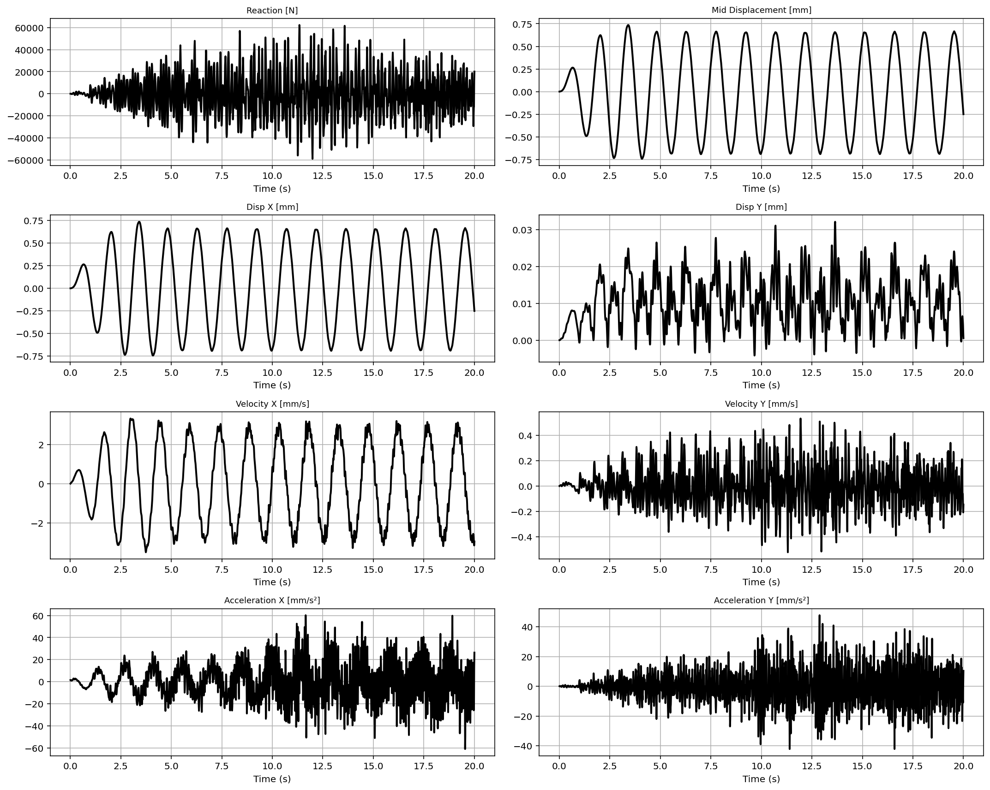

Slide 43
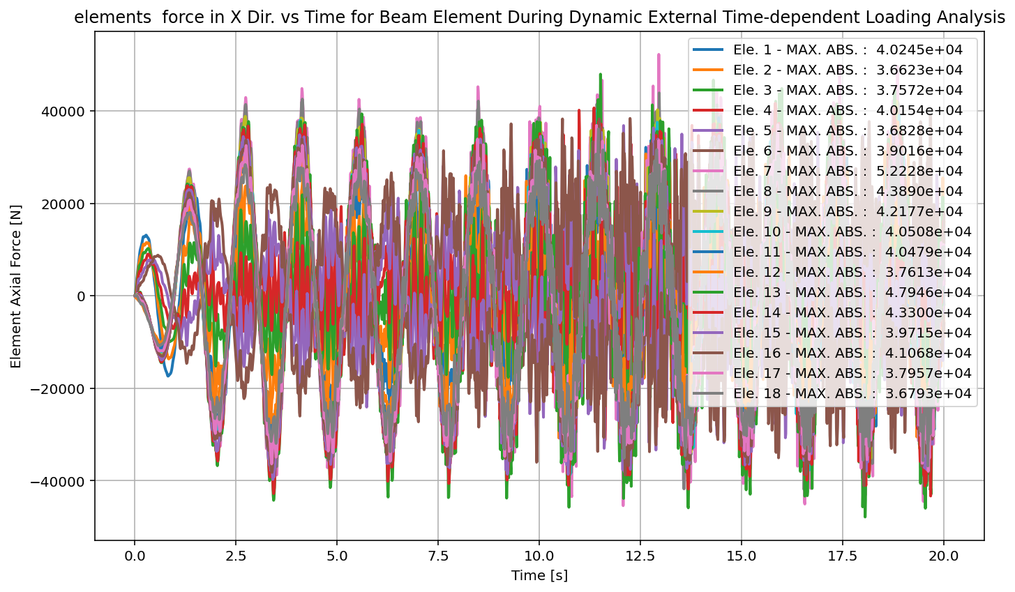

Slide 44
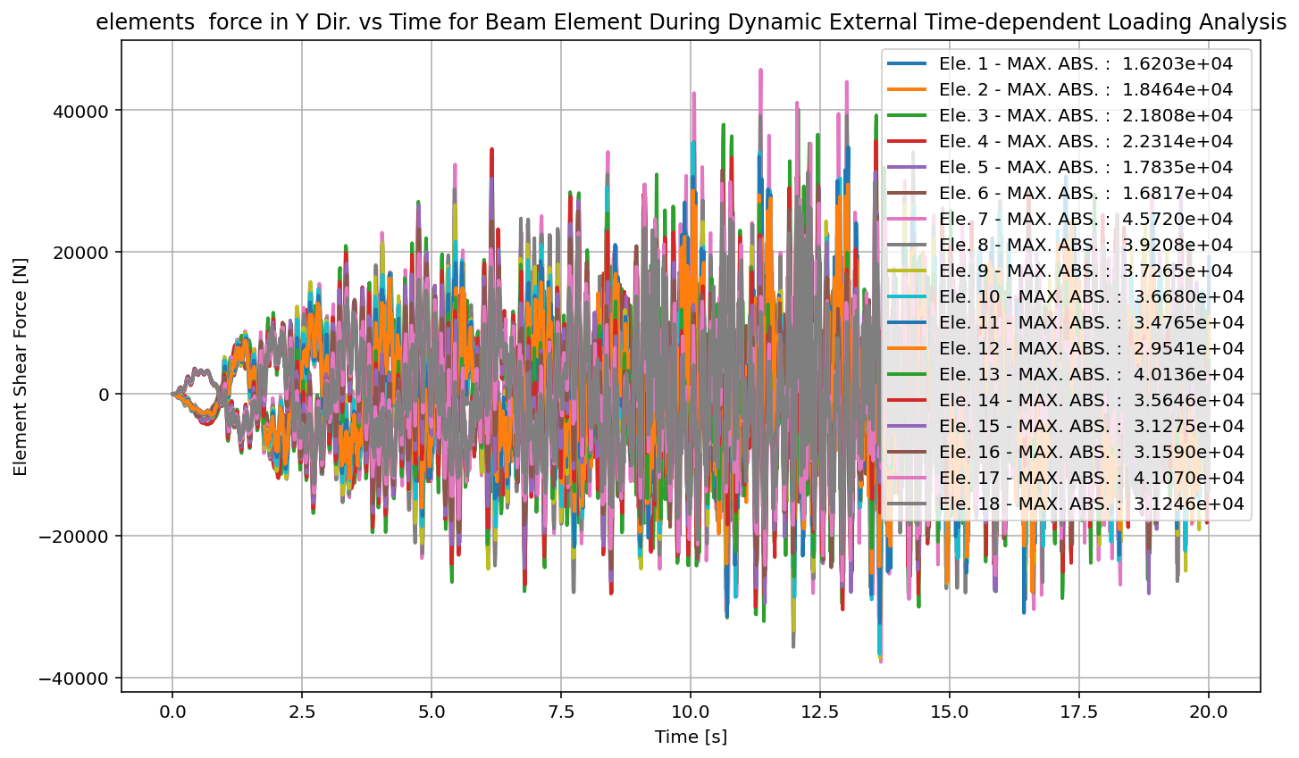

Slide 45
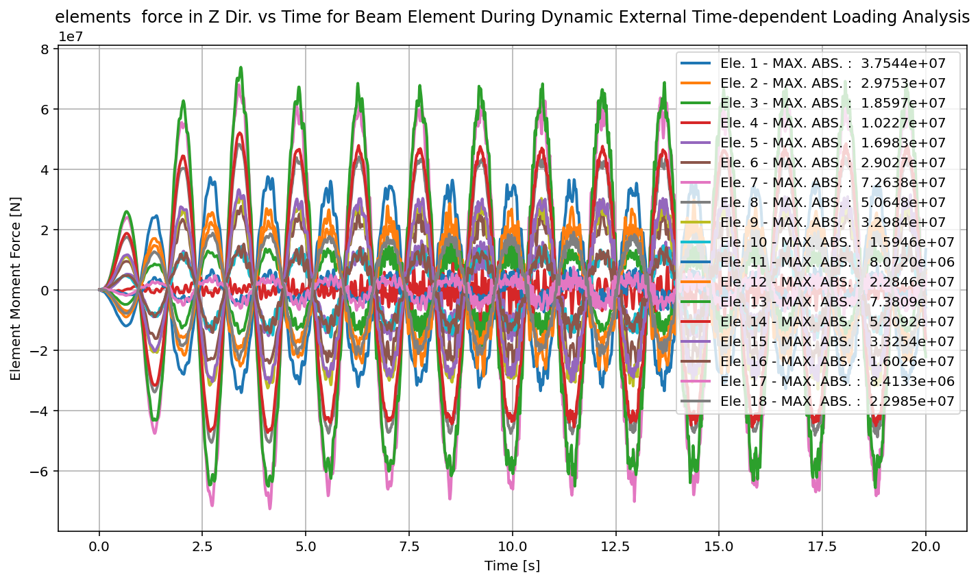

Slide 46
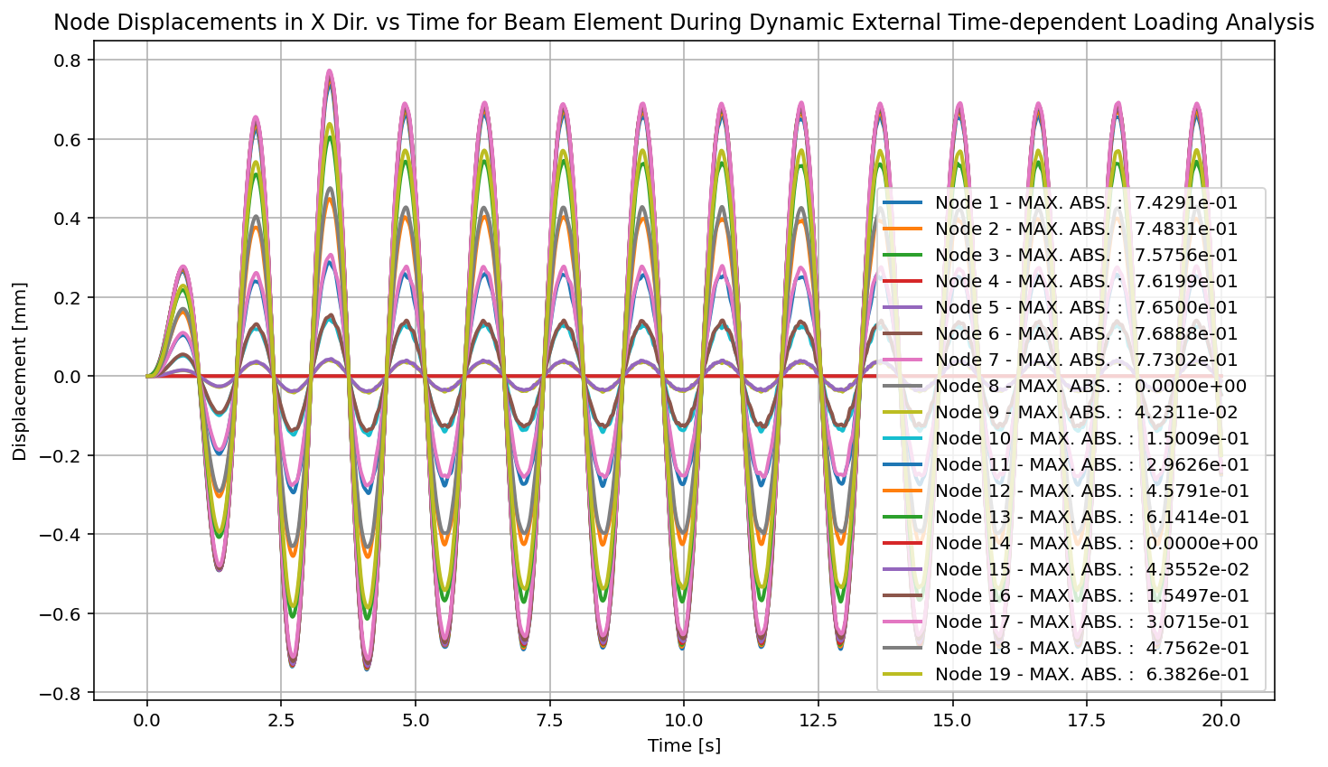

Slide 47
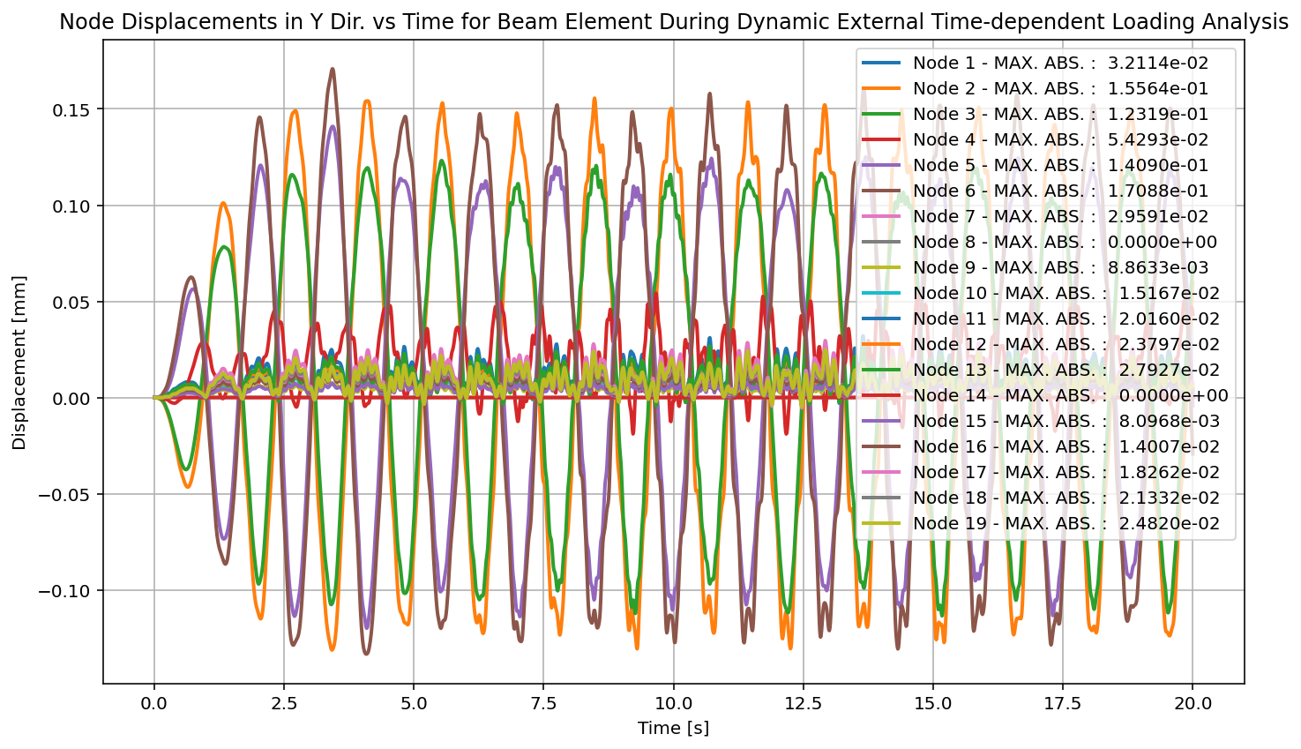

Slide 49
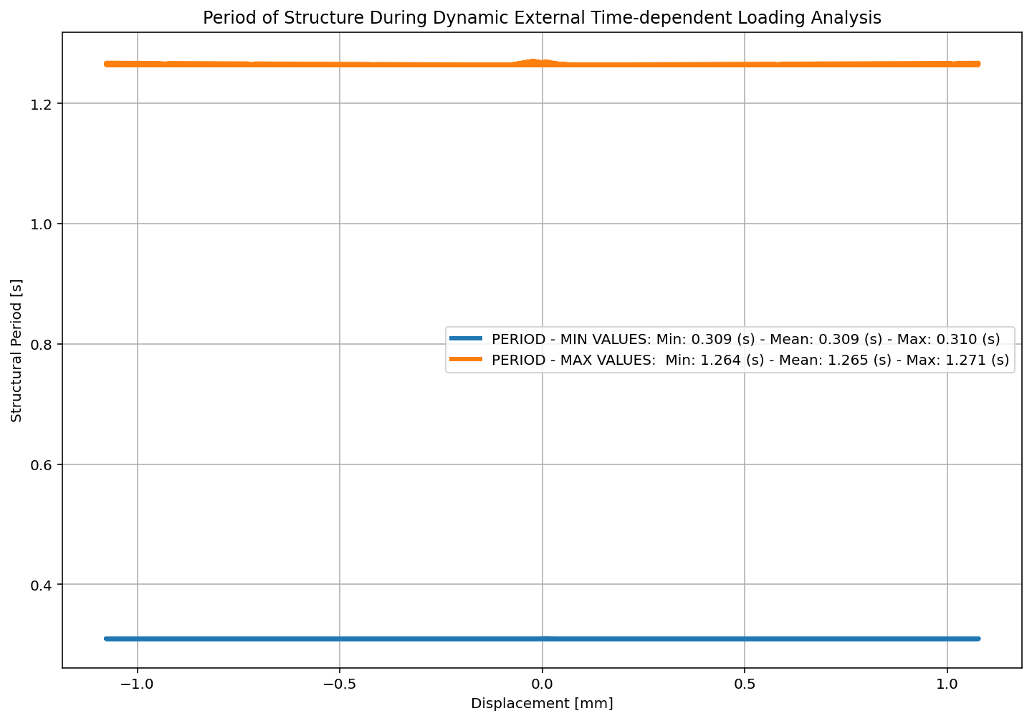

Slide 50
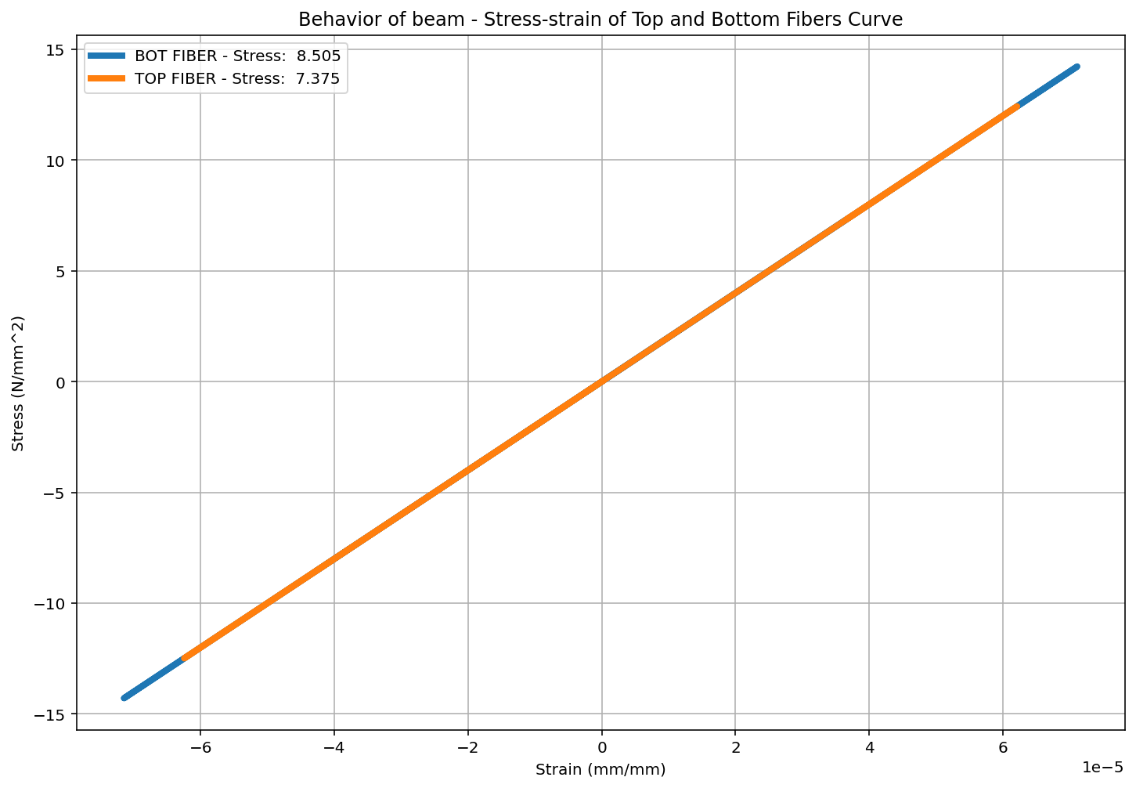

Slide 51
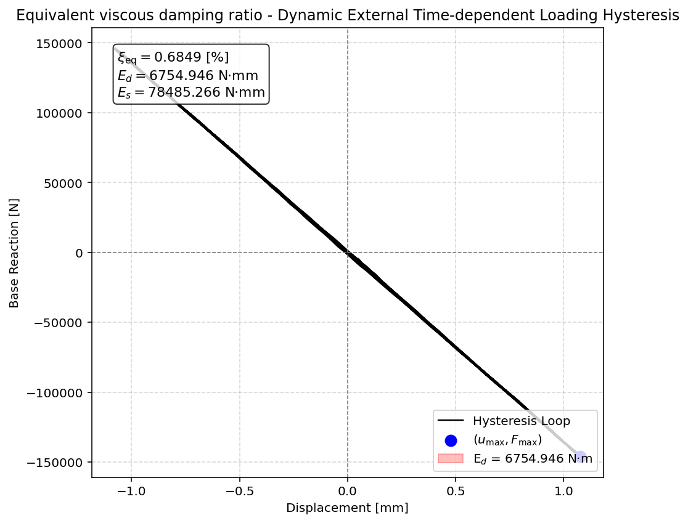

Slide 52
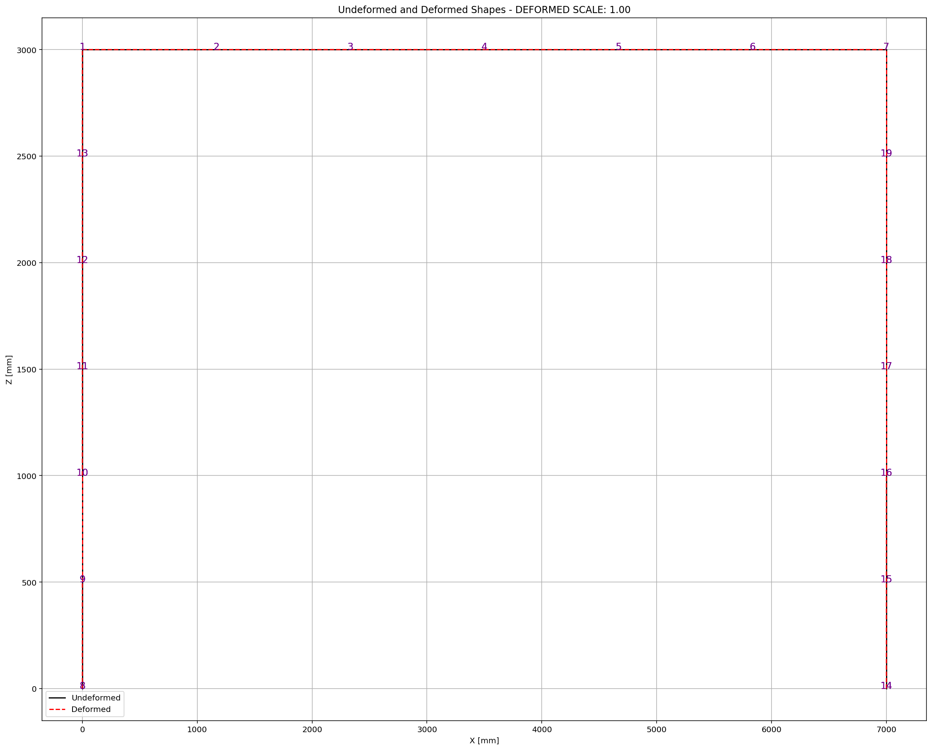

Slide 53
FREE-VIBRATION ANALYSIS

Slide 54
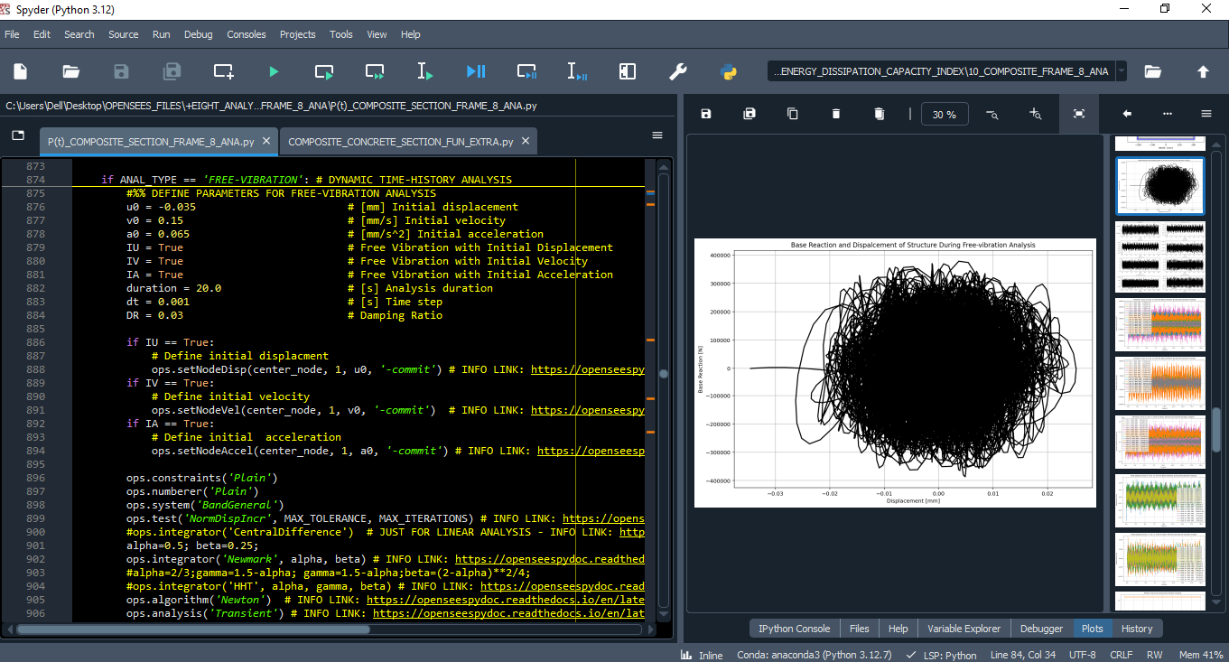

Slide 55
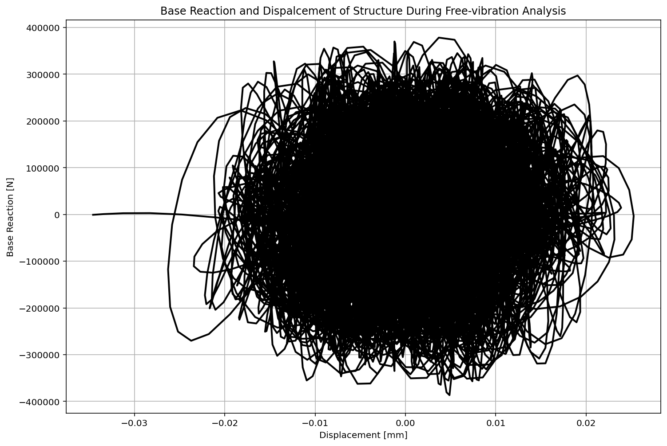

Slide 56
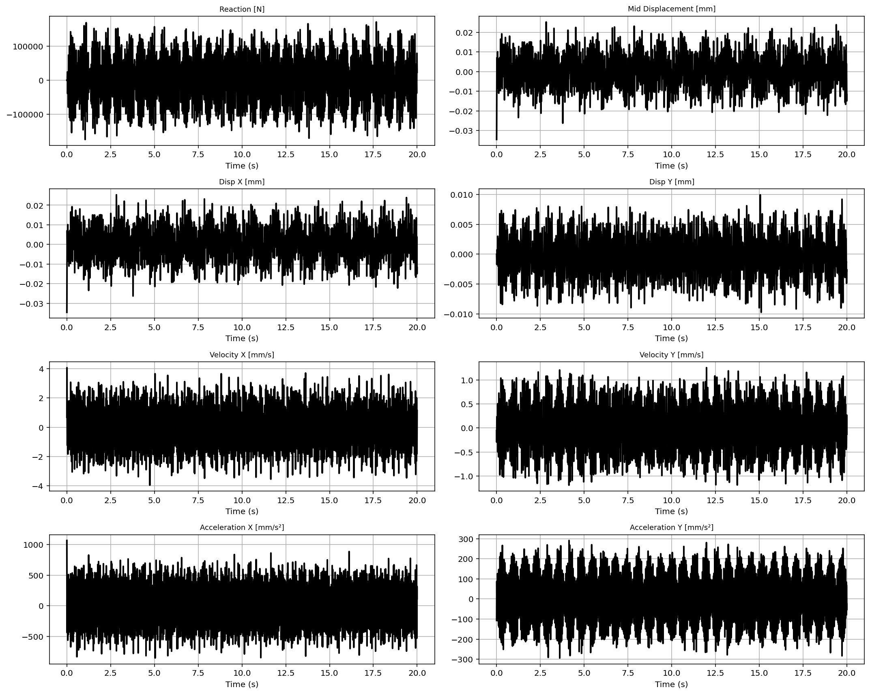

Slide 57
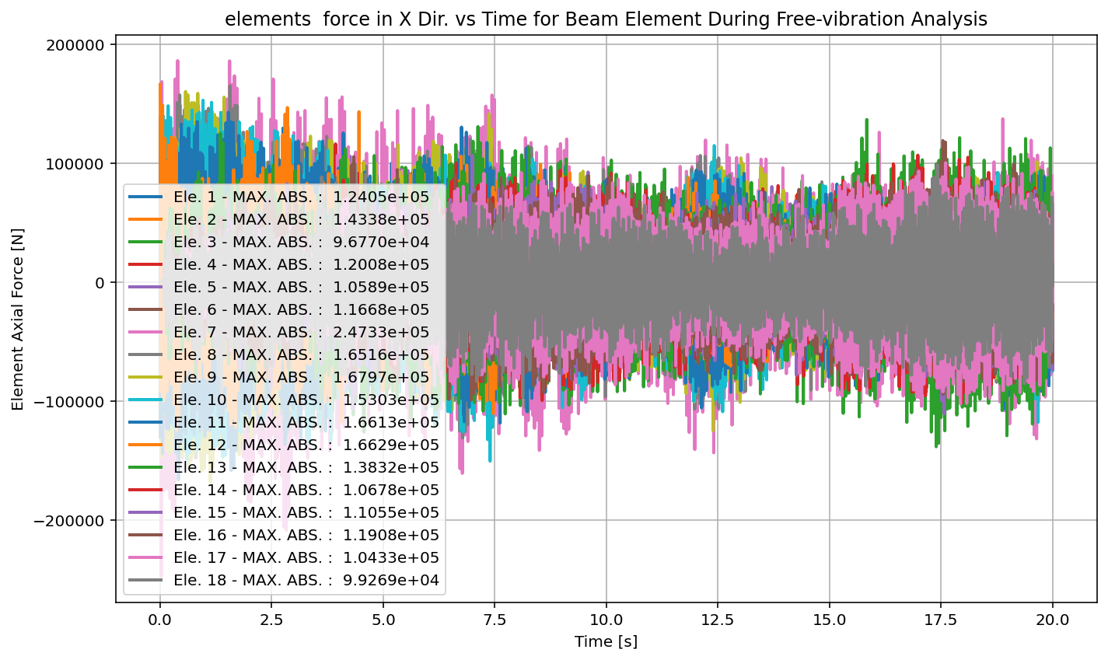

Slide 58
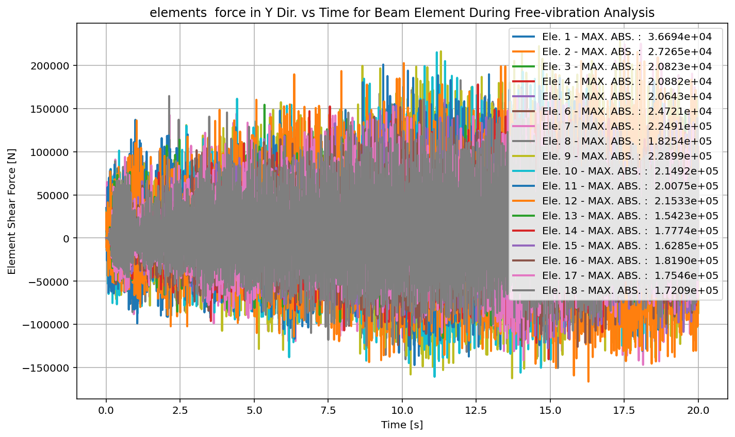

Slide 59
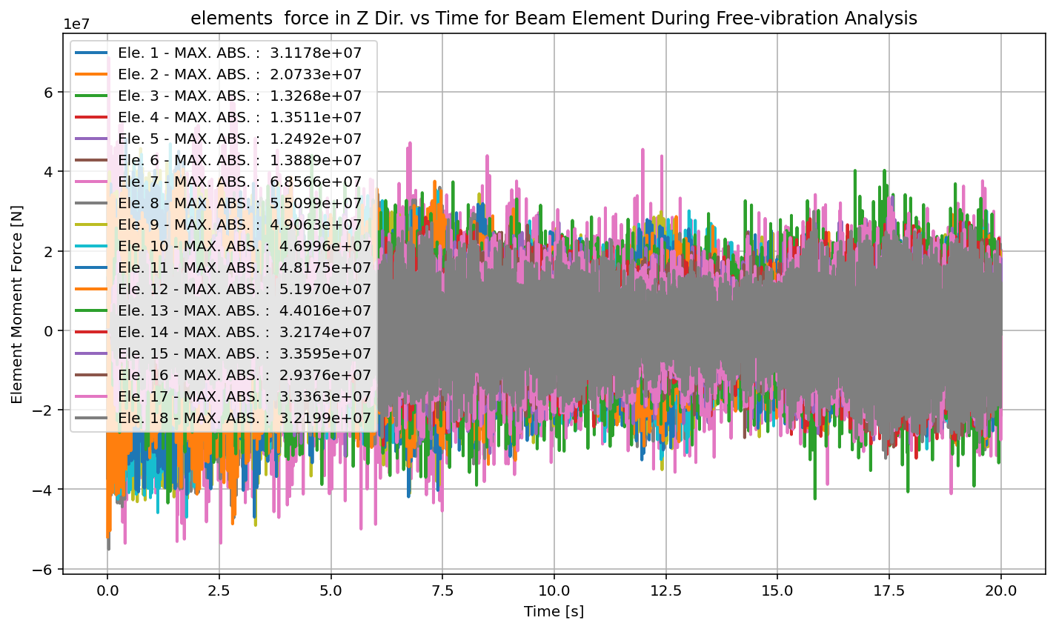

Slide 60


Slide 61


Slide 62


Slide 63


Slide 64


Slide 65


Slide 66


Slide 67


Slide 68
SEISMIC ANALYSIS

Slide 69


Slide 70


Slide 71


Slide 72


Slide 73


Slide 74


Slide 75


Slide 76


Slide 77


Slide 78


Slide 79


Slide 80


Slide 81


Slide 82


Slide 83


Slide 84
+==========================+
= Analysis curve fitted =
Disp Base Shear
----------------------------
[[0.00000000e+00 0.00000000e+00]
[1.23570961e+01 1.04798136e+06]
[3.50000000e+01 1.14617861e+06]]
+==========================+
+----------------------------------------------------+
Structure Elastic Stiffness : 84808.06
Structure Plastic Stiffness : 32747.96
Structure Tangent Stiffness : 4336.78
Structure Ductility Ratio : 2.83
Structure Over Strength Factor: 1.09
+----------------------------------------------------+
Over Strength Coefficient (Ω0): 1.0937
Displacement Ductility Ratio (μ): 2.8324
Ductility Coefficient (Rμ): 2.8324
Structural Behavior Coefficient (R): 3.0978
Structural Ductility Damage Index in X Direction: -53.2265 (%)

Slide 85


Slide 86


Slide 87
Dissipated Energy from Earthquake= 4320.60 N·mm
Dissipated Energy from Cyclic Displacement= 141183337.85 N·mm
DISSIPATED ENERGY CAPACITY INDEX: 0.003 [%]
ZONE 1: VERY MINOR DAMAGE

