Slide 1
IN THE NAME OF ALLAH, THE MOST GRACIOUS, THE MOST MERCIFUL
PUSHOVER ANALYSIS OF CONCRETE FRAME. EVALUATING STRAIN HARDENING AND ULTIMATE STRAIN CRITERIA USING OPENSEES AND CALCULATE STRUCTURAL BEHAVIOR COEFFICIENT
WRITTEN BY SALAR DELAVAR GHASHGHAEI (QASHQAI)

Slide 2
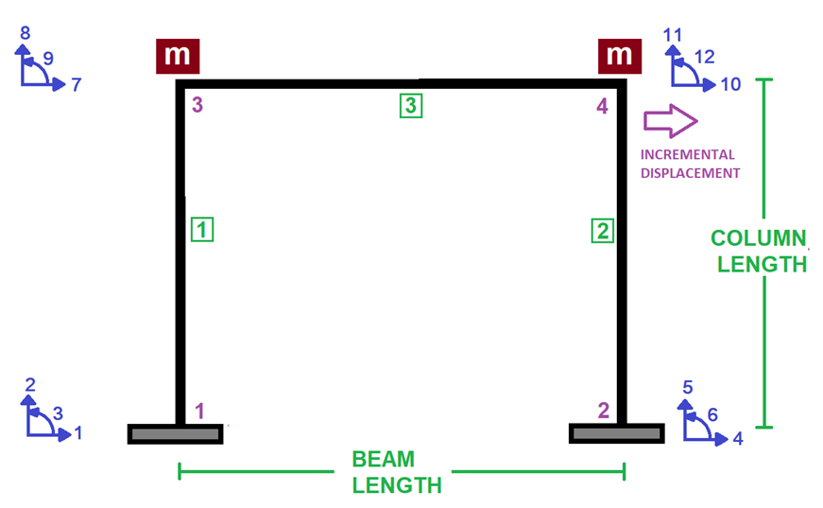

Slide 3
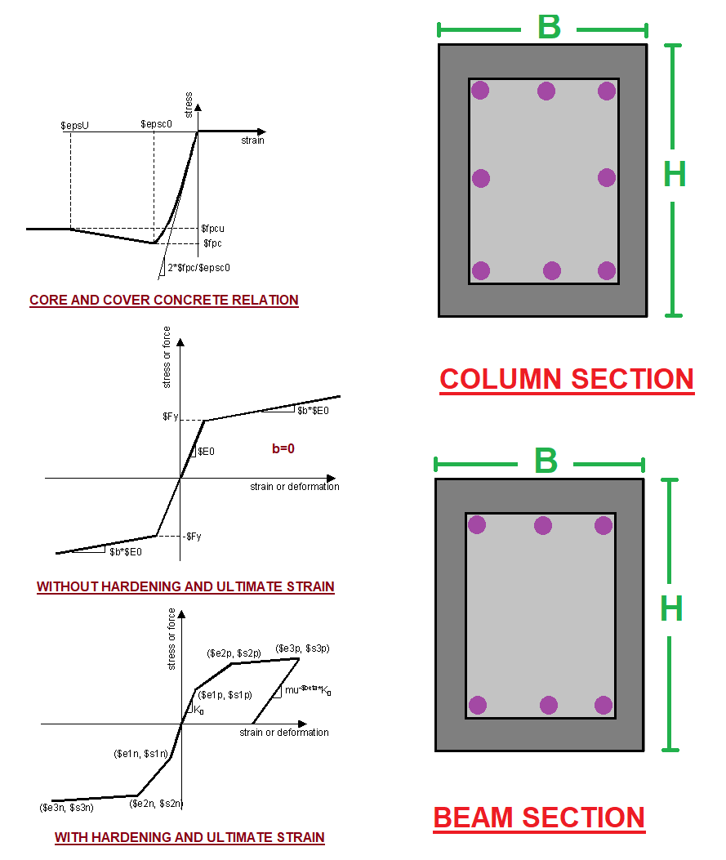

Slide 4
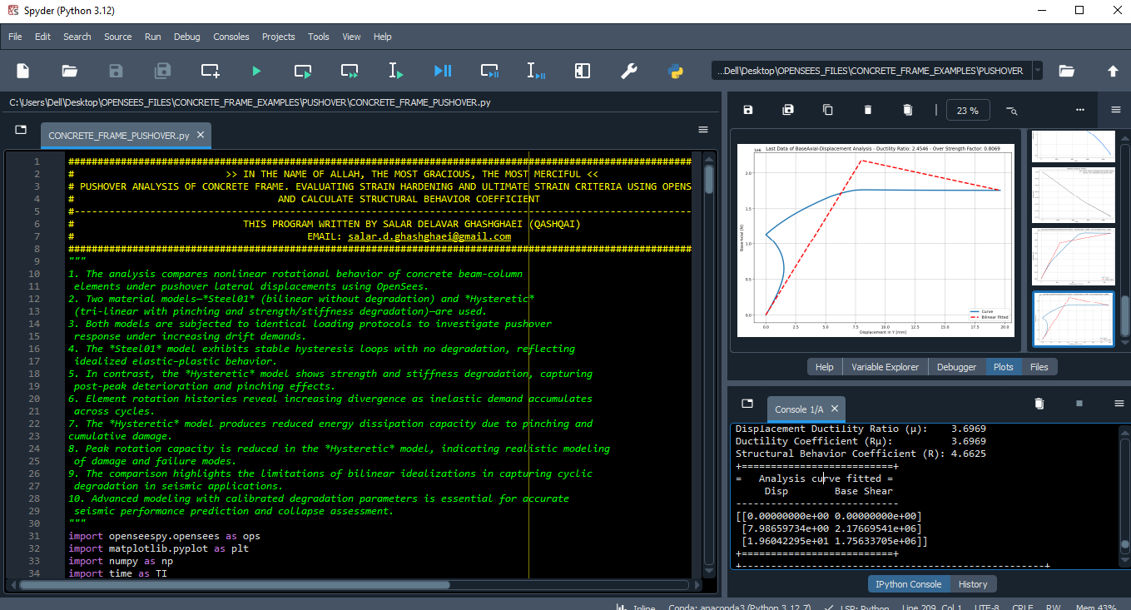

Slide 5
NONLINEAR STATIC ANALYSIS
(PUSHOVER)

Slide 6
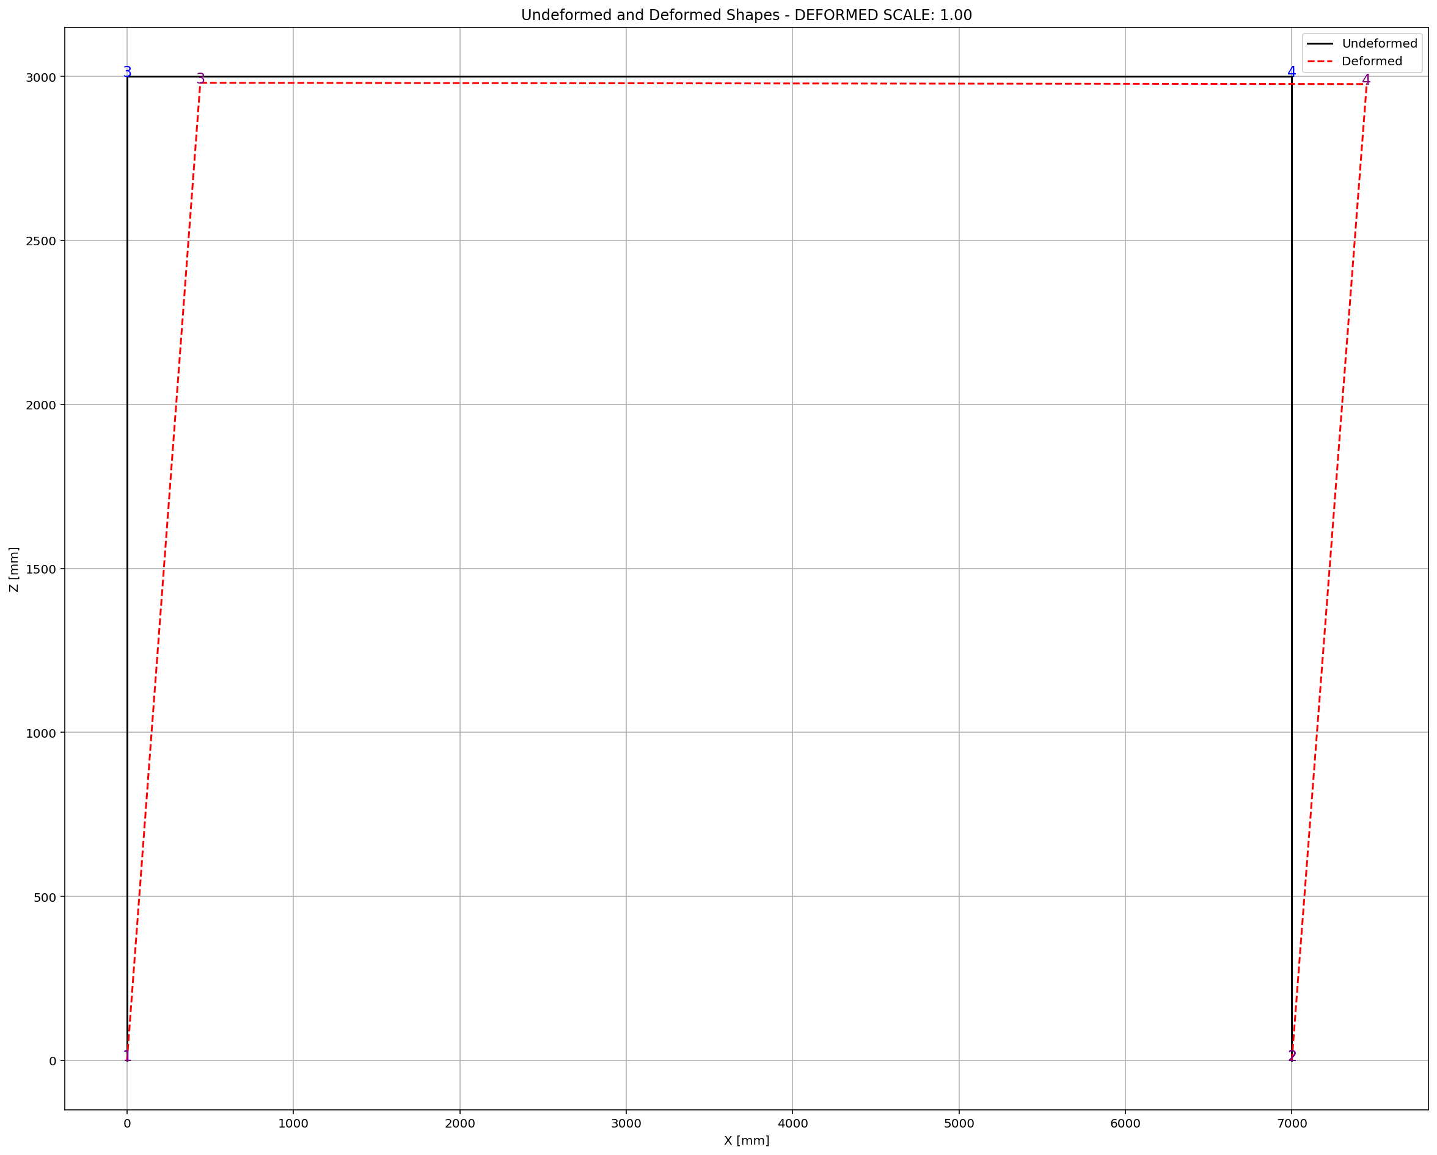

Slide 7
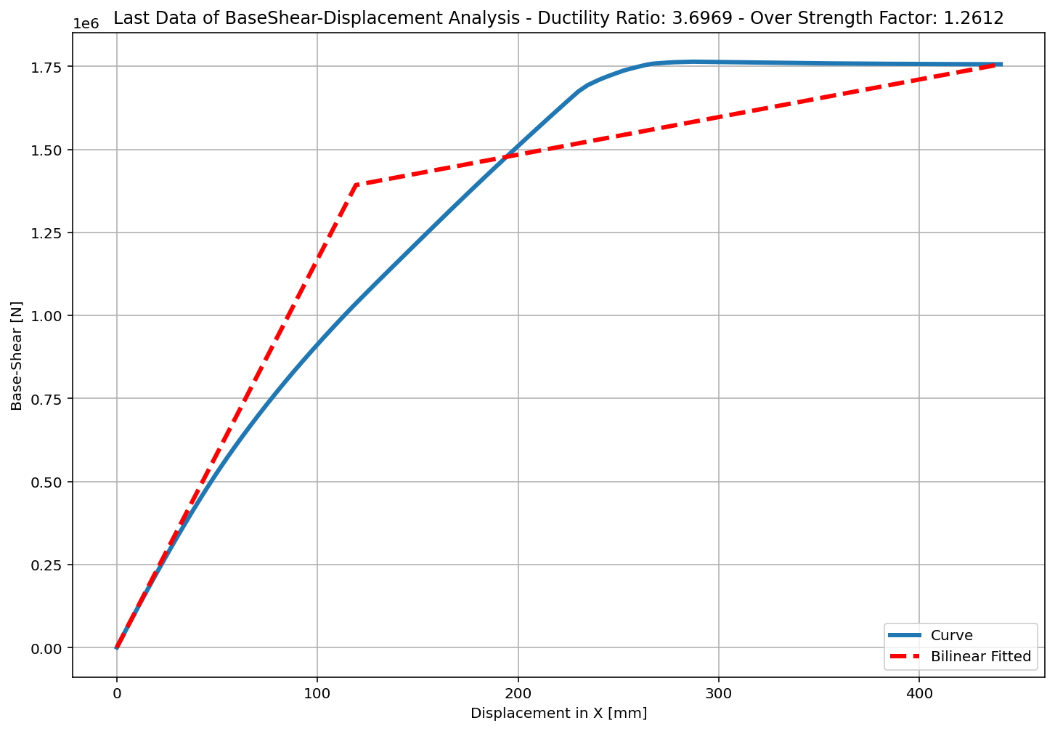
+==========================+
= Analysis curve fitted =
Disp Base Shear
----------------------------
[[0.00000000e+00 0.00000000e+00]
[1.19153827e+02 1.39259952e+06]
[4.40497762e+02 1.75633705e+06]]
+==========================+
+----------------------------------------------------+
Structure Elastic Stiffness : 11687.41
Structure Plastic Stiffness : 3987.16
Structure Tangent Stiffness : 1131.93
Structure Ductility Ratio : 3.70
Structure Over Strength Factor: 1.26
+----------------------------------------------------+
Over Strength Coefficient (Ω0): 1.2612
Displacement Ductility Ratio (μ): 3.6969
Ductility Coefficient (Rμ): 3.6969
Structural Behavior Coefficient (R): 4.6625

Slide 8
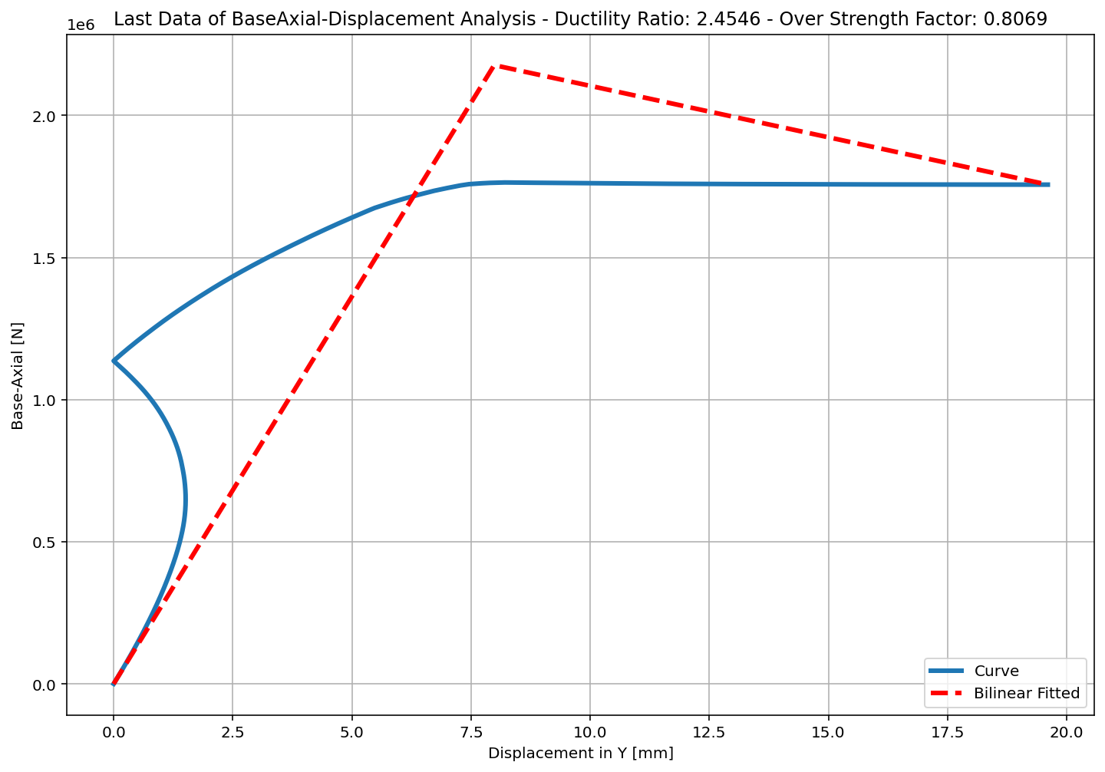
+==========================+
= Analysis curve fitted =
Disp Base Shear
----------------------------
[[0.00000000e+00 0.00000000e+00]
[7.98659734e+00 2.17669541e+06]
[1.96042295e+01 1.75633705e+06]]
+==========================+
+----------------------------------------------------+
Structure Elastic Stiffness : 272543.53
Structure Plastic Stiffness : 89589.70
Structure Tangent Stiffness : -36182.79
Structure Ductility Ratio : 2.45
Structure Over Strength Factor: 0.81
+----------------------------------------------------+
Over Strength Coefficient (Ω0): 0.8069
Displacement Ductility Ratio (μ): 2.4546
Ductility Coefficient (Rμ): 2.4546
Structural Behavior Coefficient (R): 1.9806

Slide 9
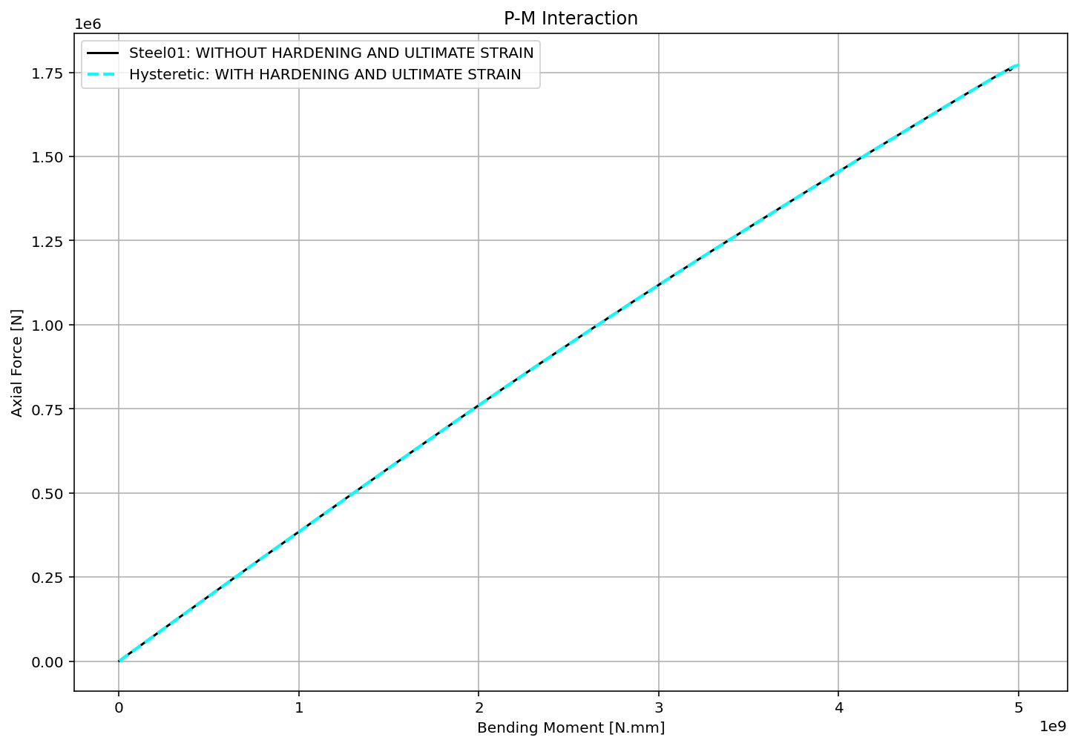

Slide 10
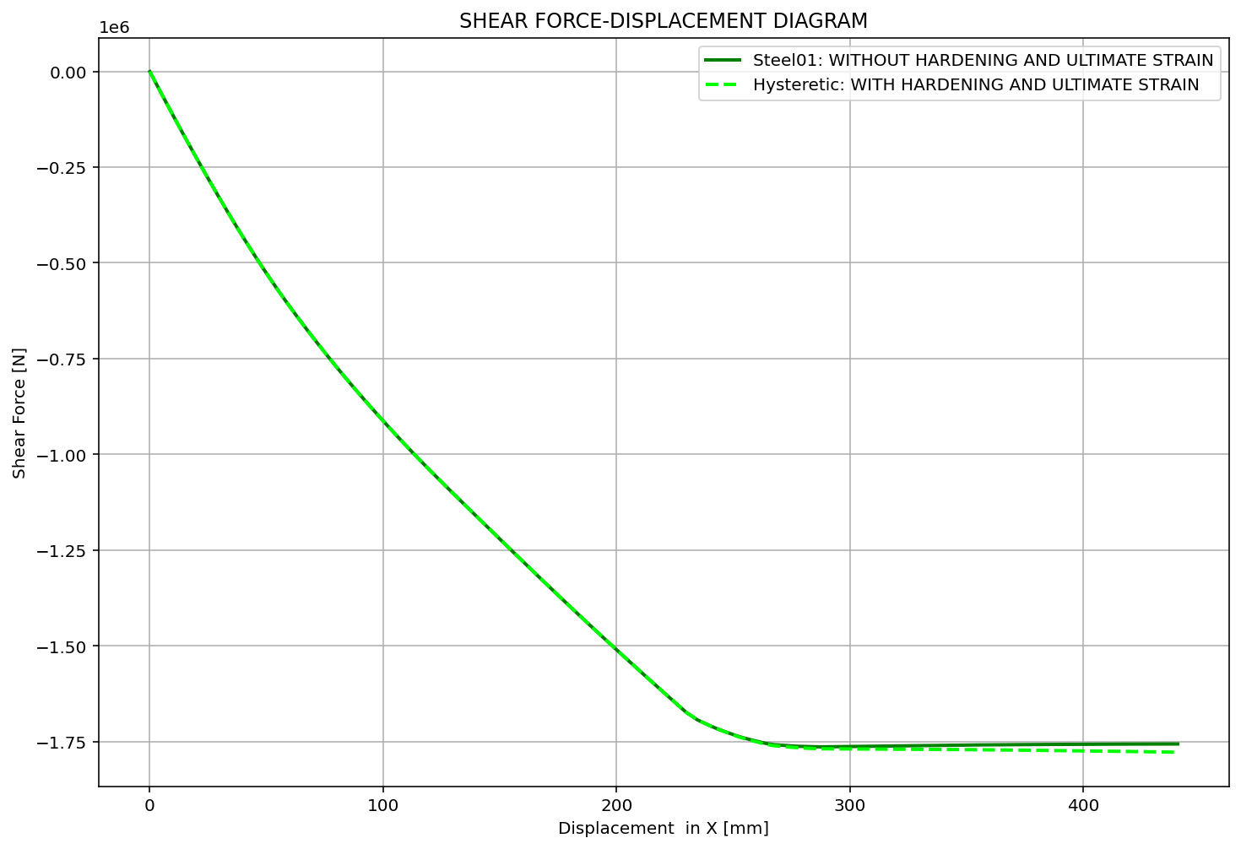

Slide 11
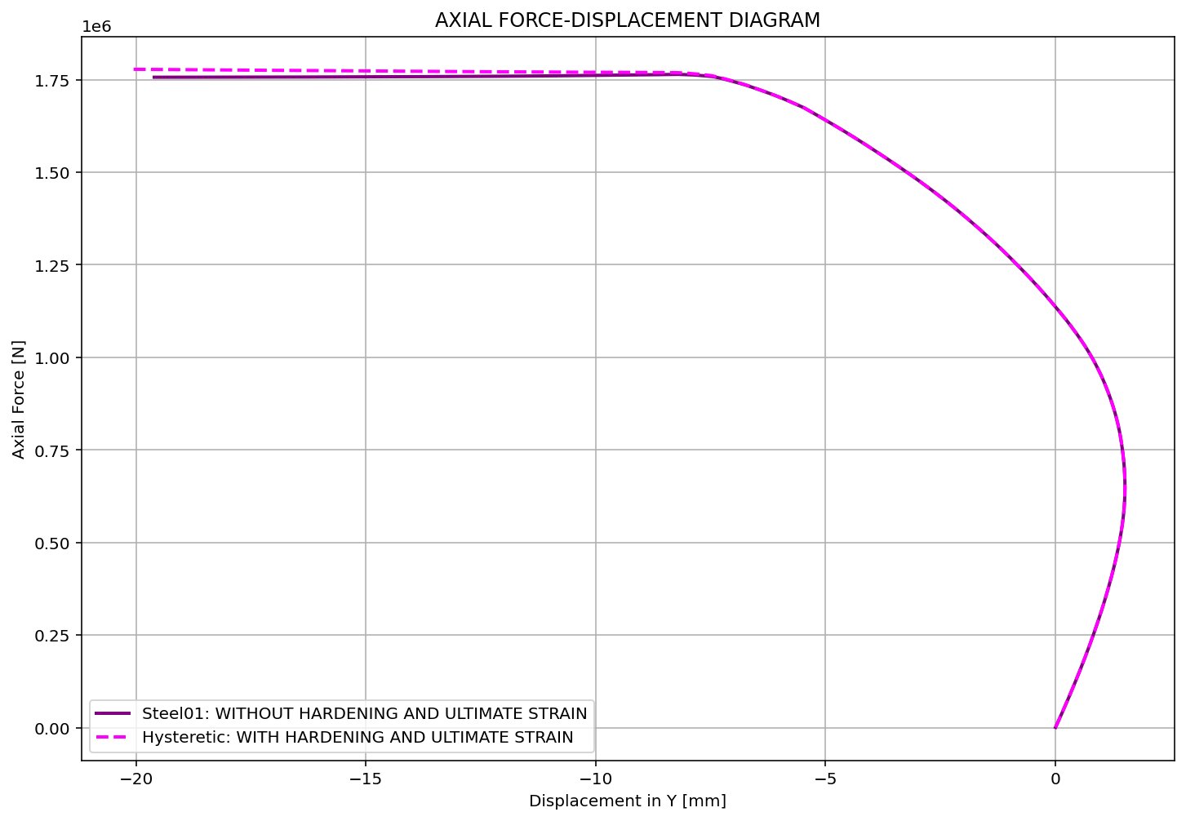

Slide 12
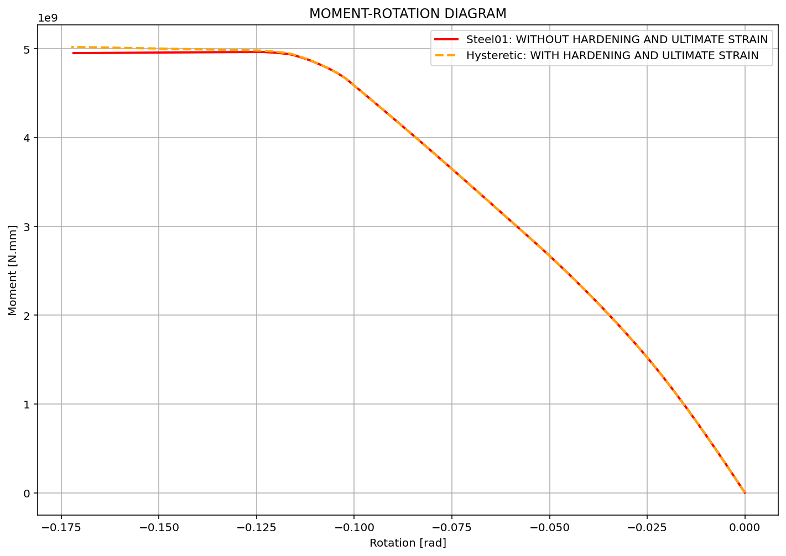

Slide 13
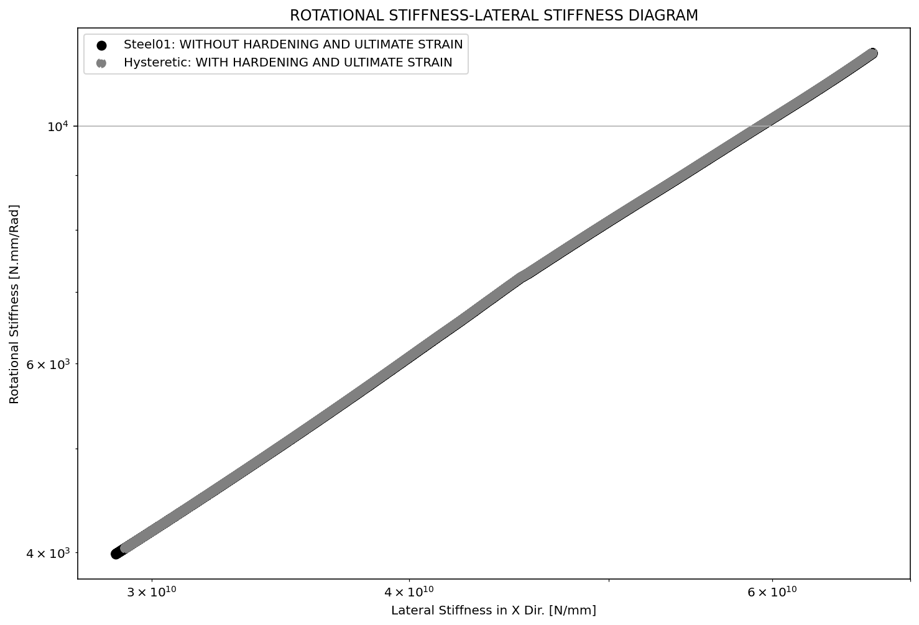

Slide 14
