Slide 1
>> IN THE NAME OF ALLAH, THE MOST GRACIOUS, THE MOST MERCIFUL <<
SENSITIVITY ANALYSIS OF SOIL DAMPING RATIO, YIELD STRENGTH, ELASTIC STIFFNESS, DUCTILITY RATIO AND OVER-STRENGTH FACTOR ON THE SEISMIC PERFORMANCE OF SOIL–STRUCTURE MDOF SYSTEMS USING OPENSEES: CYCLIC DISPLACEMENT AND SEISMIC TIME-HISTORY ANALYSES WITH EVALUATION OF PERIOD ELONGATION,ENERGY DISSIPATION CAPACITY INDEX, EQUIVALENT VISCOUS DAMPING RATIO, DUCTILITY DAMAGE INDEX AND RECONSTRUCTION COST
THIS PYTHON SCRIPT IS WRITTEN BY SALAR DELAVAR GHASHGHAEI (QASHQAI)

Slide 2
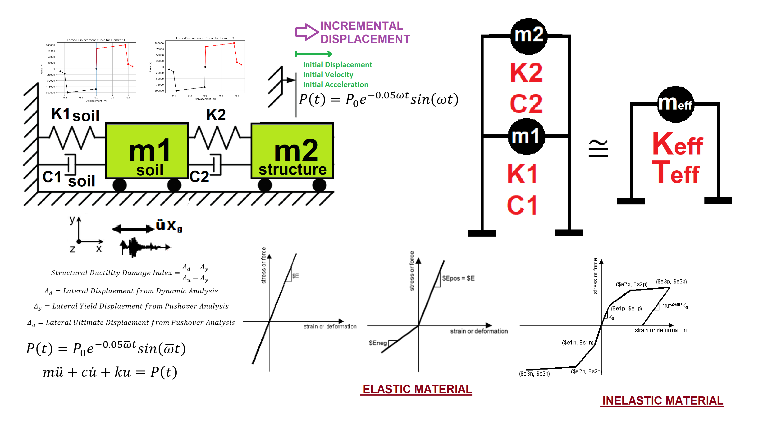

Slide 3
This OpenSeesPy-based Python framework performs a comprehensive multi-parameter
sensitivity analysis of a two-degree-of-freedom nonlinear soil–structure system subjected
to both cyclic displacement protocols and selected ground-motion time histories.
By systematically varying soil yield strength, elastic stiffness, ductility ratio,
over-strength factor, and viscous damping ratios of both soil and structure across a
discrete design space, the code assembles a high-fidelity hysteretic model using multi-linear
OpenSees hysteretic materials and parallel viscous dampers, extracts instantaneous eigenvalue
periods at every analysis step to quantify period elongation, and computes a suite of performance
metrics including peak displacement, velocity and acceleration demands, energy-dissipation capacity
index, equivalent viscous damping ratio from hysteresis loops, ductility-based damage index, and
reconstruction cost. Extensive post-processing then generates correlation scatter plots,
three-dimensional response surfaces, Pearson sensitivity heatmaps, Random-Forest safety
classification, and both main-effect and interaction ANOVA tables, thereby ranking the relative
influence of each soil and structural parameter on seismic performance and providing a rigorous
quantitative basis for performance-based design and risk assessment of soil–structure systems.

Slide 4
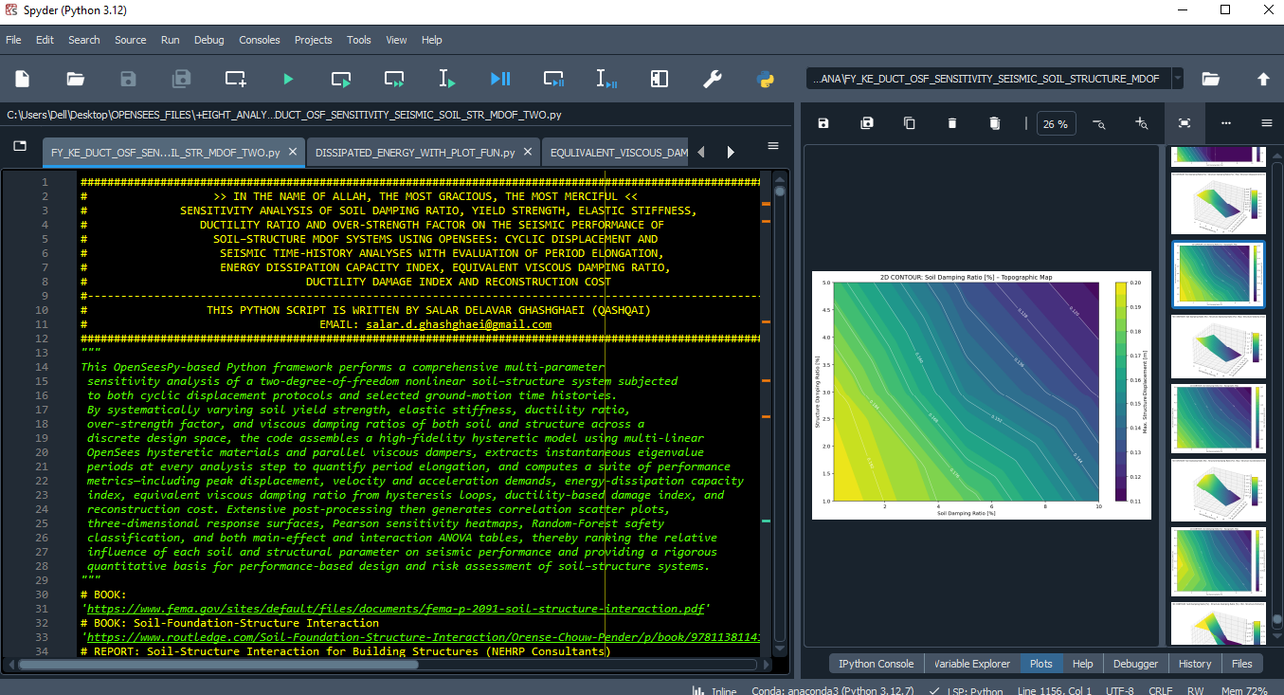

Slide 5
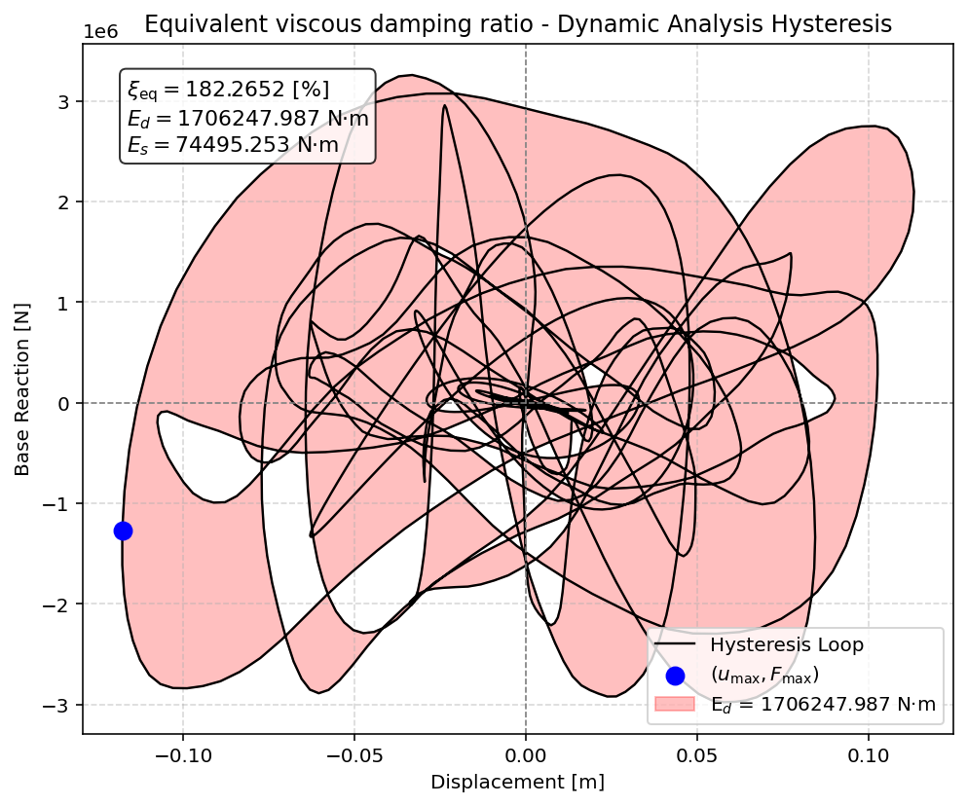

Slide 6
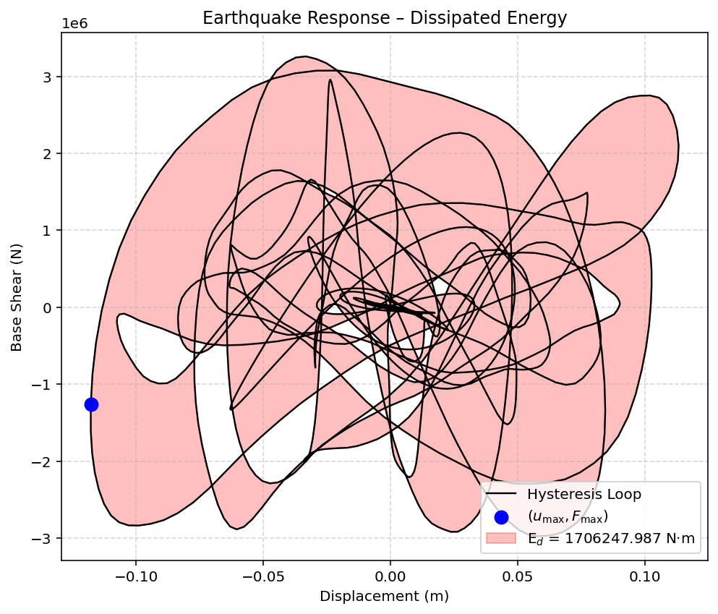

Slide 7
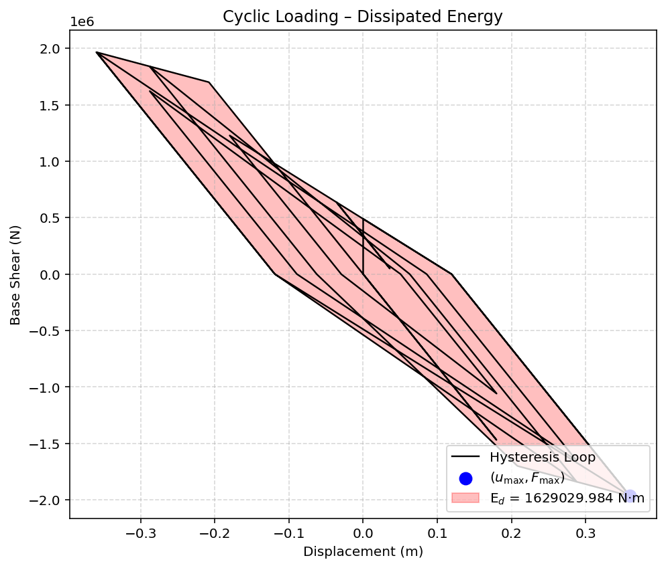

Slide 8
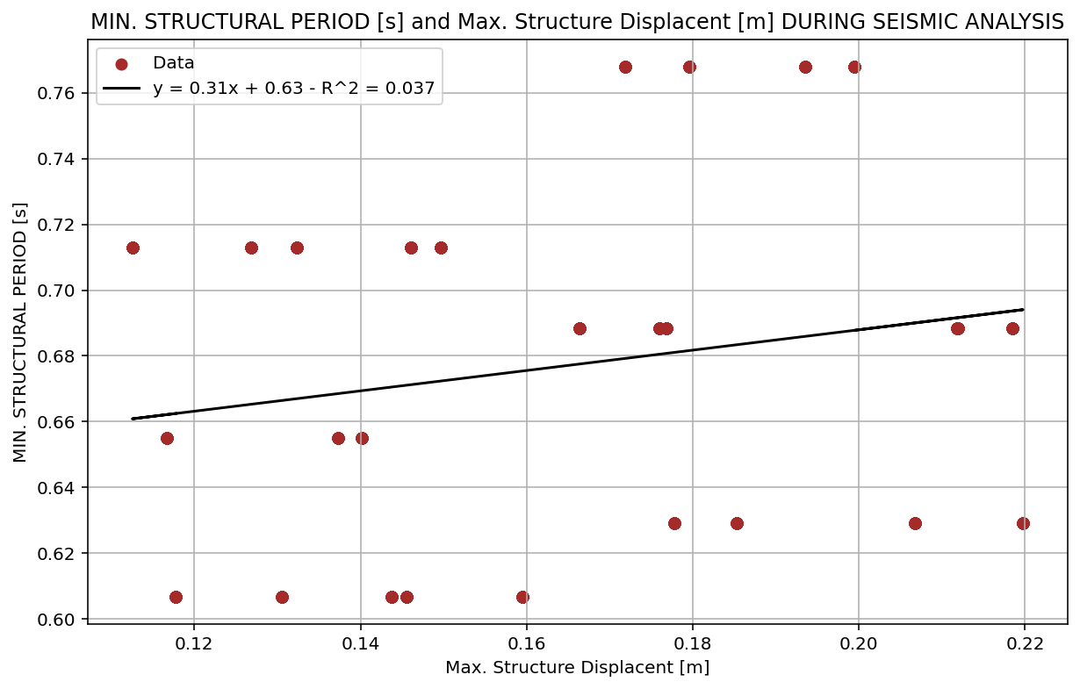

Slide 9
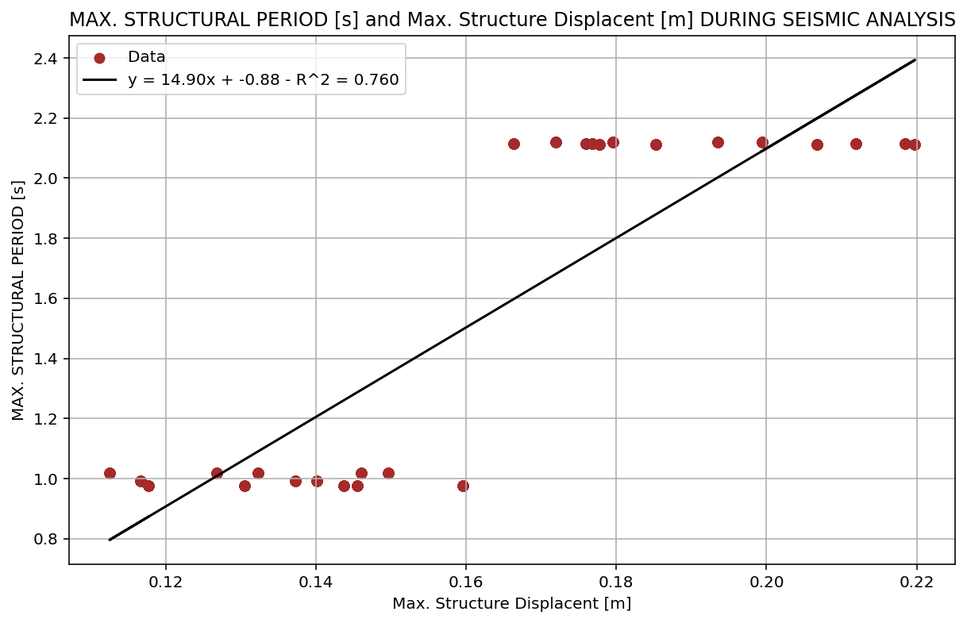

Slide 10
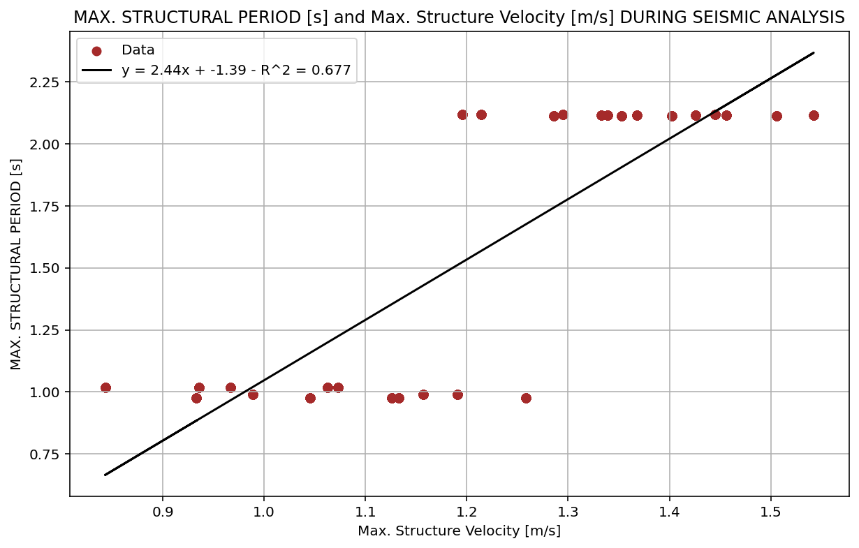

Slide 11
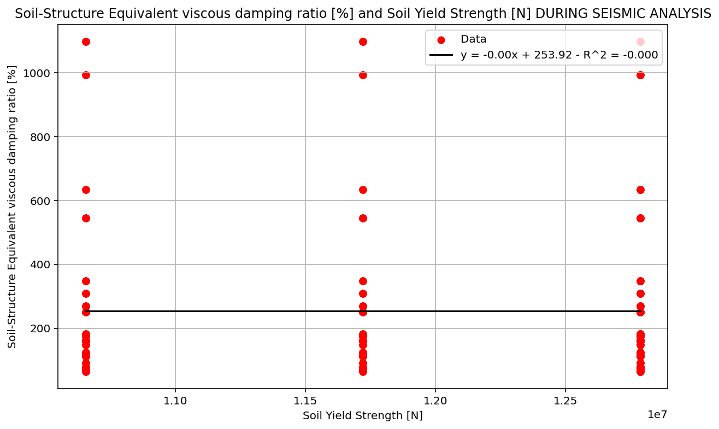

Slide 12
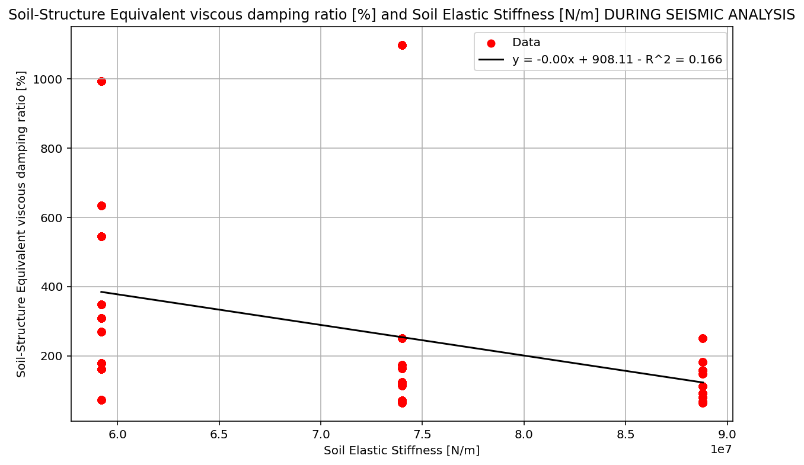

Slide 13
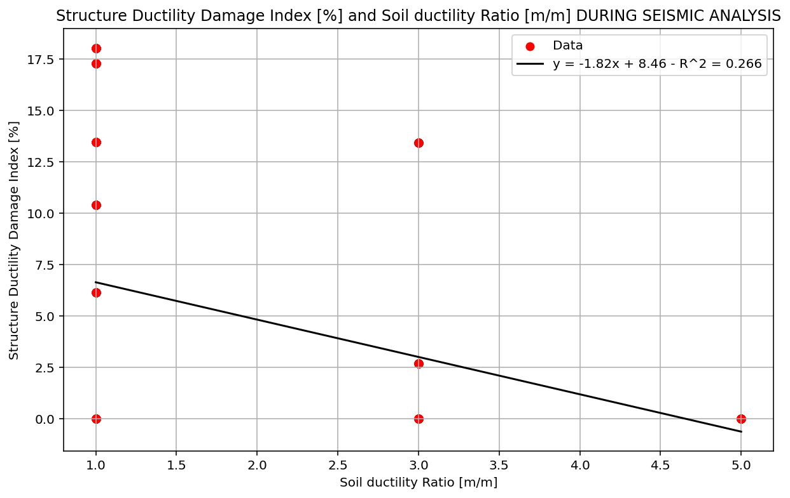

Slide 14
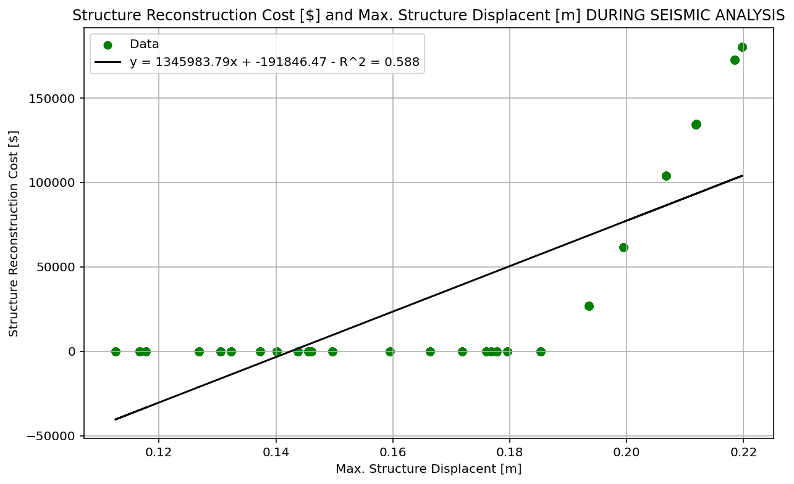

Slide 15
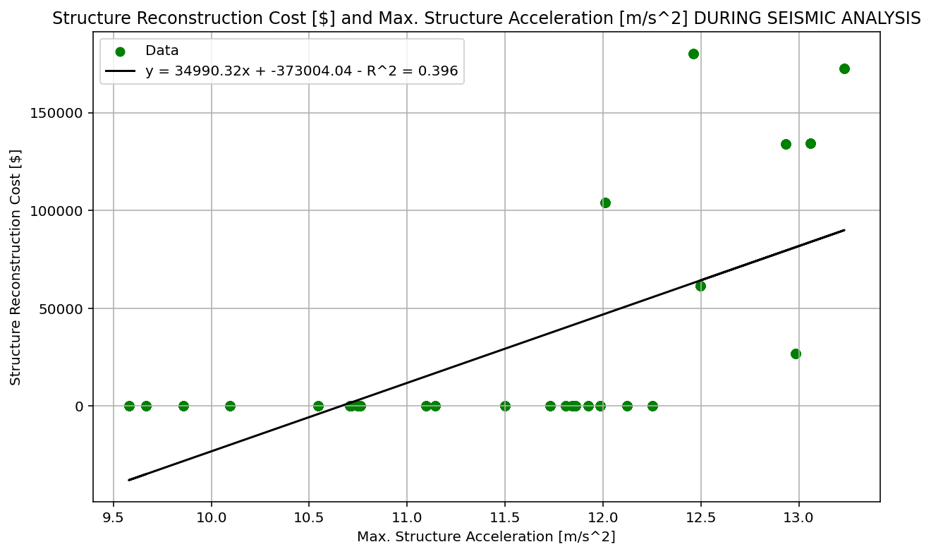

Slide 16
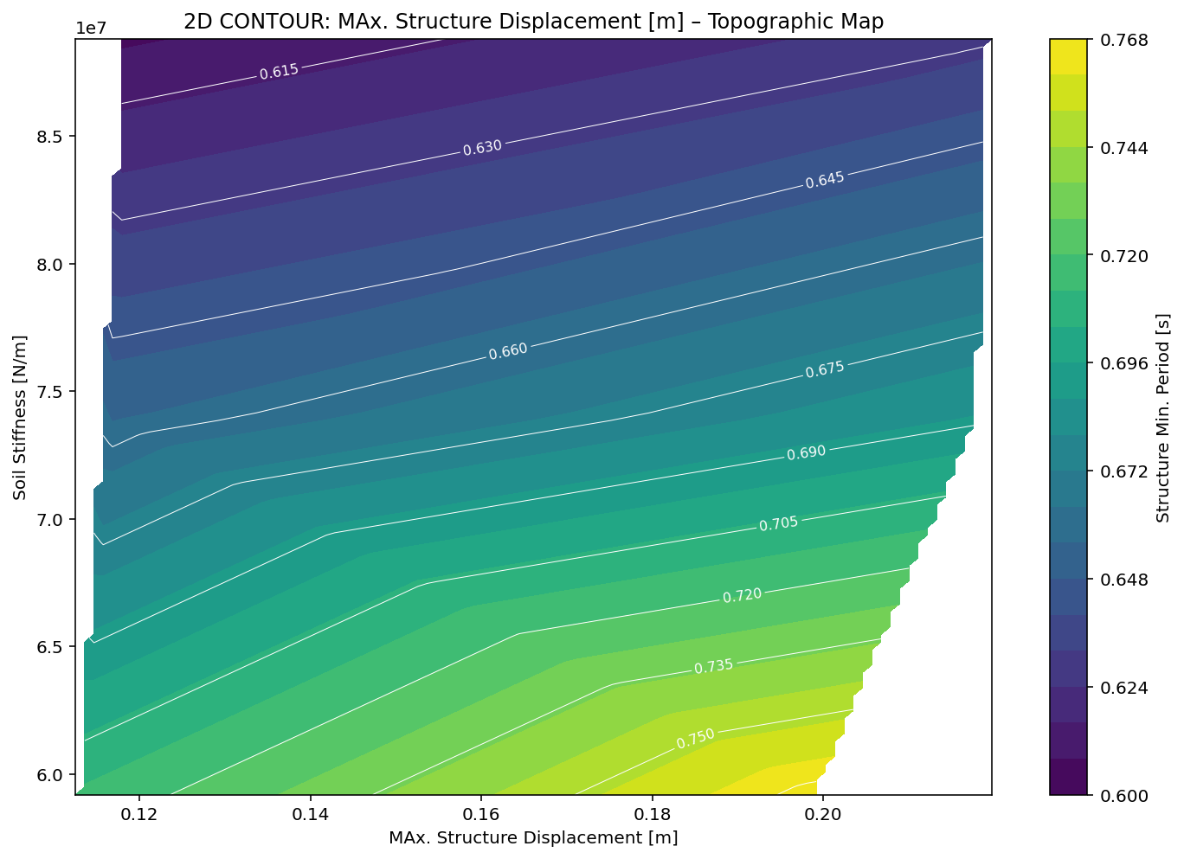

Slide 17
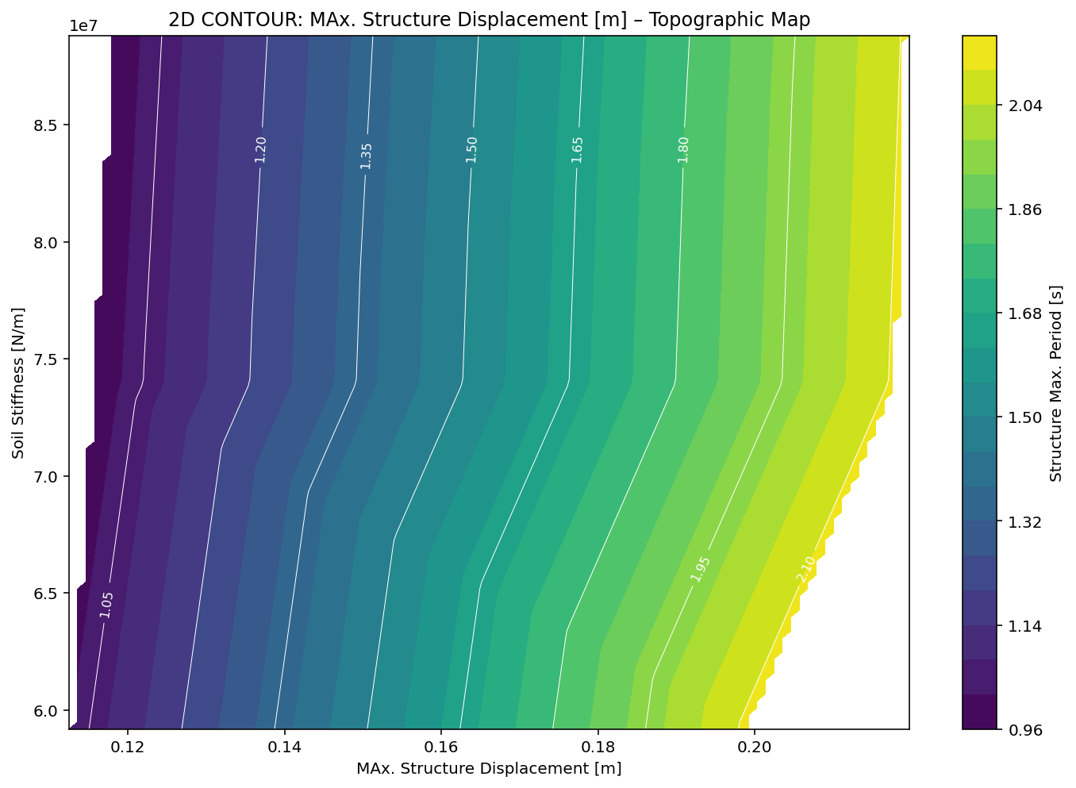

Slide 18
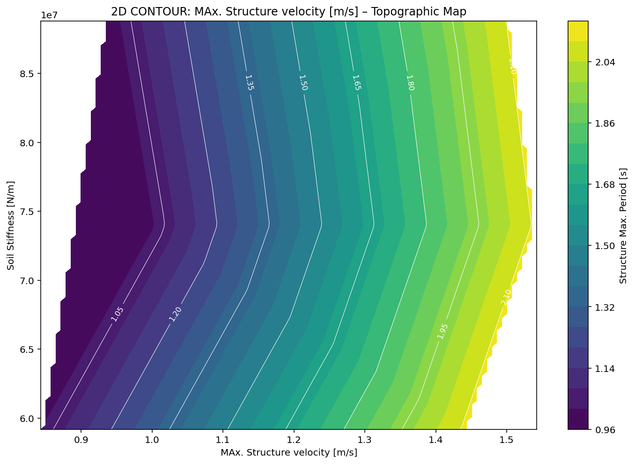

Slide 19
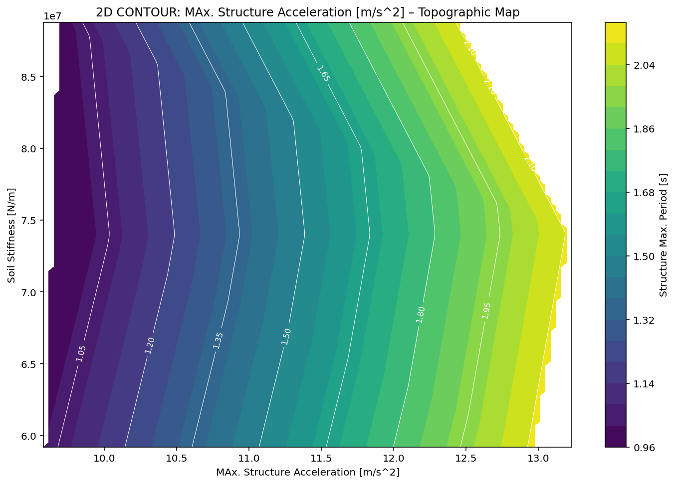

Slide 20
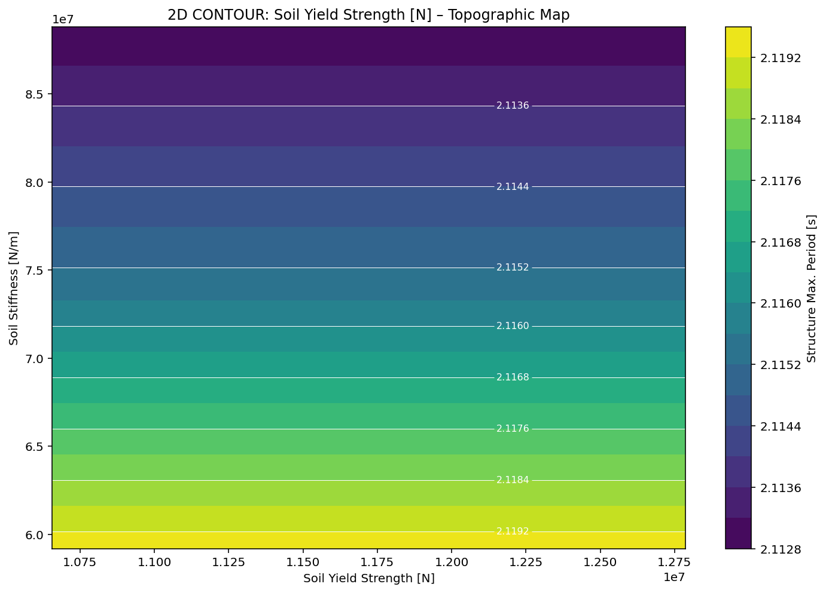

Slide 21
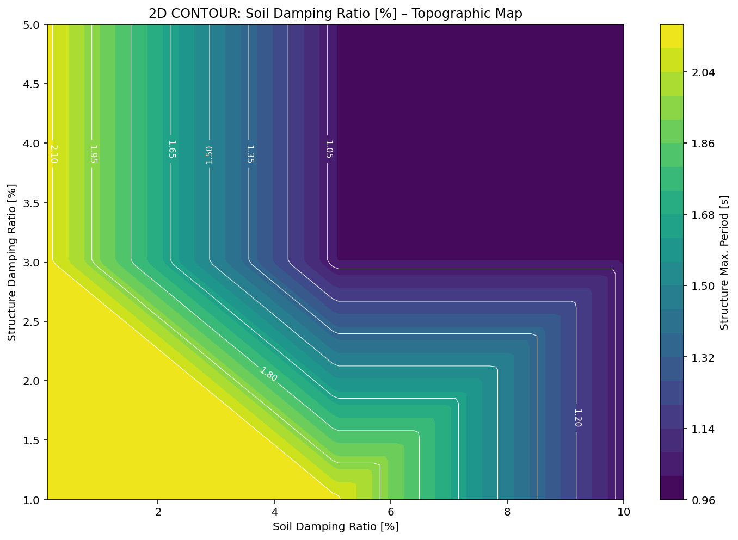

Slide 22
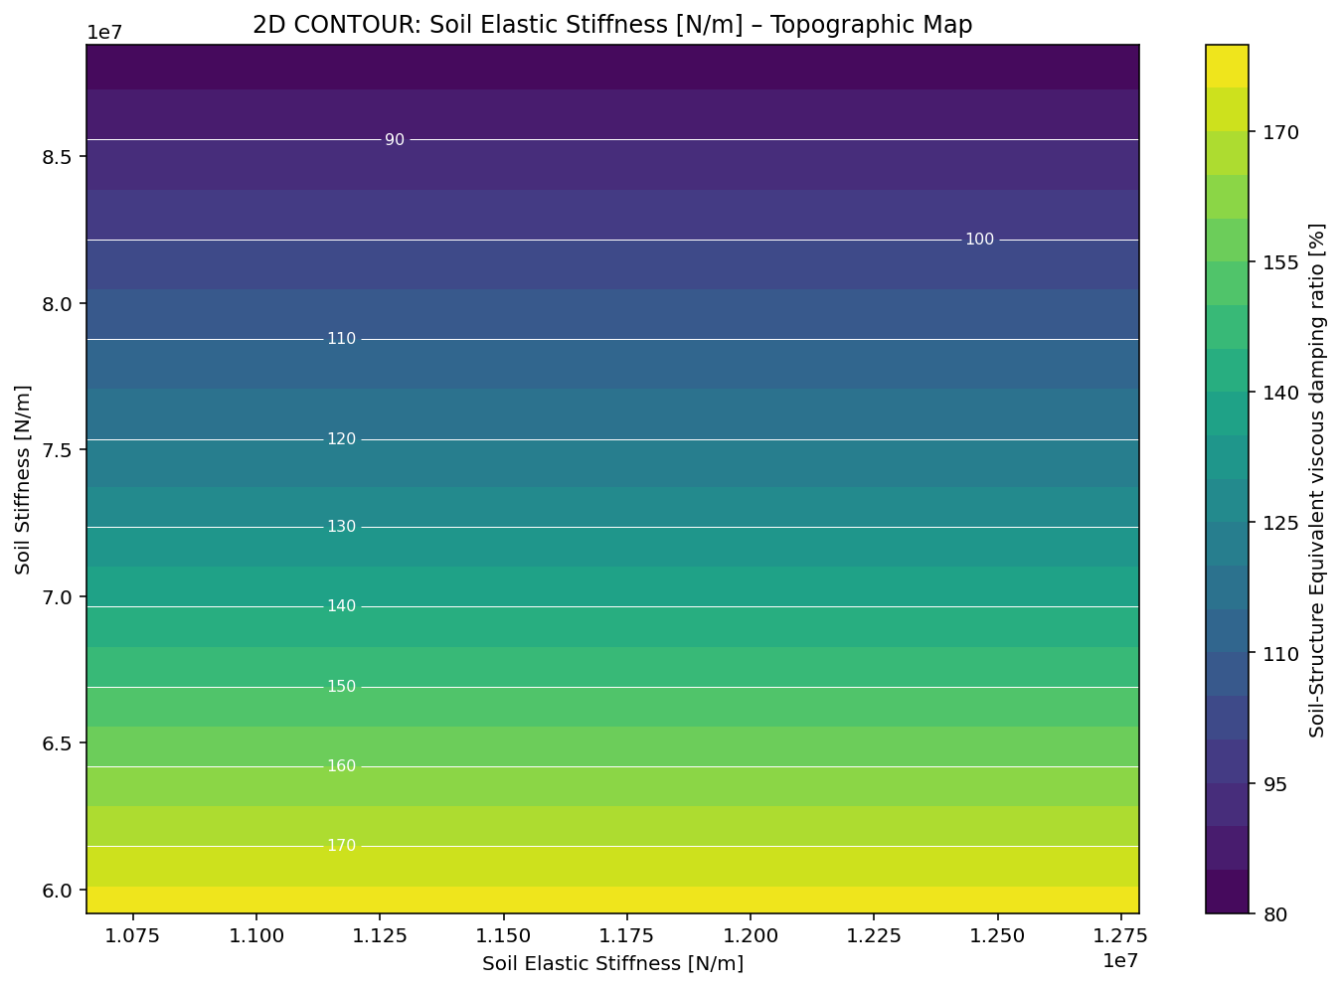

Slide 23
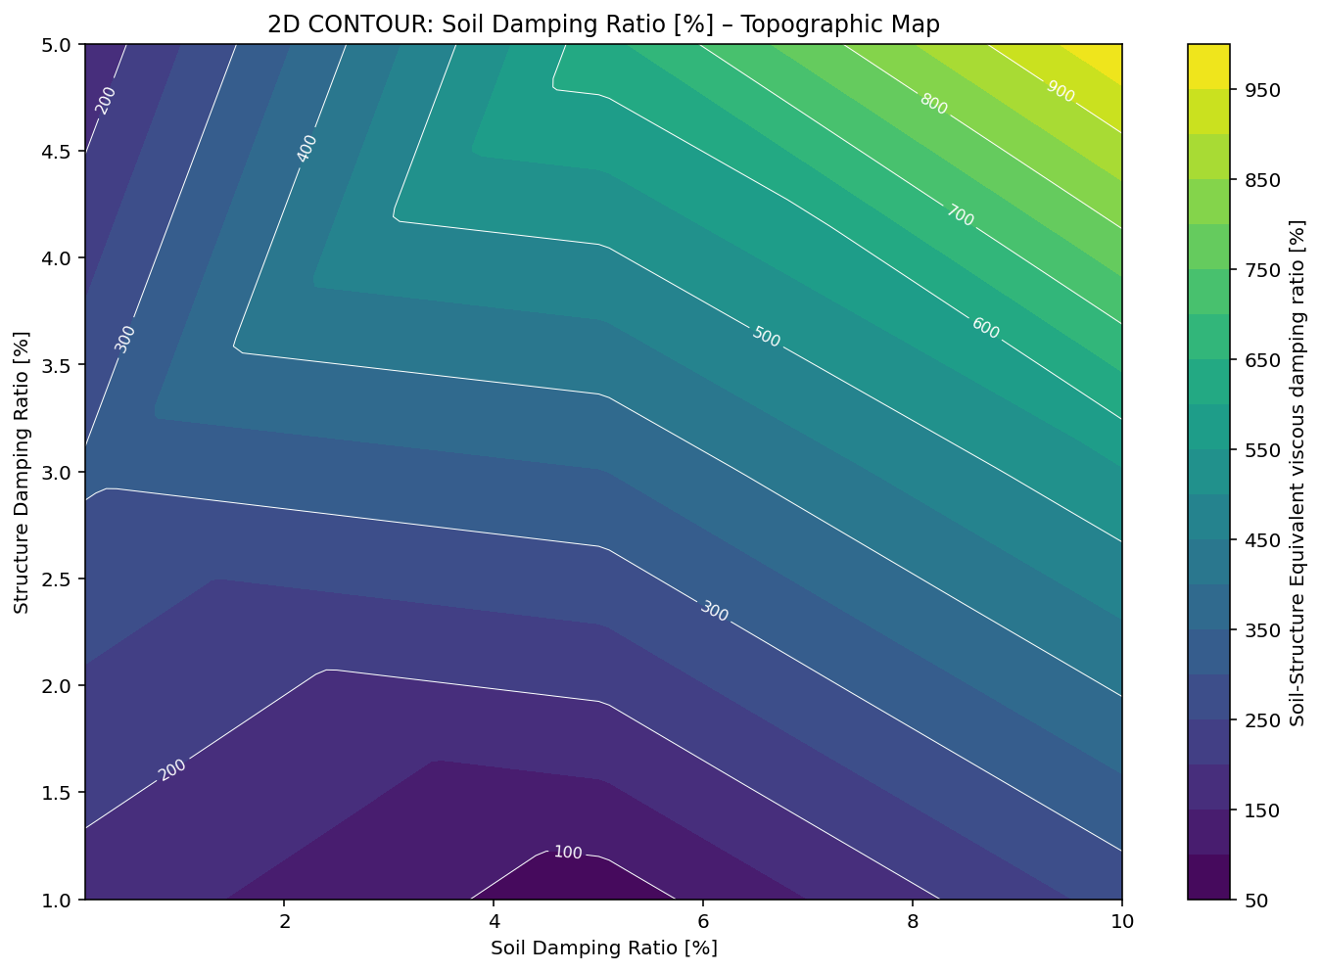

Slide 24
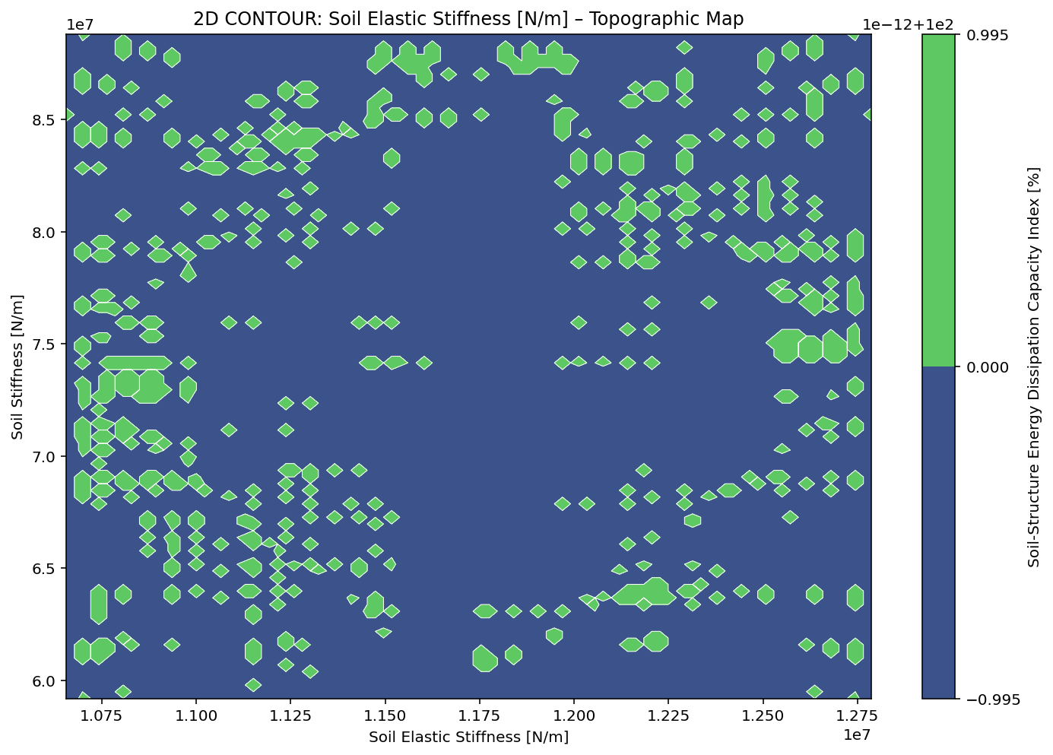

Slide 25
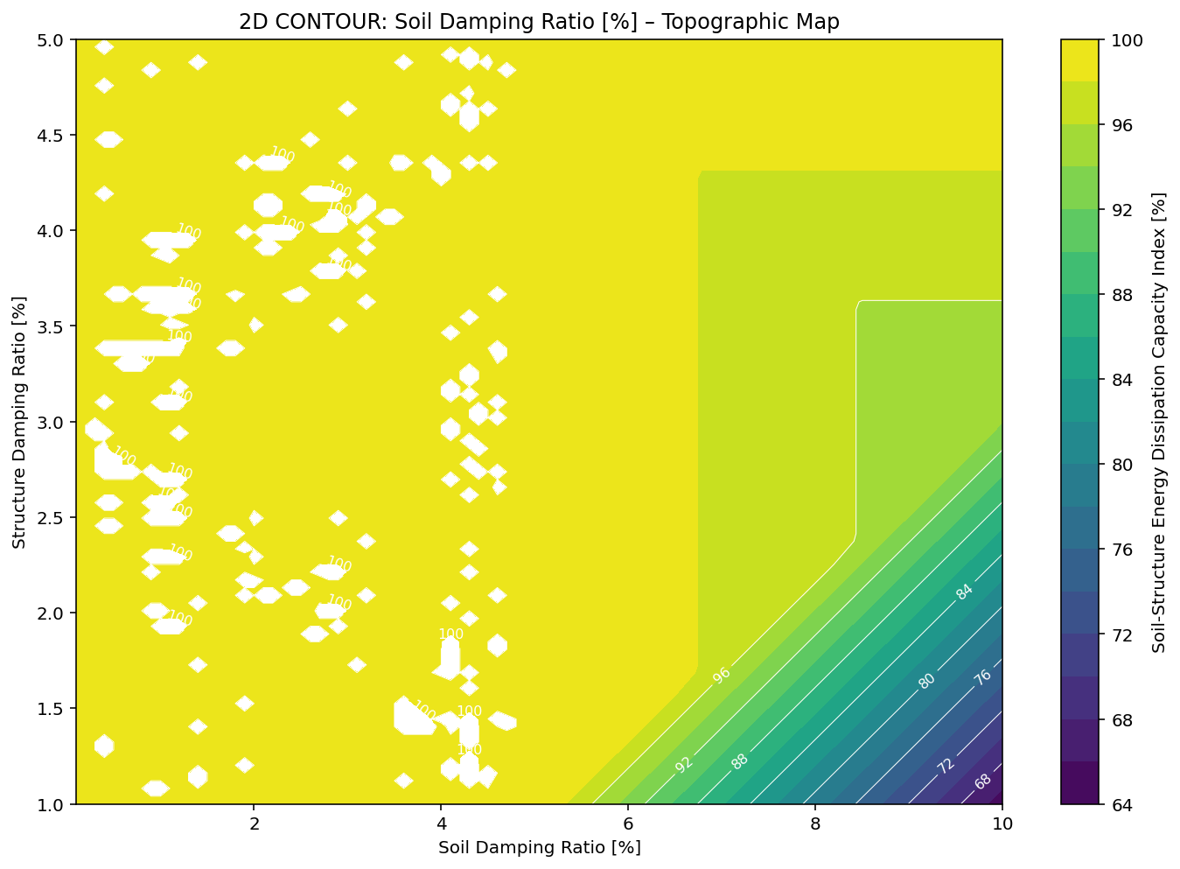

Slide 26
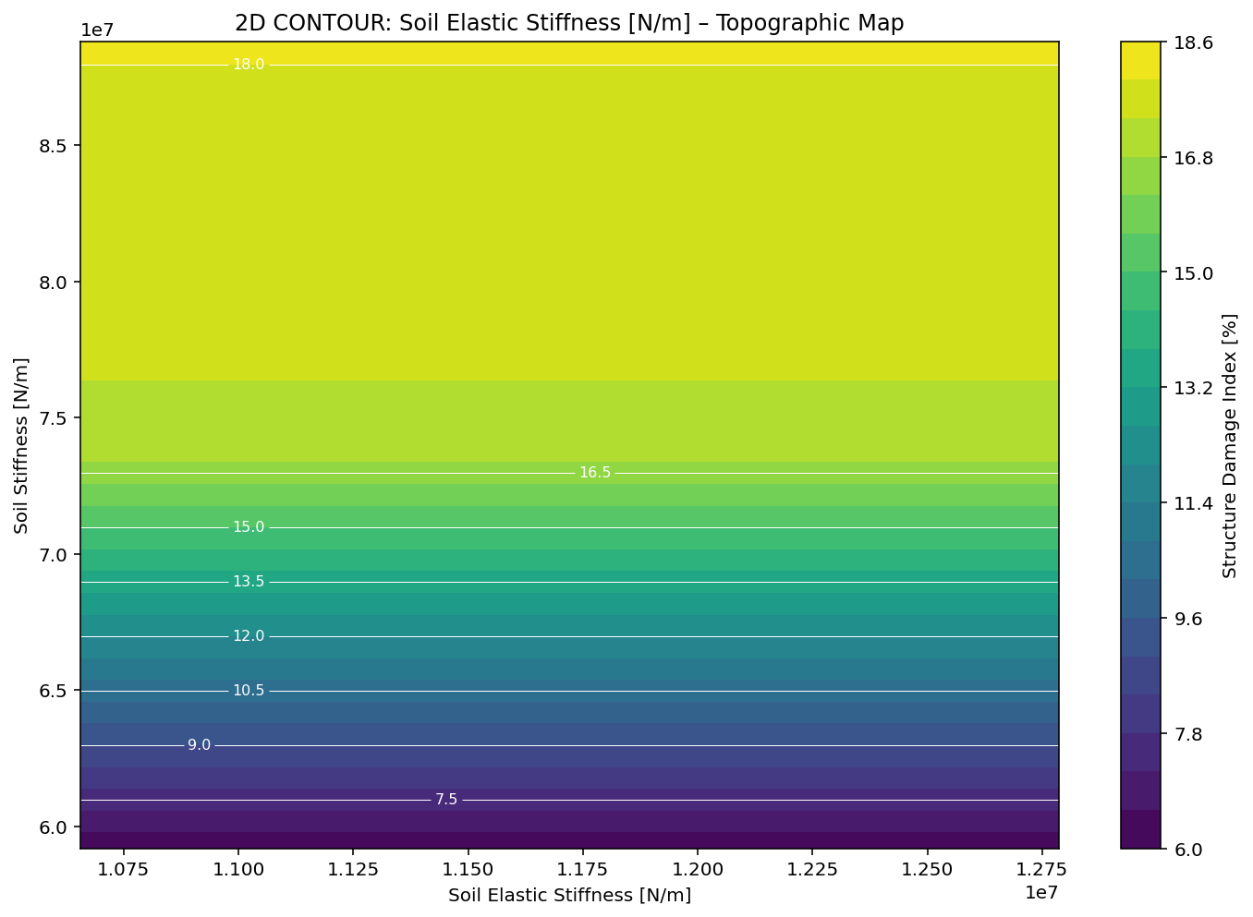

Slide 27
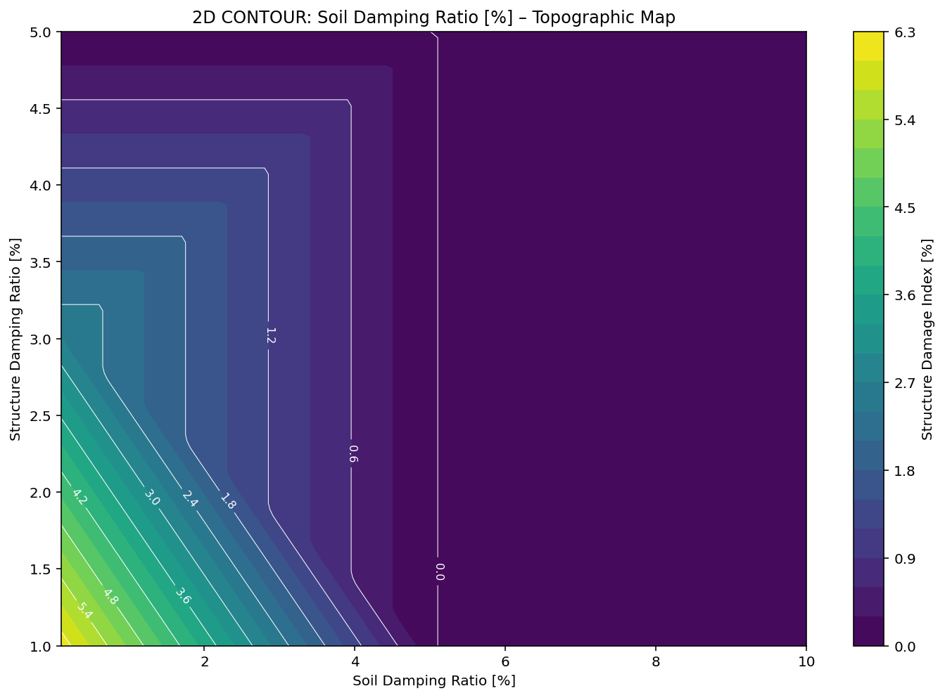

Slide 28
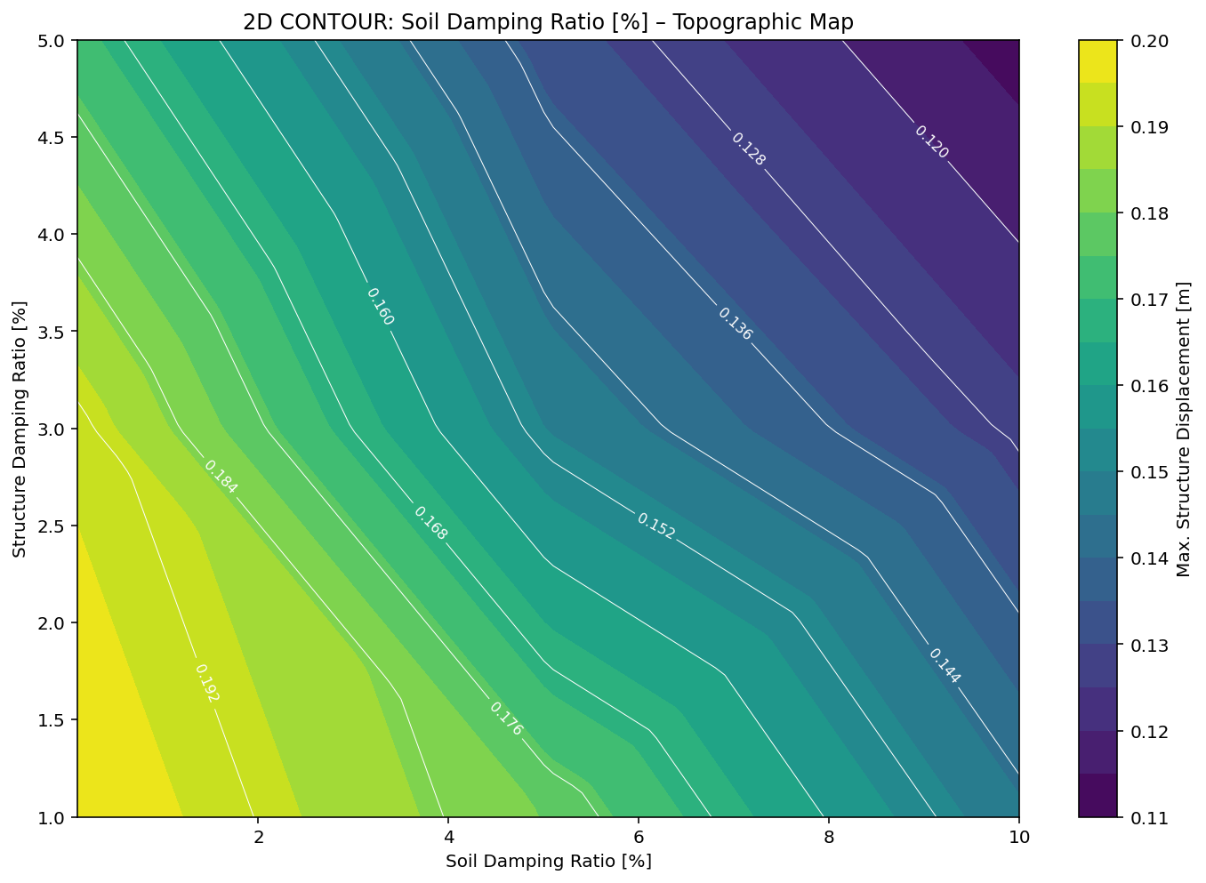

Slide 29
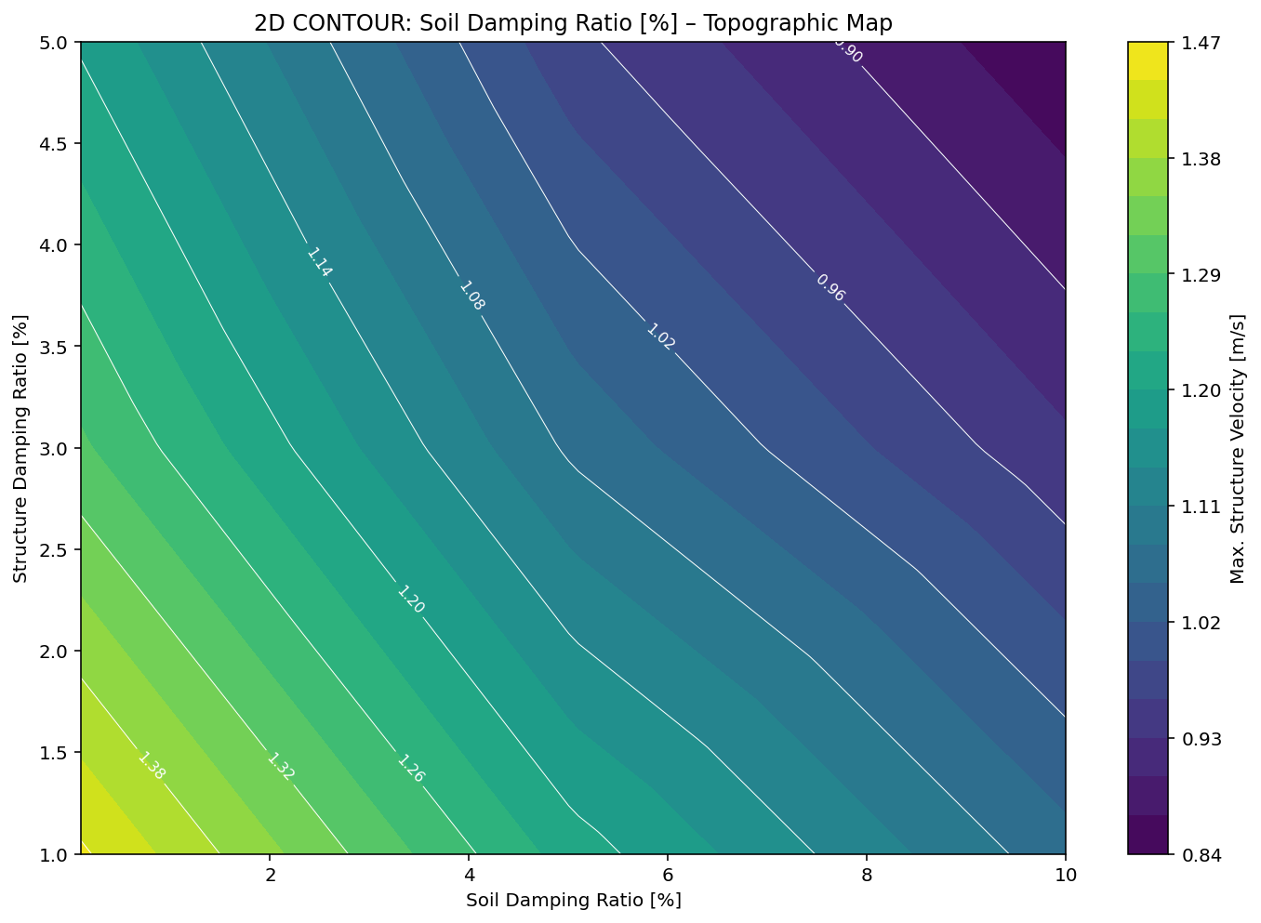

Slide 30
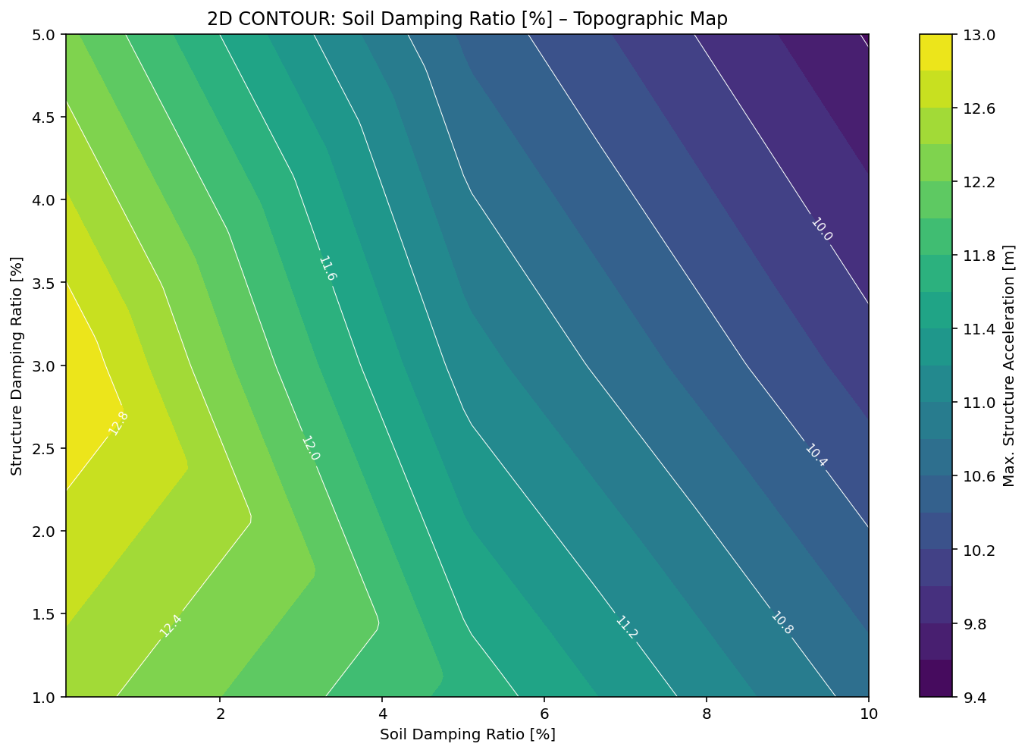

Slide 31
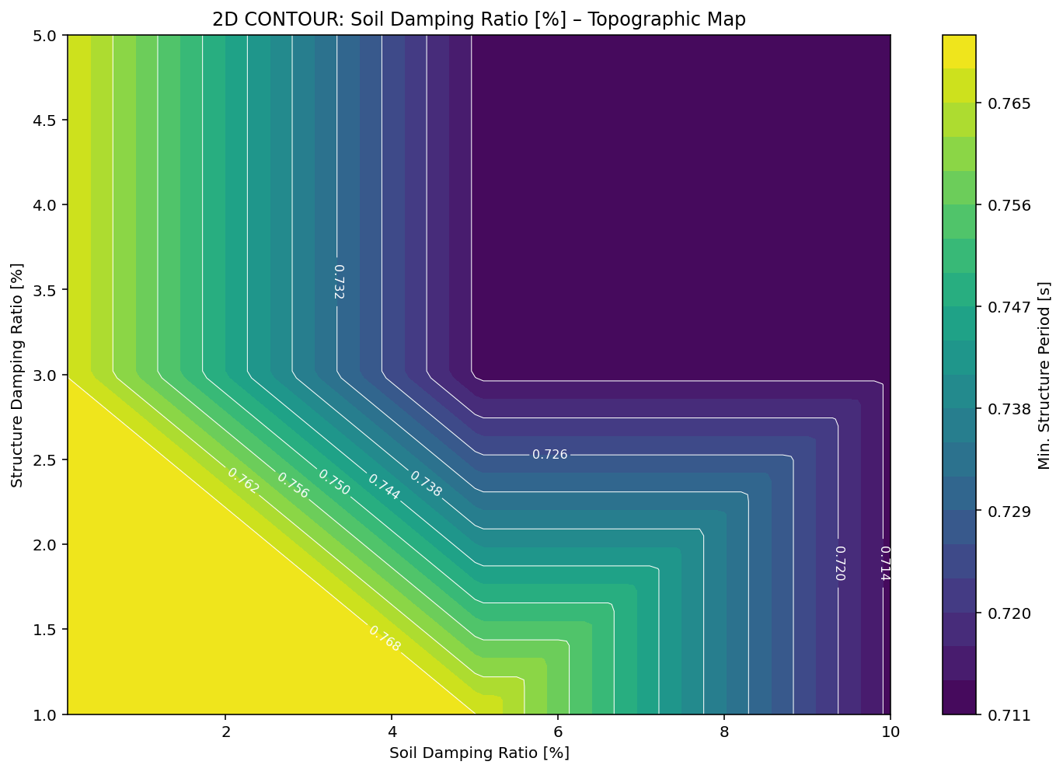

Slide 32
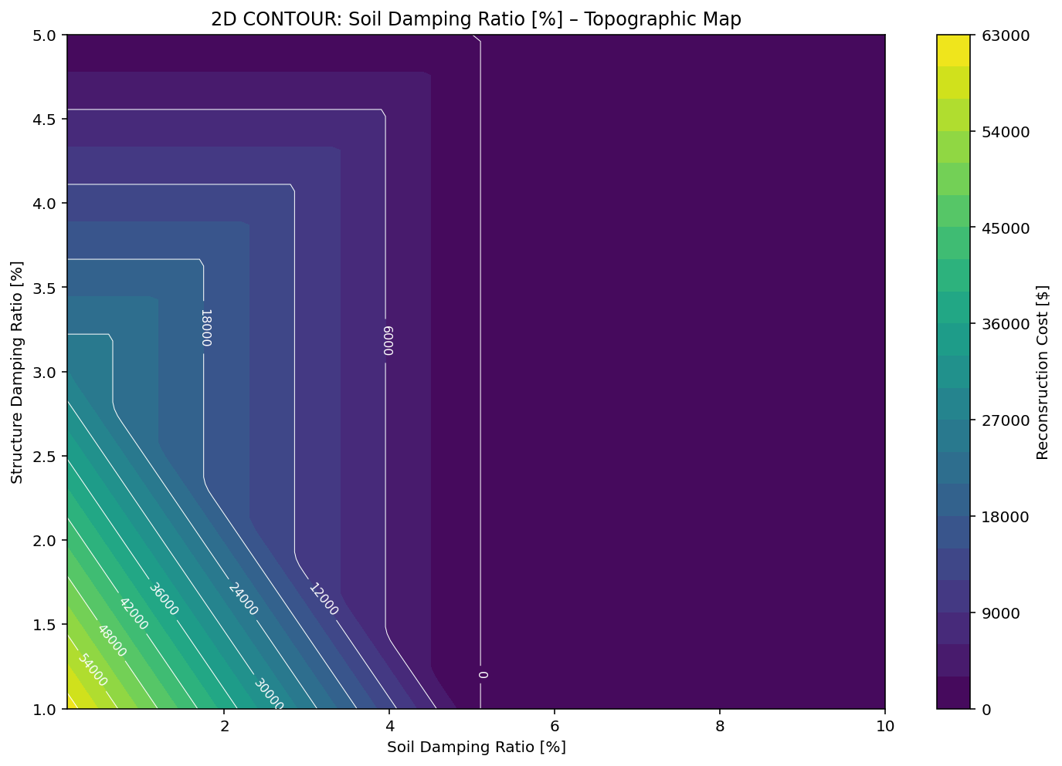

Slide 33
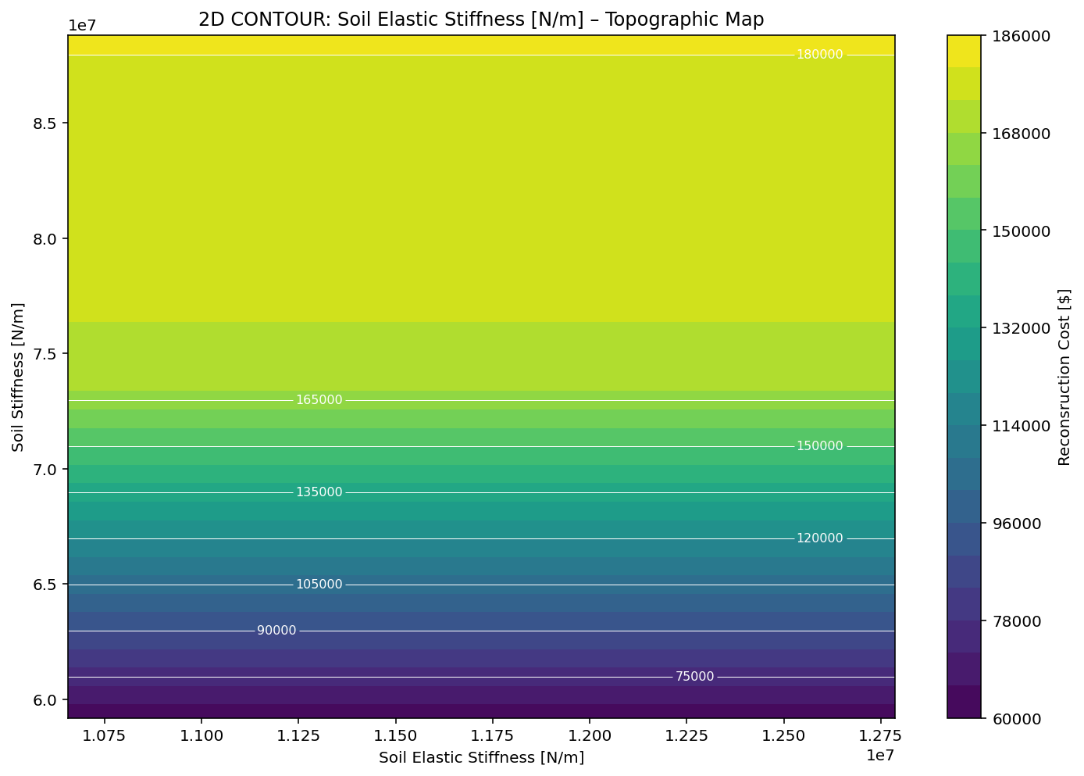

Slide 34
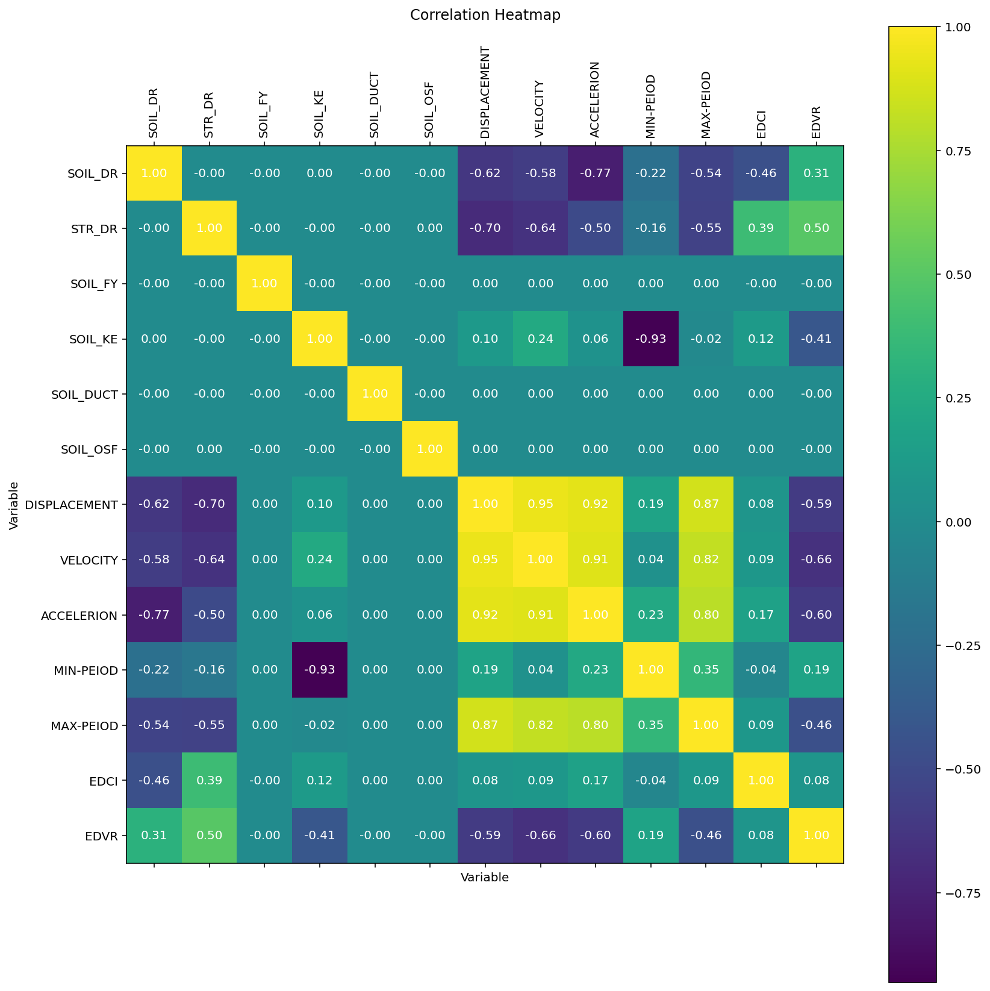

Slide 35
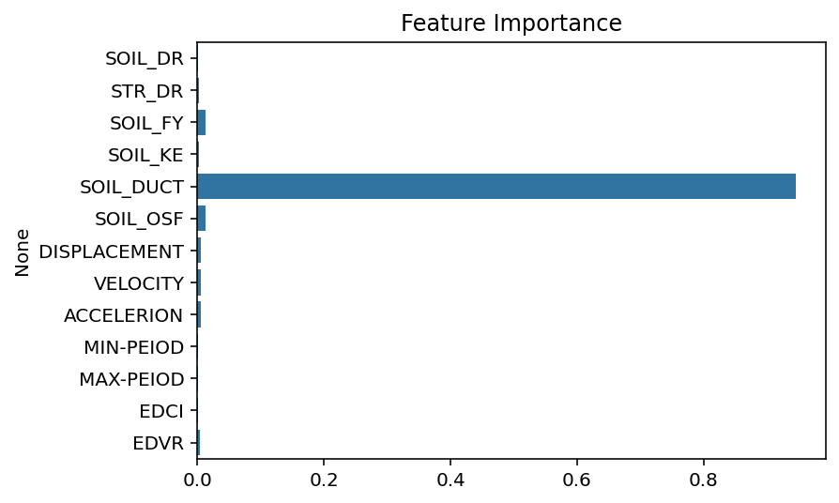

Slide 36
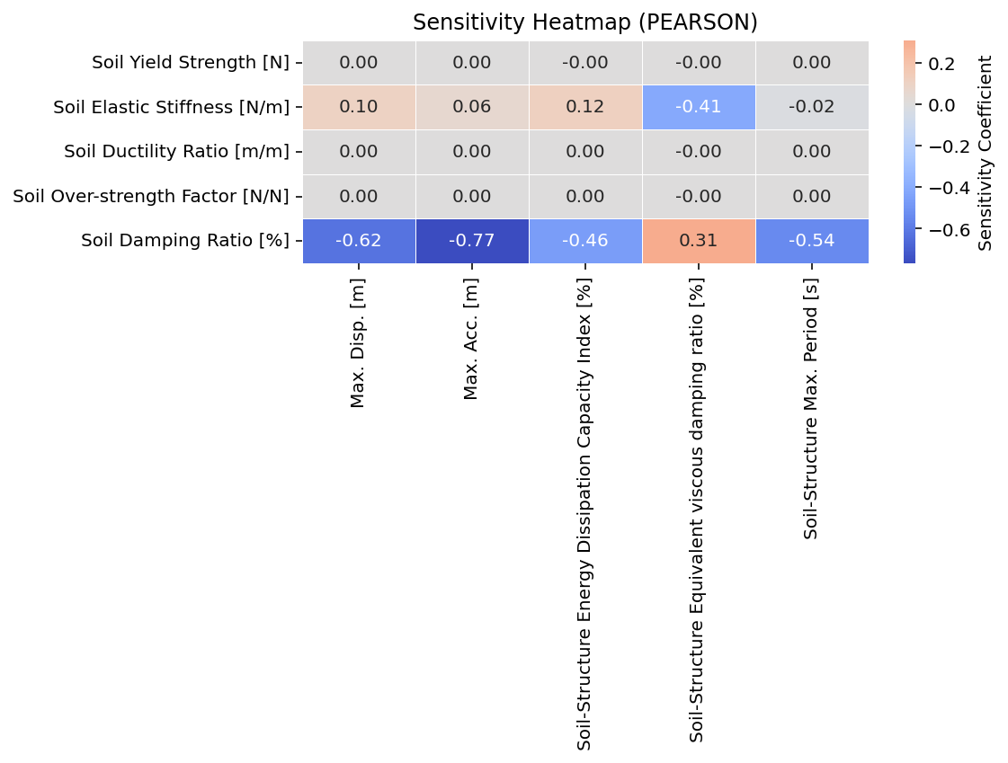

Slide 37
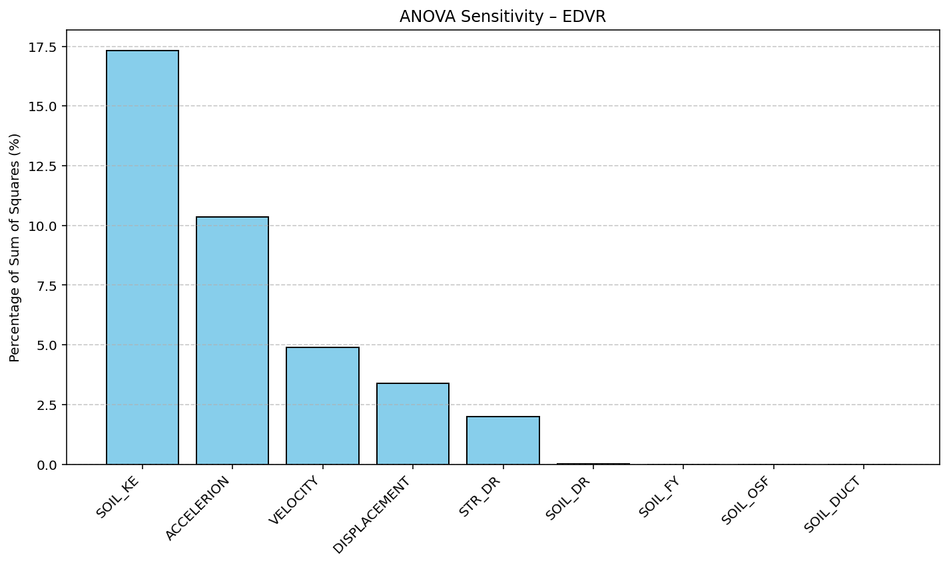

Slide 38
