Slide 1
>> IN THE NAME OF ALLAH, THE MOST GRACIOUS, THE MOST MERCIFUL <<
COMPREHENSIVE NONLINEAR SEISMIC ASSESSMENT OF A MULTI-DEGREE-FREEDOM (MDOF) STRUCTURE: AN OPENSEES FRAMEWORK FOR STATIC PUSHOVER, CYCLIC DEGRADATION, STATIC TIME-HISTORY AND DYNAMIC TIME-HISTORY ANALYSIS THIS PROGRAM IS WRITTEN BY SALAR DELAVAR GHASHGHAEI (QASHQAI)

Slide 2


Slide 3
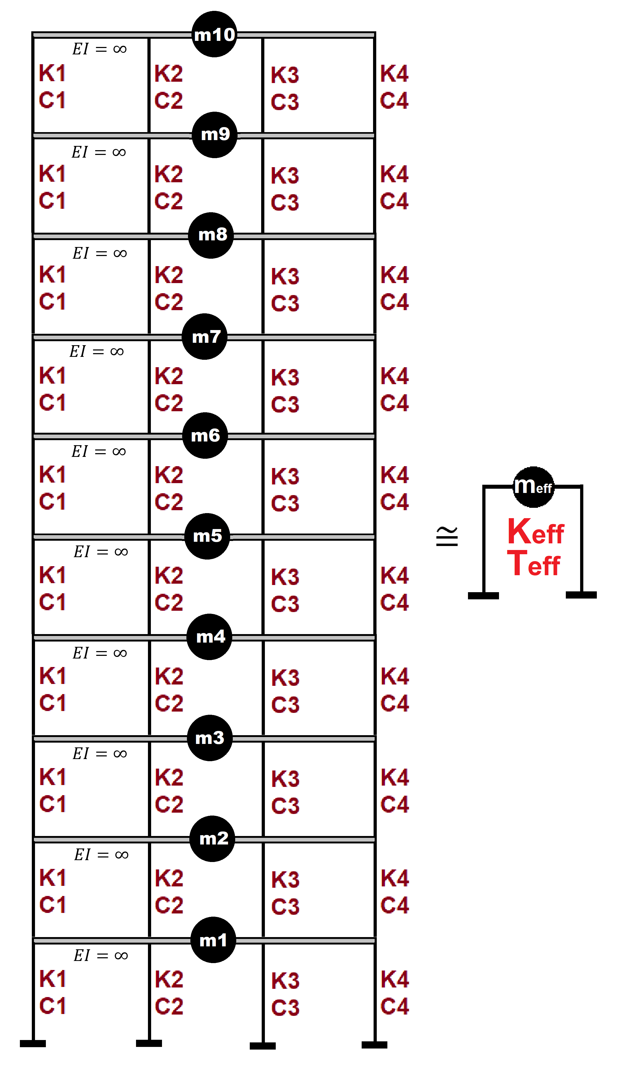

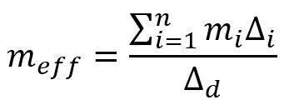
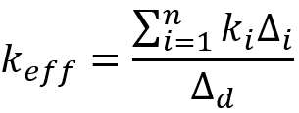
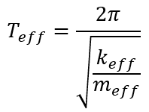
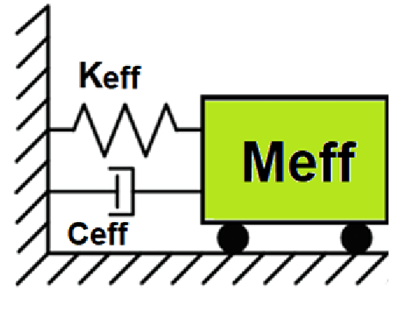
Displacement-based seismic analysis transformation,
converting a multi-degree-of-freedom (MDOF) system
into an equivalent single-degree-of-freedom (SDOF)
system for seismic assessment

Slide 4
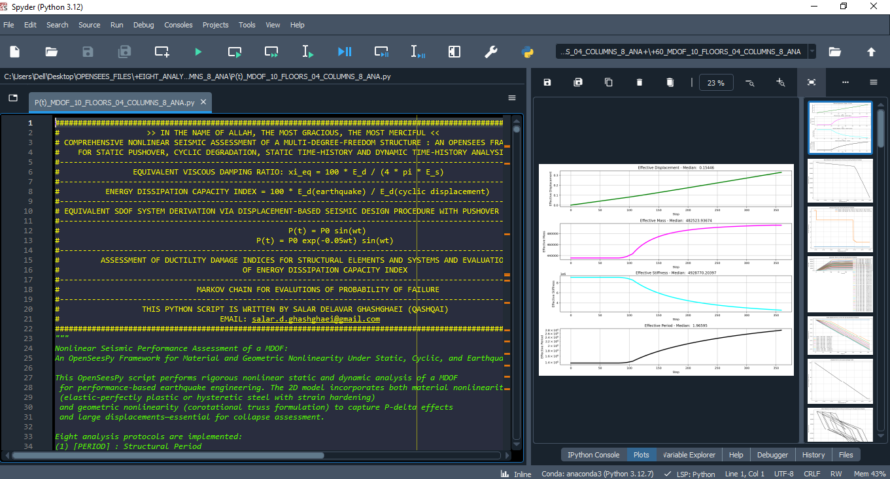

Slide 5
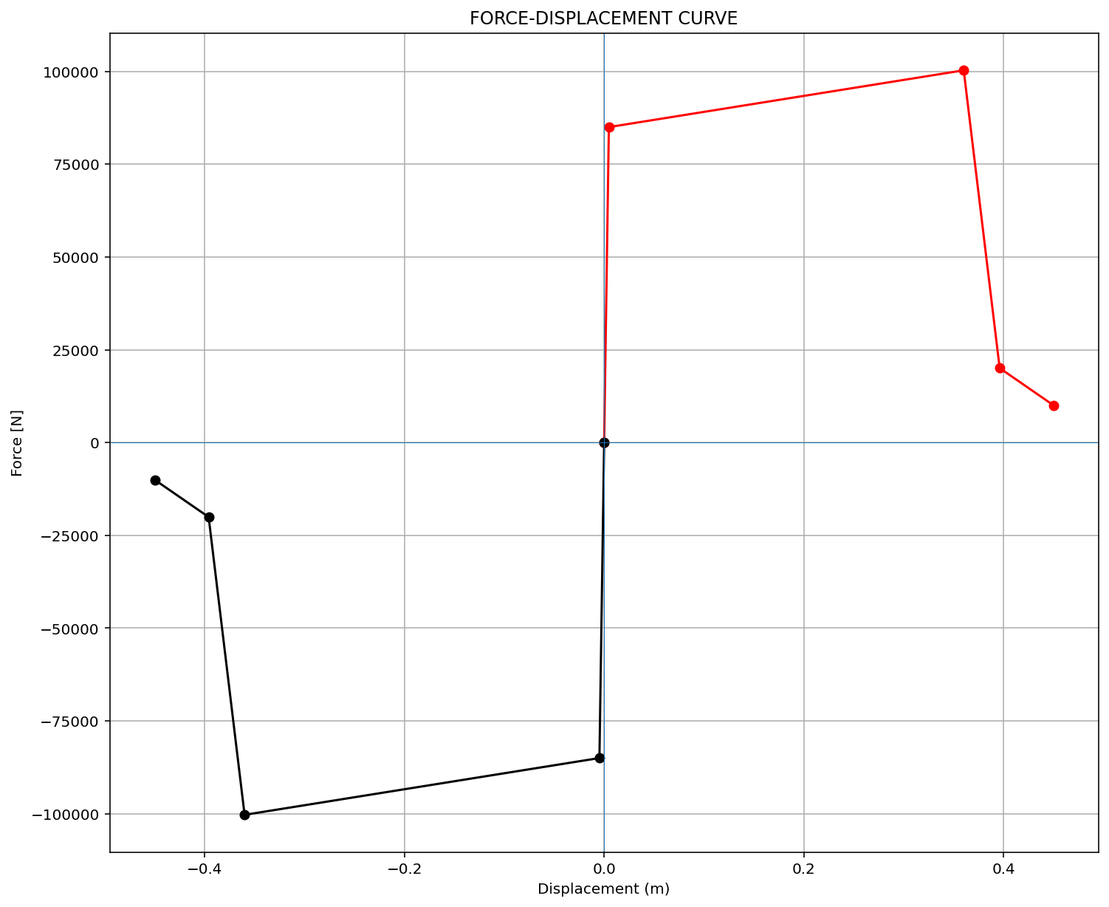
ELEMENT 01

Slide 6

ELEMENT 02

Slide 7
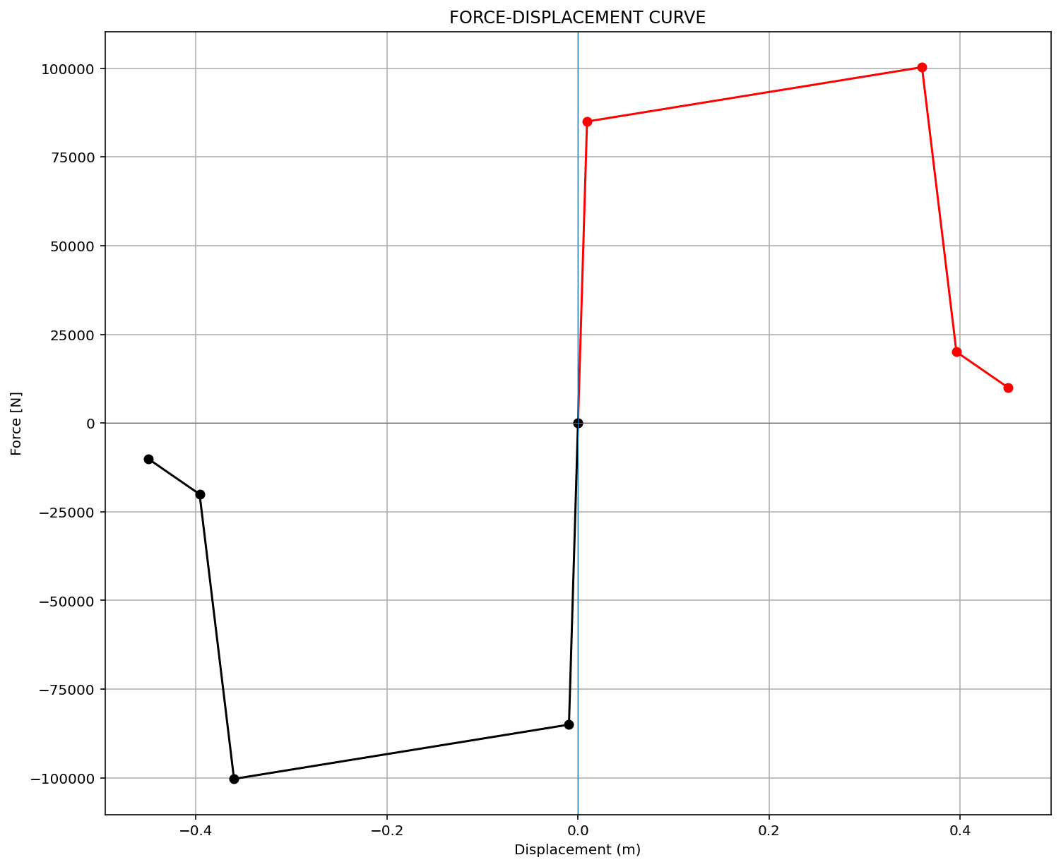
ELEMENT 03

Slide 8
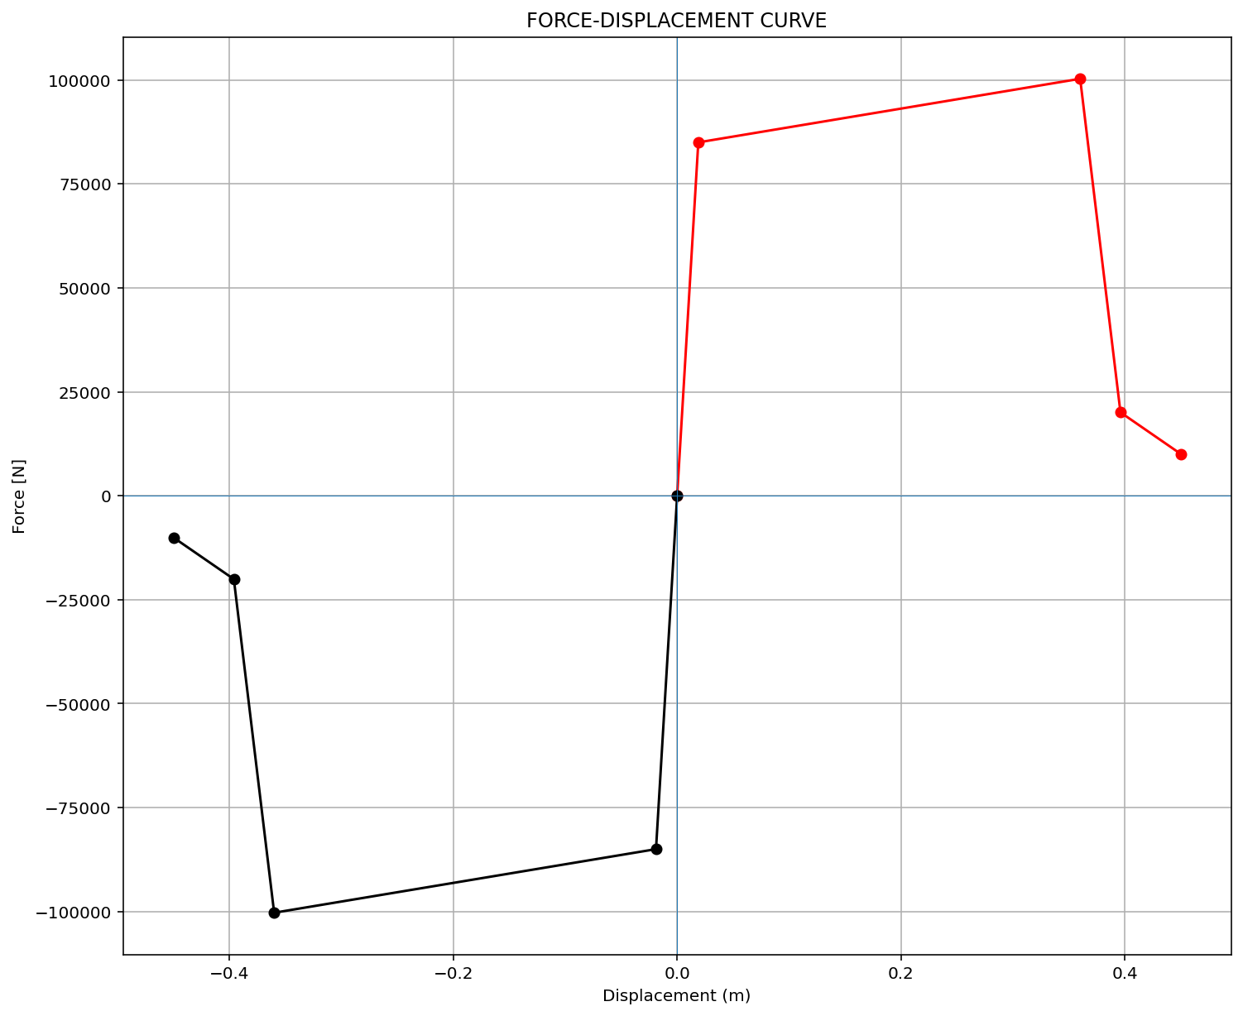
ELEMENT 04

Slide 9
STATIC ANALYSIS

Slide 10
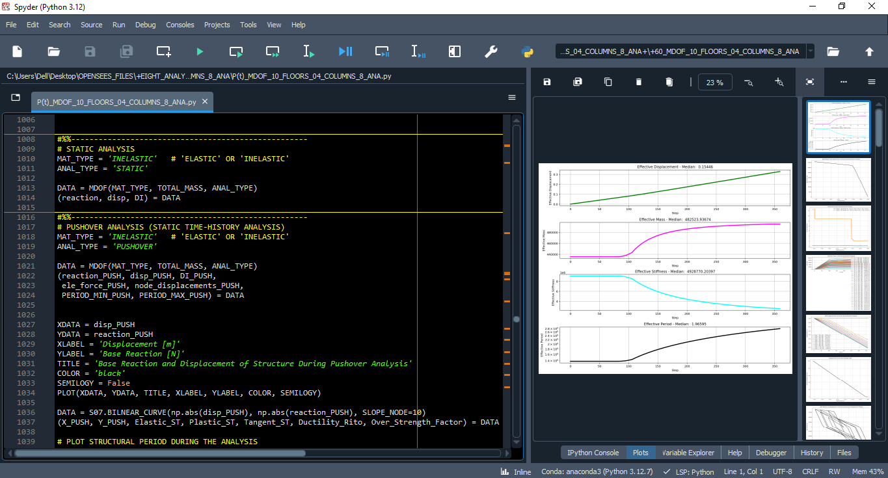

Slide 11
PUSHOVER ANALYSIS

Slide 12
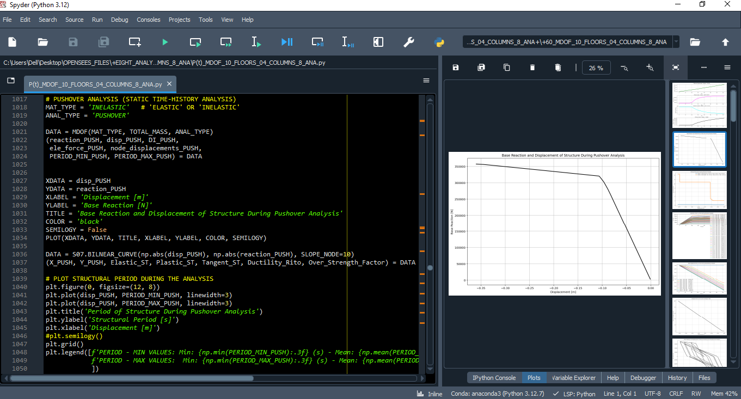

Slide 13
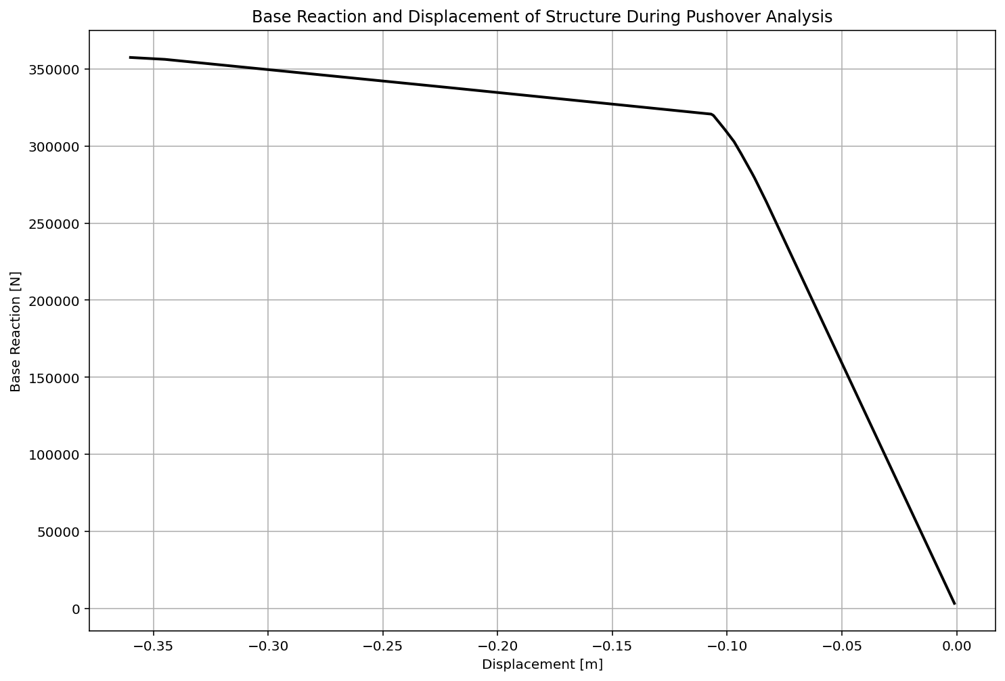

Slide 14
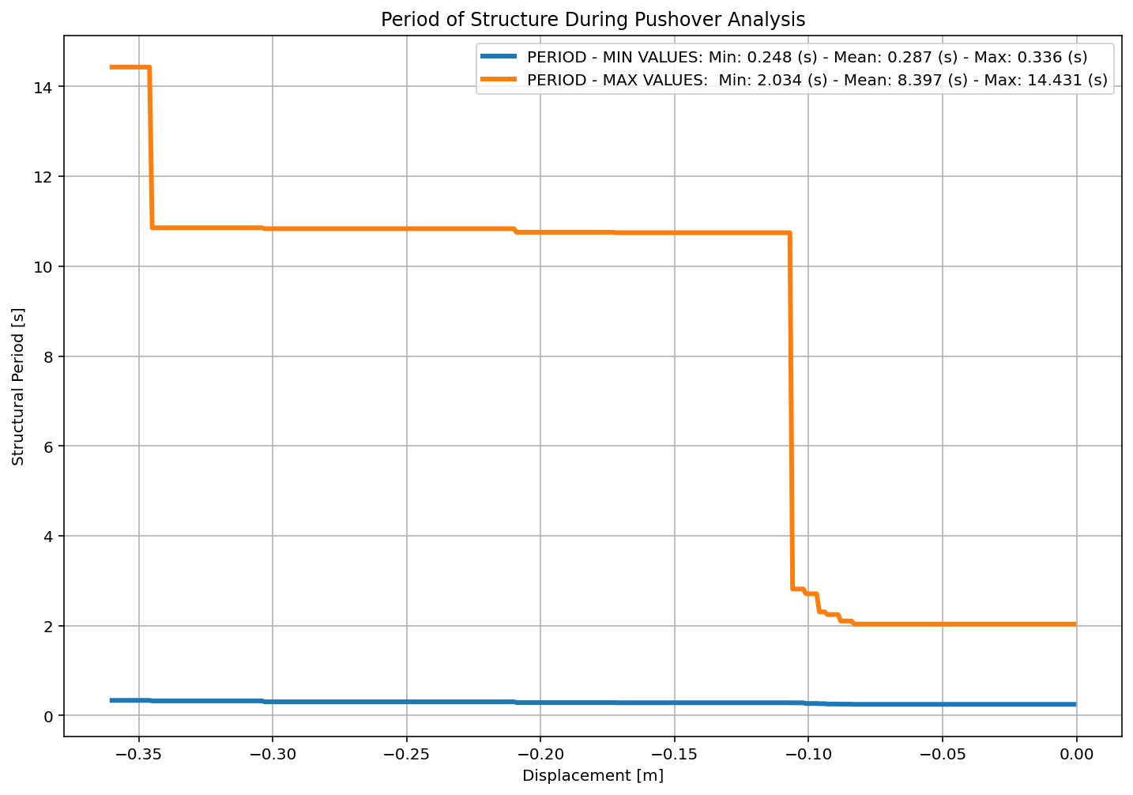

Slide 15
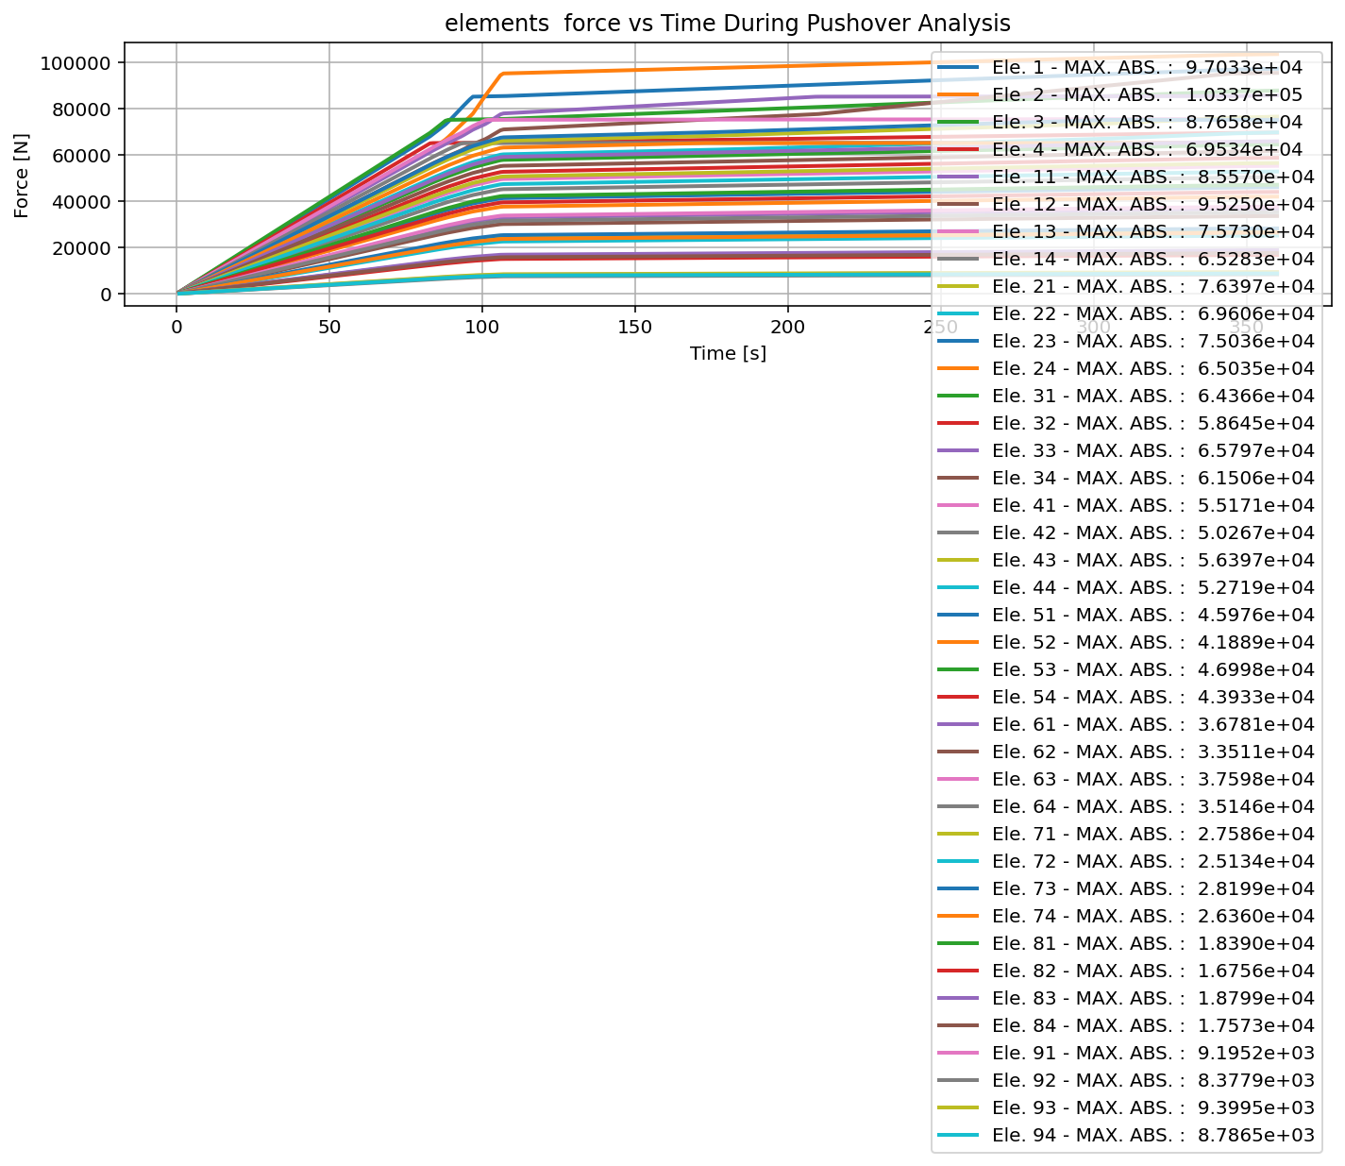

Slide 16
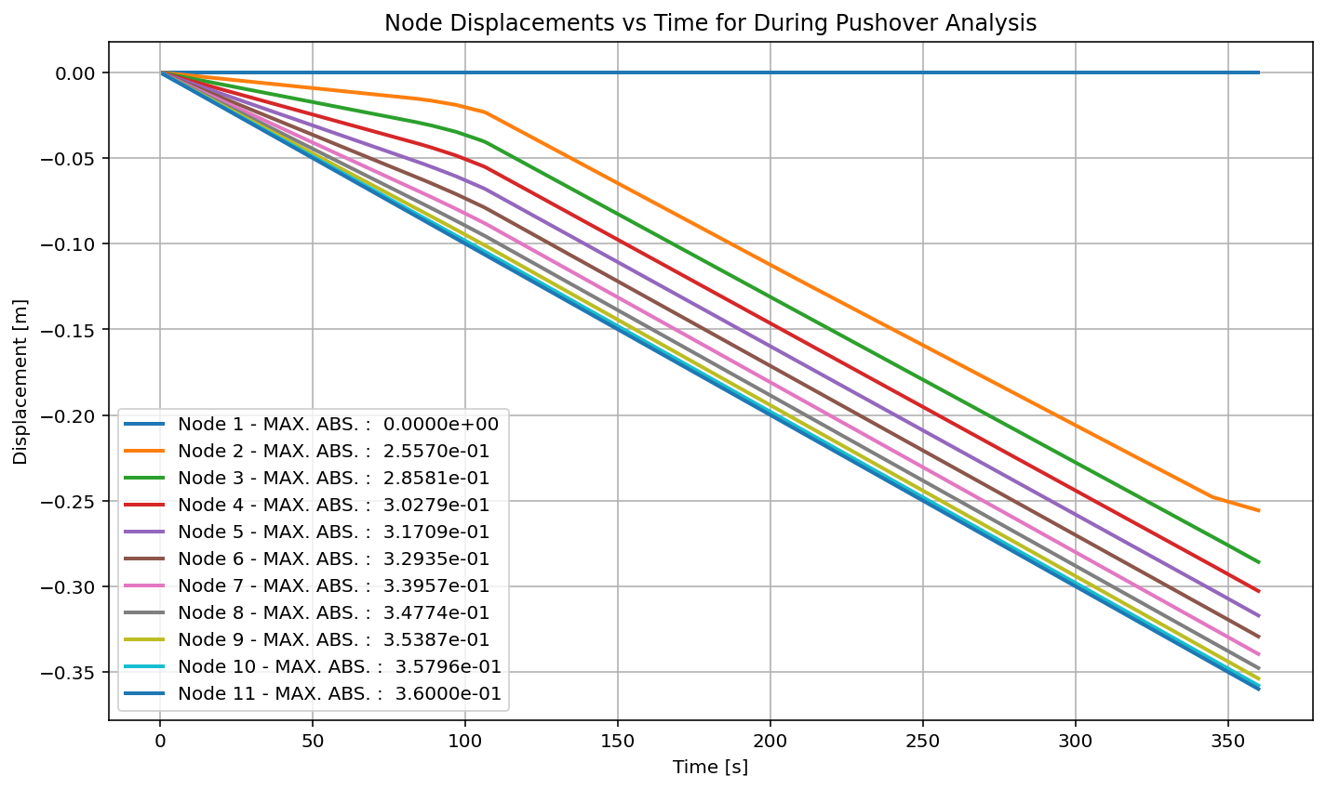

Slide 17
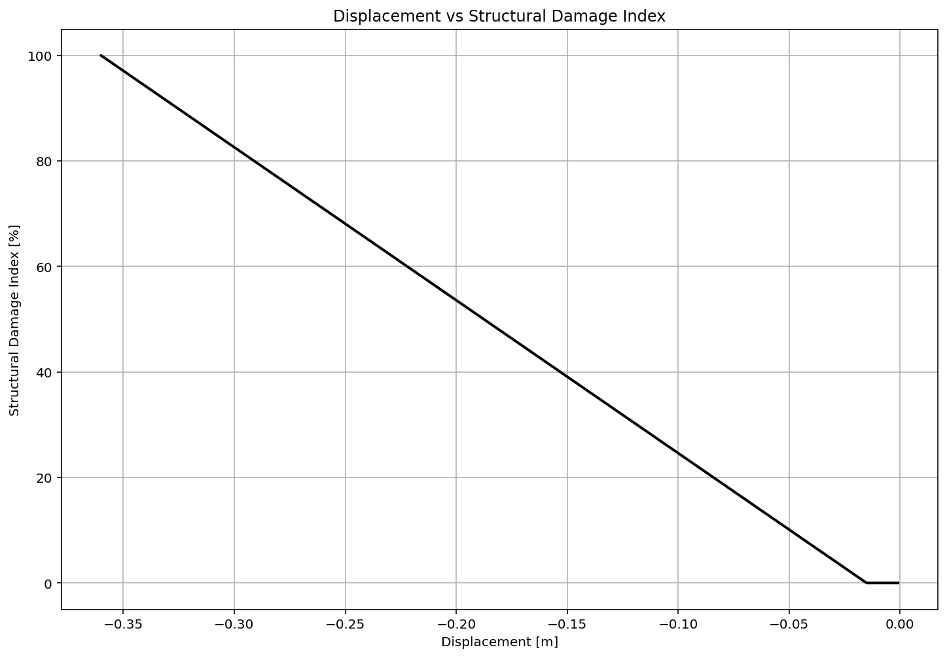

Slide 18
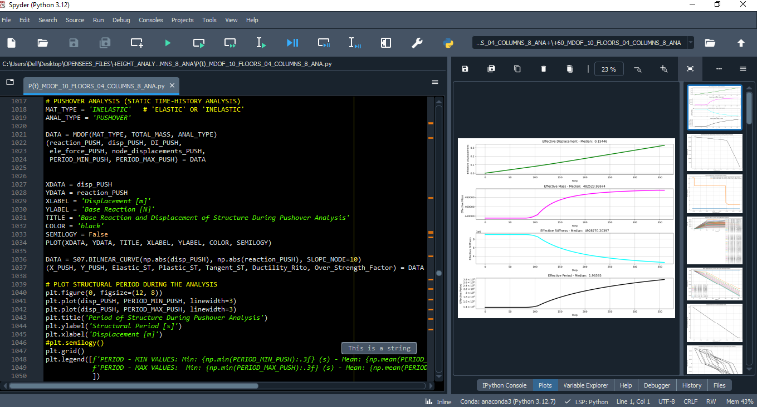

Slide 19
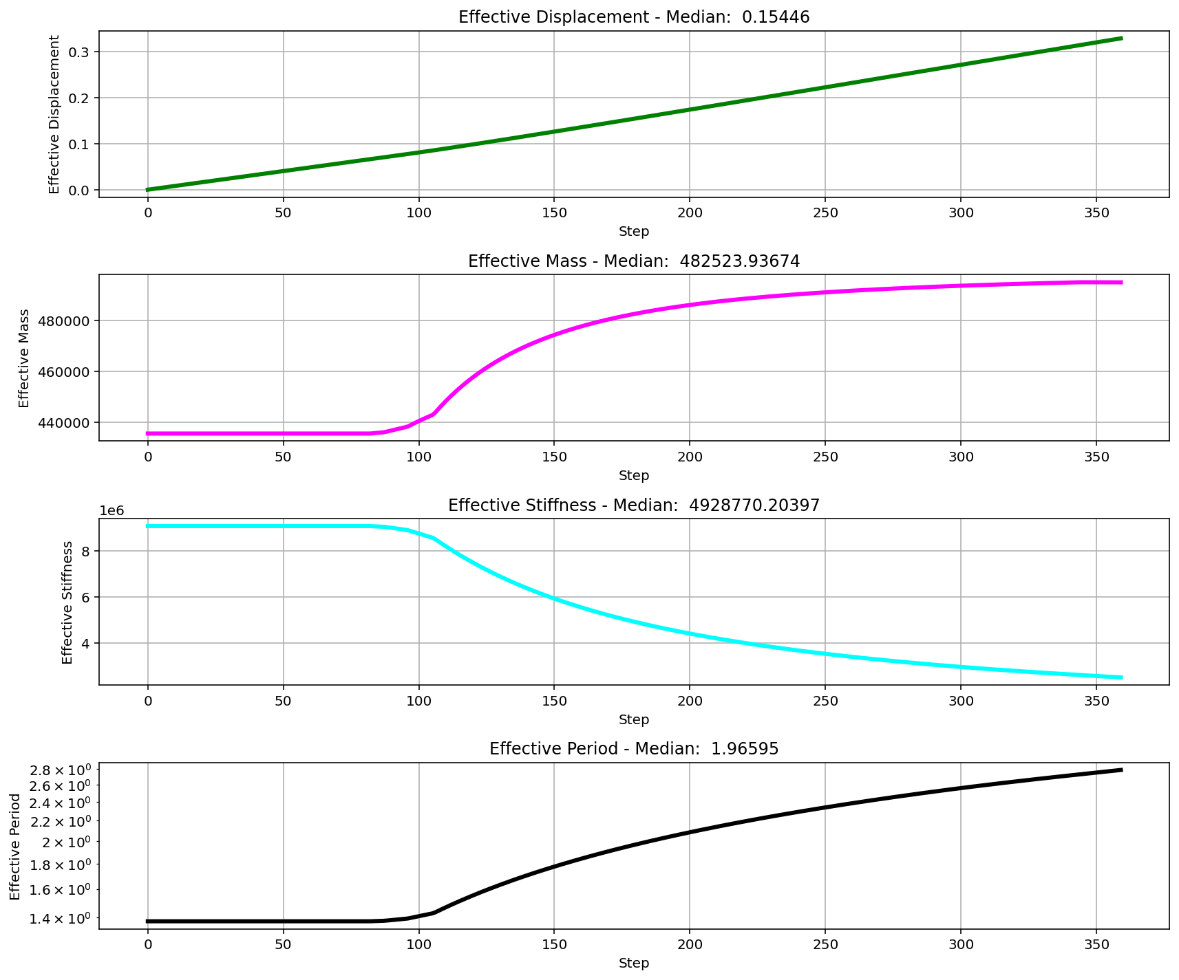

Slide 20
CYCLIC DISPLACEMENT ANALYSIS

Slide 21
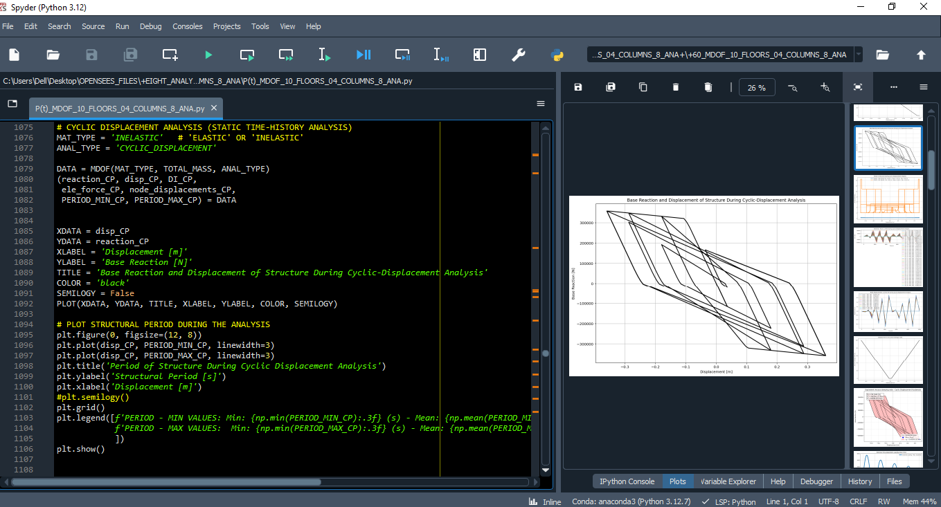

Slide 22
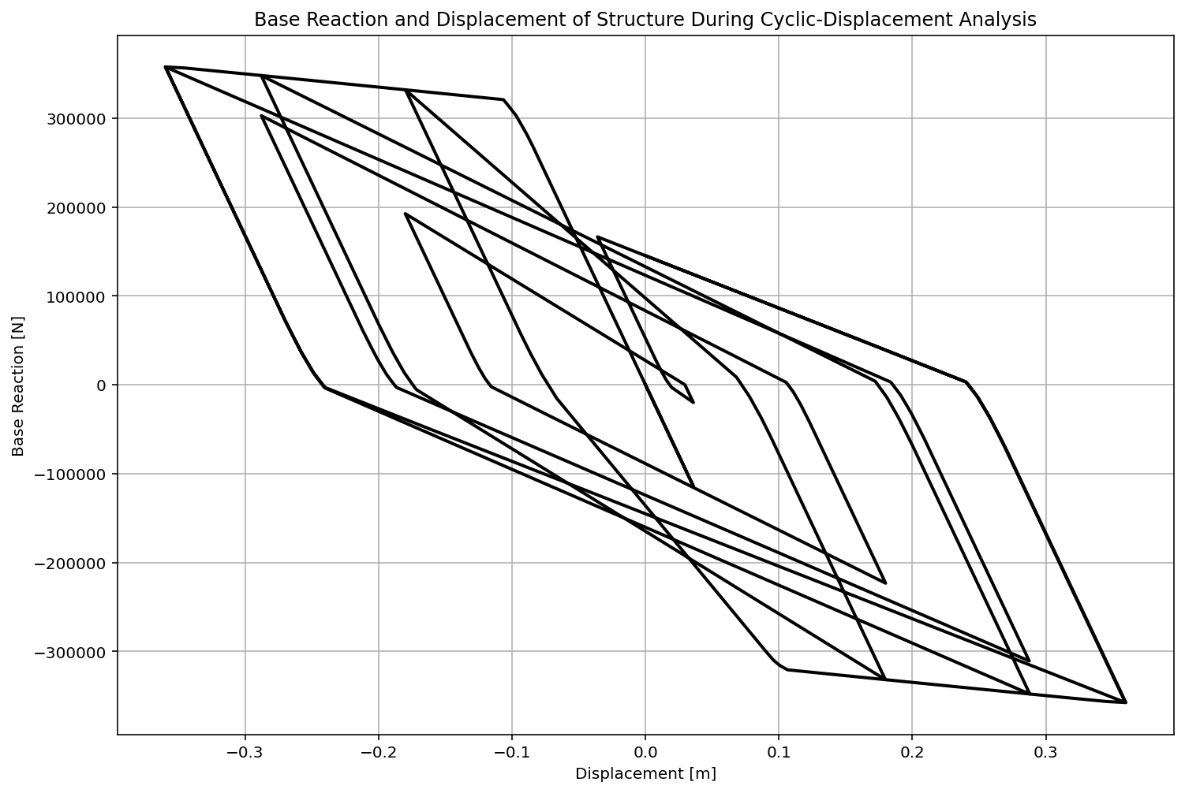

Slide 23
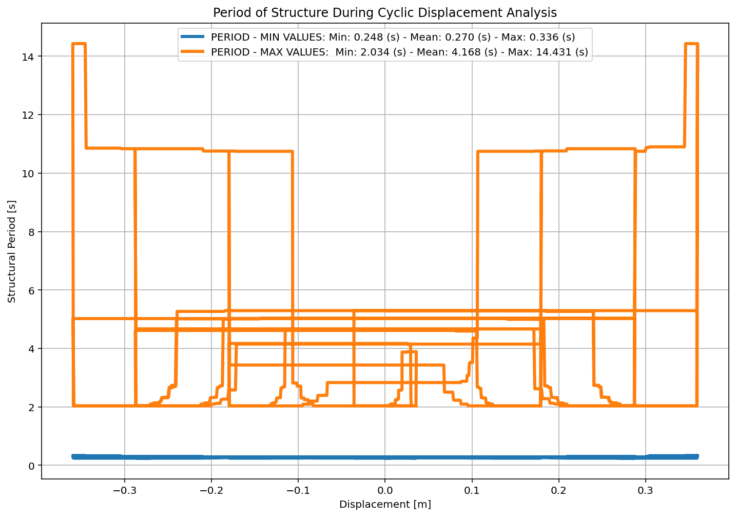

Slide 24
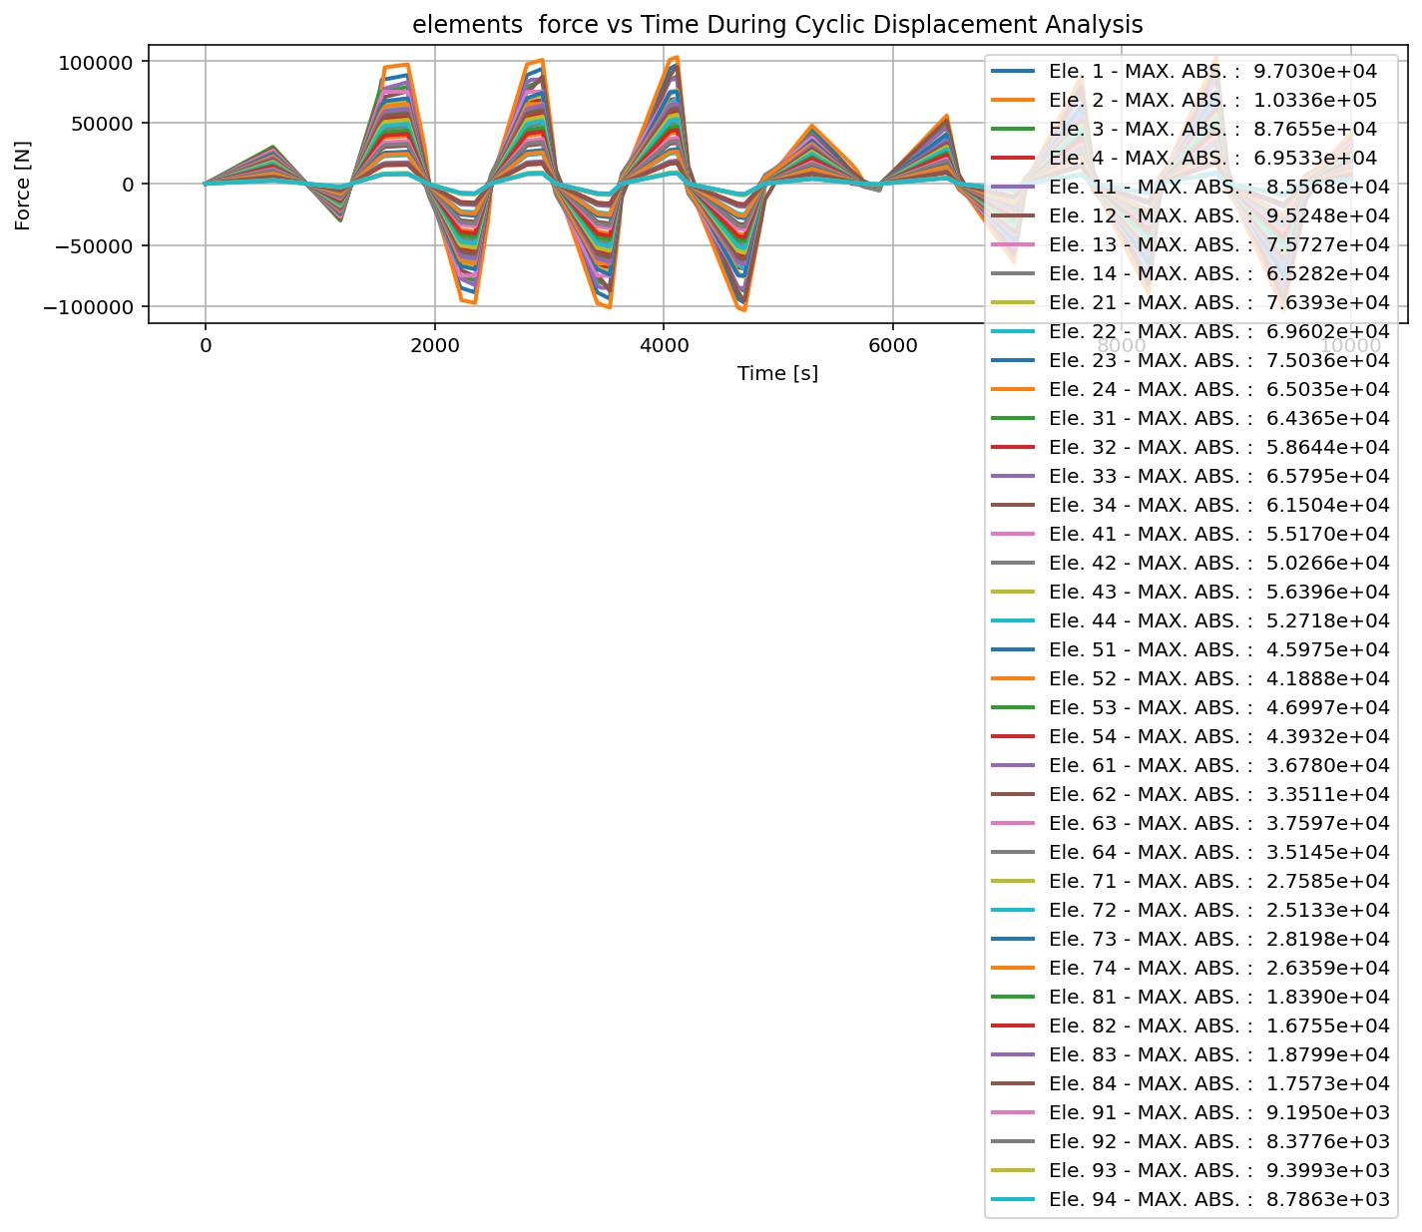

Slide 25
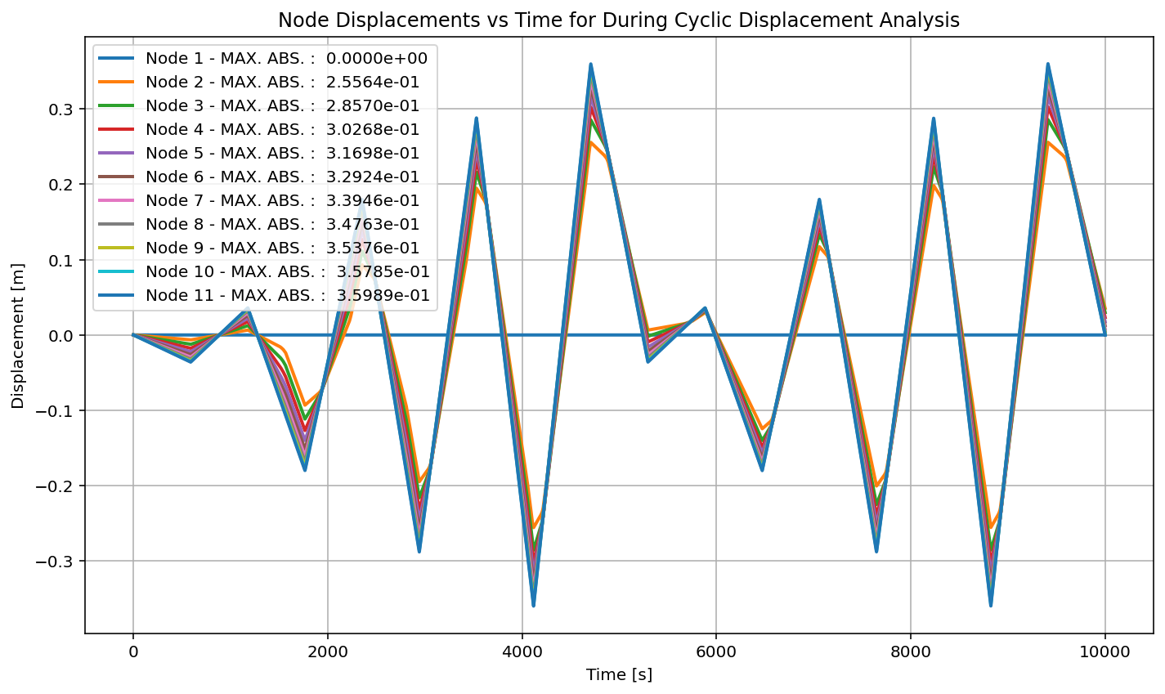

Slide 26
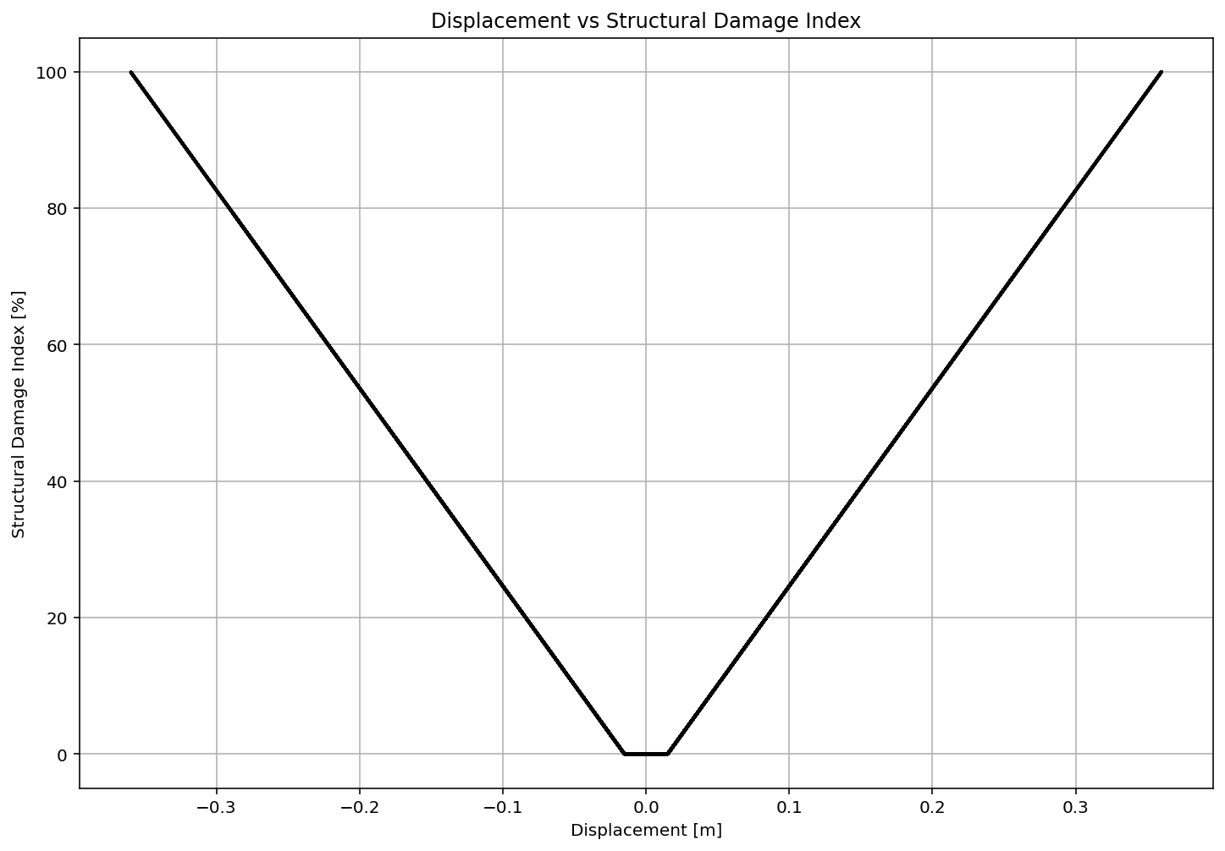

Slide 27
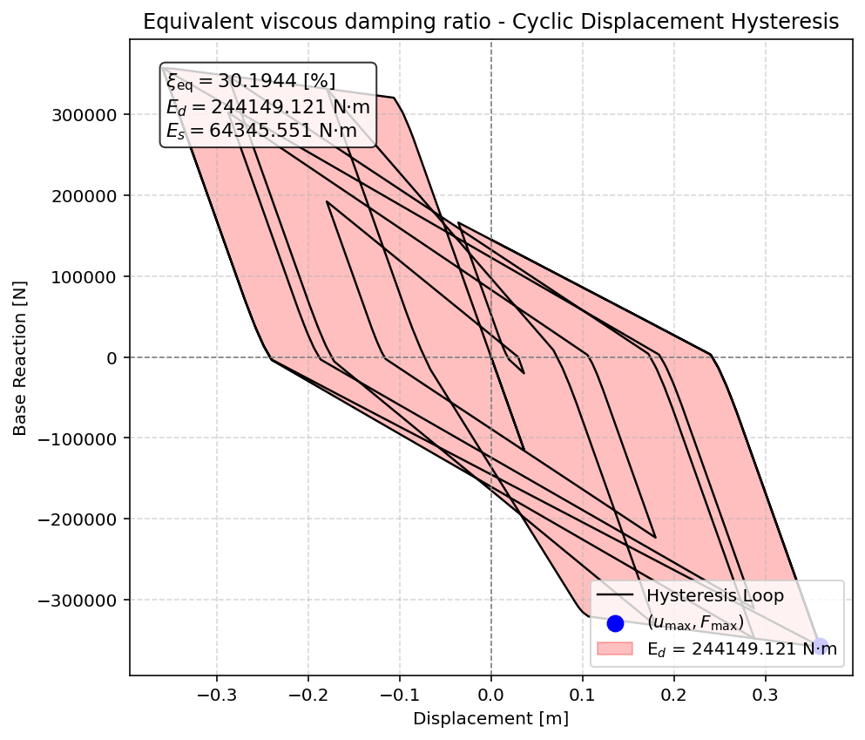

Slide 28
STATIC TIME-HISTORY WITH EXTERNAL TIME-DEPENDENT LOADING ANALYSIS

Slide 29
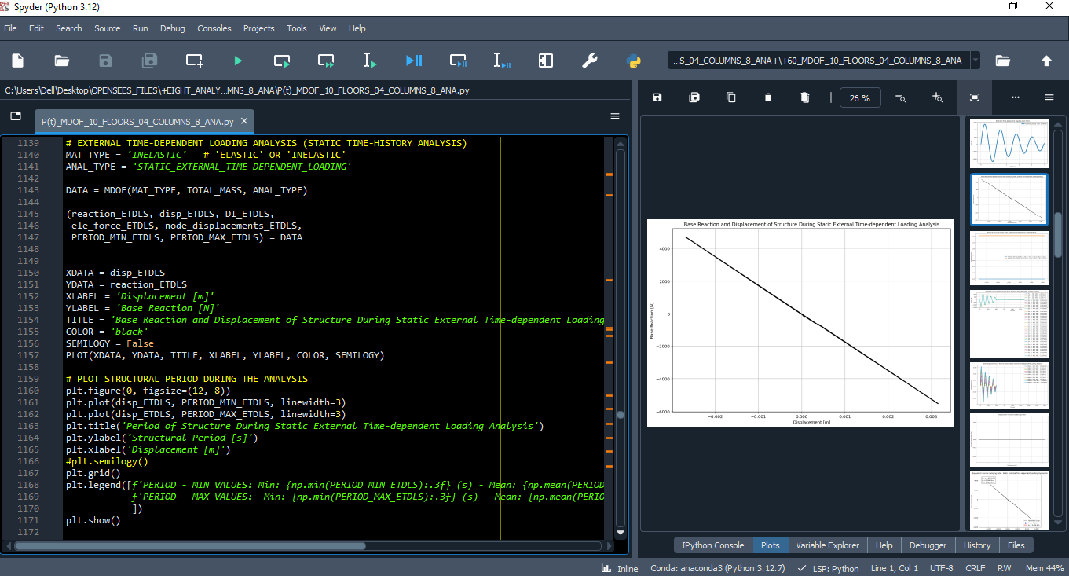

Slide 30
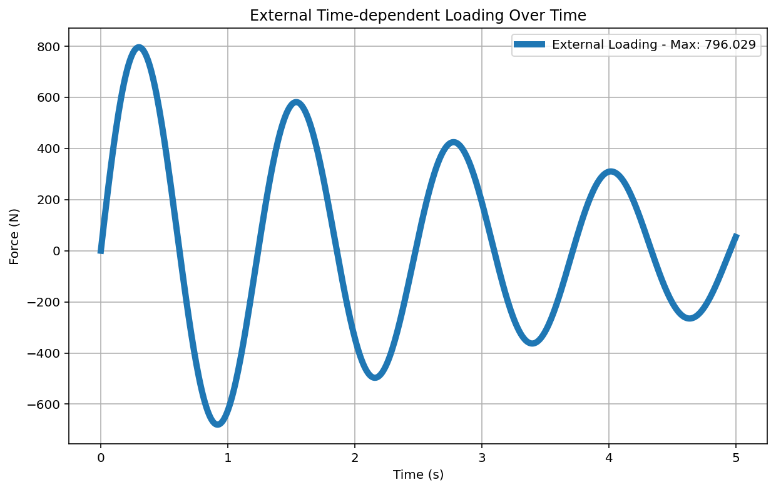

Slide 31
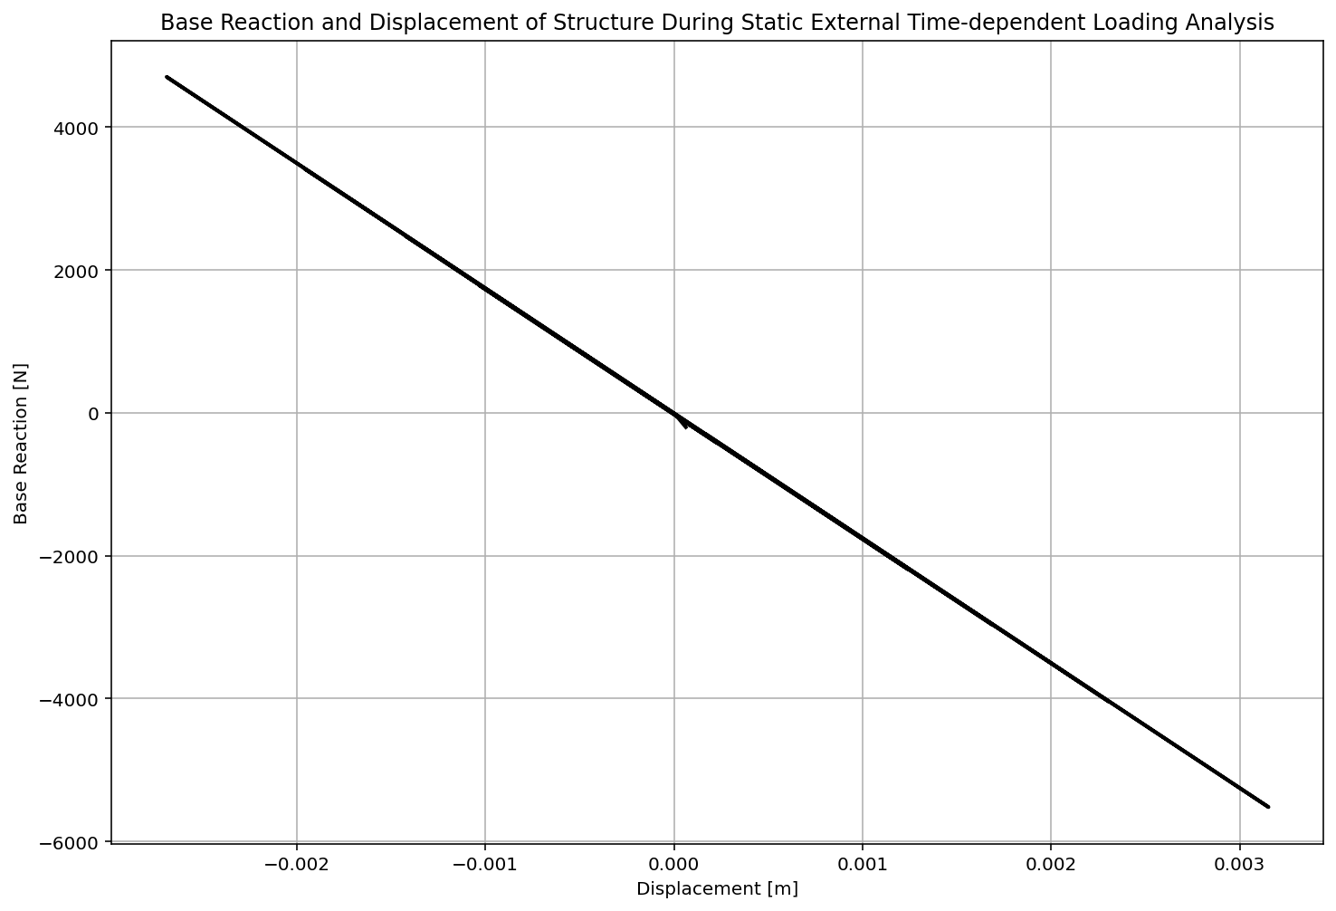

Slide 32
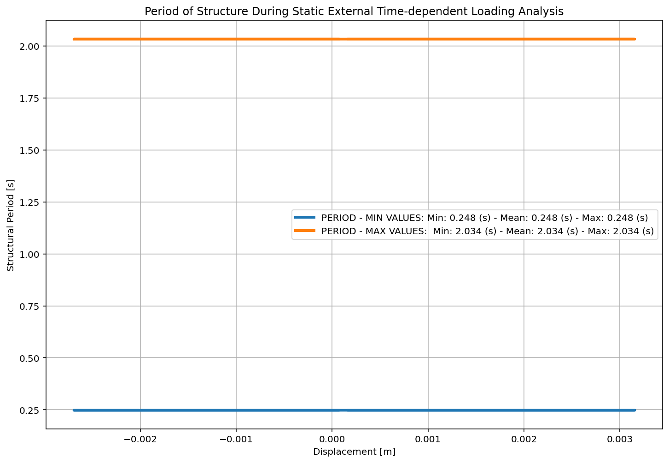

Slide 33
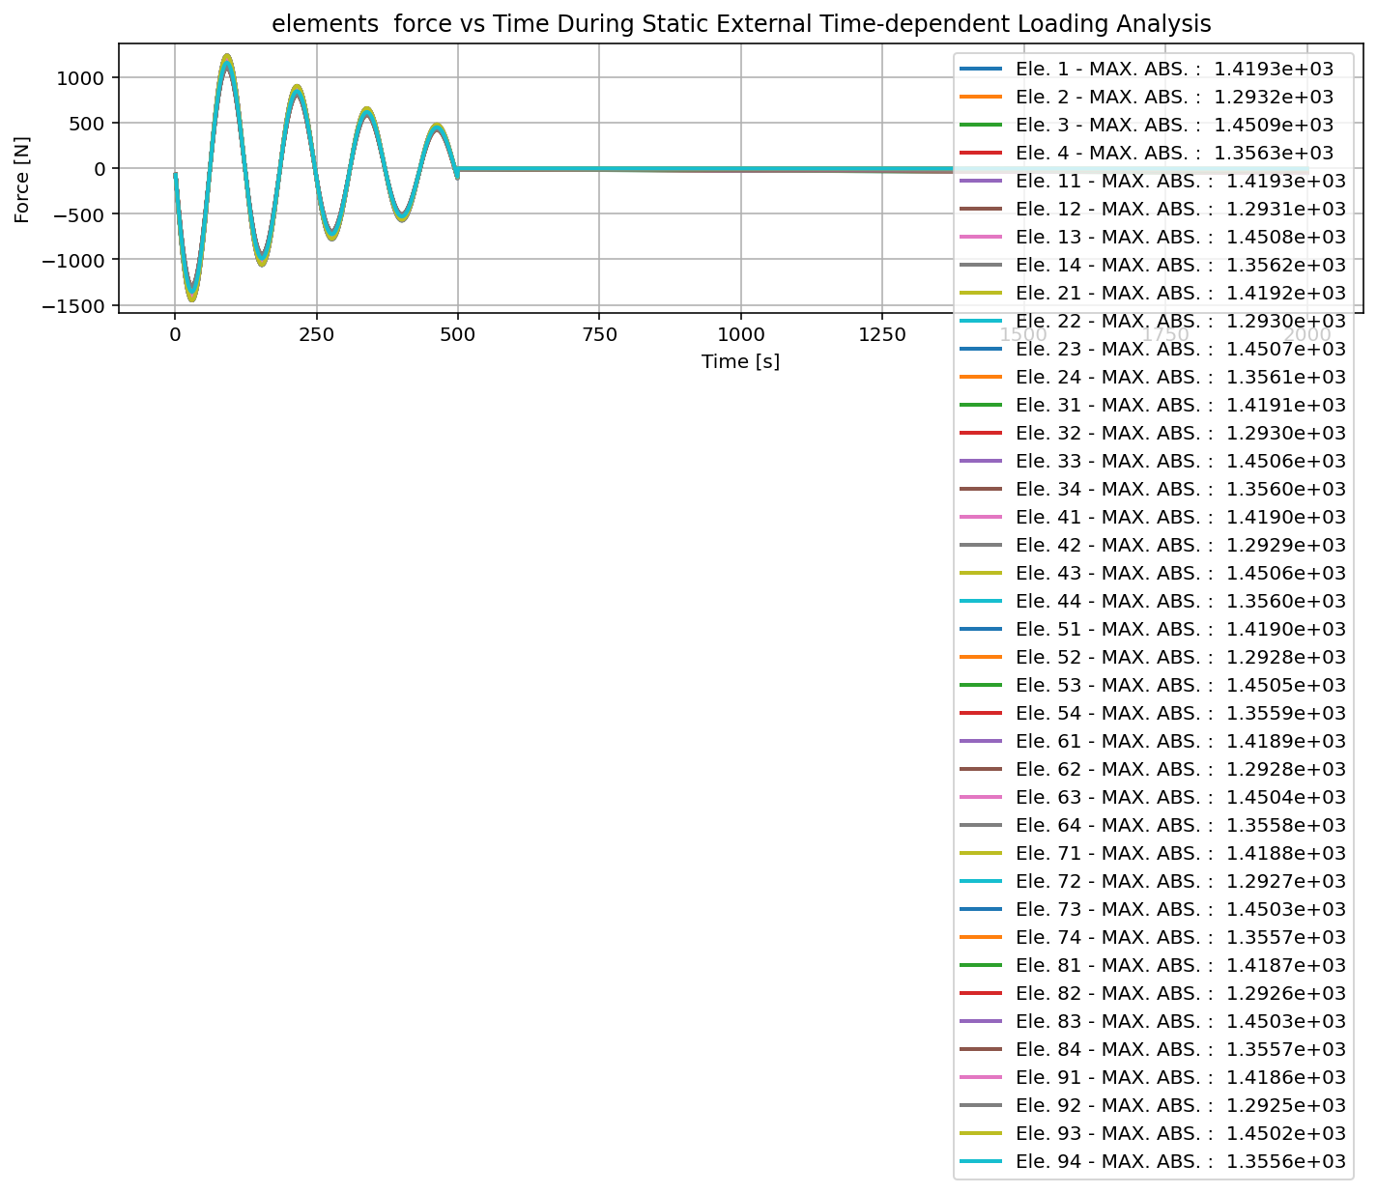

Slide 34
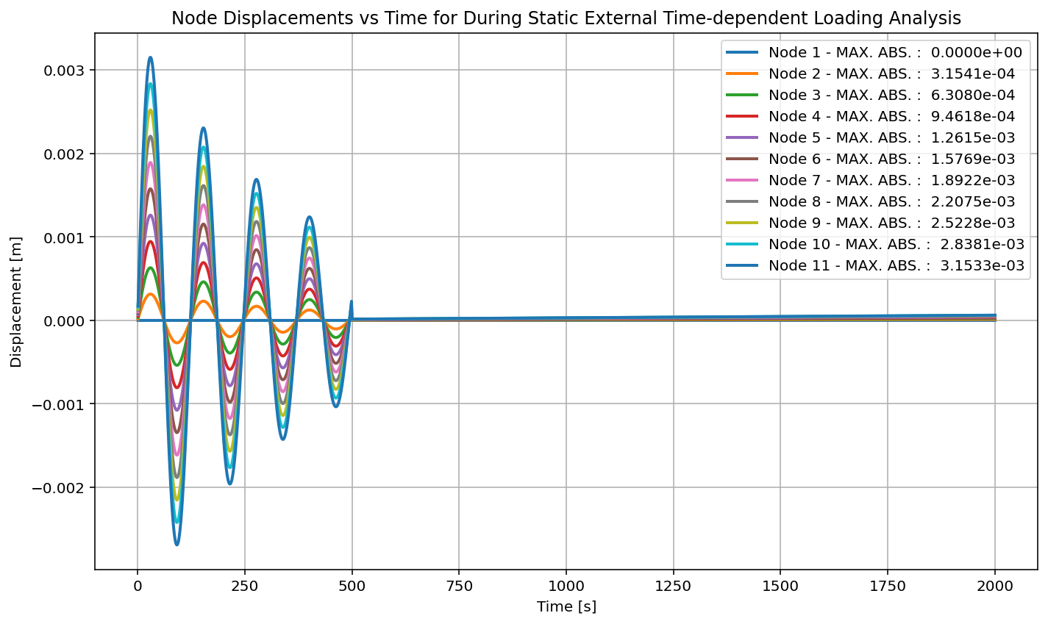

Slide 35
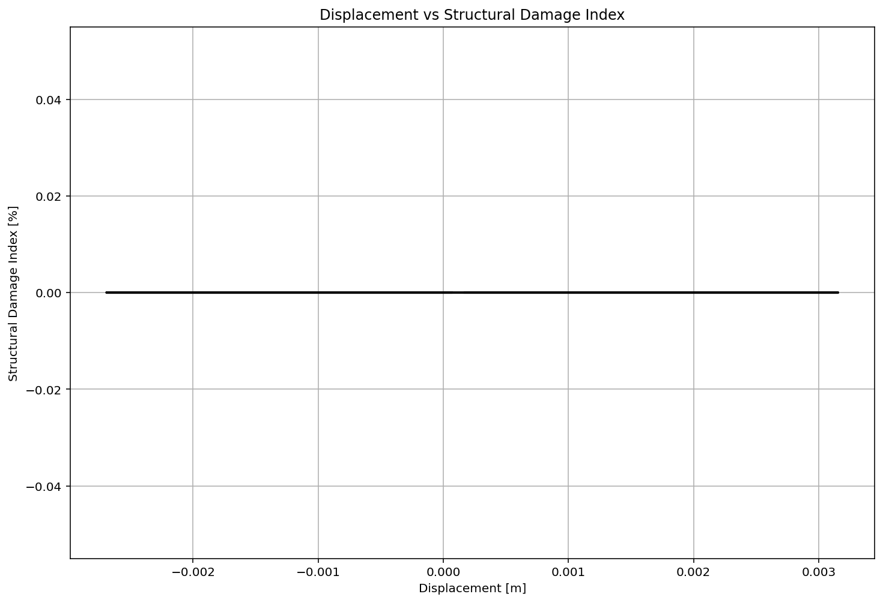

Slide 36
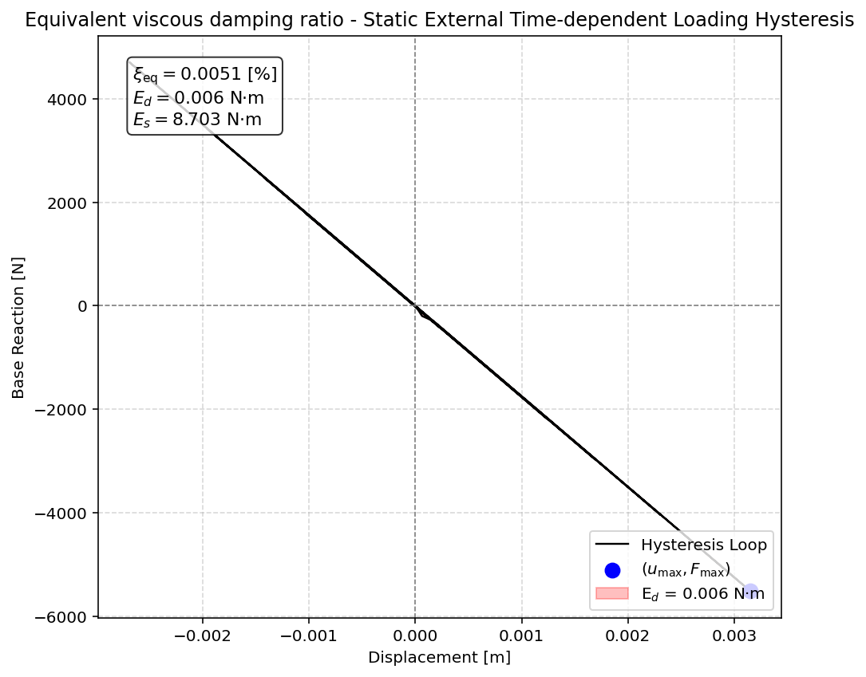

Slide 37
DYNAMIC TIME-HISTORY WITH EXTERNAL TIME-DEPENDENT LOADING ANALYSIS

Slide 38
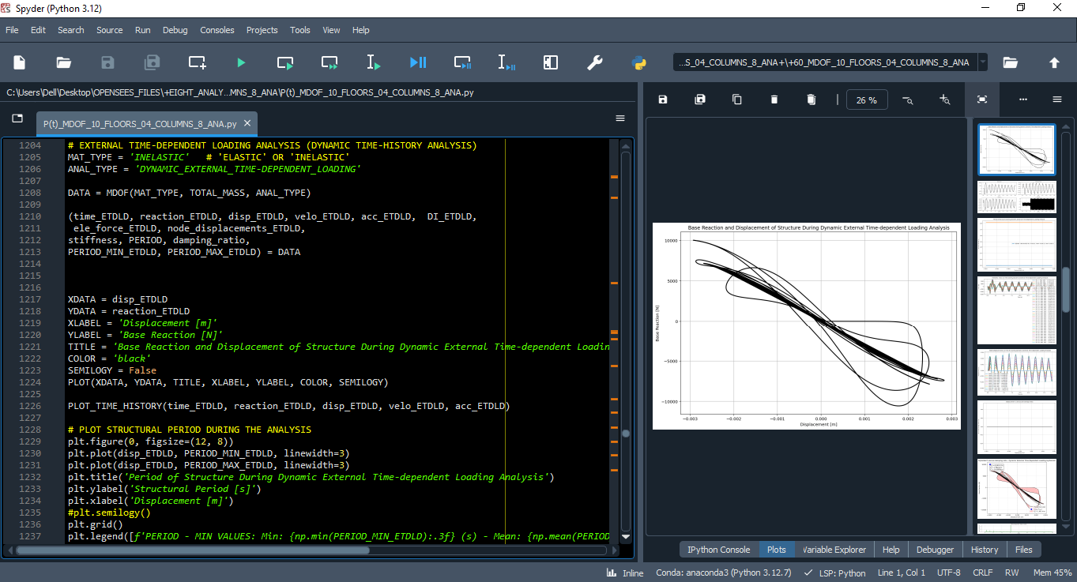

Slide 40
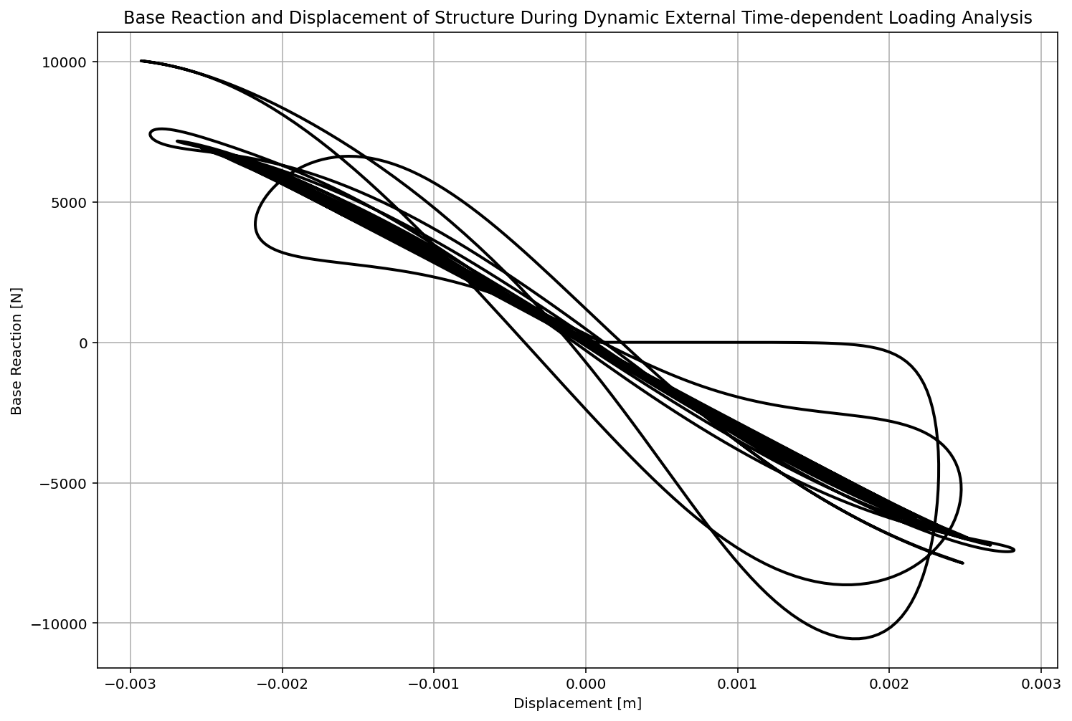

Slide 41
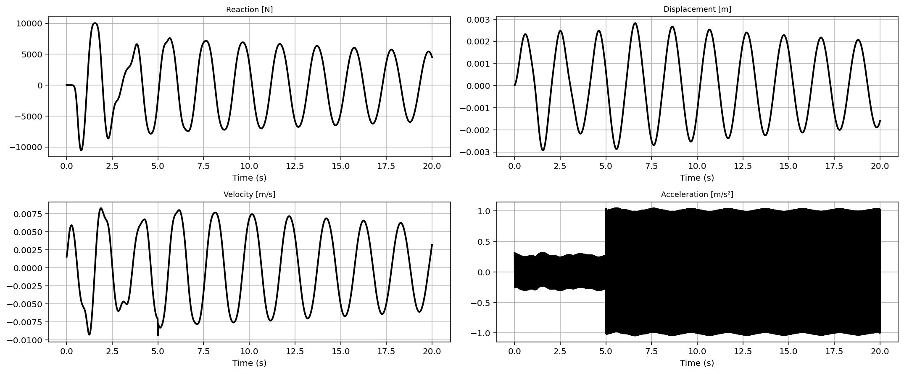

Slide 42
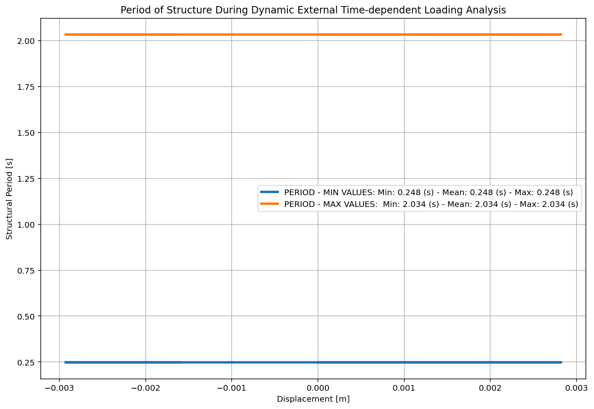

Slide 43
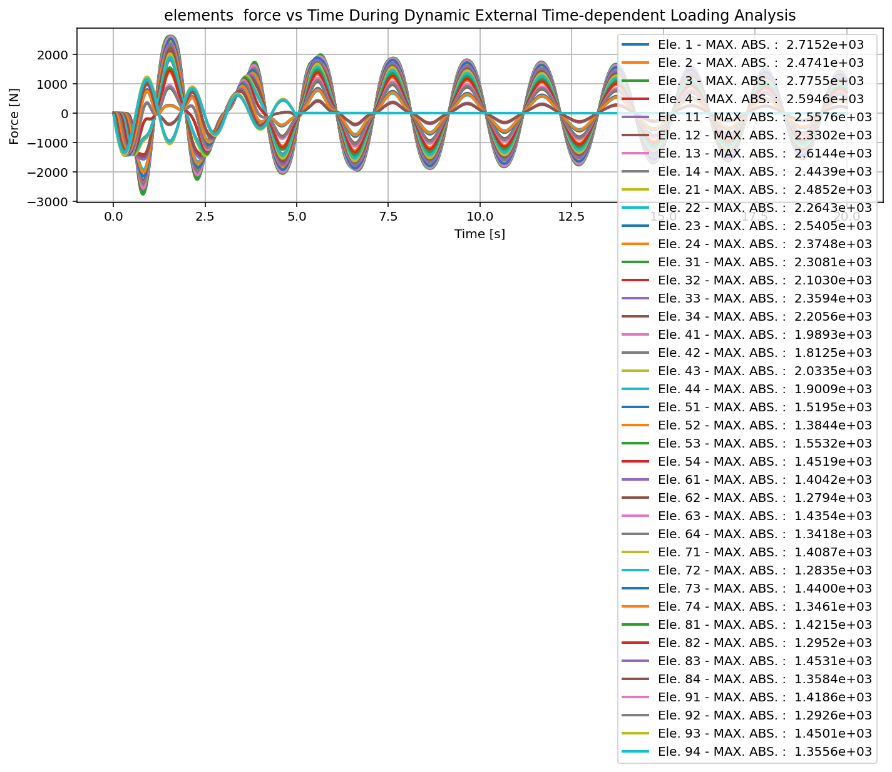

Slide 44
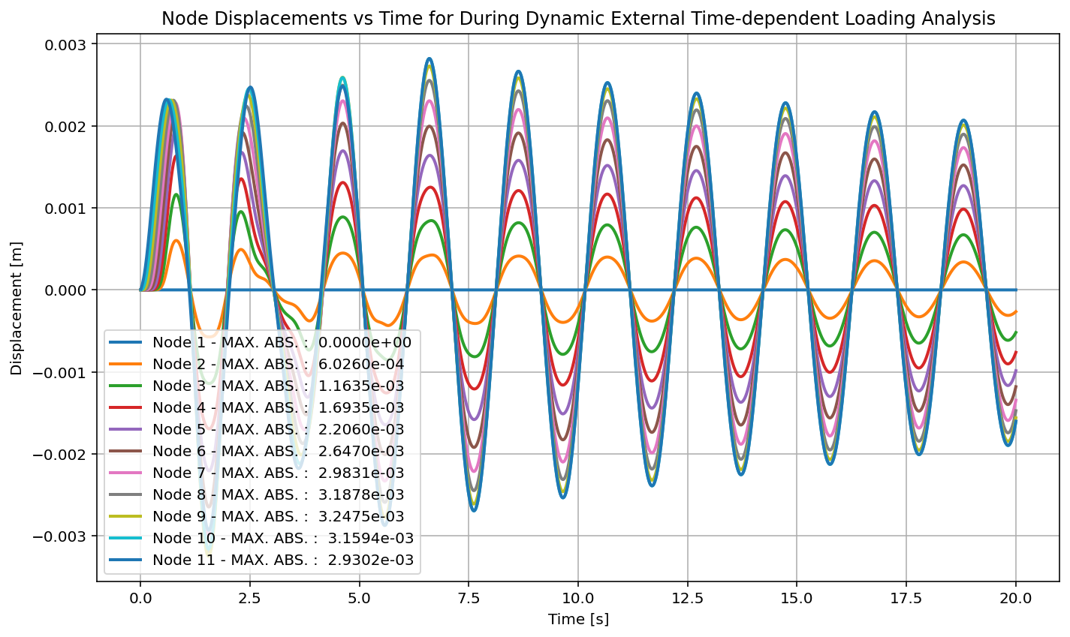

Slide 45
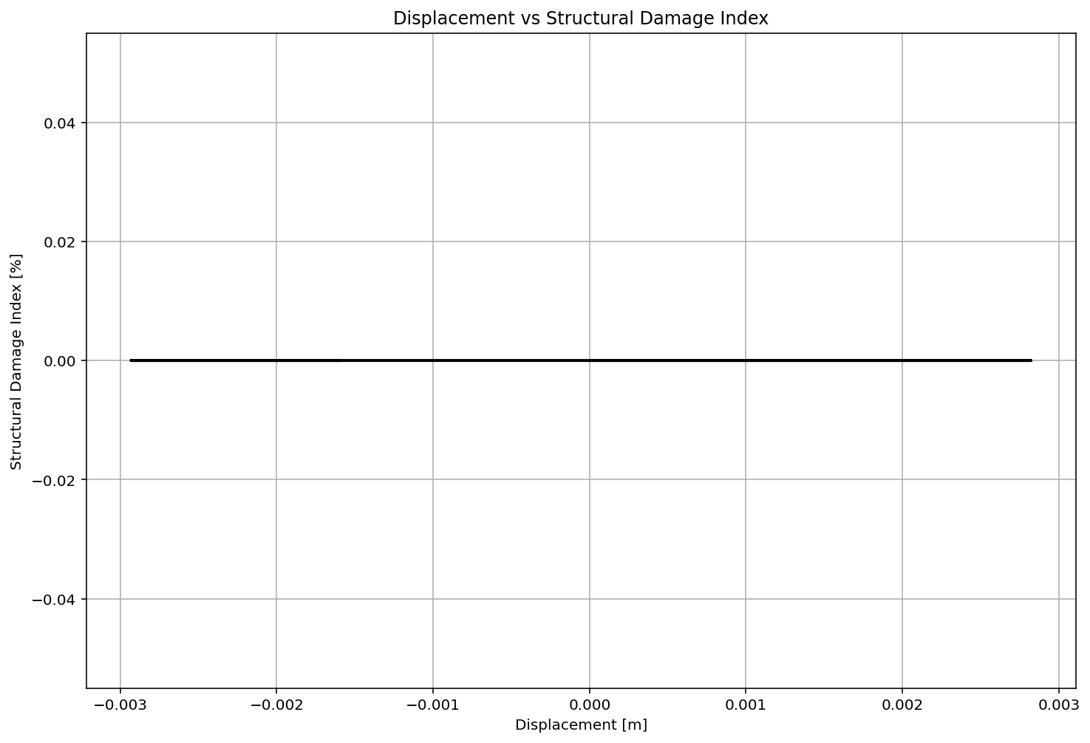

Slide 46
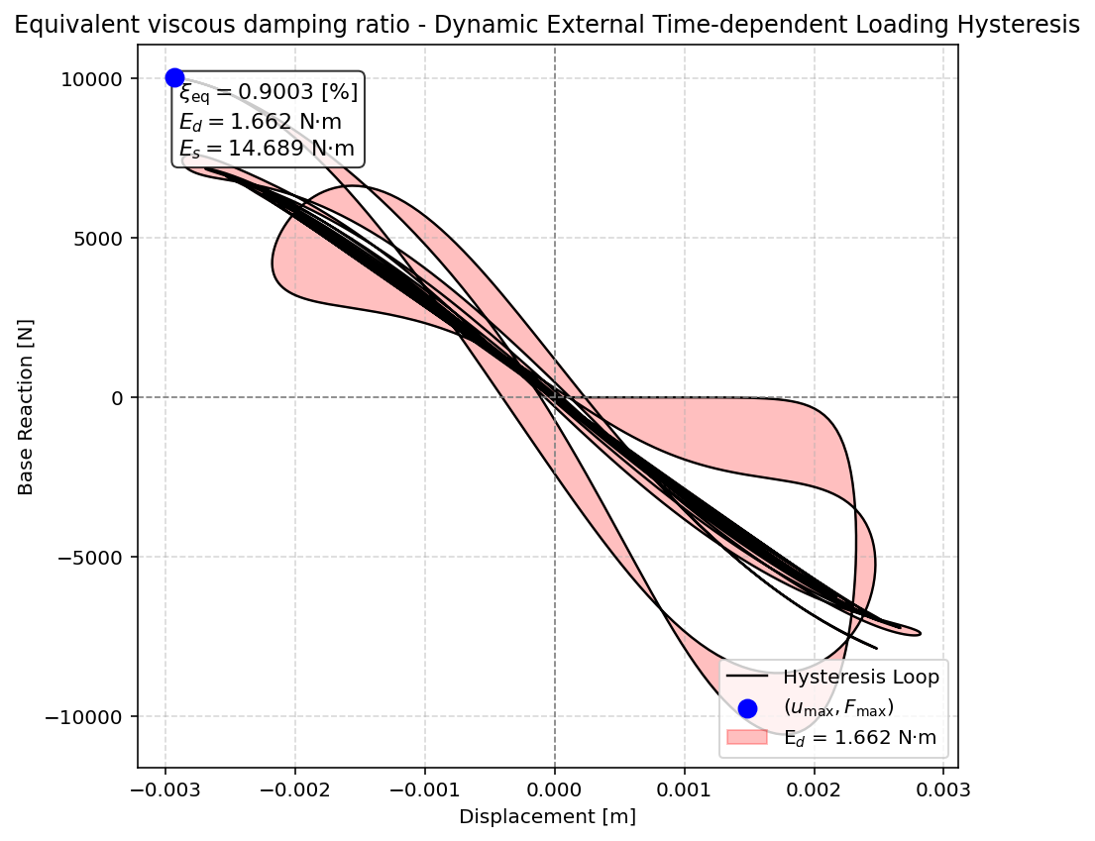

Slide 47
FREE-VIBRATION ANALYSIS

Slide 48
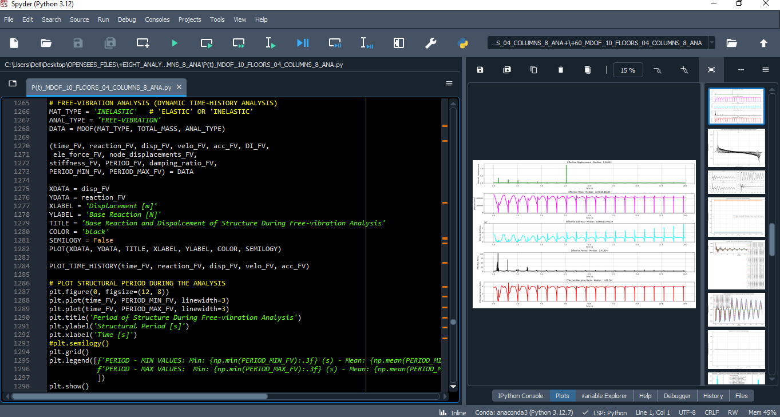

Slide 49
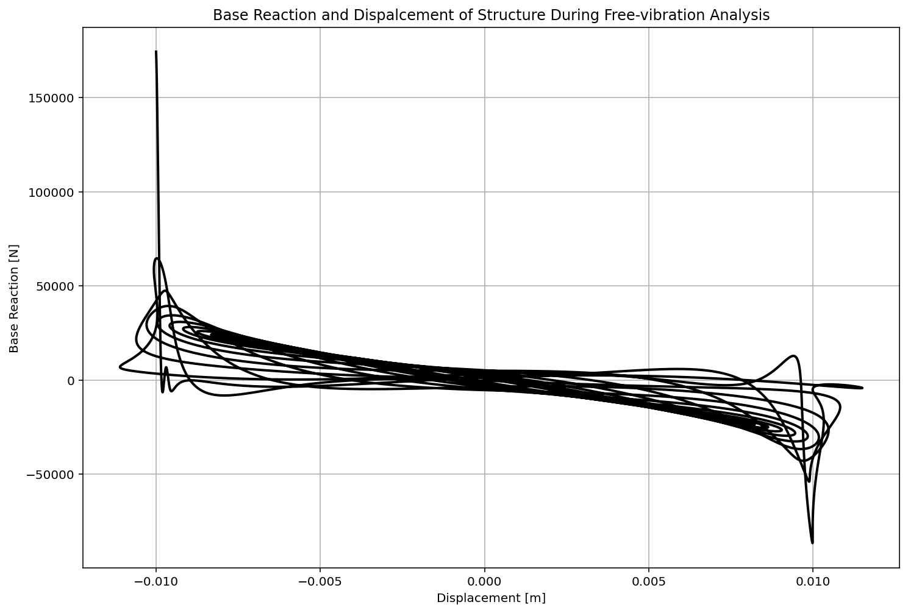

Slide 50
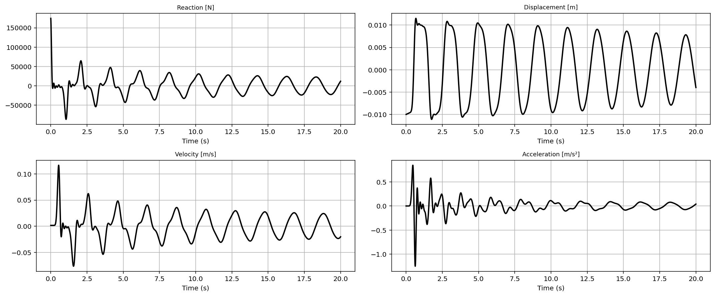

Slide 51
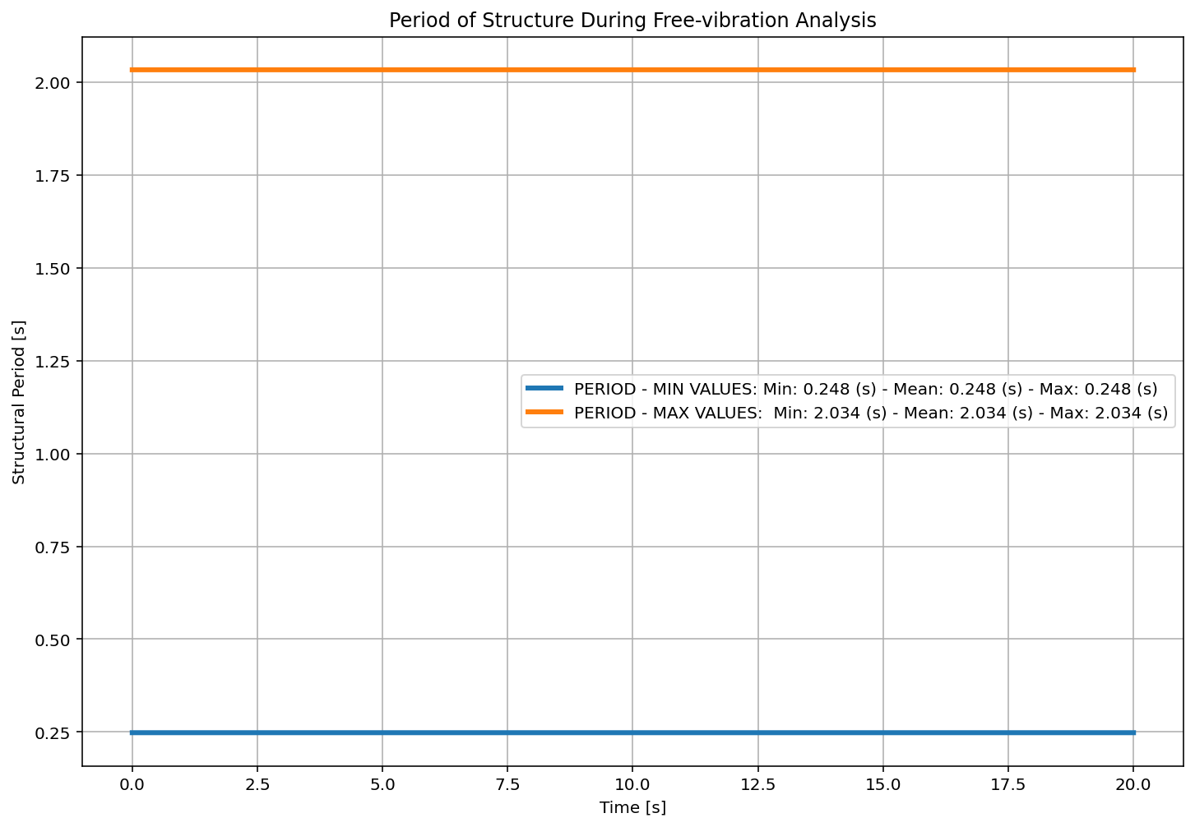

Slide 52
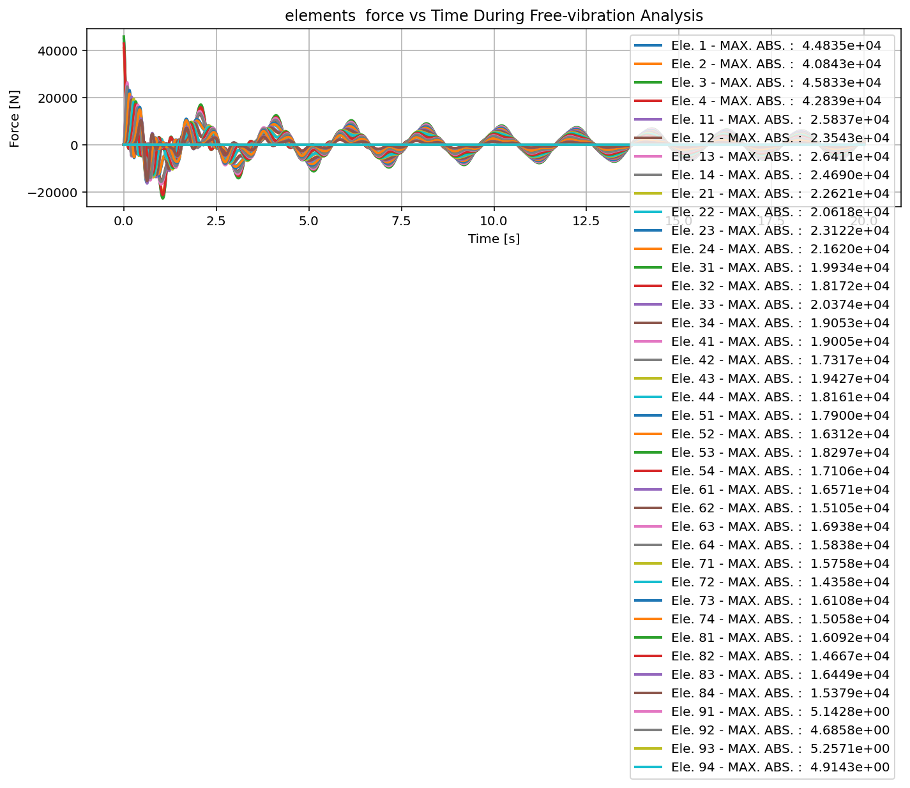

Slide 53
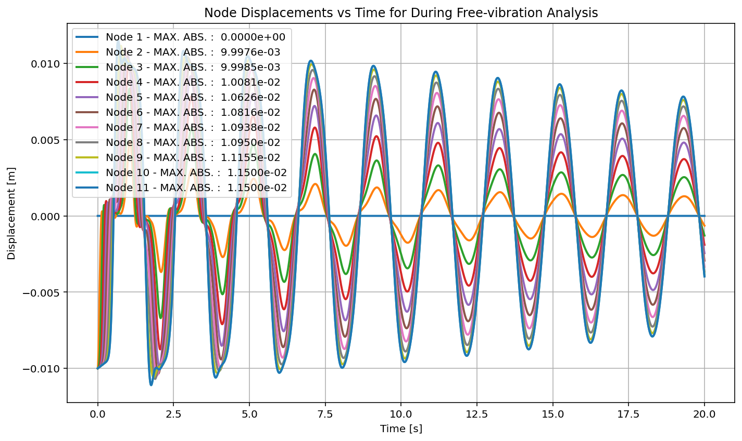

Slide 54


Slide 55
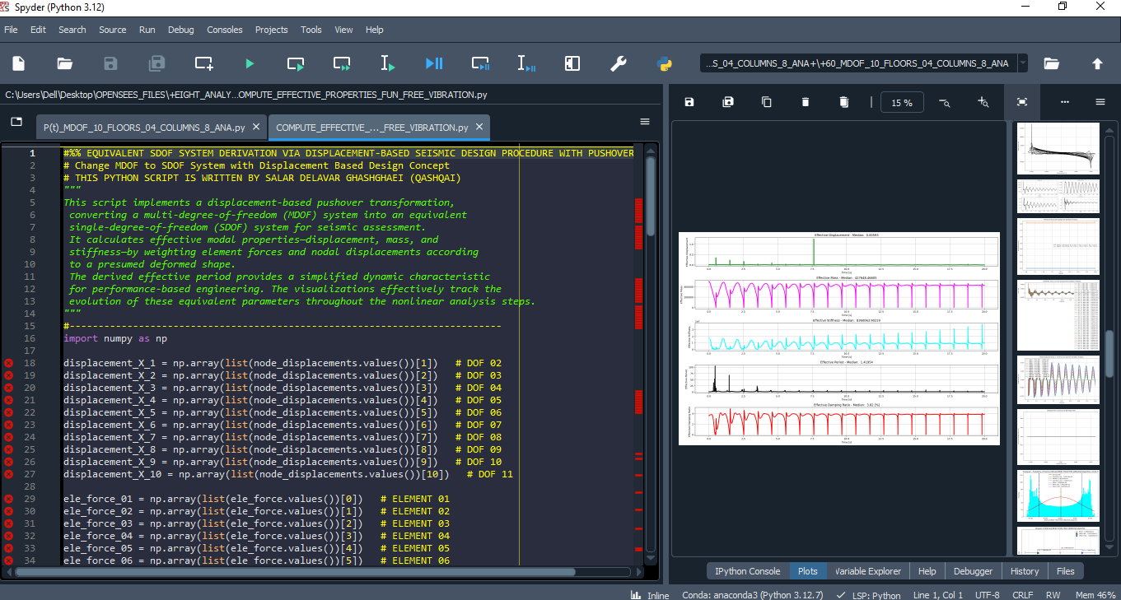

Slide 56
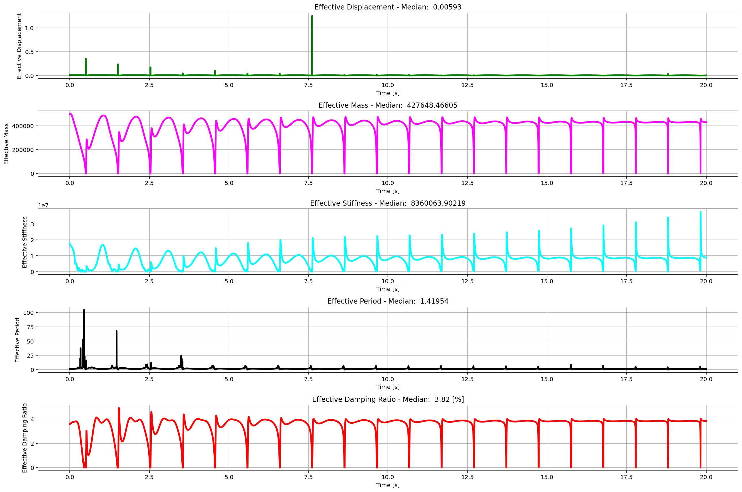
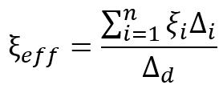

Slide 57


Slide 58


Slide 59


Slide 60


Slide 61
SEISMIC ANALYSIS

Slide 62


Slide 63


Slide 64


Slide 65


Slide 66


Slide 67


Slide 68


Slide 69


Slide 70


Slide 71


Slide 72


Slide 73


Slide 74


Slide 75
Dissipated Energy from Earthquake= 7928.94 N·m
Dissipated Energy from Cyclic Displacement= 729273.42 N·m
DISSIPATED ENERGY CAPACITY INDEX: 1.087 [%]
ZONE 1: VERY MINOR DAMAGE

Slide 76


Slide 77
+==========================+
= Analysis curve fitted =
Disp Base Shear
----------------------------
[[0.00000000e+00 0.00000000e+00]
[1.00669128e-01 3.20310863e+05]
[3.60000000e-01 3.57591396e+05]]
+==========================+
+----------------------------------------------------+
Structure Elastic Stiffness : 3181818.18
Structure Plastic Stiffness : 993309.43
Structure Tangent Stiffness : 143756.63
Structure Ductility Ratio : 3.58
Structure Over Strength Factor: 1.12
+----------------------------------------------------+
Over Strength Coefficient (Ω0): 1.1164
Displacement Ductility Ratio (μ): 3.5761
Ductility Coefficient (Rμ): 3.5761
Structural Behavior Coefficient (R): 3.9923
Structural Ductility Damage Index in X Direction: -20.1835 (%)

Slide 78


Slide 79


Slide 80


