Slide 1
>> IN THE NAME OF ALLAH, THE MOST GRACIOUS, THE MOST MERCIFUL <<
COMPREHENSIVE EVALUATION OF THE EQUIVALENT VISCOUS DAMPING RATIO OF A POST-FIRE NONLINEAR SDOF SYSTEM WITH FOUR ELEMENTS STRUCTURE UNDER MULTIPLE LOADING PROTOCOLS
THIS PROGRAM WRITTEN BY SALAR DELAVAR GHASHGHAEI (QASHQAI)

Slide 2
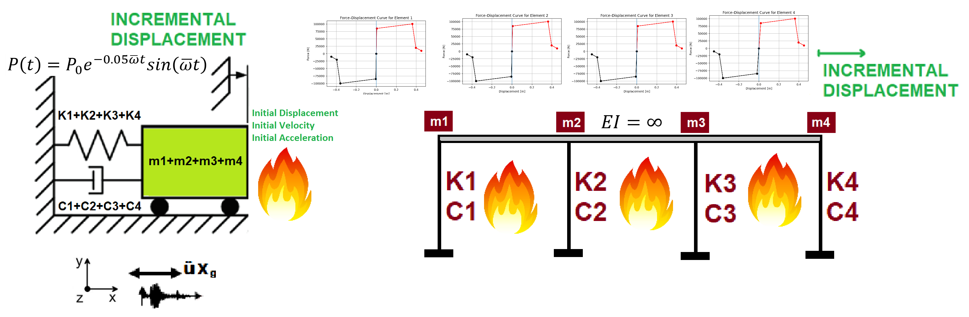

Slide 3
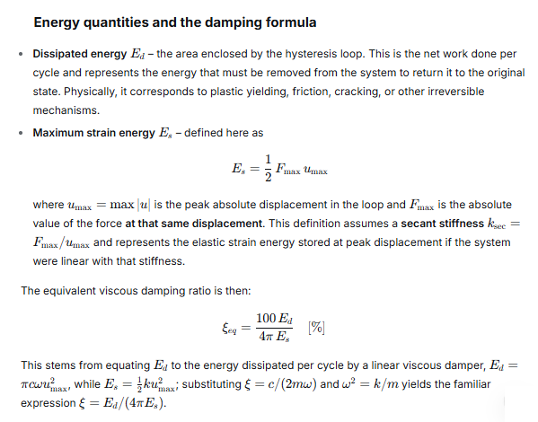

Slide 4
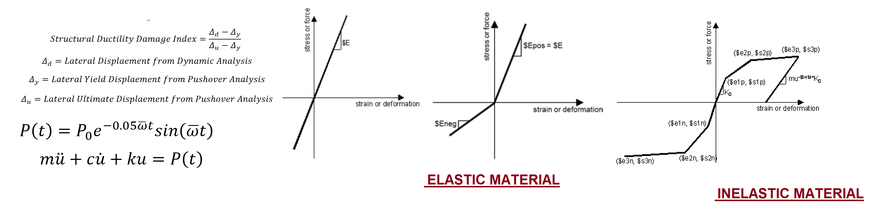

Slide 5
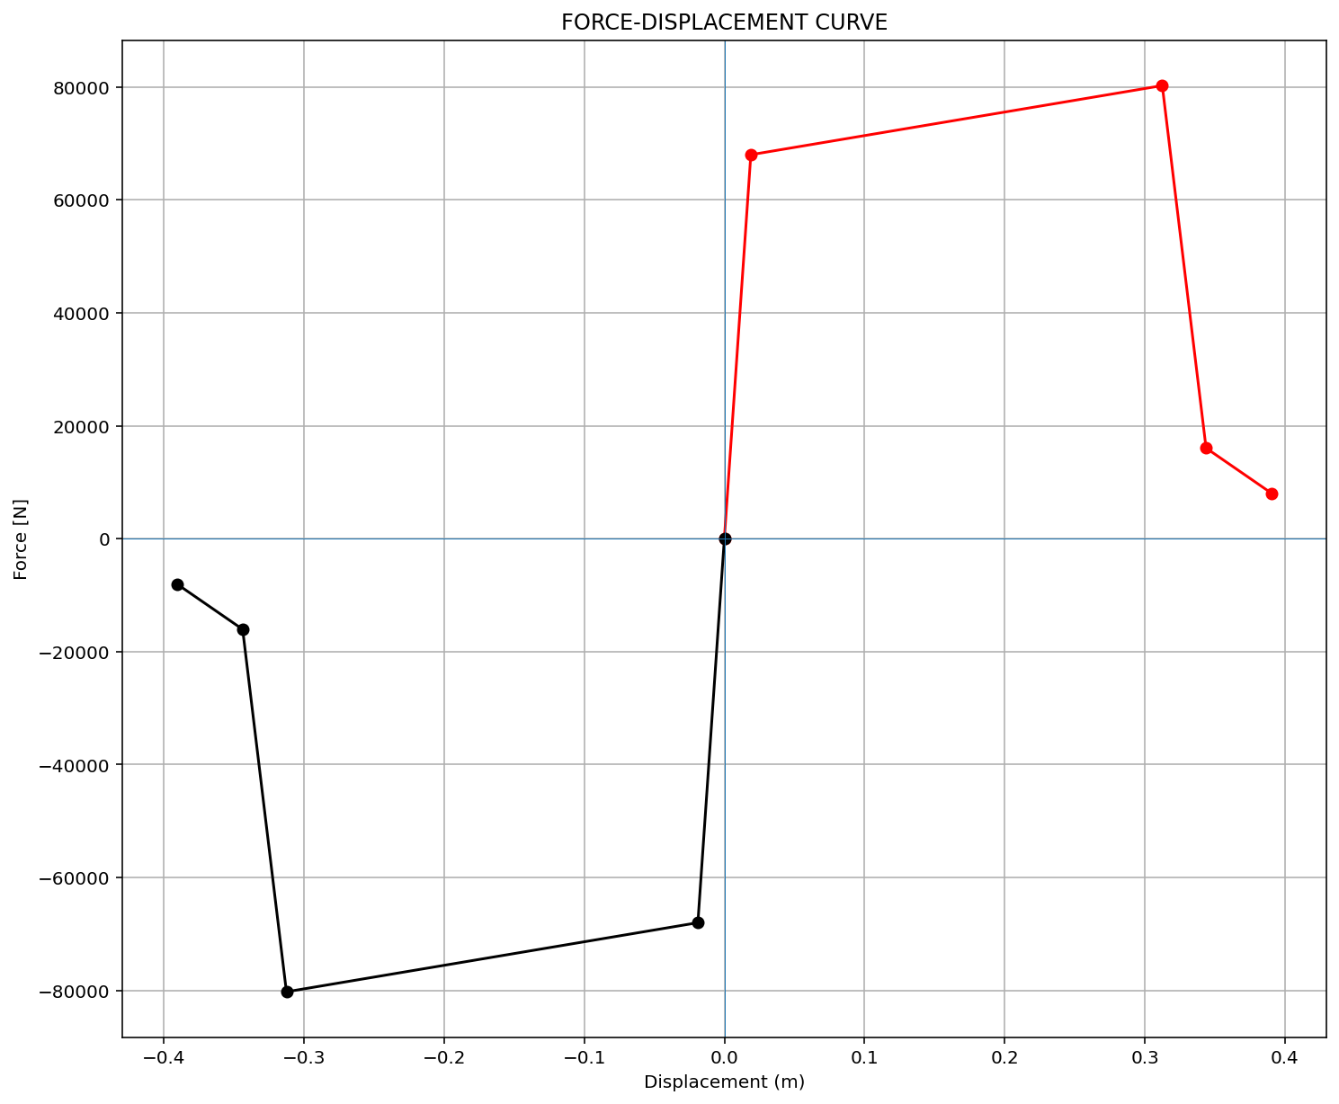
ELEMENT 01

Slide 6
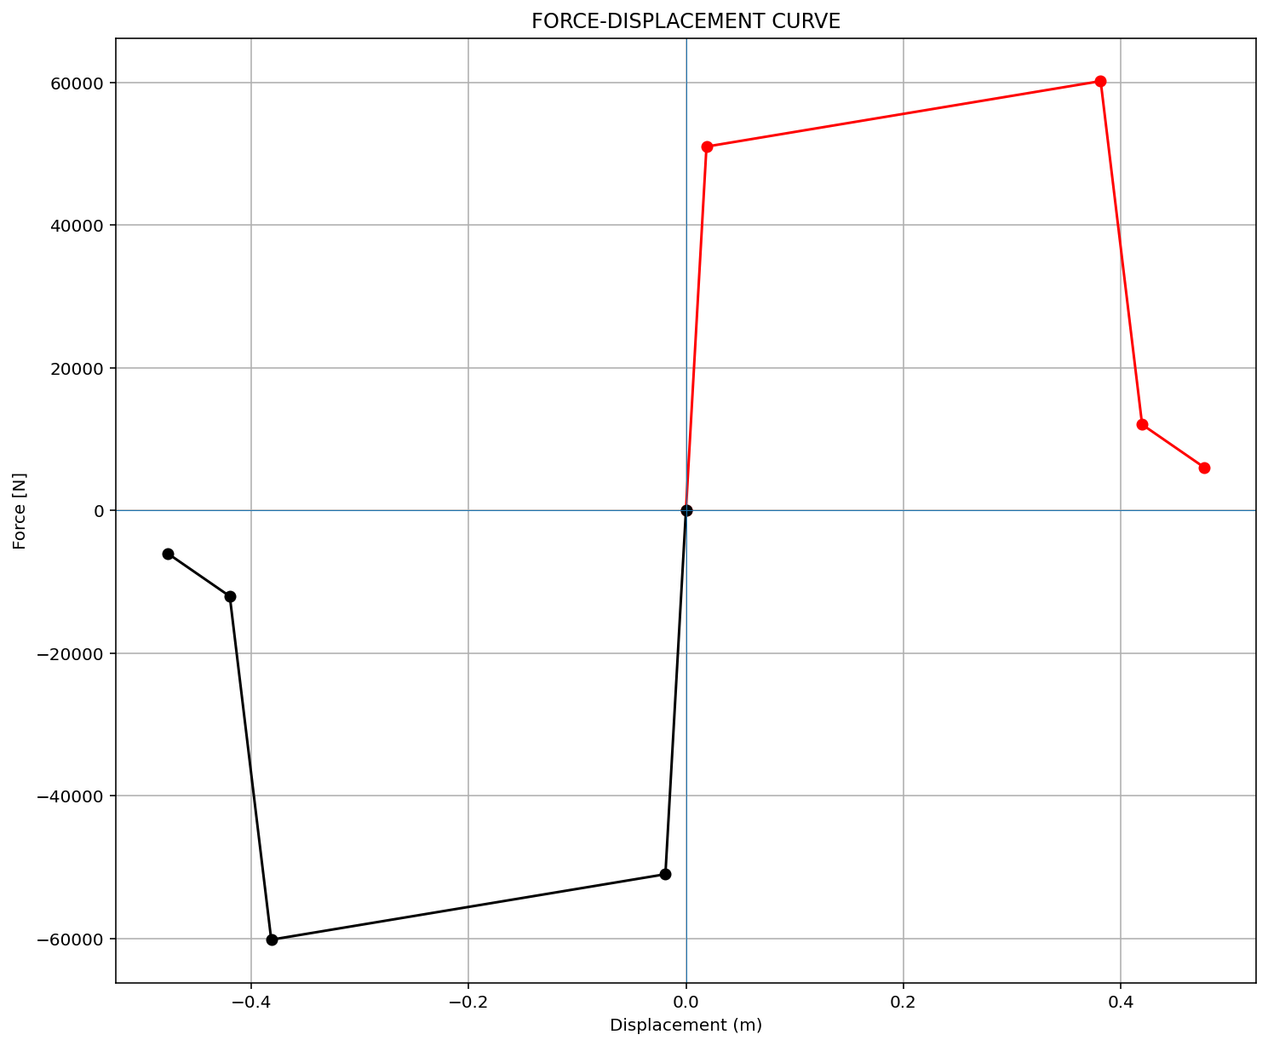
ELEMENT 02

Slide 7

ELEMENT 03

Slide 8
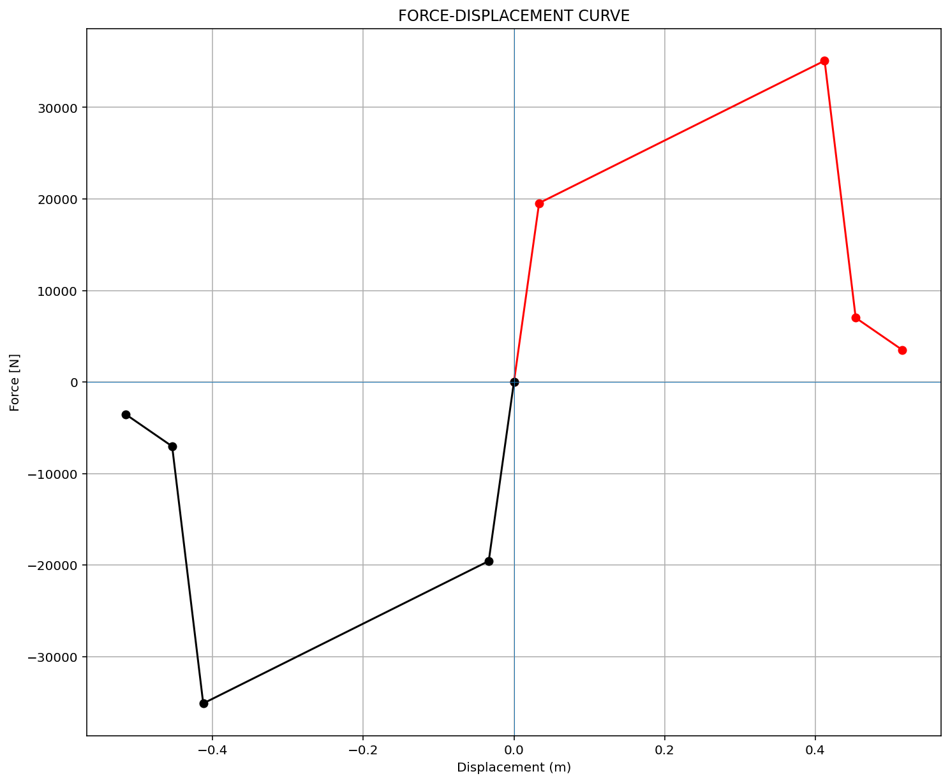
ELEMENT 04

Slide 9
CYCLIC DISPLACEMENT ANALYSIS

Slide 10
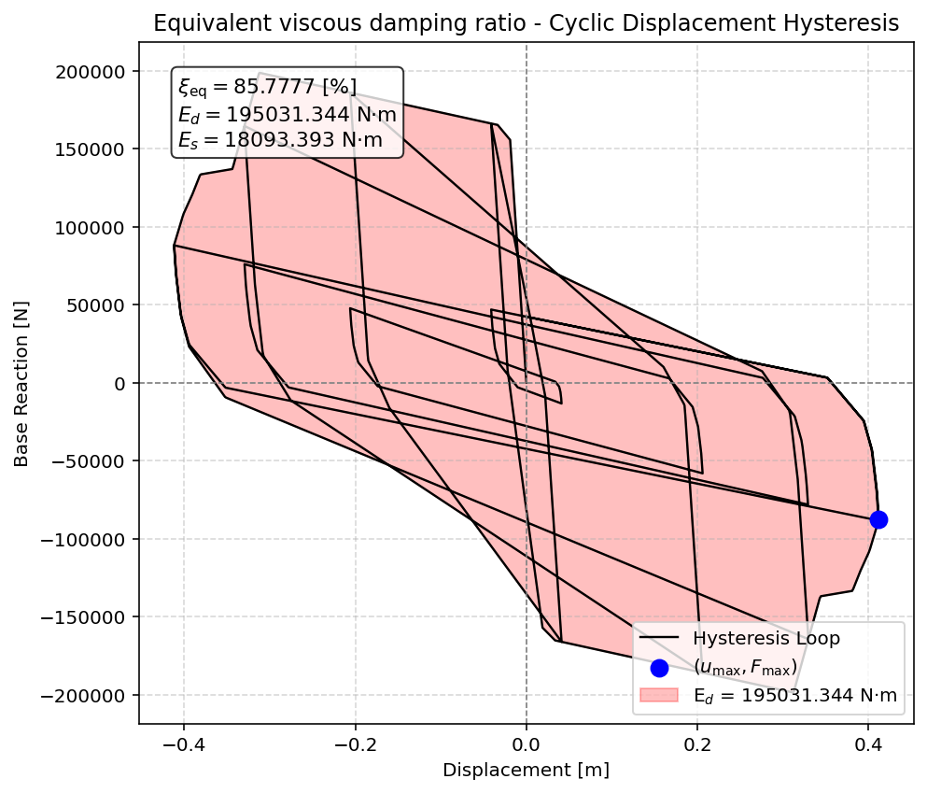

Slide 11
STATIC TIME-HISTORY WITH EXTERNAL TIME-DEPENDENT LOADING ANALYSIS

Slide 12
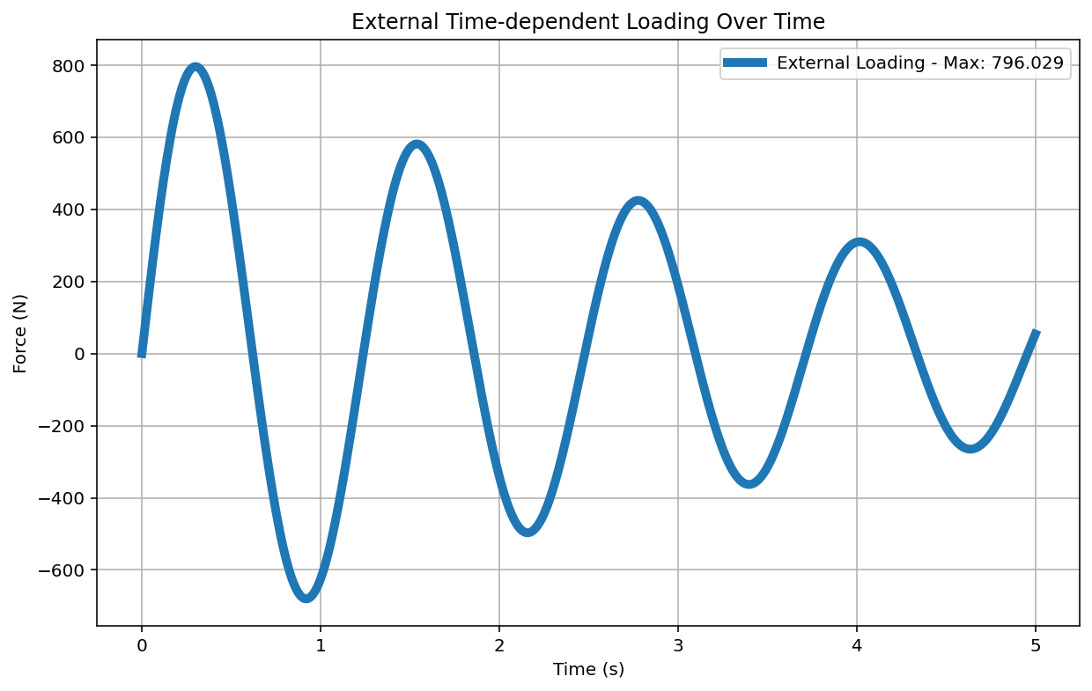

Slide 13
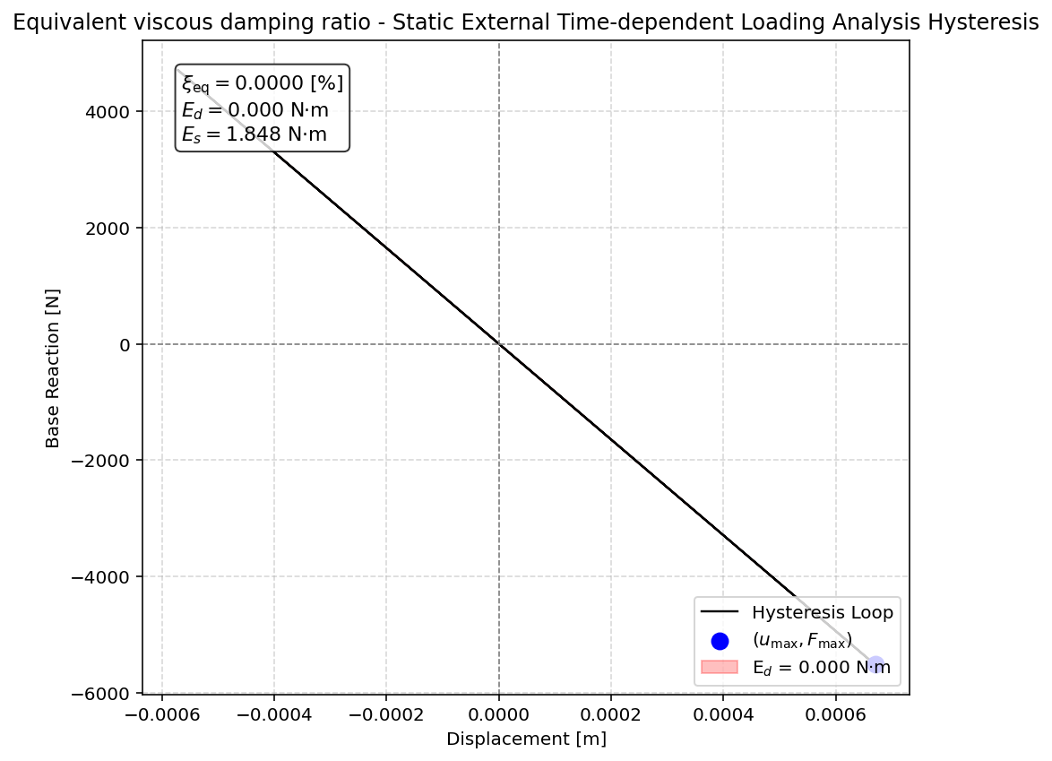

Slide 14
DYNAMIC TIME-HISTORY WITH EXTERNAL TIME-DEPENDENT LOADING ANALYSIS

Slide 16
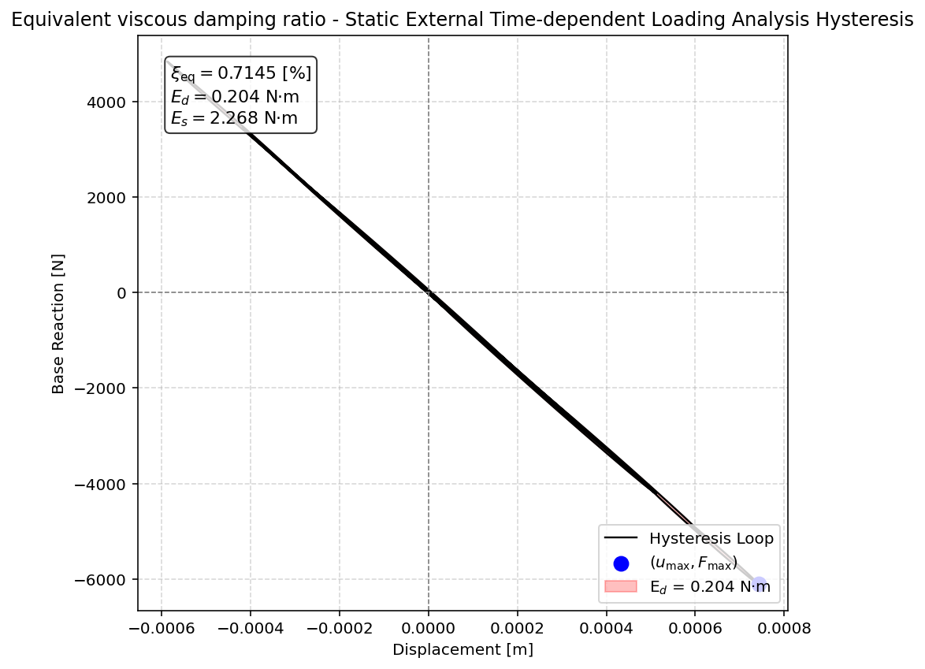

Slide 17
FREE-VIBRATION ANALYSIS

Slide 18
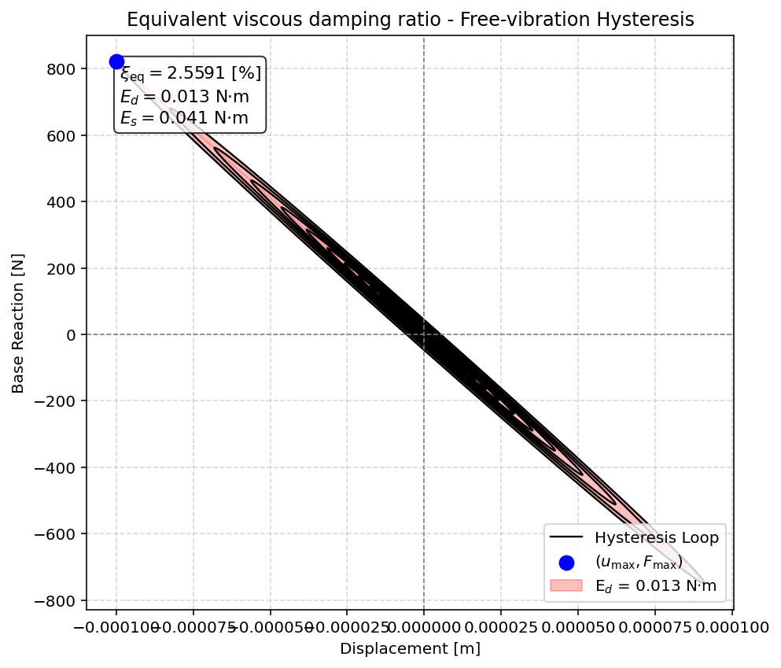

Slide 19
SEISMIC ANALYSIS

Slide 20
