Slide 1
>> IN THE NAME OF ALLAH, THE MOST GRACIOUS, THE MOST MERCIFUL <<
FRAGILITY ANALYSIS BASED ON ACCELERATION AND STRUCTURAL DUCTILITY DAMAGE INDEX AND EVALUATION OF ENERGY DISSIPATION CAPACITY INDEX WITH INCREMENTAL DYNAMIC ANALYSIS (IDA) OF A SINGLE-DEGREE-OF-FREEDOM (SDOF) SYSTEM UTILIZING 30 GROUND MOTIONS IN OPENSEES
WRITTEN BY SALAR DELAVAR GHASHGHAEI (QASHQAI)

Slide 2
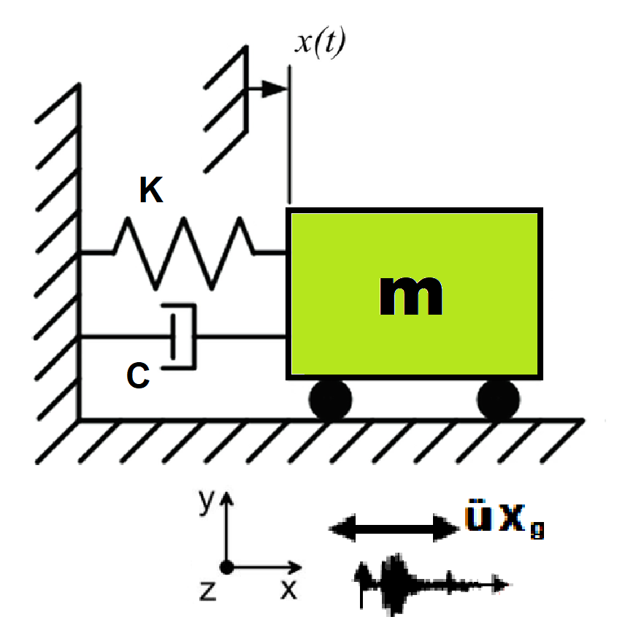
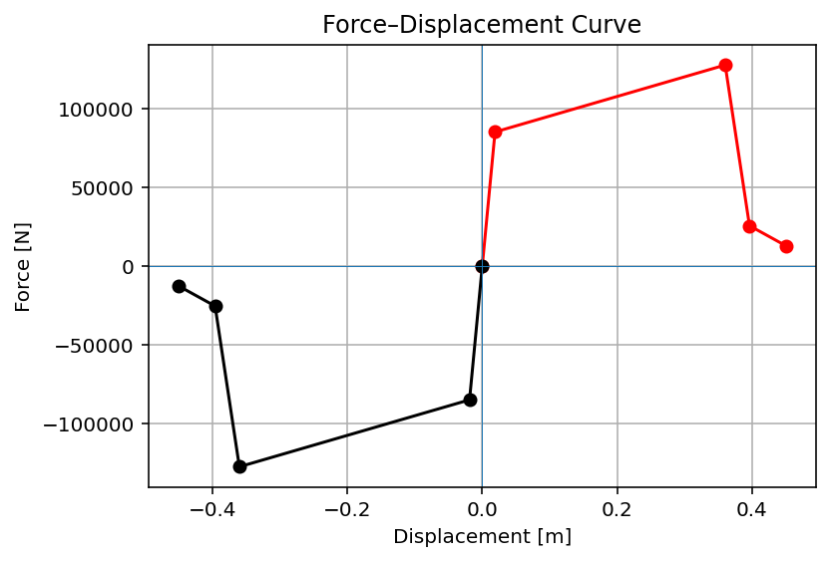

Slide 3
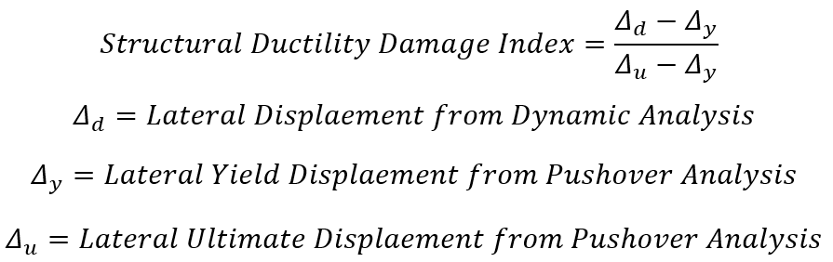

Slide 4
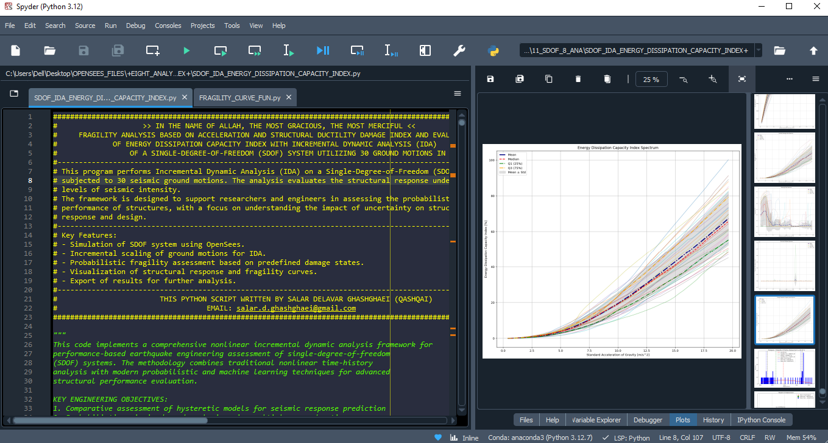

Slide 5
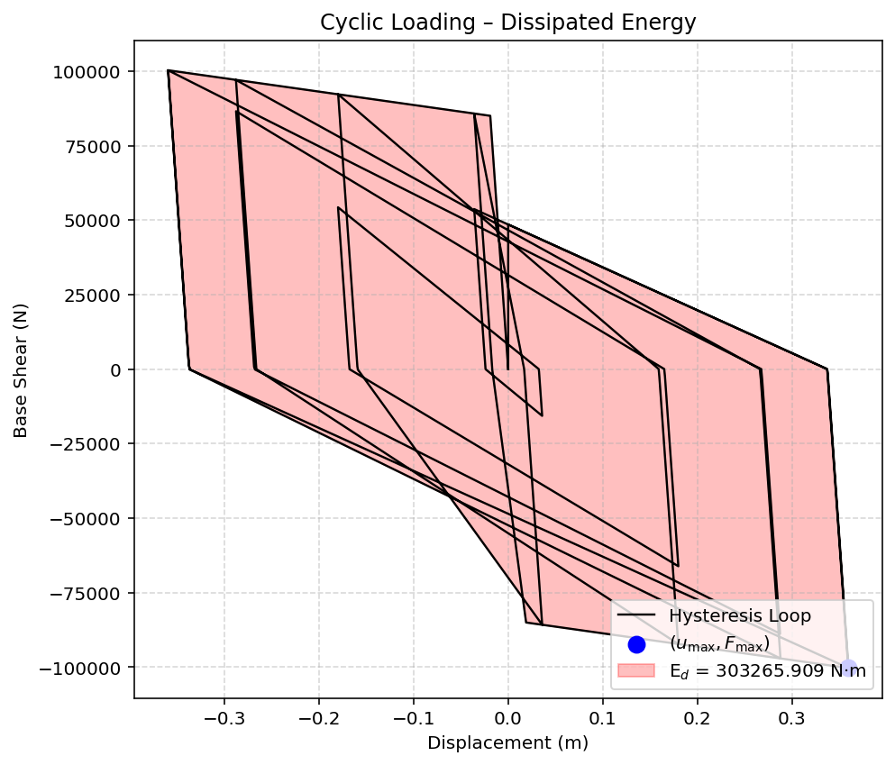

Slide 6
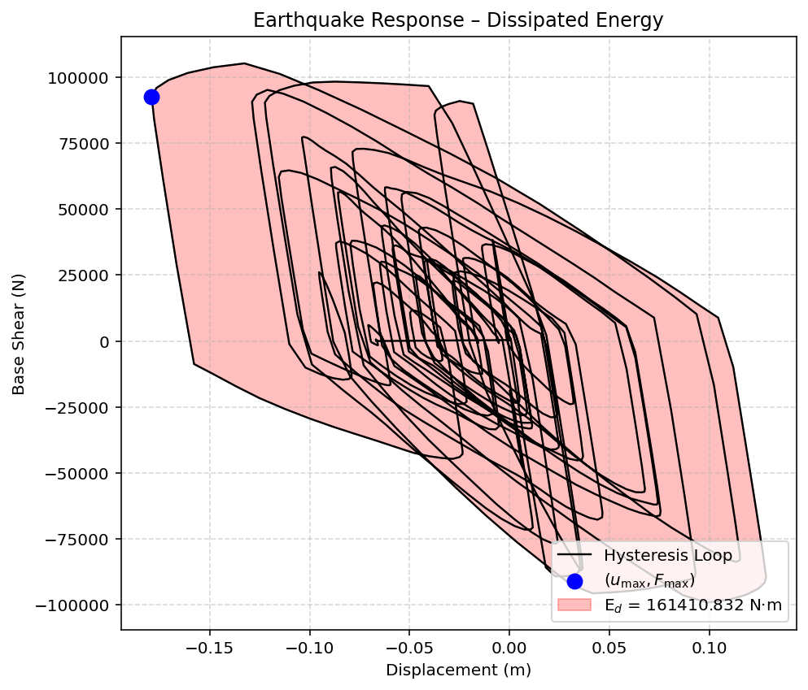

Slide 7
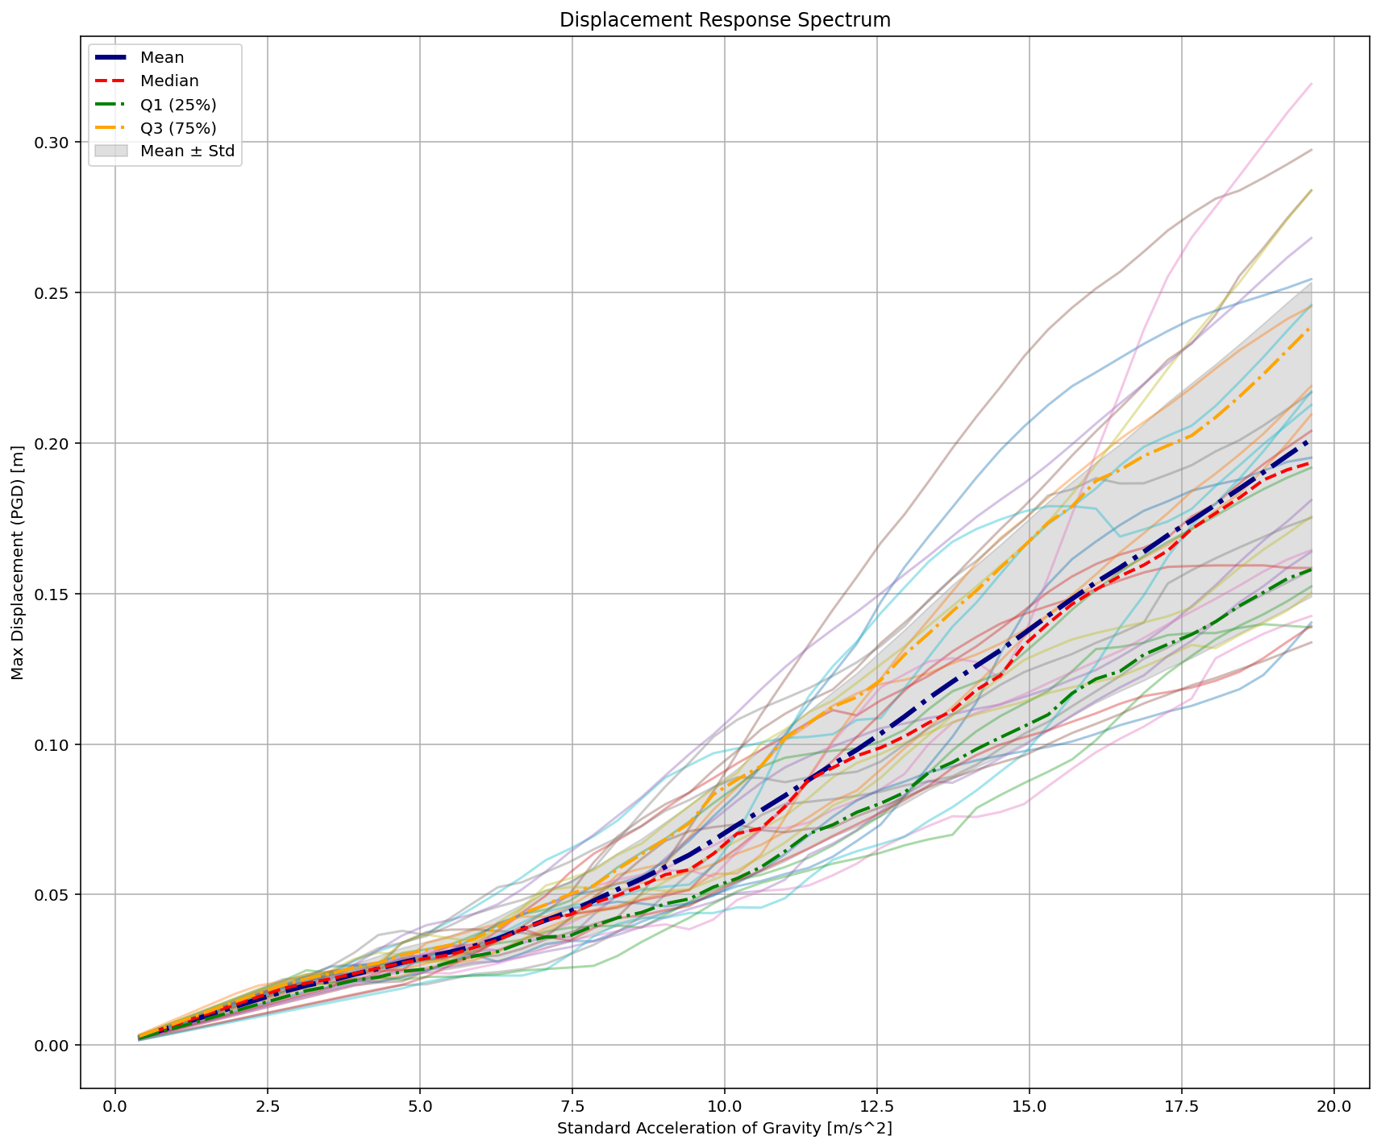

Slide 8
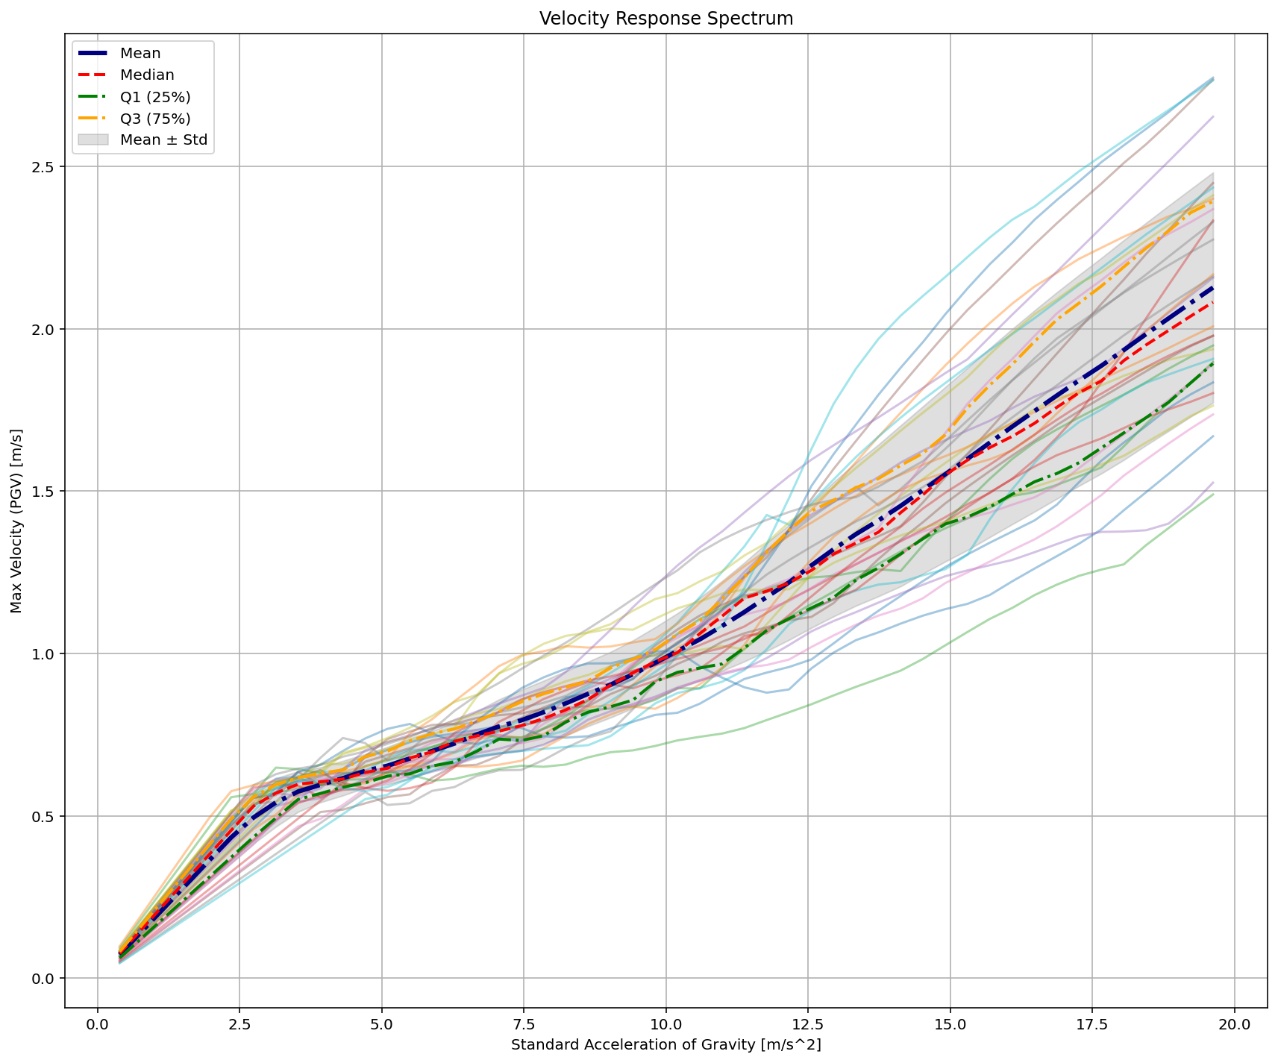

Slide 9
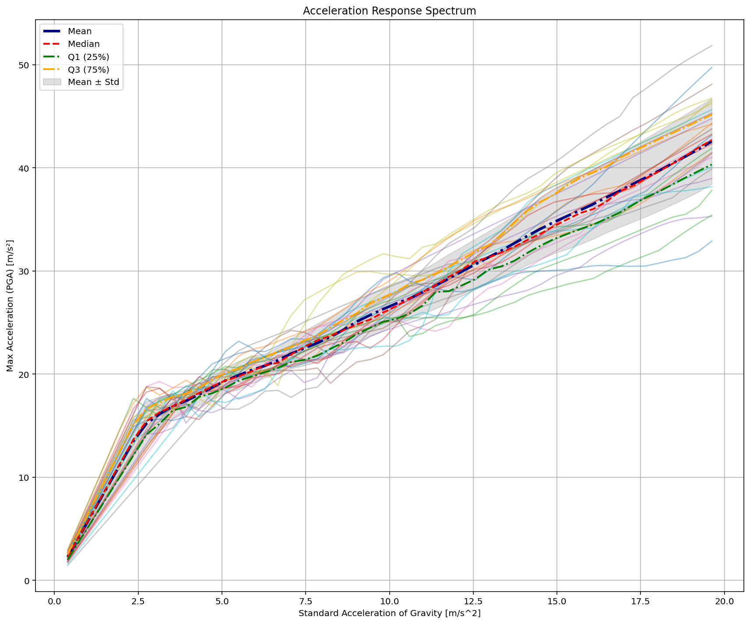

Slide 10
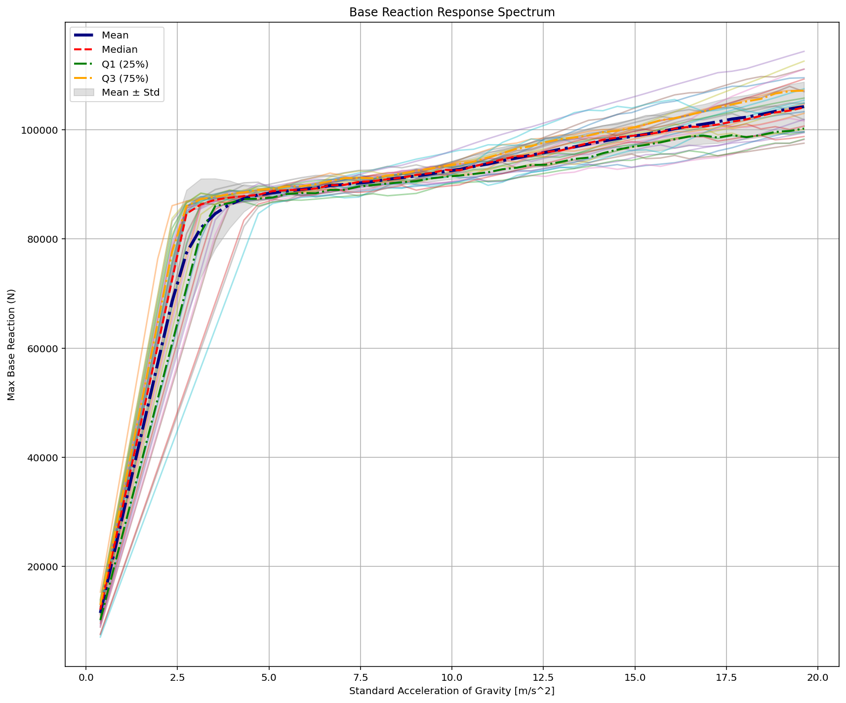

Slide 11
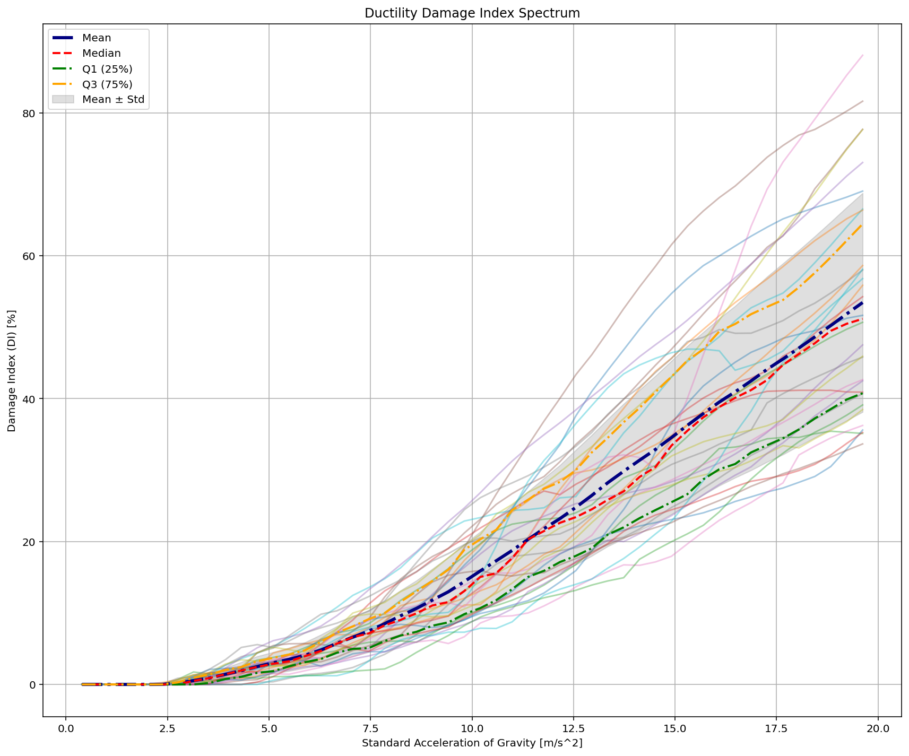
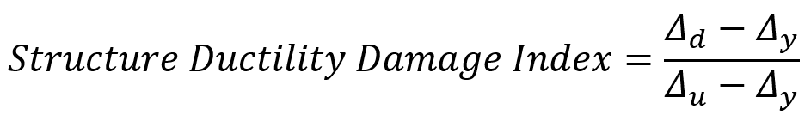

Slide 12
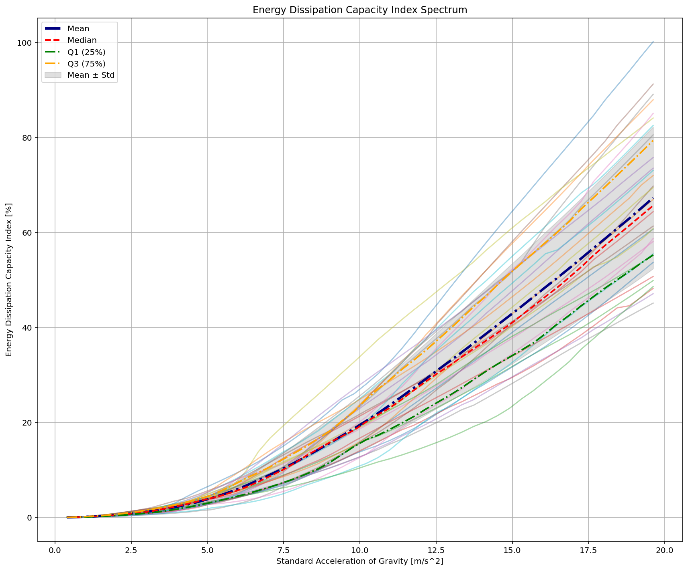

Slide 13
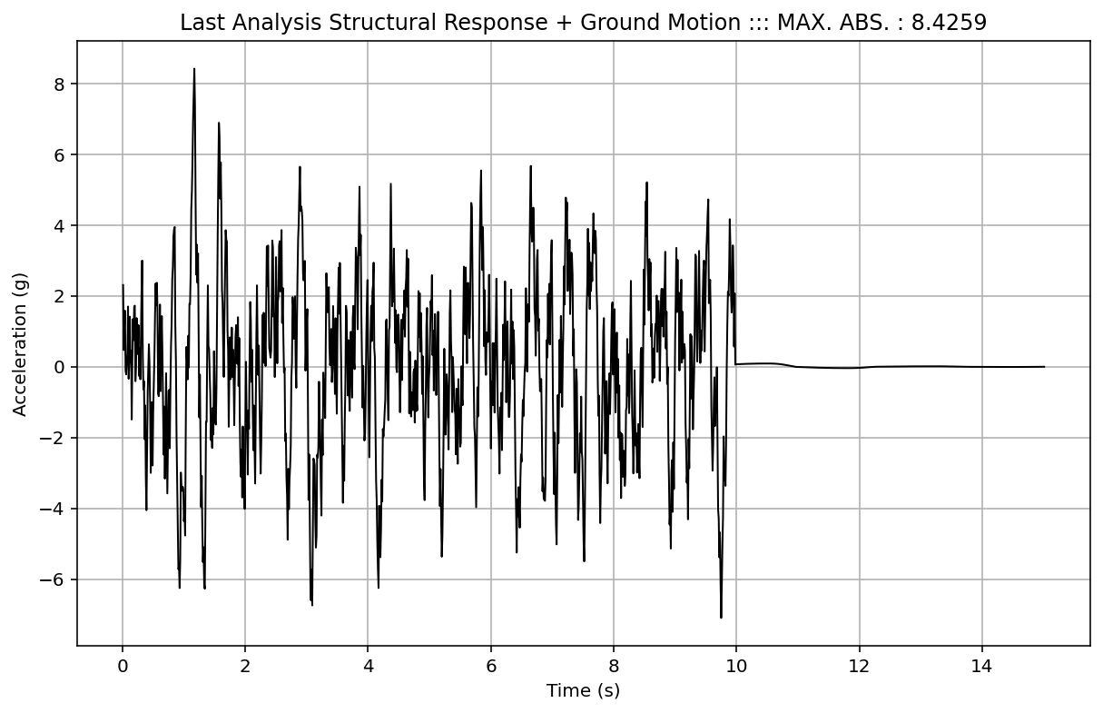

Slide 14
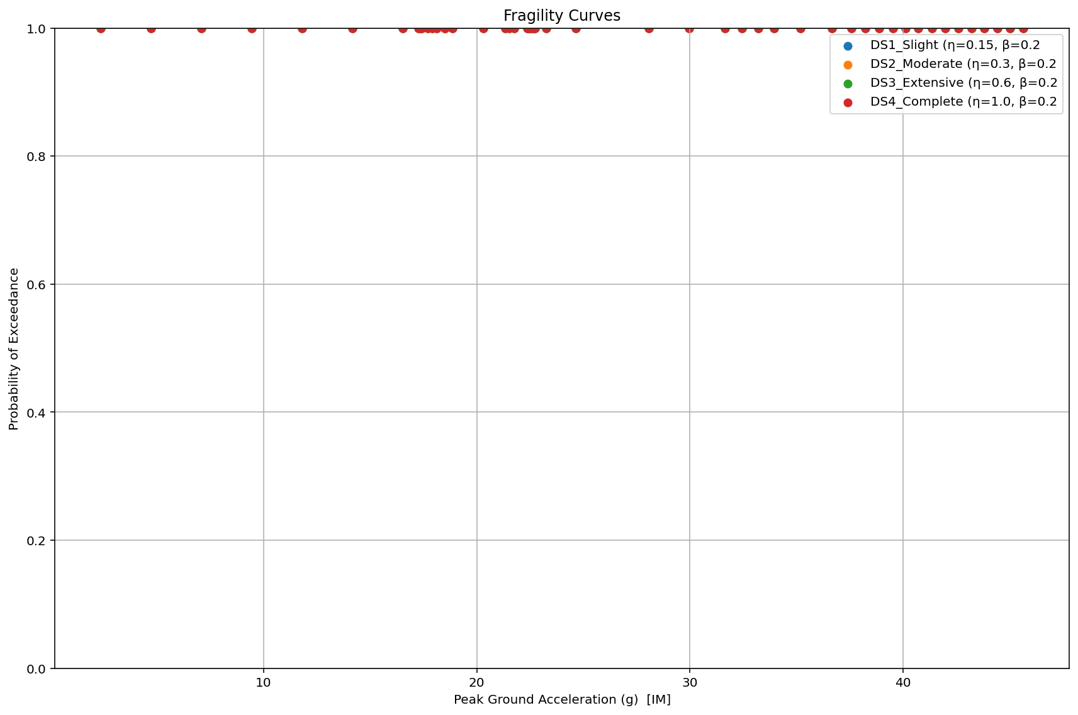

Slide 15
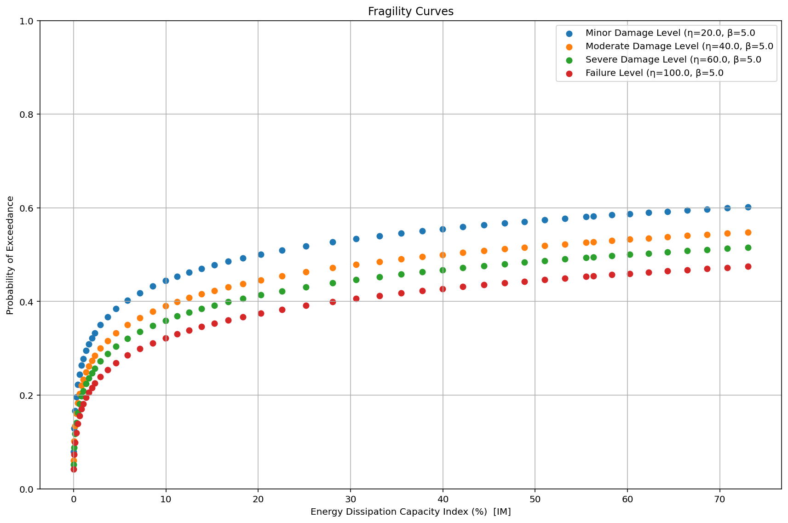

Slide 16
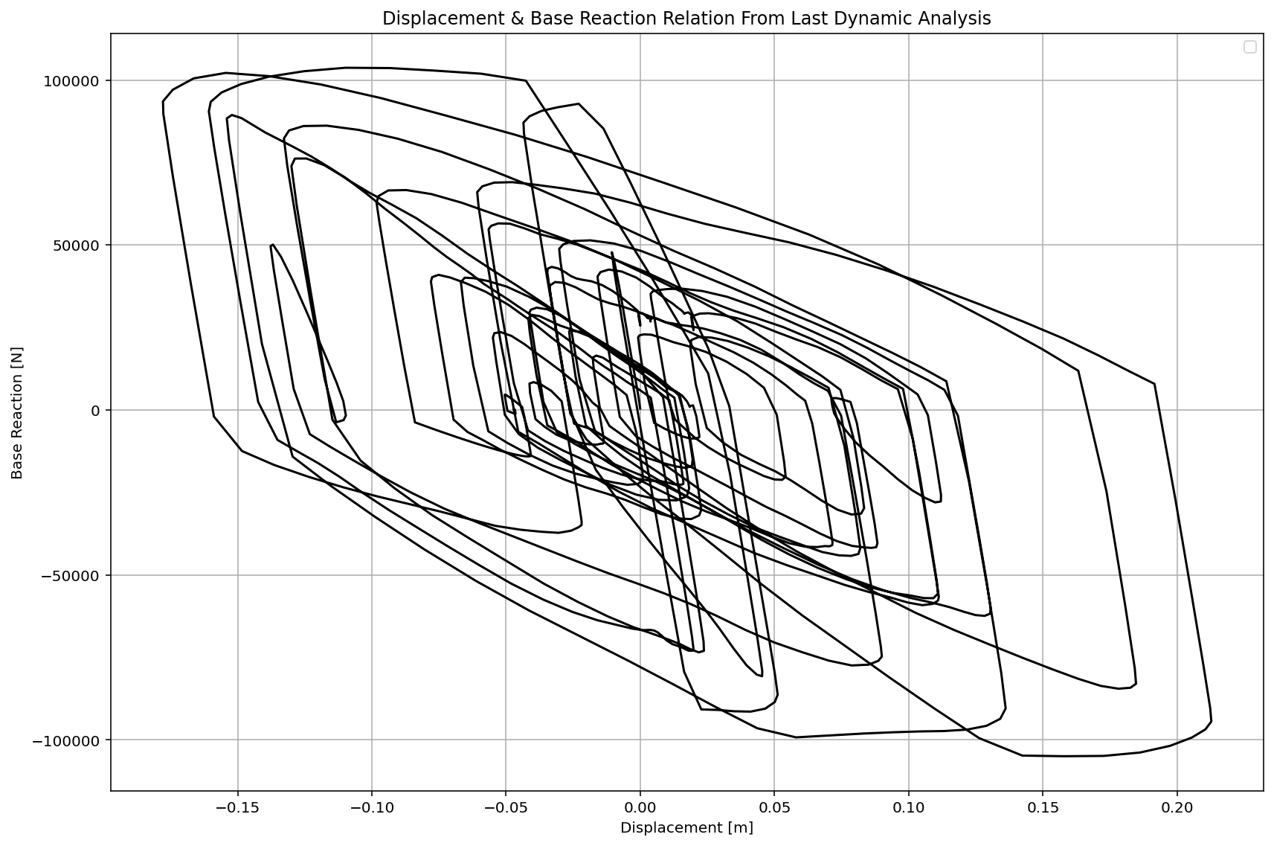

Slide 17
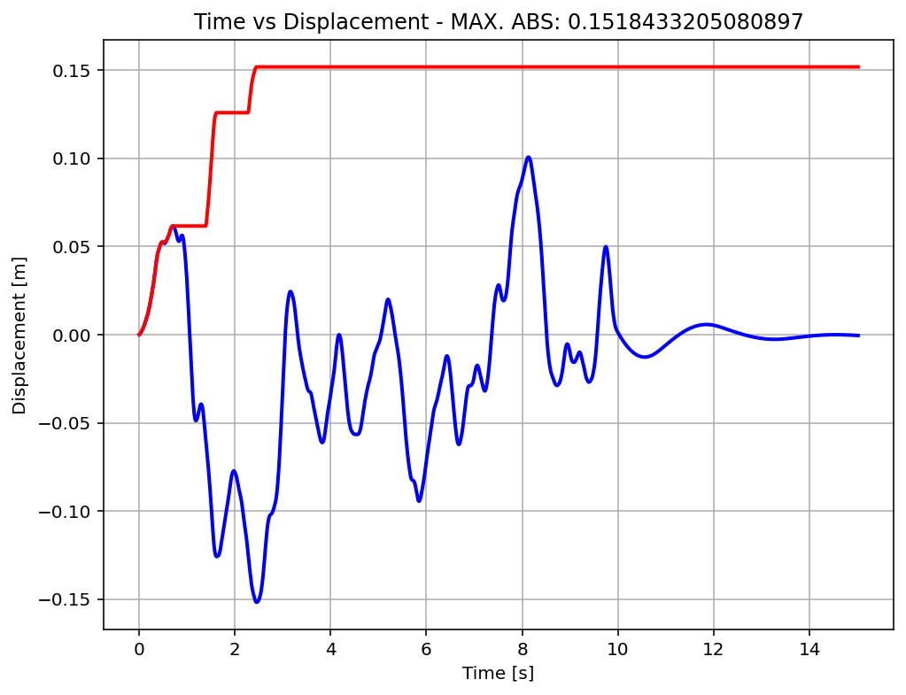

Slide 18
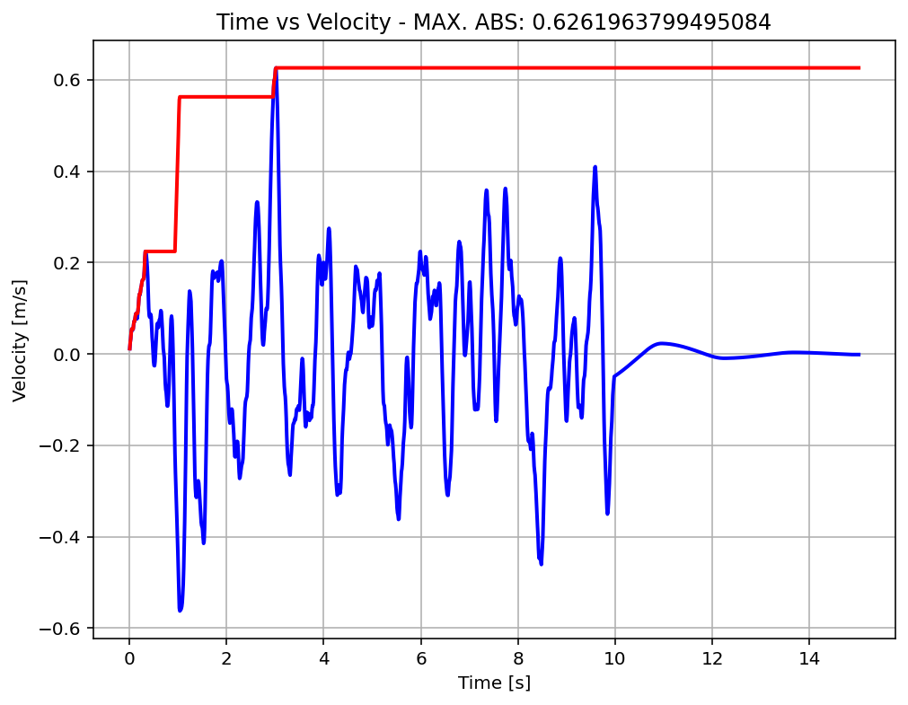

Slide 19
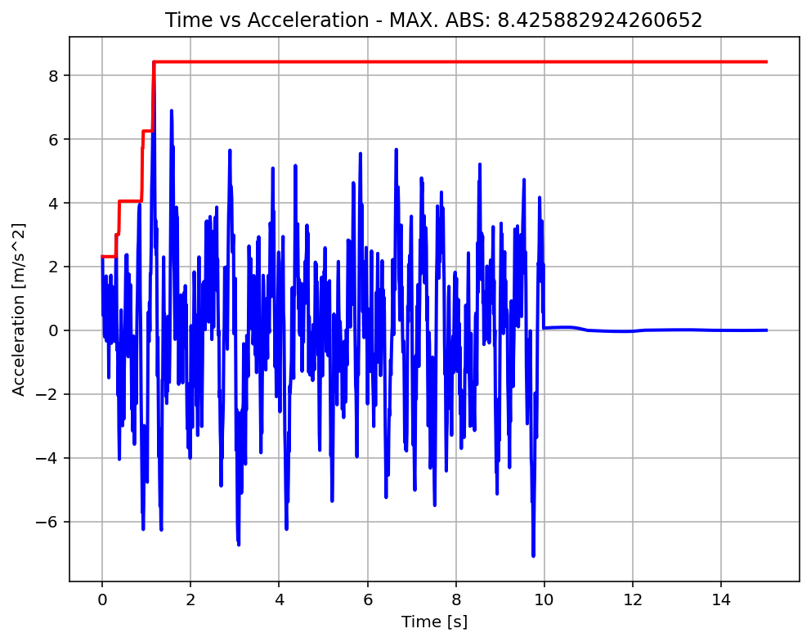

Slide 20
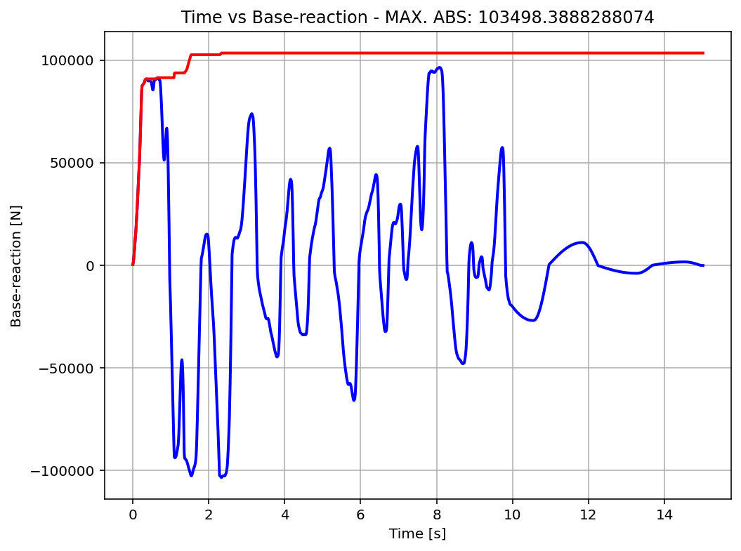

Slide 21
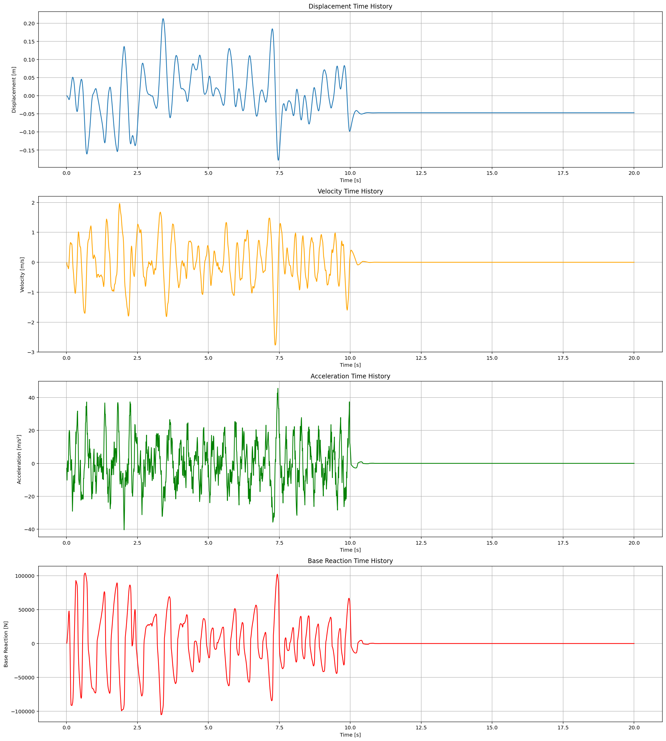

Slide 22
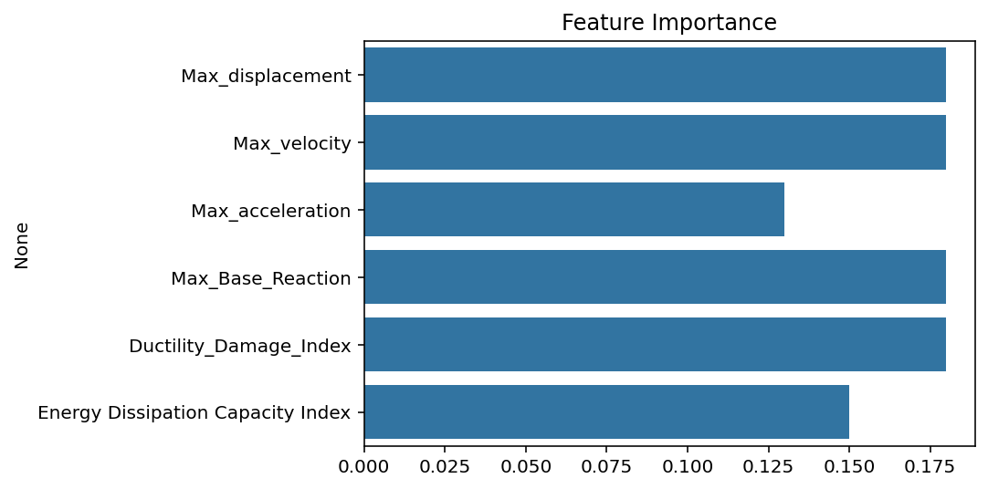

Slide 23
