Slide 1
>> IN THE NAME OF ALLAH, THE MOST GRACIOUS, THE MOST MERCIFUL <<
LINEAR ELASTIC BEAM ANALYSIS USING OPENSEES
WRITTEN BY SALAR DELAVAR GHASHGHAEI (QASHQAI)

Slide 2
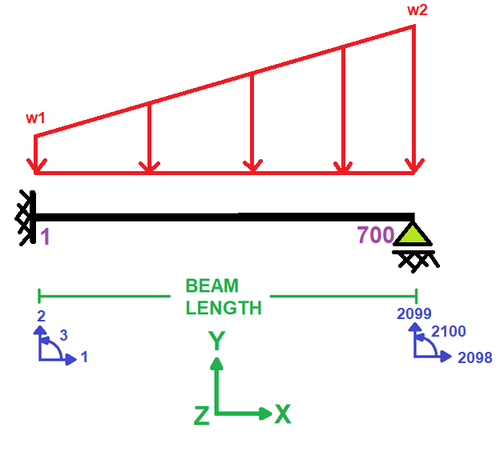

Slide 3
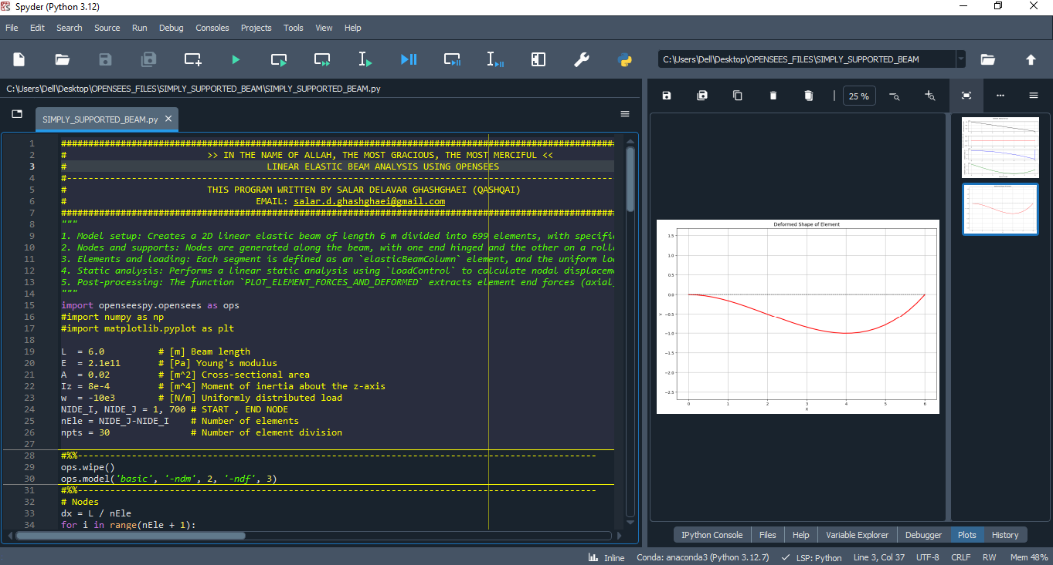

Slide 4
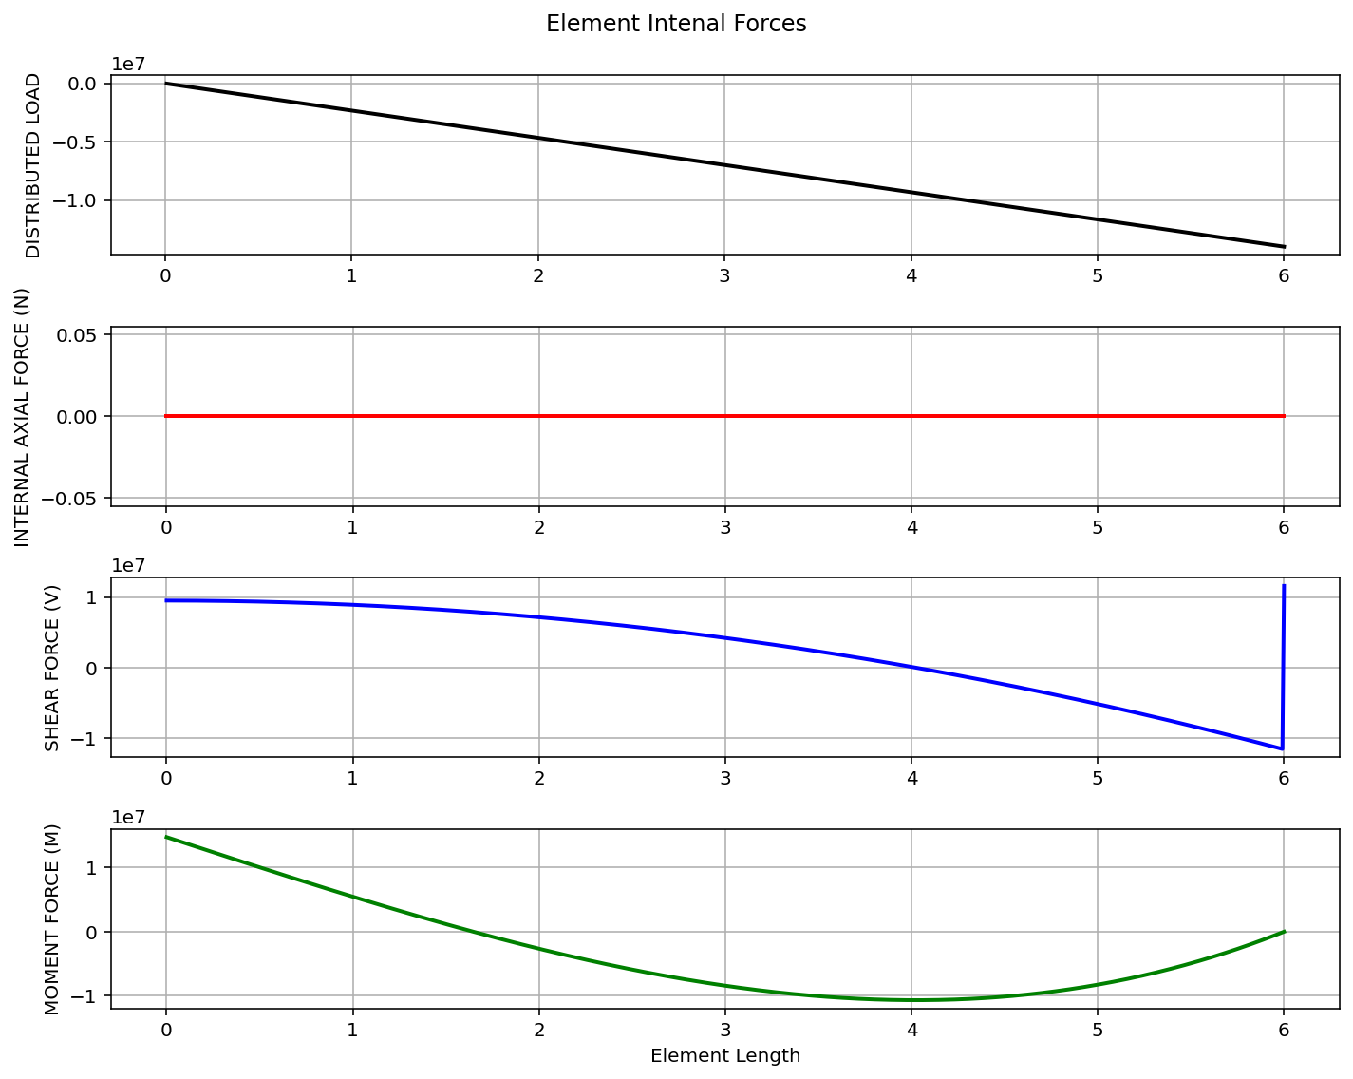

Slide 5
