Slide 1
IN THE NAME OF ALLAH, THE MOST GRACIOUS, THE MOST MERCIFUL
OPTIMIZATION OF STRUCTURAL BEHAVIOR COEFFICIENT USING PUSHOVER ANALYSIS OF CONCRETE FRAME SECTIONS:
EVALUATING STRAIN HARDENING AND ULTIMATE STRAIN EFFECTS IN OPENSEES. DETERMINING OPTIMAL COLUMN SECTION DEPTH FOR A TARGET STRUCTURAL BEHAVIOR COEFFICIENT VIA THE NEWTON-RAPHSON METHOD.
WRITTEN BY SALAR DELAVAR GHASHGHAEI (QASHQAI)

Slide 2
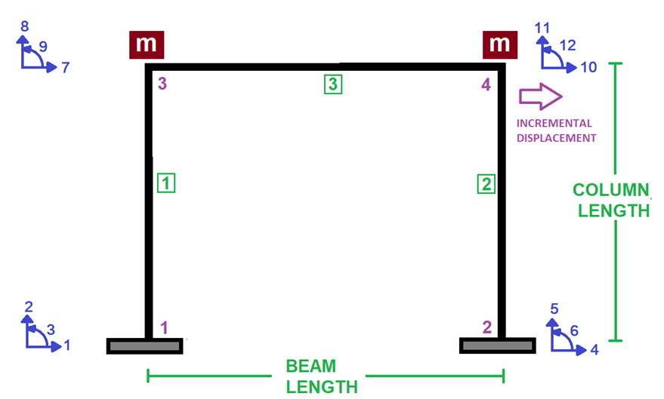

Slide 3
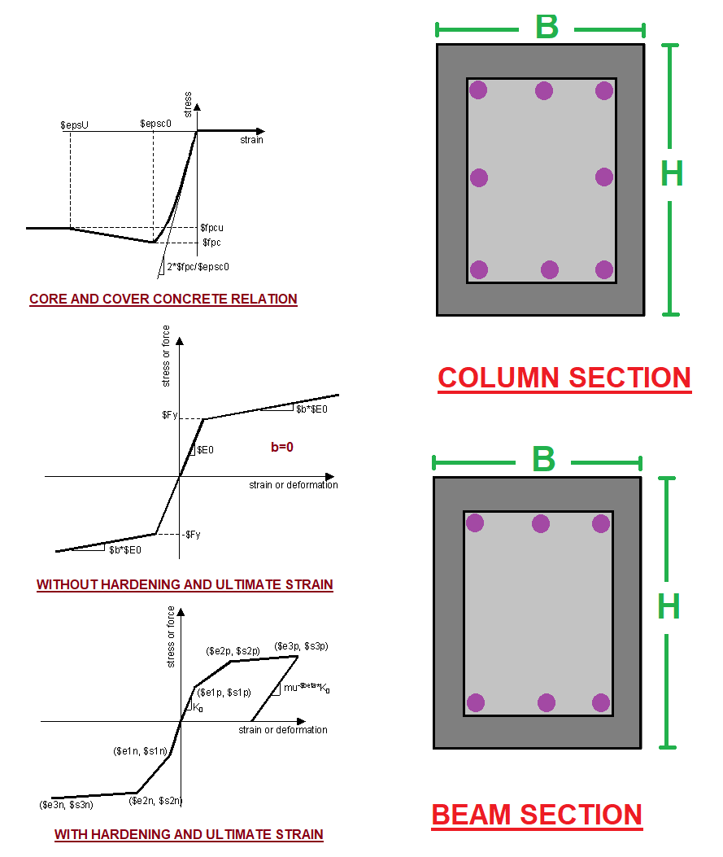

Slide 4
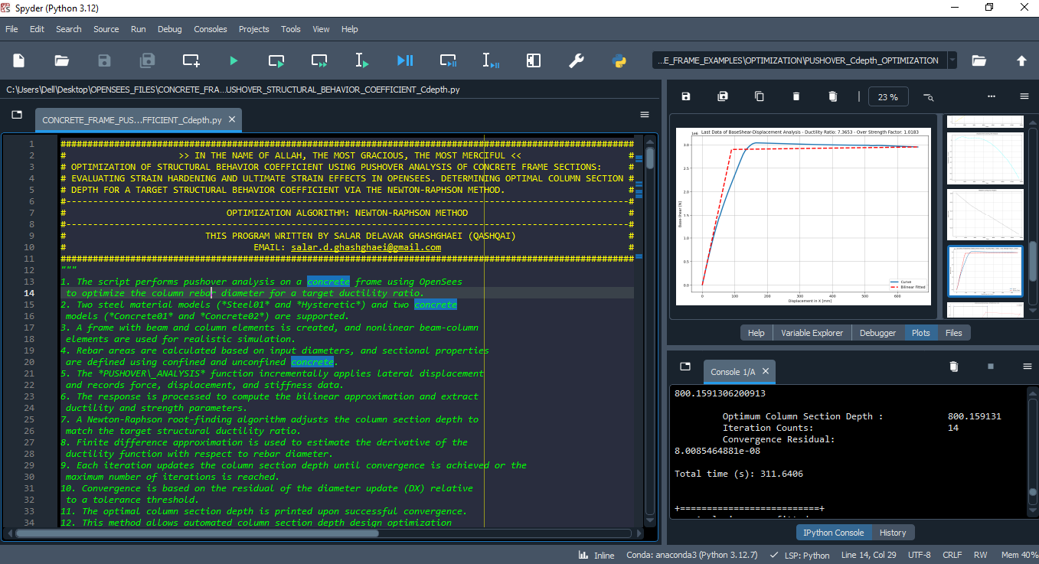

Slide 5
NONLINEAR STATIC ANALYSIS
(PUSHOVER)

Slide 6
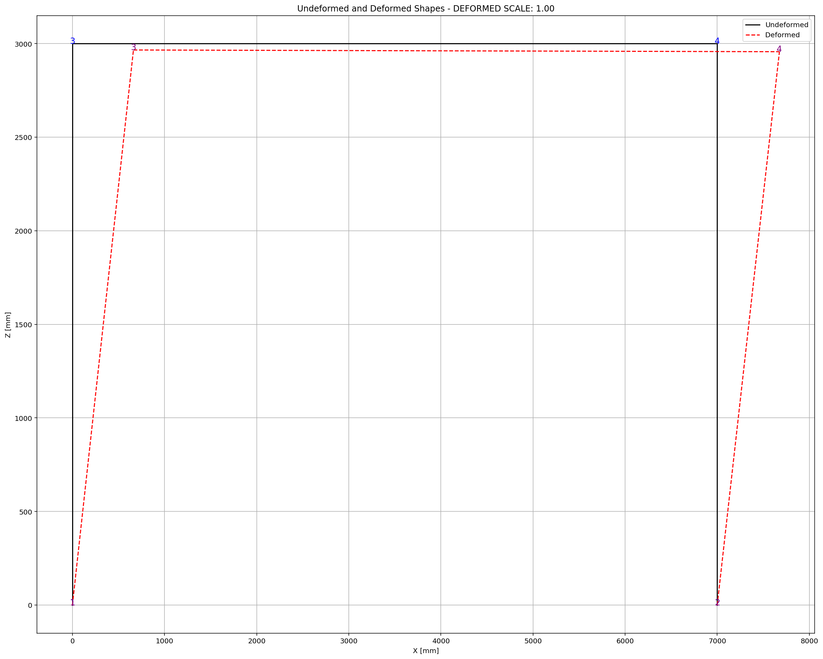
Optimum Column Section Depth : 800.159131
Iteration Counts: 14
Convergence Residual: 8.0085464881e-08
Total time (s): 311.6406

Slide 7
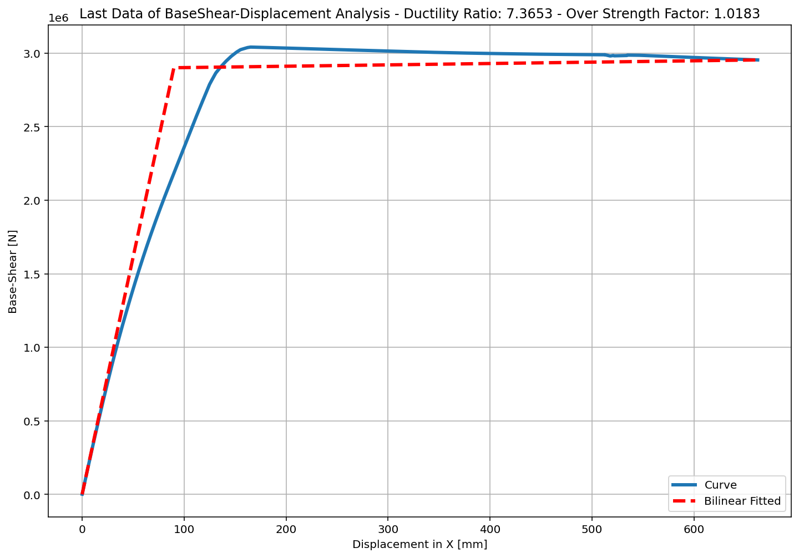
+==========================+
= Analysis curve fitted =
Disp Base Shear
----------------------------
[[0.00000000e+00 0.00000000e+00]
[8.99441255e+01 2.90071530e+06]
[6.62462079e+02 2.95377982e+06]]
+==========================+
+----------------------------------------------------+
Structure Elastic Stiffness : 32250.19
Structure Plastic Stiffness : 4458.79
Structure Tangent Stiffness : 92.69
Structure Ductility Ratio : 7.37
Structure Over Strength Factor: 1.02
+----------------------------------------------------+
Over Strength Coefficient (Ω0): 1.0183
Displacement Ductility Ratio (μ):7.3653
Ductility Coefficient (Rμ): 7.3653
Structural Behavior Coefficient (R): 7.5000

Slide 8
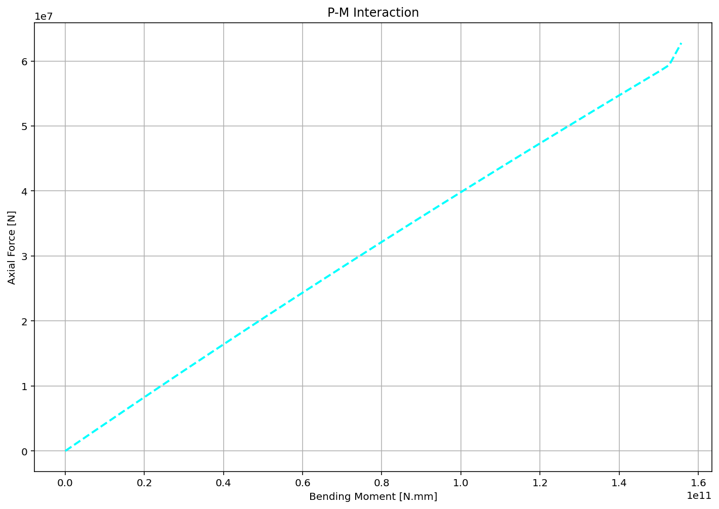

Slide 9
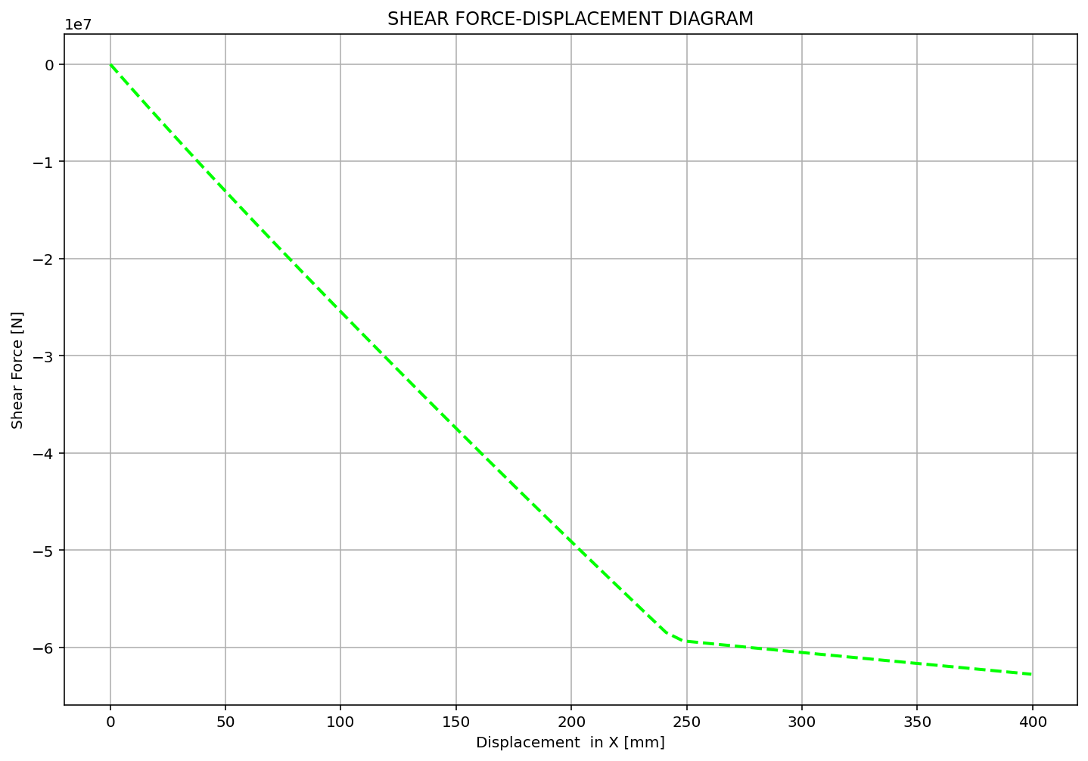

Slide 10
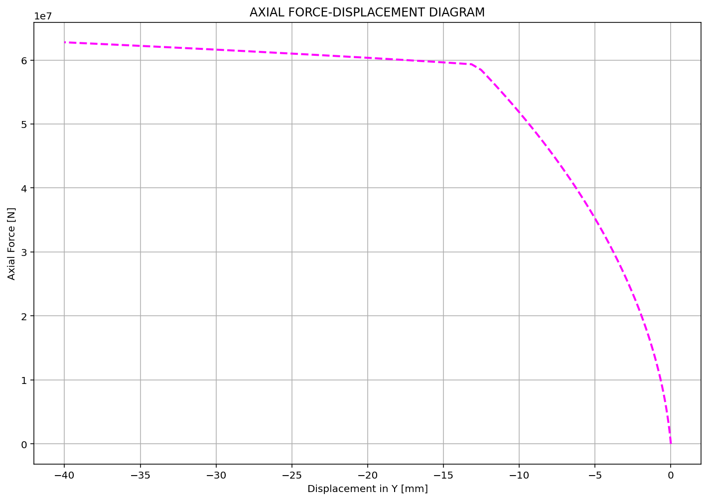

Slide 11
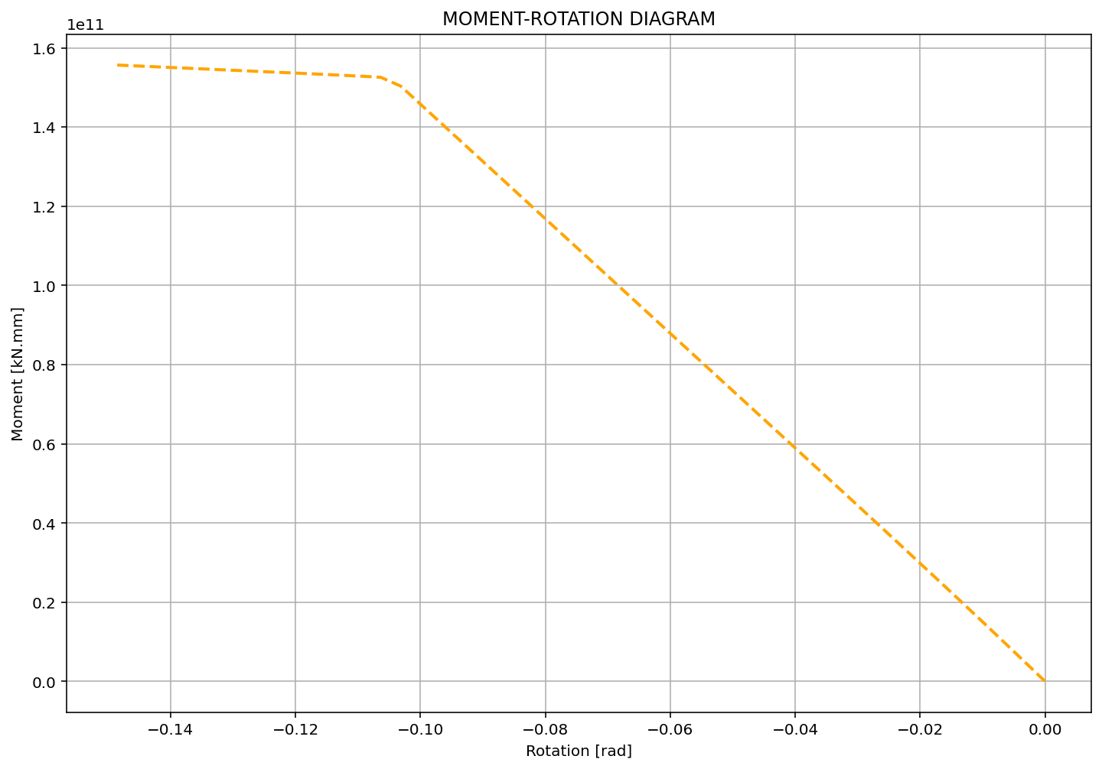

Slide 12
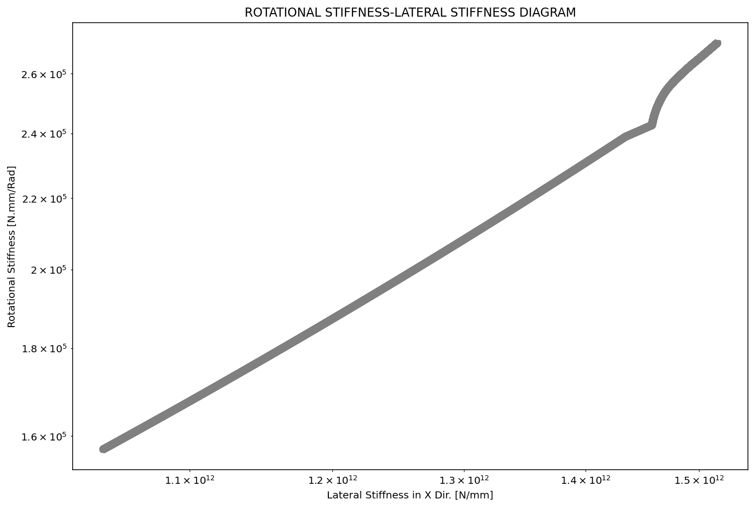

Slide 13
