Slide 1
IN THE NAME OF ALLAH, THE MOST GRACIOUS, THE MOST MERCIFUL
PUSHOVER AND DYNAMIC ANALYSIS OF CONCRETE COLUMNS WITH AXIAL AND ROTATIONAL SPRINGS FOR MODELING BEAM COLUMN JOINTS
WRITTEN BY SALAR DELAVAR GHASHGHAEI (QASHQAI)

Slide 2
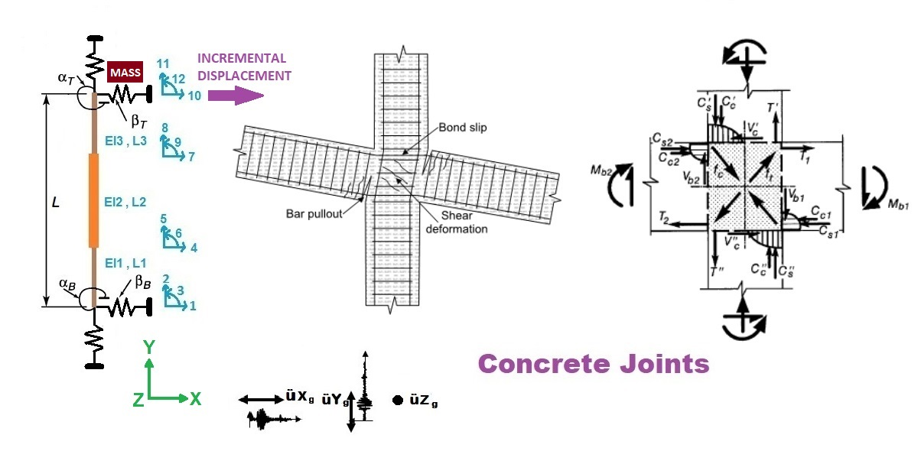

Slide 3
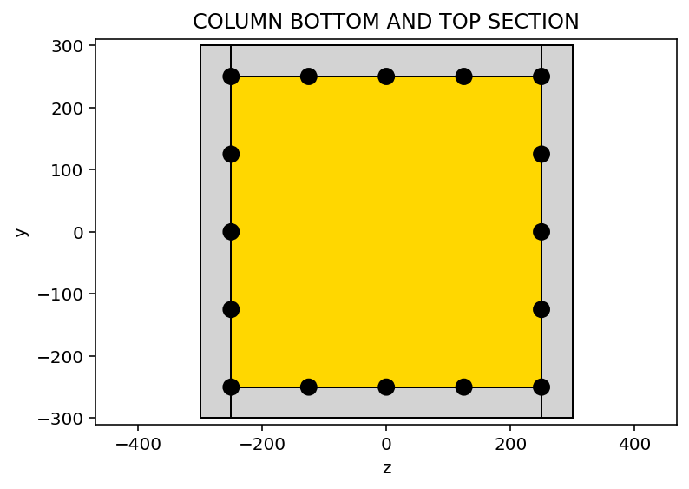
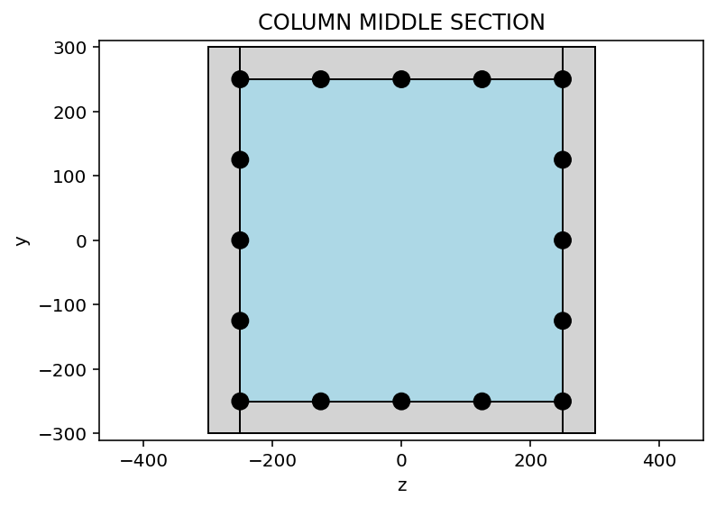

Slide 4
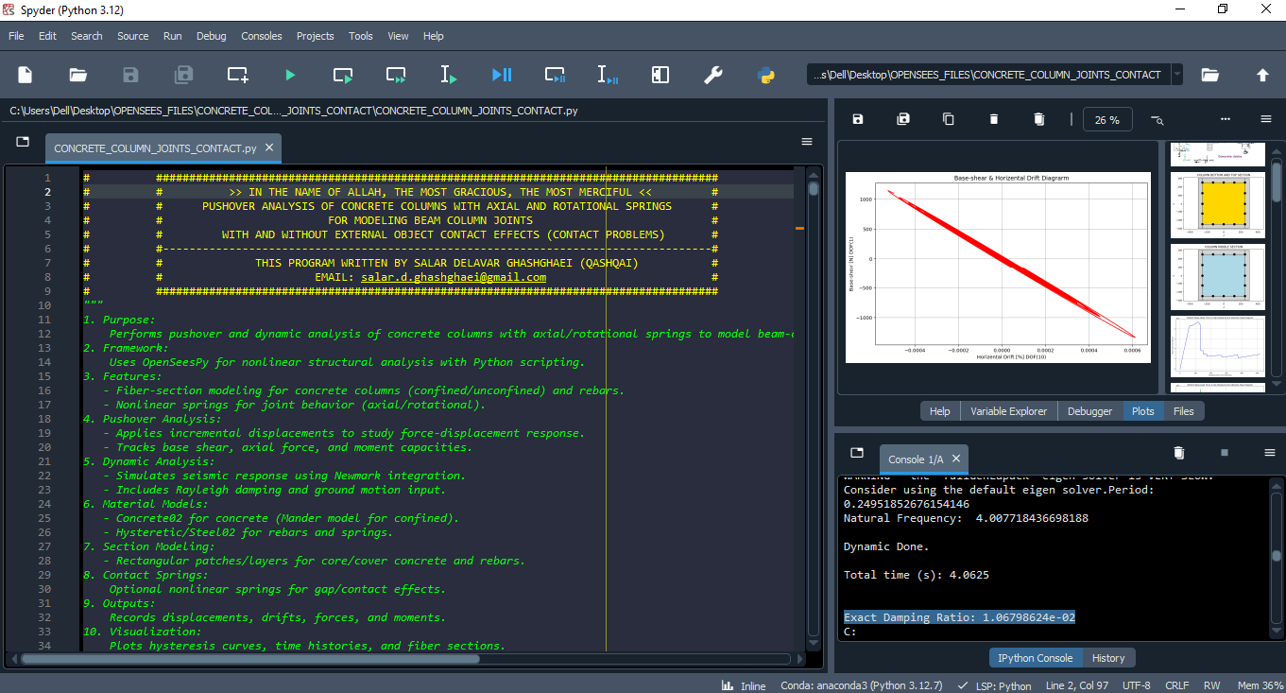

Slide 5
PUSHOVER ANALYSIS OF CONCRETE COLUMNS WITH AXIAL AND ROTATIONAL SPRINGS FOR MODELING BEAM COLUMN JOINTS

Slide 6
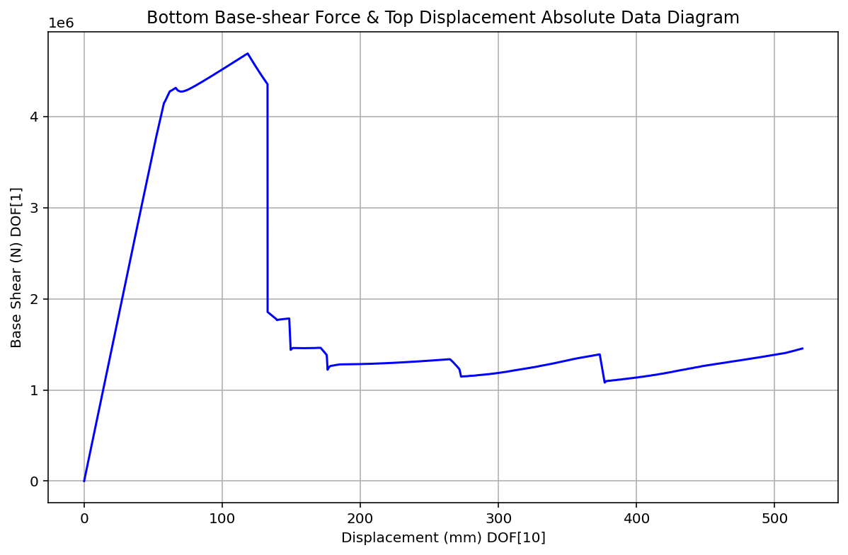

Slide 7
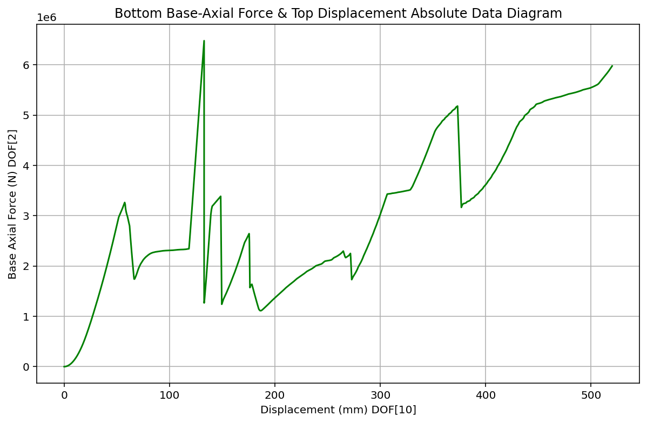

Slide 8
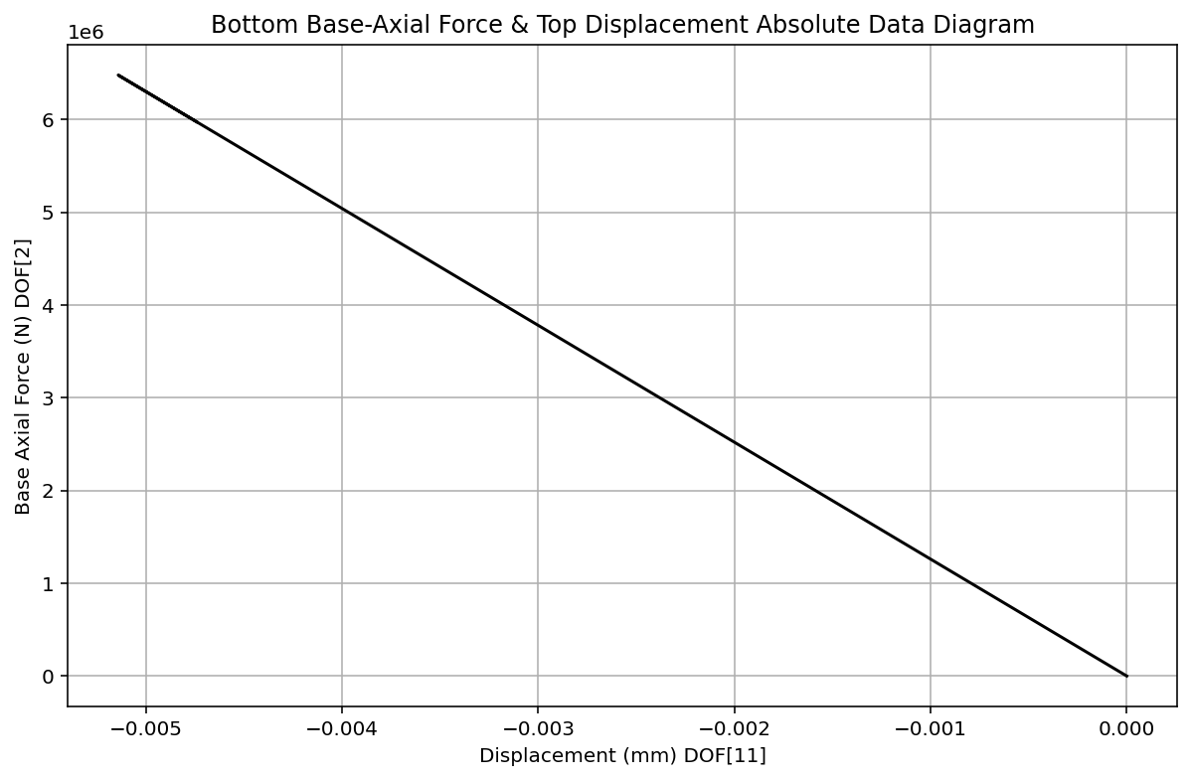

Slide 9
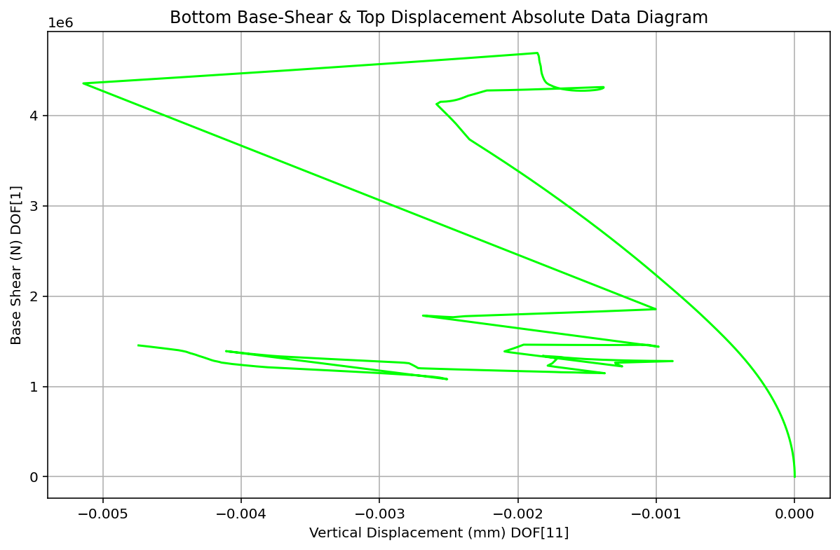

Slide 10
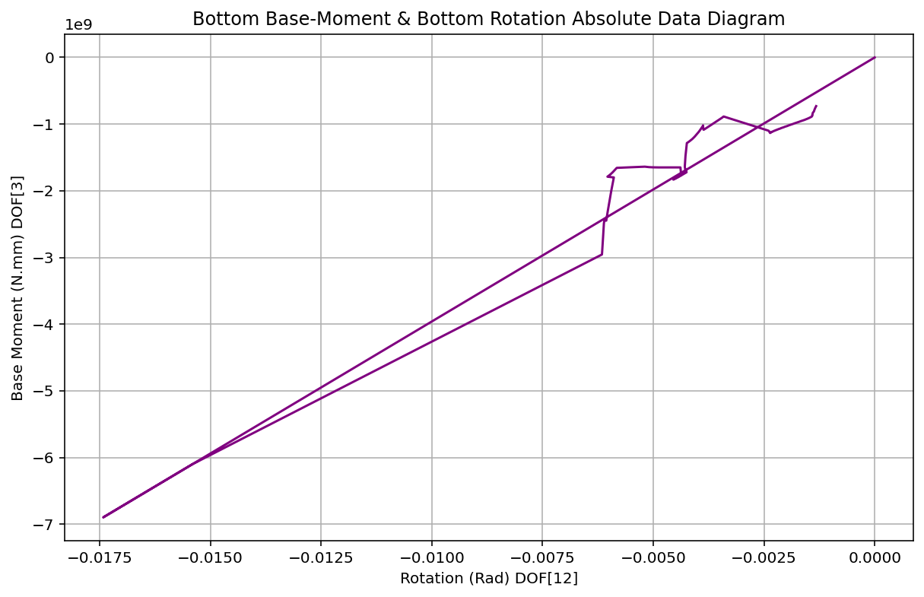

Slide 11
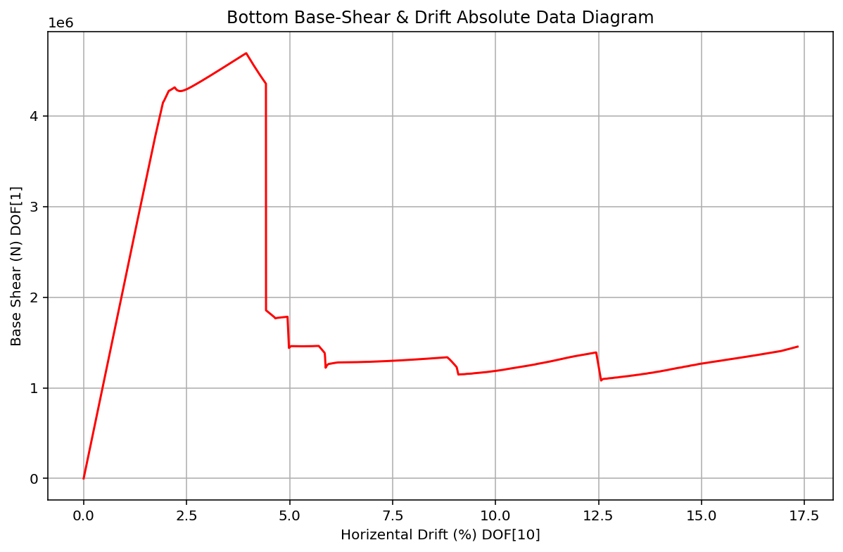

Slide 12
DYNAMIC ANALYSIS OF CONCRETE COLUMNS WITH AXIAL AND ROTATIONAL SPRINGS FOR MODELING BEAM COLUMN JOINTS

Slide 13
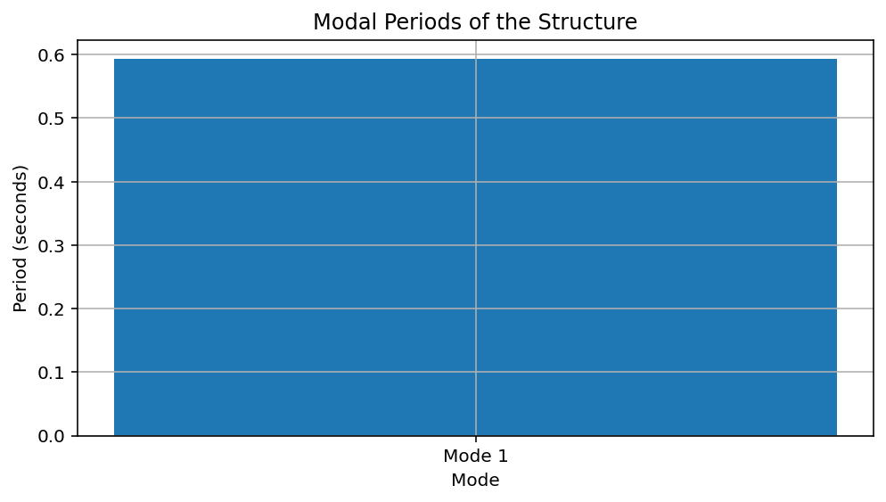
Period: 0.12475926338077073 (s)
Natural Frequency: 8.015436873396377 (Hz)

Slide 14
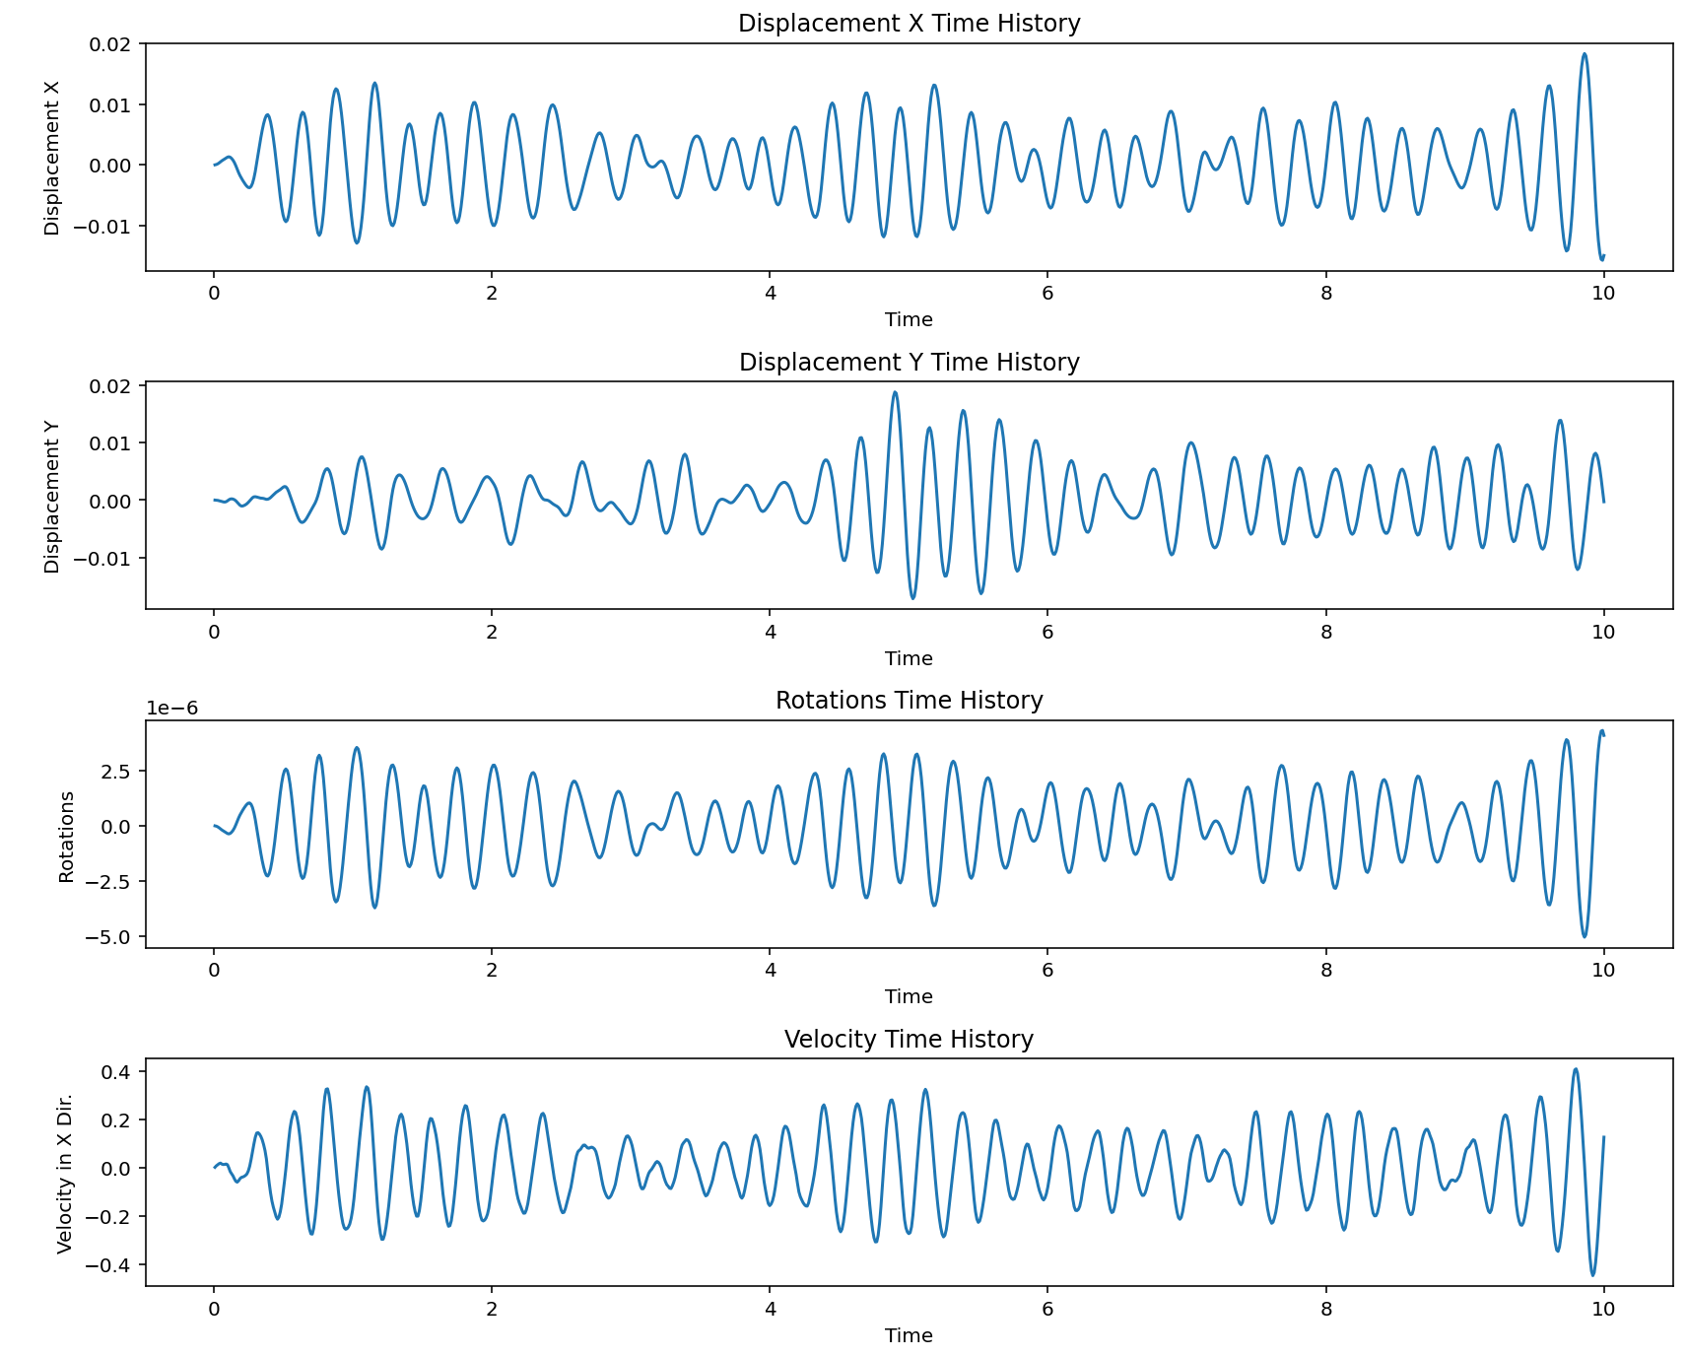

Slide 15
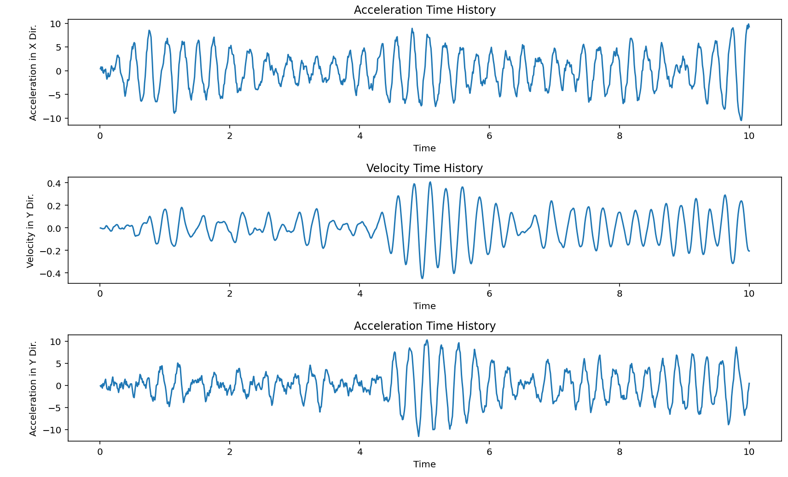

Slide 16
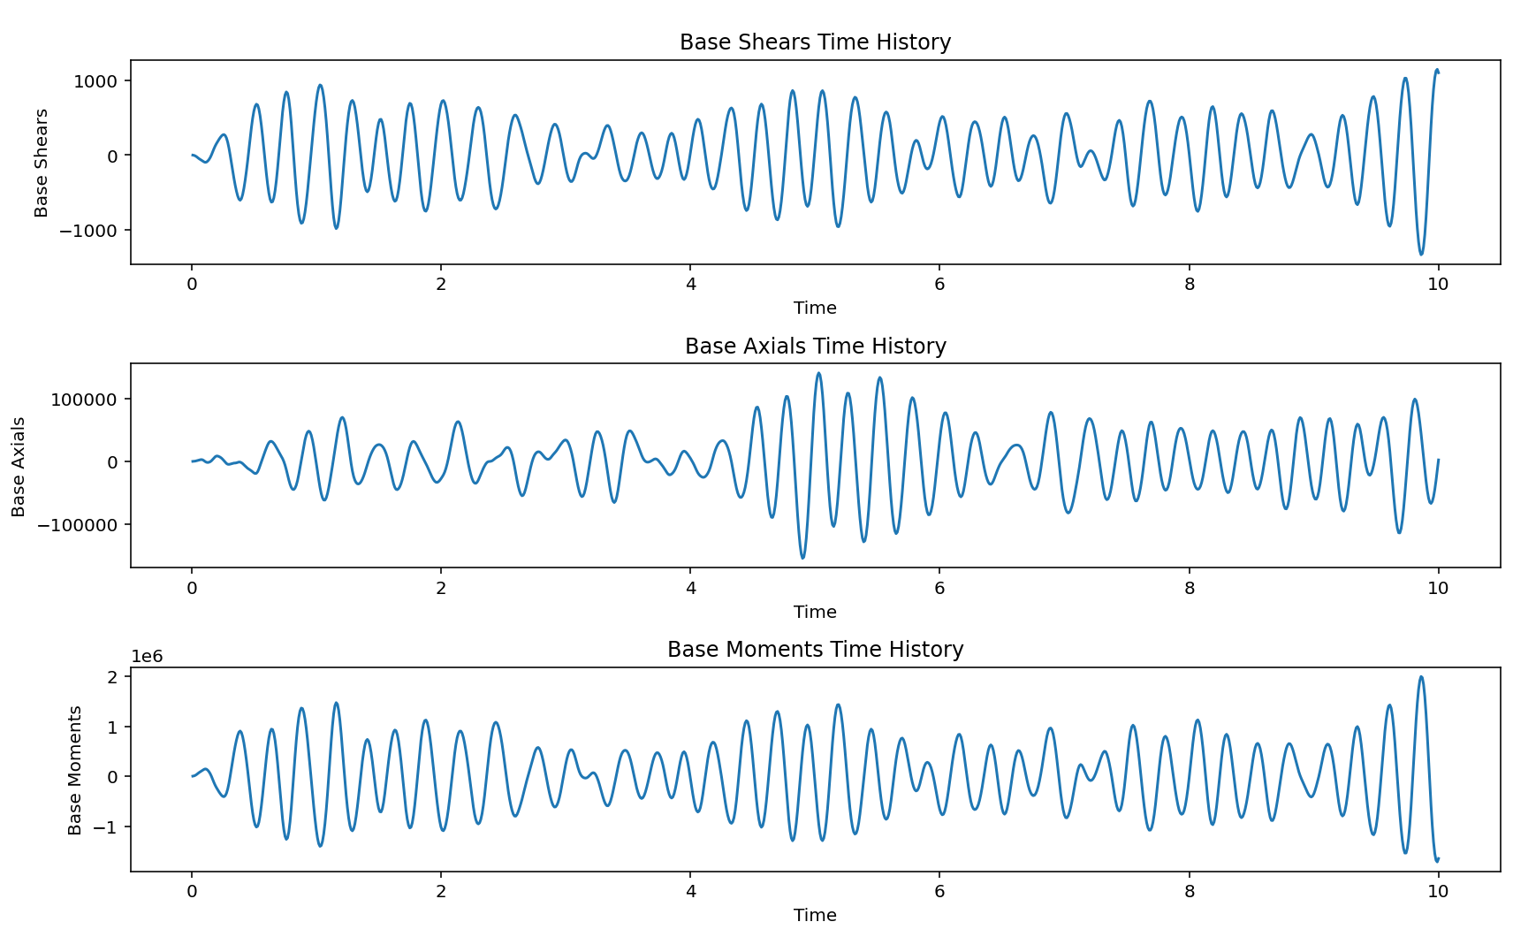

Slide 17
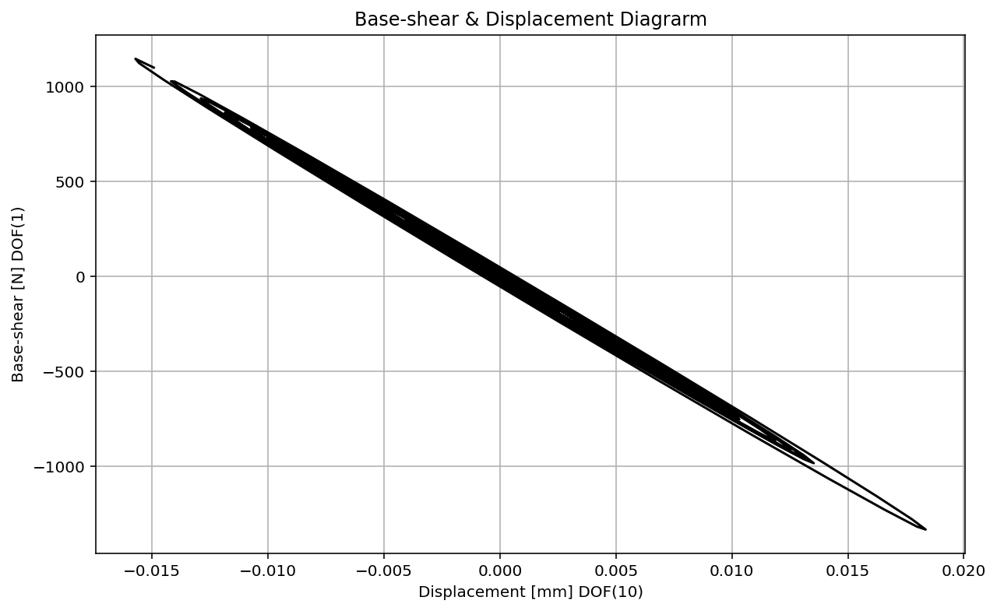

Slide 18
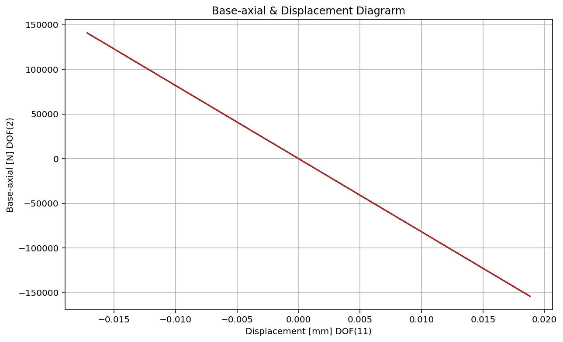

Slide 19
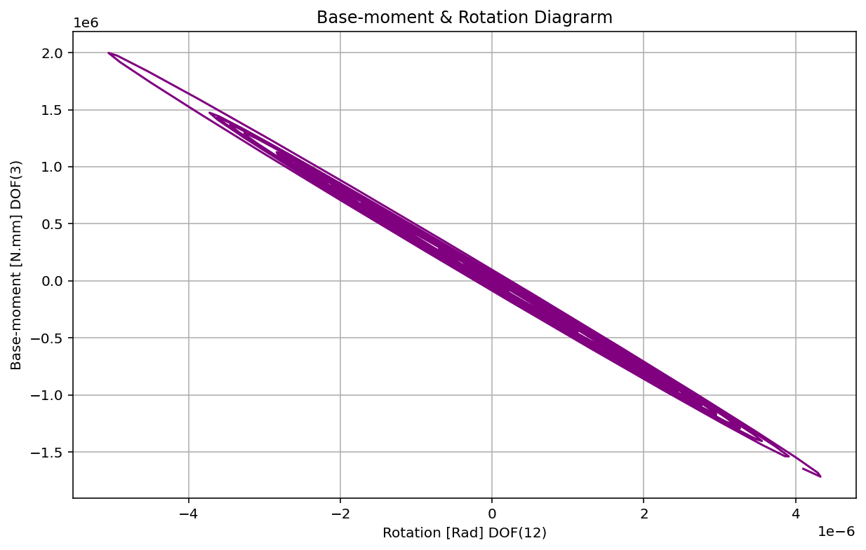

Slide 20
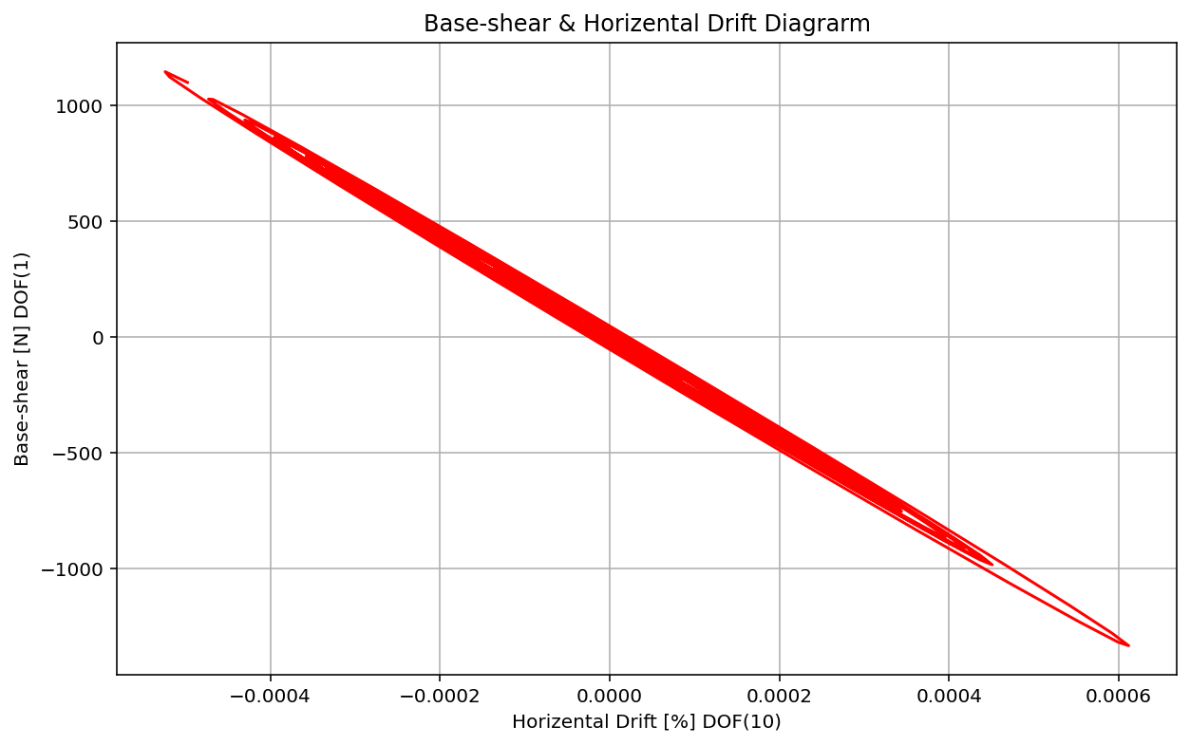

Slide 21
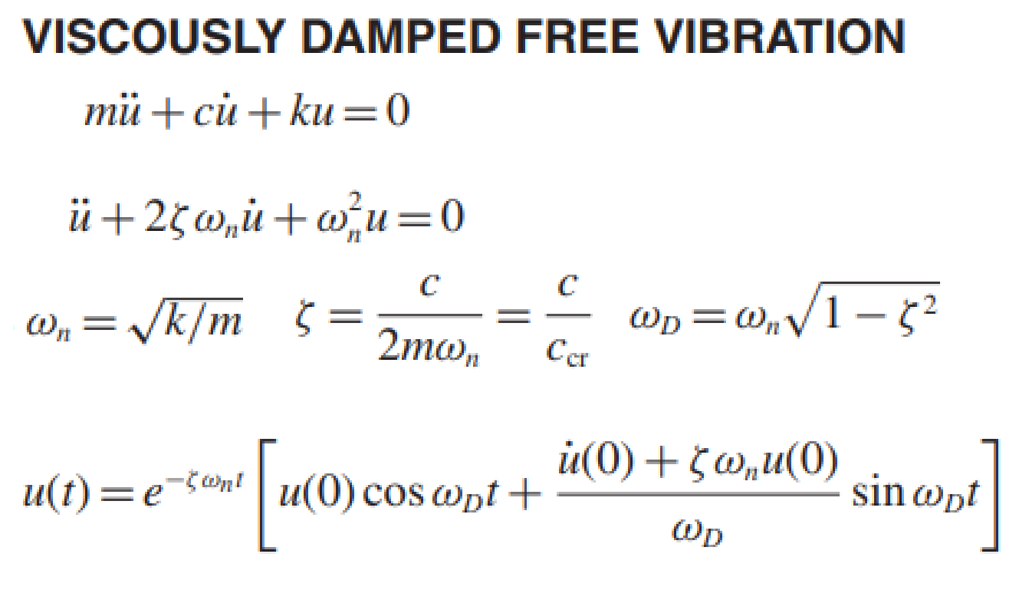
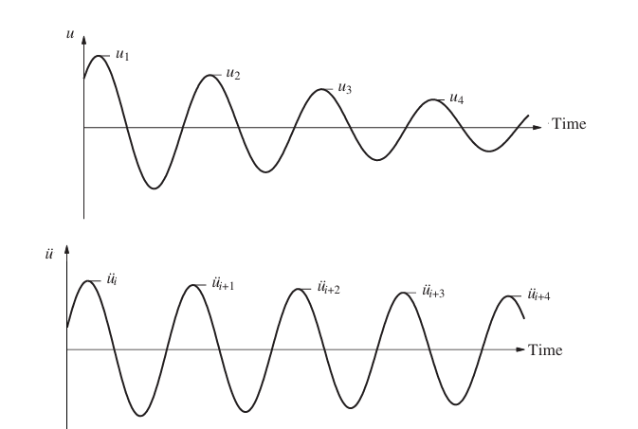
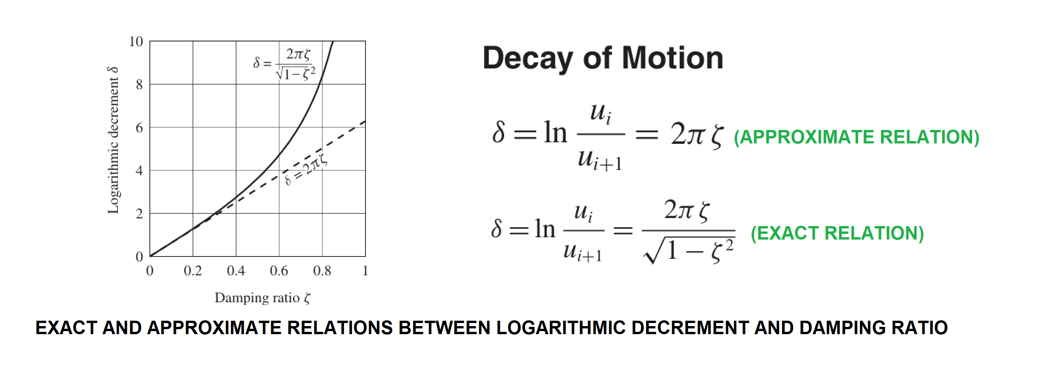
Exact Damping Ratio: 1.06798624e-02

