Slide 1
IN THE NAME OF ALLAH, THE MOST GRACIOUS, THE MOST MERCIFUL
PUSHOVER ANALYSIS OF STEEL COLUMNS WITH AXIAL AND ROTATIONAL SPRINGS FOR MODELING BEAM COLUMN JOINTS
WRITTEN BY SALAR DELAVAR GHASHGHAEI (QASHQAI)

Slide 2
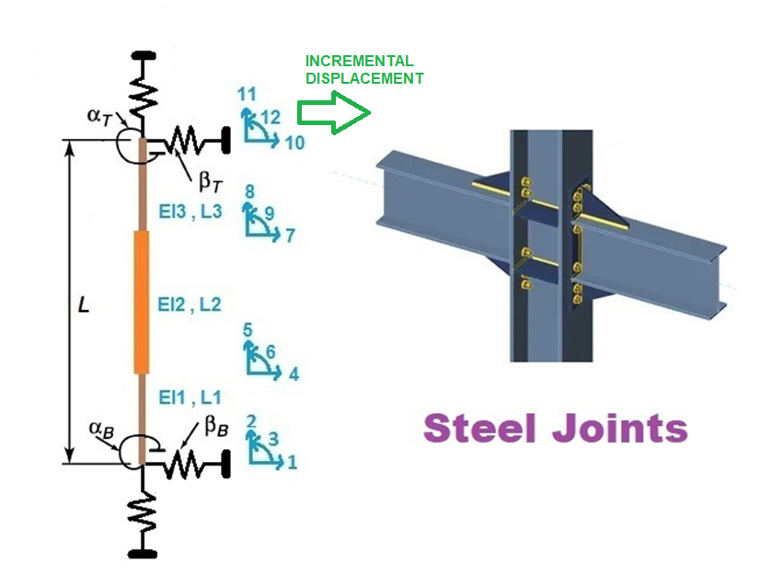

Slide 3
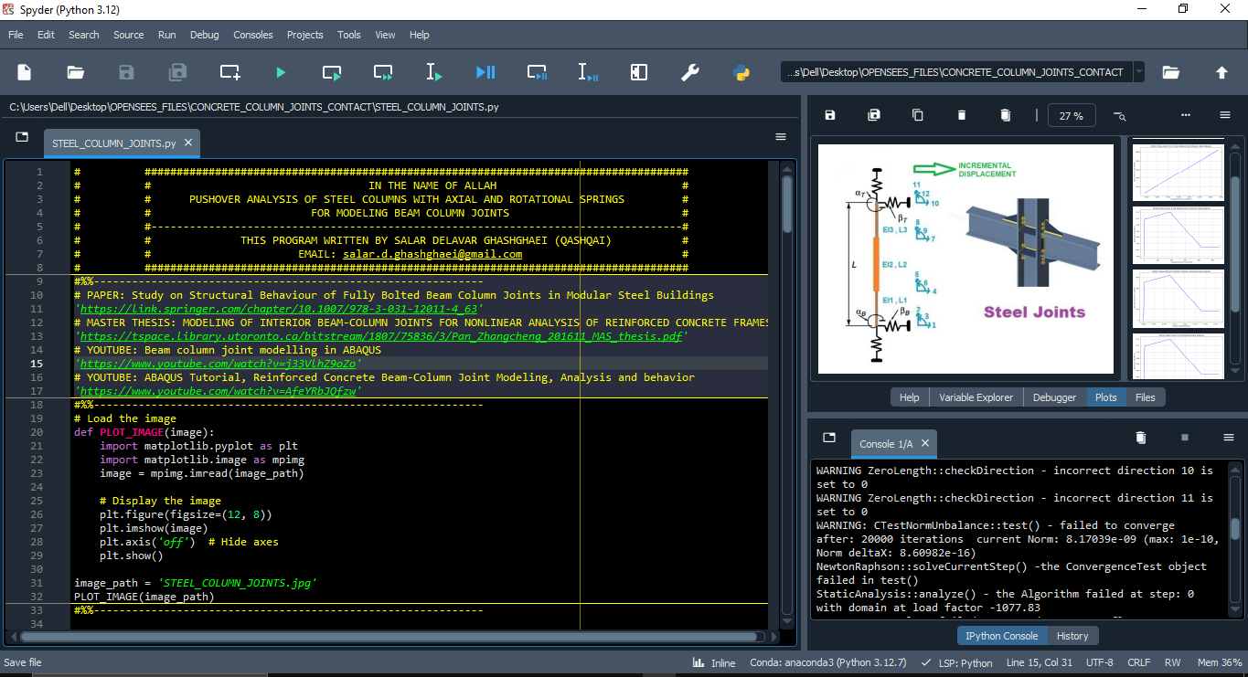

Slide 4
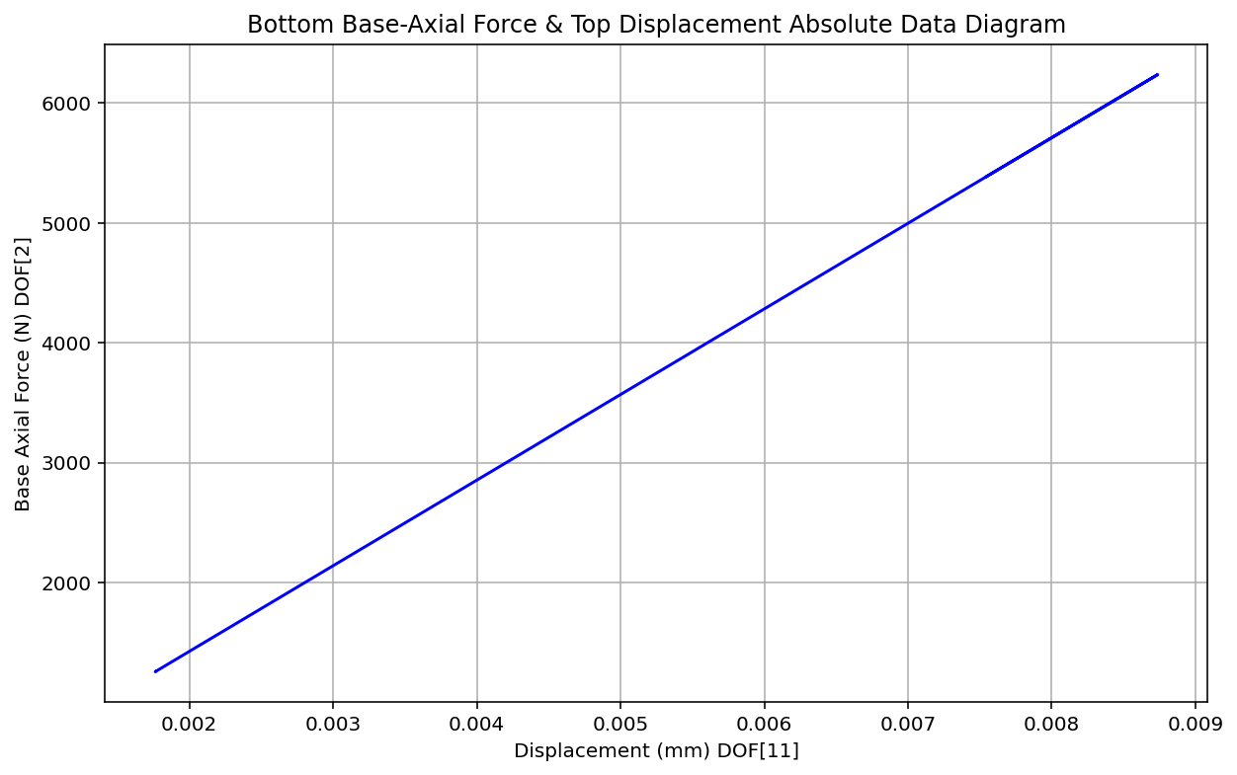

Slide 5
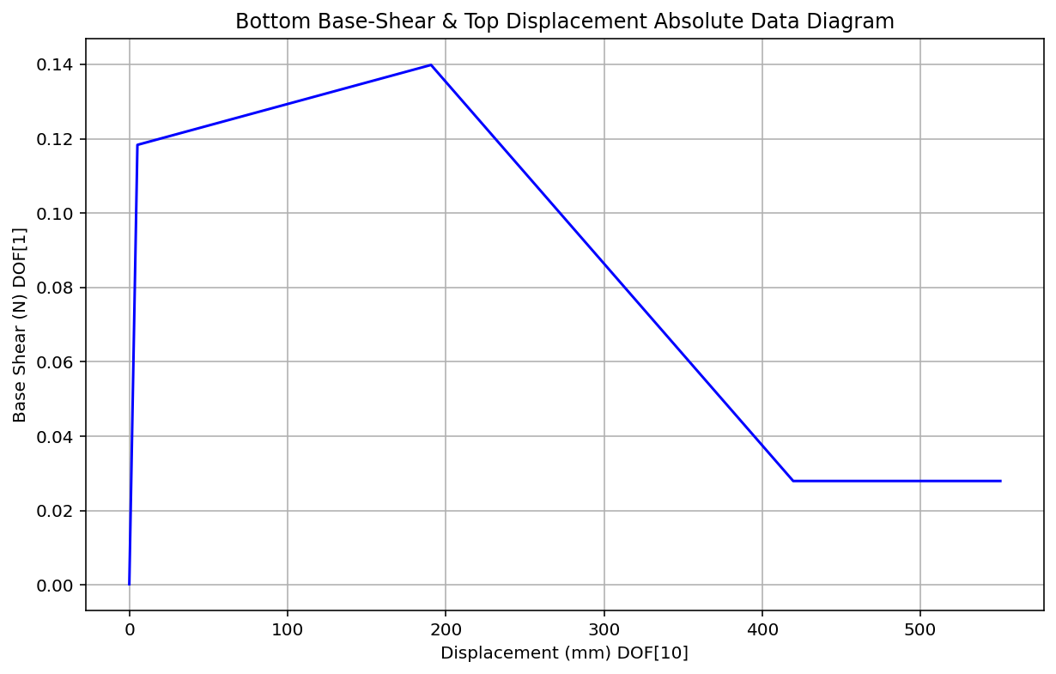

Slide 6
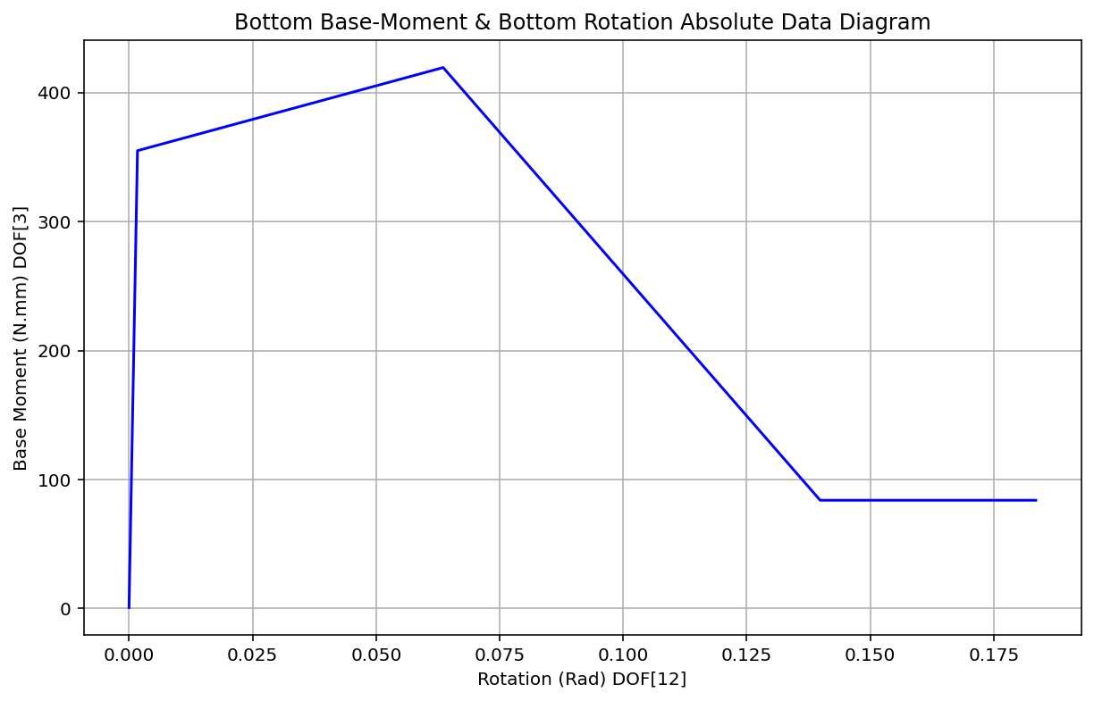

Slide 7
