Slide 1
COMP 472
Mini-Project 3
Team name: Elec Wizards
Student 1 - Salar Jaberi - 40024956
Student 2 - Faraj Shahrstan - 40041842
Student 3 - Rami Abedalaziz - 20817325

Slide 2
Introduction
In this mini-project, we were given a dataset to compute the closest synonym for each word in it. In order to do that, we used different models with different embeddings sizes.we used a function called similarity to compute the cosine similarity between 2 vectors to find the closest synonym.

Slide 3
Task 1
In task 1, we ran the embedding model word2vec-google-news-300 on the given dataset that contains the question word to find the closest synonym. We used labels to determine if the chosen words is correct. The label is either correct,wrong, or guess depends on the results from the used model.

Slide 4
Task 2
In this task, since we have the results from word2vec-google-news-300 pre-trained model, we compared these results with another Four pretrained models.
Different Corpus(C) and same Embedding (E)
Model 2: glove-wiki-gigaword-300
Model 3: fasttext-wiki-news-subword-300
Same Corpus(C) and Different Embedding (E)
Model 4: glove-twitter-25
Model 5: glove-twitter-25

Slide 5
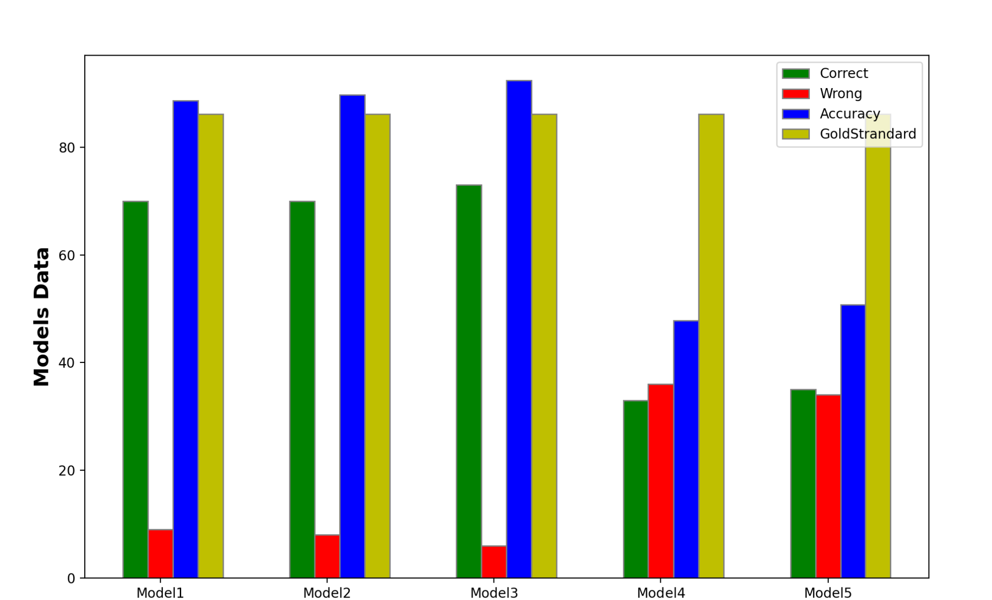
Models Analysis

Slide 6
Discussion
From the previous graph, we noticed that models 1,2,3 have the highest accuracy compared to the human gold-standard and models 4,5.
Model 1: word2vec-google-news-300
Model 2: glove-wiki-gigaword-300
Model 3: fasttext-wiki-news-subword-300
Model 4, and 5 have the lowest accuracy out of the five models
Model 4: glove-twitter-25
Model 5: glove-twitter-25
Out of all models we have tested, we found that model 3 fasttext-wiki-news-subword-300 has the highest accuracy with 92.41%.

Slide 7
Thank you

