Slide 1

Computer Vision Homework
TA: Tsai-Yu Hsu (許采玉)
Email: qqwweerr987@gmail.com

Slide 2
Homework Assignment
2021/10/06 – Homework 1 assigned, due 10/20
2021/10/27 – Homework 2 assigned, due 11/10
2021/11/21 – Homework 3 assigned, due 12/5
2021/12/5 – Homework 4 assigned, due 12/19
Notes:
1.

Slide 3
Homework Assignment
Target:
Write the main functions by yourself to deep understand the theories of computer vision.
Improve your skills about using C/C++, python language, Opencv Lib
In the future:
Develop a new algorithm/method and write main function by yourself.

Slide 4

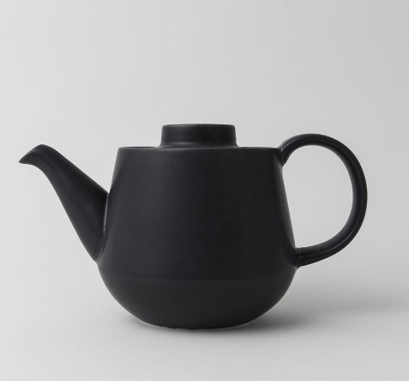
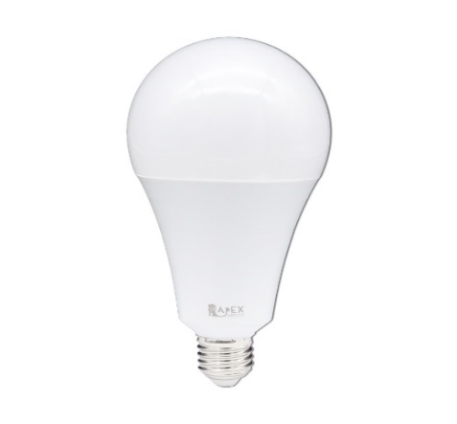
Homework 4
Active Contour :
You have to write Active Contour main functions :
Q1. Set initial points
Q2. Find the contour (3 result images)
Do not use function !!!
Q3. Save Convergence video (3 result videos)
For other functions in other tasks, you can use Lib or write it.
There are 3 test image. For each test image, you will get 1 result image and 1 result video.
So, you will get total 3 result images. Please show in your report. And place the 3 result videos in folder.
pic1.jpg
pic2.jpg
pic3.jpg

Slide 5
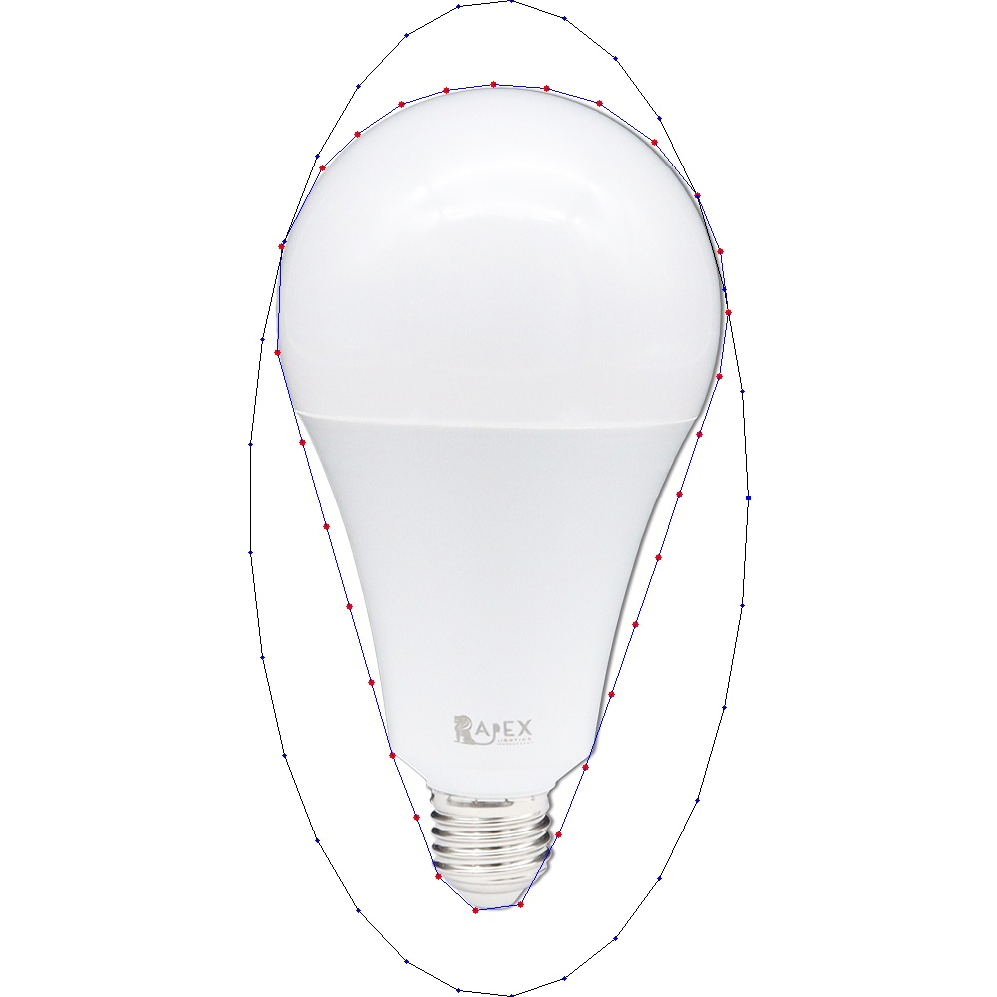
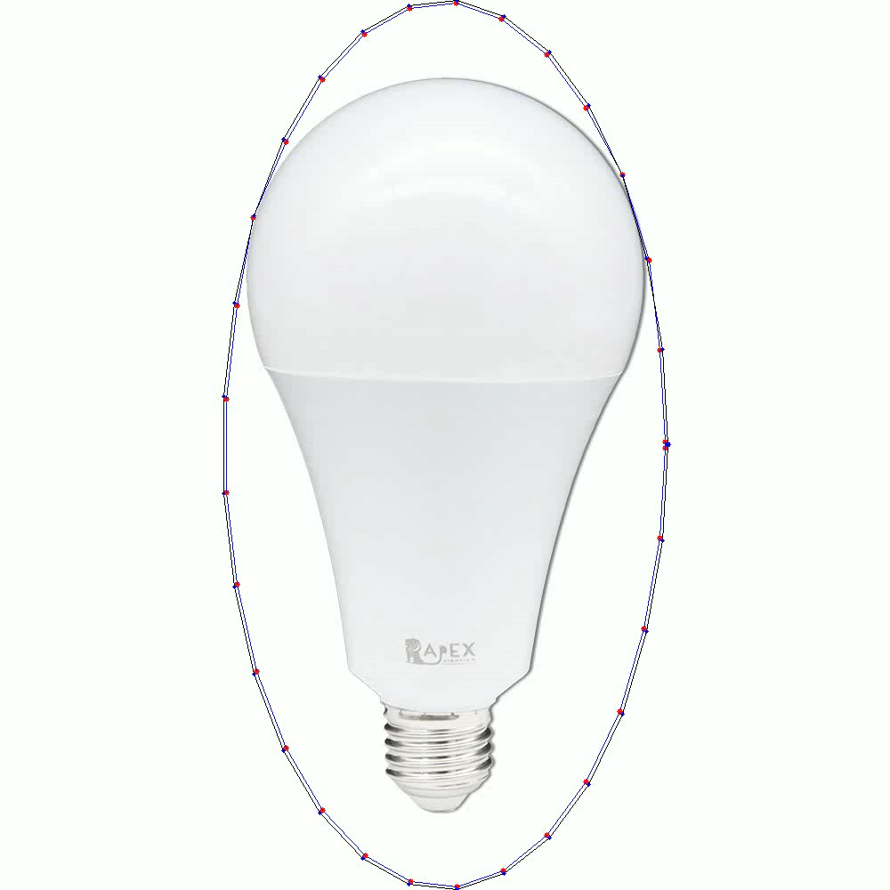
Example
result image
result video

Slide 6
Example for the rules in using Opencv Lib
Allow use Opencv for C/C++
Read, load, save, show : cvLoadImage, cvShowImage …
Define size of image: cvSize, cvGetSize
Define image : IplImage or Mat
Not Allow use
Cannot use the function of Opencv Lib to do the main part of homework.
Example:
cvtColor(image, gray, CV_RGB2GRAY); // convert RGB to Gray

Slide 7
Example for the rules in using Opencv Lib
With python using opencv
import cv2
import numpy as np
Allow use
Read, load, save, show
Define size of image:
Define image
Not Allow use
Cannot use the function of Lib to do the main part of homework.

Slide 8
Homework 04
Grade
Program (60%)
Q1: 15%
Q2: 45%
Videos (20%)
Q3: 20%
Report : 20% (English)
Describe the main part of your method in each question
Result images (3 images)

Slide 9
Homework 04
Require for program
You just create an empty project and write your homework on the one program ( using class or subprogram, …) for C/C++
name.py for python (ex: Tsaiyu.py)
Save Convergence Video (Tsaiyu.mp4)
Write your report in English (PDF)
Explain how your main function works and shows the results on your report.

Slide 10
Homework 04
Please compress your files
StudentID_hw4
Report ( Tsaiyu.pdf )
Program ( Tsaiyu.py / Tsaiyu.cpp / Tsaiyu.c )
Please send your homework to me by email.
qqwweerr987@gmail.com Remember to tell me who you are.
Deadline: 2022/12/19 23:59
For each hour late, 10% of the total possible points will be deducted.
Don’t share your code with other students.

Slide 11
Thanks for your attention

