Slide 1

Computer Vision Homework
TA: Tsai-Yu Hsu (許采玉)
Email: qqwweerr987@gmail.com

Slide 2
Homework Assignment
2022/10/03 – Homework 1 assigned, due 10/17
2022/10/24 – Homework 2 assigned, due 11/7
2022/11/21 – Homework 3 assigned, due 12/5
2022/12/12 – Homework 3 assigned, due 12/26
Notes:
1.

Slide 3
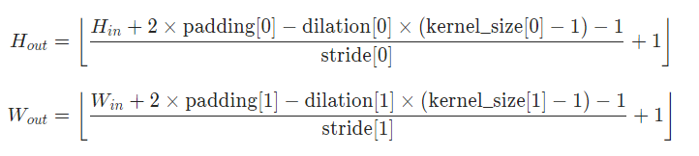
Homework1 Review
Padding
 | ✓
Img

Slide 4
Homework1 Review
Padding
 | ✓
Img
https://www.youtube.com/watch?v=h0c0Tt9wsLg&themeRefresh=1
Zero
Replicate
Mirror

Slide 5
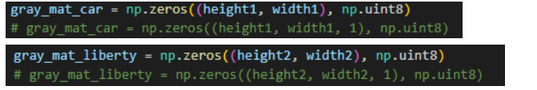
Homework1 Review
Create empty mat

Slide 6
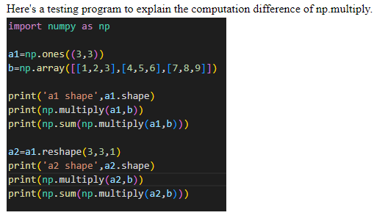
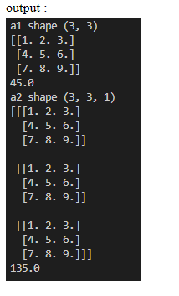
Homework1 Review
Create empty mat

Slide 7
Homework1 Review
No need to rotate the kernel

Slide 8
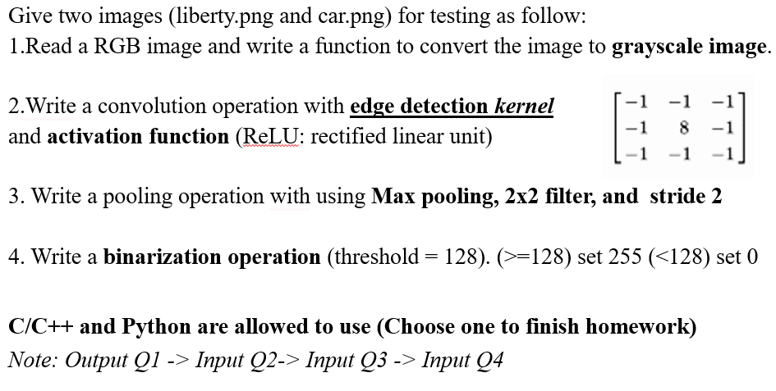
Homework1 Review
Remember to use the correct input images
Input
Q1
Q2
Q3
Q4
Output1
Output2
Output3
Output4

Slide 9
Homework Assignment
Target:
Write the main functions by yourself to deep understand the theories of computer vision.
Improve your skills about using C/C++, python language, Opencv Lib
In the future:
Develop a new algorithm/method and write main function by yourself.

Slide 10
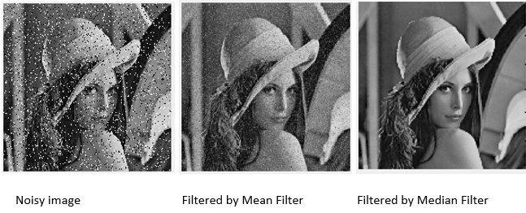
Mean filter, Median filter

Slide 11
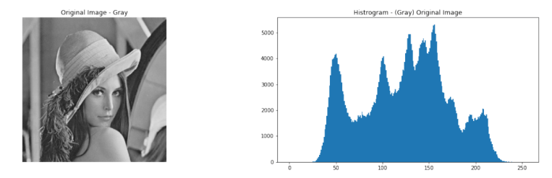
Image histogram
Count the number of each pixel intensity (0~255)
Amount
Intensity
Matplotlib
import matplotlib.pyplot as plt

Slide 12
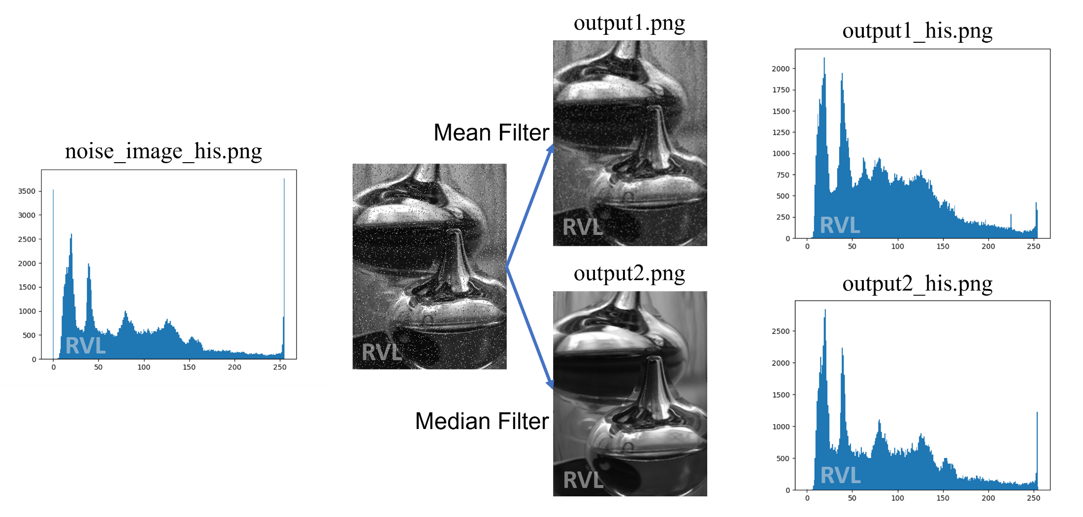
Homework 2

Slide 13
Homework 2
Give one image with Salt & Pepper Noise (noise_image.png)
for testing as follow:
1. Mean filter (save as : output1.png)
2. Median filter (save as : output2.png)
3. Image histogram : Count the number of each pixel intensity.
(save as : noise_image_his.png, output1_his.png, output2_his.png)
4. Compare : noise_image_his.png, output1_his.png, output2_his.png
(Text description)
3 output

Slide 14
Example for the rules in using Opencv Lib
Allow use Opencv for C/C++
Read, load, save, show : cvLoadImage, cvShowImage …
Define size of image: cvSize, cvGetSize
Define image : IplImage or Mat
Not Allow use
Cannot use the function of Opencv Lib to do the main part of homework.
Example:
cvtColor(image, gray, CV_RGB2GRAY); // convert RGB to Gray

Slide 15
Example for the rules in using Opencv Lib
With python using opencv
import cv2
import numpy as np
Allow use
Read, load, save, show
Define size of image:
Define image
Not Allow use
Cannot use the function of Lib to do the main part of homework.

Slide 16
Homework 02
Grade
Program (80%)
Q1 (20%)
Q2 (20%)
Q3 (30%)
Report (20%)
Q4 (10%)

Slide 17
Homework 02
Require for program
You just create an empty project and write your homework on the one program ( using class or subprogram, …) for C/C++
name.py for python (ex: Tsaiyu.py)
Write your report in English (PDF)
Explain how your main function works and shows the results on your report.

Slide 18
Homework 02
Please compress your files
StudentID_hw2
Report ( Tsaiyu.pdf ) Remember to paste your output image !
Program ( Tsaiyu.py / Tsaiyu.cpp / Tsaiyu.c )
Please send your homework to me by email.
qqwweerr987@gmail.com Remember to tell me who you are.
Deadline: 2022/11/7 23:59
For each hour late, 10% of the total possible points will be deducted.
Don’t share your code with other students.

Slide 19
Thanks for your attention

