Slide 1

Computer Vision Homework
TA: Tsai-Yu Hsu (許采玉)
Email: qqwweerr987@gmail.com

Slide 2
Homework Assignment
2021/10/06 – Homework 1 assigned, due 10/20
2021/10/27 – Homework 2 assigned, due 11/10
2021/11/21 – Homework 3 assigned, due 12/5
2021/12/12 – Homework 4 assigned, due 12/26
Notes:
1.

Slide 3
Homework Assignment
Target:
Write the main functions by yourself to deep understand the theories of computer vision.
Improve your skills about using C/C++, python language, Opencv Lib
In the future:
Develop a new algorithm/method and write main function by yourself.

Slide 4
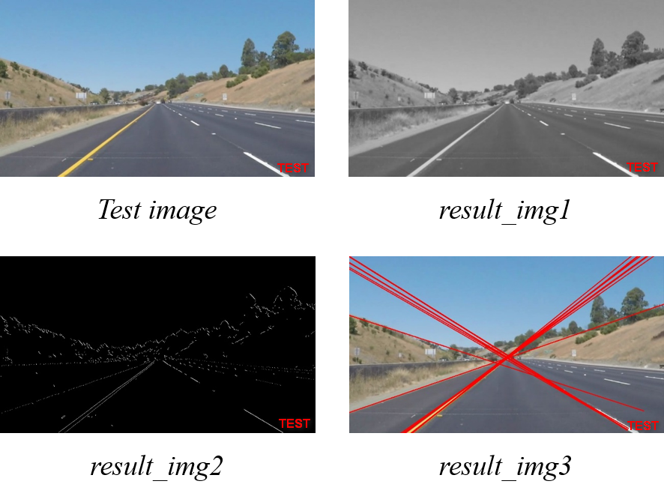
Homework 3
Lane Lines Detection:
You have to write 3 main functions :
Do not use function !!!
Q1. Gaussian Blur (result_img1)
Q2. Canny Edge detection(result_img2)
Q3. Hough Transform(result_img3)
For other functions in other tasks, you can use Lib or write it.
There are 4 test image. For each test image, you will get 4 result image.
So, you will get total 12 result images. Please show them in your report.

Slide 5
Canny
Noise reduction
Gradient calculation
Non-maximum suppression
Double threshold
Edge Tracking by Hysteresis

Slide 6
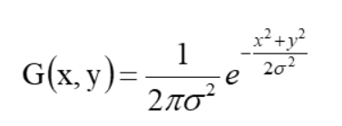
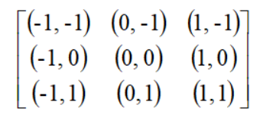
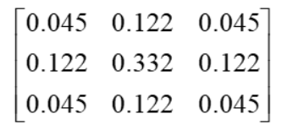
Gaussian Filter
Define Filter Size (3*3)
Define Sigma σ
step1
step2
step3

Slide 7
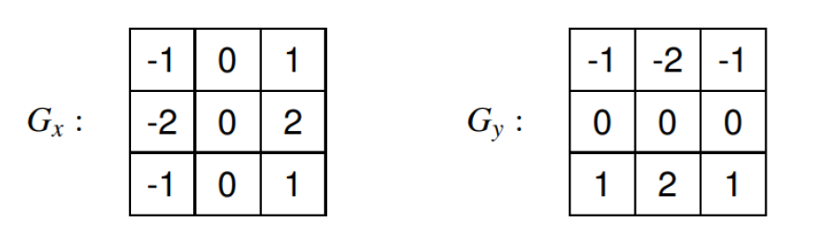



Gradient Calculation
Convolve an image f with a Gaussian of scale $σ$
Estimate the Magnitude and Directions for each pixel in the image
Magnitude
Direction
$$\left|G_{x}\right|+\left|G_{y}\right|$$
$$\tan^{−1}{\frac{G_{y}}{G_{x}}}$$

Slide 8
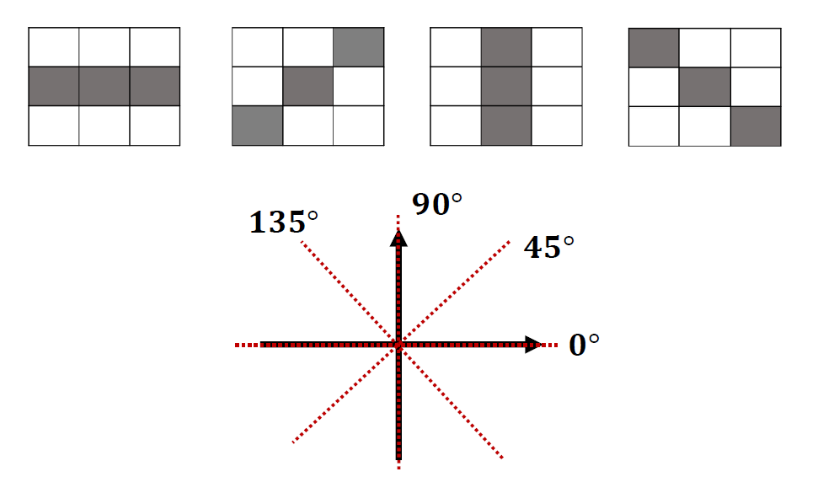
Nonmaximal suppression

Slide 9
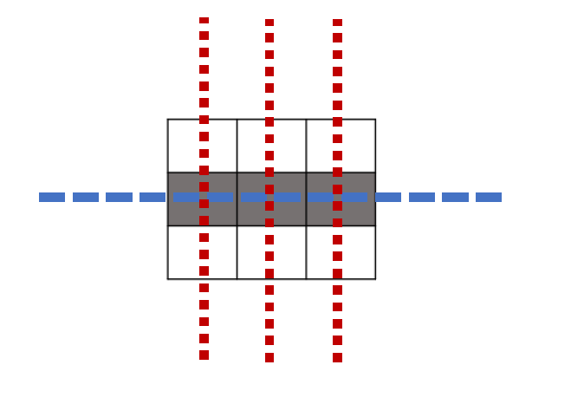
Nonmaximal suppression

Slide 10
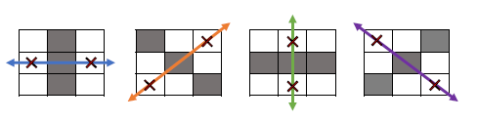
Nonmaximal suppression
Save the max intensity
Set into zero

Slide 11
Double Thresholding
Define the edge type of each pixel by setting the high threshold and low threshold

Slide 12
Edge Linking
Change the weak edge to strong edge if there exist any strong edge in its neighbor

Slide 13
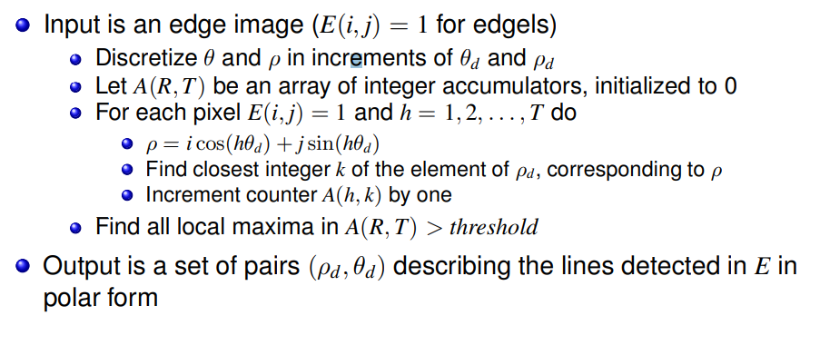
Hough Transform
Show each line on your input image

Slide 14

Hough Transform
Set the max value (upper limit) of rho and the quantification of rho and theta.
Transform the cartesian coordinate to polar coordinate .
Voting
Draw the line on the image
$ρ=x\cos{θ}+$ $y\sin{θ}$
Define Threshold
Ex: hough_img [𝜌,𝜃]+=1

Slide 15
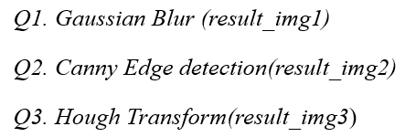
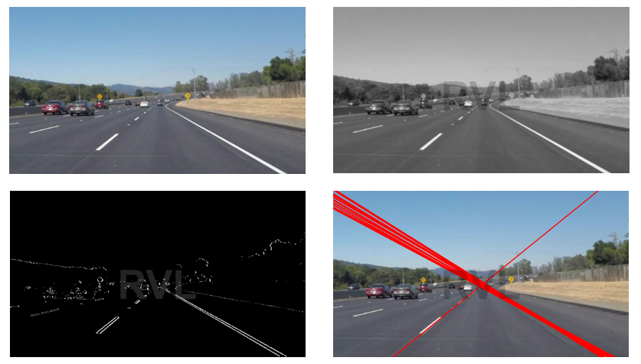
Homework 3
result_img1
result_img2
result_img3

Slide 16
Example for the rules in using Opencv Lib
Allow use Opencv for C/C++
Read, load, save, show : cvLoadImage, cvShowImage …
Define size of image: cvSize, cvGetSize
Define image : IplImage or Mat
Not Allow use
Cannot use the function of Opencv Lib to do the main part of homework.
Example:
cvtColor(image, gray, CV_RGB2GRAY); // convert RGB to Gray

Slide 17
Example for the rules in using Opencv Lib
With python using opencv
import cv2
import numpy as np
Allow use
Read, load, save, show
Define size of image:
Define image
Not Allow use
Cannot use the function of Lib to do the main part of homework.

Slide 18
Homework 03
Grade
Program (80%)
Q1: 20%
Q2: 30%
Q3: 30%
Report : 20% (English)
Describe the main part of your method in each question
Result images (12 images)

Slide 19
Homework 03
Require for program
You just create an empty project and write your homework on the one program ( using class or subprogram, …) for C/C++
name.py for python (ex: Tsaiyu.py)
Write your report in English (PDF)
Explain how your main function works and shows the results on your report.

Slide 20
Homework 02
Please compress your files
StudentID_hw3
Report ( Tsaiyu.pdf ) Remember to paste your output image !
Program ( Tsaiyu.py / Tsaiyu.cpp / Tsaiyu.c )
Please send your homework to me by email.
qqwweerr987@gmail.com Remember to tell me who you are.
Deadline: 2022/12/5 23:59
For each hour late, 10% of the total possible points will be deducted.
Don’t share your code with other students.

Slide 21
Thanks for your attention

