Slide 1

INVENTORY RISK
ANALYSIS REPORT
Distribution Company | 3,000 SKUs
Prepared by: Salau Bukola
Easy Tech Talent Challenge

Slide 2
TABLE OF CONTENTS
01
Introduction
Company background and analysis scope
02
Objectives
Goals and expected business outcomes
03
Case Problem
The inventory crisis and its scale
04
Data Processing & Methodology
Tools, calculations and classification logic
05
Key Insights
7 critical findings from the data
06
Recommendations
07
Conclusion
Summary, root cause and path forward
Easy Technologies Academy | #EasyTechTalent | Inventory Risk Analysis

Slide 3
INTRODUCTION
The company is a growing distribution business that sources products from multiple suppliers and manages inventory across several warehouses. Its core operations involve purchasing goods, storing them efficiently, and ensuring timely distribution to meet customer demand.
As the business continues to expand, effective inventory management has become critical to maintaining operational efficiency and financial performance. Management is focused on ensuring that stock levels are properly balanced, avoiding situations where too much capital is tied up in excess inventory while still preventing stock shortages.
There are also concerns around supplier reliance and how inventory is distributed across warehouse locations, as these factors could introduce additional operational and supply chain risk.
The company operates across three warehouse locations managing a portfolio of 3,000 active SKUs supplied by five key suppliers. As a distribution company, its core business depends on having the right products available at the right time, stock availability directly determines whether customer orders can be fulfilled and whether the business generates revenue.
Easy Technologies Academy | #EasyTechTalent | Inventory Risk Analysis

Slide 4
OBJECTIVES
What this analysis set out to achieve
Primary Objective
To conduct a full inventory risk assessment that enables the distribution company to make informed, data-driven decisions about stock management, procurement and operational planning.
Specific Objectives
Structure and prepare the dataset for analysis
Develop relevant calculations to measure stock health
Identify and quantify risk areas across the portfolio
Highlight operational concerns affecting business performance
Present findings clearly with actionable recommendations
Easy Technologies Academy | #EasyTechTalent | Inventory Risk Analysis

Slide 5
CASE PROBLEM
The company is currently facing concerns about the efficiency and risk exposure of its inventory management practices. Despite maintaining substantial stock levels across its warehouses, there are indications that capital may be excessively tied up in inventory, potentially impacting cash flow and overall financial performance.
At the same time, inconsistencies in stock levels suggest that some products may be overstocked while others are understocked or at risk of stockout. This imbalance raises concerns about demand planning and procurement decisions.
Additionally, the company may be increasingly dependent on certain suppliers, which could expose operations to disruption if supply issues arise. There is also a need to assess whether inventory is evenly and effectively distributed across warehouse locations, as concentration in specific locations could create further operational risk.
These challenges highlight the need for a detailed analysis to uncover inefficiencies, identify risk areas, and support better inventory management decisions
⚡ THE CORE PARADOX: The business has too much of what it does not need and too little of what it does — a procurement failure, not a cash flow problem.
Easy Technologies Academy | #EasyTechTalent | Inventory Risk Analysis

Slide 6
DATA PROCESSING & METHODOLOGY
The analysis was conducted using Excel and Power Query to transform raw inventory data into a structured and analysis-ready format.
The dataset was first cleaned by ensuring consistent data types, particularly for date fields such as Last Restock Date and Next Restock Date. Missing values and inconsistencies were reviewed to maintain data integrity. Power Query was used to standardize the dataset and create additional calculated fields required for analysis.
Key metrics were then derived to support business evaluation. These included inventory value (calculated as current stock multiplied by unit price), excess stock value, and shortfall value. Stock status categories such as Overstocked, Adequate, Understocked, Critical, and Zero Stock were created based on comparisons between current stock and reorder levels.
Further calculations were performed to assess restock cycles and identify overdue restocking risks. The dataset was then loaded into Excel, where pivot tables and calculated measures were used to aggregate data across categories, suppliers, and warehouse locations.
Finally, an interactive dashboard was developed to visualize key metrics, highlight risk areas, and support data-driven decision-making.
Easy Technologies Academy | #EasyTechTalent | Inventory Risk Analysis

Slide 7
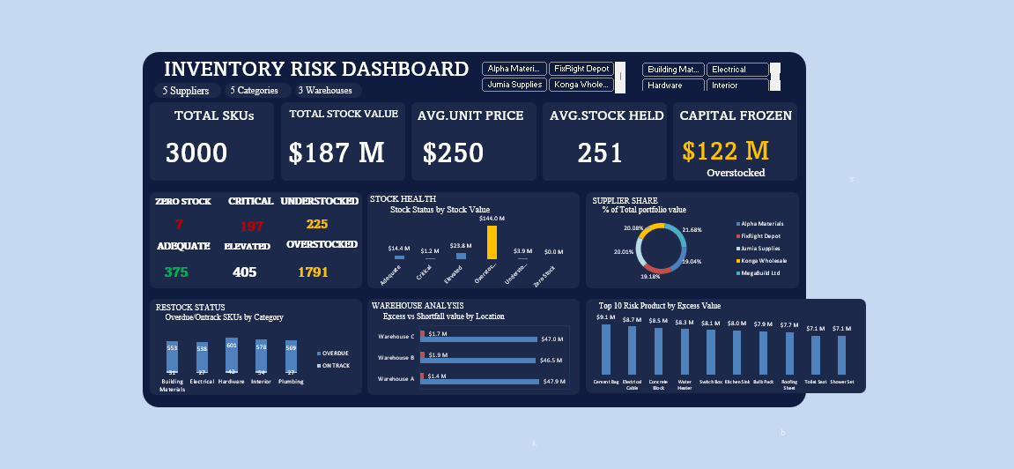
DASHBOARD
Easy Technologies Academy | #EasyTechTalent | Inventory Risk Analysis

Slide 8
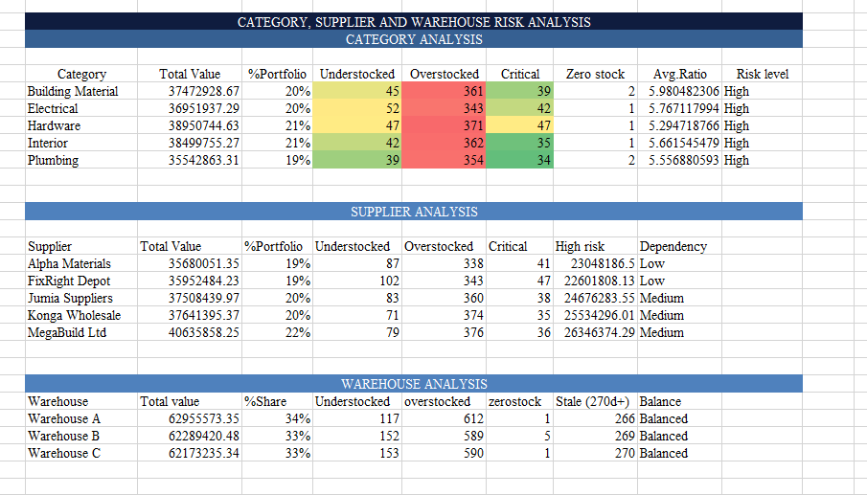
DATA PROCESSING & METHODOLOGY
Easy Technologies Academy | #EasyTechTalent | Inventory Risk Analysis

Slide 9
KEY INSIGHTS
8 critical findings from the data analysis
$122.2M is Frozen in Excess Stock.
59.7% of all SKUs (1,791 items) are overstocked above 3× their reorder level. The average overstock ratio across these items is 8.1× nearly 8 times what is operationally needed. This capital is sitting idle on shelves when it could be used to restock critical items or invested back into the business.
2. The Portfolio Has a Dangerous Paradox
The company is overstocked and understocked at the same time across all 5 categories. While 1,791 SKUs hold excessive stock, 197 SKUs are critically understocked and 7 are at complete zero. This is not a cash flow problem; it is a procurement decision problem.
3. Procurement Has Completely Failed
94.6% of all SKUs have a restock date that has already passed. This means 2,839 of 3,000 products are overdue for replenishment. This pattern is consistent across all 5 categories which confirms it is a process failure not an isolated incident.
4. 7 Products Are Generating Zero Revenue
Seven SKUs are at complete zero stock, Roofing Sheet, Ceiling Board, Water Heater, Toilet Seat, Cement Bag and Switch Box. Five of these seven are concentrated in Warehouse B, pointing to a specific operational failure at that location.
Easy Technologies Academy | #EasyTechTalent | Inventory Risk Analysis

Slide 10
KEY INSIGHTS
8 critical findings from the data analysis
5. $51.1M May Already Be Dead Stock
805 SKUs have not been restocked in over 270 days. This stock is valued at $51.1M. Items that have not moved in 9+ months carry a high risk of obsolescence, damage or expiry, none of which has been accounted for in the current portfolio valuation.
6. Warehouse B is a Concentrated Risk Point
Although all three warehouses hold approximately 33% of total portfolio value each, Warehouse B holds 5 of the 7 zero-stock items. The value distribution is balanced but the operational performance is not something specific is failing at Warehouse B.
7. Supplier Concentration Appears Balanced but Hides Risk
All five suppliers hold between 19% and 22% of portfolio value appearing well balanced. However, the real risk is product line exclusivity. If any single supplier is the sole source for a critical product line, a supply disruption would cause immediate stockouts regardless of how balanced the value percentages appear.
8. High Capital Concentration in Few Products
Top 10 products each hold $8M–$11M in stock value, showing heavy capital concentration in a small set of items.
Significant Excess Across All Top Products
Each product has very high excess value ($7M–$9M), meaning most of this stock is not immediately needed.
Easy Technologies Academy | #EasyTechTalent | Inventory Risk Analysis

Slide 11
RECOMMENDATIONS
1. Reduce Overstock Levels Through Inventory Optimization
Management should review procurement strategies and reduce purchasing volumes for slow-moving products, especially within the Hardware and Interior categories.
Implementing demand-based reorder policies will help prevent excess inventory accumulation.
2. Improve Inventory Forecasting and Reorder Planning
Current stock levels suggest forecasting inaccuracies.
Adopting data-driven demand forecasting and automated reorder thresholds can help balance inventory levels and reduce both overstock and stockouts.
3. Diversify Supplier Portfolio
Although supplier distribution is relatively balanced, the company should avoid heavy reliance on a few suppliers such as Mega Build Ltd.
Establishing alternative suppliers will help mitigate supply chain disruption risk.
4. Monitor High-Risk Inventory Categories
Categories with the highest overstock levels should be prioritized for inventory review.
Management should consider:
Discount promotions
Bundled product offers
Slower reorder cycles to reduce excess stock in these categories.
Easy Technologies Academy | #EasyTechTalent | Inventory Risk Analysis

Slide 12
RECOMMENDATIONS
5. Establish Continuous Inventory Monitoring
Management should implement a dashboard-driven monitoring system to track:
Overstock levels
Critical stock
Restock delays
Supplier exposure
This will allow early detection of inventory risk and support proactive operational decisions.
6. Pause or reduce restocking for these products
Clear excess stock through discounts or bulk sales
Adjust reorder levels based on demand
Negotiate smaller supplier orders
Easy Technologies Academy | #EasyTechTalent | Inventory Risk Analysis

Slide 13
CONCLUSION
The analysis indicates that the company’s primary inventory risk is capital inefficiency due to overstock, rather than warehouse imbalance or supplier concentration.
By optimizing procurement decisions, improving forecasting accuracy, and actively monitoring inventory health, the company can significantly reduce excess stock while maintaining product availability.
Easy Technologies Academy | #EasyTechTalent | Inventory Risk Analysis

