Slide 1
Optimizing Diagnostic Accuracy for Breast Cancer through Advanced Predictive Models
Syed Ishmam Alawee, Azmayn Inkishaf

Slide 2

Notes:
Breast cancer is the leading cause of cancer-related death in women In 2024 an estimated 310,720 new cases of invasive breast cancer will be diagnosed in women in the U.S.

Slide 3
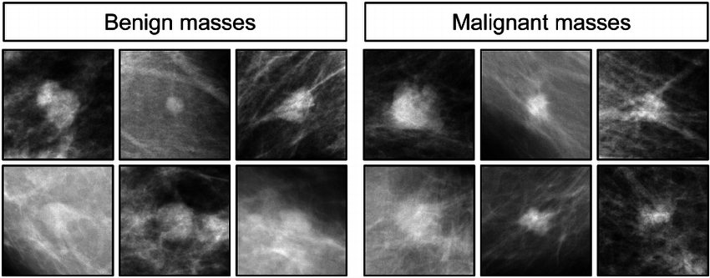
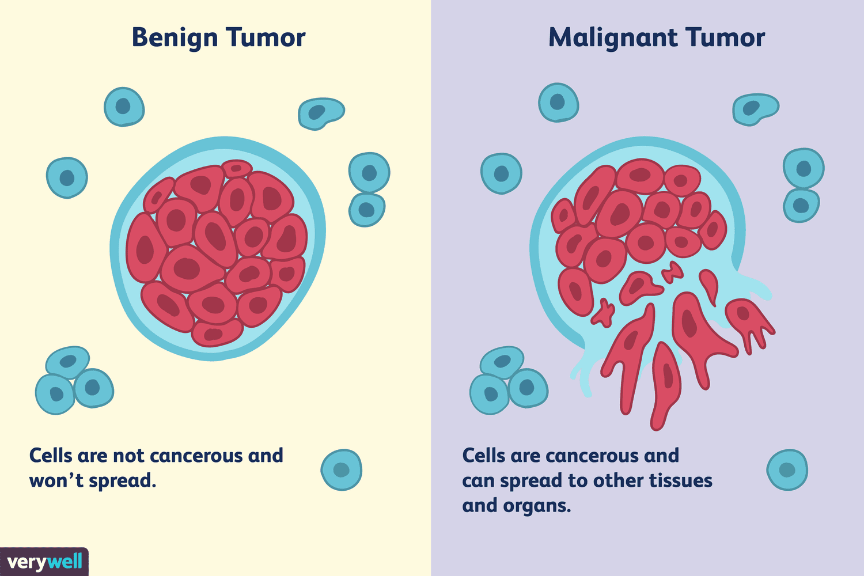
Introduction
Two categories of breast cancer:
Benign:
Nonlife threatening
well-defined and round or oval in shape
Malignant:
Life threatening
poorly defined
irregular with lobules
Screening mammography – most common way of early detection
Notes:
Screening ultrasound is becoming an important addition to routine breast cancer screening because of its superior ability in imaging dense breast tissue and its lack of ionizing radiation.
Despite its many advantages, however, the quality of ultrasound has been relatively low because of the intrinsic speckle noise and low contrast between different tissue types.

Slide 4
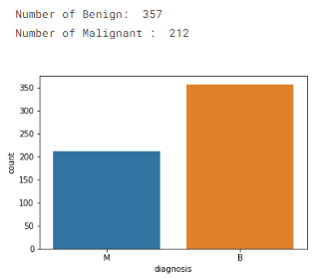
Dataset
ID number
Diagnosis (M = malignant, B = benign)
(3-32) Ten real-valued features are computed for each cell nucleus:
radius (mean of distances from center to points on the perimeter)
texture (standard deviation of gray-scale values)
perimeter
area
smoothness (local variation in radius lengths)
compactness (perimeter^2 / area - 1.0)
concavity (severity of concave portions of the contour)
concave points (number of concave portions of the contour)
symmetry
fractal dimension

Slide 5
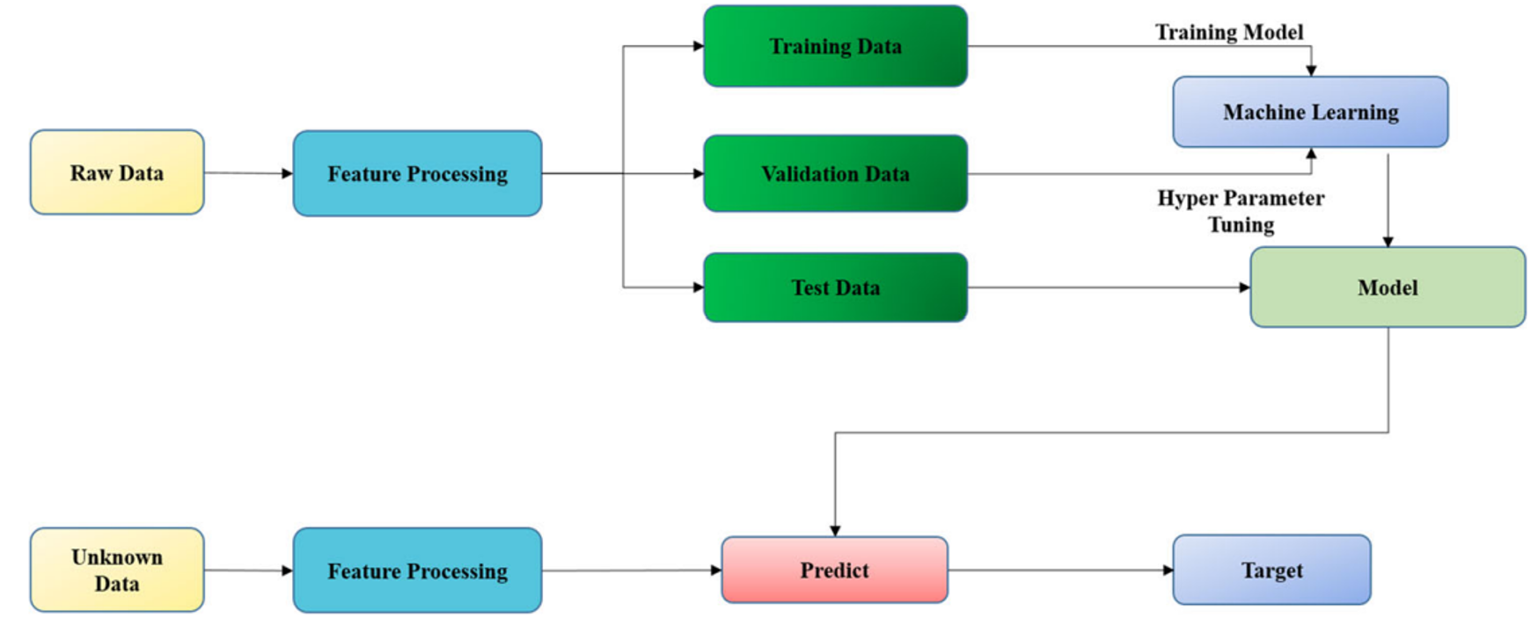
Methodology

Slide 6
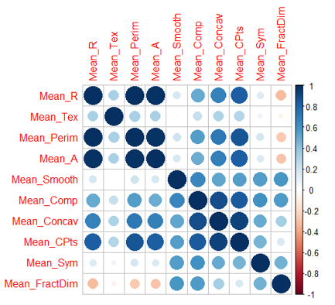
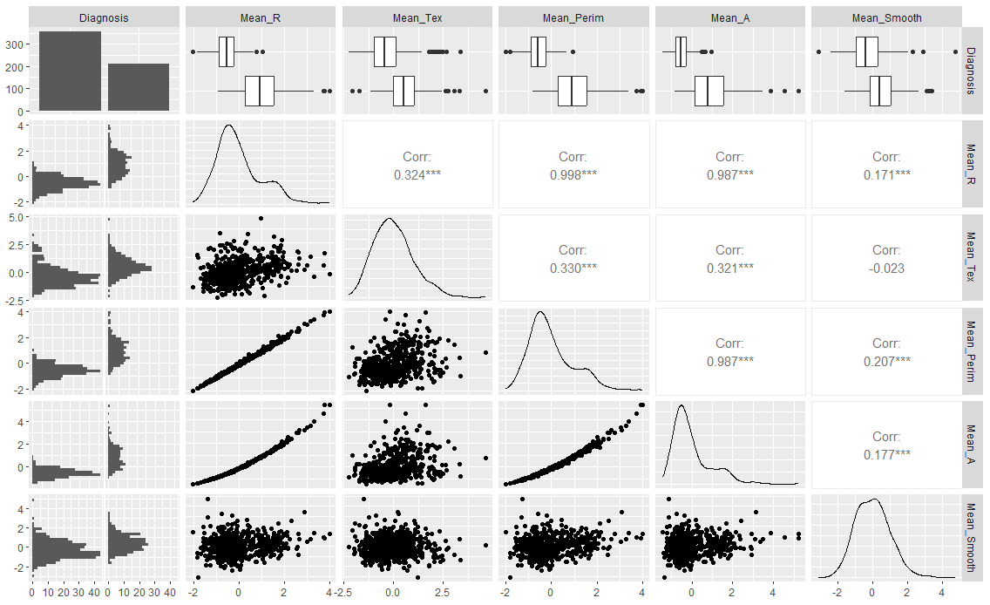
Correlation plots
Notes:
Left plot: This correlation matrix reveals how metrics are related. Strong positive correlations, shown by large dark blue circles, indicate that features like Mean_R, Mean_Perim, and Mean_A are closely related and tend to change together. Weaker or negative correlations are shown by lighter circles. This helps identify which metrics are strongly connected, suggesting similarities or redundancies, useful for feature selection and model building.
The standard error and worst features show similar patterns to the mean correlation matrix
Right plot: The plot shows strong correlations between metrics like Mean_R, Mean_Perim, and Mean_A suggest close interdependencies between body measurements.

Slide 7
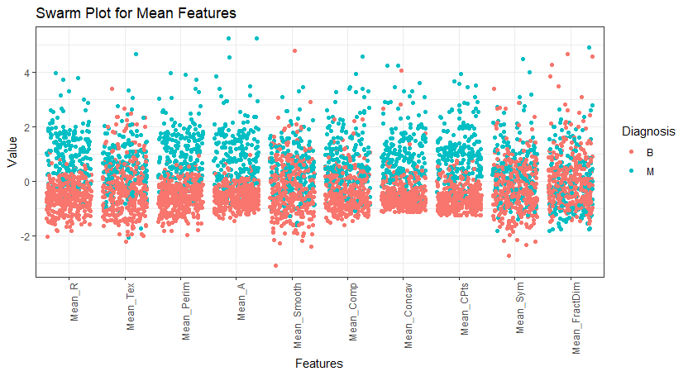
Notes:
Shows the distribution of standardized mean features for benign (B) and malignant (M) breast cancer diagnoses. Distinct clustering patterns highlight certain features like Mean_R and Mean_Concav, which demonstrate potential for differentiating between benign and malignant cases. Conversely, some features show overlap between diagnoses, suggesting they might not be as useful for classification alone. The plot helps identify which features hold the most diagnostic value, offering guidance for feature selection in machine learning models.
Conclusion has to indicate why mean features are being chosen

Slide 8
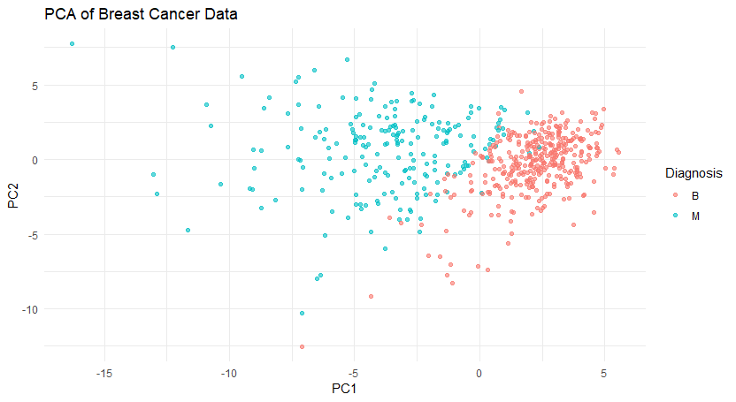
Notes:
This PCA plot shows a clear separation between benign (B) and malignant (M) breast cancer cases, revealing distinct differences between benign and malignant cases. This shows that these components can be valuable features for models that aim to distinguish different cancer diagnoses.

Slide 9
ML Models
Logistic Regression
Straightforward
Works well with binary outcomes
SVM
Powerful for separating complex, non-linear data
Ability to effectively differentiate between closely related features
KNN
Straightforward and non-parametric
Adaptable to the data's structure
Classifies new data based on similarity to past cases
Useful in recognizing patterns in new patients based on historical data
Decision Trees
Offer a clear visualization of decision-making processes
Random Forest
Effective in handling the complexities and variances in healthcare data
Improves diagnostic accuracy by combining multiple decision trees
Reducing the likelihood of overfitting
Providing feature importance for interpretability
Notes:
Logistic Regression: It’s a straightforward model that works well with binary outcomes like benign and malignant cancer classifications. It provides interpretable results, which is crucial in healthcare for understanding how features contribute to predictions.
Random Forest: This ensemble method is effective in handling the complexities and variances in healthcare data. It improves diagnostic accuracy by combining multiple decision trees, reducing the likelihood of overfitting, and providing feature importance for interpretability.
Support Vector Machines (SVM): SVMs are powerful for separating complex, non-linear data. Their ability to effectively differentiate between closely related features makes them valuable for distinguishing subtle differences between benign and malignant cases.
Decision Trees: They offer a clear visualization of decision-making processes, which is beneficial in healthcare for understanding and communicating how diagnostic decisions are made.
k-Nearest Neighbors (KNN): KNN is straightforward and non-parametric, making it adaptable to the data's structure. It classifies new data based on similarity to past cases, which can be useful in recognizing patterns in new patients based on historical data.
In healthcare, these models are beneficial because they can enhance diagnostic accuracy, identify patterns in complex datasets, and provide interpretable insights into diagnostic decisions. This is essential for effective diagnosis, tailored treatment plans, and improving patient outcomes.

Slide 10




Evaluation
Evaluation (Talk about why we chose these evaluations in terms of healthcare)
Accuracy
Sensitivity
Specificity
AUC ROC
SHAP

Slide 11
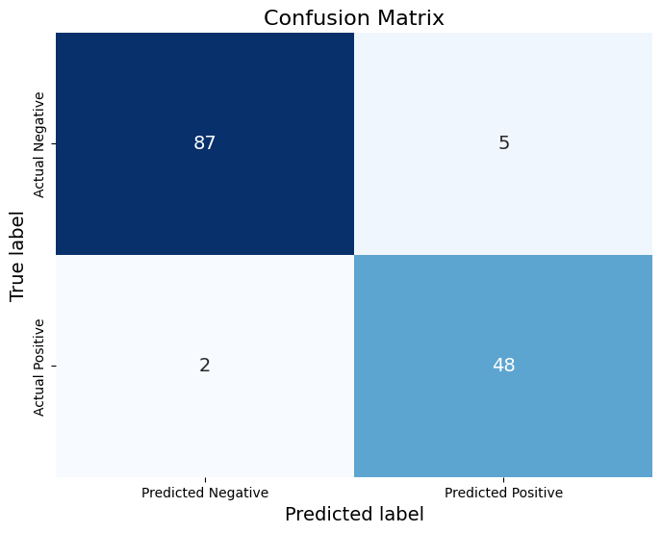
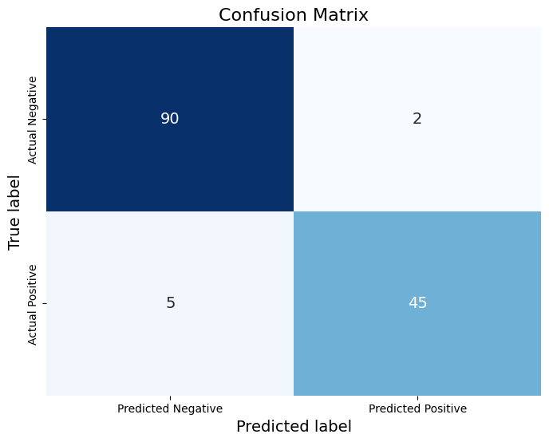

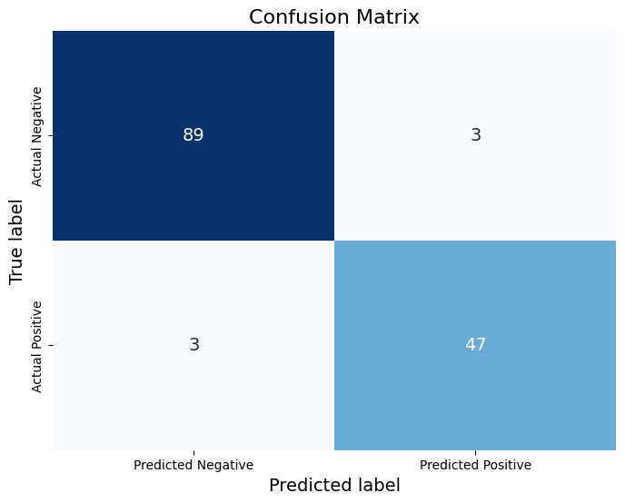

Results
Confusion Matrix: Logistic Regression, Support Vector, Knearest Neighbor, Decision Tress, Random Forest (Left to right)

Slide 12
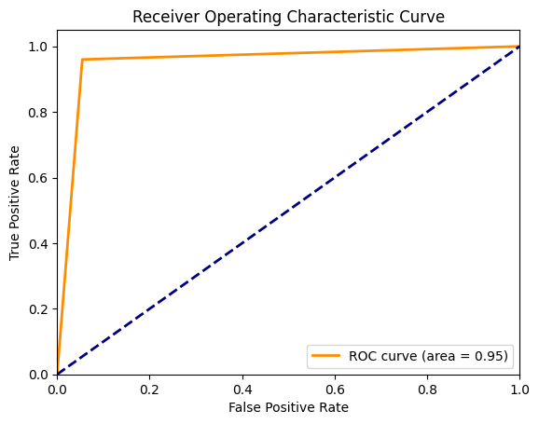



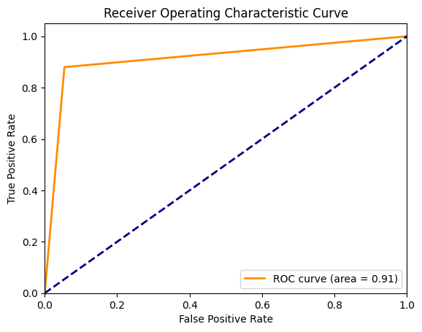
Results
AUCROC: Logistic Regression, Support Vector, Knearest Neighbor, Decision Tress, Random Forest (Left to right)

Slide 13
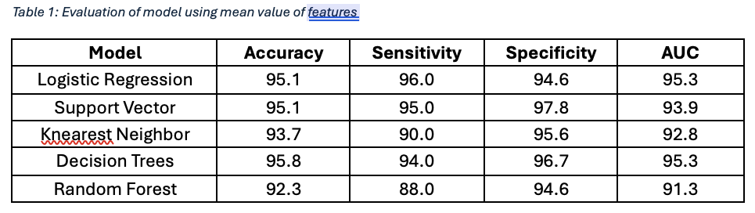
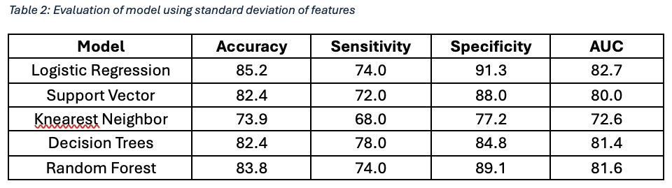
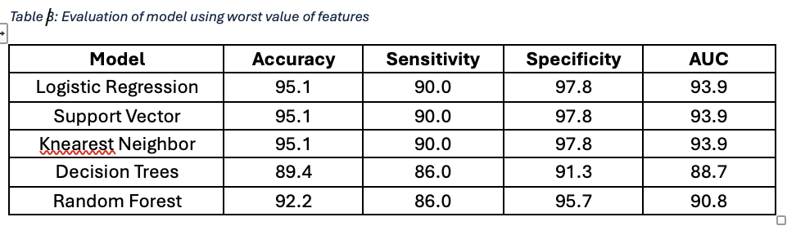
Results

Slide 14
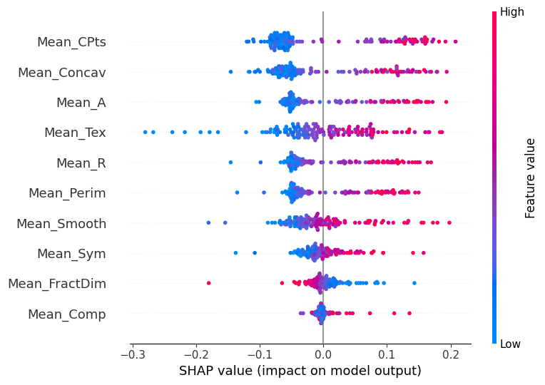
Results

Slide 15
Conclusion
Different version of the features improved different aspect of the models
Support vector machine performed the best as seen in other papers relating to healthcare
Hyperparameter tuning did not lead to much improvement in these model but can be useful if tailored for individual healthcare institutions

