Slide 1
NYU TANDON
IE-GY 9113B · Systems Integration: From ERP to Agentic AI
Sweetgreen
Reliable kitchen availability before automated order handling
Lab 2 live tests 6 October 2026
Board presentation excerpt: S3–S7 | Make tests completed
Notes:
Lab 2 excerpt in the supplied course template. S3-S5 retain the prior diagnosis. S6-S7 now contain observed live Make results. No coursework submitted.

Slide 2
NYU TANDON
DIAGNOSE
Context & backbone
Order-to-pickup reliability is the primary operations thread.
Order capture and payment establish the accepted specification.
Kitchen availability determines whether staff can fulfill it.
Customer recovery updates the order and payment records.
Working archetype: common process, locally managed exceptions.
PROJECT SCOPE
Order to pickup
MODEL BASIS
Functional hypothesis
EVIDENCE
Synthetic sandbox
The handoff depends on shared order IDs, accepted item details and a trustworthy kitchen availability timestamp.
Architecture and operating-model claims require validation with restaurant staff.
S3 · Context & backbone Memo §2
IE-GY 9113B · Sweetgreen · Lab 2
Notes:
40 seconds. Source: Backbone-Context-Note-Sweetgreen.pdf and Context-and-Diagnosis-Brief-Sweetgreen.pdf, plus the original Order and Payment map. This is a functional project hypothesis, not a verified description of Sweetgreen internal applications. Our operations thread follows the order specification through kitchen feasibility and recovery.

Slide 3
NYU TANDON
DIAGNOSE
The strategic problem
A confirmed order can conflict with kitchen availability.
Cached availability can approve an item the kitchen cannot make.
Staff must hold the order, contact the customer and repeat checks.
The pickup promise slips while recovery consumes staff capacity.
Assembly automation still needs a reliable fulfillment decision.
LAB 1 SAMPLE
6 exceptions / 30 orders
MODELED IMPACT
$44 labor + refunds
LATE READINESS
18.7 min / exception
Board consequence: unresolved data disagreement can erode service reliability and consume the capacity automation is meant to release.
Synthetic illustration, not measured Sweetgreen performance or forecast savings.
S4 · The strategic problem Memo §2
IE-GY 9113B · Sweetgreen · Lab 2
Notes:
40 seconds. Source: Sweetgreen_Lab1_Gemini_Sandbox.xlsx. Six synthetic exceptions consume 60 modeled recovery minutes at $0.40/minute ($24) plus $20 refunds, total $44. They total 112 late-ready order-minutes, mean 18.7. The sample is seeded and is not a population estimate. We do not count waste from partial preparation because the mapped availability check precedes preparation.

Slide 4
NYU TANDON
DIAGNOSE
Backbone diagnosis
Condensed Lab 1 process with control points and diagnostic markers.
D1 accepted?
CP1 order spec
D2 feasible?
Availability
Prepare and
quality check
Pickup
CP4 complete
LAB MARKERS
1 Correction / remake
loop: worst friction
2 D2 availability:
rules-based target
3 D3 recovery:
human judgment
No: hold
CP2 issue log
D3 recovery
Customer choice
CP3 change
Consent; recheck D2
Cancel: CP5 cancellation/payment state + CP6 refund/void record
Friction chain: availability conflict causes a hold, customer recovery and repeat checks. Late pickup and recovery costs follow.
CP = new authoritative record. Quality and payment gates remain in the full Lab 1 map.
S5 · Backbone diagnosis Memo §3
IE-GY 9113B · Sweetgreen · Lab 2
Notes:
40 seconds. Source: original Order and Payment diagram and Lab 1 annotated map. This is a condensed map for presentation; the full map retains rejection, quality, payment-captured and escalation routes. CP1 records accepted items and promise, CP2 the issue, CP3 customer-approved changes, CP4 collection, CP5 cancellation and capture state, CP6 refund or void outcome. Marker 1 is the correction/remake loop, marker 2 D2, marker 3 D3. The remediation-loop cost itself remains unmeasured. A quality mismatch loops to correction and recheck in the full map.

Slide 5
NYU TANDON
AUTOMATE
Automation opportunity
Lab 1 identified D2 availability. Lab 2 builds and tests the automation.
First: check every original line against kitchen availability.
Now: log every failed approval check for human review.
Human-led: D3 recovery, consent and customization feasibility.
The first build writes a recommendation to an audit sheet.
TESTED IN MAKE
Positive item match
Current availability
Source age 0-60 min
NEW, no exception
Staff + data review
REMAINING
Live feed + deduplication
Five modules: Search Rows, Router and three audit writers for approval, staff recovery review and data repair review.
60-minute freshness limit is illustrative. Live use needs approved limits and duplicate protection.
S6 · Automation opportunity Memo §4
IE-GY 9113B · Sweetgreen · Lab 2
Notes:
Lab 1 supplied the process map, diagnosis and Gemini sandbox. Lab 2 prepared seven unique sample orders: H1 normal single item, H2 normal two items, B1 unavailable stock, B2 blocked re-entry, B3 missing availability, B4 stale source and B5 unmatched item. Seven was the chosen test count. B3-B5 are additional Lab 2 test mutations. Five modules: Search Rows, Router, and three Google Sheets Add a Row modules. Current run THREE_OUTCOMES_01, rule three-outcomes-v3, on 6 October 2026 at 22:39:07-08 UTC. AutoActions rows 25-31: H1/H2 APPROVE, B1/B2 STAFF_REVIEW, B3/B4/B5 DATA_REVIEW. Approval requires current_available=1, NEW status, prior_exception=0, positive line_count equal to matched_line_count, KITCHEN source, and present source_age_min in 0-60. Staff route matches current_available text 0 OR BLOCKED status OR prior_exception text 1. Remaining cases use DATA_REVIEW fallback. Operational flags take priority over concurrent data issues. Input test_group matches ^(HAPPY|BREAK)$ with limit 7. AutoActions contains 30 outputs across repeated tests, not 30 unique orders. Historical naive tests approved four problem cases and silently dropped B3. Adding a Router alone did not fix the rules. Guarded-v2 caught all five as REVIEW before the current split. Writes are audit recommendations and proposed roles, not notifications or completed work. Partial CP2 logging is implemented. D3 recovery and CP3 consent remain human. Scenario inactive. Frozen historical data, illustrative 60-minute threshold. Live feed, duplicate protection and review closure remain future work. ROI assumptions: 660 orders/month,20% exceptions,45 seconds manual,10 seconds routine,15 extra seconds per exception,10 minutes recovery retained,$24/hour,4 build hours,1 maintenance hour/month,$0 classroom license. Baseline $726,after labor $616,upkeep $24,capacity value $86/month,build $96,payback1.12months. Re-estimate actual build effort. Sources: W06_Lab2_Automate_StudyNote_v1.pdf; Lab 1 Gemini sandbox; https://us2.make.com/3120988/scenarios/6536204/edit ; https://docs.google.com/spreadsheets/d/1chr9ntqh-wlb9ISlzznErcPFoL6J1Jox-j0NSWImkP0/edit .

Slide 6
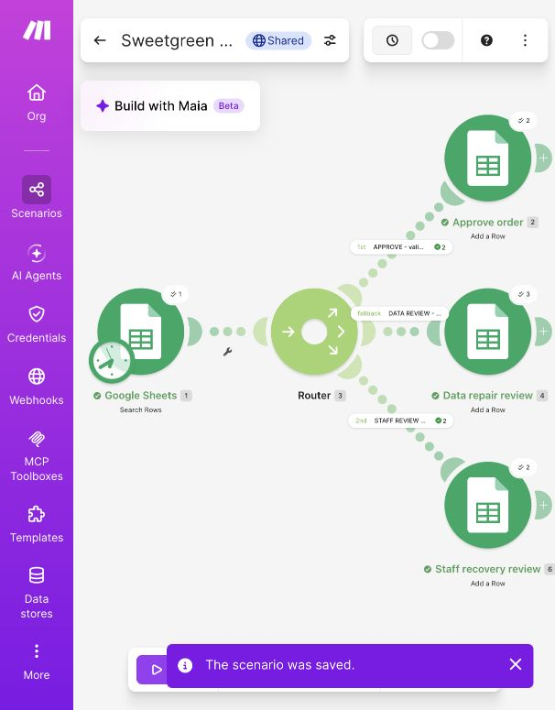
NYU TANDON
AUTOMATE
Automation journey
Lab 2 tests: seven unique orders, two normal and five problem cases.
Original rule: four false approvals and one silent drop.
Current run: two staff reviews and three data reviews.
Both normal cases approved. Seven orders, seven final decisions.
30 log rows include repeated tests of the same seven orders.
ACTUAL MAKE RUN
Illustrative ROI: $726 baseline minus $616 labor and $24 upkeep = $86/month capacity value. $96 build; 1.12-month payback.
2 approvals / 2 staff / 3 data reviews.
ROI inputs unmeasured. Guarded routing passed seven sandbox cases; production controls remain incomplete.
S7 · Automation journey Memo §4
IE-GY 9113B · Sweetgreen · Lab 2
Notes:
Lab 1 supplied the process map, diagnosis and Gemini sandbox. Lab 2 prepared seven unique sample orders: H1 normal single item, H2 normal two items, B1 unavailable stock, B2 blocked re-entry, B3 missing availability, B4 stale source and B5 unmatched item. Seven was the chosen test count. B3-B5 are additional Lab 2 test mutations. Five modules: Search Rows, Router, and three Google Sheets Add a Row modules. Current run THREE_OUTCOMES_01, rule three-outcomes-v3, on 6 October 2026 at 22:39:07-08 UTC. AutoActions rows 25-31: H1/H2 APPROVE, B1/B2 STAFF_REVIEW, B3/B4/B5 DATA_REVIEW. Approval requires current_available=1, NEW status, prior_exception=0, positive line_count equal to matched_line_count, KITCHEN source, and present source_age_min in 0-60. Staff route matches current_available text 0 OR BLOCKED status OR prior_exception text 1. Remaining cases use DATA_REVIEW fallback. Operational flags take priority over concurrent data issues. Input test_group matches ^(HAPPY|BREAK)$ with limit 7. AutoActions contains 30 outputs across repeated tests, not 30 unique orders. Historical naive tests approved four problem cases and silently dropped B3. Adding a Router alone did not fix the rules. Guarded-v2 caught all five as REVIEW before the current split. Writes are audit recommendations and proposed roles, not notifications or completed work. Partial CP2 logging is implemented. D3 recovery and CP3 consent remain human. Scenario inactive. Frozen historical data, illustrative 60-minute threshold. Live feed, duplicate protection and review closure remain future work. ROI assumptions: 660 orders/month,20% exceptions,45 seconds manual,10 seconds routine,15 extra seconds per exception,10 minutes recovery retained,$24/hour,4 build hours,1 maintenance hour/month,$0 classroom license. Baseline $726,after labor $616,upkeep $24,capacity value $86/month,build $96,payback1.12months. Re-estimate actual build effort. Sources: W06_Lab2_Automate_StudyNote_v1.pdf; Lab 1 Gemini sandbox; https://us2.make.com/3120988/scenarios/6536204/edit ; https://docs.google.com/spreadsheets/d/1chr9ntqh-wlb9ISlzznErcPFoL6J1Jox-j0NSWImkP0/edit .

