Slide 1
IE-GY 9113B · Systems Integration: From ERP to Agentic AI
Sweetgreen: Order & Payment
Lab 1 — Diagnose & Map a Process
Map · three diagnostic points · curveball · synthetic data · board-level consequence
Week 3 Lab 1 · September 18, 2026

Slide 2
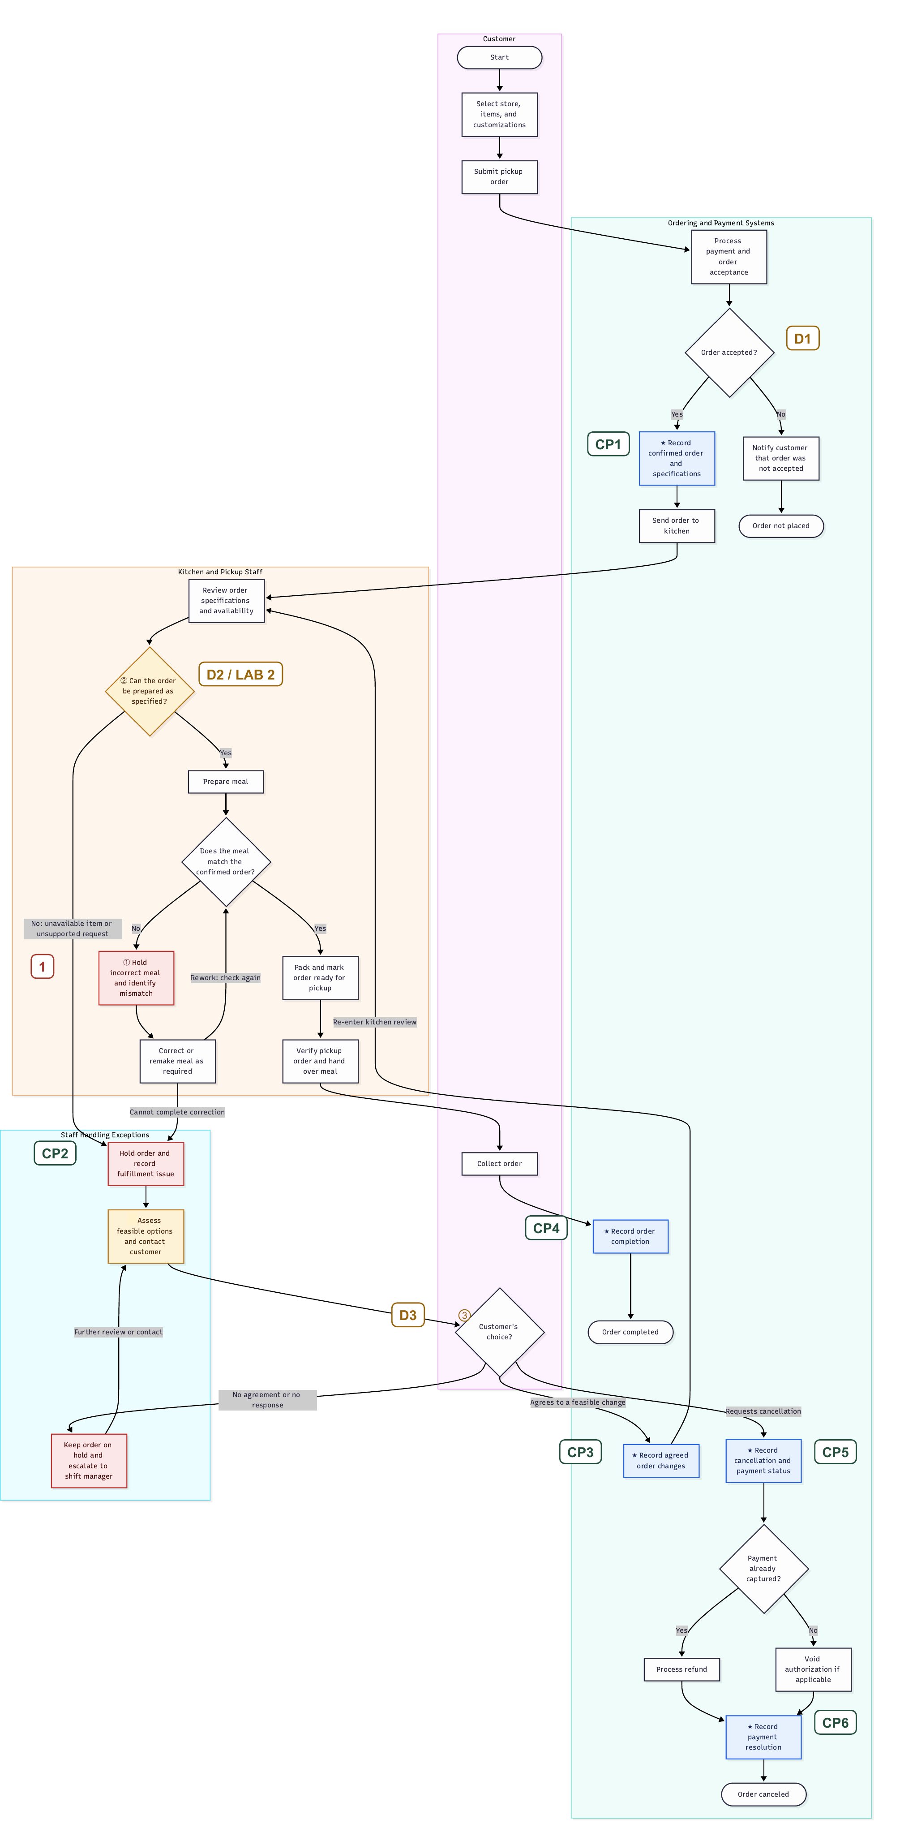
DIAGNOSE
The process map
Digital ordering hands off to kitchen execution at G → H → I — exactly where this map's rejection/rework path lives.
①
Worst friction
Hold → correct/remake → recheck loop when the meal doesn't match the confirmed order.
②
Stable rules → Lab 2
Can the order be prepared as specified? Automate first — but the input needs a freshness gate (see curveball).
③
Judgment → Lab 3
Staff assess feasible options and the customer consents. No clean rule for which compromise to offer.
Sweetgreen · Order & Payment · Lab 1 · IE-GY 9113B
2

Slide 3
CURVEBALL
Nightly batch, not real time
Deck card #3. Availability data feeding decision ② now comes from two places — a live system, and a nightly legacy cache — and they don't always agree.
BEFORE
AFTER — CURVEBALL ABSORBED
② Can the order be prepared as specified?
STALE: do live and cached availability agree?
One clean yes/no rule against a single availability check. Easy to automate — nothing left to design.
A precondition sits in front of ②. When the nightly cache disagrees with the live system, the order holds for a reason distinct from “unavailable item” — a freshness gate, not a menu fix.
24 menu configurations seeded 10 live/cache mismatches
Sweetgreen · Order & Payment · Lab 1 · IE-GY 9113B
3

Slide 4
DATA, GENERATED LAST
Board-level consequence
$44
6 / 30
20%
18.7 min
synthetic orders reworked
rework rate
average lateness
in modeled exposure
60 labor minutes × $0.40/min + $20 refunds = $44, or $7.33 per affected order.
Availability mismatch
→
Hold + manual contact
→
Correction + kitchen re-entry
→
Late pickup
→
Extra labor + refunds
Synthetic, illustrative sample — not measured Sweetgreen performance. No company-wide extrapolation from 30 orders at one modeled store.
Sweetgreen · Order & Payment · Lab 1 · IE-GY 9113B
4

Slide 5
WHAT THE BOARD COULD FUND
Two targets, one milestone
LAB 2 — MAKE (NEXT WEEK: RPA)
LAB 3 — RELEVANCE AI
D2: the freshness gate
D3: the recovery decision
Automate “can the order be prepared as specified” — but the automation has to resolve live-vs-cached disagreement, not just the yes/no rule.
Staff assess feasible options and the customer consents. An agent can support that judgment; it can't make the customer's choice.
Fewer missed pickup promises, less avoidable recovery work. $44 is modeled exposure, not a guaranteed saving.
S5 · Backbone diagnosis · Memo §3 · Milestone 1: Diagnose

