Slide 1
MODULE 2 · THE AUTOMATION LADDER
Sweetgreen: RPA-Candidate Scan
Automate the rule, route the exception — where a bot belongs on Sweetgreen's order-and-payment flow
IE-GY 9113B · Systems Integration: From ERP to Agentic AI
Week 4 · Board Memo §4 (Automation Journey) · Storyboard S6 · Milestone 1: Diagnose

Slide 2
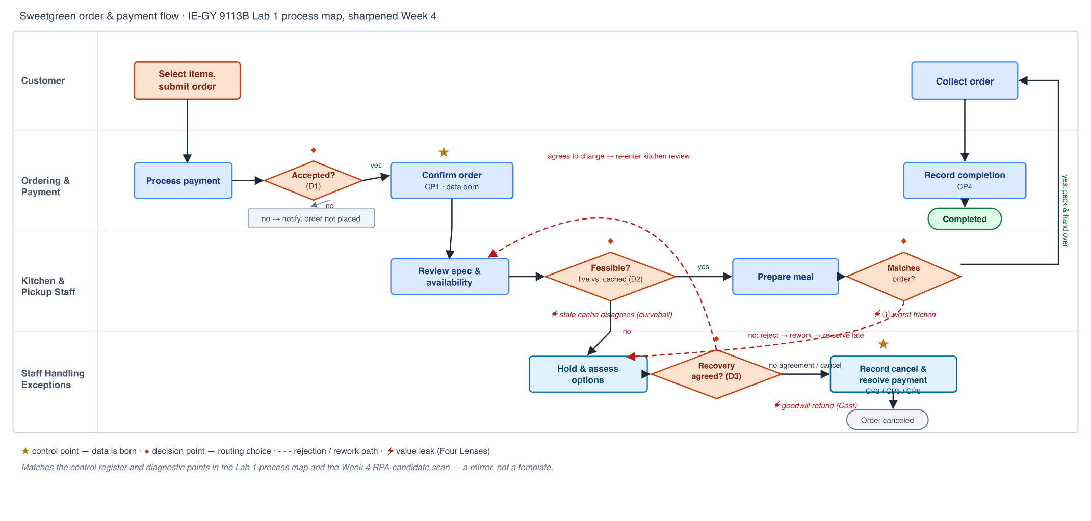
BREAKOUT 1 · THE MAP, TAGGED END TO END
Where each step actually belongs
IE-GY 9113B · Systems Integration · Week 4
2

Slide 3
BREAKOUT 2 · RUN THE THREE TESTS
Two candidates, two tools
Repetitive + rules-based + stable, or it isn't a candidate. Both of Sweetgreen's diagnostic points from Lab 1 pass — into different tools.
D2 — Feasible? (live vs. cached availability)
D3 — Recovery agreed? (staff assess options)
→ RPA · Lab 2 (Make)
→ AI agent · Lab 3, Week 9
Repetitive: every order passes through it. Rules-based: approve when live and cached availability agree and the customization is supported, else hold — a complete rule once the freshness gate is folded in. Stable: the rule and its two source systems (Olo, Crunchtime) don't change often.
Thread: Operations & Supply Chain, primarily — also touches Cash (fewer wrongly-accepted orders) and Customer (fewer holds).
Prize: 6 of 30 synthetic orders (20%) hit the mismatch and enter exception recovery — $44 modeled exposure, 18.7 min late on average.
Unattended on the routine path; the human stays at the exception queue, every time the gate disagrees.
Repetitive: every exception reaches it. Rules-based: no — two reasonable staff members could offer different resolutions to the same customer; depends on urgency, prep ETA, and consent. Fails the rules test outright.
This is the judgment step: an assistant can recommend a recovery option for manager review, but it can't make the customer's choice.
Not this week's build target — previewed now, built in Lab 3 once intelligent automation (Week 7) and agent design (Week 8) are covered.
IE-GY 9113B · Systems Integration · Week 4
3

Slide 4
HONEST REJECTIONS
What we rejected, and why
A scan that only says yes hasn't done the diagnostic work. Three steps, three different reasons to say no.
D1 — Order acceptance beyond payment
Repetitive and probably stable, but the map doesn't yet state the full acceptance rule. Automating an underspecified rule risks locking in an implicit policy — a mapping gap, not an automation call yet.
Quality gate — does the meal match the order?
Passes the rules test on paper, but fails the RPA pattern itself: the input is a physical, visually verified meal, not screen-readable system data. Kept as a routing decision, not elevated to a control point.
The stock-accuracy root cause behind the mismatch
Automating around a stale cache (checking it faster) would pave the cow path. The fix is closing the sync gap between Olo and Crunchtime — a redesign question, not an RPA question.
IE-GY 9113B · Systems Integration · Week 4
4

Slide 5
BREAKOUT 3 · COST IT, AND GOVERN IT
D2, costed and governed
~10
The number, order-of-magnitude
10 min manual reconciliation per affected order (60 min / 6 orders in the 30-order sandbox). Labor-removed side of payback; the Make build + licence side is Lab 2's number, not yet known. This is a shape, not a commitment — validate against real per-store volume and mismatch rates.
staff-hours a day, order of magnitude, at an assumed 300 orders/store/day and a 20% mismatch rate — not sourced, validate before board use
Attended or unattended?
Human oversight & workforce note
Unattended, with a human checkpoint
A narrower claim than “redeployment”
Unattended on the routine path — no human needed when live and cached availability agree. The human stays exactly where the map already routes them: at the exception queue, every time the gate disagrees. Not case-by-case on the happy path — every time on the path that needs judgment.
Every freshness disagreement routes to a person, never auto-resolved — guessing which source is right is exactly the silent-wrong-answer risk a confident bot creates.
This candidate removes a manual copy-and-compare check, not a role. Freed minutes return to staff already doing exception handling. A fuller workforce answer, as automation scales past this one candidate, is Board Memo §7's job.
IE-GY 9113B · Systems Integration · Week 4
5

Slide 6
WHERE THIS LANDS
The scan is the argument.
The build is Lab 2.
Board Memo §4
Automation Journey — this scan is the evidence
Slide S6
Automation-opportunity slide, still inside Milestone 1: Diagnose
Lab 2, Week 6
Build the D2 freshness-and-feasibility gate in Make, then break it
Lab 3, Week 9
Build the D3 recovery-assist agent, previewed here
Full detail: wiki/project/RPA-Candidate-Scan-Sweetgreen.md

