Slide 1
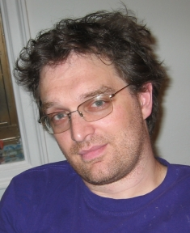
Machine Learning the Future http://hunch.net/~mltf
John Langford
Microsoft Research

Slide 2
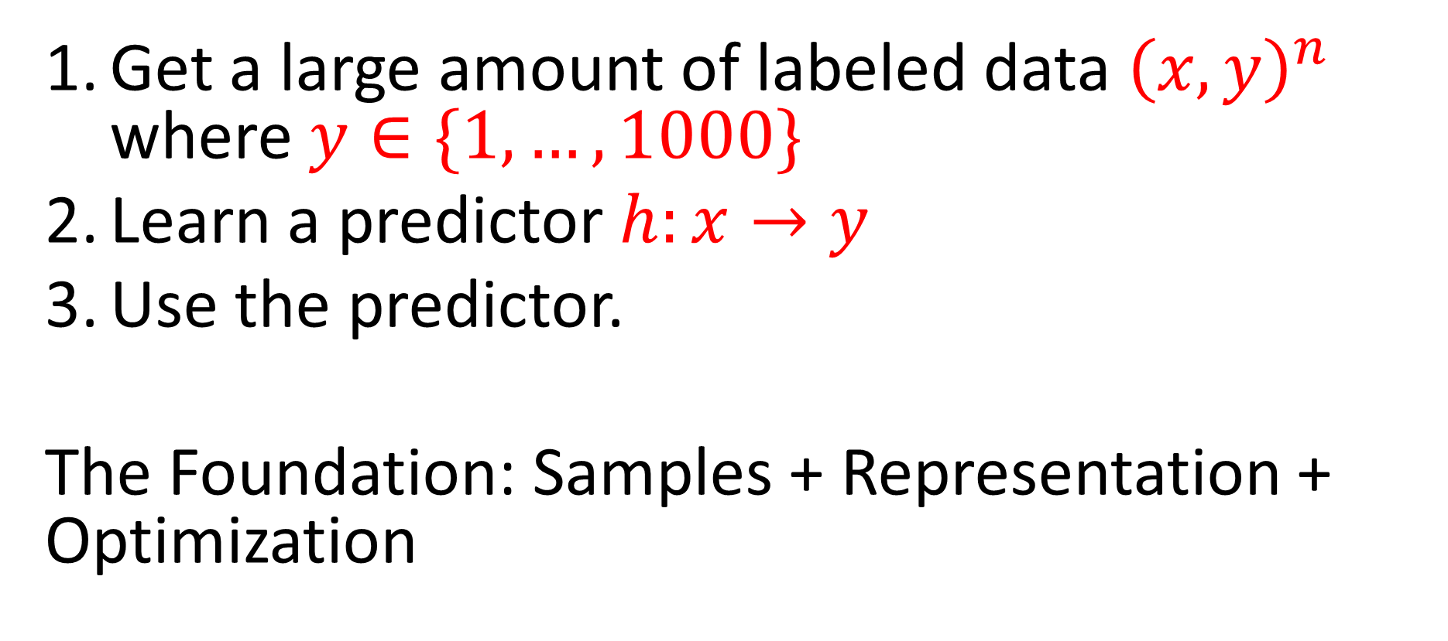
Machine Learning in the present
Get a large amount of labeled data ${\left(x,y\right)}^{n}$ where $y∈\{1,…,1000\}$
Learn a predictor $h:x→y$
Use the predictor.
The Foundation: Samples + Representation + Optimization

Slide 3
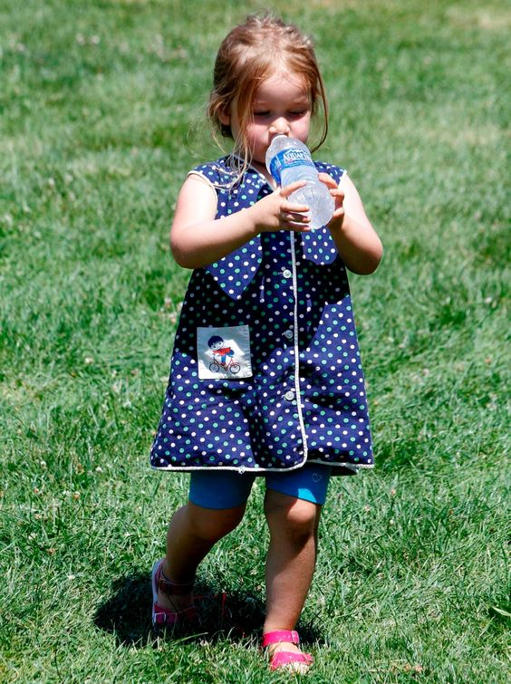
Where is my
self-driving car?

Slide 4
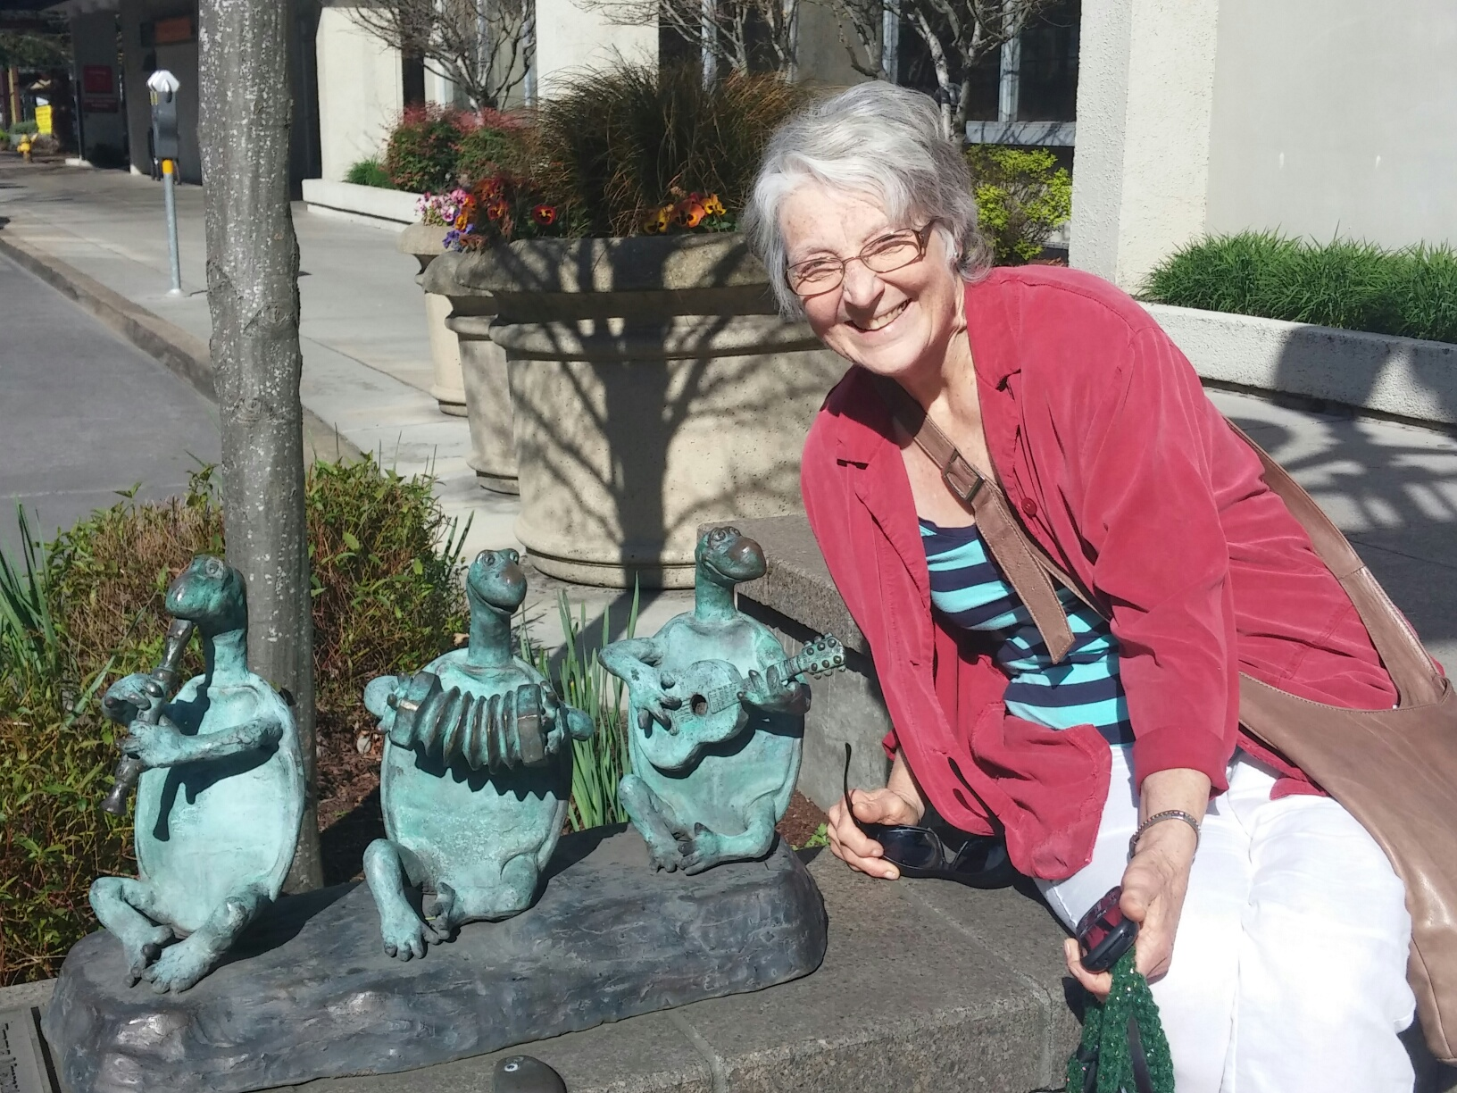
Who is that?

Slide 5
Other applications
Personalized medicine?
Conversational Agents?
Machine Translation?
Personal Assistants?
Your job?

Slide 6
How do we succeed?
What is necessary for success?
And what is a compatible solution?

Slide 7
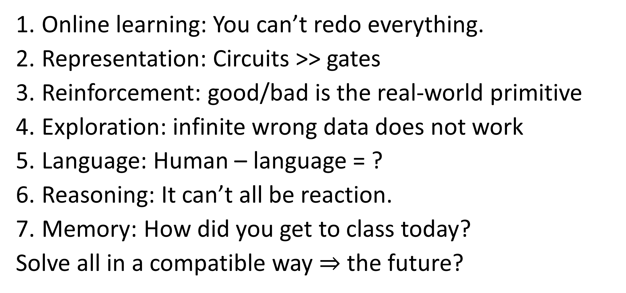
Pieces to solve
Online learning: You can’t redo everything.
Representation: Circuits >> gates
Reinforcement: good/bad is the real-world primitive
Exploration: infinite wrong data does not work
Language: Human – language = ?
Reasoning: It can’t all be reaction.
Memory: How did you get to class today?
Solve all in a compatible way $⇒$ the future?

Slide 8
Supervised
Learning
=Representation
+Optimization
Exploration
Active
Contextual
Bandit
Bandits
Contextual
Decision
Process
Markov
Decision
Process
Policy
Improvement
Q-learning
Reinforcement

Slide 9
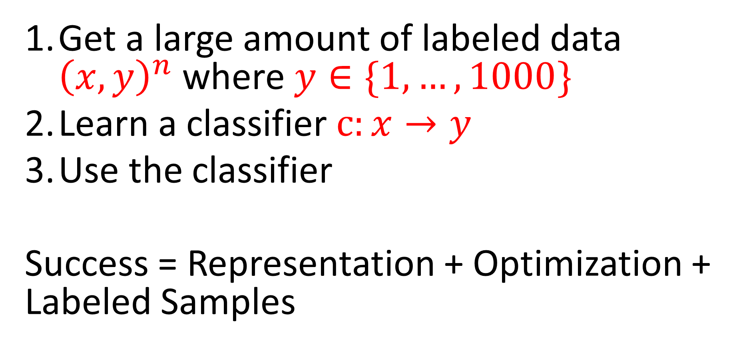
For today: revisit foundations. Why does this work?
Get a large amount of labeled data ${\left(x,y\right)}^{n}$ where $y∈\{1,…,1000\}$
Learn a classifier $c:x→y$
Use the classifier
Success = Representation + Optimization + Labeled Samples

