Slide 1
Assignment 6
Orientation
CIDM6330

Slide 2
Step 1
Domain Model

Slide 3
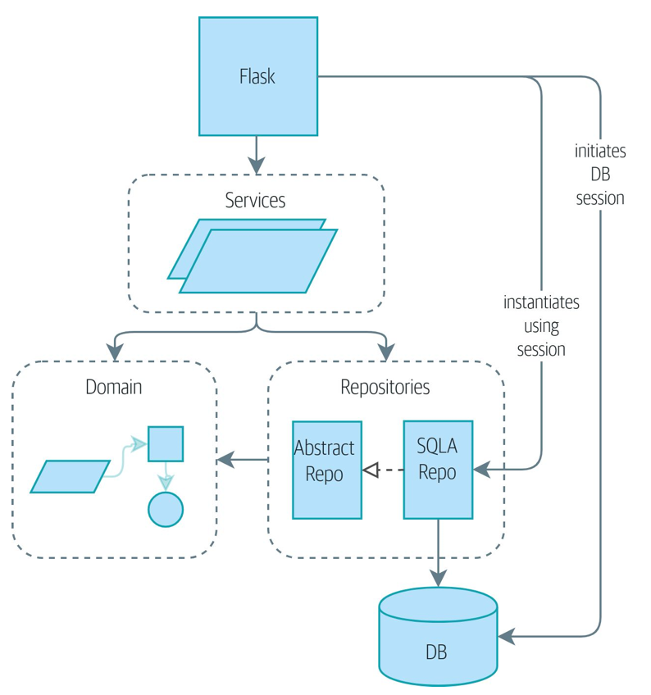
First, let’s consider an initial target architecture
git clone https://github.com/cosmicpython/code.git
cd code
git checkout chapter_06_uow
# or to code along, checkout Chapter 4:
git checkout chapter_04_service_layer

Slide 4
Pre-requisites
Establish the Domain Modules and Package
https://realpython.com/python-modules-packages/
Modules will contain:
The python classes that model your domain entities (focus on this for now)
Any other “helper” routines
Your Package will contain
All of the modules
You must design this first

Slide 5
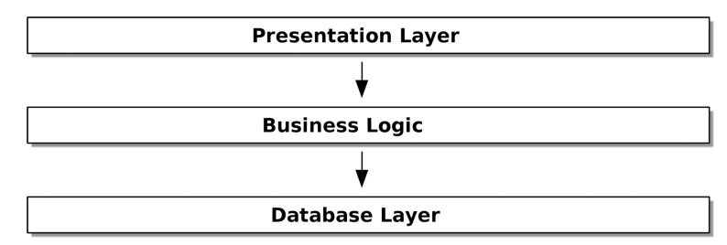
Stepping Back in Time
First thing is the Domain Model and where it “fits”
Consider this:

Slide 6
Designing the Domain Entities
We will ensure that our domain entity models (python classes) adhere to the SOLID principles:
https://www.digitalocean.com/community/conceptual_articles/s-o-l-i-d-the-first-five-principles-of-object-oriented-design
How do we “derive” these?
And extend from assignment 3?
Let’s explore basic principles (elaborated in detail in the APP book)

Slide 7
Terminology
A model is a map of a process or phenomenon that captures a useful property.
The domain model is the mental map that business owners have of their businesses.
The natural language (and jargon) of the business is embedded in the model
The terminology used by business stakeholders represents a distilled understanding of the domain model, where complex ideas and processes are boiled down to a single word or phrase.

Slide 8
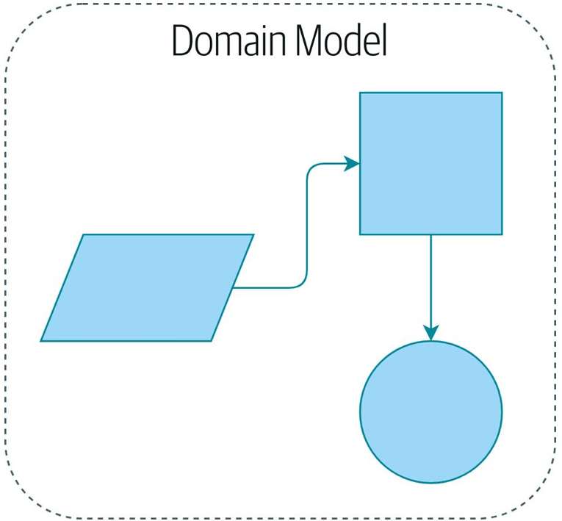
A model domain model
Entity
Service
Value Object

Slide 9
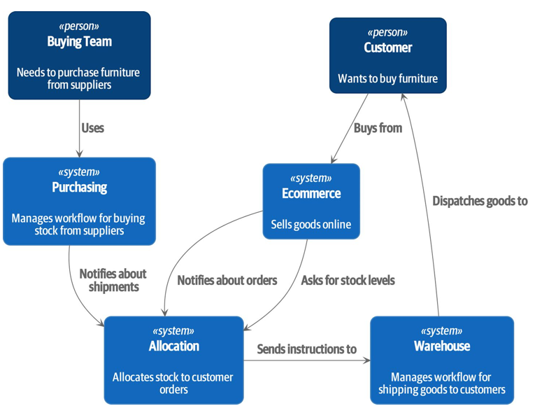
A sub system

Slide 10
Step 2
Data Persistence and the Repository Pattern

Slide 11
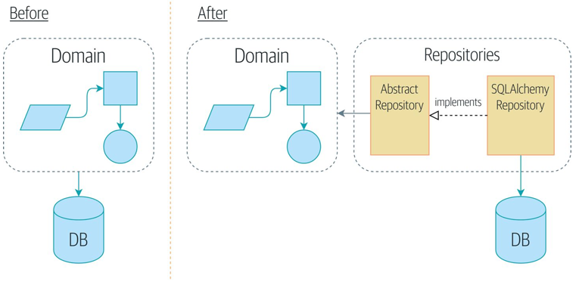
Repository Pattern

Slide 12
Persisting the Domain Model
Whilst the domain model, and its tests, stand alone
This is not practical without the details of implementation: databases, web frameworks, APIs, etc.
Data Persistence almost always means: Write to a database
The flask tutorial shows this in a simple manner
The Barky refactor shows this in an extensive manner (we are headed in this direction)

Slide 13
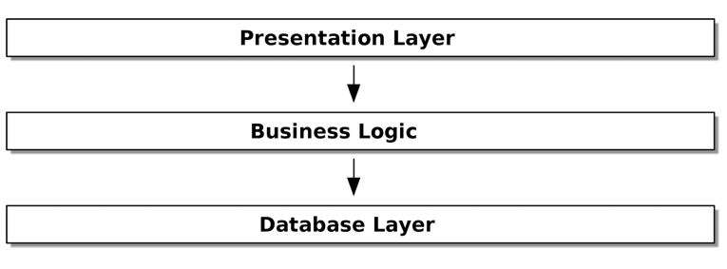
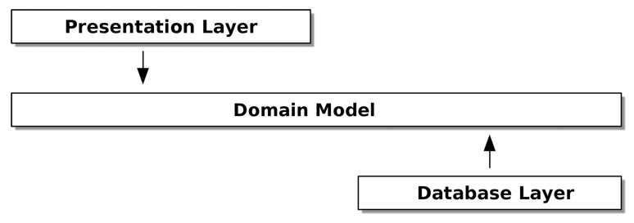
Dependency Inversion Principle

Slide 14
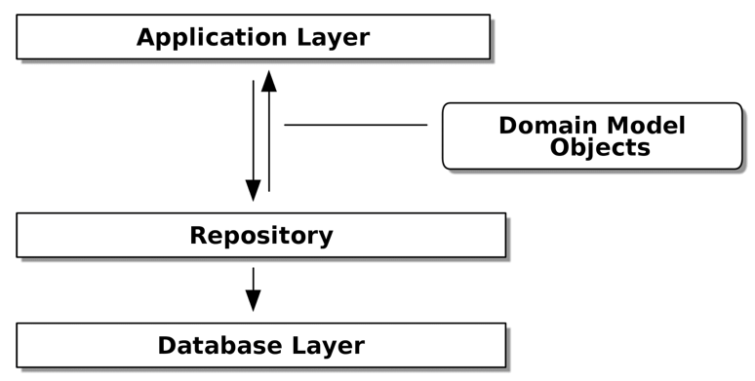
Repository Pattern Steps In

Slide 15
Testing
You can now easily interchange between the “real” repository and a “fake” repository for the purposes of testing.

Slide 16
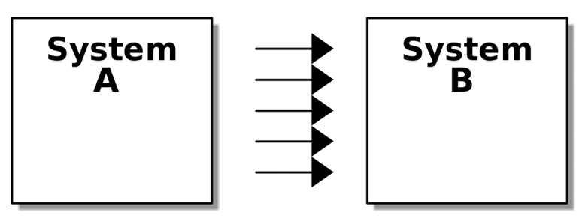
Repository Pattern is an Exemplar Abstraction
Our System
SQLAlchemy

Slide 17
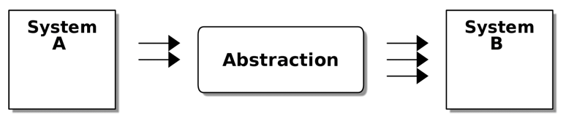
Repository Pattern is an Exemplar Abstraction
Our System
Repository
SQLAlchemy

Slide 18
Step 3
Service Layer via Flask API

Slide 19
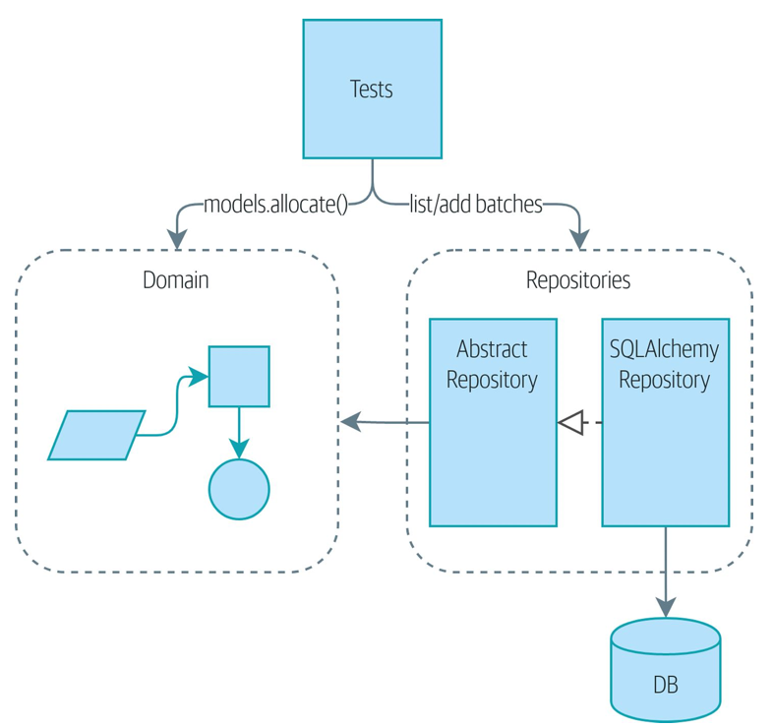
We have demonstrated testability

Slide 20
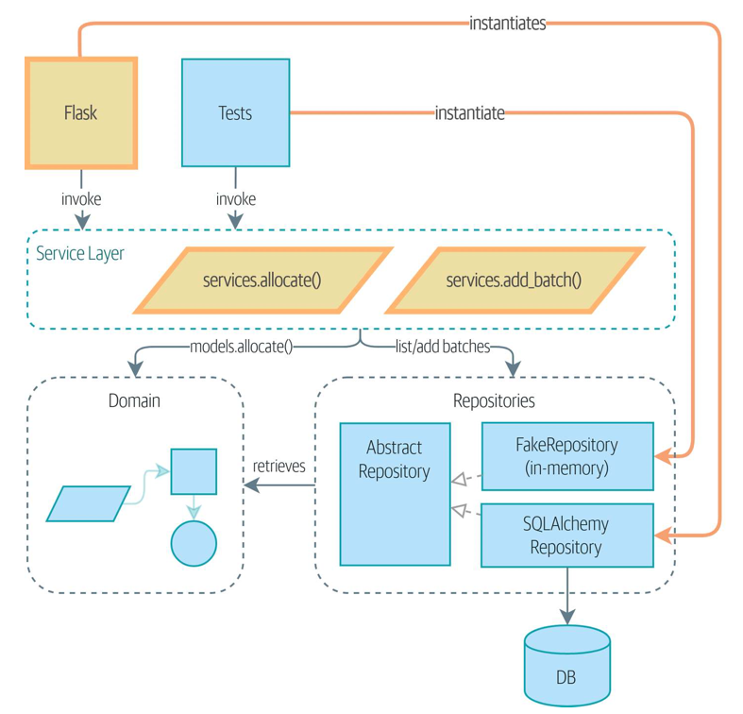
The utility of a service layer
We will “broker” access to “inner layers” via services

Slide 21
The approach
“Asks” that the system/sub-system are triggered by an “outward-facing” API
Implemented via Flask
Forward requests to the Repository
Test via the API to the Fake Repository
Build “end-to-end” tests:
They start at the “top” and ensure that an answer that traverses the system, through its layers, comes back with the expected answer
These are also called integration tests or functional tests

Slide 22
Services?
Service Layer: Services meant to answer requests from the outside world and conduct the orchestration necessary to develop and deliver the expected reply/answer. Typically:
Get data from the database
Update the domain model
Persist any change
Inform any presentation aspects
Domain Service: logic that belongs in the domain model but doesn’t sit naturally inside a stateful entity or value object.
Consider the need to locale-specific sales tax on an e-commerce order as an example.

Slide 23
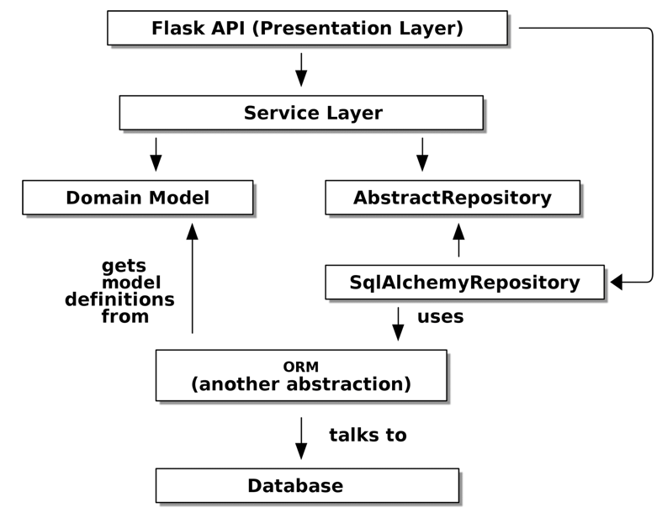
Full circle to “assignment 5”

Slide 24
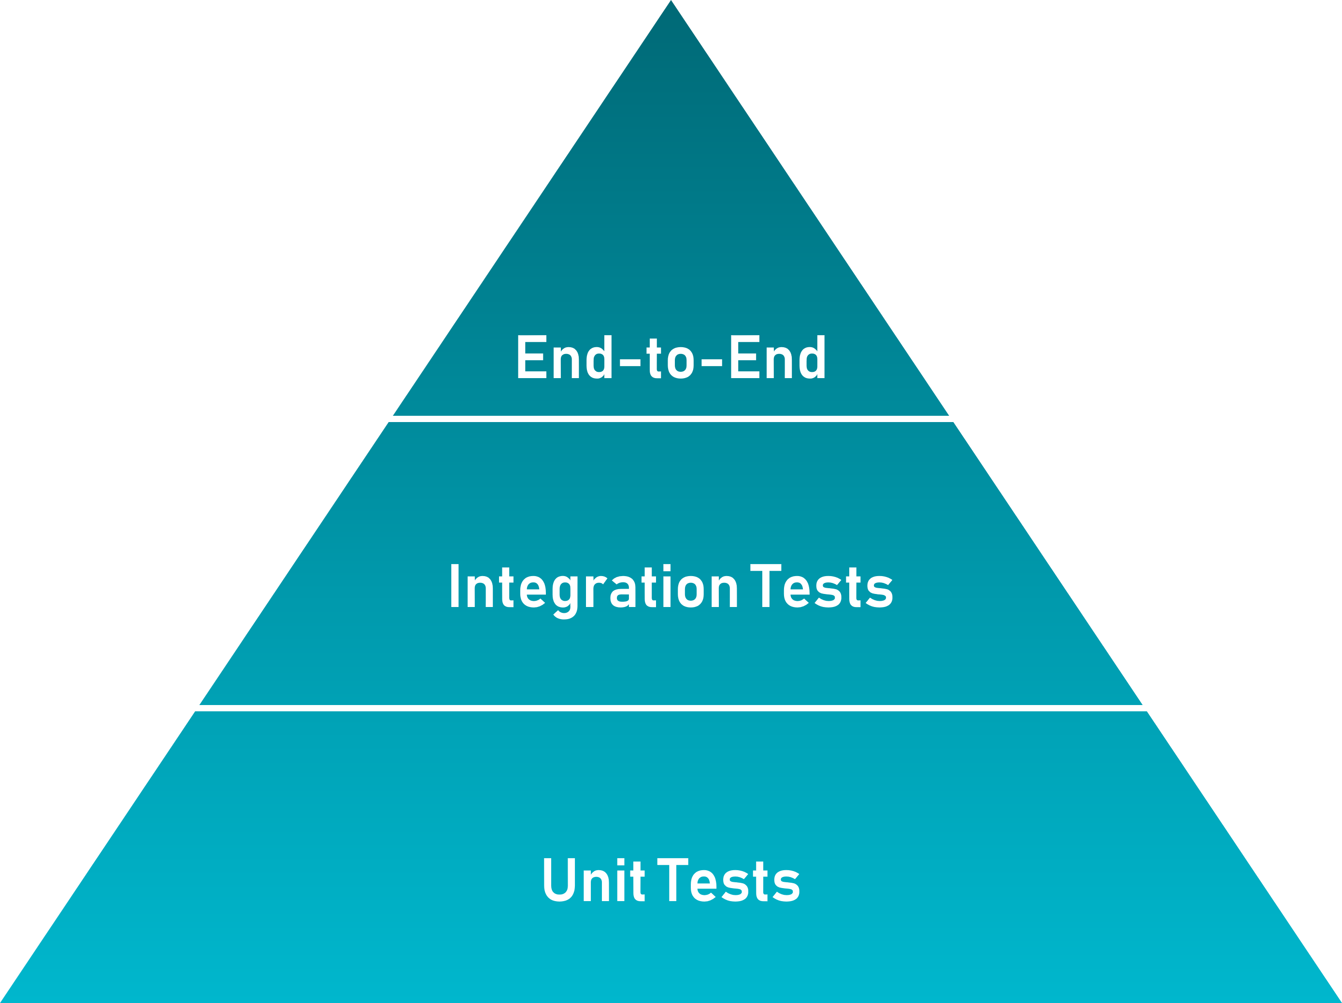
Testing Pyramid

