Slide 1

eGorilla P2P Application
Subject: Software Engineering
Academic Year: 2008/2009
Group: B
Complutense University of Madrid

Slide 2
Summary Of Contents
A global vision about the following documents:
  Software Configuration Management.
  Software Risk Management.
  Software Requirements Specification.
  General Use Case.

Slide 3
Software Configuration Management
Purpose:
  To control each time the system state that is developing
  To define the software configuration elements
  What SCM activities are to be done, how they are to be done, who is responsible for doing specific activities, when they are to happen, and what resources are required...

Slide 4
Software Configuration Management
Software Configuration Elements:
  Software Requirements Specification Document
  Software Risk Management Document
  Use Case Document
  Software Configuration Elements Table
  Use Case Document
  Planification Document
  Server and Client packages
A successful Plan reflects its project environment

Slide 5
Software Configuration Management
Limitations:
  Time : academic year, 9 months approximately
  Software/hardware available at university laboratories
  People involved and time project
SCM activities
  Identifying baselines: each partial delivery will produce a new baseline, which will be composed by the "ECS" especified by the teacher

Slide 6
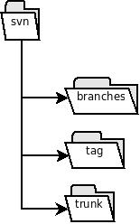
Software Configuration Management
  Configuration control: Subversion

Slide 7
Software Requirements Specification - Introduction
Document generated according to the IEEE Std. 830-1998

Slide 8
Software Requirements Specification - Introduction
Purpose:
  To develop a software application based on a P2P network with an adapted protocol according to the requirements of the application.

Slide 9
Software Requirements Specification - Introduction
Scope of the system:
  Multi-platform.
  Each node is conected to only one server at a time.
  Identification File System indepedent of the file names.
  Unique Node Identification.
  Sharing uncomplete files is allowed.
  Downloading from different nodes simultaneously with an Error Recovery System.
  Efficient use of the user’s network resources.

Slide 10
Software Requirements Specification - Introduction
Definitions, Acronims & Abbreviations:
  P2P
  SVN
  Nodo
  Fake
  IP, TCP, UDP
  Máquina Virtual de Java (JVM)‏
  eDonkey 2000 y Kad

Slide 11
Software Requirements Specification - Introduction
References:
  “The eMule Protocol Specification”:
  http://www.sourceforge.net
  Página oficial del emule:
  http://www.emule-project.net
  IEEE Std. 830-1998

Slide 12
Software Requirements Specification - Introduction
General View of the Document:
  It contains specifications of basic funcionalities and requirements of The eGorilla Application.
  It doesn’t contains any kind of information about implementation or algorithmics used or similar.

Slide 13
Software Requirements Specification - General Description
Product Perspective:
  To develop a fast & reliable system, allowing users to share files with as many clients as possible.

Slide 14
Software Requirements Specification - General Description
Product Functions:
  Application Connection System.
  File Sharing System between P2P network clients.
  File Downloading System between P2P network clients.
  File Searching in the P2P network.
  Updated Client Table of the current list of clients connected to the system.
  Preferential Attention of the user querys.
  Multimedia File Previewing.
  Help System about the system working.

Slide 15
Software Requirements Specification - General Description
User Features:
  Dedicated to users that lack expert knowledge about the Internet or similar applications.
  Minimum knowledge level necessary about the use of Operating Systems.

Slide 16
Software Requirements Specification - General Description - Restrictions
Politics & licenses:
  Use of General Public License (GPL).
    Free Software.

Slide 17
Software Requirements Specification - General Description - Restrictions
HW Restrictions:
  Natural troubles with network connections.
  Limited use of resources relating to the Computer-Science Faculty labs.

Slide 18
Software Requirements Specification - General Description - Restrictions
SW Restrictions:
  The users must have previously installed:
    Multimedia Applications to prewiew the current downloads.
    Current version of the Java Virtual Machine.

Slide 19
Software Requirements Specification - General Description - Restrictions
Simultaneous Activities:
  Other Projects.
  Work.

Slide 20
Software Requirements Specification - General Description - Restrictions
Audit:
  The teacher will evaluate the results according to the value derived from the system developed.

Slide 21
Software Requirements Specification - General Description - Restrictions
Control Functions:
  Repository:
http://code.google.com/p/egorilla/trunk
  Google Group:
http://groups.google.es/group/egorilla
  Others
    Weekly Meetings.

Slide 22
Software Requirements Specification - General Description - Restrictions
Programming Languages:
  Use of Java programming language.

Slide 23
Software Requirements Specification - General Description - Restrictions
Communication Protocols:
  TCP/IP.
  UDP.
  Communication Protocol of The eGorilla Application.

Slide 24
Software Requirements Specification - General Description - Restrictions
Hability Requirements:
  The developers should have knowledge about:
    Programming Languages.
      Object-Oriented Languages.
    Server-Client Architecture.
    CASE tools.

Slide 25
Software Requirements Specification - General Description - Restrictions
Critical to the Application:
  Maximum.
    The goal is to develop a sofware that is:
      Reliable.
      Sustainable.
      Portable.
      Safe.

Slide 26
Software Requirements Specification - General Description - Restrictions
Security Considerations:
  Avoid outside access of the system resources.

Slide 27
Software Requirements Specification -General Description - Supositions & Dependencies
Possible integration with other programming languages such as C, C++ or C#.

Slide 28
Software Requirements Specification -General Description – Future Requirements
Efficient Control of the user resources concerning user network.

Slide 29
Software Requirements Specification - Specific Requirements – External Interfaces
User Interface (RE_IE_IUsuario):
  Simple & Attractive Interface.
  Drag & Drop.
  Different areas to separate all the funcionalities of the application.

Slide 30
Software Requirements Specification - Specific Requirements – External Interfaces
User Interface:
  R1_U – ConnectServer
  R2_U – QueryDownloads
  R3 _U – QuerySharedFiles
  R5 _U – InitiateDownload
  R6_U – DisconnectServer
  R7_U – QueryStatistics
  R9_U – CancelDownload
  R10_U – PauseDownload
  R11_U – ResumeDescarga
  R12_U – PreviewDownload
  R13_U – ConfigureClient

Slide 31
Software Requirements Specification - Specific Requirements – External Interfaces
Server Administration Interface (RE_IE_IServidor):
  Use a Settings File to configure the interface

Slide 32
Software Requirements Specification - Specific Requirements – External Interfaces
Server Administration Interface (RE_IE_IServidor):
  R1_S – QueryAcceptClient
  R2_S – UpdateFileTable
  R3_S – QueryFileSearch
  R4_S – GetFileFonts
  R5_S – QueryDisconnectClient
  R6_S – InitiateServer
  R7_S – ConfigureServer
  R8_S – Turn-OffServer
  R9_S – QueryFileDownload

Slide 33
Software Requirements Specification - Specific Requirements – External Interfaces
Server-Client Communication Interface (RE_IE_IClienteServidor):
  Client applications connect to the server using The eGorilla Application Network Protocol.
  Querys made by Clients will be resolved efficiently by the Server.

Slide 34
Software Requirements Specification - Specific Requirements – External Interfaces
Server-Client Communication Interface (RE_IE_IClienteServidor):
  R4 _U – FileSearch

Slide 35
Software Requirements Specification - Specific Requirements – External Interfaces
Client–Client Communication Interface (RE_IE_IClienteCliente):
  A Client will connect to another Client in order to transfer desired file fragments.
  Bidirectional Connection during File Transfers.

Slide 36
Software Requirements Specification - Specific Requirements – External Interfaces
Client–Client Communication Interface (RE_IE_IClienteCliente):
  R14_U – MensajeAUsuario

Slide 37
Software Requirements Specification - Specific Requirements – Functions
Client Functions:
  Connection to the P2P Network.
  Concurrent viewing of all the downloading files.
  Concurrent viewing of all the shared files.
  View Statistics of the activity of the client.
  View a list of all avaible servers.
  Search Files.

Slide 38
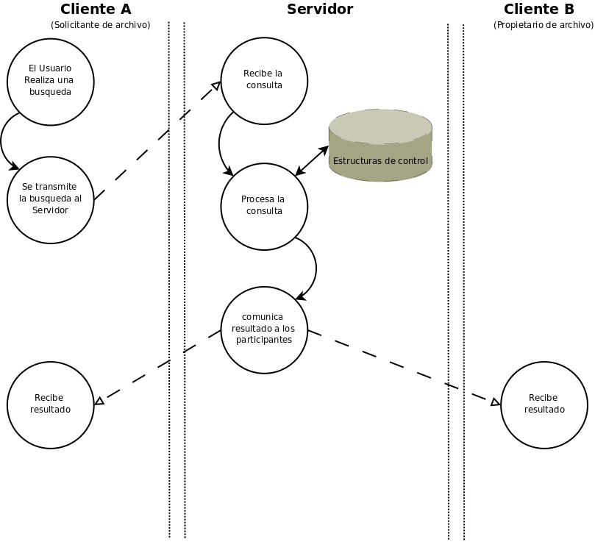
Software Requirements Specification - Specific Requirements – Functions

Slide 39
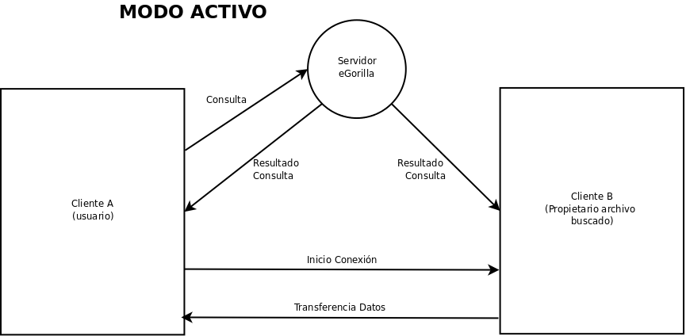
Software Requirements Specification - Specific Requirements – Functions

Slide 40
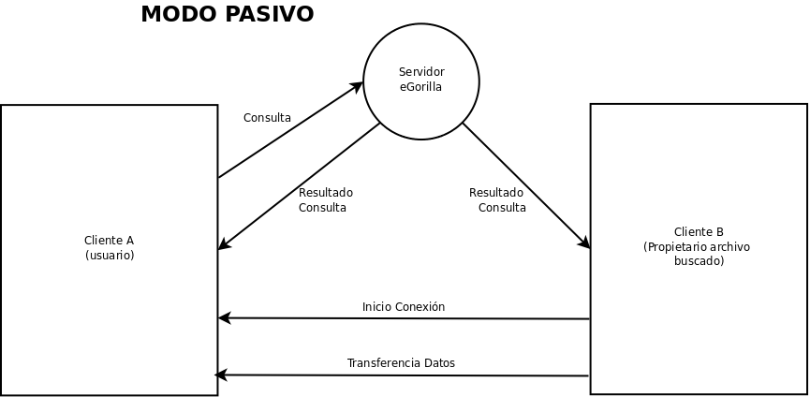
Software Requirements Specification - Specific Requirements – Functions

Slide 41
Software Requirements Specification - Specific Requirements – Functions
Server Functions:
  Knowledge of all the clients & shared files of the system.
  Registration of each client who logs into the system.
  Resolve all the querys made by the users.
  Update periodically all of the information previously mentioned.
  Configure the settings of the applications.

Slide 42
Software Requirements Specification - Specific Requirements – Performance Requeriments
Maximize the network resources for the users.

Slide 43
Software Requirements Specification - Specific Requirements – Design Requirements
Use of The Object-Oriented Paradigm.

Slide 44
Software Requirements Specification - Specific Requirements – System Attributes
The System has to be:
  Reliable.
  Sustainable.
  Portable.
  Safe.

Slide 45
Software Requirements Specification - Appendix
It will be completed according to the development of the application.

Slide 46
General Use Case
In order to make the design of the document a little bit easier, the group has decided to separate the current document from the two following points of view:
  Server.
  Client.

Slide 47
General Use Case
Use of Case View captures the funcionality of a system according to the way that system is displayed to external users.
Distributes the system funcionality into meaningful transactions for the ideal users of a system.

Slide 48
General Use Case
Important:
  This is a Peer-To-Peer Application based on the concept of every node in the network acting as a server and client simultaneously for the rest of the nodes in the network.
  It isn’t an Application based on Server-Client Architecture!

Slide 49
General Use Case - Server
Actor Identification:
  Administrator: Person who cares about the correct configuration and operation of the server.
  Client: Is the eGorilla Applicacion controlled by a user.

Slide 50
General Use Case - Server
Use Case Identification:
  QueryAcceptClient
  UpdateFileTable
  QuerySearchFile
  GetFileFonts
  QueryDisconnectServer
  InitiateServer
  ConfigureServer
  Turn-OffServer
  QueryDownloadFile
  GetWantedFilesList

Slide 51
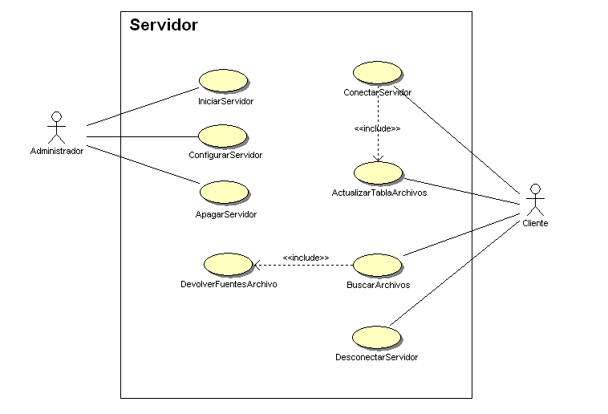
General Use Case - Server

Slide 52
General Use Case - Client
Actor Identification:
  User: Person who controls the eGorilla Application.
  Client: Is the eGorilla Application controlled by a user.
  Server: Application designated for the control of all the files and information used by the eGorillaApplication.

Slide 53
General Use Case - Client
Use Case Identification:
  ConnectServer
  QueryDownloadedFiles
  QuerySharedFiles
  SearchFile
  InitiateDownload
  DisconnectServer
  QueryStatistics
  CancelDownload
  PauseDownload
  ResumeDownload
  PreviewDownload
  ConfigureClient
  SendTextMessage

Slide 54
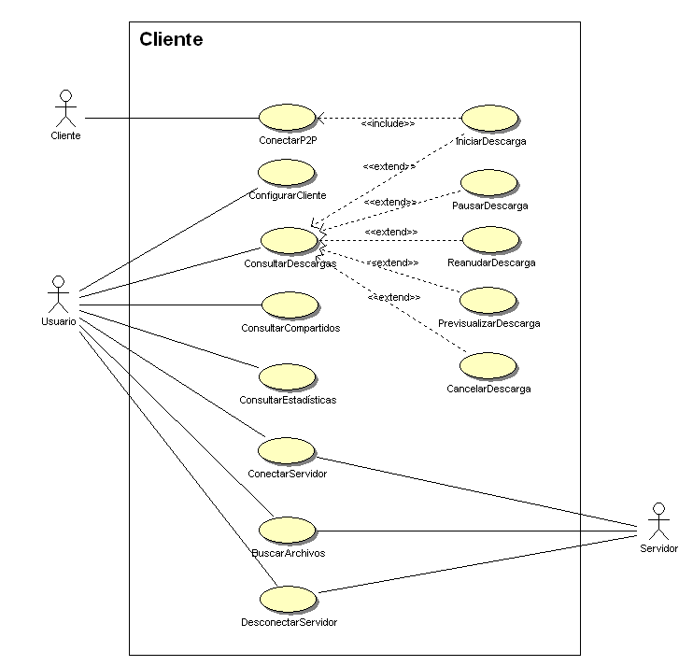
General Use Case - Client

Slide 55
Bibliography
The following documents are available in the eGorilla Application Repository:
  https://egorilla.googlecode.com/svn/trunk/doc

Slide 56
Bibliography
  Casos de uso.doc
  Especificacion_De_Requisitos.doc
  Gestion de riesgos.doc
  Plan_de_Gestion_de_Configuracion.doc

Slide 57
Demonstration
Demonstration of the current prototype.

