Slide 1

The eGorilla P2P Application
Subject: Software Engineering
Academic Year: 2008/2009
Group: B
Complutense University of Madrid

Slide 2
Summary Of Contents
A global vision about the following documents:
  Software Requirements Specification.
  General Use Case.
  Software Risk Management.
  Software Configuration Management.

Slide 3
Software Requirements Specification

Slide 4
Software Requirements Specification - Introduction
Document generated according to the IEEE Std. 830-1998

Slide 5
Software Requirements Specification - Introduction
Purpose:
  To develop a software application based on a P2P network with an adapted protocol according to the requirements of the application.

Slide 6
Software Requirements Specification - Introduction
Scope of the system:
  Multi-platform.
  Each node is conected to only one server at a time.
  Identification File System indepedent of the file names.
  Unique Node Identification.
  Sharing uncomplete files is allowed.
  Downloading from different nodes simultaneously with an Error Recovery System.
  Efficient use of the user’s network resources.

Slide 7
Software Requirements Specification - Introduction
Definitions, Acronims & Abbreviations:
  P2P
  SVN
  Nodo
  Fake
  IP, TCP, UDP
  Máquina Virtual de Java (JVM)‏
  eDonkey 2000 y Kad

Slide 8
Software Requirements Specification - Introduction
References:
  “The eMule Protocol Specification”:
  http://www.sourceforge.net
  Página oficial del emule:
  http://www.emule-project.net
  IEEE Std. 830-1998

Slide 9
Software Requirements Specification - General Description
Product Perspective:
  To develop a fast & reliable system, allowing users to share files with as many clients as possible.

Slide 10
Software Requirements Specification - General Description
Product Functions:
  Application Connection System.
  File Sharing System between P2P network clients.
  File Downloading System between P2P network clients.
  File Searching in the P2P network.
  Updated Client Table of the current list of clients connected to the system.
  Preferential Attention of the user querys.
  Multimedia File Previewing.
  Help System about the system working.

Slide 11
Software Requirements Specification - General Description
User Features:
  Dedicated to users that lack expert knowledge about the Internet or similar applications.
  Minimum knowledge level necessary about the use of Operating Systems.

Slide 12
Software Requirements Specification - General Description - Restrictions
Politics & licenses:
  Use of General Public License (GPL).
    Free Software.

Slide 13
Software Requirements Specification - General Description - Restrictions
HW Restrictions:
  Natural troubles with network connections.
  Limited use of resources relating to the Computer-Science Faculty labs.

Slide 14
Software Requirements Specification - General Description - Restrictions
SW Restrictions:
  The users must have previously installed:
    Multimedia Applications to prewiew the current downloads.
    Current version of the Java Virtual Machine.

Slide 15
Software Requirements Specification - General Description - Restrictions
Control Functions:
  Repository:
http://code.google.com/p/egorilla/trunk
  Google Group:
http://groups.google.es/group/egorilla
  Others
    Weekly Meetings.

Slide 16
Software Requirements Specification - General Description - Restrictions
Programming Languages:
  Use of Java programming language.

Slide 17
Software Requirements Specification - General Description - Restrictions
Communication Protocols:
  TCP/IP.
  UDP.
  Communication Protocol of The eGorilla Application.

Slide 18
Software Requirements Specification - General Description - Restrictions
Hability Requirements:
  The developers should have knowledge about:
    Programming Languages.
      Object-Oriented Languages.
    Server-Client Architecture.
    CASE tools.

Slide 19
Software Requirements Specification - General Description - Restrictions
Critical to the Application:
  Maximum.
    The goal is to develop a sofware that is:
      Reliable.
      Sustainable.
      Portable.
      Safe.

Slide 20
Software Requirements Specification - General Description - Restrictions
Security Considerations:
  Avoid outside access of the system resources.

Slide 21
Software Requirements Specification - Specific Requirements – External Interfaces
User Interface (RE_IE_IUsuario):
  Simple & Attractive Interface.
  Drag & Drop.
  Different areas to separate all the funcionalities of the application.

Slide 22
Software Requirements Specification - Specific Requirements – External Interfaces
User Interface:
  R1_U – ConnectServer
  R2_U – QueryDownloads
  R3 _U – QuerySharedFiles
  R5 _U – InitiateDownload
  R6_U – DisconnectServer
  R7_U – QueryStatistics
  R9_U – CancelDownload
  R10_U – PauseDownload
  R11_U – ResumeDescarga
  R12_U – PreviewDownload
  R13_U – ConfigureClient

Slide 23
Software Requirements Specification - Specific Requirements – External Interfaces
Server Administration Interface (RE_IE_IServidor):
  Use a Settings File to configure the interface.

Slide 24
Software Requirements Specification - Specific Requirements – External Interfaces
Server Administration Interface (RE_IE_IServidor):
  R1_S – QueryAcceptClient
  R2_S – UpdateFileTable
  R3_S – QueryFileSearch
  R4_S – GetFileFonts
  R5_S – QueryDisconnectClient
  R6_S – InitiateServer
  R7_S – ConfigureServer
  R8_S – Turn-OffServer
  R9_S – QueryFileDownload

Slide 25
Software Requirements Specification - Specific Requirements – External Interfaces
Server-Client Communication Interface (RE_IE_IClienteServidor):
  Client applications connect to the server using The eGorilla Application Network Protocol.
  Querys made by Clients will be resolved efficiently by the Server.

Slide 26
Software Requirements Specification - Specific Requirements – External Interfaces
Server-Client Communication Interface (RE_IE_IClienteServidor):
  R4 _U – FileSearch

Slide 27
Software Requirements Specification - Specific Requirements – External Interfaces
Client–Client Communication Interface (RE_IE_IClienteCliente):
  A Client will connect to another Client in order to transfer desired file fragments.
  Bidirectional Connection during File Transfers.

Slide 28
Software Requirements Specification - Specific Requirements – External Interfaces
Client–Client Communication Interface (RE_IE_IClienteCliente):
  R14_U – MensajeAUsuario

Slide 29
Software Requirements Specification - Specific Requirements – Functions
Client Functions:
  Connection to the P2P Network.
  Concurrent viewing of all the downloading files.
  Concurrent viewing of all the shared files.
  View Statistics of the activity of the client.
  View a list of all available servers.
  Search Files.

Slide 30
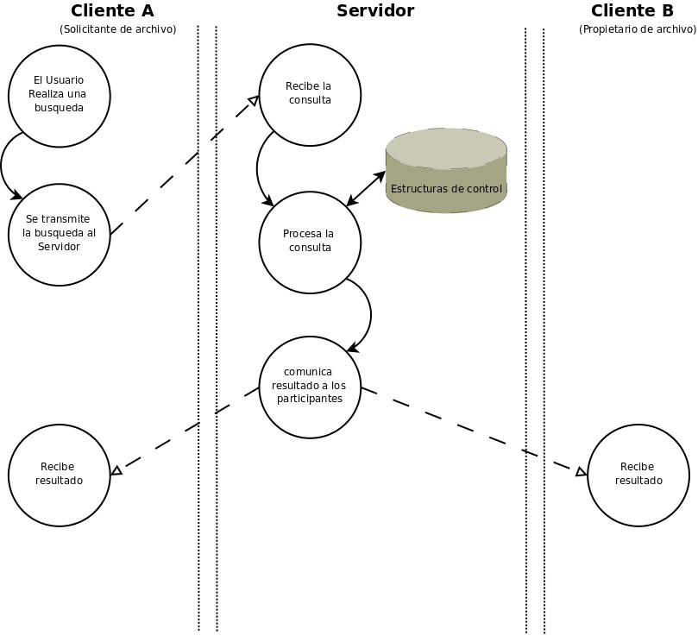
Software Requirements Specification - Specific Requirements – Functions

Slide 31
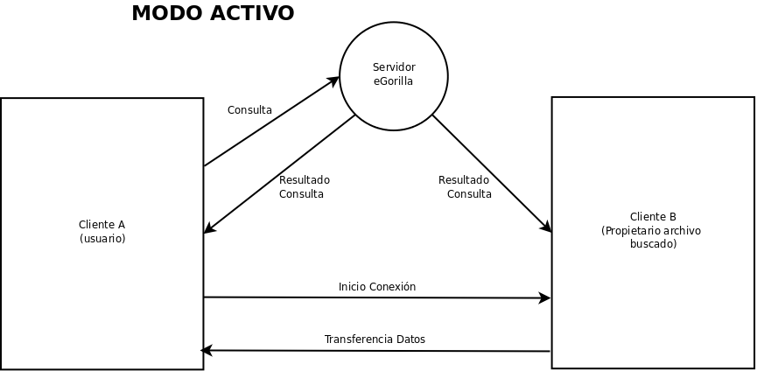
Software Requirements Specification - Specific Requirements – Functions

Slide 32
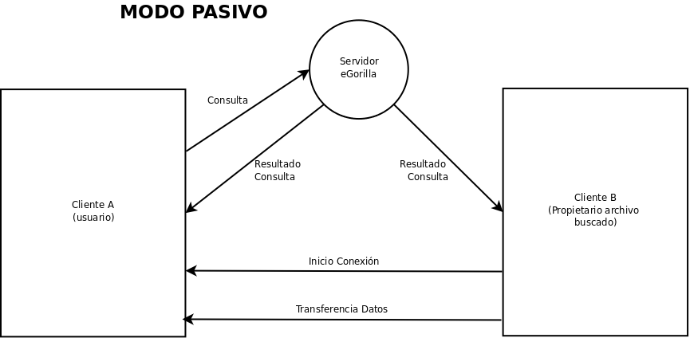
Software Requirements Specification - Specific Requirements – Functions

Slide 33
Software Requirements Specification - Specific Requirements – Functions
Server Functions:
  Knowledge of all the clients & shared files of the system.
  Registration of each client who logs into the system.
  Resolve all the querys made by the users.
  Update periodically all of the information previously mentioned.
  Configure the settings of the applications.

Slide 34
Software Requirements Specification - Specific Requirements – Performance Requeriments
Maximize the network resources for the users.

Slide 35
Software Requirements Specification - Specific Requirements – Design Requirements
Use of The Object-Oriented Paradigm.

Slide 36
Software Requirements Specification - Specific Requirements – System Attributes
The System has to be:
  Reliable.
  Sustainable.
  Portable.
  Safe.

Slide 37
Software Requirements Specification - Appendix
It will be completed according to the development of the application.

Slide 38
General Use Case

Slide 39
General Use Case
In order to make the design of the document a little bit easier, the group has decided to separate the current document from the two following points of view:
  Server.
  Client.

Slide 40
General Use Case
Use of Case View captures the funcionality of a system according to the way that system is displayed to external users.

Slide 41
General Use Case
Important:
  This is a Peer-To-Peer Application based on the concept of every node in the network acting as a server and client simultaneously for the rest of the nodes in the network.
  It isn’t an Application based on Server-Client Architecture!

Slide 42
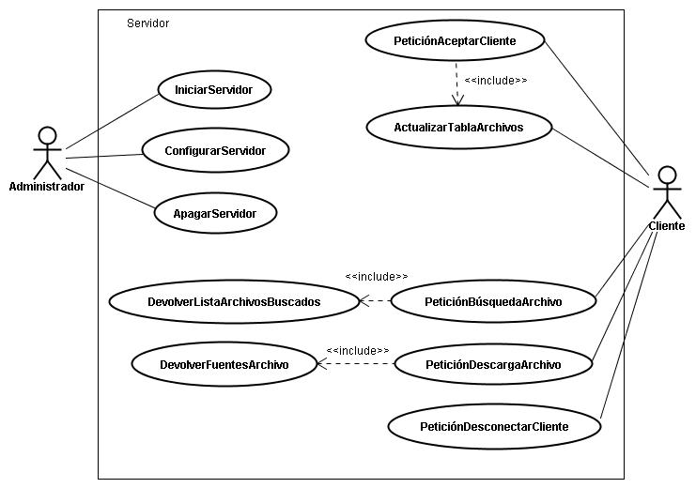
General Use Case - Server

Slide 43
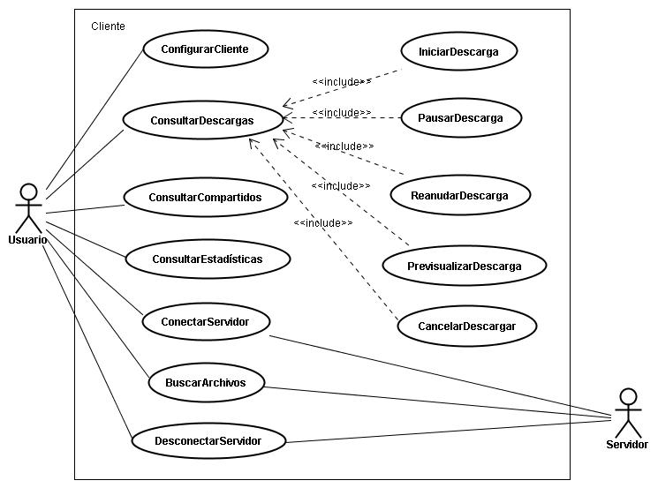
General Use Case - Client

Slide 44
Software
Risk
Management

Slide 45
Software Risk Management – Introduction
Purpose:
  To identificate the main risks of the application that will help us to know about the future project menaces and, in consequence, help us to resolve them.

Slide 46
Software Risk Management
Projects Risks:
  Possible changes in the number of Group members.
  Restrictions about the use of the Faculty labs resources.
  Wrong planning concerning the project duration.
  Important changes in the Original Requirements Specification.

Slide 47
Software Risk Management
Product Risks:
  Difficulties about the Protocol Integration.
  Problems with many elements relationed with the source code such as libraries, external functions…

Slide 48
Software Risk Management
Business Risks:
  Nobody wants the application.
  Legal problems concerning the Shared File Systems currently available.

Slide 49
Software
Configuration
Management

Slide 50
Software Configuration Management
Purpose:
  To control each time the system state is developed.
  To define the software configuration elements.
  Which and How SCM activities have to be done.
  Who is the responsable to do specific activities.
  When they have to happen.
  What resources are required.
  Etc.

Slide 51
Software Configuration Management
Software Configuration Elements (SCE):
  Software Requirements Specification Document
  Software Risk Management Document
  Use Case Document
  Software Configuration Elements Table
  Use Case Document
  Planification Document
  Server and Client packages

Slide 52
Software Configuration Management
Limitations:
  Time : Academic year, 9 months approximately.
  SW/HW available at Faculty labs.
  People involved and time project.

Slide 53
Software Configuration Management
SCM activities:
  Identifying baselines: Each partial delivery will produce a new baseline.
  Which one will be composed by the “SCE" especified by the teacher of the subject.

Slide 54
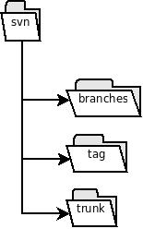
Software Configuration Management
  Configuration control: Subversion

Slide 55
Bibliography
The following documents are available in the eGorilla Application Repository:
  https://egorilla.googlecode.com/svn/trunk/doc

Slide 56
Bibliography
  Casos de uso.doc
  Especificacion_De_Requisitos.doc
  Gestion de riesgos.doc
  Plan_de_Gestion_de_Configuracion.doc

Slide 57
Demonstration
Demonstration of the current prototype.

