Slide 1
Windows memory Manipulation
Defense Against The Dark Arts
Aditya Kapoor
Intel Security

Slide 2

About me
Research Architect @McAfee Labs.
Have been with McAfee for last 10 years. Yes I have reversed on win 98 too →
Started into reversing as it was needed to finish my masters project and thesis. Also I needed funding and my professor needed someone to reverse a metamorphic virus. Spent months reading Intel instruction manual.
One of the early few researchers who analyzed Sony rootkit in 2006.
Now a days develop next-gen security products.

Slide 3
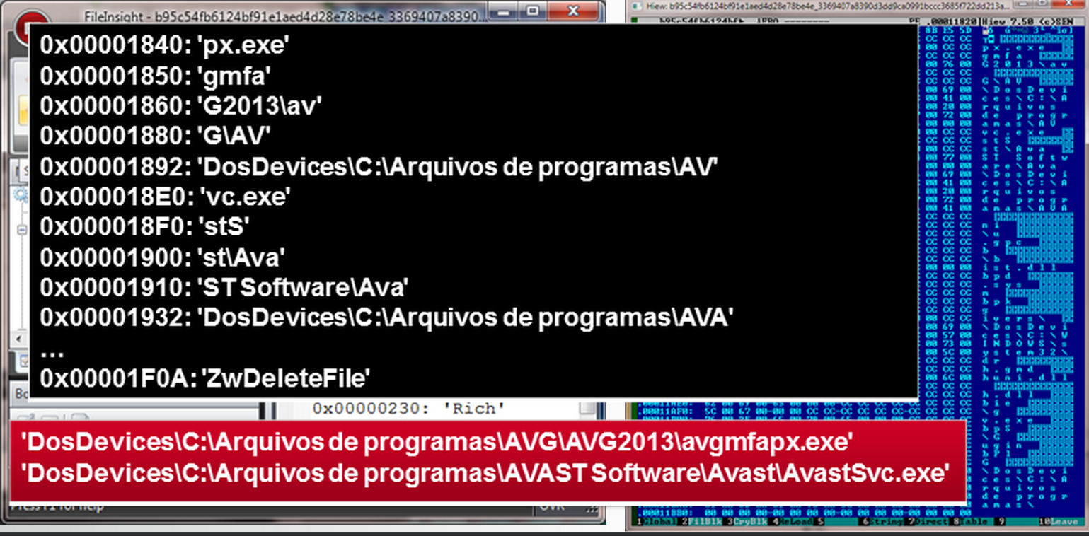

RECAP (weeks 1 – 4)
So far you have (I hope)
Learnt basics of malware analysis
Explored executable (PE) files and their properties
Stared at hex code and data
Learned about how to hunt for malicious traces using forensic tools.
Peered into memory basics.
Learnt various stages of attack
Reviewed how malware like to persist on the machine they once take over.
And how to defend against them.
Learnt and explored exploit world and how we get infected in the first place.
Today we will learn about art of stealth, persistence by malicious code. Along the way we will learn some essential windows internals.

Slide 4
This weeks goal
Day 1: Understand concepts of stealth by means of memory manipulation Day 2: Debug and Explore various stealth techniques

Slide 5
Overview: DAY 1
What are rootkits? How are rootkits created?
We will brush up following OS and system fundamentals first
User mode memory basics
Kernel Memory basics
Hooking basics

Slide 6
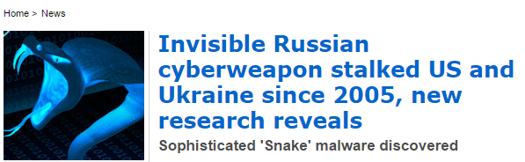
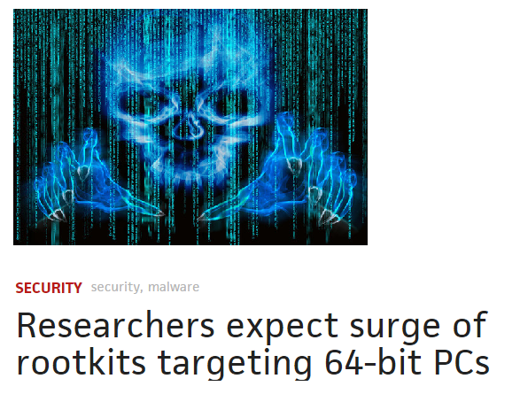
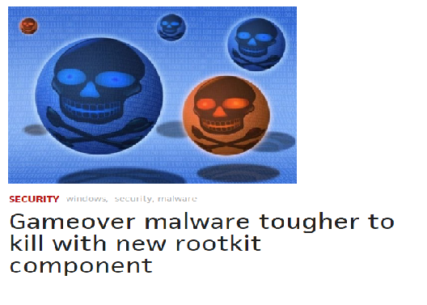
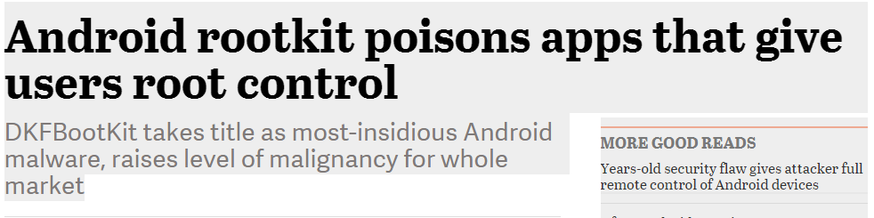
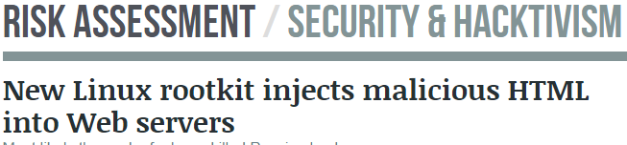
Relevant topic? OfCourse – see press articles

Slide 7
Rootkits/Stealth
Rootkit Definition
Malware that actively conceals its existence and actions from users and system processes.
Approximately 10% of current malware use rootkit
Rootkits are most prevalent in 32 bit Windows
Handful of families so far for 64 bit
Rootkits are one of the best way to learn
about kernel security challenges.

Slide 8
Rootkits/Stealth
Challenges once malicious code enters kernel
Harder for rootkits to enter 64 bit kernel
Rootkits can infiltrate 64 bit OS Kernel by
Bypassing driver signing check (e.g. using testsigning mode)
Modifying the windows boot path (MBR etc) – Secure boot prevents this.
Kernel exploits in Windows kernel or third party drivers.
Stealing valid digisigs (Similar to Stuxnet)

Slide 9
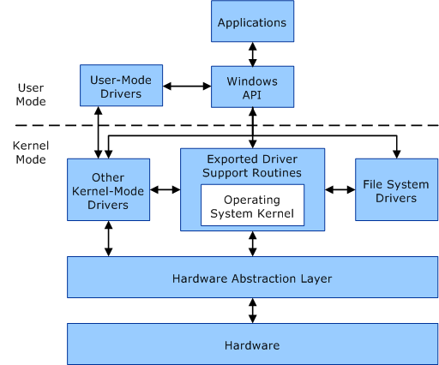
kernel vs user
EXE/DLL files
.sys files
Most rootkits are here

Slide 10
Kernel memory
Is a flat memory model with no security separation.
Any kernel driver can access any part of memory.
Composed of windows kernel (ntoskrnl.exe) as well as driver code.
Many important structures that are prime targets for stealth.
SSDT, IRP, IDT etc.
Windbg commands: .process command, lm, !devobj, !drvobj, !devstack, !irp etc. Virtual to physical memory etc.

Slide 11
Lab 1
Say Hello to Agony!

Slide 12
Rootkit agony analysis (approx. 30 min)
Quick and high level analysis.
Extract and copy file from C:\Users\Admin\Desktop\malware\WindowsInternals\Agony.zip
Determine the file and registry changes using the skills developed so far (e.g cuckoo), use regshot, procmon or any other tools that you please.
Some commands to try on LiveKD tool (C:\Users\Admin\Desktop\Tools\WindowsInternals\livekd.exe)
dps nt!KiServiceTable L 191
U NtQueryDirectoryFile
U NtEnumerateValueKey

Slide 13
Cuckoo instructions
Bring up VM
Copy C:\Users\Admin\Desktop\malware\WindowsInternals\Agony.zip to \desktop\bad (no extension)
Run FakeNet
Run CMD
CD C:\ANALYZER
ANALYZER.PY
See results in C:\CUCKOO
Notes:
File, registry, disk, memory, network, basic static analysis
Create slides, one for each tool; add notes to cover the topics to be covered for each tool.
ProcessHacker (let Aditya cover this in his class)
FileInsights (save for the next class)
ProcessExplorer: Discuss lower pane, usefulness of handles. Process suspension, CreateDump, Executable properties, image cmd-line params, thread suspension, TCP/IP, and Strings. Right-click select columns->add Autostart location
ProcMon: Just make the point about realtime file, reg changes
AntiSpy, Process: right-click-> Show Tree & Lower Pane (similar to processexplorer)
Driver tab, Start type and load order usefulness
Hooks: Go to Tools ‘Forbid creating file’, then flip back to show it’s hooking SSDT:NtCreateFile for protection, right-click restore the function to the original pointer
AutoStart
Network
Now rerun the sample from before (modified malware\Week1\Class1\Lab2\Replication\Sample1\0012b0384774e51acd053c0f6b1dd112) and show the tools in action.
Process Monitor, filter for bad.exe, and run
Show process activity,
cmd /c echo Y|cacls C:\WINDOWS\system32\drivers\etc\hosts /t /g everyone:F
cmd /c attrib -r -a -s -h C:\WINDOWS\system32\drivers\etc\hosts
Process Create: "C:\Program Files\tongji2.exe“
cmd /c ""C:\ntldrs\funbots.bat" “
"C:\Program Files\Internet Explorer\IEXPLORE.EXE" http://timeless888.com/tong.htm
Show network activity
Show registry:
HKCU\Software\Microsoft\Windows\CurrentVersion\Run\skunser = C:\ntldrs\svchest.exe
Show file:
CreateFile:
C:\Users\Admin\AppData\Local\Microsoft\Windows\Temporary Internet Files\Content.IE5\KLTT2YG3\pao[1].exe
C:\Program Files\tongji2.exe
C:\ntldrs\svchest.exe
C:\ntldrs\Isinter.gif
C:\ntldrs\funbots.bat
C:\ntldrs\system.yf
Show TCP activity
Process Explorer:
Show tongji2.exe process, strings
Show iexplore.exe spawns
AntiSpy
Show process Started Time
Autostart, startup, and Scheduled Tasks
Network
FlyPaper
Show process termination blocking:
Cmd.exe with cmd-line params in memory
Conhost
Attrib
Cacls
Allows for c:\ntldrs\funbots.bat to be seen

Slide 14
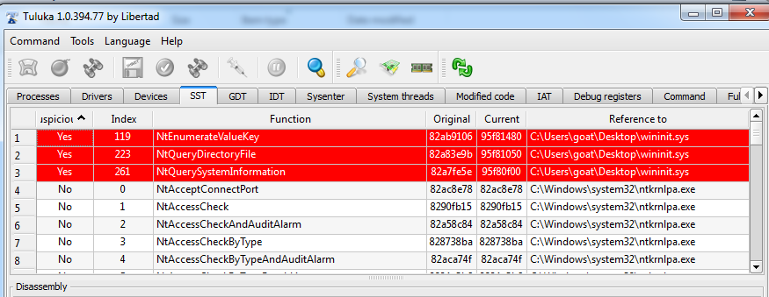
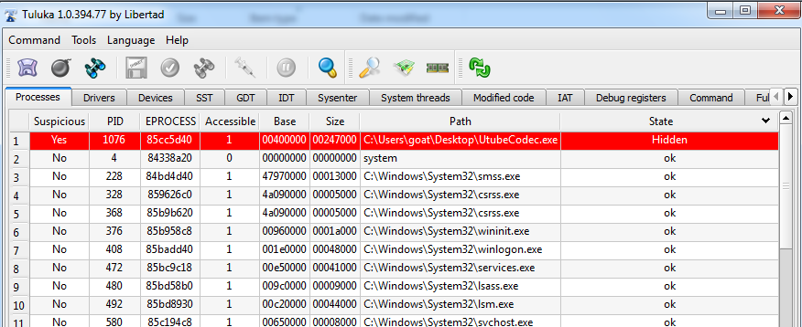
Simple Memory manipulation effect

Slide 15
Thread basics
Thread / application (lets assume word)
HLL | Assembly | Machine code (Hex)
X = 4 Y = 5 Z = X + Y | Mov eax, 4 Mov ebx, 5 Add eax, ebx | B9 04 00 00 00 B8 05 00 00 00 03 c3
CPU
Math processor
RAM
B9 04 00 00 00
B8 05 00 00 00
03c3
B9 04 00 00 00
B8 05 00 00 00
03 c3
BUS
Execution engine etc.
Instruction pipeline
Registers
*Ref: Inspired from https://www.youtube.com/watch?v=hsERPf9k54U

Slide 16
Thread basics
Thread / application (lets assume word)
CPU
HLL | Assembly | Machine code (Hex)
X = 4 Y = 5 Z = X + Y | Mov eax, 4 Mov ebx, 5 Add eax, ebx | B9 04 00 00 00 B8 05 00 00 00 03 c3
B9 04 00 00 00
B8 05 00 00 00
03c3
Math processor
B9 06 00 00 00
B8 07 00 00 00
03c3
RAM
Priority = 9
Execution engine etc.
B9 04 00 00 00
B8 05 00 00 00
03 c3
Thread
Scheduler
(Time Slice)
BUS
Instruction pipeline
Registers
Priority = 4
Priority = 5
Priority = 9
Priority = 3
B9 06 00 00 00
B8 07 00 00 00
03 c3
Thread / application (lets assume excel)
HLL | Assembly | Machine code (Hex)
X = 6 Y = 7 Z = X + Y | Mov eax, 6 Mov ebx, 7 Add eax, ebx | B9 06 00 00 00 B8 07 00 00 00 03 c3
Most Applications today are multithreaded. We don’t really want to wait for function like ‘print’ to finish.
*Ref: Inspired from https://www.youtube.com/watch?v=hsERPf9k54U

Slide 17
Thread basics – CPU HYperthreading
CPU
Math processor
Execution engine etc.
Instruction pipeline 1
Instruction pipeline 2
Registers
*Ref: Inspired from https://www.youtube.com/watch?v=hsERPf9k54U

Slide 18
Thread basics – DUAL core
CPU
Math processor
Math processor
Execution engine etc.
Execution engine etc.
Registers
Instruction pipeline 1
Registers
Instruction pipeline 2
*Ref: Inspired from https://www.youtube.com/watch?v=hsERPf9k54U

Slide 19
Threads
Thread is the smallest ‘unit’ of execution that can execute code.
There are few important concepts of a thread
Thread Context
Thread Stack
Thread Environment Block (TEB)
Thread Scheduling
Thread – Process relationship
Thread Object defines a thread
Kernel Object are data structure defined by OS to describe various OS constructs, thread being one such construct.
TEB, ThreatStack, Context, Priority, State etc are all defined within this struct.
Windbg command to see thread object : KD> dt _KTHREAD

Slide 20
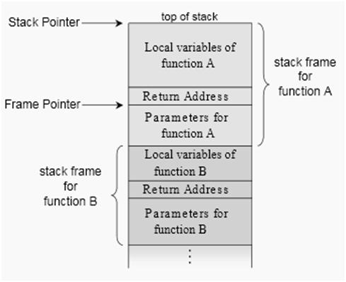
Thread deep dive
Thread context stores all the related register values of the thread.
During execution register values are stored in CPU , else they are in Memory.
KD> DT _CONTEXT
Each Thread has its own stack.
User mode stack
Used for thread’s function calls and local variables
Kernel Stack
Used when control is transferred from user to kernel.
Data is copied for security.
TEB : KD> DT _TEB
TEB contains threat specific information like Exception handling and TLS
Image Credits: http://www.codeproject.com/Articles/662735/Internals-of-Windows-Thread

Slide 21
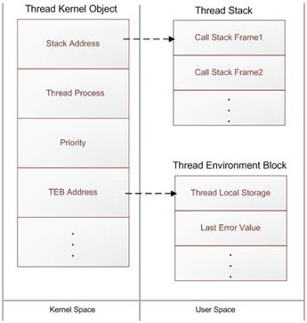
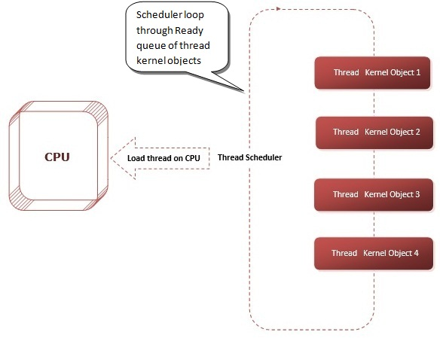
Thread Deep dive
Image Credits: http://www.codeproject.com/Articles/662735/Internals-of-Windows-Thread

Slide 22
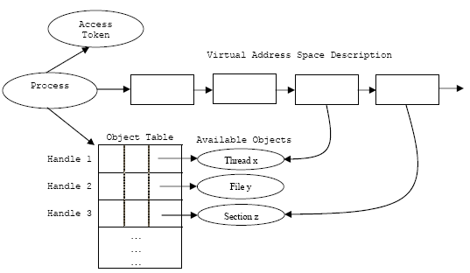
Process memory
Tool : Process hacker
Processes are implemented as objects.
An executable process may contain one or more threads.
process includes an object table that has handles to other objects known to this process.
A process needs atleast one thread to execute.

Slide 23
Lab 2
Peering into process memory

Slide 24
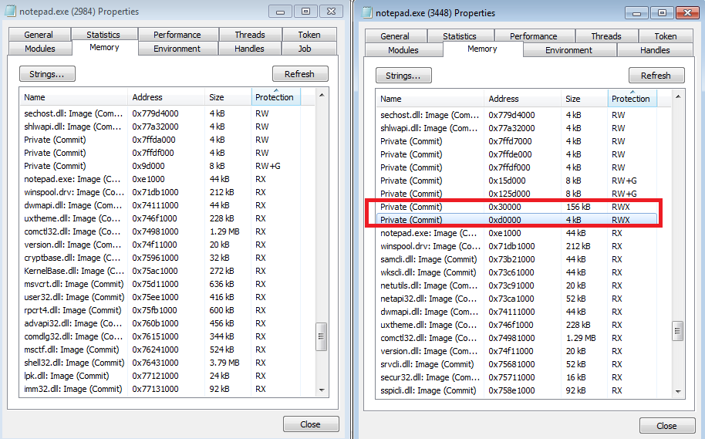
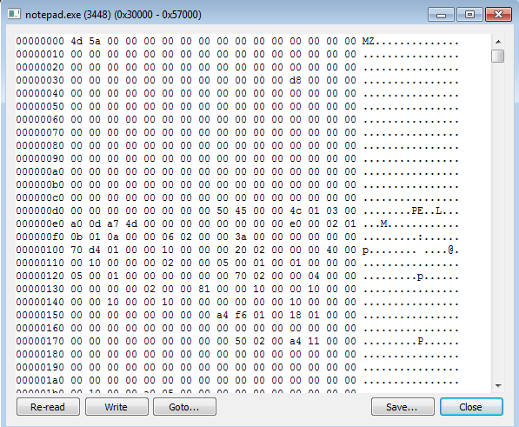
Process memory (approx. 20 min)
Process infected with ZBOT @ 0x30000

Slide 25
Hooking basics

Slide 26
Techniques RECAP
Process (Before Hook)
Process (After Hook)
Hacker Defender
Headers Code Section … Call FindNextFile … Import data section FindNextFile: 0x12345678
Kernel32.dll
0x12345678: FindNextFile Code
Headers Code Section … Call FindNextFile … Import data section
FindNextFile: 0x12345678 Kernel32.dll 0x12345678: FindNextFile Code
Rootkit Code. 0x70034622: MyfindnextFile …
Replace first five bytes of code with
jmp 0x70034622
User Memory
Rootkit.sys
NtosKrnl.exe
Index of SSDT
Bagle
Exported function (NtQuerySystemInfo)
Jmp “rootkit.sys”
Index of IRPTable of a device driver
Kernel Memory
TDSS
Index of IDT
Apropos
Legitimate Device Driver
Spam-Mailbot aka: Rustock
SysEnter/Int2E (MSR)

Slide 27
A detection strategy
VirusScan
User Memory
Code sent to scanner for scanning
Initiate Rootkit Scanning
Kernel module of VirusScan
Detect Detour
Kernel Memory
Rootkit.sys
Index of SSDT
NtosKrnl.exe
Bagle
Exported function (NtQuerySystemInfo)
Jmp “rootkit.sys”
Index of IRPTable of a device driver
Srizbi
Index of IDT
Apropos
Legitimate Device Driver
Spam-Mailbot aka: Rustock
SysEnter/Int2E (MSR)

Slide 28
Lab 3
Kernel debugging 101

Slide 29
DEEPDIVE: Cekno Analysis and detection (45 min)
Lets see how we can detect anomalies created by Cekno rootkit
We need to learn few things first.
Kernel debugging – more powerful than merely using liveKD.
Finding memory patterns and following the pointers in memory
Along with some good notes taking capability ☺
Kernel debugging
Is like any other program debugging you do in your HLL code.
You are looking at assembly code, but don’t let it bother you too much
It’s a cool way to be able to trace each and every instruction of OS from a remote machine.
Vast amount of code – so we need
Smart debugging , and context aware debugging.. (wait did we define what a context aware really mean?)

Slide 30
Kernel debugging and context
You have two machines , one is a debugger and another a debugee.
Talking to each other via virtual serial port.
You can ‘break’ into the debugger using CTRL+Break or break button in windbg. This will suspend the debugee and no more instructions can execute.
When in debugger VM you can try following commands
!process 0 0 -> Lists all the running processes (Returns EPROCESS Object)
!process -1 0 -> Returns current process.
.process /i <eprocess> -> Change the context to process described by <eprocess>
Lmu -> Lists all the user mode modules within a process.
How do you know whats the CONTEXT (kernel or user mode) , what process are you broken into.

Slide 31
Cekno analysis goals
Who is modifying kernel . Find the thread responsible.
How is it modifying it , peer into assembly code ..
How can we detect the malicious code?
Can we repair it?

Slide 32
Cekno debugging
Connect kernel debugger / Debuggee
In the debugee, run tuluka and find the index number of NtQuerySystemInformation.
Switch to debugger and launch windbg using the command described in class notes.
In Windbg Display SSDT table in the debugger using command
Dd kiservicetable (it begins at index 0)
How will you find the memory location of NtQuerySystemInformation? Lets call this location X.
In the debugger create a break points for location X , using command
Ba w1 <X>
Switch to debugee and extract and execute file from Cekno.zip in the RDP (Debugee image)

Slide 33
Cekno debugging
Did you get a ‘breakpoint hit’ ?
If yes, How do we find who did it?
!thread
Kb
Lets look at the disassembly and think about a detection logic.

Slide 34
Day 2
Explore various stealth techniques

Slide 35
Stealth techniques examples

Slide 36
Techniques employed by various rootkits
Inline hooks
HackerDefender
Zbot
Import Table hooks
Adcliker-BA
Qoolaid
DKOM
TDSS
Inline hook (Kernel)
Apropos
IRP hook
TDSS, ZeroAccess
SSDT hook
Ntrootkit-K
IDT hook
Apropos
Sysenter hook
Spam-mailbot.c
Filter driver
SearchNet
PigSearch
MBR
Mebroot, TDSS

Slide 37
Bootkits: Another technique of stealth
Disktrack
SST.B
Tdss
“uEFI-kit”
Voodoo
Vbootkit
Whistler
Shamoon
Brain
Flip
Stalker
StealthMBR
Ramnit
XPAJ
1986
1989
1990
1991
2000
2005
2007
2009
2010
2011
2012
2013
Stoned
MichaelAngelo
Eye Bootroot
StealthMBR V2
South Korean Wiper
Bioskit
Cidox
Gapz
Mbro
Rioader
W64/Tdss.d
Popureb
Fisp
Tdss.g
EvilCore
Guntior
Lapka
Cmoser
Bootkor
Niwa

Slide 38
System boot process
Pre-boot – Power on self test to diagnose memory, hardware components.It loads the bios that locates the boot device and then loads and runs MBR.
Boot
initial boot loader, OS selection
MBR finds the active partition and load the boot sector in memory to execute it.
Boot sector loads the NTLDR from disk (Real mode) which then continues to load the operating system . Ntoskrnl.exe continues to initialize.
Structure of a classical generic MBR
Address |  | Description |  | Size (bytes)
Hex | Dec
+000h | +0 | Bootstrap code area |  | 446
+1BEh | +446 | Partition entry #1 | Partition table (for primary partitions) | 16
+1CEh | +462 | Partition entry #2 |  | 16
+1DEh | +478 | Partition entry #3 |  | 16
+1EEh | +494 | Partition entry #4 |  | 16
+1FEh | +510 | 55h | Boot signature^{[a]} | 2
+1FFh | +511 | AAh
Total size: 446 + 4×16 + 2 |  |  |  | 512

Slide 39
StealthMBR – installs kernel rootkit via Mbr
AV Process
Kernel memory
Thread 1
Thread 2
Rootkit Thread (Watcher)
….
Rootkit Thread
Thread 3
….
Rootkit Thread (Watcher)
Read request
CDROM: IRP Dispatch Table
CDROM.sys
Hijacked
Disk: IRP Dispatch Table
Rootkit module
Disk.sys
Filter Function
Ideally
Original MBR
Sector 0
Infected MBR
Sector 60 Sector 61
Rootkit Installer
Sector 62
Original MBR
End Sectors
Rootkit driver
Hard Disk

Slide 40
Lab 4
Kernel structure analysis using windbg (IRP, Driver_Object, Device_Object)

Slide 41
Trends in Stealth Malware
File forging
Memory forging
Self protection
Attack AV
Disassociating memory from file-on-disk
Removing dependency on files
Untrusting the trusted

Slide 42
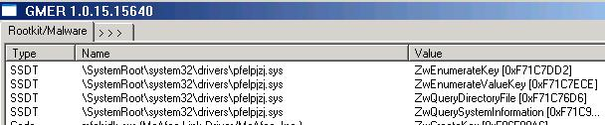
Disassociating memory from file-on-disk
Rootkit’s memory can give-away its associated file on disk
For example: NtQuerySystemInformation with SysModuleInfo
Memory scanner needs to know the file
For remediation the file-on-disk needs to be removed
Can be very generic for early load anti-rootkit solutions
Techniques like : Koutodoor, patch Module_Entry etc
Problem because it can be difficult to track kernel memory

Slide 43
File Content Forging
Overwrite existing files and forge the ‘view’ such that AV gets the clean view instead of malicious
File forging used by Tdss.c, ZeroAccess
Better than hiding files
Hidden files can be located using file-system parsers etc
Comparing file contents is time consuming
Forging can work well from layers below file-system (NTFS )
Can expect
Forging incorrect contents (mebromi forges zeros for MBR)
Create new malicious files but forge clean contents

Slide 44
Removing Dependency on Files
Scanners based on direct file-system (FS) parsers worked well
Therefore having no file in the FS helps rootkits, so :
Move malicious code to boot process: MBR or VBR or ???
Move malicious code to bios ☹
And move encrypted malicious code to raw sectors or as a file
Has added advantages in 64-bit Windows
Recent examples: TDSS.d, Whistler, Fisp, Popureb, Mebromi

Slide 45
From Limited Self Preservation…
Defend components and/or attack security components
Watcher threads
To monitor and protect memory hooks and disk changes
TDSS, StealthMBR etc
To rewrite registry, files, gain exclusive locks from SYSTEM etc
Festi, NtRootkit-H, Tdss
Attack from kernel (mostly name based)
Callback registration to attack during process, module load etc
Storm worm, BlackEnergy
ObfDereferenceObject
Simfect / QVOD

Slide 46
To Holistic Self Defenses
Behavioral identification of AV
Identify the AV activity by monitoring the behavior of the process or thread, if it triggers their behavioral detection logic, the AV is terminated.
Untrusting the AV and whitelisting of legitimate applications
Trust based deterrence in the rootkits
Threats establish trust on the essential drivers for the system and everything else could be locked out.
AV now has to find ways to get trusted by malware to get a chance to even load.

Slide 47
Lab 5
Analyze banker rootkit using windbg.

Slide 48

Brazilian Banker rootkit
Has both x86 and x64 versions
Uses bcdedit to bypass driver signing requirements
DISABLE_INTEGRITY_CHECKS
TESTSIGNING ON
Prevents security tools from loading
OS callbacks such as PsSetLoadImageNotifyRoutine
Use KernelDetective tool to see the list of callback handlers on your system.
Patched Entry Point
B8010000c0 mov eax, 0c0000001h
C20800 ret 8
…………….

Slide 49
Brazilian Banker rootkit
Has both x86 and x64 versions
Uses bcdedit to bypass driver signing requirements
DISABLE_INTEGRITY_CHECKS
TESTSIGNING ON
Prevents security tools from loading
OS callbacks such as SetLoadImageNotifyRoutine
Also used by BlackEnergy rootkit
Image identification by name
Generic security tool identification

Slide 50
Questions?

Slide 51
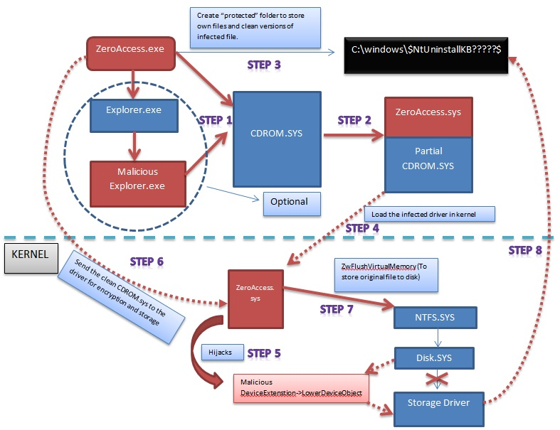
Optional work
Dissect zeroaccess.
Ref tutorials at http://fumalwareanalysis.blogspot.com/2012/03/malware-analysis-tutorial-20-kernel.html

Slide 52
http://www.tenouk.com/ModuleT.html

Slide 53
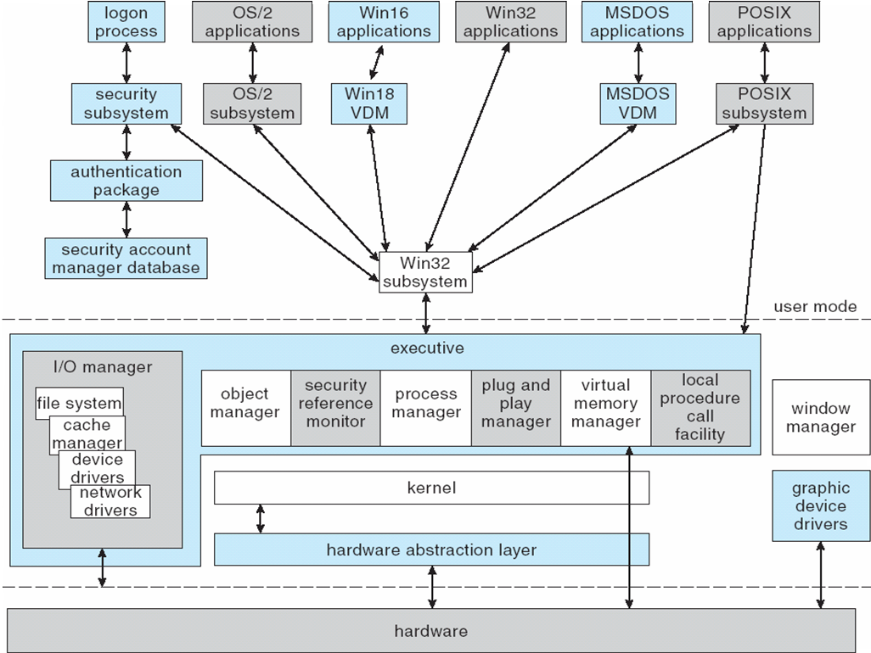
Windows architecture
Operating system concept essentials* -8th edition (silberchatz et. al.)

