Slide 1

Network Security
Defense Against The Dark Arts
Ram Venugopalan
Geoffrey Cooper
Intel Security

Slide 2
Agenda
Lesson 1 (90min)
Introduction
Classroom Exercise – Defense in depth
Classroom Exercise – Zone policy
Network Security Technologies
Describe homework assignment
Lab 2 (90min)
Derive intelligence from packet meta-data only.
Homework
Define inter-zone policy for zone diagram (slide 12)
Color Jon Postel’s discussion of the Robustness Principle—Green/Right; Red/Wrong.
Lesson 2 (90min)
Homework review
Network Security Technologies (finish)
Network Security Tools
Wrapup
Prep for lab
Lab 1 (90min)
Derive intelligence from captured packet content

Slide 3
Pre-Reading
Wikipedia is a great resource for network protocols descriptions. The RFC’s are better, of course, but much harder to read. But the RFC’s are referenced in the Wikipedia articles, if you prefer to try.
IP/UDP/TCP—Get a basic understand of the protocol function and protocol header formats.
http://en.wikipedia.org/wiki/Ip_address
http://en.wikipedia.org/wiki/IPv4
http://en.wikipedia.org/wiki/Transmission_Control_Protocol
http://en.wikipedia.org/wiki/User_Datagram_Protocol
http://en.wikipedia.org/wiki/Stateful_firewall ⬅ Read History & Description sections.
TLS—Understand the function of the protocol and the handshake. The second reference (from: High Performance Browser Networking) might be easier to read (only read until “Optimizing for TLS”).
http://en.wikipedia.org/wiki/Transport_Layer_Security
or
http://chimera.labs.oreilly.com/books/1230000000545/ch04.html
Not required, but recommended that you skim it before Lab2, and it’s a fun read:
Using Metadata to find Paul Revere by Kieran Healy

Slide 4
Additional Light Reading / Viewing / Listening
Background info:
The KGB, The Computer, And Me—Cliff Stoll goes after Soviet spies. The true story of a very early network security breach. Also described in detail in The Cuckoo’s Egg. Very Berkeley, put sprouts on anything you eat while watching.
Average amount of bandwidth used in DDoS attacks spiked eight-fold in early 2013.
Additional examples / more detail:
Did you install iOS 7.0.6 yet? If not, stop reading and do so NOW. Do not pass GO, do not collect $200 in your banking app, because someone will take it away from you! Here is what happened. While you are enumerating the software engineering processes that must have been missing for this to happen, read about TLS and think about the security implications. Can an unpatched iOS detect a Man in the Middle?
Very cool methods to poison OSPF routing tables, taking over networks in new and interesting ways. If the paper is too dry, you can watch the video from BlackHat.
Dan Kaminsky shocked the world in 2008 by explaining how to subvert the Domain Naming System on which the Internet relies. This guide explains how DNS works and what he discovered. It is a classic poisoning attack. He presented this at BlackHat, and you can listen to him do it (the video link doesn’t seem to work but the audio link is fine).
RFC on Defending against sequence number attacks. Early work on prediction attacks.
What about the last packet in a TCP connection?
All the Internet traffic in China ended up in Wyoming one day. Or did it? Learn about the Great Firewall of China.
Cutting Edge
Advanced Evasion Techniques: combining multiple (permitted) protocol features so as to exhaust resources in the IPS. See BlackHat presentation from summer 2013. There is also a paper.
Using Metadata to find Paul Revere by Kieran Healy — It is claimed that surveillance of data is bad and of meta-data is ‘OK.’ What if the British had used modern meta-data against the Patriots?

Slide 5

Overview
An overview of network security

Slide 6
Why do we need network security?
Helping Host-based protections
Keep dangerous hosts/data out / Create a safe space (Kindergarten rules)
Prevent exfiltration of critical data
Protect hosts missing internal protection (legacy, mobile, visitors, BYOD, IoT)
Hiding network traffic is different from hiding on the host (raise the bar)
Threats come in from the network
DDoS
Attacks from the network in (e.g., Stack overflow, Morris Worm)
Threats out ON the network
Worms
Botnets
Theft of network resources
Threat to critical infrastructure, espionage
Remember other vectors
—CD, USB

Slide 7
Robustness Principle: 1980-1989
…from RFC-1122 Jonathan Postel, 1989
1.2.2 Robustness Principle
At every layer of the protocols, there is a general rule whose application can lead to enormous benefits in robustness and interoperability [ref to rfc760, 1980]:
“Be liberal in what you accept, and conservative in what you send”
Software should be written to deal with every conceivable error, no matter how unlikely; sooner or later a packet will come in with that particular combination of errors and attributes, and unless the software is prepared, chaos can ensue. In general, it is best to assume that the network is filled with malevolent entities that will send in packets designed to have the worst possible effect. This assumption will lead to suitable protective design, although the most serious problems in the Internet have been caused by unenvisaged mechanisms triggered by low-probability events; mere human malice would never have taken so devious a course!
Adaptability to change must be designed into all levels of Internet host software. As a simple example, consider a protocol specification that contains an enumeration of values for a particular header field—e.g., a type field, a port number, or an error code; this enumeration must be assumed to be incomplete. Thus, if a protocol specification defines four possible error codes, the software must not break when a fifth code shows up. An undefined code might be logged (see below), but it must not cause a failure.
The second part of the principle is almost as important: software on other hosts may contain deficiencies that make it unwise to exploit legal but obscure protocol features. It is unwise to stray far from the obvious and simple, lest untoward effects result elsewhere. A corollary of this is "watch out for misbehaving hosts"; host software should be prepared, not just to survive other misbehaving hosts, but also to cooperate to limit the amount of disruption such hosts can cause to the shared communication facility.
Homework: Do you agree? Color this Green/Red where you agree/disagree
And Explain Your Reasoning

Slide 8
Network-based Protection Strategies
Positive policy
Firewalls / Security Zones
Defense in Depth
Intrusion Detection
Honeynets / Intrusion Deception
Quarantine
Reputation (also host-based)

Slide 9
Positive Policy (in the host: “Whitelisting”)
Definition of what you expect/allow to happen
Other things are suspicious and not permitted
Why this this a fundamental concept?
Defender advantage, allows use of internal conventions and choices, attacker has to guess (e.g., which addresses are valid, where are the servers, critical data?)
Limits the attack surface (makes other kinds of protection more effective)
Provides a hook for other trust mechanisms: identity, trust chaining
Policy domain versus threat domain (finite vs. infinite enumeration)
However, Policy may detect a threat, but it doesn’t name the threat!!!
Set of Things Permissible in My Network
(BIG but FINITE)
Set of things NOT Permissible in My Network
(INFINITE)
Policy
Threat Detection

Slide 10
Firewalls and Security Zones
Most common implementation of policy is to define zones in the network with policy between the zones
Firewalls are devices that sit between the zones and filter traffic for policy
Over time, more functions have been added to firewalls (e.g., Routing, NAT, IPS)
Firewalls are big business, almost an industry of their own
Commonly used zones:
Internet Intranet Testing Labs
Extranet Corporate Data Center
DMZ User Stations (DHCP Pools)
Firewalls are best at describing policy from IP⬄IP address. More advanced concepts:
Application + IP to IP (GMAIL from User Stations to Internet)
User + IP to IP (Finance Worker from User Stations to Financial Data Center)

Slide 11
Thinking about zones & Policy
What inter-zone traffic
makes sense?
DMZ
INTERNET
DATA CENTERS
INTRANET
Cloud
DC
Corp
DC
CORPORATE
EXTRANET
Partner Sites
External Access Points
Trusted clients
LABS

Slide 12
Zones and Policy – Homework assignment
# | Source | Destination | Service | Action | Alert | Comment
1 | Intranet | Internet | (HTTP & TCP/80) | (HTTPS & TCP/443) | Permit | No | Everyone on the Intranet is allowed to browse the Internet
2 | Intranet | ??? | DNS & UDP/53 |  | No | How do you think DNS should work from the Intranet out?
3 | Intranet | Internet | SMB | Deny | Yes | Do not allow file browsing over the internet, alert so we can catch the sucker.
4
5
6
38
39
40 | ANY | ANY | ALL | DENY | NO | Firewall policy is best done with a deny all rule at the bottom.
Fill in the policy here

Slide 13
Other Firewall-like devices
Web Gateway
Proxies web connections to apply policy (HTTP proxy / transparent proxy)
On premise or in the cloud
URL reputation
Typically provides inspection of web content (JavaScript attacks, java code). General anti-malware analysis also makes sense (e.g., file reputation, anti-virus scanning).
Able to leverage the interactive nature of web browsing to interact with the user (e.g., progress bars as a file is downloading to the proxy, configurable error “landing pages”).
Email Gateway
Proxies SMTP connections. Typically, the customer sets the MX record to point at the gateway’s IP address and configures the mail server IP into the gateway
On premise or in the cloud
Original mission was anti-spam (typically >99% accuracy, but there is still a lot left)
File scanning for malware has become equally important
Trending towards Data Loss Prevention (DLP)—scanning of files against dictionaries to determine if they contain secrets.

Slide 14
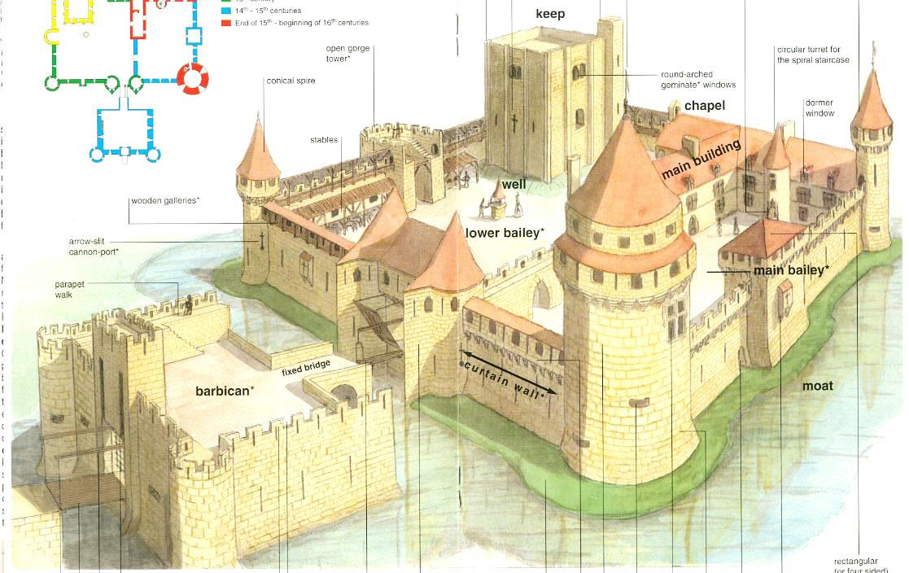

Defense in Depth
Layered defenses
Surrounding terrain
Watch towers
Moat/barbican
Drawbridge / portcullis
Curtain wall/batteries
Bailey
Keep ⬅King lives here
Classroom Project: How does this apply to the network?
http://www.castles.org/Kids_Section/Castle_Story/parts.htm

Slide 15
Defense In Depth – NetWork Example
REPUTATION
INTERNET
SIEM
VISITORS
Feeds from all
Security devices
FIREWALL
IPS
DMZ
IPS
DATA CENTER
(CORPORATE SERVICES)
FIREWALL
FIREWALL
USER WORKSTATIONS
ENCLAVE
REMOTE DESKTOP SERVER
CRITICAL DATA
HOST-BASED TECHNOLOGIES

Slide 16
INTRUSION DETECTION
Intrusion detection (IDS/IPS)
Use signatures/anomaly detection to detect attacks
Extra info to use: OS type, Protocol fields, known exploit tools, packet techniques
Advantages:
Catch known attacks quickly and efficiently
Good information on attacks
Virtual patching
Disadvantages:
Zero day attacks (arms race phenomenon)
False positives

Slide 17
Honeynets / Intrusion Deception
Idea: Catch the flies in honey
Attackers don’t know the structure of the network under attack.
We can devise a phony network to waste their time or deceive them
An early version of the concept appears in The Cuckoo’s Egg (Cliff Stoll, 1989). Nova covered this true story, too (honeypot part: 39:30-44:30)
Use unassigned internal addresses
Apply sucker algorithms to slow down the attacker
E.g., wait a long time, then ack 1 byte, then repeat
Create phony content for the attacker to download or look at.
Problem:
Requires a lot of configuration per site, less common than firewalls, etc..
Some vendors provide solutions

Slide 18
Quarantine
Concept: place hosts that misbehave into a quarantine area where they can’t “infect” anyone else
Commonly deployed on network entry
801.11x switch fabrics with Network Admission Control products (not very common)
Airport wireless logins (very common)
Software Defined Networks (SDN) – new concept, getting bigger fast
Firewalls often implement a “Blacklisting” mechanism, sort of like a quarantine
Behavior indicates the machine is infected or user doing something wrong (policy violations, IPS signatures, reputation)
Typically, black list the remote host that brought about the infection
A limited quarantine works better for local hosts when possible, because users don’t like to be blacklisted (remember, the user probably didn’t realize they were doing anything wrong)

Slide 19
Reputation
Big Data solution
Collect a list of bad and good things, serve the list out from The Cloud
IP addresses that were associated with malware or botnets
IP addresses of spammers
URLs that reference pages with scripting attacks, drive-by-downloads, etc.
URL classification and categorization
Files that come from known program releases
Files that come from known viruses, or tend to be included in viruses
McAfee GTI is a prominent example
Issues:
Multi-function hosts
Stale data
Zero day susceptibility

Slide 20
Network Security Technologies
Detection
Protection
Policy
Passive capture
Packet filtering
Deep Inspection
Crypto Inspection (“SSL Inspection”)
Proxy / Gateway
Vulnerability Scanning
Intrusion Detection
Static analysis
Dynamic analysis
Security Information & Event Management (SIEM)
Reputation / Cloud data analysis
Policy
Identity / Trust
Blocking traffic
Modifying traffic to remove suspicious parts (Man in the Middle)
Translation (NAT, Load balancing, Reverse proxy, URL mapping)
Routing
Encryption

Slide 21
Network Security Technologies
Detection
Products
Protection
Policy
Passive capture
Packet filtering
Deep Stateful Inspection
App Identification
Crypto Inspection (“SSL Inspection”)
Proxy / Gateway
Vulnerability Scanning
Intrusion Detection
Static analysis
Dynamic analysis
Security Information & Event Management (SIEM)
Reputation / Cloud data analysis
Firewall
IPS
Next-Gen Firewall
Next-Gen IPS
Web Gateway
Email Gateway
Data Loss Protection
Identity management / authentication
Advanced Threat Detection (zero day protection)
Policy
Identity / Trust
Blocking traffic
Modifying traffic to remove suspicious parts (Man in the Middle)
Translation (NAT, Load balancing, Reverse proxy, URL mapping)
Routing
Encryption
SIEM

Slide 22
Network Security Technologies
Classroom – draw some lines to show which products have which technologies
Detection
Products
Protection
Policy
Passive capture
Packet filtering
Deep Stateful Inspection
App Identification
Crypto Inspection (“SSL Inspection”)
Proxy / Gateway
Vulnerability Scanning
Intrusion Detection
Static analysis
Dynamic analysis
Security Information & Event Management (SIEM)
Reputation / Cloud data analysis
Firewall
IPS
Next-Gen Firewall
Next-Gen IPS
Web Gateway
Email Gateway
Data Loss Protection
Identity management / authentication
Advanced Threat Detection (zero day protection)
Policy
Identity / Trust
Blocking traffic
Modifying traffic to remove suspicious parts (Man in the Middle)
Translation (NAT, Load balancing, Reverse proxy, URL mapping)
Routing
Encryption
SIEM

Slide 23
Network Security Products
IDS ➔ Passive Capture + Deep Stateful Inspection + Intrusion Detection
IPS ➔ IDS + Blocking traffic
NGIPS ➔ IPS + Packet Filtering + Crypto Inspection + Static Analysis
Firewall ➔ Packet Filtering + Deep St. Inspection + Policy
NGFW ➔ Firewall + IPS + Crypto Inspection + App ID
Web Gateway ➔
Proxy + Intrusion Detection + Static Analysis + Crypto Inspection + Policy
Email Gateway ➔ Proxy + Intrusion Detection
Data Loss Prevention (Data at Rest) ➔
Vulnerability Scanning + Intrusion Detection + Dictionary Lookups

Slide 24
Threats: MITM – Person in the MIddle
Threats across the network stack and defenses against them

Slide 25
MITM –man in the Middle
A⬄B and M is in the middle, intercepting and (possibly) changing messages
Example
Alice wants to have lunch with Bob, Alice sends Bob a message
Unbeknownst to Alice or Bob, the evil Mallory is intercepting all messages!
Mallory rewrites the messages. What can he do?
Send Alice’ message to ask Charlie instead
Rewrite Bob’s message to spurn Alice, messing up their relationship
Rewrite Alice’ message to send Bob off to Costco to buy $50 of potato chips and rewrites Bob’s message so that Alice meets Mallory instead
Checks outstanding warrants, notices that Bob is a wanted felon, sicks the police on Bob while warning Alice off
Remember: MITM has great power for both good and evil.
Apply Spider Man morale.

Slide 26
MITM Examples (Black Hat ☹)
ARP poisoning
Flood network with ARP responses
Typically: fool hosts into thinking that the Internet gateway is at your MAC address instead of the real one
TCP hijacking
Inject, Delete or change data into a TCP stream (and fix up packets so no one notices)
Example: HTTP user logs in, then you change a transaction in a HTTP stream, add a transaction to HTTP
You request to withdraw $100, attacker generates a withdrawal for $1 and a check for $99 to his henchman
Example: SSL Renegotiate attack (advanced topic)
MITM intercepts initial SSL handshake request (Client Hello)
MITM opens SSL handshake to destination and sends initial request, followed by a renegotiation request
MITM lets user request proceed as renegotiation

Slide 27
MITM Examples (Good Guy ☺)
Terminating TCP Proxy
Terminate TCP connections on one side, create a completely new connection on the other side
Rewrite all headers so that an attacker can’t transmit protocol attacks through the firewall. Repackage TCP packets to make efficient use of packet size, remove overlapping segments, retransmissions
HTTP Proxy
Intercept all HTTP traffic
Verify destination against list of “dangerous” hosts
Look for strangely encoded URLs that users normally wouldn’t use (e.g., ../ as %2e%2e%2f, or otherwise obfuscated URLs)
Detect and remove malicious Javascript or EXE files from remote sites from response

Slide 28
MITM Examples (Good Guy ☺☺)
Mail Proxy
Prevent attackers from sending EXE files
Look for sensitive data being exfiltrated in emails
SSL MITM
Intercept SSL, decrypt and re-encrypt
In front of a server, by sharing the private key
In front of a client, by spoofing the certificate
Other creative ways to spoof the certificate
Use DNS MITM to fool the client into believing the certificate is valid

Slide 29
Detection of (TCP) MITM
The trick is to use an HMAC (Crypto Hash, Pseudo Random Function), such as MD-5, (SHA-1), SHA-256, SHA-3
Avoid the compromised MD5 hash!!
If each packet has a hash on it, the receiver can detect if the MITM changes the packet
Here’s how it works

Slide 30
Detection of MITM – The Crypto Hash
Example packet stream: (I want to buy pig #)(3)(, please)
Attacker changes it to: (I want to buy pig #)(10)(, please) ⬅ you get pig #10 ☹
Fix1: Pick a shared secret and add a SHA-256 of each message with the secret, as below:
(3)[78e72…2131399] ⬅ receiver checks hash and can detect the MITM mods
But MITM can still replay a packet: (I want to buy pig #)(3)(3)(,please)
Fix2: chain packets, using sequence numbers, or just chain the hashes
Now MITM changes to middle of the stream are detectible!
Still more to do.
Stream setup
need to protect the end of the stream.
Shared secret? What shared secret?
Crypto Hash Example:
$ echo -n "3SECRET1052" | sha256sum
78e728e9cf18f13e7a6b71366a3143430d975ee180b7f4e79b41074262131399

Slide 31
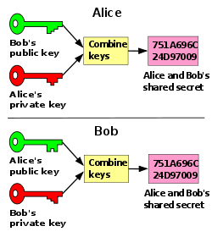
Detection of MITM: The Shared Secret
Alice needs N² secrets to talk with her associates
This is called the N squared problem. The solution is Public Key Cryptography aka Asymmetric Cryptography
In PK Crypto, the public key is known to everyone, and the private key is secret.
There are several schemes:
Diffie-Hellman, RSA, ElGamal, Elliptic Curve
Publish the public key and sign it in a Certificate
Chain certificates back to a Certificate Authority
Shared Secret
created through
Commutative
properties
of the keys
(look it up)
Diffie-Hellman Shared Secret generation

Slide 32
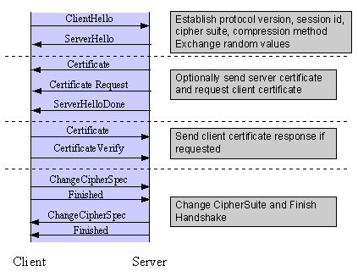
Putting it Together: SSL / TLS
Figuring out how to secure communications is hard. Fortunately, we can use TLS as a stock solution. And we do, millions of times each day.
It is not perfect. Think about what guarantees are made by TLS and what guarantees are not made.
For example, you can fool people with SSL MITM a lot of the time
People don’t understand the messages from the browsers
The browsers rely on DNS, which can be spoofed
Sometimes, keys and certificates can be stolen or forged externally

Slide 33
TLS/SSL Guarantees
The host you connect to has the private key of the server certificate
The DNS name of this host, stored in the server certificate (CN=) resolves to the same IP address that you connected to
The connection is as hard to decrypt as the ciphersuite selected, given that the random numbers in use are cryptographically strong (i.e., impossible to predict)
The integrity of the data is guaranteed by as strong a hash as specified in the ciphersuite selected
The connection cannot be decrypted later if the server is compromised, ONLY IF the ciphersuite with perfect forward secrecy (PFS)
The client is guaranteed to own the secret key of the client certificate, if a client certificate is in use (⬅approximately never)
The client DNS, stored in the client certificate resolves to the same IP address seen by the server (if there is a client certificate)
RSA does NOT have PFS
Note that
Client Certs are almost NEVER used

Slide 34

TLS Vulnerabilities
Even though TLS is very well designed, an implement can still fail. Take it as a lesson about the vigilance necessary to maintain cybersecurity
In April 2014, the Heartbleed vulnerability caused a rash of TLS patching.
Caused by a missing bounds check
Code was checked in at 11:59pm on Dec 31, and no one read it for a long time
Estimated that half the servers in the Internet were vulnerable
No forensic evidence whether servers were actually compromised
Any data in the server could have been compromised, including other people’s passwords, or the server’s private key
Heartbleed (CVE-2014-0160) is also a lesson about data separation. If you really need to separate risks, you have to separate the data into different paths. This is rarely done because of cost.
We have also seen several other TLS vulnerabilities since, such as “Triple Handshake” attack, Berserk, Poodle.

Slide 35
Threats: Hidden Data transmissions
Threats across the network stack and defenses against them

Slide 36
Covert Channels
Hidden from traditional network control devices
Leverages channels to transmit information that weren’t intended to do so.
Usually very low bandwidth
Examples:
TCP ISNs
Ack sequence numbers
IP ID
TCP reXmit patterns
Proxies are great at stopping this at the root (why?)
Ref: http://caia.swin.edu.au/cv/szander/publications/szander-ieee-comst07.pdf

Slide 37
Legitimate channel misuse
Hiding in Plain Sight:
IRC, AOL, etc.
JPG of a text message, screen capture, picture of a landmark
Protocols on the wrong port number or raw TCP connections
Payload tunneling:
HTTP CONNECT Tunneling
TCP over UDP
Simple use: Used to access free wifi using TCP over DNS port 53 that usually left open/uncontrolled
IP over ICMP
Overlapping IP segments
Data at the end of a datagram or a file
Steganography (concealed writing)
Concealing a message/image/file within another message/image/file
Looks no different from normal, unless you’re looking for it
Example:
Adjust the color of specific pixels in order to transmit a message

Slide 38
Policy Holes and limitations
Old policy never expired even after need is non-existent
IPV6 in IPv4 tunnels/6to4/Teredo
Network devices that don’t perform deep inspection (or not configured) let IPv6 though unchecked
New and upcoming tunneling that isn’t detected:
EtherIP
Encrypted traffic that can’t be/isn’t MITMed:
IPSec
SSL

Slide 39
Lab 2 Intro

Slide 40
Lab 2 Intro
When you monitor a network to protect it, there are two basic ideas:
Get as much depth of data as possible, so you can dive deeply into the content and determine exactly what is happening. ⬅ Lab1
Get as many different conversations as possible, so you can see the overarching patterns in the data that reveal the structure of the network (and of any attacks on it). ⬅ Lab2
We created one lab for each of these.
Lab1 looks at one case of a network incident and asks you to analyze it in detail.
Lab2 looks at lots of network traffic and asks you to see what you can learn about it without looking into the details of each packet.
We decided to do Lab2 first ☺
We have prepared some real-world packet header data for you. The data is in CSV format, and includes packet length and addressing information from the IP, TCP, UDP and ICMP headers.
You will write a script to analyze the data and characterize the networks.

Slide 41
Starter Script (Python)
from CSVPacket import Packet, CSVPackets
import sys
IPProtos = [0 for x in range(256)]
numBytes = 0
numPackets = 0
csvfile = open(sys.argv[1],'r')
for pkt in CSVPackets(csvfile):
numBytes += pkt.length
numPackets += 1
proto = pkt.proto & 0xff
IPProtos[proto] += 1
print "numPackets:%u numBytes:%u" % (numPackets,numBytes)
for i in range(256):
if IPProtos[i] != 0:
print "%3u: %9u" % (i, IPProtos[i])
Add your code in here

Slide 42
Starter Script Output
$ python scancsv.py R.csv
numPackets:99142 numBytes:71683046
1: 7
2: 2
6: 39138
17: 59995
Fields for class Packet:
pkt.length,
pkt.proto, pkt.ipsrc, pkt.ipdst
pkt.tcpsport, pkt.tcpdport, pkt.tcpflags
pkt.udpsport, pkt.udpdport
pkt.icmptype, pkt.icmpcode

Slide 43
Starter Script (Perl)
map {($_==-1 && print "numPkts:$n numBytes:$b\n\nIP Protocols\n", map{$p[$_]&&"$_: $p[$_]\n"} (0..$#p)) || (/^(\d+)\,(\d+)\,/&&++$n&&($b+=$1)&&++$p[$2])} <>,-1;
☺

Slide 44
Real Starter Script (Perl)
...
# variables that get stuffed with successive packet values
my ($len, $proto, $ipsrc, $ipdst, $tcpflags, $tcpsport, $tcpdport, $udpsport, $udpdport, $icmpcode, $icmptype);
my ($pkt,$pktnum);
while ( $pkt = $csv->getline($fh) ) {
next unless $len > 0;
$tcpflags = hex($tcpflags); # fix this up
++$pktnum;
# Compute statistics
++$numPackets;
$numBytes += $len;
++$IPProtos[$proto] if $proto >= 0 && $proto < 256;
# <add more here>
#################
}
...
# Print statistics to STDOUT.
print "Num packets: $numPackets, Num bytes: $numBytes\nIP Protocols:\n";
for ( my $i = 0; $i < 256; $i++ ) {
if ( $IPProtos[$i] > 0 ) {
printf "%3u: %10u\n", $i, $IPProtos[$i];
}
}
Add your code here

Slide 45
Homework (Presented Earlier)
Network Diagram + Spreadsheet to fill in policy
Jon Postel statement on Robustness Principle, read and color red/green and defend
your decision

Slide 46
Lecture 2

Slide 47
Homework Review
Robustness Principle / Firewall Policy

Slide 48
Threats: Reconnaissance a.k.a. RECON
Threats across the network stack and defenses against them

Slide 49
Reconnaissance – What is it?
Active
Attacker wants to attack vulnerable machines on a network
Attacker needs to find addresses for services that can be attacked
Passive
Attacker is able to see data on the network (wiring closet, ISP)
Attacker wants to learn about people

Slide 50
Active Reconnaissance
Basic tool is scanning—trying to connect to many hosts and services (ports)
Goal is to get the IP address and UDP/TCP port of a service you can attack
NMAP is a common tool
Kinds of simple scans:
Ping (ICMP ECHO / ECHO_REPLY)
TCP port scan (SYN/SYNACK)
Other TCP scans (data/RST, FIN/RST) ⬅ requires more state in the firewall to block
UDP scans (UDP data packet / ICMP Destination Unreachable)
Randomize the order
Slow scan (i.e., over months) ⬅ hard to find without a SIEM
Scanning for vulnerabilities
White hat / Black hat
Send an attack to a <IP,port>, see if it works, if not, try the next <IP,port>

Slide 51
NMAP host1 (A.B.C.D)
~$ sudo nmap -sT -sV A.B.C.D
Starting Nmap 5.21 ( http://nmap.org ) at 2014-01-28 13:46 PST
Nmap scan report for XXX (A.B.C.D)
Host is up (0.11s latency).
rDNS record for A.B.C.D: XXX.mcafee.com
Not shown: 984 closed ports
PORT STATE SERVICE VERSION
135/tcp open msrpc Microsoft Windows RPC
139/tcp open netbios-ssn
445/tcp open netbios-ssn
514/tcp filtered shell
902/tcp open ssl/vmware-auth VMware Authentication Daemon 1.10 (Uses VNC, SOAP)
912/tcp open vmware-auth VMware Authentication Daemon 1.0 (Uses VNC, SOAP)
1025/tcp open msrpc Microsoft Windows RPC
1026/tcp open msrpc Microsoft Windows RPC
1028/tcp open msrpc Microsoft Windows RPC
1029/tcp open msrpc Microsoft Windows RPC
1433/tcp open ms-sql-s Microsoft SQL Server
1720/tcp open tcpwrapped
3389/tcp open microsoft-rdp Microsoft Terminal Service
4445/tcp open unknown
5357/tcp open http Microsoft HTTPAPI httpd 2.0 (SSDP/UPnP)
6000/tcp open X11 (access denied)
2 services unrecognized despite returning data. :
Nmap done: 1 IP address (1 host up) scanned in 192.69 seconds

Slide 52
NMAP Host2 (D.E.F.G)
~$ sudo nmap -sT -sV D.E.F.G
Starting Nmap 5.21 ( http://nmap.org ) at 2014-01-28 13:54 PST
Nmap scan report for D.E.F.G
Host is up (0.0020s latency).
Not shown: 999 filtered ports
PORT STATE SERVICE VERSION
22/tcp open ssh OpenSSH 5.3 (protocol 2.0)
MAC Address: 00:0C:29:EC:A6:F3 (VMware)
Service detection performed. Please report any incorrect results at http://nmap.org/submit/ .
Nmap done: 1 IP address (1 host up) scanned in 14.40 seconds
Which would you rather attack?

Slide 53
Active Recon /Vulnerability Scanning Tool
Generate scan list
Scan
Test Vulns
Notify sysadmin
Fix machine
Adjust Firewall/IPS
Call the FBI
Good
Guys
Scan Records
Database
Compromise machine
Take what you can
Use it to attack others
Bad
Guys
User Interface
Database browser
Configuration
Note that the attack tools and the defense
tools look about the same.

Slide 54
Passive Reconnaissance
Please keep in mind that this is generally illegal !!
Getting the data
Tapping ISPs
Hiding equipment in wiring closets
Listening to radio signals
“Envelope” data
Who is talking to alqaeda.org
Direct connection ➔ Connectivity matrix ➔ Clustering
Passive mapping of services, like NMAP but without sending anything
Passive DNS
User name gleaning (examine logins to services on FTP, HTTP, Kerberos, certificates)
Content
Web pages, files, e-mails (wireshark export command)

Slide 55
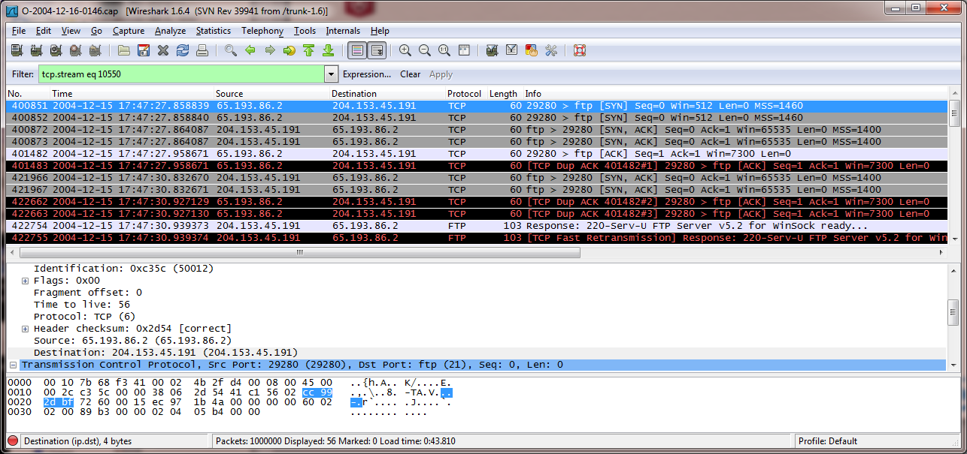
Example using Wireshark—header analysis
Things we learn:
IP Addresses, apply DNS and whois
FTP protocol (control connection)
MAC addresses of the routers
Packet sizes

Slide 56
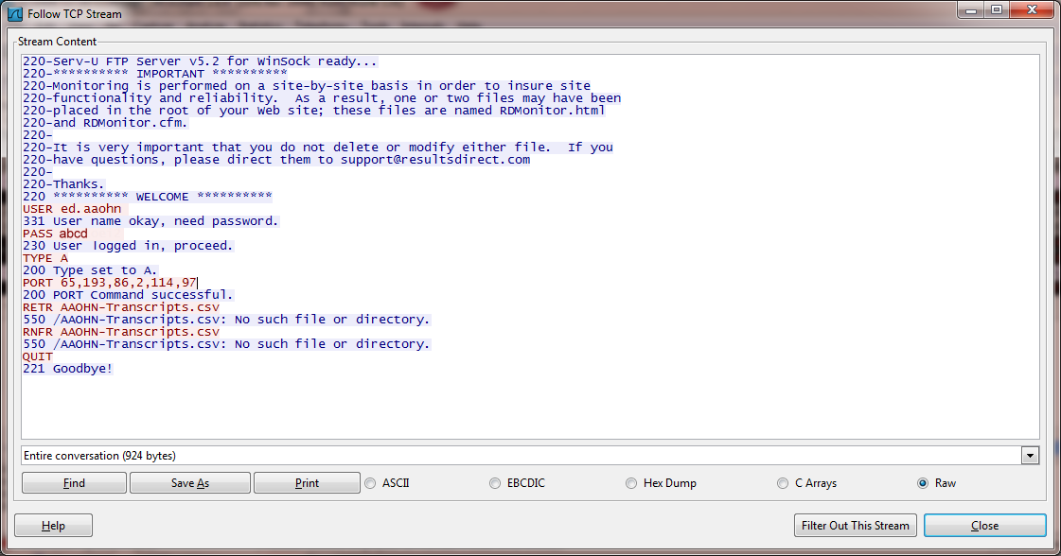
Example Using Wireshark—content analysis
Things we learn:
AAOHN – google lookup shows org’n
“Ed” is the sysadmin there
We have his password (not really abcd)
There are lists of transcripts on the site
ResultsDirect.com is probably the ISP
To keep them happy, leave RDMonitor.html
If the requested file had existed, we could
snarf a copy sent to 65.193.86.2 port 29281
And most importantly:
Don’t use FTP!

Slide 57
RECON - Defenses
Policy and Deep Inspection helps
Honeynets can slow down reconnaissance
Generally, these are detected using log-correlation
SIEM
IPS
Firewall
It is hard to defend against passive reconnaissance, except using physical security or crypto

Slide 58
Threats: Spoofing
Threats across the network stack and defenses against them

Slide 59
Spoofing – What is it?
Spoofing: Attacker masquerades as another network entity in order to gain some advantage over the network defenses of the target.
LAND Attack: A DoS attack that relied on spoofing
IP and ARP spoofing to perform MITM attacks
Used to poison ARP DBs to perform MITM
Predictive spoofing: TCP resets, TCP sequence number prediction to get through NATs (more later)
Legitimate uses: for load testing with large number of users
What can be spoofed?
TCP sequence numbers
IP addresses
MAC addresses
E-mail addresses
HTTP fields – e.g. referrer fields

Slide 60
Spoofing – Defenses
Most network security solutions perform some basic checks to detect and defend against spoofing
Reverse Path Filtering
Ingress filtering including dropping packets from bogons
For more information see: RFC 3704, Ingress Filtering for Multihomed Networks
Egress filtering to ensure that only packets that belong to appropriate internal networks (and no source IPs that belong to the network device itself) are routed through.

Slide 61
Threats: Resource consumption Attacks
Threats across the network stack and defenses against them

Slide 62
Denial of Service (DOS)
DoS = Denial of Service
About consuming resources for an extended period of time such that the targeted service is degraded, some times to a point where it is unusable
DDoS = Distributed DoS
Asymmetrical resource utilization (attackers needs to spend fewer resources than the subject of attack) is the key to the success of most DoS attacks
DDoS leverages large numbers of computers to perform one or more resource exhaustion attacks against a target such that it is overwhelmed and unable to perform its function.
Harder to defend against
Motivation for a DoS attack:
Hacktivism
Financial Gain
Cyber War
Cyber Terrorism
Unintentional: slashdot, reddit, etc.

Slide 63
Types of DOS
Network exhaustion: Flooding the network so that the service is unreachable or is reachable with such high latency that it is useless
E.g.: DNS amplification attacks
CPU exhaustion: Make CPU so busy, legitimate traffic cannot be served.
E.g: TCP ACK flood: Busy servers could spend CPU searching for right TCB, Fragmentation attack: don’t send the first fragment.
Memory exhaustion: Cause server to run out of memory and slow down/crash
E.g: TCP SYN flood (NMAP can do this, but don’t try it on the campus net!)
Storage exhaustion: Cause server to run out of disk space
Application vulnerability exploitation: making the application unavailable by crashing it or the OS.
Other finite resources: sockets, TCP listen queue, connection pool, firewall session tables, SSL exhaustion, etc.
E,g.: CVE-2009-2874,CVE-2009-1928,CVE-2009-2858,CVE-2009-2726,CVE-2009-2540,CVE-2009-2299,CVE-2009-2054,CVE-2008-180,CVE-2008-2121,CVE-2008-2122,CVE-2008-1700,CVE-2007-103,CVE-2006-1173,CVE-2007-0897, slowloris, etc.

Slide 64
DDoS Methods
Leverage a large number of internet connected endpoints:
Use Botnets to DoS a target.
E.g.: http://arstechnica.com/security/2013/04/fueled-by-super-botnets-ddos-attacks-grow-meaner-and-ever-more-powerful/
Leverage amplification methods (response much larger than request)
DNS amplification (300Gbps attack – against Spamhaus in 2013)
NTP amplification (400Gbps attack - 2014)

Slide 65
DoS Defenses
Network traffic validation and cleansing by network products
Firewall proxies validate application protocols and prevent protocol vulnerabilities from being exploited.
Check for spoofed addresses
Ensure that known attacks like the LAND attack, SMURF, SYN Flood etc are defended against.
Firewall, IPS and other network products alone are not sufficient against DDoS.
Traffic scrubbing centers (e.g. cloudflare, akamai, prolexic)
Partial defense against DDoS
Traffic redirected to global scrubbing centers with massive amounts of bandwidth (multiple Tbps) that lets only legitimate traffic through to customer devices.

Slide 66
Threats: Bugs and Back Doors
Threats across the network stack and defenses against them

Slide 67
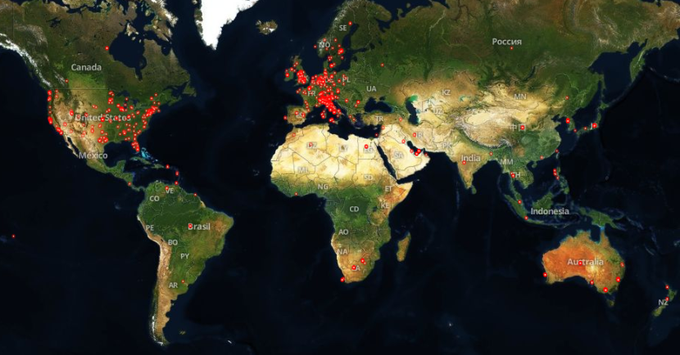
“routers that contain a backdoor”
http://shodanio.wordpress.com/2014/02/18/introducing-shodan-maps/

Slide 68
Bugs and Backdoors
Backdoors are intentional, bugs are unintentional, the threat of compromise is the same
Common bugs:
Built-in or default passwords
Susceptibility to Nasty Packets (aka Packet Bombs )
Protocol design bugs, esp combined with the Robustness Principle
Password in the clear
Amplification characteristics (e.g., NTP), response data >> request data
Legacy features that are still enabled (e.g., Telnet escape codes in FTP, old HTTP methods)
Buffer overflow (now enhanced to Return Oriented Programming)
Part of an historical Internet attack: the Morris Worm.

Slide 69
Defense: The Basics: Packet filtering, NAT and Proxying
The first defensive technologies and their evolution

Slide 70
Packet Filtering
Basic first step toward protecting your network
Clear network boundaries and segmentation is key
Policy driven whitelisting method to allow only expected traffic to cross the network boundary
Typically uses basic layer 3 and 4 properties of a packet (addresses and ports) to be controlled via policy
Basic packet validation including defense against segmentation, fragmentation attacks, malformed packets and streams is implicit
Stateful vs. stateless packet filtering
Importance of stateful packet filtering
Packet filtering of protocols that establish negotiated/parallel data connections e.g. FTP.
Transparent/Bump-in-the-wire packet filtering

Slide 71
Deep Inspection
Adds inspection of the data portion of the packet in addition to the network headers:
Trace protocol headers
Multiple protocols (modern firewalls recognize the protocols dynamically)
Signature processing on content (IPS)
Dictionary processing on content (“Data Loss Protection”)

Slide 72
Proxying
Basic limitation of basic packet filtering:
Cannot understand higher level applications and protocols and hence cannot easily shield internal endpoints from application level attacks
Unable to control dynamic protocols such as SIP, H.323.
Proxies:
MITM: Terminate TCP connections and establish new ones
Inspects and sometimes modifies application data to prevent attacks
Provides nuanced and granular access control based on application specific information.
Transparent vs. non-transparent proxy.
Cons: lower performance compared to basic packet filtering (why?)
Some popular proxies: H.323, SIP, HTTP, FTP, SMTP
FTP, SIP send actual IP addresses as part of their protocol, so NAT must be applied by the proxy in these cases.

Slide 73
NAT: Network Address Translation
Initially proposed to allow multiple endpoints to share the same IP address
Mitigated the high-demand and low-availability of IPv4 addresses.
Makes it harder for attacker to learn the network architecture by hiding local IP addresses
How it works:
Temporarily maps a connection from a local private IP and port to a public IP address and port to be used on the public side of that communication.
How many concurrent connections can a single public IP address support?
Basic types of NAT:
Static NAT: Can be a one-to-one mapping of public address to local private address
Dynamic/masquerade NAT: One IP address shared by all local endpoints.
NAT Pool: A pool of public IP addresses dynamically and/or statically mapped to pools of internal addresses.
PAT: Port address translation: Connections to a specific port on public IP are mapped to a specific local private IP and port.

Slide 74
Getting past NAT
NAT prevents you from connecting directly to a specific endpoint behind a NAT device
STUN: Simple Traversal of UDP through NAT
Uses an external STUN server to derive the mapping of the external port and IP address being used for their connection.
Needs both parties to connect to the STUN server so that the server can provide the other’s public IP and port information to each party and allow them to connect directly
Fails on NAT implementation where connections to different destination endpoints from the same source endpoint results in different ports/addresses.
TURN: Traversal Using Relay NAT
An intermediate server relays messages to both parties behind NAT.
Works more generally, but more resource intensive on the TURN server.

Slide 75
Recent Developments In Firewalling (NGFW)
Applications are not port and protocol specific anymore (why?)
Application Identification based on content in network streams
Identification and enforcement of applications independent of port and protocol
Stronger links between endpoints and firewalls to identify the source application of the traffic
Consumption of external threat intelligence sources and leveraging them in policy
Check URLs and files being transmitted to identify maliciousness with external as well as internal sources

Slide 76
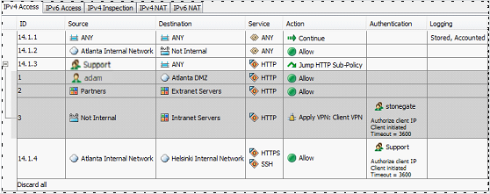
NGFW Policy
Match Active Directory group/user name
Policy sub-routines (templating)
Logical Expressions
Policy recognizes protocols and verifies them
Policy-based routing to VPN
Named objects
Notes:
The Next Generation Firewall is a mix of firewall and Intrusion Prevention technology.
Using Policy as the weapon, it tries to integrate as many different kinds of objects into the policy as possible.
Besides transport + port, we add protocol recognition
Then we permit logical expressions, and allow the user these and other things as named objects (see: Atlanta Internal Network)
Also: policy subroutines
Also: users and user groups from Active Directory
Also: VPN as target of policy (“Policy-based routing”

Slide 77
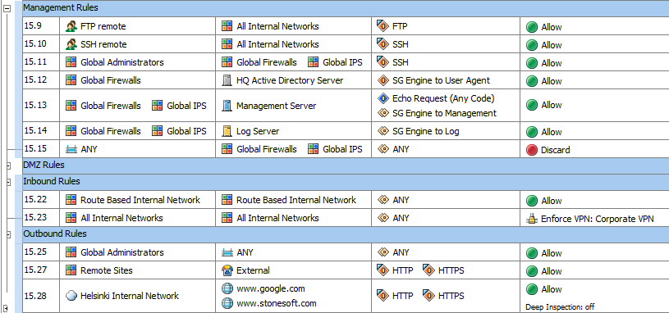
NGFW Policy
Match Active Directory group/user name
Policy sub-routines and templates
(not shown)
Logical expressions of objects
(not shown)
Named objects
Policy binds at push time to DNS
Policy recognizes protocols and verifies them
Policy-based routing to VPN

Slide 78
VPN / IPSec
IPSec is a security layer at Layer 3 (IP level). IPSec allows IP packets to be encrypted between two endpoints under a Security Association (SA). When you construct a network out of IPSec tunnels, it is called a Virtual Private Network (VPN). [Strictly speaking, other kinds of tunnels can be used for VPN, such as phone lines, X.25…]
IPSec uses the Authentication Header (AH) between the IP header and the payload.
IPSec can be used in “transport mode” to secure a single IP connection. This is rare today. Some people want to deploy this pervasively for IPv6 networks.
IPSec is most commonly deployed in tunnel mode, where complete IP packets are encapsulated inside the AH. This “IP-in-IPSec” tunnel allows a connection between a machine and a network (or two networks) over the Internet.
Strictly speaking, IPSec is only about existing connections. They are set up like this:
Client machine uses the Internet Key Exchange (IKE) protocol, which runs over UDP. IKE uses a Diffie Hellman public key exchange. Authentication is via password (shared secret), client certificate, or OTP token
After the IKE exchange, a Security Association (SA) is set up between two peers, and they can exchange encrypted IP packets across this SA.
Firewalls commonly provide IPSec services. It is common for firewall managers to have wizards to set up VPN topologies in stars, meshes, point-to-point. Dedicated VPN boxes also exist.
Because of NAT firewalls, it is common to tunnel the Security Association over UDP or TCP. There are also variants such as L2TP (over PPP) or PPTP (over GRE)

Slide 79
Defense: NIPS
Evolution of defensive technologies

Slide 80
IPS: Why did we need them?
NIPS: Network Intrusion Prevention System
Early Firewalls looked at protocols and network traffic, but not very much at the data
Attacks could be contained in data allowed by firewall policy
IPS systems were required to catch the attack at the perimeter, before it ever reached the intended target
Evaluates packet data against known and unknown attacks
IPS detection strategies
Signature-based
Anomaly-based

Slide 81
Signature based IPS
Watches for patterns of traffic or application data presumed to be malicious.
Knowledge about known attacks is derived from a database of attack signatures.
Advantages:
Fewer false positives (Depends on signature quality)
Faster to deploy and easier to understand behavior.
Disadvantages:
Can detect only known attacks or variations.
Requires constant updating with new signatures.
A Key Application is “Virtual Patch”
Organizations take days to weeks before they can safely patch all their systems. In the meantime, they are vulnerable. Knowing this, attackers analyze the patched (e.g., Microsoft “Patch Tuesday”) to find vulnerabilities to use.
Network IPS vendors quickly supply signatures to match traffic that targets these vulnerabilities, thus protecting the unpatched systems with a “virtual” patch in the IPS

Slide 82
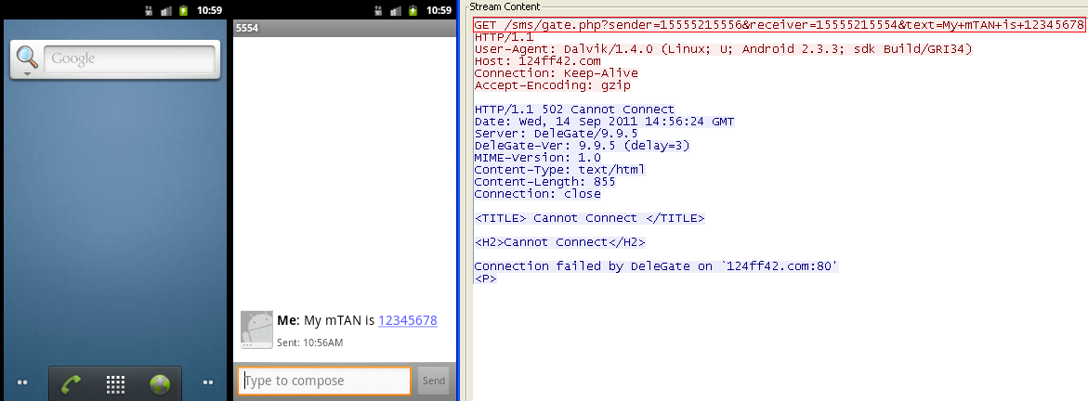
IPS Example: Virtual Patch for Android/SPITMO
The SPITMO malware can force your Android phone to send personal info out to the Internet.
Can we prevent this using a NIPS? Yes!! The signature scans the outbound HTTP request for a pattern like this:
Match Request Line: ^GET /sms/get.php\?.*sender=[0-9]+&receiver=[0-9]+&text=.*$
AND Match Header Line: ^User-Agent: ^Dalvik.*$
AND Match Header Line: ^Host: ^[0-9a-f]+.com$

Slide 83
Anomaly based IPS—“Network Behavior Analysis”
Monitors network traffic for application content presumed to be different from “normal” patterns.
Knowledge of “normal” traffic patterns is based on trends derived from long-term monitoring.
Advantage:
Has the potential to detect hitherto unknown attacks
Disadvantages:
Often produces a comparatively higher number of false positives due to the unpredictable nature of users and networks.
Often requires extensive training sets of system event records to characterize normal behavior patterns.

Slide 84
IPS Today aka NGIPS
Integration with endpoint technologies for application anomaly detection
Integration with Firewalls to form NGFW/NGIPS
Application aware:
Automatic file extraction and scanning regardless of network and application protocol
Context aware: dynamic correlation of signatures to achieve low false positive rates
SSL Inspection
Static analysis for packet techniques or shell code
Dynamic analysis—run a file in a VM and see what happens
Integration with multiple threat intelligence sources, e.g., reputation
Very high scale throughput (100Gbps +)

Slide 85
Network Security tomorrow
Effect of new technologies on network security

Slide 86
Intelligent And connected security
Network devices are at the vanguard of security by preventing threats from getting into the network
Does so by emulating certain endpoint targeted threats and may not be able to catch everything
Does not necessarily see the whole picture
Intelligence sharing between endpoints with network devices and network devices with other network devices is key

Slide 87
Advanced Evasion Techniques (AET)
Early IPS was easy to fool by breaking up attacks on packet boundaries, foozling checksums, etc.. Pretty much all these “evasion techniques” have been fixed.
Lately, it has been shown that combining multiple evasion techniques at once can still cause many devices to fail to notice simple attacks through Stateful Deep Inspection.
Sometimes the combination finds limits in the code (e.g., each evasion takes a little memory, but the combination takes even more)
Some devices have fixed evasions, but still don’t process packets the same way as hosts do (perhaps for performance reasons)
Some devices have special “anti-evasion” modes that need to be enabled
This is important because IPS’ are used as the major defense while endpoints are being patched (this is called “virtual patching”). AET shows how new vulnerabilities can “breeze through” the IPS and affect unpatched machines.
The “Evader” tool from Stonesoft, Finland (now McAfee/Intel) does a random walk through multiple evasion techniques. It has been shown to affect most IPS’ in the market, usually within 24 hours
Notes:
https://media.blackhat.com/us-13/US-13-Opi-Evading-Deep-Inspection-for-Fun-and-Shell-Slides.pdf
(see test results slide 48 on)

Slide 88
Software Defined Networks (SDN)
Researchers at UC Berkeley and Stanford wanted to develop an experimental network, but they couldn’t because they would lose access to their email (and everything else).
So they figured out how to reprogram a switch remotely using a protocol called OpenFlow, so that they could both keep the old network and experiment on it.
This turned into Software Defined Networking. In 10 years, this may be renamed “network switching.”
http://en.wikipedia.org/wiki/Software-defined_networking

Slide 89
How a Switch Works
In a conventional switch
Existing flows are forwarded by the interface hardware based on flow tables.
New flows are processed by embedded control logic according to standard algorithms.
Switch
Control Logic
Flow Tables
New flows
Existing Flows
Interface Hardware

Slide 90
OpenFlow SDN
In an OpenFlow SDN
Existing flows are processed by the switch
New flows are processed by the OpenFlow Controller
The OpenFlow protocol is used to connect the two
External Information
OpenFlow Controller
Control Logic
OpenFlow Protocol
Switch
Flow Tables
New flows
Existing Flows
Interface Hardware

Slide 91
Lab Intro

Slide 92
Lab 1 Introduction
Wireshark usage tips, demo with FTP capture file
Network threat detection challenges
Challenge 1:
Investigate a network attack:
Which systems (i.e. IP addresses) are involved?
What can you find out about the attacking host (e.g., where is it located)?
How many TCP sessions are contained in the dump file?
How long did it take to perform the attack?
Which operating system was targeted by the attack? And which service? Which vulnerability?
Can you sketch an overview of the general actions performed by the attacker?
What specific vulnerability was attacked?
What actions does the shellcode perform? Pls list the shellcode.
Do you think a Honeypot was used to pose as a vulnerable victim? Why?
Was there malware involved? Whats the name of the malware? (We are not looking for a detailed malware analysis for this challenge)
Challenge 2:
Step 1: Having accepted the Jensen case, Jack and his team install network taps and wireless capture devices in Mr. Jensen's business and home. During monitoring, Jack and his team discover an interesting suspect, Betty. This could be the woman Mrs. Jensen fears her husband is having an affair with. Jack assigns you to look further into the information capture. You learn that a meeting has been setup.
Use the packet capture to learn more about the case and answer the following question: What day of the week is the meeting scheduled for?
Step 2: Betty attempts to keep her tracks covered as she establishes a meeting location with Gregory.
Use the step 2 packet capture to answer the following question: What city are they meeting?
Assign who gets to do which challenge(s)
Teams of 3 and 4.

Slide 93
Questions?
ramv@mcafee.com
geoffrey_cooper@mcafee.com || geoffrey.cooper@intel.com

Slide 94
Overflow Sections (Will present if there is time)
(Predictive Attacks / Database Poisoning)

Slide 95
Threats: Predictive Attacks
Threats across the network stack and defenses against them

Slide 96
Predictive Attacks
In a predictive attack, the attacker predicts the behavior of the target, causing the target to help play a part in the attack.
TCP Reconnaissance through firewall—FIN scan
Final TCP packet in a connection (FIN+ACK) might be lost (two generals problem), so TCP mandates that an unknown FIN+ACK results in a RST packet. This gives predicted behavior of an unknown TCP host.
If firewall rules are not clever enough, sending a sweep of FIN+ACK packets can allow you to map out internal services through a firewall, even if SYN+ACK will not transit the firewall.
(mitigated by stateful connection tracking and violating the TCP spec)
(besides, what use is it to know an internal server, even a vulnerable one, if you can’t open a connection to it? Go to the next slide)

Slide 97
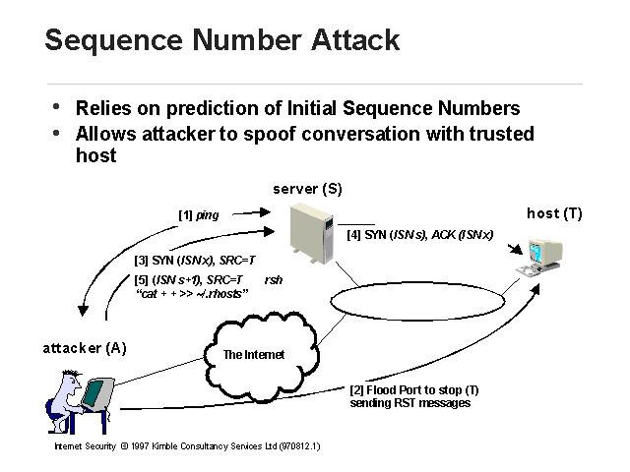
TCP Sequence Number (Prediction) attack (RFC1948)
Send TCP open (“ping”) to server to determine its initial sequence number (ISN)
Flood target to squelch the RST
Send SYN spoofed from target with predicted ISN (here assumes N+1)
Target sends SYN+ACK; flooding prevents its RST from reaching the server
Send the attack to the server. The illustrated attack exploits using an insecure protocol (RSH) inside a firewall, assuming bad guys can’t get in to exploit it.
http://www.abcseo.com/papers/security/img40.html

Slide 98
Threats: Database Poisoning
Threats across the network stack and defenses against them

Slide 99
Database Poisoning
Target is serving a database to its clients
Attacker inserts invalid data into the database, causing clients to help the attacker
ARP poisoning (see MITM)
DNS poisoning:
Confuse the targets into connected to you instead of Google
Confuse targets into accepting invalid certificates (TLS relies on DNS lookup matches to verify the connection)
Confuse targets into connecting to the wrong services, such as Active Directory (DNS service queries)
In 2008, Dan Kaminsky showed how this could be done on a large and arbitrary scale.

Slide 100
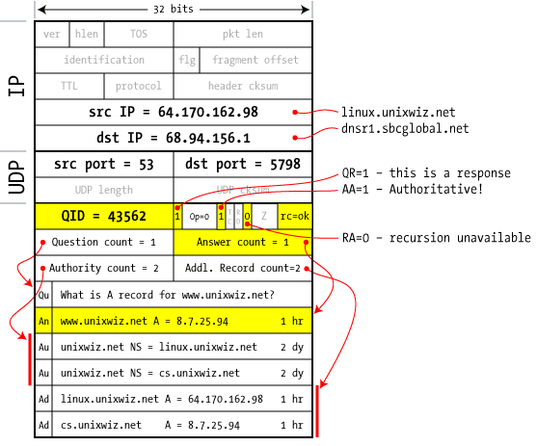
DNS Queries
DNS queries work from the root servers down. www.unixwiz.net
Each query either gives the answer or tells you where to ask next, so eventually you get the answer
The last server is owner of the domain name. DNS forces a query to the known server that owns the domain.
DNS responses must satisfy:
UDP port (changes when server reboots)
Internal consistency checks
Query ID (QID)
Kaminsky determined that all of these could be predicted
First good answer is used
DNS Response packet
http://unixwiz.net/techtips/iguide-kaminsky-dns-vuln.html

Slide 101
Kaminsky DNS Poisoning
Determine the authoritative server of the victim domain, by querying it
Get the server to query your own domain (e.g., boris.badenov.su)
This gives you info about how to predict the response from the victim.
Next query the same server about the victim domain.
… and immediately flood the server with predicted (but forged) responses
UDP port info will be the same as earlier
Query ID’s increment linearly, so flood the next 1000 of them
Respond quickly, before the real response arrives
Include a long time to live so the victim server will cache YOUR information for a long time
Read: http://unixwiz.net/techtips/iguide-kaminsky-dns-vuln.html
Listen: https://www.blackhat.com/html/webinars/kaminsky-DNS.html

Slide 102
New Stuff: Attack on OSPF Routing (RFC 2328)
Owning the Routing Table, 2011, Alex Kirshon, Dima Gonikman, Dr. Gabi Nakibly (BlackHat paper and video)
OSPF is a Link State routing protocol, where each node repeatedly sends Link State Advertisements (LSA) to indicate what nodes it is connected to. Each node then builds a routing map based on all the LSA.
The protocol defines uniqueness uses the LSA sequence number, checksum and age; the checksum is not secured by a secret.
Attacker: listens for a LSA, then sends an update just after.
This is a Predictive Attack—causes the real update to be seen as a duplicate
Routing tables now corrupted for 30 minutes
Attacker can segment the network
Attacker can route everything through himself or blackhole everything
If Interested: see video / paper

