Slide 1
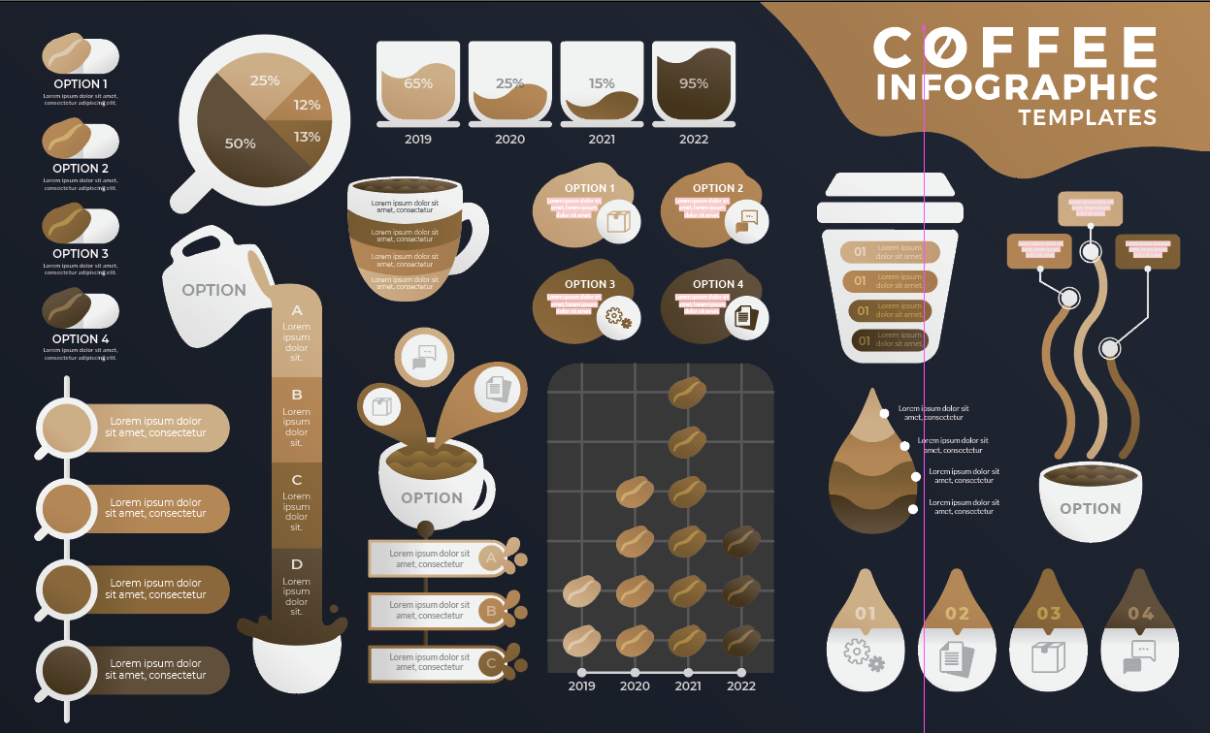
#1B222D
#A47B4E

Slide 2


#4A1405
#DCB88F
#1A202B

Slide 4


Slide 5


Slide 6
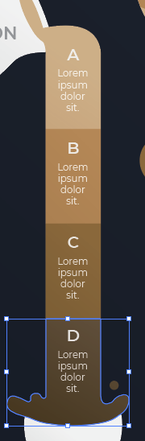
#594833
#836338
#B38655

