Slide 1
Docker

Slide 2
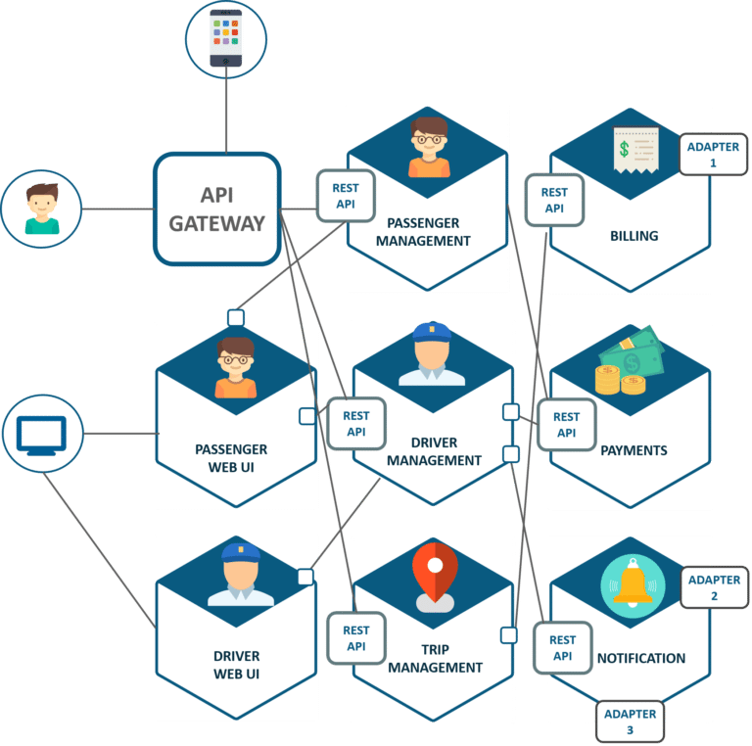
IT system

Slide 4
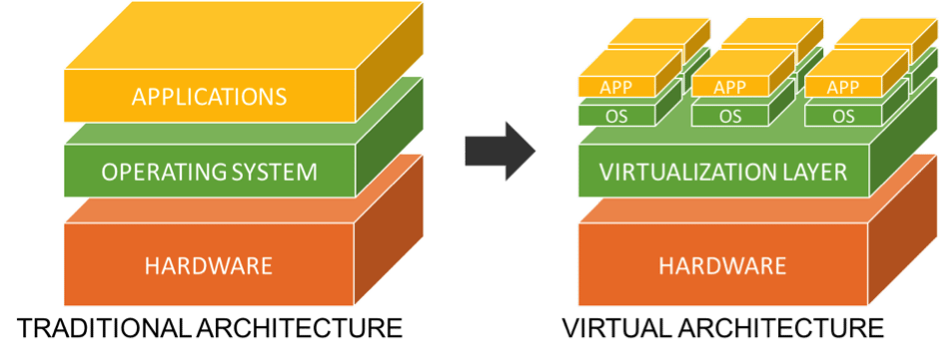
Virtualization

Slide 5
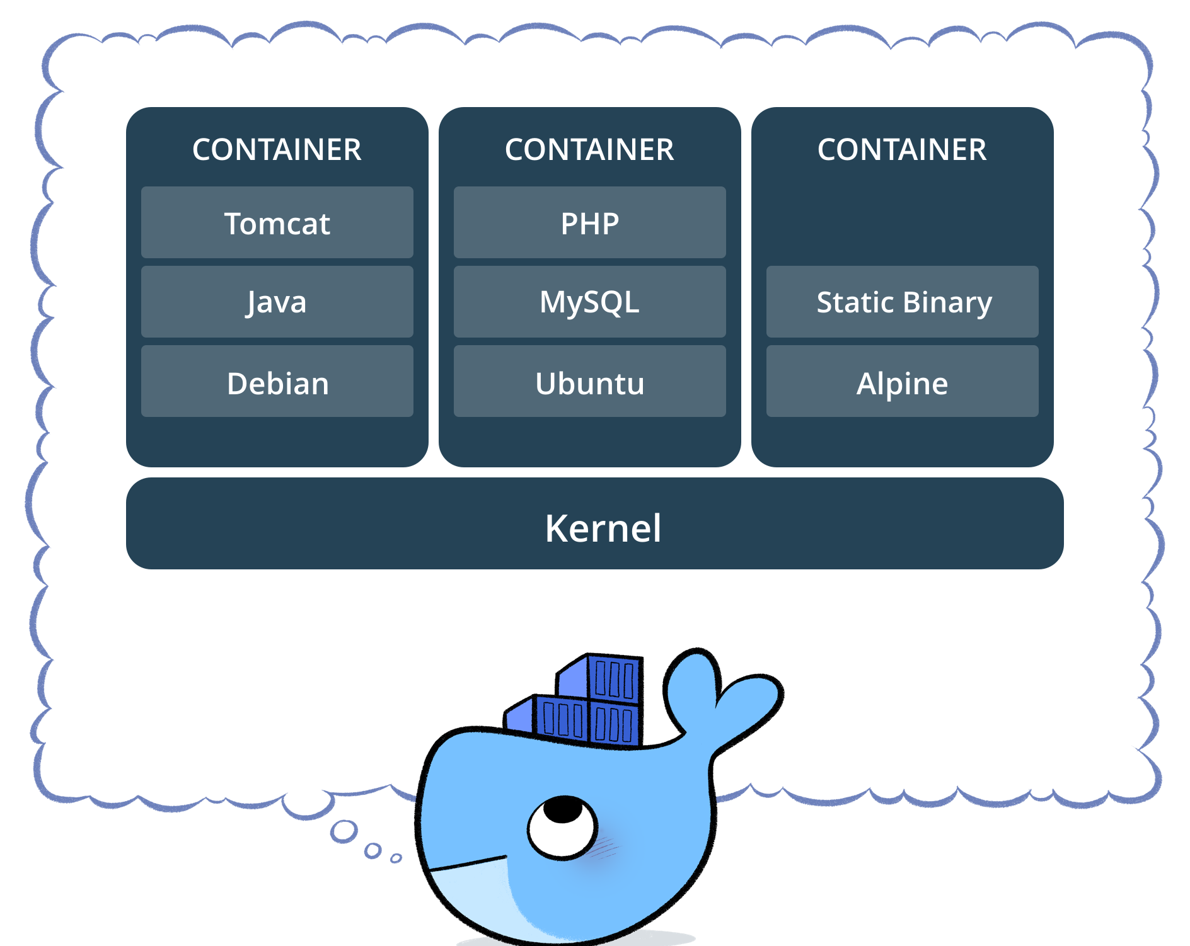
Docker
Lightweight containers
Standarization
Easy to configure
Easy to share
CI, CD, Testing

Slide 6
Components
Images
Containers
Volumes
Registries

Slide 9
Docker compose

Slide 14
Kubernetes
basics

Slide 15
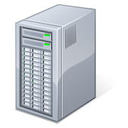
application

Slide 16
Docker
at the begining was Docker (or different container system)

Slide 17
but what if…
Container fails?
Load grows?
Loads decreases?
We need to have something to handle those situations

Slide 18
Kubernetes
Kubernetes (K8s) is an open-source system for automating deployment, scaling, and management of containerized applications.
For local testing
minikube
Docker Desktop

Slide 19
Architecture
MASTER
NODES

Slide 20
Architecture – more deeply
kube-controller-manager
cloud-controller-manager
api-server
kubelet
kube-proxy
etcd
scheduler
MASTER
NODE

Slide 21
Kubernetes cluster

Slide 22
Kubernetes cluster – deploy app

Slide 23
Basic Kubernetes elements
Pods
Services
Volumes
Labels
Selectors
Namespaces
….

Slide 24
kubectl
Command line tool for manage of Kubernetes
You can use direct parameters or YAML or JSON files for example for more complex configuration

Slide 25
namespace
groups objects/resources/pods/…. under one name
for example
dev
test
prod

Slide 26
pod
10.0.0.123
simpliest execution unit of Kubernetes system
encapsulates volumes, network and optionss
pod can run one or more containers
most common container system for pod is Docker, but you can use different one
labels
volume

Slide 27
service
abstraction that defines a logical set of pods
10.0.0.123
10.0.0.124
labels
labels
volume
volume

