Slide 1

DESIGN AND FABRICATION OF 6-AXIS GESTURE CONTROLLED ROBOT
Guided by,
Mrs. Indu V Nair
Assistant Professor
DEPT.OF ECE
UKFCET
Presented by,
Saleeja S
UKP18EC084
S7ECE
UKFCET

Slide 2
CONTENTS
INDRODUCTION
EXPERIMENTAL PROCEDURE
COMPONENTS
BLOCK DIAGRAM OF THE SYSTEM
EXPERIMENTAL ANALYSIS
CONCLUSION
FUTURE SCOPE
REFERENCES

Slide 3
OBJECTIVE
The objective of the paper is to develop a six DOF robot arm for an intelligent robot.

Slide 4
INDRODUCTION
The six axis robot is fabricated and controlled by using the gestures.
Easily accessible since the robot does not need higher efforts of controlling.
Arduino controller is used to control the robot.
Transmitter and receiver are used for transmission of signal.
Human resources are being minimized.
Helpful in medical operation and industrial heavy vehicle lifting etc…..

Slide 5
EXPERIMENTAL PROCEDURE
DESIGN OF THE ROBOTIC ARM
A robotic arm is a mechanical arm which performs actions similar to that of human hand when programmed and interfaced.
An acrylic plastic material is used for fabrication of prototype model.
The robot arm has the ability to move in six axis directions with six servo motor.
The end effector act as a gripper for grabbing, picking, and placing the objects.
The base is capable of rotating at 180 degrees

Slide 6
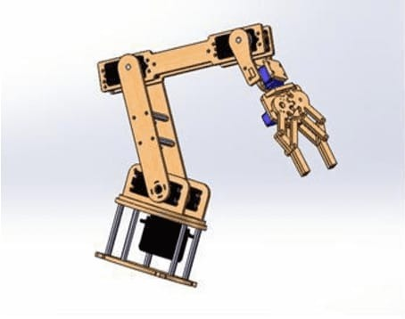
Figure 1: 3D model of the robot

Slide 7
FORWARD KINEMATICS
Forward kinematics is used to determine the x and y position of the gripper.
The position of gripper can be calculated by
X-position = l1cos(Ө1)+l2cos(Ө1+Ө2)+l3cos(Ө1+Ө2+ Ө3 ) …..
Y-position = l1sin(Ө1) +l2sin(Ө1+Ө2)+l3sin(Ө1+Ө2+ Ө3 )….

Slide 8
COMPONENTS
ACCELEROMETER
It is used to sense change in dynamic and static acceleration due to motion.
The robotic arm is controlled by using an accelerometer sensor with an artificial intelligence algorithm.
The accelerometer is attached to the human arms.
The robotic arm performs the action same as that of the gesture .

Slide 9
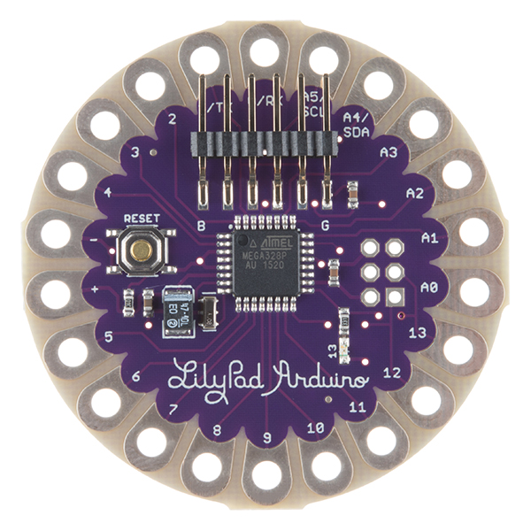
ARDUINO-LILYPAD
The lilypad Arduino is based on the ATmega168v or the ATmega328v.
It has total of 14 digital input output pins and the clock speed is 8MHz.

Slide 10
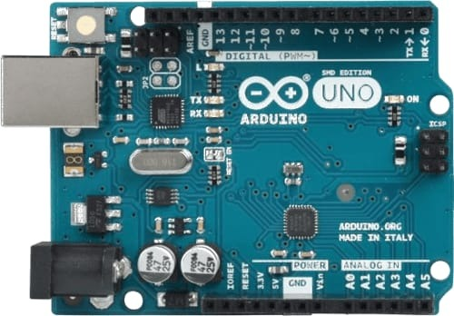
ARDUINO-UNO
Arduino-uno is based on microchipATmega328P.
It has 14 digital input output pins and clock speed is 16MHz.
It receives the decoded signals from the decoder and operates the motor driver

Slide 11
SERVO MOTOR
Servo motor has precise control over rotary and linear actuation.
It has the ability to move in rotary or linear manner and can withstand the position precisely.

Slide 12
RF- TRANSMITTER AND RECEIVER
The RF-transmitter-receiver is used to transmit and receive signals between the hand and the robotic arm.
The communication is done between the transmitter and receiver using the RF module
The transmitting device will transmit command to robot so that it can move onwards, turning left and right, backwards.

Slide 13
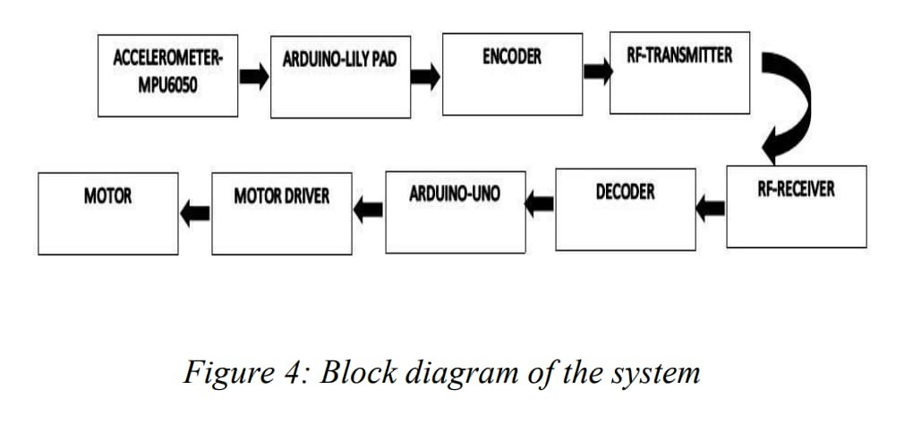
BLOCK DIAGRAM OF THE SYSTEM

Slide 14
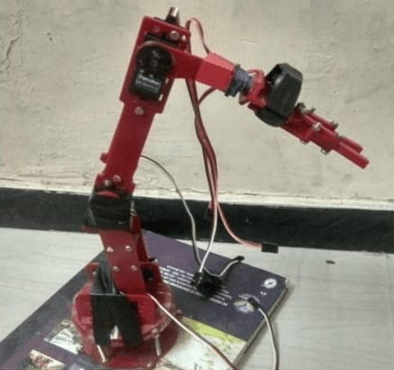
EXPERIMENTAL PROCEDURE

Slide 15
The robot accomplishes the given command accurately and smoothly.
The accuracy of the robot operation is influenced based on the external forces.
The speed of motor can be control.
The hand movements can be detected and the motion is effected relatively.

Slide 16
CONCLUSION
The six axis robot works with the gesture of the hand.
Today, technology is developing in the same direction in the line with rapidly increasing human needs. This work of six-axis robotic arm that makes the life easier
It can be utilized to do distant medical surgeries in remote areas

Slide 17
FUTURE SCOPE
Future surgeons can control a robotic arm which assists the doctor or imitates his actions.

Slide 18
REFERENCE
Rajesh Kannan Megalingam, Shiva Bandhyopadhyay, Gedela Vamsy Vivek, Muhammad Juned Rahi, "Hand Gesture Based Wireless Robotic Arm Control for Agricultural Applications," in Materials Science and Engineering 225 (2017).
Ali Karim, Julian Hitzer, Armin Lechler and Alexander Verl, "Analysis of the dynamic behavior of a six-axis industrial robot within the entire workspace in onAdvanced Intelligent Mechatronics (AIM)Sheraton Arabella Park Hotel, Munich, Germany, July37 (2017)respect of machining tasks," 2017 IEEE Internationa Conference.

Slide 19
R. Deepan, Santhana Vikrama Rajavarman and K. Narasimhan, "Hand Gesture Based Control of Robotic Hand using Raspberry Pi Processor," Asian Journal of Scientific Research, 8: 392-402. [4] Wilson F. Cueva C. Hugo M. Torres S. John Kern M.,"7 DOF Industrial Robot Controlled by Hand Gestures Using Microsoft Kinect v2," 2017 IEEE 3rd Colombian Conference on Automatic Control (CCAC).
Zhirong Lin, Houde Dai, Zhouxin Wu, Yadan Zeng,Shijian Su, Xuke Xia, Mingqiang LinPatrick Hung-Hsiu Yu, "Analysis of a six-axis industrial robot’s dynamic path accuracy based on an optical tracker," 2017 5th International Conference on Enterprise Systems.

Slide 20
THANK YOU

