Slide 1
PARABELLO
Presented by
Guided by
Mohammed Ramees P Askar sir(BCA Dept)
Mahir Hussain
Rajasajad

Slide 2
Overview
Introduction
Existing System
Advantages
Proposed System
Disadvantages
Requirements
DFD
Methodology
Architecture Diagram
Modules
Forms
Tables
Conclusion
Reference

Slide 3
ABSTRACT
The purpose of Parabello system is to provide a single interface for both search and compare process before buying
Publish most adaptable vehichle for buyer
The project is to develop a web application for buyers and sellers where they can find right way to sell and buy cars
This application also provide option for renting vehichle by accepting required id from occupier

Slide 4
EXISTING SYSTEM
Existing online comparison websites and marketplace
It is hard to find the both compare and buying feature in a same website
Fraud buyers and sellers
Lack of rental service options

Slide 5
DISADVANTAGE
Every users can’t buy vehichle
Some websites have to pay for registration
Annoying ads
Renting will be on owner’s personal risk

Slide 6
Proposed system
ONLINE COMPARE AND MARKETPLACE
Registered users and public users
Public users can compare vehichles
Only verified vehichles are published
Only verified buyers can purchase
No registration Fees

Slide 7
ADVANTAGES
Best vehichle for buyers are provided by the system
Clear verification
Local contact : Reduce fraud buyer
Compare option
Purchase or rent vehichle
User friendly
need less technical and professional knowledge

Slide 8
Requirements
Software requirements:
Html 5
J Query
PHP
MySql
Visual studio code
Hardware requirements:
2GB RAM
Intel Pentium CPU
720p Display

Slide 9
MODULE DESCRIPTION
Admin : Complete access for the web site
Vehichle upload : uploading & editing the advertisement
User Module : Module dedicated for user activities and compare
Registration Module : Registration activities
Login module :verifying and redirecting to user module
Verification module : verifiying the vehichle and id’s uploaded by
seller/buyer

Slide 10
DFD

Slide 11
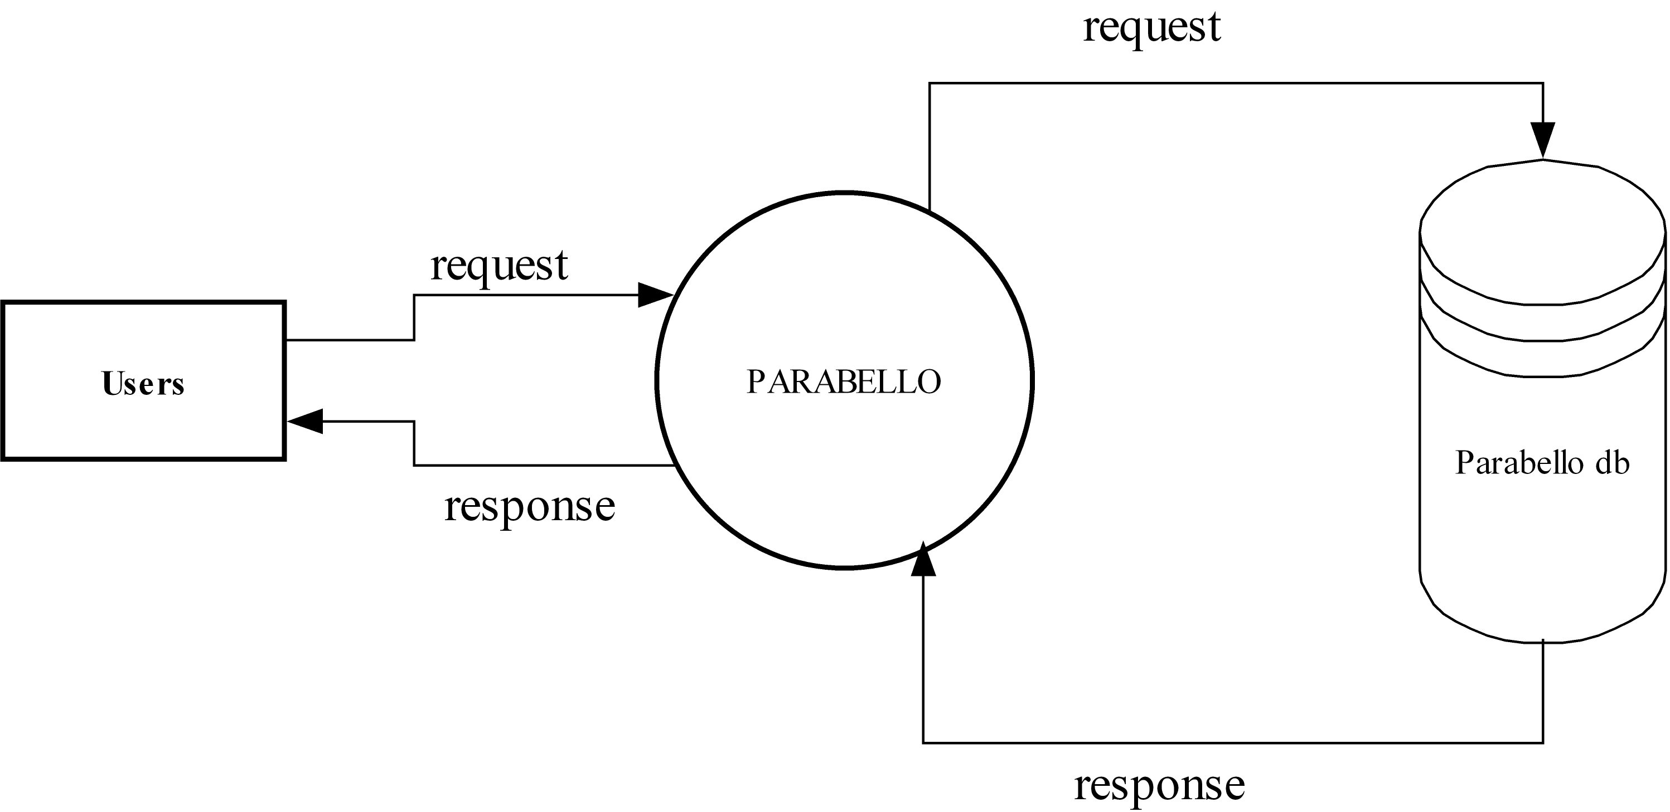
Level 0

Slide 12
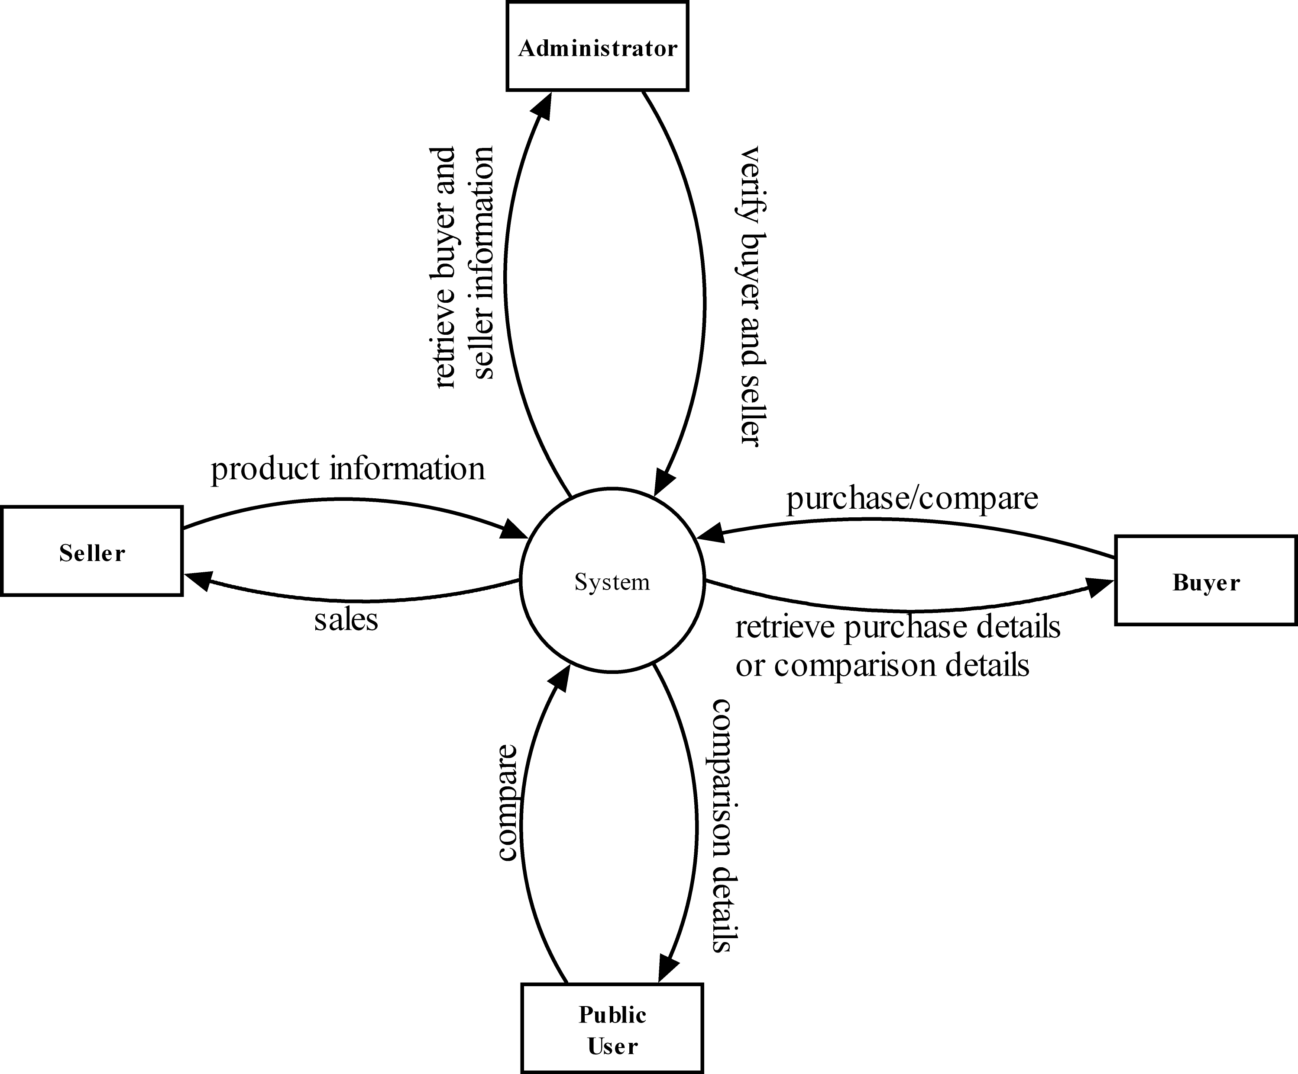
Level 1

Slide 13
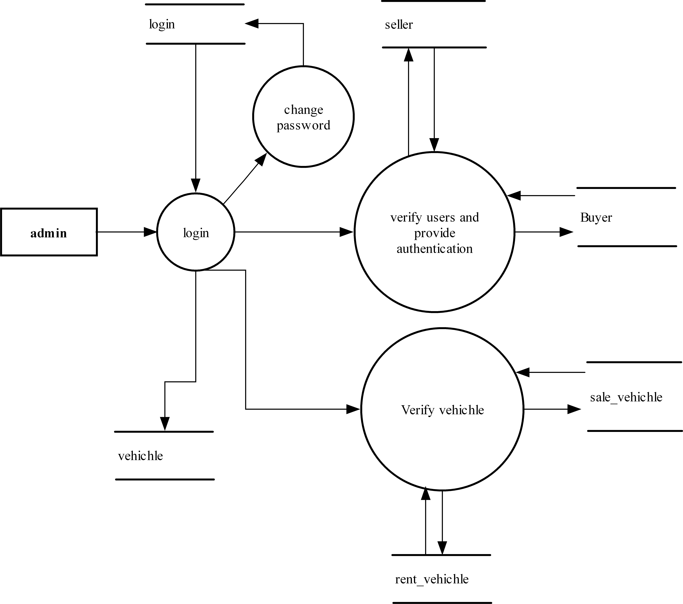
ADMIN

Slide 14
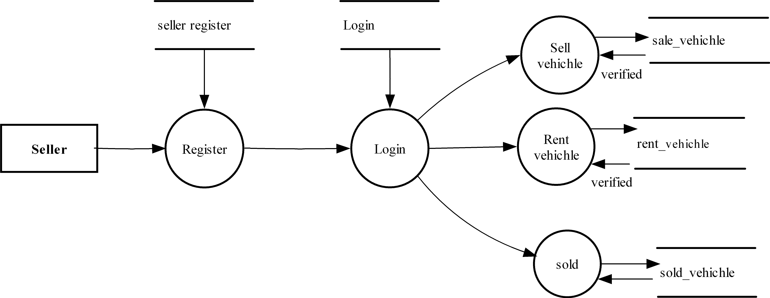
SELLER

Slide 15
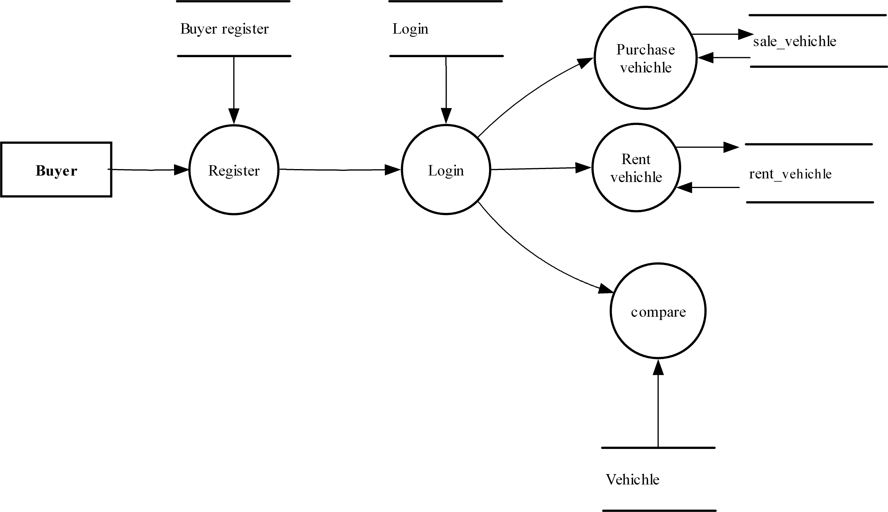
BUYER

Slide 16
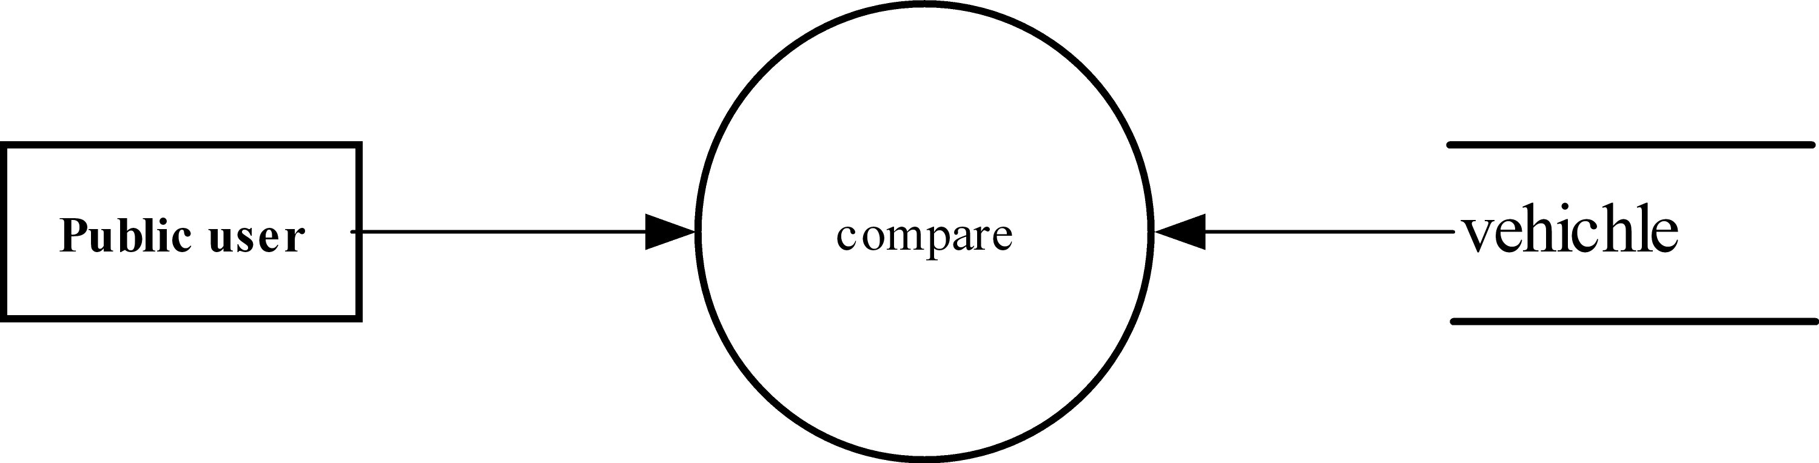
PUBLIC USER

Slide 17
TABLES

Slide 18
TABLE FOR ADMIN LOGIN
No | Column name | datatype | key
1 | Admin_id | Varchar(10) | Primary key
2 | password | Vrachar(20) | Not null

Slide 19
TABLE FOR INSERT CAR
No | Column name | Data type | key
1 | iCar_id | Varchar(30) | Not null,primary key
2 | Name_car | Varchar(30) | Not null
3 | yom | Varchar(30) | Not null
4 | mileage | integer | Not null
5 | capacity | Varchar(10) | Not null
6 | Fuel_type | image | Not null
7 | safety | Varchar(20) | Not null
8 | Price | integer | Not null
9 | Body_type | Varchar(20) | Not null
10 | comfort | integer | Not null
11 | maintenance_cost | integer | Not null

Slide 20
TABLE FOR SELLER REGISTRATION
No | Column name | Data type | key
1 | Seller_id | Varchar(10) | Not null, Primay key
2 | name | Varchar(50) | Not null
3 | email | Varchar(30) | Not null
4 | mob_no | Varchar(10) | Not null
5 | city | Varchar(35) | Not null
6 | address | Varchar(50) | Not null

Slide 21
TABLE FOR SELLER LOGIN
NO | Column name | Data type | key
1 | seller_id | Varchar(10) | Not null, foreign key
2 | password | Varchar(30) | Not null

Slide 22
TABLE FOR ADD SELLING VEHICHLE
No | Column name | Data type | key
1 | Car_id | Varchar(30) | Not null,primary key
2 | Seller_id | Varchar(10) | Foreign key,not null
3 | model | integer | Not null
4 | color | Varchar(30) | Not null
5 | Kms_driven | integer | Not null
6 | fuel_type | Varchar(10) | Not null
7 | image | image | Not null
8 | city | Varchar(20) | Not null
9 | rate | integer | Not null
10 | status | Varchar(20) | Not null

Slide 23
TABLE FOR ADD RENTING VEHICHLE
No | Column name | Data type | key
1 | rcar_id | Varchar(30) | Not null,primary key
2 | model | integer | Not null
3 | color | Varchar(30) | Not null
4 | KMs driven | integer | Not null
5 | Fuel type | Varchar(10) | Not null
6 | image | image | Not null
7 | city | Varchar(20) | Not null
8 | rent_rate | integer | Not null
9 | status | Varchar(20) | Not null

Slide 24
TABLE FOR SOLD CARS
NO | Column name | Data type | key
1 | Sold_car_id | Varchar(10) | Not null,Primary key
2 | Car_id | Varchar(30) | Not null,foreign key
3 | buyer_id | Varchar(10) | Not null,foreign key

Slide 25
TABLE FOR BUYER REGISTRATION
No | Column name | Data type | key
1 | buyer_id | Varchar(10) | Not null,primary key
2 | name | Varchar(30) | Not null
3 | mob_no | Varchar(10) | Not null
4 | adhar_no | Varchar(20) | Not null
5 | email | Varchar(30) | Not null
6 | city | Varchar(35) | Not null
7 | address | Varchar(50) | Not null

Slide 26
TABLE FOR BUYER LOGIN
No | Column name | Data type | key
1 | buyer_id | Varchar(10) | Not null, foreign key
2 | password | Varchar(30) | Not null

Slide 27
FORMS

Slide 28


Slide 29
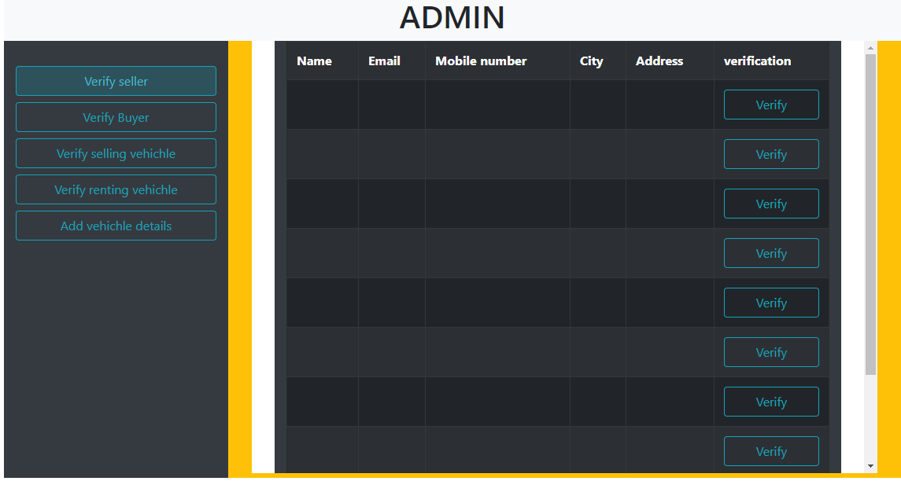

Slide 30
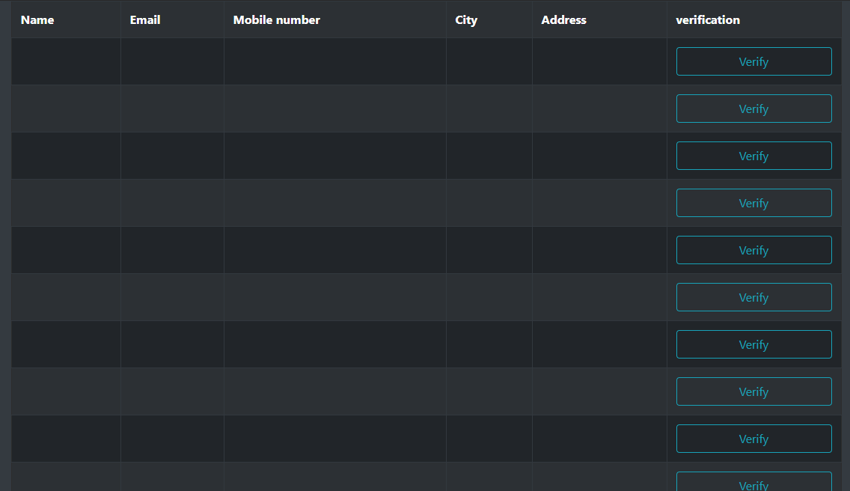

Slide 31
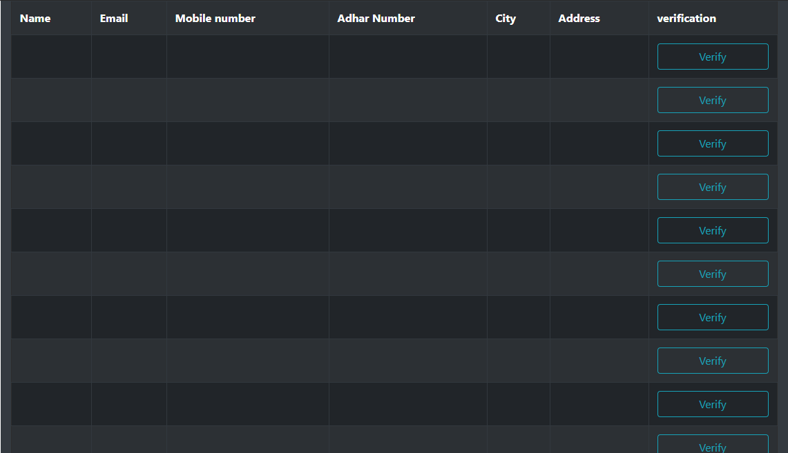

Slide 32
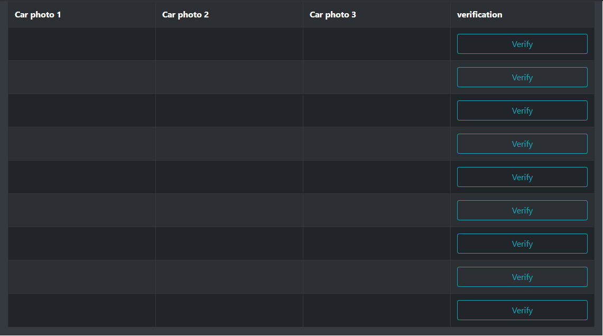

Slide 33
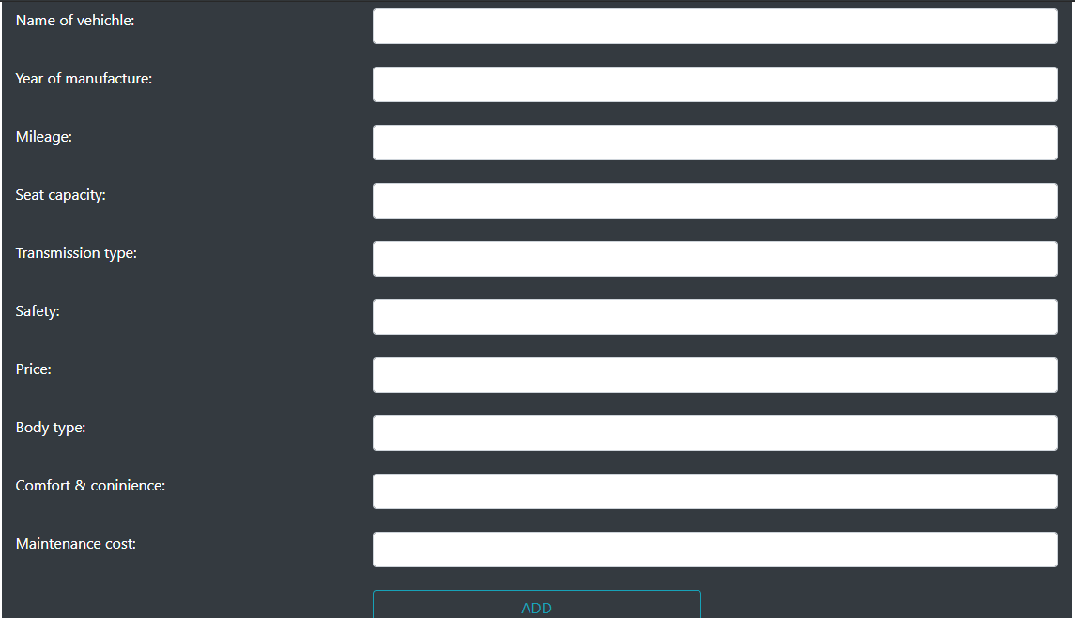

Slide 34
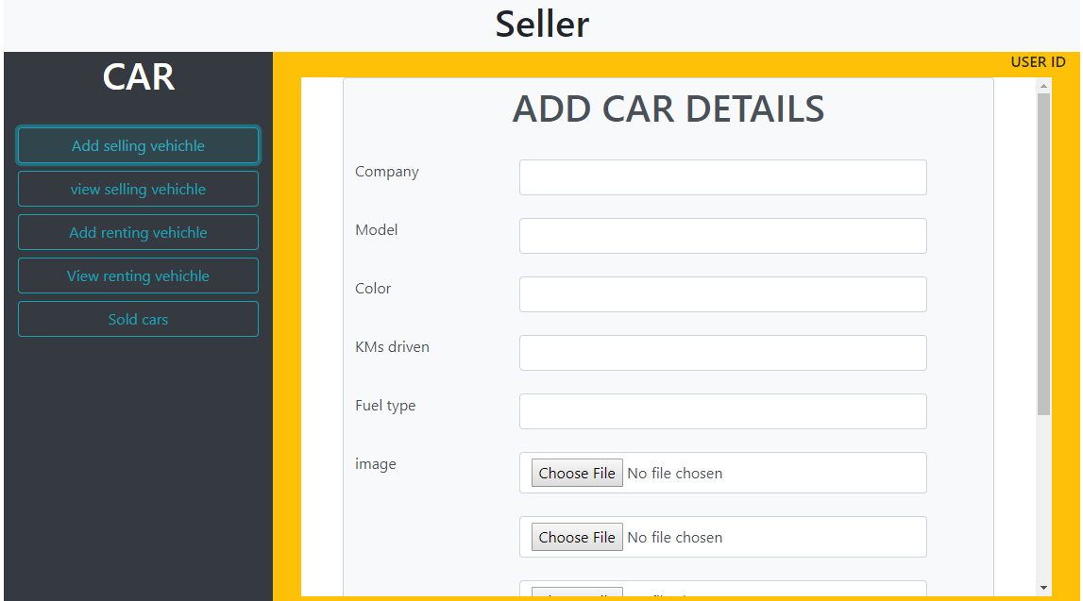

Slide 35
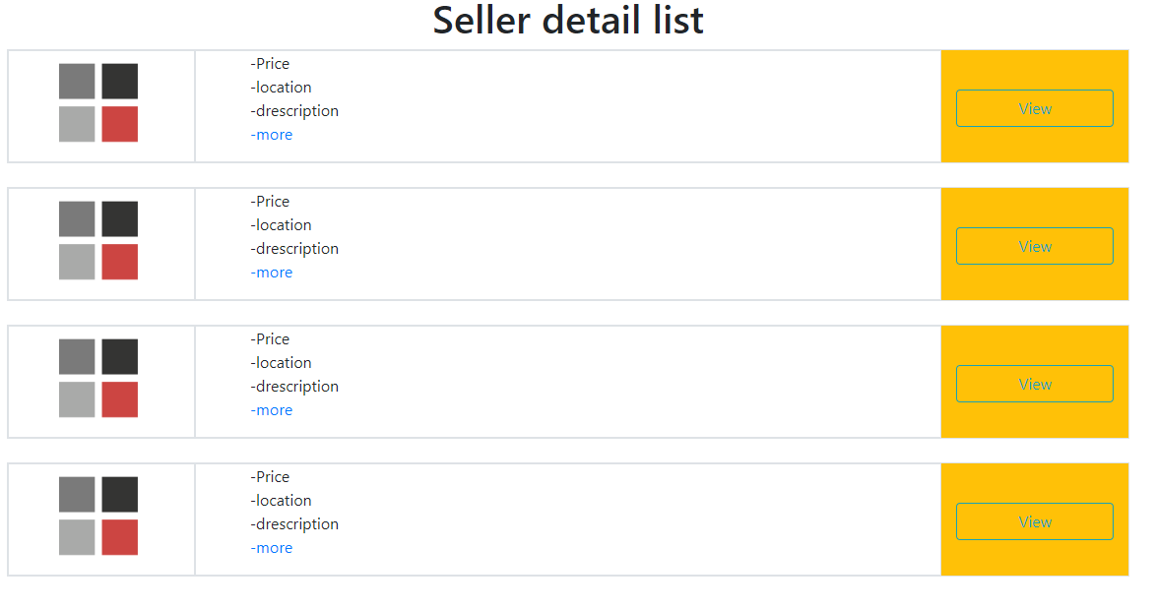

Slide 36
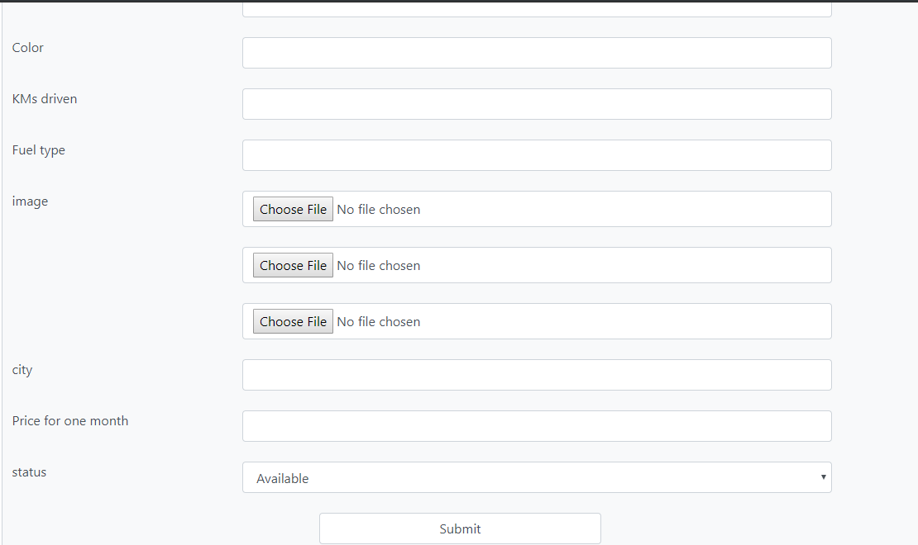

Slide 37
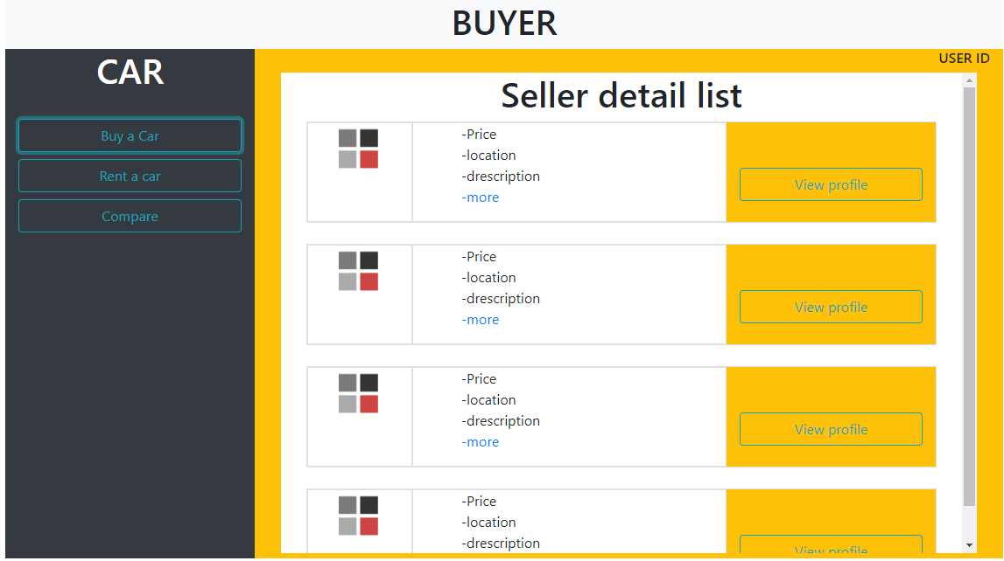

Slide 38
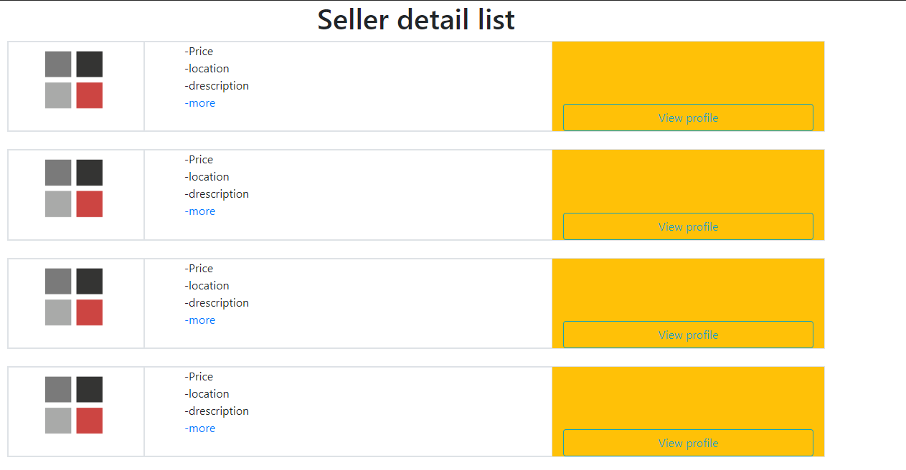

Slide 42
