Slide 1

CSJM UNIVERSITY KANPUR
B.TECH PROJECT PRESENTATION
SUBMITTED BY-
SALEEM KHAN (043)
MOHD FAISAL (029)
SUBMITTED TO-
ER. MOHD. SHAH ALAM SIR

Slide 2
PROJECT TITLE
IMAGE SEGMENTATION WITH MACHINE LEARNING

Slide 3
INTRODUCTION
The Image Segmentation is ability of computer to segment different object and precisely outline their entire form in an image . With that, we are significantly expand the scope of accuracy and precision among image annotation task and apply it to innovative technological advancements.
PROBLEM STATEMENT
The goal of this project is to create a model that will be able to segment different objects and precisely outline their entire form in an image using concept of U-Net architecture.
The major goal of proposed system is to determine best segmentation method and implement best fitting and optimal architecture so that we can get better precision and recall.

Slide 4
Methodologies for IMAGE SEGMENTATION-
Dataset Used–
We used a Dataset from www.kaggle.com. The name of this dataset is people segmentation
In form of images and mask_images file. This dataset is basically a image file which contains 5678 images of people and 5678 images of their mask of different sizes.
LIBRARIES USED -
NumPy
Scikit Learn
OpenCV
Tensorflow
Conv2D
MaxPool2D
Conv2DTranspose

Slide 5
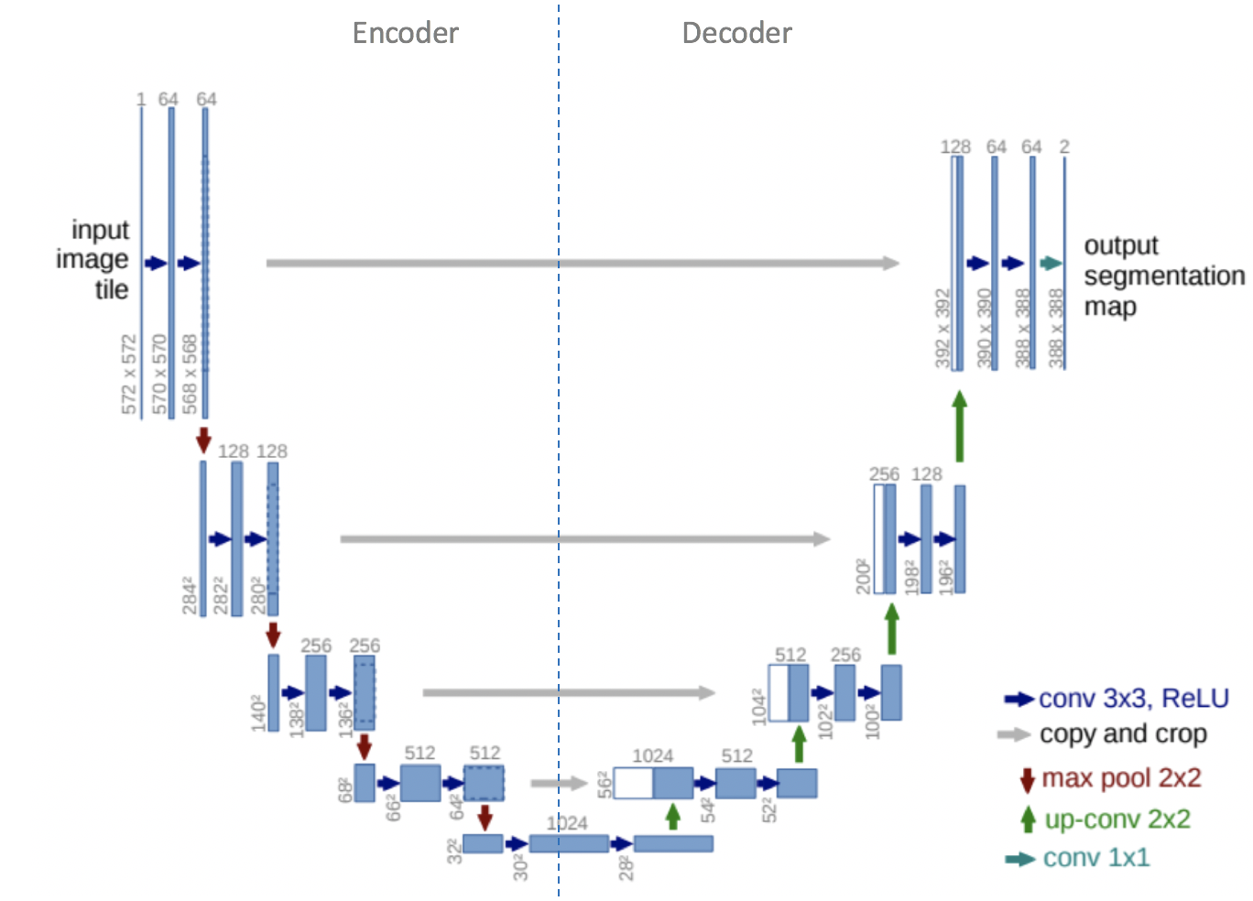
MODEL USED – > U-NEt Architecture

Slide 6
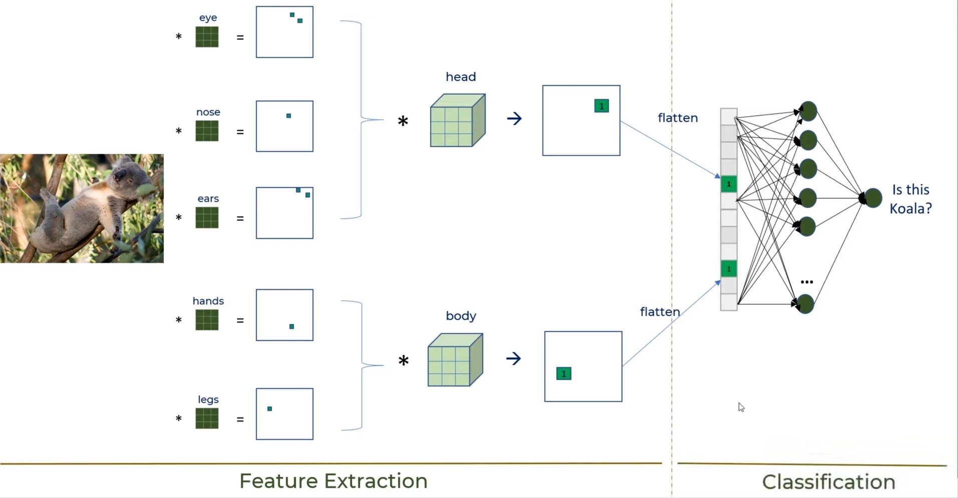
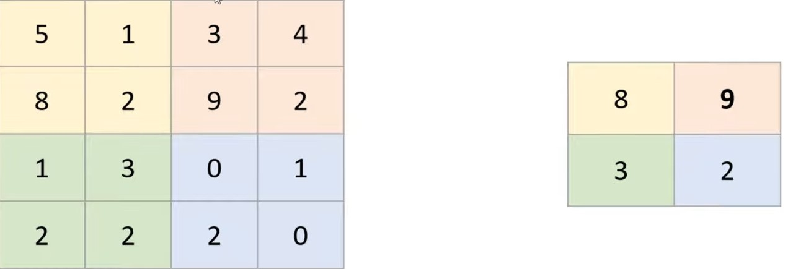
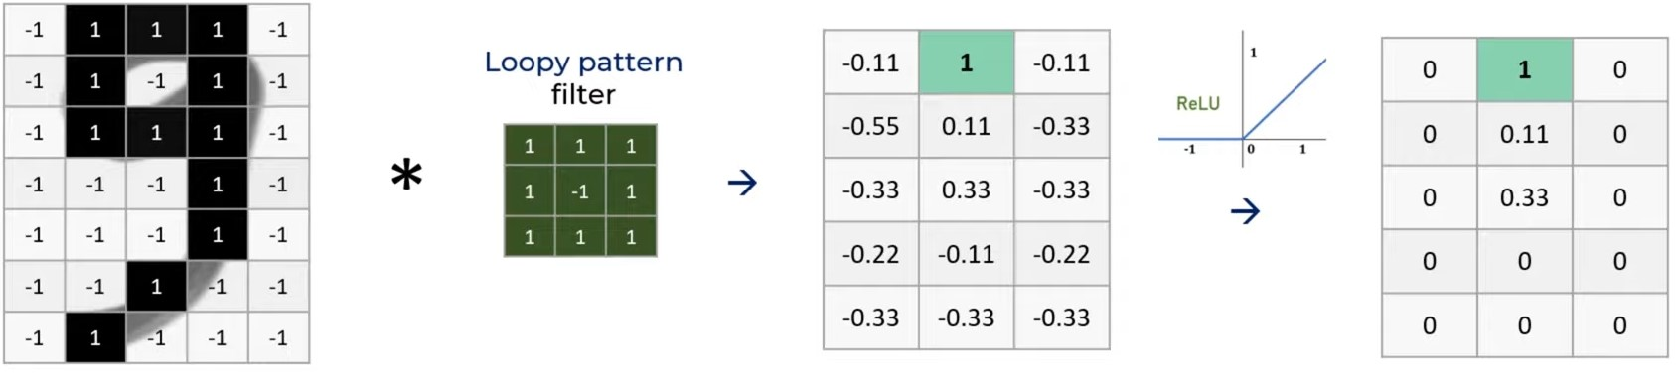
Feature Extraction using feature channels-
---------------------------------------------------------------------------------------------------------------
MaxPooling-
2 by 2 filter with stride = 2
---------------------------------------------------------------------------------------------------------------
Rectified Linear Unit-

Slide 7
PRE - PROCESSING
import LIBRARIES and dataset –
import os
import numpy as np
import cv2
from glob import glob
from sklearn.model_selection import train_test_split
def load_dataset(dataset_path):
images = glob(os.path.join(dataset_path, "images/*"))
masks = glob(os.path.join(dataset_path, "masks/*"))
train_x, test_x = train_test_split(images, test_size=0.2, random_state=42)
train_y, test_y = train_test_split(masks, test_size=0.2, random_state=42)
Pre-processing data -
def preprocess(image_path, mask_path):
def f(image_path, mask_path):
image_path = image_path.decode()
mask_path = mask_path.decode()
x = read_image(image_path)
y = read_mask(mask_path)
return x, y
image, mask = tf.numpy_function(f, [image_path, mask_path], [tf.float32, tf.float32])
image.set_shape([256, 256, 3])
mask.set_shape([256, 256, 1])

Slide 8
Model construction
Import libraries -
from tensorflow.keras.layers import Conv2D, BatchNormalization, Activation, MaxPool2D, Conv2DTranspose, Concatenate, Input
from tensorflow.keras.models import Model
Model construction -
Convolutional block -
def conv_block(input, num_filters):
x = Conv2D(num_filters, 3, padding="same")(input)
x = BatchNormalization()(x)
x = Activation("relu")(x)
x = Conv2D(num_filters, 3, padding="same")(x)
x = BatchNormalization()(x)
x = Activation("relu")(x)
Return x
Encoder block -
def encoder_block(input, num_filters):
x = conv_block(input, num_filters)
p = MaxPool2D((2, 2))(x)
return x, p

Slide 9
Continue.....
Decoder block -
def decoder_block(input, skip_features, num_filters):
x = Conv2DTranspose(num_filters, (2, 2), strides=2, padding="same")(input)
x = Concatenate()([x, skip_features])
x = conv_block(x, num_filters)
Return x
Model construction -
def build_unet(input_shape):
inputs = Input(input_shape)
s1, p1 = encoder_block(inputs, 64)
s2, p2 = encoder_block(p1, 128)
s3, p3 = encoder_block(p2, 256)
s4, p4 = encoder_block(p3, 512)
b1 = conv_block(p4, 1024)
d1 = decoder_block(b1, s4, 512)
d2 = decoder_block(d1, s3, 256)
d3 = decoder_block(d2, s2, 128)
d4 = decoder_block(d3, s1, 64)
outputs = Conv2D(1, 1, padding="same", activation="sigmoid")(d4)
model = Model(inputs, outputs, name="U-Net")
return model

Slide 10
COMPILING AND TRAINING THE MODEL
Compiling the model –
model = build_unet(input_shape)
model.compile(
loss="binary_crossentropy",
optimizer=tf.keras.optimizers.Adam(lr),
metrics=[
tf.keras.metrics.MeanIoU(num_classes=2),
tf.keras.metrics.Recall(),
tf.keras.metrics.Precision()
]
)
Training and Validation -
model.fit(
train_dataset,
validation_data=test_dataset,
epochs=epochs,
steps_per_epoch=train_steps,
validation_steps=test_steps,
callbacks=callbacks
)

Slide 11
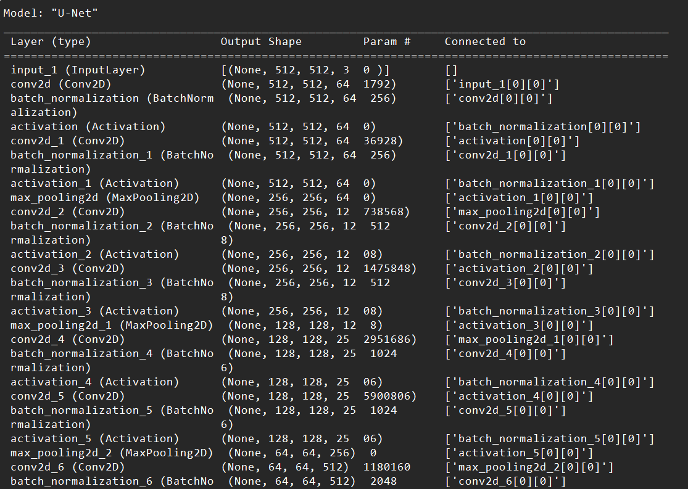
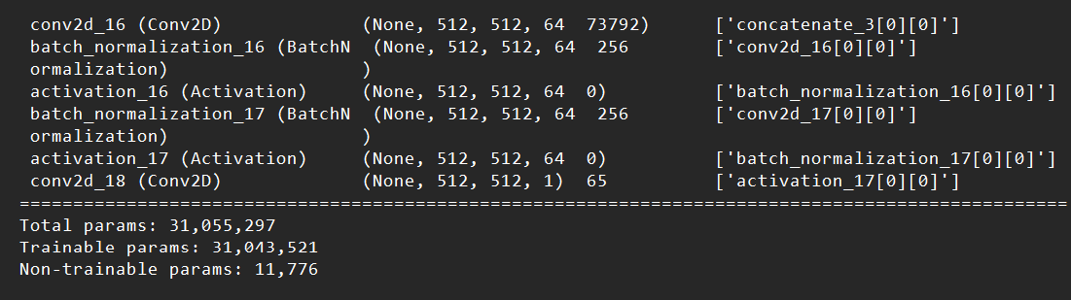
MODEL SUMMARY
Output -
Command:-
Model.summary()
.
.
.
.
.

Slide 12
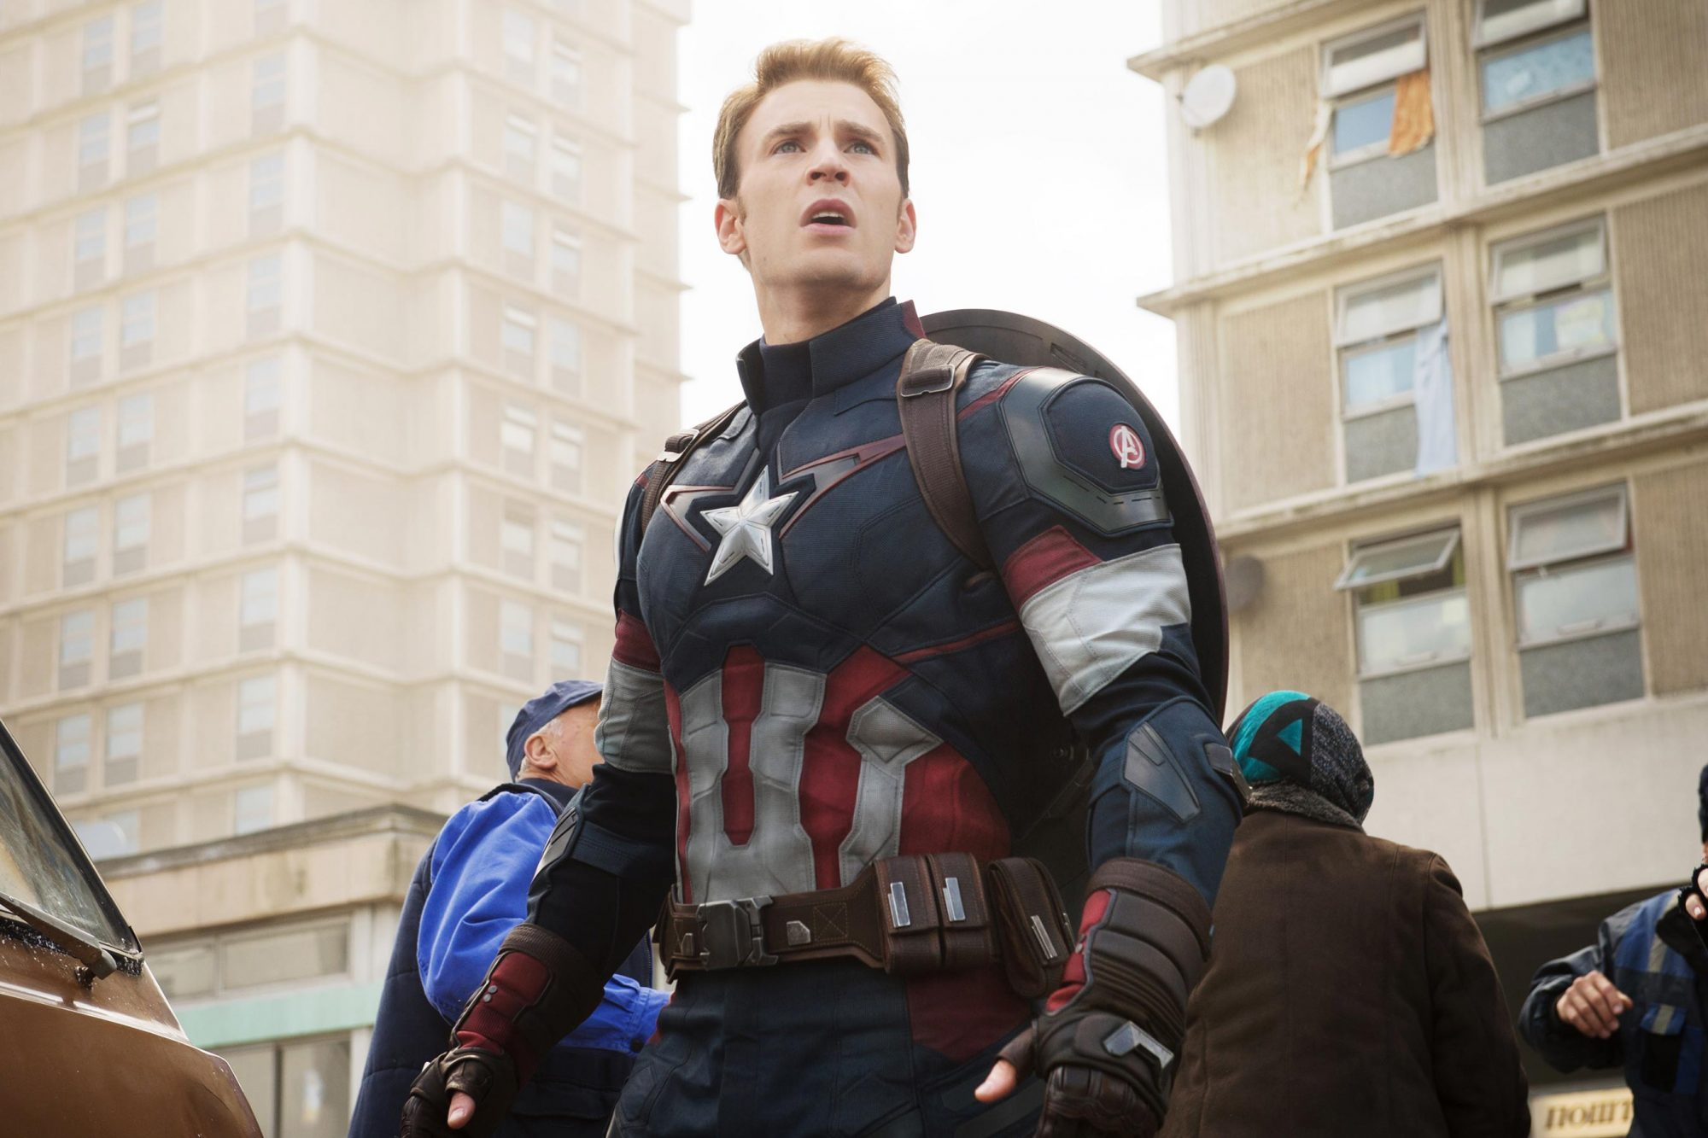
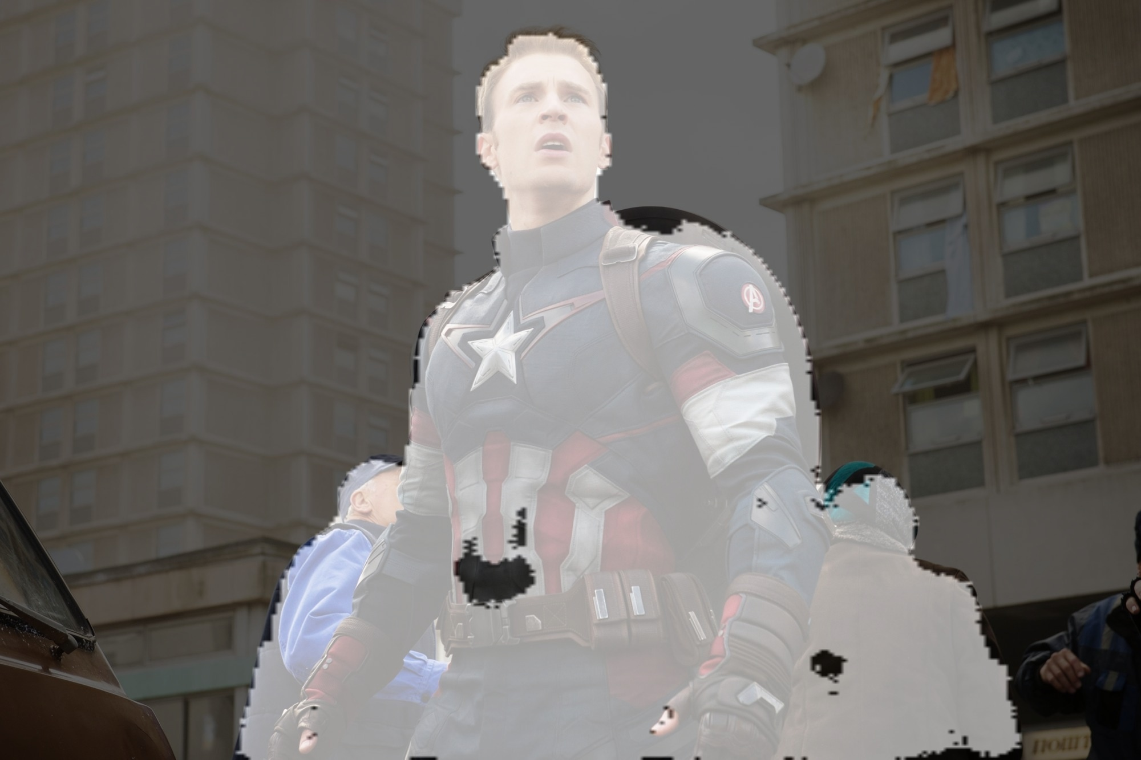
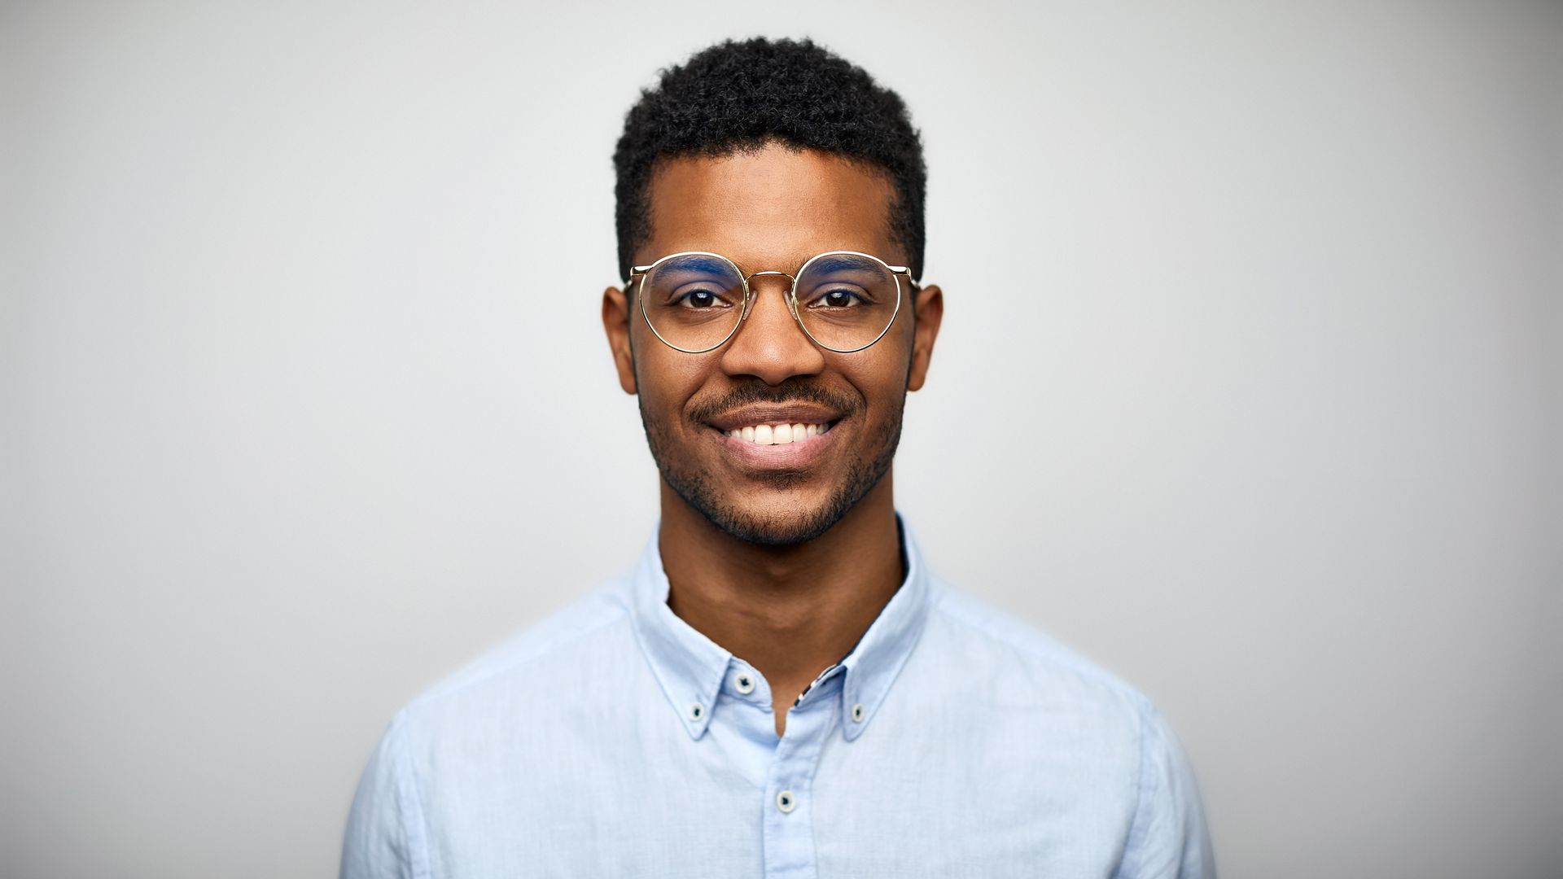
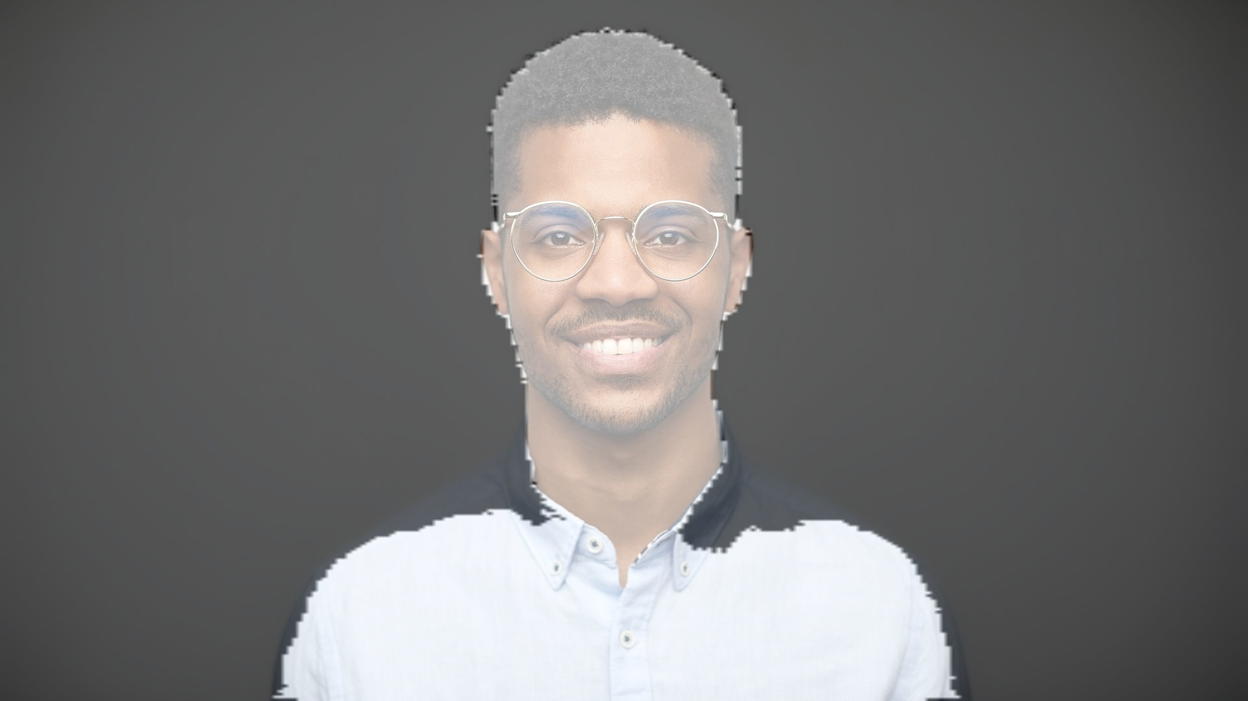
PREDICTION FROM RANDOML INPUTS

Slide 13
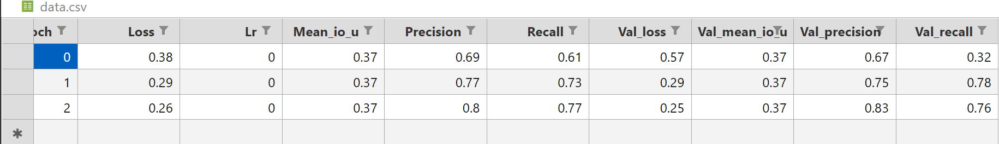
PRECISION AND RECALL WHEN TRAINED ON 3 EPOCHS
Hyperparameters-
dataset_path = "people_segmentation"
input_shape = (256, 256, 3)
batch_size = 12
epochs = 3
lr = 1e-4
model_path = "unet.h5"
csv_path = "data.csv"

Slide 14
WORK PROGRESS
Work done in this semester
Study Semantic segmentation, U-Net Architecture and Deep Learning.
Build a U-Net model.
Model Training.
Model Testing on random inputs.
Work for next semester
Work on video background changer.
Work on increasing accuracy more.
Will develop the UI for model on one of following methods –
=> Live video Cam background changer.
=> Merging an Object into another video
without green background.

Slide 15
THANK YOU.....

