Slide 1
AtliQ Hardware – Ad-Hoc Insights

Slide 2
Company Overview
AtliQ Hardware is a global hardware manufacturing company.
Headquartered in India, serving customers across APAC, EU, LATAM, and NA regions.
Offers a wide range of products, including PCs, peripherals, and accessories.
Sells through multiple channels such as Retailers, Direct, and Distributors.
Focused on delivering quality products and excellent customer service.
Uses data-driven decision making to improve sales performance and profitability.

Slide 3
Objective
Solve 10 ad-hoc business requests for AtliQ Hardware.
Use SQL queries to extract and analyze relevant data.
Provide insights on sales, customers, products, and finance.
Enable stakeholders to get quick answers to critical business questions.
Support data-driven decision-making with clear, actionable insights.

Slide 4
Request 1
Provide the list of markets in which customer "Atliq Exclusive" operates its business in the APAC region.
select distinct(market) from dim_customer
where customer="Atliq Exclusive" and region="APAC"
order by market;

Slide 5
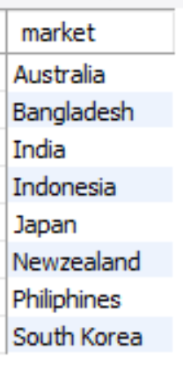
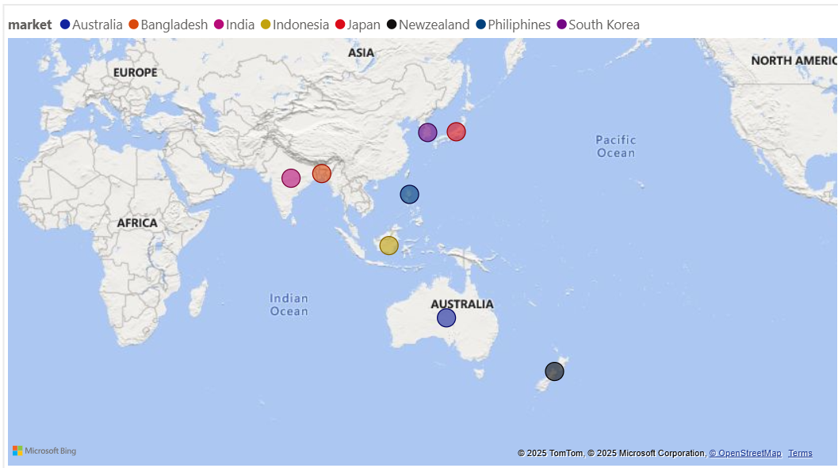
Visual:
Output:
Insights:
AtliQ Exclusive operates in 9 APAC countries, showing a wide geographical reach across Asia-Pacific.

Slide 6
Request 2
What is the percentage of unique product increase in 2021 vs. 2020? The final output contains these fields, unique_products_2020, unique_products_2021, percentage_chg
with products_count as (
select g.fiscal_year, count(distinct(p.product_code)) as unique_products
from dim_product p
join fact_gross_price g
on g.product_code=p.product_code
group by g.fiscal_year)
select
y20.unique_products as unique_products_2020,
y21.unique_products as unique_products_2021,
round(((y21.unique_products-y20.unique_products)*100/nullif(y20.unique_products, 0)), 2) as perctge_chg
from products_count y20 cross join products_count y21
where y20.fiscal_year=2020 and y21.fiscal_year=2021;

Slide 7
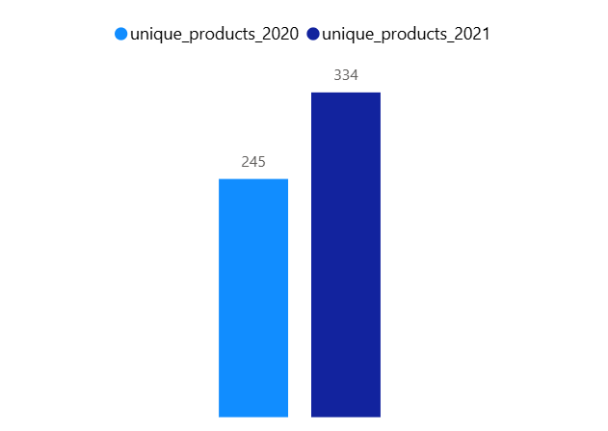
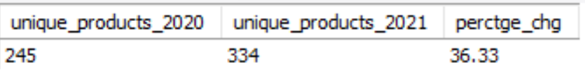
Visual:
Output:
Insights:
1. The number of unique products increased from 245 in 2020 to 334 in 2021, reflecting a strong 36.3% growth in product variety.
2. This increase in product variety shows AtliQ is actively innovating and expanding its offerings to capture a wider customer base.

Slide 8
Request 3
Provide a report with all the unique product counts for each segment and sort them in descending order of product counts. The final output contains 2 fields, segment, product_count
select
segment, count(distinct(product_code)) as product_count
from dim_product
group by segment
order by product_count desc;

Slide 9
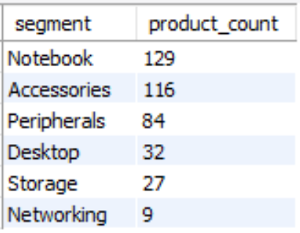
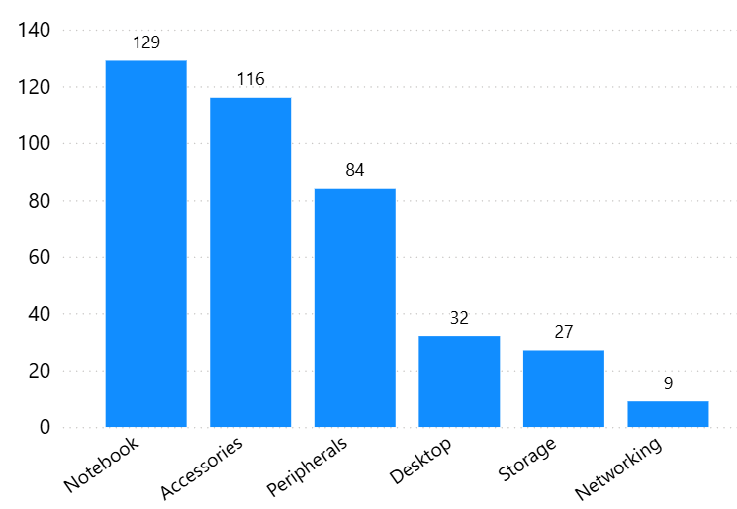
Visual:
Output:
Insights:
1. Most unique products are concentrated in Notebooks and Accessories, showing these as the company’s strongest segments.
2. Networking and Storage have very few products, highlighting limited focus in these areas.

Slide 10
Request 4
Follow-up: Which segment had the most increase in unique products in 2021 vs 2020? The final output contains these fields, segment, product_count_2020, product_count_2021, difference
with cte1 as(
select
p.segment, s.fiscal_year, count(distinct(p.product_code)) as unique_product
from dim_product p
join fact_sales_monthly s
on s.product_code=p.product_code
group by p.segment, s.fiscal_year)
select
c1.segment,
c1.unique_product as product_count_2020,
c2.unique_product as product_count_2021,
c2.unique_product-c1.unique_product as difference
from cte1 c1 join cte1 c2 on c1.segment=c2.segment and c1.fiscal_year=2020 and c2.fiscal_year=2021
order by difference desc;

Slide 11
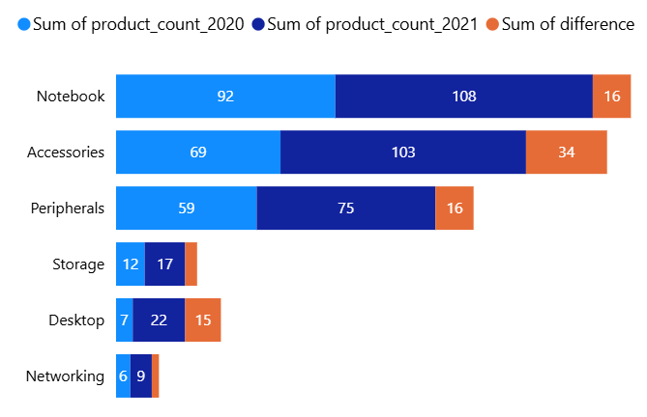
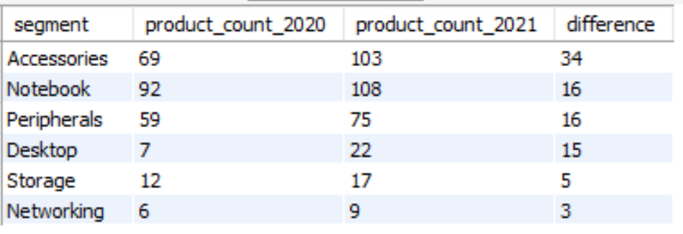
Visual:
Output:
Insights:
1. Accessories had the largest growth (+34 products), making it the fastest-expanding segment; the company should continue investing here to leverage demand.
2. Notebooks, Peripherals, and Desktops grew moderately, while Storage and Networking lagged—the company may need to either boost focus in these weaker areas or deprioritize them if they’re not strategic.

Slide 12
Request 5
Get the products that have the highest and lowest manufacturing costs. The final output should contain these fields, product_code, product, manufacturing_cost
(select
p.product_code, p.product, m.manufacturing_cost
from dim_product p
join fact_manufacturing_cost m
on m.product_code=p.product_code
order by m.manufacturing_cost asc limit 1)
union all
(select
p.product_code, p.product, m.manufacturing_cost
from dim_product p
join fact_manufacturing_cost m
on m.product_code=p.product_code
order by m.manufacturing_cost desc limit 1);

Slide 13
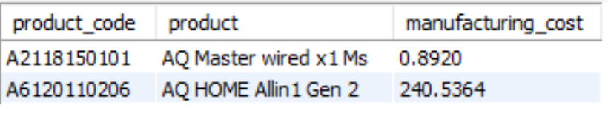
Output:
Insights:
AQ Master wired x1 Ms is having the low manufacturing cost of 0.8920.
AQ HOME Allin 1 Gen 2 is having the high manufacturing cost of 240.5364.

Slide 14
Request 6
Generate a report which contains the top 5 customers who received an average high pre_invoice_discount_pct for the fiscal year 2021 and in the Indian market. The final output contains these fields, customer_code, customer, average_discount_percentage
select
c.customer_code, c.customer,
round(avg(p.pre_invoice_discount_pct)*100, 2) as average_discount_percentage
from dim_customer c
join fact_pre_invoice_deductions p
on c.customer_code=p.customer_code
where fiscal_year=2021 and market='India'
group by c.customer_code, c.customer
order by average_discount_percentage desc limit 5;

Slide 15
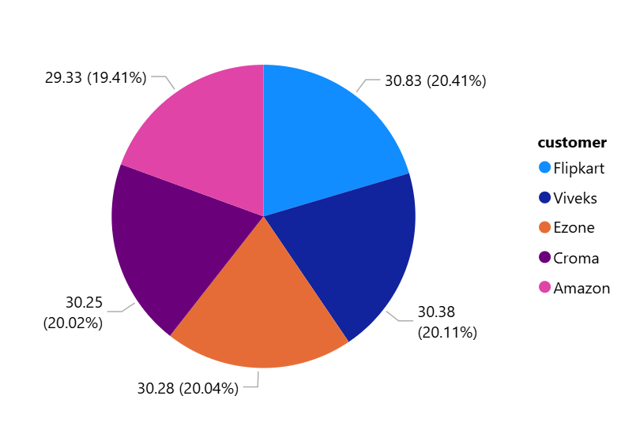
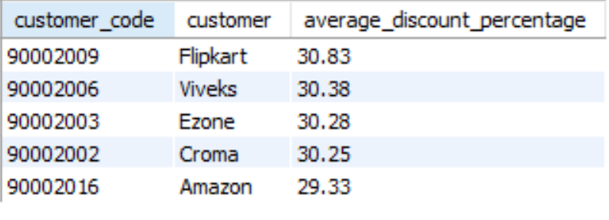
Visual:
Output:
Insights:
The report shows that Flipkart, Viveks, Ezone, Croma, and Amazon received the highest average pre-invoice discounts in 2021 for India.
This indicates the company gave major discounts to its top retail partners, likely to boost sales volume and strengthen relationships.

Slide 16
Request 7
Get the complete report of the Gross sales amount for the customer “Atliq Exclusive” for each month . This analysis helps to get an idea of low and high-performing months and take strategic decisions. The final report contains these columns: Month, Year, Gross sales Amount
select
monthname(s.date) as Month, Year(s.date) as Year,
round(sum(g.gross_price*s.sold_quantity), 2) as Gross_sales_Amount
from dim_customer c
join fact_sales_monthly s
on s.customer_code=c.customer_code
join fact_gross_price g
on g.product_code=s.product_code and g.fiscal_year=s.fiscal_year
where c.customer='Atliq Exclusive'
group by Year(s.date), month(s.date), monthname(s.date)
order by Year(s.date), month(s.date);

Slide 17
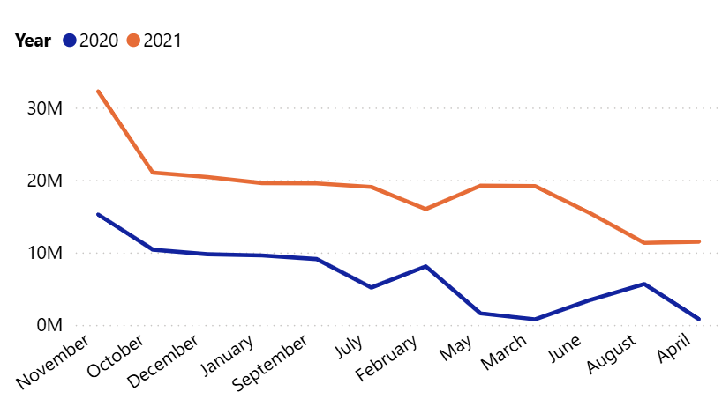
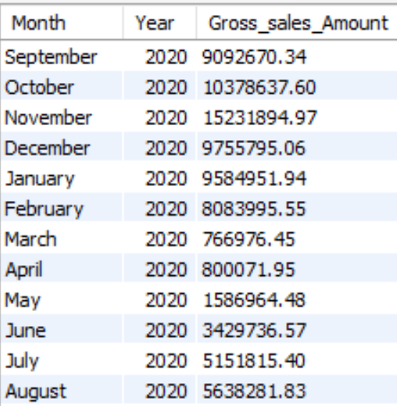
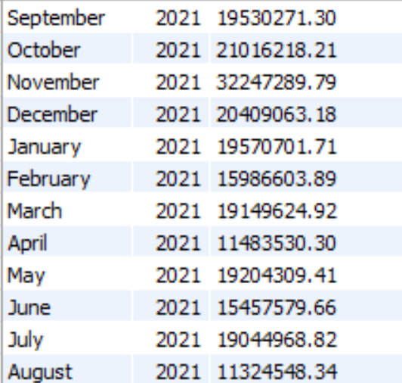
Visual:
Output:
Insights:
1. In 2021, gross sales for AtliQ Exclusive were much higher than in 2020, peaking in September–November. 2. This shows strong early-year demand in 2021, while 2020 had relatively lower and fluctuating sales.

Slide 18
Request 8
In which quarter of 2020, got the maximum total_sold_quantity? The final output contains these fields sorted by the total_sold_quantity, Quarter, total_sold_quantity
with cte1 as(select
case
when month(date) IN (9,10,11) then 'Q1’
when month(date) IN (12,1,2) then 'Q2’
when month(date) IN (3,4,5 ) then 'Q3’
when month(date) IN (6,7,8) then 'Q4'
end as Quarter,
sum(sold_quantity) as total_sold_quantity
from fact_sales_monthly
where fiscal_year=2020
group by Quarter)
select * from cte1
order by total_sold_quantity desc;

Slide 19
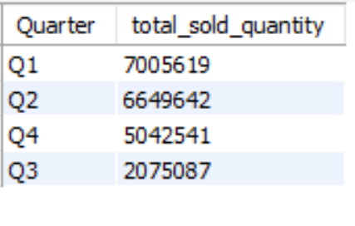
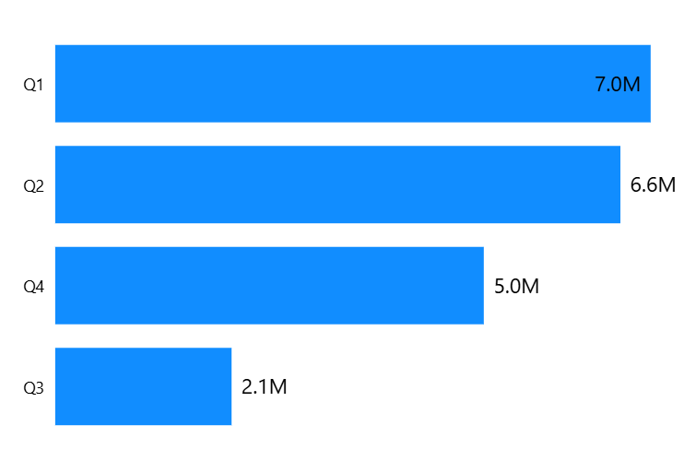
Visual:
Output:
Insights:
In 2020, Q1 had the highest sales with over 7M units sold, followed closely by Q2. This shows the company saw peak demand early in the year, which likely boosted revenue during that period.

Slide 20
Request 9
Which channel helped to bring more gross sales in the fiscal year 2021 and the percentage of contribution? The final output contains these fields, channel, gross_sales_mln, percentage
with cte1 as(select
c.channel, round(sum(g.gross_price*s.sold_quantity)/1000000, 2) as gross_sales_mln
from dim_customer c
join fact_sales_monthly s
on s.customer_code=c.customer_code
join fact_gross_price g
on g.product_code=s.product_code
where s.fiscal_year=2021
group by channel)
select
channel, gross_sales_mln,
round((gross_sales_mln/sum(gross_sales_mln) over())*100, 2) as percentage
from cte1
order by gross_sales_mln desc;

Slide 21
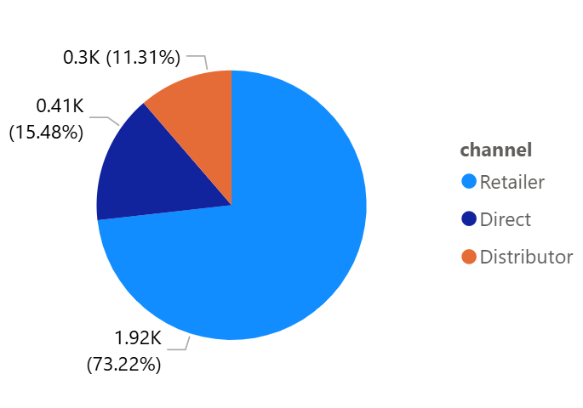
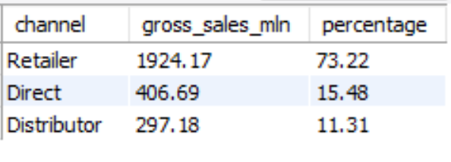
Visual:
Output:
Insights:
In 2021, retailers contributed the highest sales with a 73% share, much more than direct and distributor channels. This highlights that retail was the key source of the company’s revenue.

Slide 22
Request 10
Get the Top 3 products in each division that have a high total_sold_quantity in the fiscal_year 2021? The final output contains these fields, division, product_code, product, total_sold_quantity, rank_order
with cte1 as(select
division, product, p.product_code, sum(sold_quantity) as total_sold_quantity
from dim_product p
join fact_sales_monthly s
on s.product_code=p.product_code
where s.fiscal_year=2021
group by division, product, product_code),
cte2 as(
select
division, product_code, product, total_sold_quantity,
rank() over(partition by division order by total_sold_quantity desc) as rank_order
from cte1)
select * from cte2
where rank_order<=3;

Slide 23
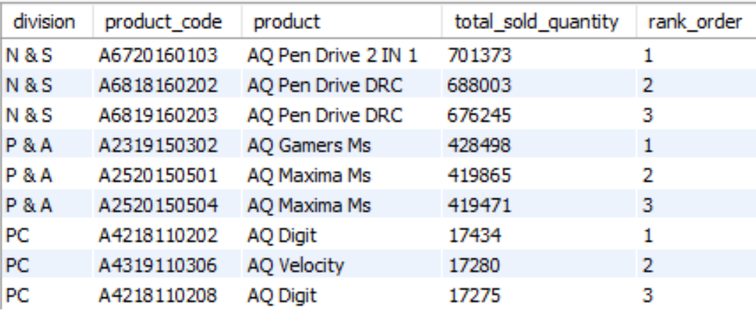
Output:

Slide 24
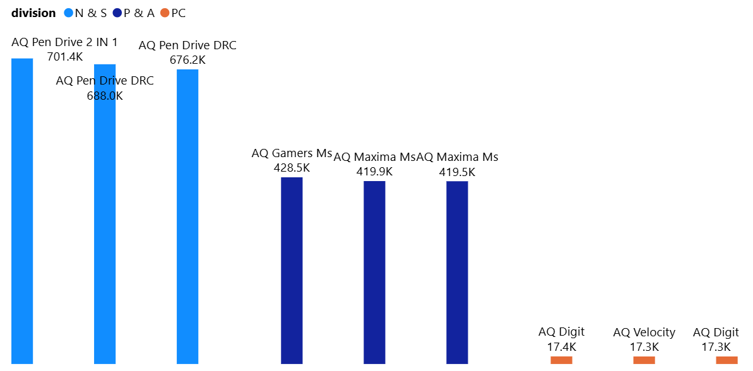
Visual:
Insights:
1. In 2021, the N & S division dominated sales with pen drives leading the top products, while PC division products had very low sales volumes. 2. This shows that storage devices were the key revenue drivers, whereas PC products contributed the least.

