Slide 1




Innovative Use of Behavioural Data and Explainable AI for Early Gambling Addiction Detection
MSC Research Project
Behavioral Data
Machine Learning
Explainable AI
Responsible Gambling
Saleem Pasha Shaik
23407719
Master Of Science in Data Analytics
National College Of Ireland
Supervisor: Jorge Basilio

Slide 2

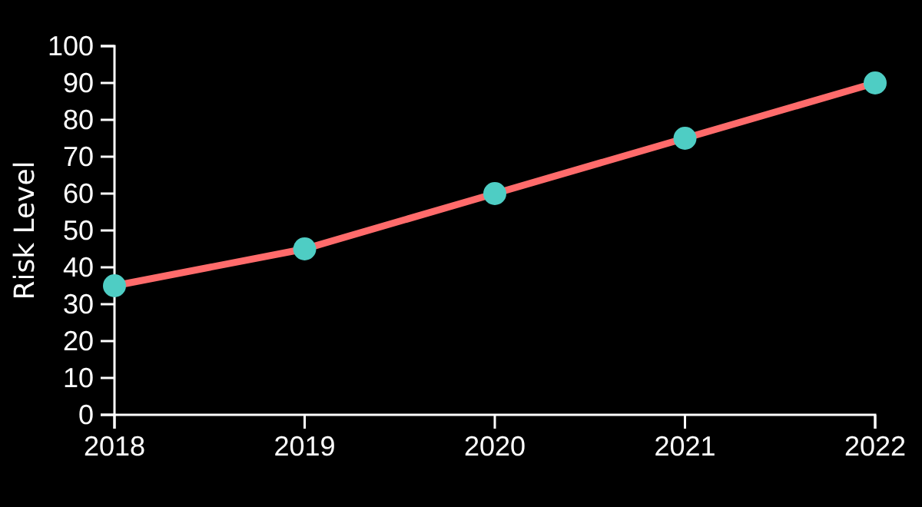
Introduction
Growth in Accessibility: Proliferation of online betting platforms has significantly increased gambling accessibility.
Rising Concerns: gambling problem manifesting as both behavioral and financial issues
Early Detection Need: Critical to identify addictive patterns early before severe addiction develops
Data-Driven Approach: Behavioral data analytics and deep learning offer robust solutions for early detection
Importance for Responsible Gambling:
Research is crucial for developing proactive RG initiatives,
enabling timely interventions and supporting player well-being.

Slide 3







Research Problem & Objectives
Problem Statement
Traditional systems fail to detect escalating gambling behavior early
Growing online betting accessibility exacerbates identification challenges
Primary Objectives
Player Segmentation
Behavioral Analysis
Utilize K-Means clustering to categorize players into risk groups
Identify key behaviors indicative of escalating gambling activity
Forecasting
Model Evaluation
Develop models for time-series forecasting of betting patterns
Compare ML/DL models using metrics like MSE and RMSE
Explainability
Apply LIME to enhance model transparency for responsible gambling interventions

Slide 4

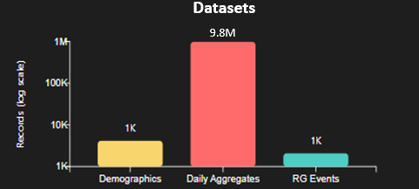


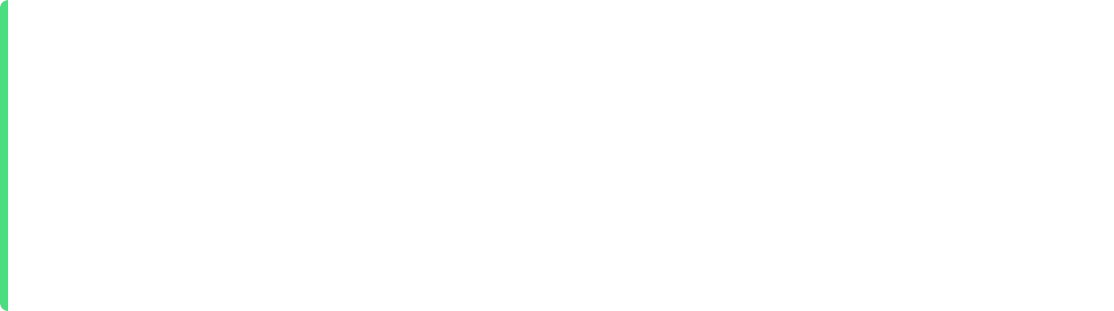

Dataset Overview
Demographics
4,134 records
8 variables
Age, gender, country, registration date
Daily Aggregates
981,782 records
6 columns
Key Behavioral Features
Turnover, hold, product type, bets, betting dates
Turnover
Hold
RGsumevents
NumberOfBets
RG_case
RG Events
2,068 records
Data Challenges
6 attributes
Missing Values in RG event and date fields
Type, frequency, time of alerts
Time Inconsistencies across datasets

Slide 5
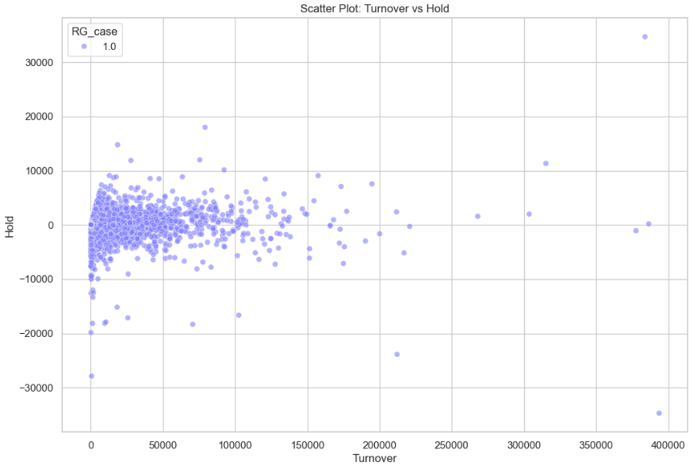
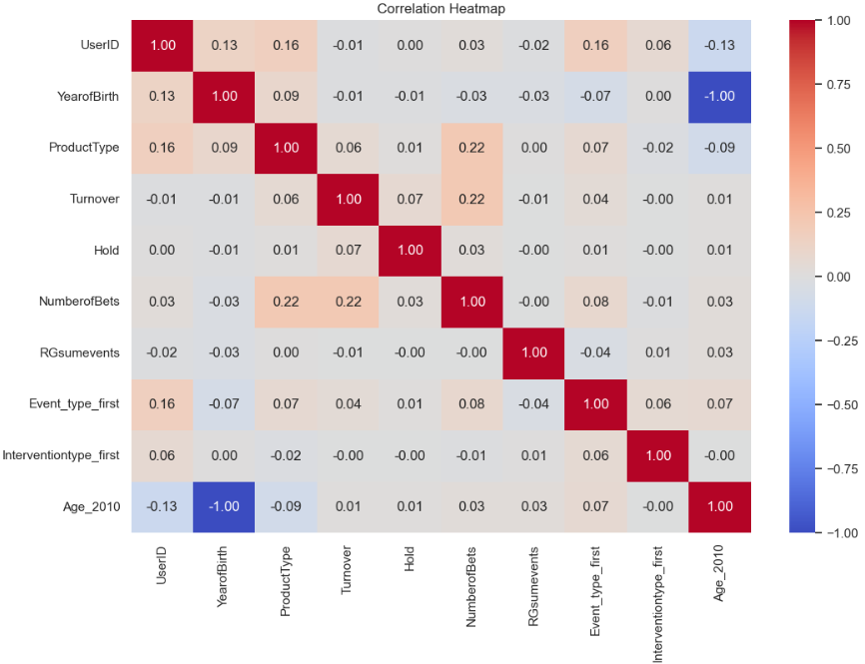
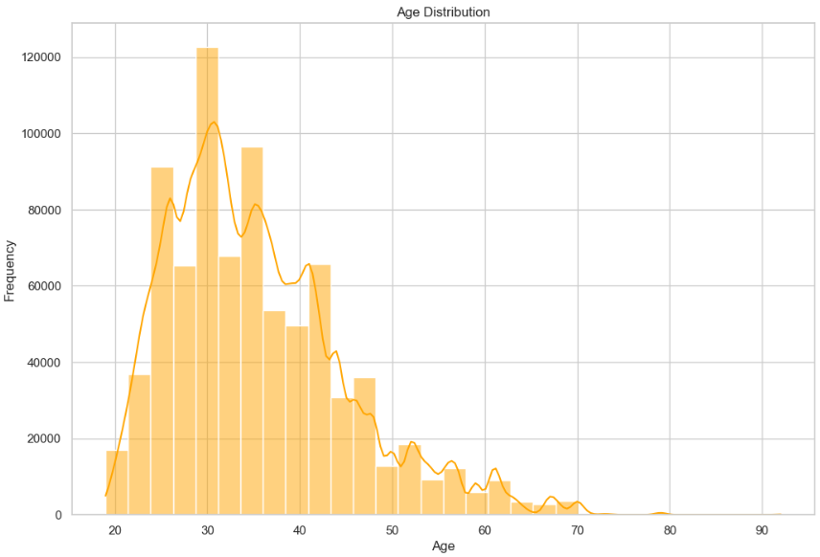
.
Exploratory Data Analysis
Turnover vs Hold Scatter Plot:
Shows the relationship between money wagered (Turnover) and actual financial loss/win (Hold).
Helps identify risky behavioural patterns
Correlation Heatmap:
Visually shows relationships between all behavioural variables
Demonstrates your feature engineering and data understanding.
Age-Based Hold Distribution
Useful because age is a key demographic factor in gambling-risk studies.
Shows how financial loss varies across age groups.

Slide 6
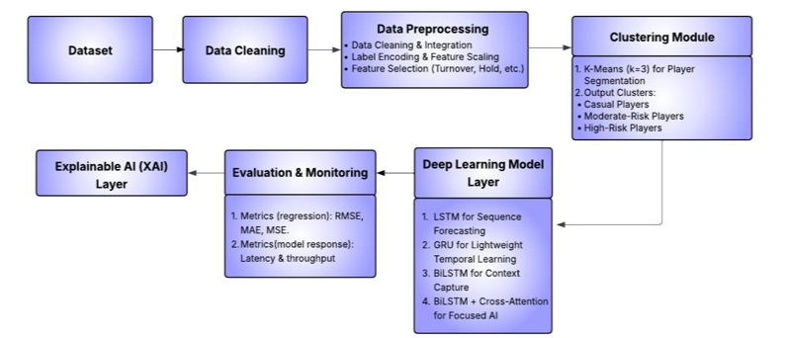
Methodology
Data
Data Merge/Transform
Data Clean
Clustering
Data Filter
Future Forecast
Explainable AI
Evaluation/Monitor
Time Series Models
Design Specification:
The system is built through a sequential process, starting from importing necessary libraries and progressing through each stage up to model comparison.
The architecture uses ensemble machine learning & Deep Learning models, namely Clustering, LSTM, GRU, BiLSTM and BiLSTM Cross Attention.

Slide 7


Data Preprocessing
Merging Datasets by UserID
Handling Missing Values
Combined demographic, daily aggregation, and RG intervention datasets using outer joins to create comprehensive player records (981,000+ records).
Addressed inconsistencies and missing values to ensure data quality and consistency across the merged dataset.
Feature Engineering (Age_2010)
Label Encoding
Created new features like Age_2010 (YearofBirth - 2010) and rolling turnover averages to capture behavioral patterns.
Converted categorical variables (CountryName, Gender, ProductType) into numerical format for machine learning algorithms.
Behavioural Feature Selection
7-day Rolling Window Creation
Filtered data to retain relevant variables like Turnover, Hold, NumberofBets, RGsumevents, and RG_case.
Applied 7-day rolling window to time-series data to capture short-term behavioral trends and patterns.

Slide 8
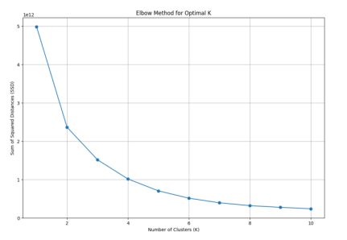



Clustering Approach
Elbow Method for Optimal K
K-Means Clustering
Algorithm: K-Means for player segmentation
Optimal K: k=3 selected using Elbow Method
Clusters represent different behavioral risk groups
Features Used
Cluster Labels
Turnover
Hold
NumberOfBets
RG_case
RGsumevents
Early Players
Low risk, early engagement
Moderate Gamblers
Medium risk, controlled play
Aggregated behavioral features were already normalized, ensuring equal contribution to the model
Problem Gamblers
High risk, problematic behavior

Slide 9

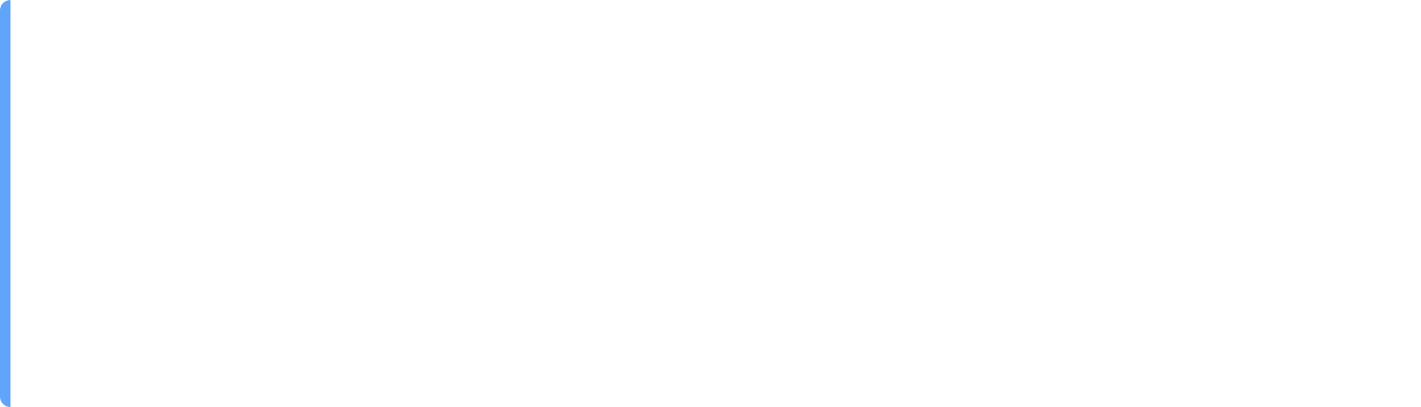

Cluster Evaluation
Silhouette Score = 0.9719
Calinski-Harabasz Index = 930068.37
Higher is better (Max = 1). Indicates excellent cluster separation and cohesion.
Higher is better. Reflects strong inter-cluster variance and compact grouping.
Davies-Bouldin Index = 0.4924
Lower is better. Shows minimal overlap among clusters.
Window Rolling & LR Scheduler
Rolling windows were used to convert continuous gambling behaviour into fixed-length sequences suitable for deep learning models.
Each window captures recent behavioural history, allowing the model to learn patterns leading up to a risk event.
Converts the dataset into a supervised time-series format, essential for LSTM, GRU, and attention.
Rolling windows enable the system to predict near-future turnover movements, improving early detection of escalating gambling risk.
LR Scheduler automatically reduces the learning rate during training when the model stops improving, Used to achieve good model accuracy, Helps model not get stuck and stabilize training.

Slide 10


Time Series Models
LSTM
GRU
Long Short-Term Memory: Captures long-term dependencies in sequential data for gambling pattern analysis.
Gated Recurrent Unit: Simplified LSTM variant with fewer parameters for efficient sequential data processing.
BiLSTM
BiLSTM + Cross Attention
Bidirectional LSTM: Processes data in both directions to capture comprehensive temporal relationships.
Integrates cross-attention with BiLSTM to focus on significant time steps in player behavior.
Latency & Throughput
Latency measures how long the model takes to generate one prediction, indicating responsiveness in real-time systems.
Throughput represents how many predictions the model can make per second, reflecting system scalability.
These metrics show whether the forecasting pipeline can support continuous monitoring required for responsible gambling interventions.
Lower latency and higher throughput ensure timely alerts, allowing operators to detect risk escalation quickly.

Slide 11
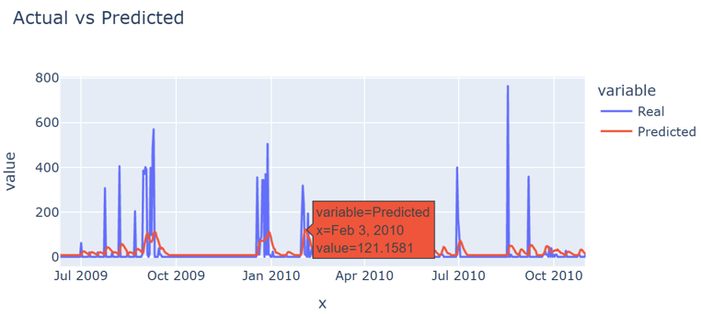
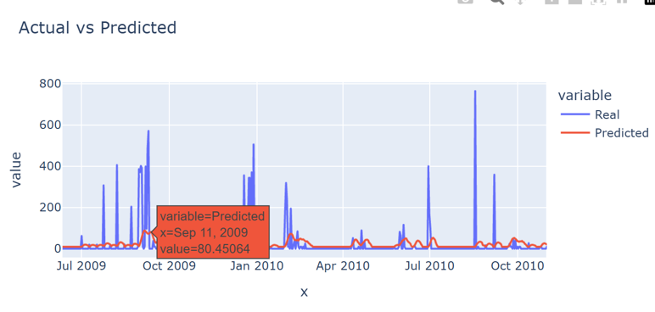
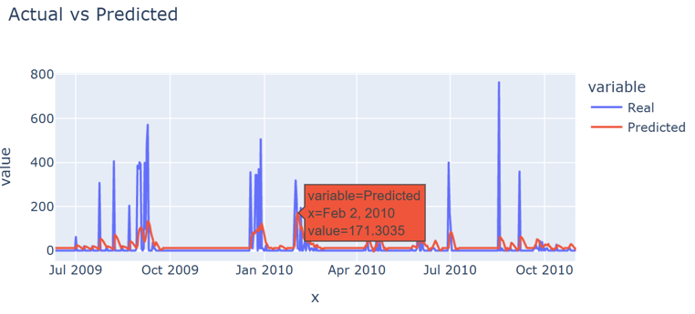
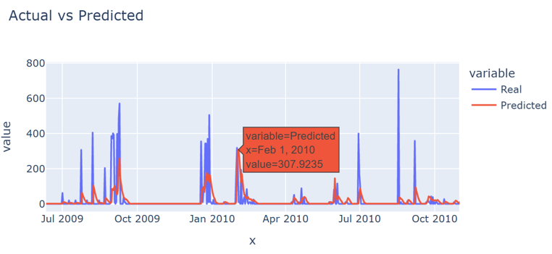
Evaluation and Monitoring
LSTM
GRU
BiLSTM
BiLSTM + Cross Attention

Slide 12
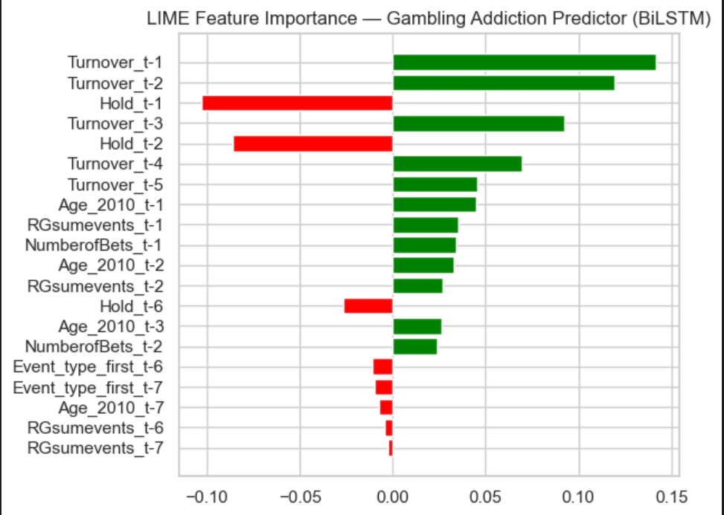
Forecasting Results/Metrics
Performance Metrics
Model Response
Model
MSE
RMSE
MAE
Model | Latency per Prediction (ms) | Throughput (Predictions/sec)
LSTM | 122.6306 | 2298.41
GRU | 119.8880 | 3532.58
BiLSTM | 84.9619 | 2018.00
BiLSTM Cross Attention | 124.3032 | 2201.47
LSTM 0.5183 0.7199 0.2951
GRU 0.5082 0.7129 0.2750
BiLSTM 0.5109 0.7148 0.2974
BiLSTM Cross Attention 0.4915 0.7010 0.2579
Explainable AI (LIME)
Purpose of Explainability
• Enhances transparency of deep learning predictions.
• Builds trust in AI systems for sensitive applications
• Provides insights beyond "black box" approaches
LIME's Mechanism:
Creates small modified samples around the chosen data point.
Creates local surrogate models for specific predictions
Reveals logic behind deep learning model decisions

Slide 13


Conclusion & Future Work
Conclusions
Future Work
Effective Player Segmentation:
Transformers:
Successfully segmented players into distinct risk groups using K-Means clustering
Explore Transformer-based architectures for enhanced accuracy
Forecasting Captures Risk:
Richer Features:
Deep learning models effectively captured temporal dependencies and escalating patterns
Incorporate more behavioral and psychological features
LIME Adds Transparency:
Real-time Dashboard:
Provided crucial explainability to deep learning models
Develop real-time monitoring for responsible gambling

Slide 14
Thank you

