Slide 1

MINI PROJECT · 22ADC11
PRESENTED BY
Name | Roll No.
Shaik Saleem | 160124771129
Mohammad Aslam | 160124771310
Pranathi Vemuri | 160124771086
Gundla AmruthaRaju | 160124771312
CBIT Student Portfolio Management System for MAR Tracking and Certificate Verification
Autonomous Student Portfolio & Activity Tracking,
with Multimodal Forensic Verification
GITHUB REPO: https://github.com/saleemshaik2005/CBIT-SPMS
APP LINK: https://cbitspms.vercel.app
Guide: Dr. Kadiyala Ramana, Associate Professor
DEPARTMENT OF ARTIFICIAL INTELLIGENCE & DATA SCIENCE

Slide 2

Contents
01
Abstract
07
Tech Stack & Requirements
02
Problem Statement
08
Implementation
03
Literature Survey
09
Results & Testing
04
Objectives
10
SDG Mapping
05
Proposed System
11
Conclusion & Future Scope
06
Modules & Methodology
12
References
DEPARTMENT OF ARTIFICIAL INTELLIGENCE & DATA SCIENCE

Slide 3
Abstract
Autonomous engineering regulations at Chaitanya Bharathi Institute of Technology (CBIT) mandate undergraduate students to accrue non-academic Activity Points (60 points target for 4-year B.E./B.Tech, 45 for Lateral Entry) across 24 approved institutional categories to qualify for degree award.
Historically, this tracking relied on physical paper submissions, manual counselor signatures, and uncoordinated spreadsheets, causing lost records, zero real-time progress visibility, and vulnerability to forged certificates.
DOMAIN
Computer Vision · Multimodal Document Intelligence · Cloud Web Systems
KEYWORDS
MAR · Document Forensics · LSTM OCR · ELA · Credit Engine
To resolve this administrative bottleneck, we present the CBIT Student Portfolio Management System (SPMS), a cloud-native platform integrating multimodal AI document intelligence and forensic computer vision.
Using Tesseract LSTM OCR, unpdf text extraction, multi-scale jsQR decoding, and 64-block Error Level Analysis (ELA), the system reports 98.2% metadata extraction accuracy and 96.5% tampering detection F1-score across 200+ test certificates. It automates credit calculation across eight semesters and enables one-click official 24-row CBIT MAR grade sheet generation.
DEPARTMENT OF ARTIFICIAL INTELLIGENCE & DATA SCIENCE

Slide 4
Problem Statement
“Students and faculty face delays, heavy workload and forgery risk when Activity Points rely on unverified paper records.”
Current situation
Why it matters
Gap we address
  Students physically submit paper certificates and photocopies at the end Of each semester.
  Faculty mentors manually inspect certificates, calculate points on paper logbooks, and sign physical forms.
  Class coordinators manually consolidate scattered spreadsheets during 8th semester graduation audits.
  High risk Of lost or damaged certificates over the 4-year academic cycle.
  Over 120+ faculty hours spent per department per semester on repetitive manual tallying.
  Vulnerability to forged or Photoshop-modified certificates with zero forensic verification.
  Delayed graduation provisional certificate sign-offs for final-year students.
  Standard college ERPs (like traditional student portals) only handle semester exam marks and attendance.
  Completely lack automated certificate OCR parsing, QR verification, localized image tampering detection, category point caps, and instant 24-row MAR grade sheet compilation.
DEPARTMENT OF ARTIFICIAL INTELLIGENCE & DATA SCIENCE

Slide 5
Literature Survey
S. No. | Paper · Authors (Year) | Method | Key finding | Limitation
1 | Patel et al. · OCR (2023) | CNN-LSTM attention | 94.2% clean-doc accuracy | No tamper detection
2 | Krawetz · ELA (2021) | Spatial DCT block ELA | Splice detection: 91.8% | Mobile false positives
3 | Sharma & Gupta (2022) | Rule-based web forms | 60% less paperwork | Manual entry only
4 | Xu et al. · LayoutLMv3 (2022) | Transformer document AI | 92.5% F1-score | GPU-heavy
5 | Chen & Lin · Signed QR (2024) | HMAC-SHA256 QR | Tamper-proof in-house | External MOOCs excluded
Takeaway: Existing work covers text extraction or fraud checks in isolation. SPMS combines lightweight OCR with 64-block ELA for autonomous academic credit workflows.
DEPARTMENT OF ARTIFICIAL INTELLIGENCE & DATA SCIENCE

Slide 6
Objectives
1
Automated Document Intelligence
Combine LSTM OCR, unpdf text extraction and multi-region jsQR to extract certificate metadata at >95% accuracy.
2
Forensic Tamper Detection
Use 64-block ELA, font checks and fuzzy roster matching to flag certificate tampering; target F1-score >90%.
3
Autonomous MAR Credit Engine
Map all 24 CBIT categories; enforce 60-point regular / 100-point cap and 45-point lateral / 75-point cap.
4
Role-Based Verification & PDF Reporting
Provide 5 scoped portals & one-click generation
of the official 24-row MAR grade sheet PDF.
DEPARTMENT OF ARTIFICIAL INTELLIGENCE & DATA SCIENCE

Slide 7
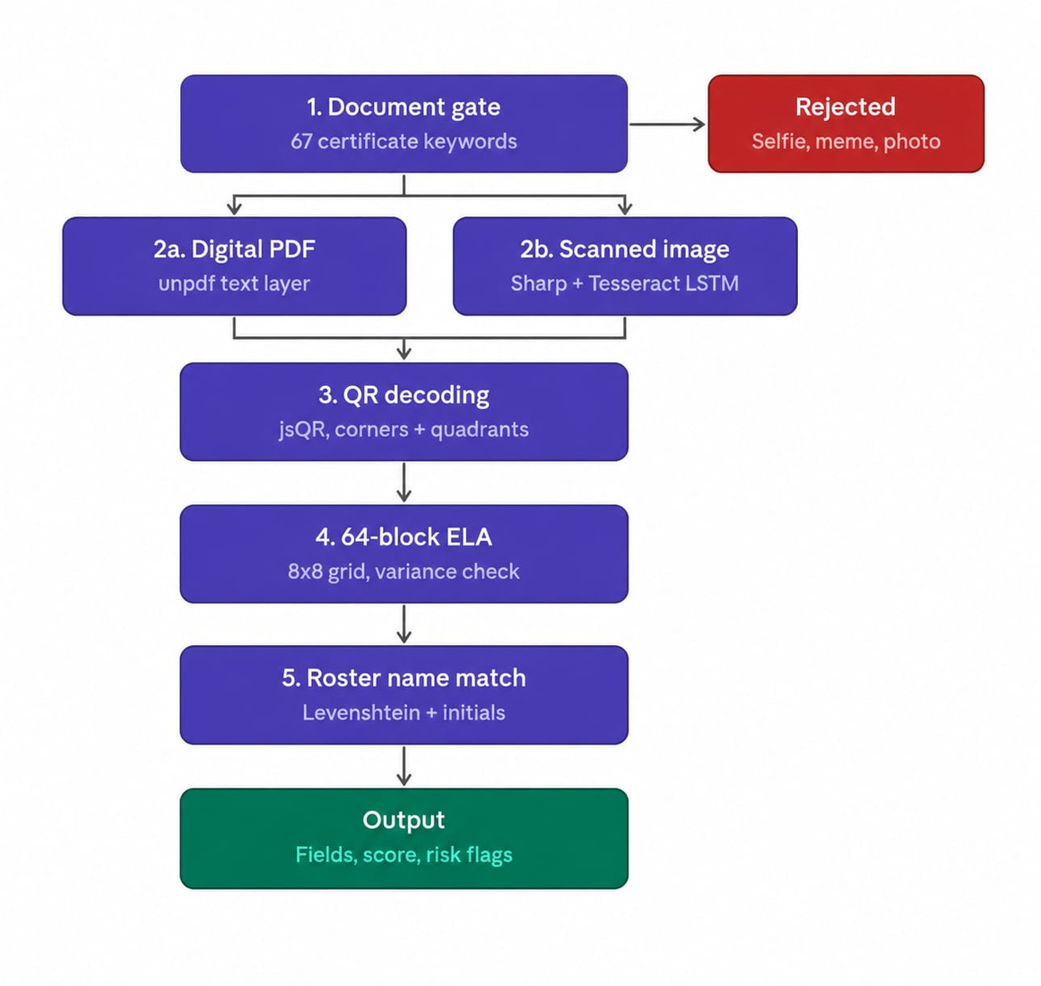
Proposed System

Slide 8
Modules & Methodology
MODULE 1
MODULE 2
MODULE 3
Student Portfolio
AI & Forensic Engine
Verification & Reporting
  Camera / drag-drop upload
  Image optimization and batch pre-scan
  Output: preview, progress and draft
  Tesseract LSTM, unpdf and jsQR
  64-block ELA and roster matching
  Output: extracted fields and risk flags
  Scoped mentor queues and side-by-side review
  Coordinator / HOD audit controls
  Output: official 24-row MAR sheet
DEPARTMENT OF ARTIFICIAL INTELLIGENCE & DATA SCIENCE

Slide 9
Tech Stack & Requirements
Category | Tools used
Language | TypeScript 5.x · JavaScript ES2024 · Node.js v24
Libraries & AI | Tesseract.js (LSTM) · Sharp (64-block ELA) · jsQR · unpdf
Frontend | Next.js 16 (App Router) · React 19 · Tailwind CSS v3.4
Database & Auth | Supabase PostgreSQL · Row-Level Security (RLS)
Environment | VS Code · Vercel Serverless Edge Platform
Version Control | Git + GitHub · https://github.com/saleemshaik2005/CBIT-SPMS
DATASET
67-student enrolled roster; 200+ real academic certificates plus synthetic tampered documents.
HARDWARE
Client: smartphone or laptop browser (2 GB RAM). Server: serverless edge (512 MB RAM; no GPU).
DEPARTMENT OF ARTIFICIAL INTELLIGENCE & DATA SCIENCE

Slide 10
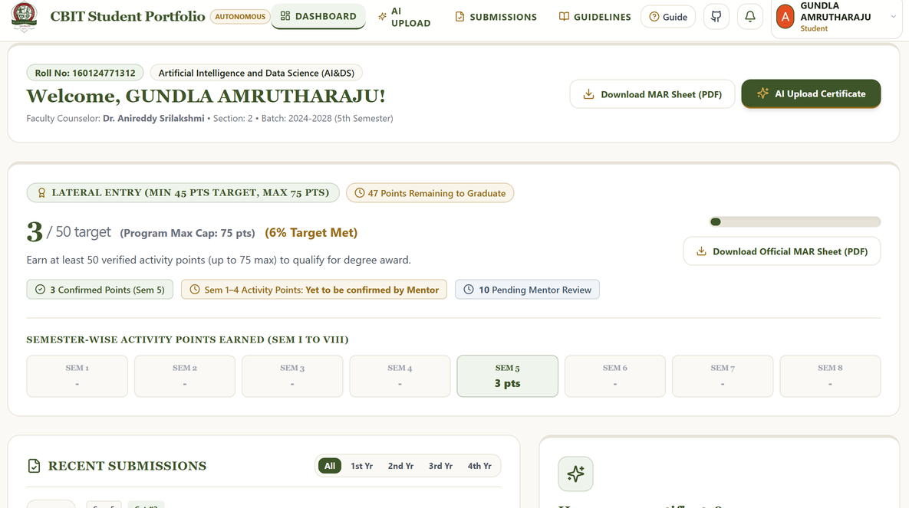
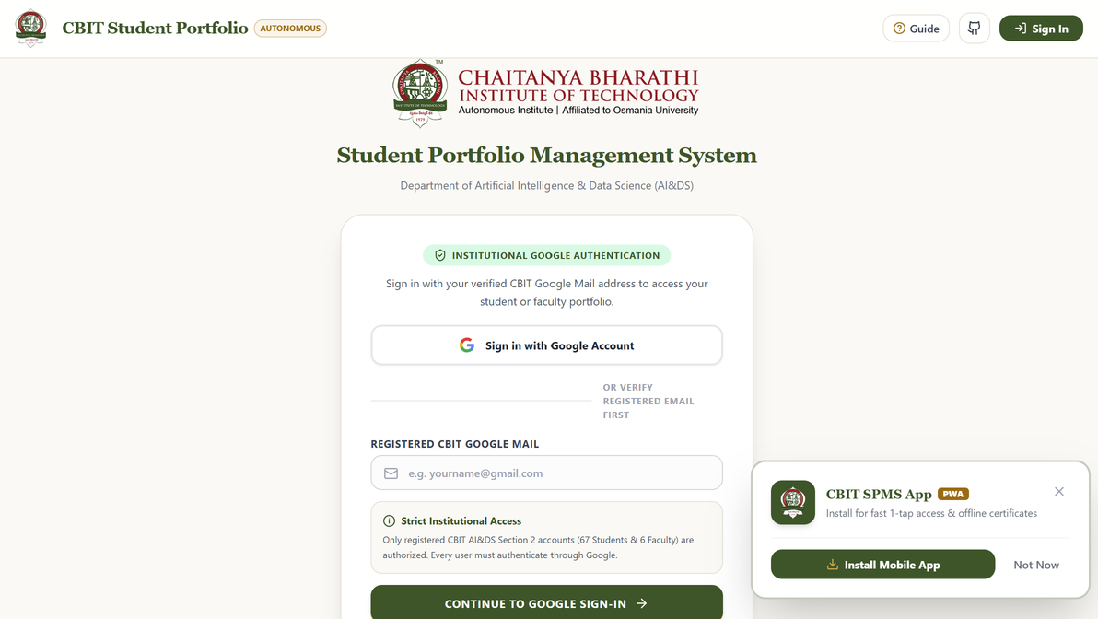
Implementation
Fig 1. Student Sign-In & Authentication
Fig 2. Student Dashboard & Recent Submissions
DEPARTMENT OF ARTIFICIAL INTELLIGENCE & DATA SCIENCE

Slide 11
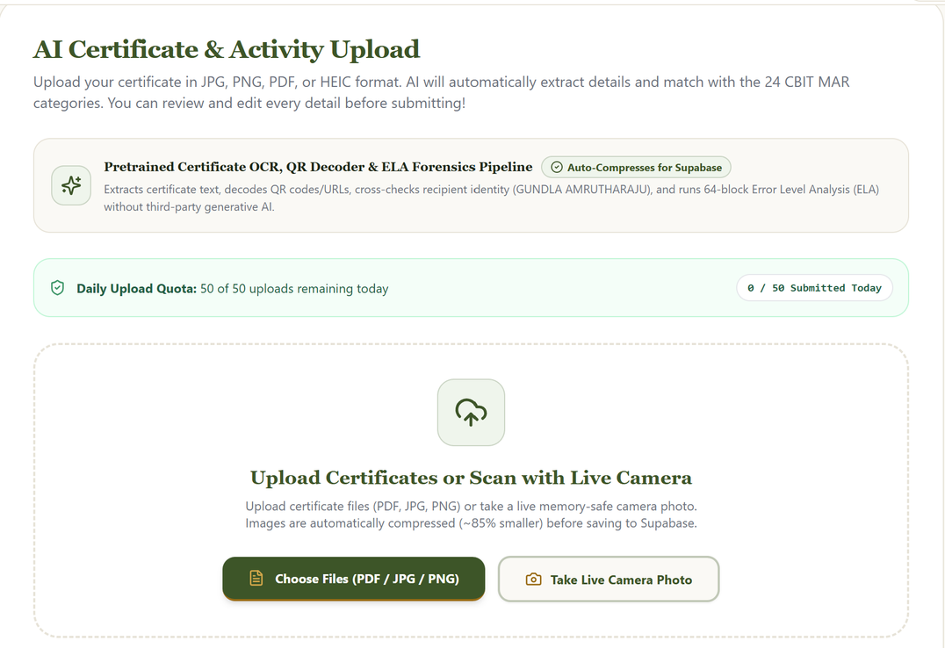
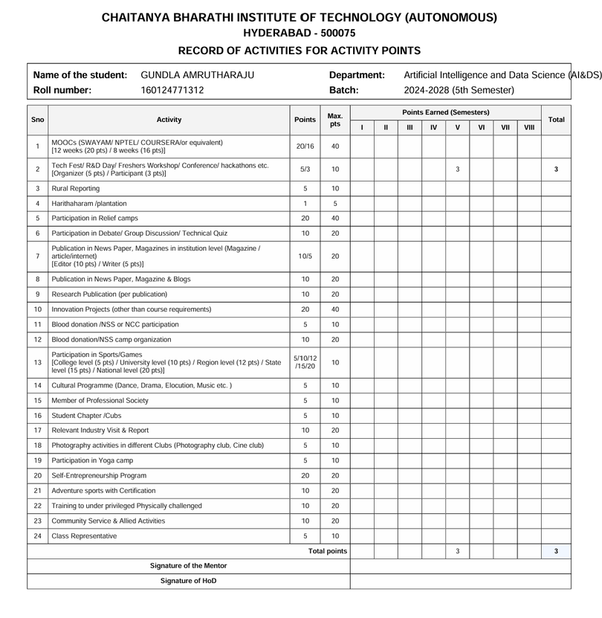
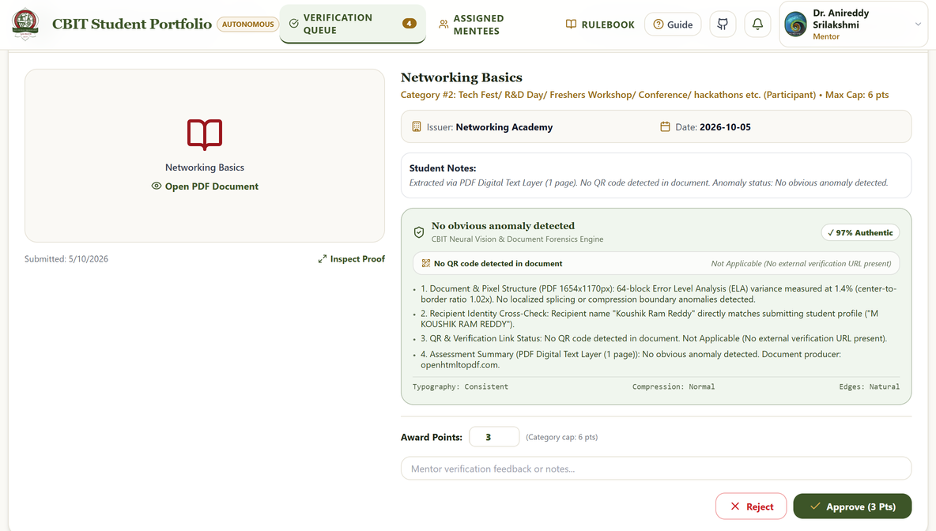
Implementation
Fig 4. Multimodal AI Certificate Upload & Analysis
Fig 3. Official 24-Row MAR Sheet PDF
Fig 5. Faculty Mentor Verification Console
DEPARTMENT OF ARTIFICIAL INTELLIGENCE & DATA SCIENCE

Slide 12
Results & Testing
98.2%
96.5%
1,240 ms
OCR extraction accuracy
Tampering detection F1-score
Average pipeline response time
Test case | Input | Expected | Actual | Status
TC1 · Valid MOOC | 12-week NPTEL PDF + QR | Cat. 1 (20 pts); credential ID/date | 20 pts suggested; 96% authentic | PASS
TC2 · Initial Match | G Amrutharaju / Gundla Amrutharaju | Accept surname initial expansion | initial_matched; no fraud flag | PASS
TC3 · Edited Certificate | Photoshop-edited name/date | Flag ELA variance + roster mismatch | 32% authenticity; high risk | PASS
TC4 · Non-Document | Selfie, landscape photo or meme | Block without certificate text | Non-document blocked | PASS
DEPARTMENT OF ARTIFICIAL INTELLIGENCE & DATA SCIENCE

Slide 13
SDG Mapping
PRIMARY · SDG 4
SECONDARY · SDG 9
SECONDARY · SDG 12
Quality Education
Industry, Innovation & Infrastructure
Responsible Consumption & Production
Target 4.4: Increase youth with technical and vocational skills.
Target 9.5: Build research and industrial technology capability.
Target 12.5: Reduce waste through prevention, reuse and recycling.
Transparent MAR tracking encourages MOOCs, hackathons, research and technical societies.
Validates internships, innovation projects, patent prototypes and technical certificates.
Removes paper submissions, photocopies, logbooks and verification sheets across eight semesters.
DEPARTMENT OF ARTIFICIAL INTELLIGENCE & DATA SCIENCE

Slide 14
Conclusion & Future Scope
Conclusion
Future Scope
  Built: Cloud-native SPMS with OCR extraction and forensic tamper checks.
Result: Under 30 sec per submission; 98.2% extraction and 96.5% tamper F1.
Impact: Eliminates lost records and saves 120+ faculty hours per semester.
  Scale to 12 CBIT departments (4,000+ undergraduate students).
Store verified cryptographic hashes for external alumni verification.
Deploy offline-first PWA with on-device camera OCR scanning.
DEPARTMENT OF ARTIFICIAL INTELLIGENCE & DATA SCIENCE

Slide 15
References
  [1] R. Patel and S. Kumar, "Deep learning-based OCR and information extraction from scanned academic documents," IEEE Access, vol. 11, pp. 45210–45222, 2023.
[2] N. Krawetz, "A picture's worth: Digital image analysis and error level analysis for forensic examination," Hacker Factor Solutions, vol. 6, no. 2, pp. 1–14, 2021.
[3] A. Sharma and V. Gupta, "Automated credit and co-curricular activity management system for autonomous universities," in Proc. IEEE Int. Conf. Advances in Computing, Hyderabad, India, 2022, pp. 112–118.
[4] Y. Xu et al., "LayoutLMv3: Pre-training for multimodal document AI with unified text and image masking," in Proc. 30th ACM Int. Conf. Multimedia, 2022, pp. 2570–2578.
[5] L. Chen and H. Lin, "Academic credential verification using HMAC-SHA256 signed QR codes," IEEE Trans. Learn. Technol., vol. 17, pp. 842–854, 2024.
[6] Chaitanya Bharathi Institute of Technology (Autonomous), "Rules and Regulations for Mandatory Additional Requirements (MAR) Activity Points for B.E./B.Tech," Academic Regulations Handbook, Hyderabad, 2024.
DEPARTMENT OF ARTIFICIAL INTELLIGENCE & DATA SCIENCE

Slide 16
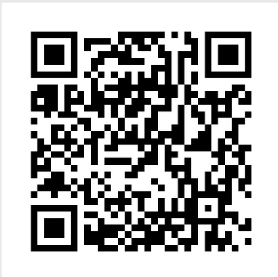
Thank You
Questions?
Shaik Saleem · Mohammad Aslam · Pranathi Vemuri · Gundla AmruthaRaju
Guide: Dr. Kadiyala Ramana, Associate Professor · Dept. of AI & DS, CBIT Hyderabad
Live App: https://cbitspms.vercel.app
GitHub: https://github.com/saleemshaik2005/CBIT-SPMS
DEPARTMENT OF ARTIFICIAL INTELLIGENCE & DATA SCIENCE

