Slide 1
Lecture One
STAT 153/STAT 248, Fall 2026
Aditya Guntuboyina (Fall 2026)

Slide 2
What is Time Series?
Time series is a set of observations each one being recorded at a specific time
The websites https://fred.stlouisfed.org/ and https://trends.google.com have many examples of time series that we will use in this class

Slide 3
US Population
Population of the United States
observation_date | POPTHM
1959-01-01 | 175818
1959-02-01 | 176044
1959-03-01 | 176274
1959-04-01 | 176503
1959-05-01 | 176723
1959-06-01 | 176954
1959-07-01 | 177208
1959-08-01 | 177479
1959-09-01 | 177755
1959-10-01 | 178026
1959-11-01 | 178273
1959-12-01 | 178504
1960-01-01 | 178925
1960-02-01 | 179326
1960-03-01 | 179707
1960-04-01 | 180067
1960-05-01 | 180408
1960-06-01 | 180728
Units are thousands so that 300,000 actually refers to 300 million
This dataset is downloaded from FRED

Slide 4
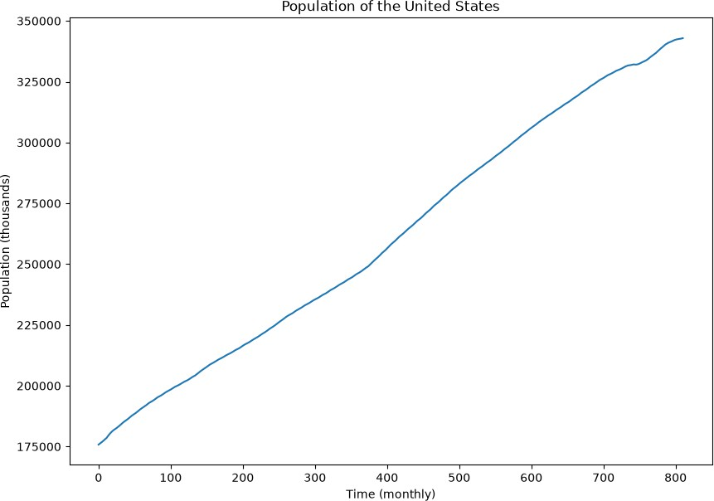

Slide 5
Questions
Prediction: what is an estimate of the population at a future point (e.g., Jan 2040)?
What is the rate of growth of the American population?
Has the growth rate been roughly constant over time?
What is the period where the population grew the fastest? Slowest?

Slide 6
Time Series Analysis answers such questions by fitting statistical models to observed time series data

Slide 7
Time Series Prediction/Forecasting
One of the most important questions in time series analysis is that of prediction (estimating future values based on the given data)

Slide 8
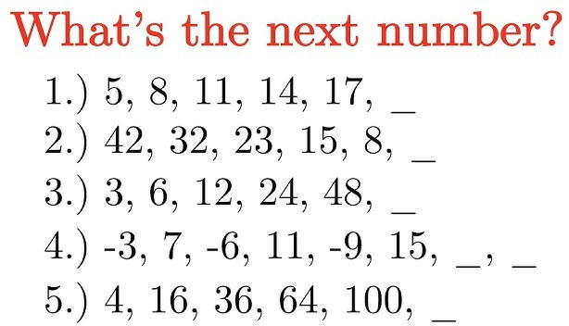

Slide 9
Basic Time Series Prediction Problem
Find the next number: 5, 8, 13, 20, 29, 40, #
The answer is 53 but how did we arrive at it? We noticed that y_{t} is a function of the time :
y_{t} = t² + 4
In other words, we performed a (quadratic) regression of y_{t} over time

Slide 10
Regression over time
The first time series technique we will study is regression over the time variable
Simple linear regression of the time series y_{t} on the time variable will fit a line to the observed time series data
Multiple linear regression of y_{t} on
and other
functions of (such as powers, sinusoids etc) will fit more general functions to the data

Slide 11
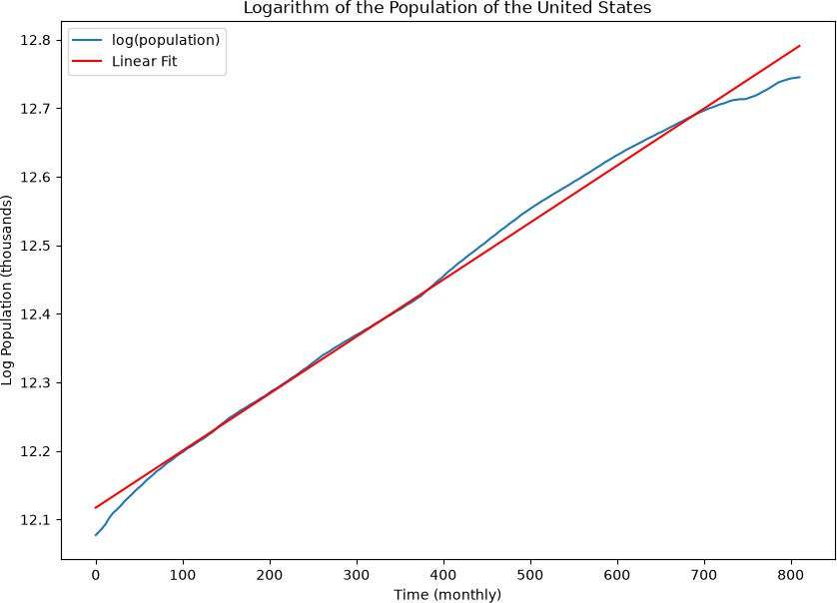
Linear regression of y_{t} on 1,t

Slide 12
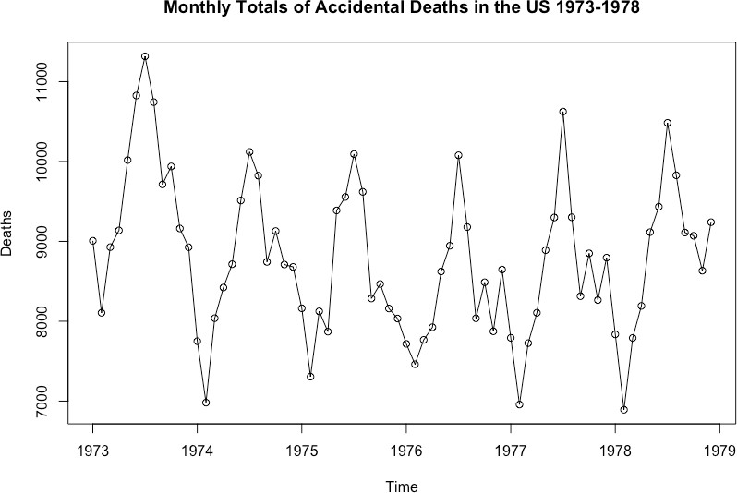

Slide 13
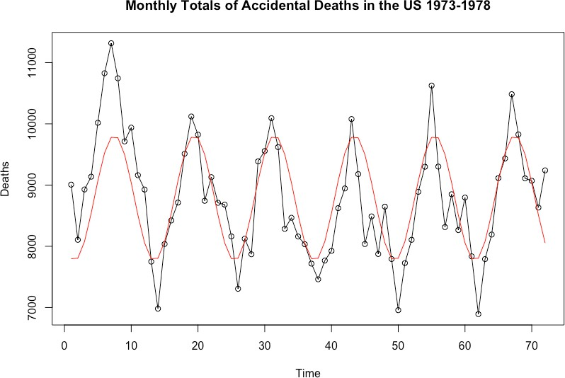
Linear regression of y_{t} on 1, cos(πt/6), sin(πt/6):

Slide 14
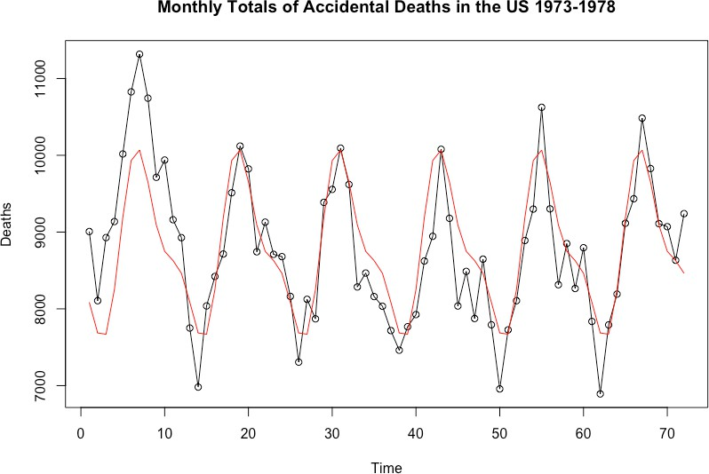
y_{t} ~ 1, cos(πt/6), sin(πt/6), cos(πt/3), sin(πt/3)

Slide 15
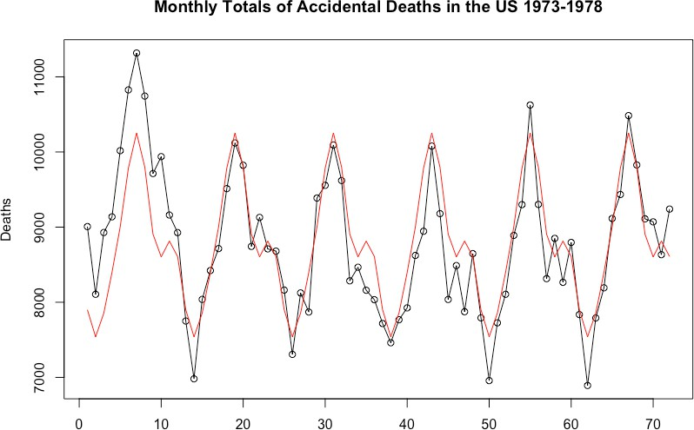
cos(πt/6), sin(πt/6), cos(πt/3), sin(πt/3), cos(πt/2), sin(πt/2)

Slide 16
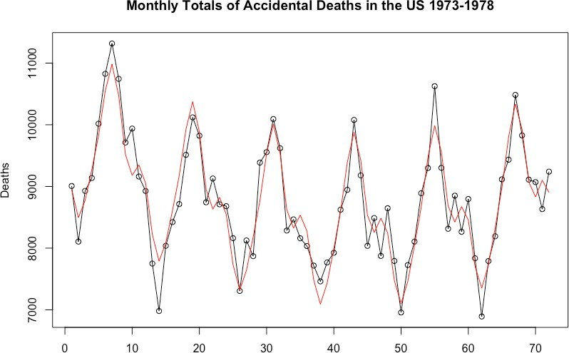
y_{t} ∼ sinusoids + quadratic

Slide 17
Topic One: Multiple Linear Regression
These models clearly give (sometimes reasonable) solutions to the prediction problem
The first topic in this course is multiple linear regression
We will go over the usual frequentist inference but also discuss in detail Bayesian inference for linear regression

Slide 18
Topic Two: Nonlinear Regression
For many time series, nonlinear regression over leads to much more useful and realistic models

Slide 19
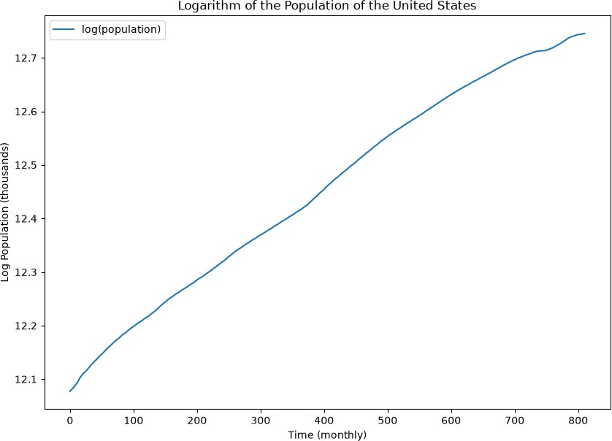

Slide 20
Linear regression of y_{t} on 1,t

Slide 21
For the US population dataset, simple linear regression over fits one line to the entire data which is clearly unrealistic
Quadratic (and higher order polynomial) regression does not seem ideal either. These models are also not very interpretable in terms of growth rates
A more realistic model here is:
y_{t} = β₀ + β₁t + α₁(t − c₁)₊ + α₂(t − c₂)₊ + error
This model allows for three diﬀerent slopes (growth rates)
This is a nonlinear regression model with parameters β₀, β₁, α₁, c₁, α₂, c₂

Slide 22
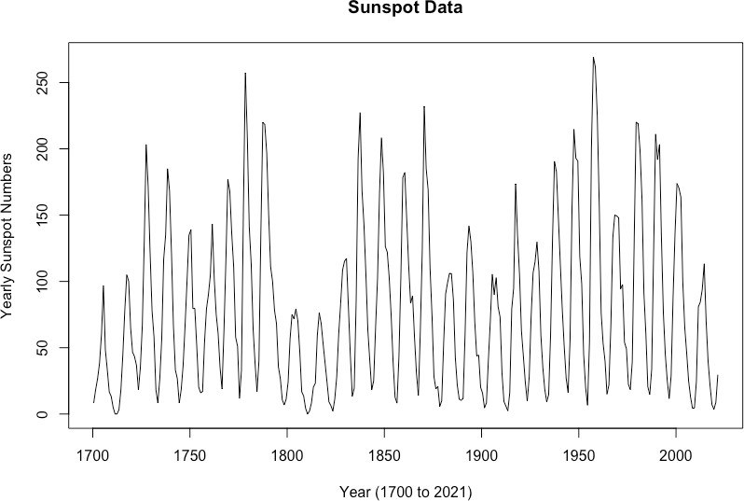
Annual Sunspots Data

Slide 23
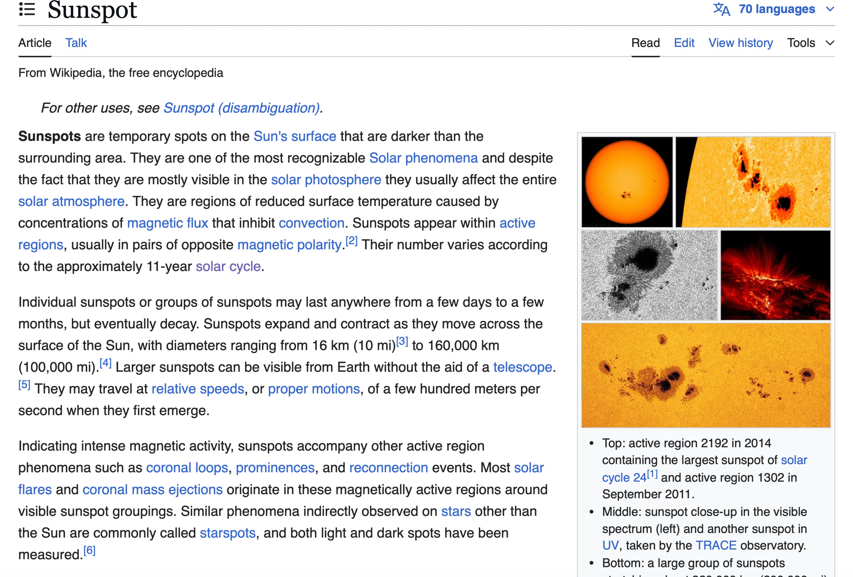

Slide 24
Wikipedia says that the number of sunspots varies according to the 11 year solar cycle
Why should the periodicity be exactly 11? Why not 10.5 or 11.5? What is the uncertainty around 11?
Can the periodicity be figured out from the dataset?
One way to do this is to fit the model:
y_{t} = β₀ + β₁ cos(ωt) + β₂ sin(ωt) + error
This is a nonlinear regression model with parameters β₀, β₁, β₂, ω

Slide 25
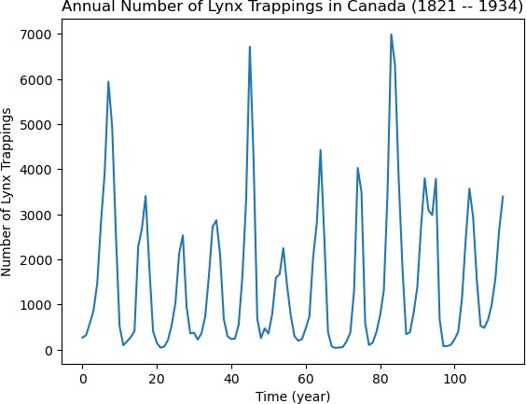
Lynx Trappings Dataset

Slide 26
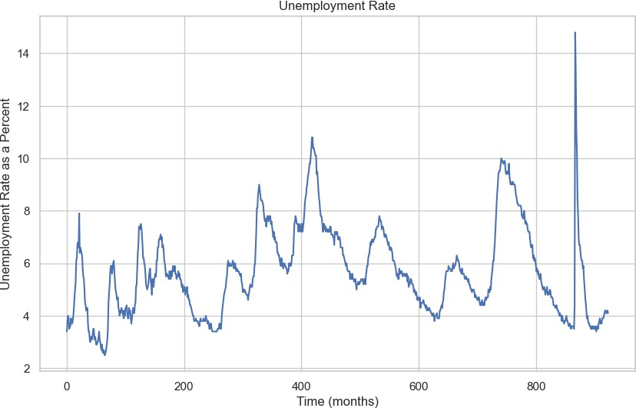
Unemployment Rate from FRED

Slide 27
The model:
y_{t} = β₀ + β₁ cos(ωt) + β₂ sin(ωt) + error is closely related to Fourier Analysis
We will study concepts such as Fourier Frequencies, Discrete Fourier Transform and the Periodogram
These are extensively used in engineering time series analysis
We shall look at some practical applications of these concepts

Slide 28
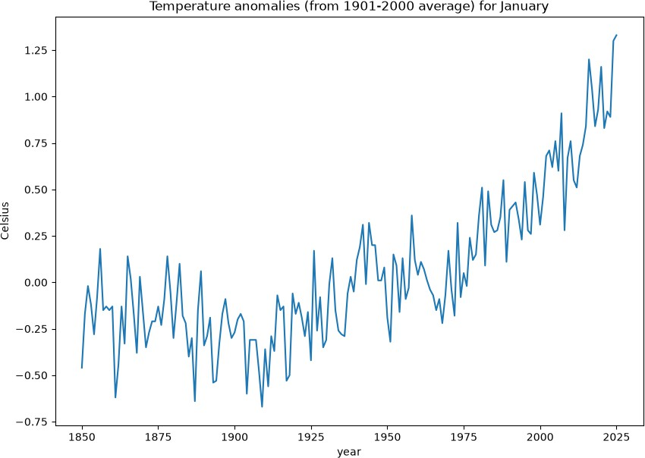
Topic Three: High-dimensional Regression

Slide 29
Topic Three: High-dimensional Regression
To get a good idea of the underlying trend in this data, fitting a single line is clearly not ideal
k
Fitting y_{t} = β₀ + β₁t + ∑ α_{j}(t − c_{j})₊ + ϵ is
j=1
also not likely to be good if k is small. But if k is large, there is risk of overfitting
In such cases, we take k to be large, and fit the model using regularization.

Slide 30
Topic Three: High-dimensional Regression
We work here with the ‘full’ model:
y_{t} = β₀ + β₁t + β₂(t − 2)₊ + β₃(t − 3)₊ + … + β_{n−1}(t − n + 1)₊ + ϵ
We study the Ridge and LASSO regularizations for fitting this model
This model gives a good representation of the trend present in the data removing the artifacts of noise

Slide 31
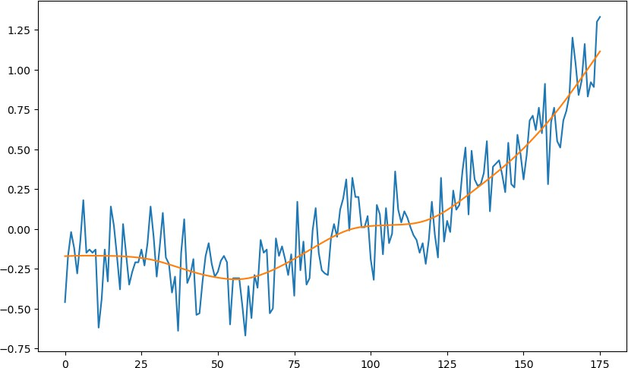
Here is this model (with Ridge regularization) applied to the temperature anomalies dataset:

Slide 32
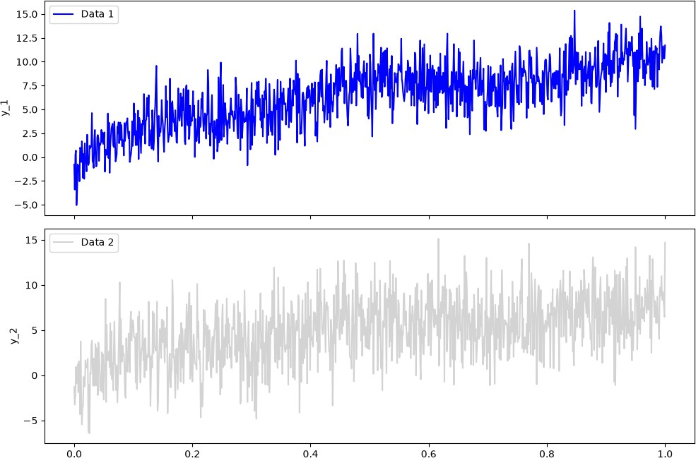
Comparing Trends in Two Datasets

Slide 33
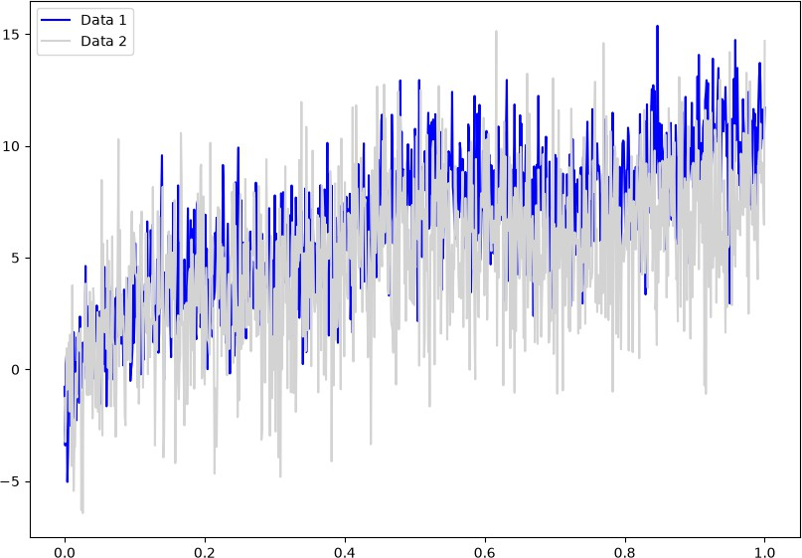

Slide 34
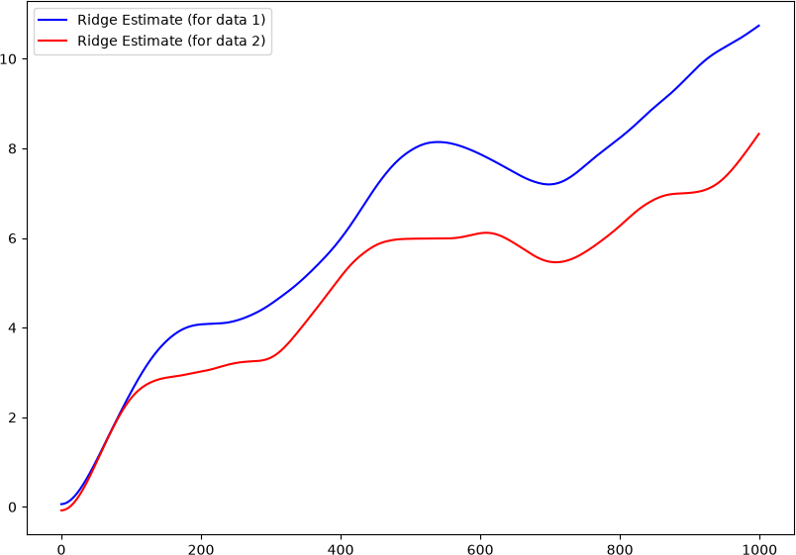
The diﬀerences can be seen much more clearly if we use this high-dimensional model (with ridge regularization) to estimate the underlying trends

Slide 35
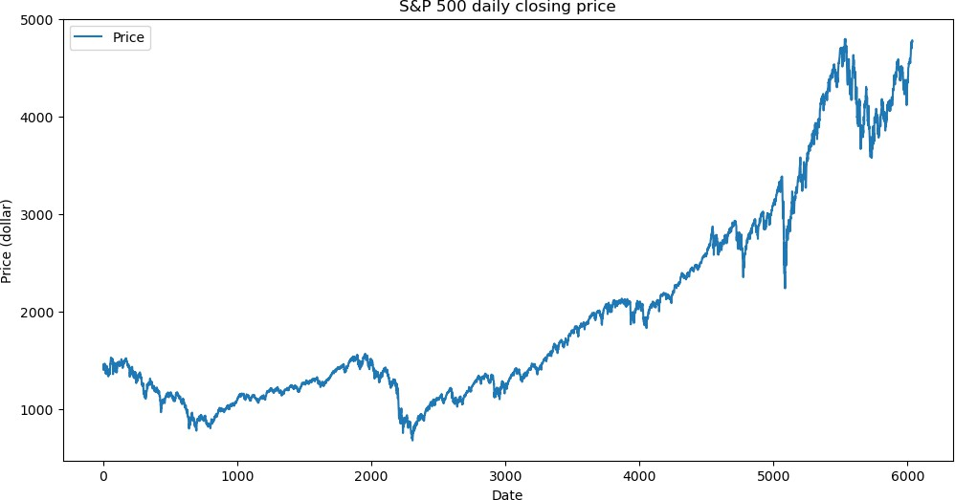
Topic Four: Variance Modeling
Daily closing prices P_{t} of S&P 500 (2000-01-01 to 2024-01-01)

Slide 36
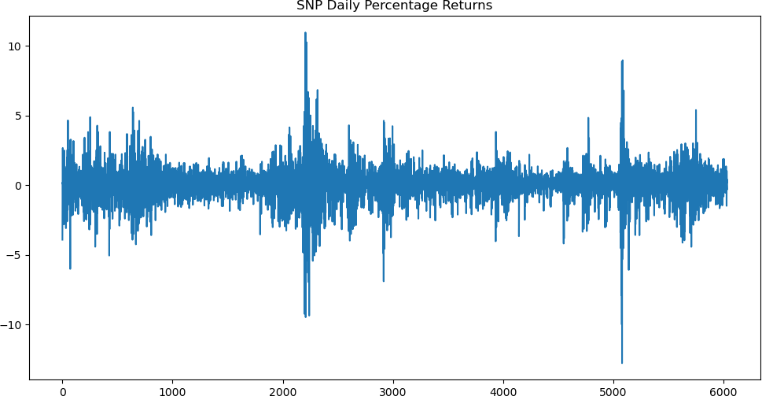
Stock Returns
t
P − P
r = 100 × ₍log P − log P
Note r ≈ 100 ×
t
t−1
t t t−1
)
t
^{P}t−1

Slide 37
Financial analysts also study the volatility of stock price returns
For estimating volatility, it is common to use
2
the model: r ∼ N(0,σ ) and then to model
t t t
(which is a proxy for volatility) as a function of
These are examples of variance models as opposed to the mean (regression) models we saw so far

Slide 38
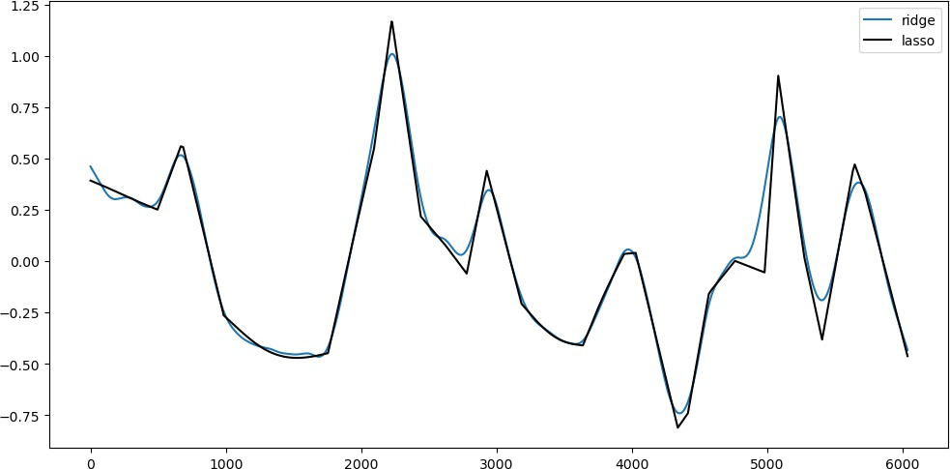
For the S&P returns data, below is an estimate of log σ_{t}

Slide 40
Spectral Analysis
Spectral Analysis is a special case of variance modeling where the variance model is applied to the Discrete Fourier Transform of the data (as opposed to the data directly)
This is one of the most important tools used by Engineers for Signal Processing

Slide 41
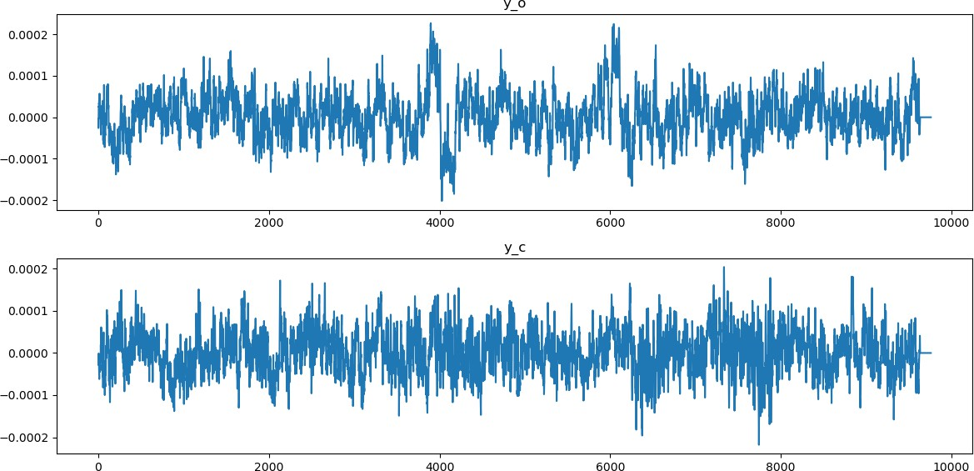
EEG Example: Eyes open vs Closed
How to quantify the diﬀerences between these two time series?

Slide 42
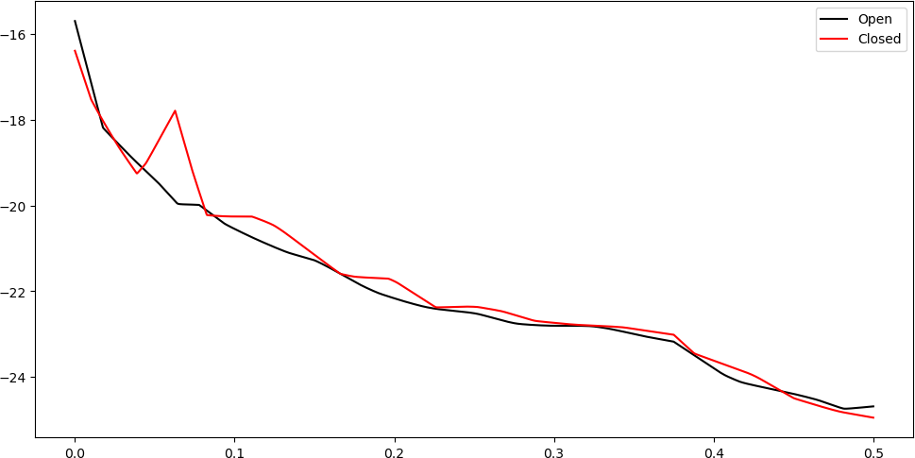
Spectra estimates (multiply x axis by 160 for Hz):
There is a clear diﬀerence in the spectra at around the 10 Hz frequency which is a known fact from cognitive neuroscience.

Slide 43
Topic Five: Lagged Regression (ARIMA)
Find next number: 1, 1, 2, 3, 5, 8, 13, 21, 34,
55, 89, #
This is the Fibonacci sequence
(y_{t} = y_{t−1} + y_{t−2}) and the next number is 144
Here regression over time will not work
Instead, we have to regress y_{t} over its own lagged values y_{t−1} and y_{t−2}
This is called Lagged Regression or AutoRegression

Slide 44
AutoRegression is the main idea behind the ARIMA class of models which are widely used for time series prediction
ARIMA stands for AutoRegressive Integrated Moving Average Models
The basic idea is simply to do a linear regression of y_{t} on x_{t} = (1,y_{t−1}, …, y_{t−p}) for some fixed lag p ≥ 1
ARIMA models give decent predictions on real datasets and are used extensively

Slide 45
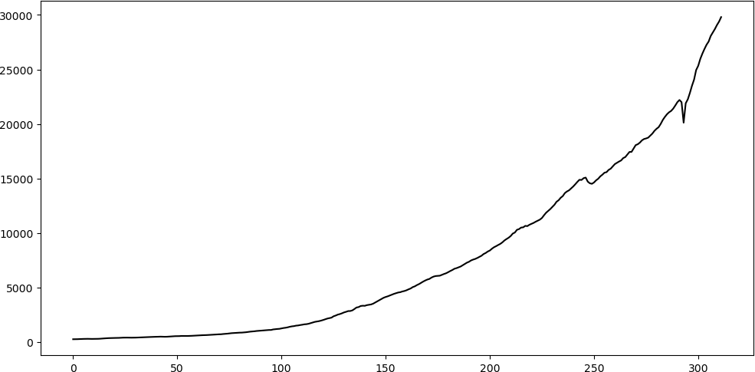
ARIMA Example One
FRED data on GNP (seasonally adjusted, billions of dollars). This is a quarterly dataset (four quarters in a year).

Slide 46
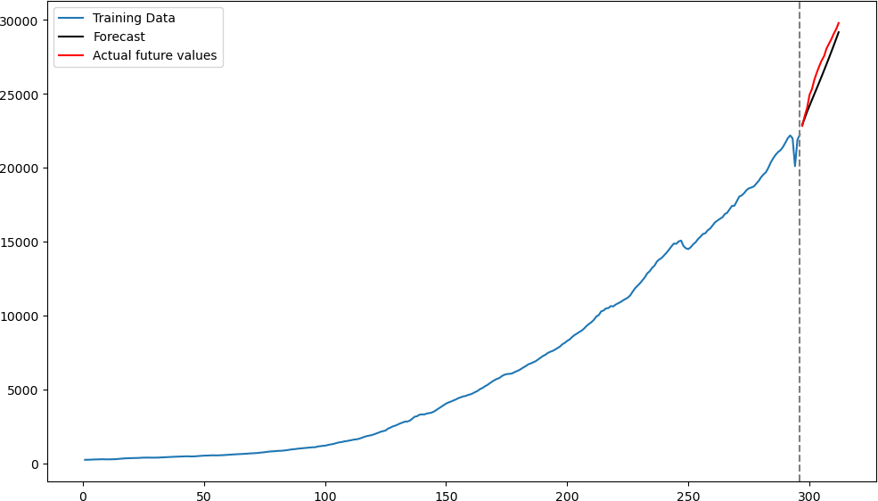
Here are the predictions given by an AR model for the last four years (= 16 quarters).

Slide 47
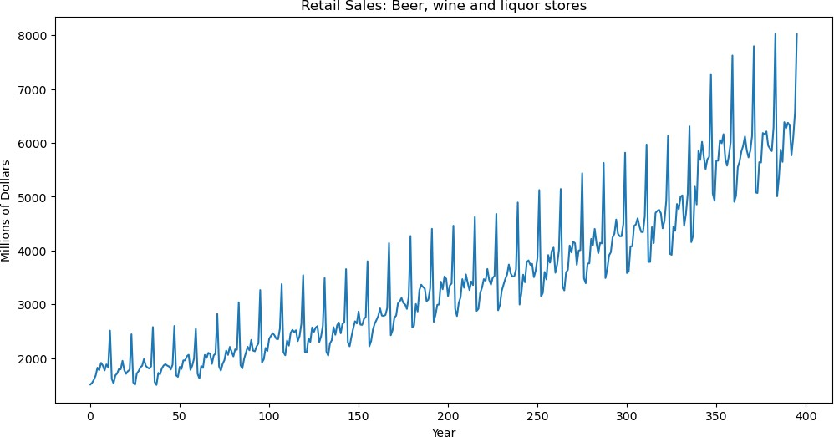
ARIMA Example Two
FRED data on monthly retail sales (in millions of dollars) for beer, wine and liquor stores (typo on axis label: should be month not year)

Slide 48
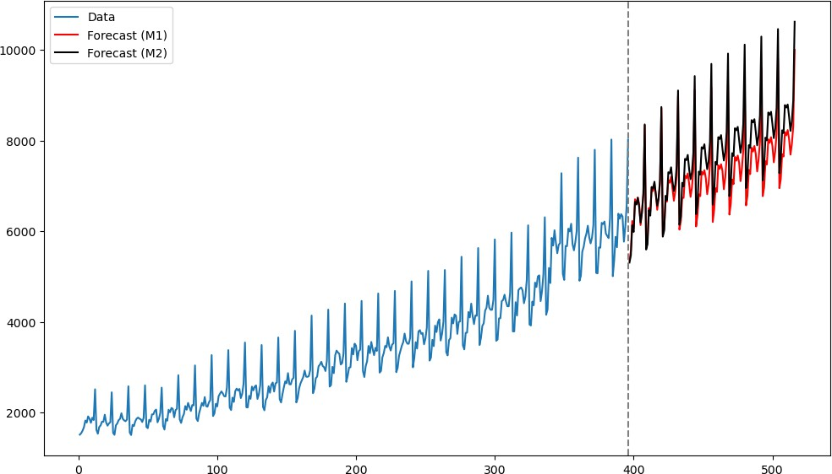
Below we plot the data along with predictions by two diﬀerent ARIMA models

Slide 49
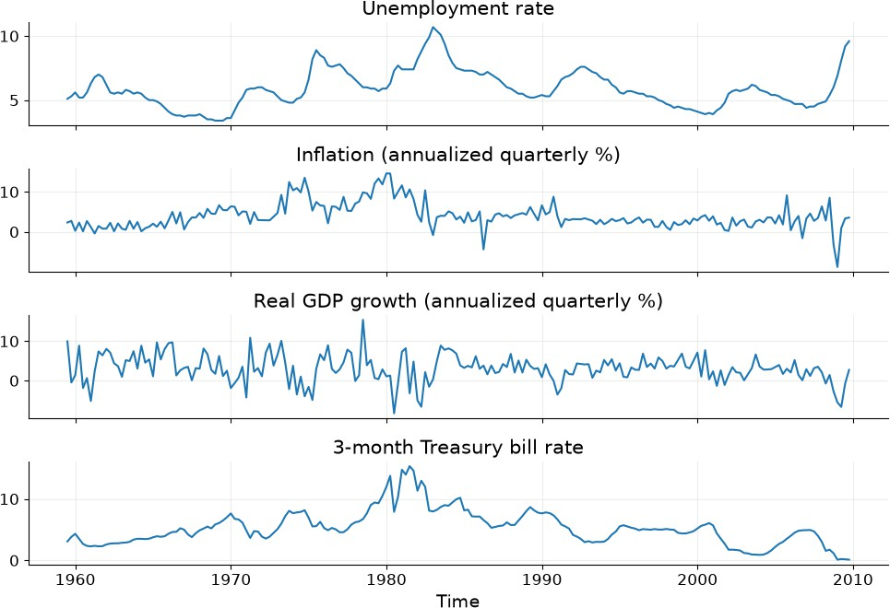
Topic Six: Vector Time Series

Slide 50
Topic Six: Vector Time Series
Vector time series means each y_{t} is a vector
Many interesting questions arise in the analysis of vector time series
In the unemployment, inflation, GDP growth rate, interest rate data, we may ask:
  Can we forecast inflation better using past inflation as well as unemployment, GDP growth rate and interest rates?
  Does a slowdown in economic activity tend to precede an increase in unemployment?
  After interest rates increase, what happens to the other variables?

Slide 51
Topic Seven: Neural Networks
AR models are simply linear regression of y_{t} on lagged covariates x_{t} := (1,y_{t−1}, …, y_{t−p})
It is natural to use nonlinear regression of y_{t} on
x_{t} for improved predictive power
We perform this nonlinear regression using single hidden-layer neural networks
These is Nonlinear AutoRegression which fits functions y_{t} = f(x_{t}) = f(y_{t−1}, …, y_{t−p})

Slide 52
Topic Seven: Neural Networks
A drawback of these models is that we have to select the value of appropriately
Even if
is chosen well, the dependence of y_{t}
on its past values abruptly cuts oﬀ at
RNNs are a way of fitting functions which use all the past values: y_{t} = f_{t}(x_{t}, x_{t−1}, …, x₁)
We shall study vanilla RNNs and more fancy variants such as LSTMs and GRUs (and possibly also transformers)

Slide 53
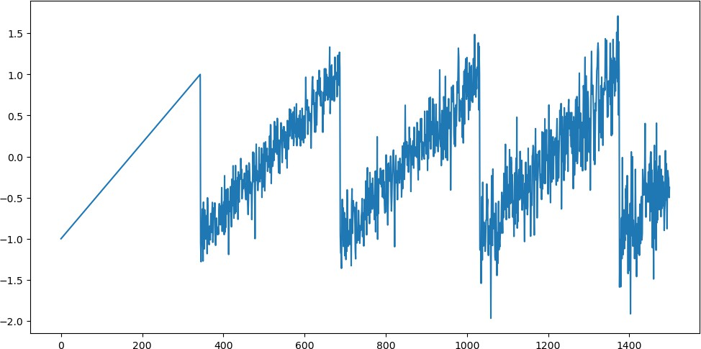
Here is a simulated data generated as: y_{t} = y_{t−p} + ϵ_{t} for p = 344

Slide 54
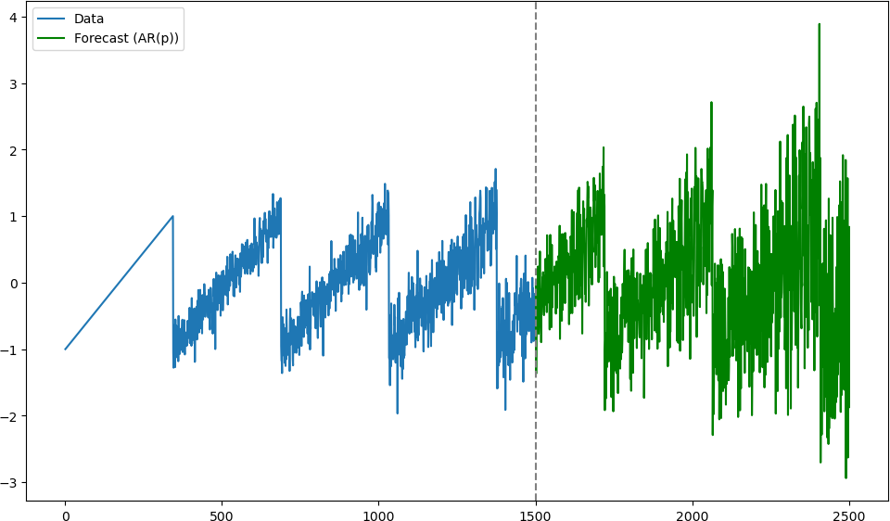
Here are the forecasts by the AR model with the correct :

Slide 55
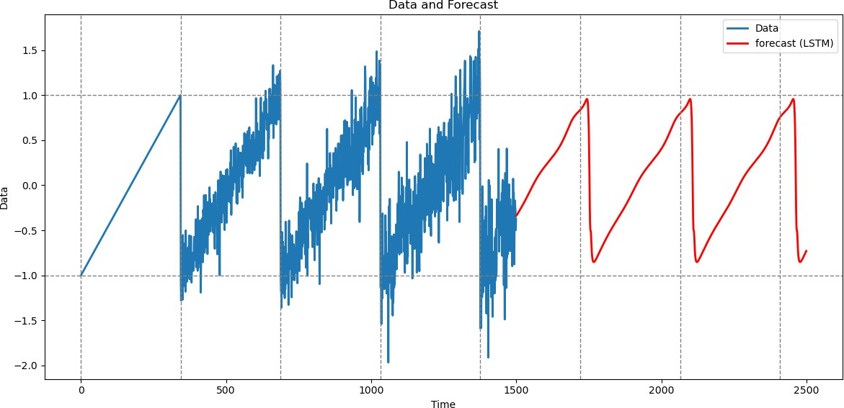
Here are the forecasts by an LSTM (which does not use knowledge of the true ):

Slide 56
Topic 1: Multiple Linear Regression
Topic 2: Nonlinear Regression
Topic 3: High-dimensional Regression
Topic 4: Variance Models and Spectral Analysis
Topic 5: ARIMA modeling
Topic 6: Vector Time Series (VAR models)
Topic 7: Neural Networks

Slide 57
We will work with a variety of models and will apply them to a variety of real time series datasets
We fit models to data mostly using likelihood maximization (sometimes with additional regularization terms)
We will also look at some Bayesian techniques

