Slide 1

TEL AVIV UNIVERSITY · FACULTY OF ENGINEERING · SCHOOL OF ELECTRICAL ENGINEERING
DLX-NN
A RISC processor that computes neural-network activation functions in hardware
Saed Abu Fool · Saleh Khalil
Supervisor: Oren Ganon
Notes:
Good morning. We are Saed Abu Fool and Saleh Khalil, and this is our final
project, supervised by Oren Ganon.
In one sentence: we took a classic teaching processor, the DLX, and we taught
it to compute neural-network activation functions directly in hardware —
sigmoid, tanh, GELU, ReLU and softmax — instead of running them as software
subroutines.
In the next 25 minutes: what the baseline processor could do, what we added, how
accurate it is, how much faster, and what it cost in area. At the end we run a
real handwritten-digit classifier on it.
SOURCE: project_book/sections/titlepage.tex (supervisor); LaTeX/project_book.tex (student names)

Slide 2
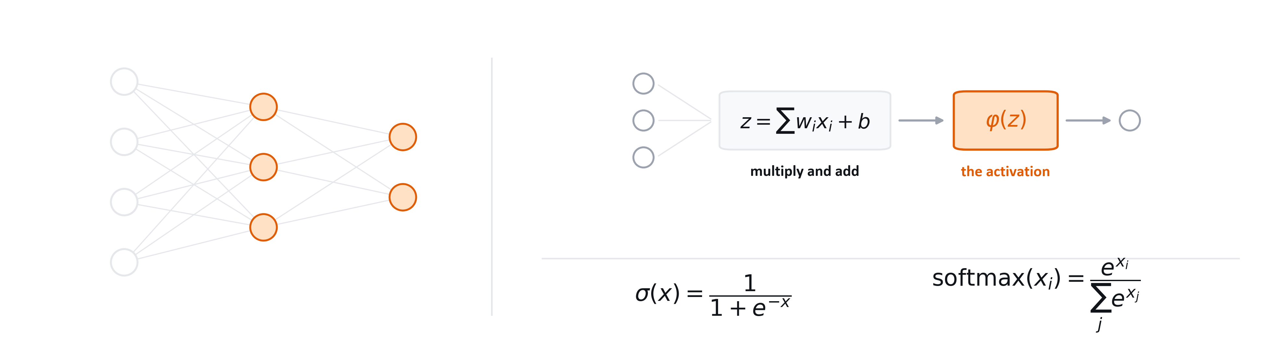
A neural network is cheap arithmetic, plus one expensive step
WHY THIS MATTERS
every neuron
exp · ÷
1 instruction
an activation runs at every neuron, on every layer, on every input
the two operations it needs — and the two this processor lacks
what we built: each activation in a single machine instruction
2
Notes:
Start with why anyone would want this at all.
Neural networks are not only a data-centre thing any more. They run on the small
devices around you — a sensor that recognises a sound, a camera that spots a
face, a controller that reads a gauge. Those devices do not have a graphics card
and most of them do not even have a floating-point unit. They have a small
integer processor, exactly like the one this project is built on.
Now, what does a neural network actually ask that processor to do? Look at the
left. This is a tiny network — four inputs, three neurons, two outputs. The
lines are multiply-and-add: every connection multiplies an input by a weight,
and the neuron sums them. That part is easy. Any processor with an adder can do
it.
The expensive part is the circles. Every neuron, after it has done its sum,
applies an activation function — the orange box on the right. And this is not an
optional flourish. Without it, a stack of layers collapses into a single linear
function, and the whole network becomes useless. Whatever you have heard about
deep learning, this non-linear step is what makes depth mean anything.
So how hard can one function be? Look at the two formulas. Sigmoid is one over
one plus e to the minus x. Softmax is e to the x over the sum of e to the x.
Between them they need an exponential and a division.
Our processor has neither. No exponential instruction, no divider. So on this
machine every activation has to be faked in software, out of adds, shifts and
branches — and it has to be faked once per neuron, per layer, per input, which
is where the time goes.
That is the opening the project attacks: take the one expensive step, and make
it a single instruction the hardware executes directly.
SOURCE: README.md 'Motivation'; the activation formulas are the standard definitions, evaluated in Q16.16 throughout this work

Slide 3
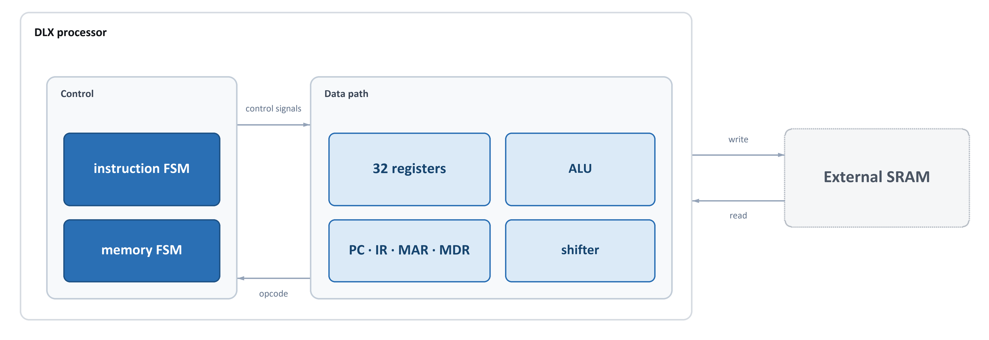
Where we started: the DLX processor
BASELINE
It can do: add · subtract · and · or · xor · compare · shift · load · store · branch · jump
It cannot do: any neural-network activation function — no exponent, no divide, no multiply
3
Notes:
This is the processor we were given. The DLX is a textbook 32-bit RISC machine.
It is multi-cycle and not pipelined: one instruction is finished before the next
one starts, and each instruction takes several clock cycles.
On the left, control — two state machines: one walks every instruction through
fetch, decode, execute, write-back; the other runs the handshake with memory,
because the SRAM is asynchronous.
In the middle, the data path. Thirty-two registers of 32 bits, an ALU that adds,
subtracts and compares, working registers, and a shifter that moves exactly one
bit per instruction — there is no barrel shifter.
Now the important line at the bottom. This machine has no multiplier, no
divider, and certainly no exponential. So every neural-network activation
function has to be built out of adds, shifts and branches, in software. That is
slow, and that is the problem this project attacks.
SOURCE: README.md 'Architecture Overview'; docs/architecture_block_diagrams.md (BEFORE)

Slide 4
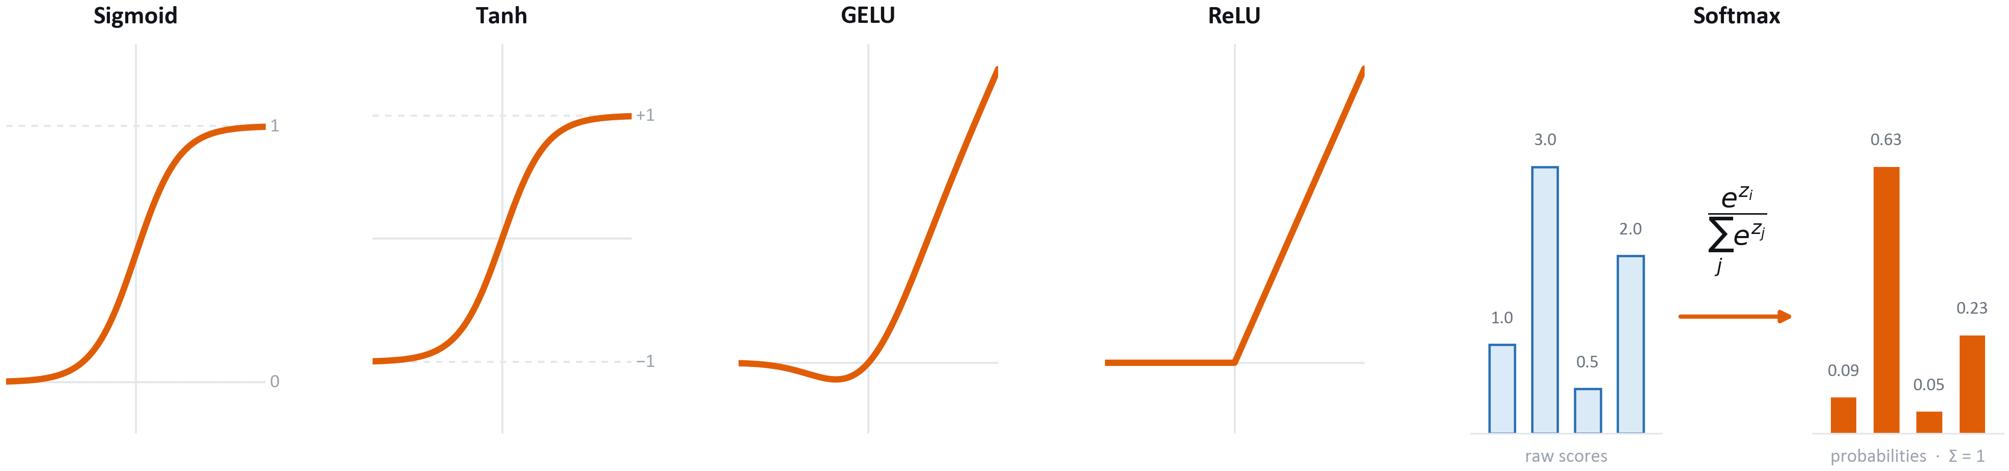
What the processor has to compute
THE GOAL
AND IT MUST MEET THREE REQUIREMENTS
≤ 0.025
≥ 30 %
≤ 20 %
mean squared error against exact math
fewer clock cycles than the software version
extra chip area over the plain DLX
4
Notes:
A neural network is mostly multiply-and-add, which any processor can do. The
hard part is the activation function — the non-linear step after each layer.
Without it the whole network collapses into one linear function.
Five of them, left to right. Sigmoid squashes any number into zero-to-one, tanh
into minus-one-to-one. GELU is the smooth gate used in modern transformer
models. ReLU keeps positives and zeroes negatives.
The fifth one is different in kind. Softmax is not a curve — it takes a whole
vector of scores and turns it into a probability distribution that sums to one.
Every output depends on every input. Remember that difference; it drives the
entire hardware design later.
Three requirements defined the project. Accuracy: mean squared error no worse
than 0.025 versus exact mathematics. Speed: at least a thirty percent cut in
clock cycles against the software implementation — that is requirement R1, the
headline one. Area: no more than twenty percent extra chip area.
Everything from here answers those three numbers.
SOURCE: results/DLX-NN_Project_Targets.xlsx, sheet '1. Accuracy'; results/DLX-NN_Project_Targets.xlsx, sheet '2. Cycle Count' (raw simulator logs: results/timing results/*.txt); results/DLX-NN_Project_Targets.xlsx, sheet '3. Area' (raw: results/Utilization_Summary/*.pdf)

Slide 5
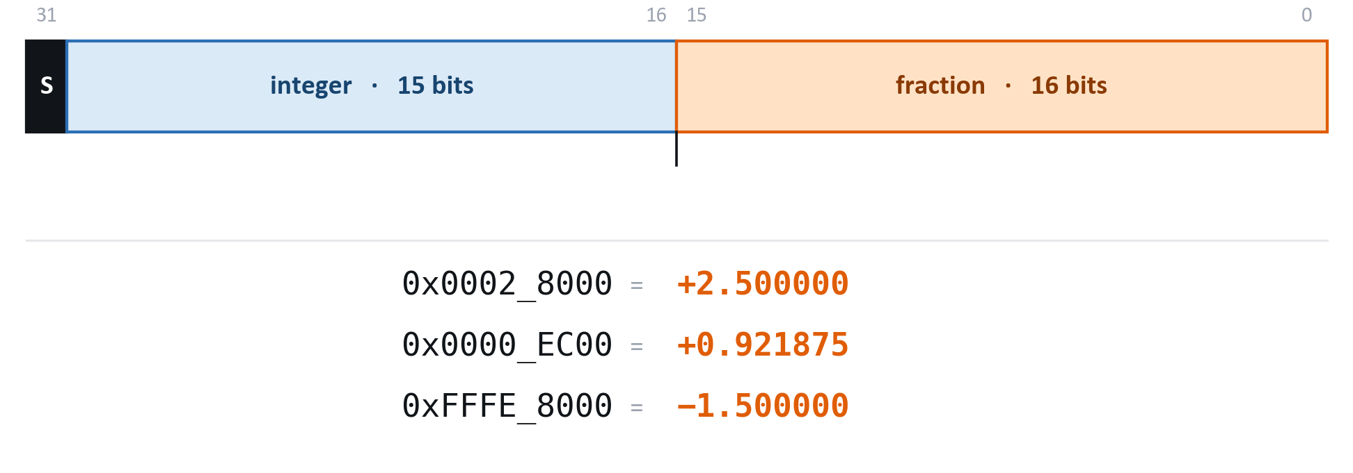
Every number is a 32-bit integer with an implied point
FIRST, HOW WE STORE A FRACTION
2⁻¹⁶
[−32768, +32767.99998]
0 extra
the smallest step we can represent about 0.000015
the exact range it covers plenty for a neural network
hardware for add and subtract they are ordinary integer ops
5
Notes:
Before the five functions, one slide on how this machine holds a number, because
every value you see for the rest of the talk is in this format.
The DLX has no floating-point unit. It has no floating-point anything. So we use
fixed point, which is the old trick of storing a fraction as an ordinary
integer and simply agreeing where the decimal point sits.
Q16.16 means: thirty-two bits, split down the middle. Bit thirty-one is the
sign, two's complement like any integer. The next fifteen bits are the whole
part. The bottom sixteen bits are the fraction. The point sits between bit
sixteen and bit fifteen and it never moves — that is the whole idea, and it is
why this is called fixed point.
Concretely: the hex word 0x0002_8000 is the integer 163,840. Divide by 65,536 —
that is two to the sixteen — and you get 2.5. That is not a made-up example; it
is the actual word we loaded into the processor for the sigmoid test, and
0x0000_EC00 underneath it is the actual word it gave back, which is 0.921875.
The third row is minus one and a half, stored as plain two's complement.
Why this matters for the hardware. Adding two Q16.16 numbers is just adding two
integers — the existing ALU already does it, no new hardware at all. Multiplying
needs one extra step, a shift right by sixteen. And dividing by a power of two,
which is what our whole approximation strategy relies on, is a single shift.
The cost is resolution: the smallest step is two to the minus sixteen, about
fifteen millionths. The range is not symmetric: it runs from minus 32,768 up to
plus 32,767.99998, because two's complement gives one extra step on the
negative side and the largest positive value is one resolution step short of
32,768. For neural
network activations, where the interesting values live between about minus five
and plus five, both are far more than enough — and the accuracy results in a few
minutes confirm it.
SOURCE: README.md 'Fixed-Point Representation (Q16.16)'; worked values from results/timing results/sigmoid_accel.txt and relu_accel.txt

Slide 6
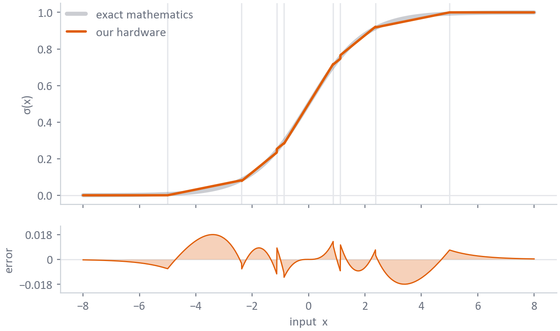
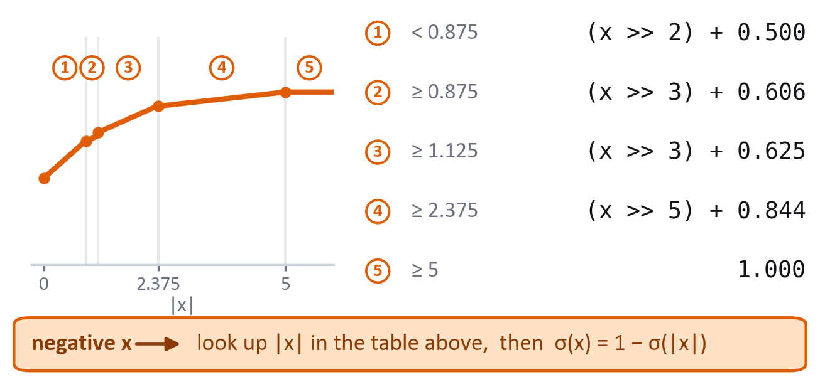
Sigmoid: a curve made of five straight lines
ACTIVATION FUNCTION 1 OF 5
HOW OUR HARDWARE DOES IT
σ(x) ≈ (x ≫ k) + b
Five straight segments replace the curve. Every slope is a power of two — shifts, not multiplies.
ACCURACY
4.69e−5
mean squared error over [-10, 10] requirement ≤ 0.025 · PASS
6
Notes:
The first and most important one, because three of our five functions are built
on top of it. The grey line is the exact sigmoid, the orange line is what our
silicon produces, and at this scale you cannot separate them.
The trick is on the right. Instead of an exponential, we replace the curve with
five straight segments — the joins are the faint vertical lines. A segment is
slope times x plus an offset, and every slope is a power of two: a quarter, an
eighth, a thirty-second. Multiplying by an eighth is shifting three places
right, which is free. So sigmoid costs a comparison, a shift and an add.
Negative inputs need no segments at all: sigmoid of minus x is one minus sigmoid
of x, so we mirror.
The bottom strip is the error. The needles near plus and minus one are the joins
between segments. The worst absolute error is 1.8 hundredths, out at x around
three and a half, and the mean squared error over the whole sweep is 4.7 times
ten to the minus five — five hundred times better than the requirement.
SOURCE: results/DLX-NN_Project_Targets.xlsx, sheet '1. Accuracy'; curve plotted from the RTL in design/

Slide 7
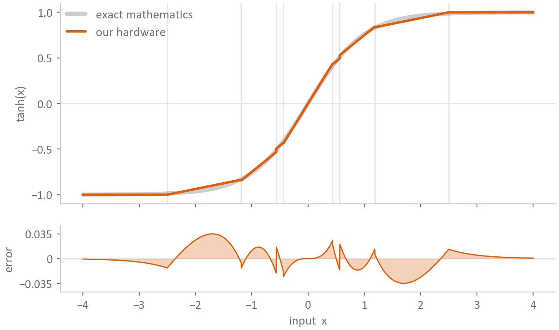
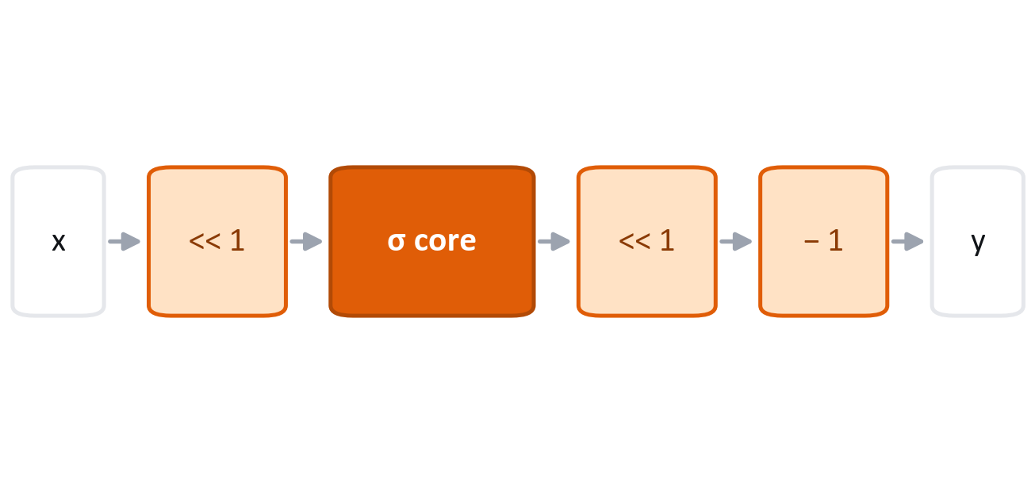
Tanh: the same block, used twice
ACTIVATION FUNCTION 2 OF 5
HOW OUR HARDWARE DOES IT
tanh(x) = 2·σ(2x) − 1
No new hardware: double the input, double the output, subtract one.
ACCURACY
2.34e−4
mean squared error over [-4, 4] requirement ≤ 0.025 · PASS
7
Notes:
Tanh is mathematically the sigmoid stretched and shifted: tanh of x equals two
sigmoid of two x, minus one.
That identity is worth real money in hardware. It means we do not build a tanh
unit. We take the input, shift it left by one — that is times two — push it
through the same sigmoid block, shift the result left by one, and subtract one.
Two shifts and an add.
Because the input is doubled, the curve saturates twice as early: by the time x
reaches about two and a half, the output is pinned at plus or minus one, exactly
like the real tanh.
The error also doubles, since we doubled the sigmoid output. It is still
2.3 times ten to the minus four — a hundred times inside the requirement.
SOURCE: results/DLX-NN_Project_Targets.xlsx, sheet '1. Accuracy'; curve plotted from the RTL in design/

Slide 8
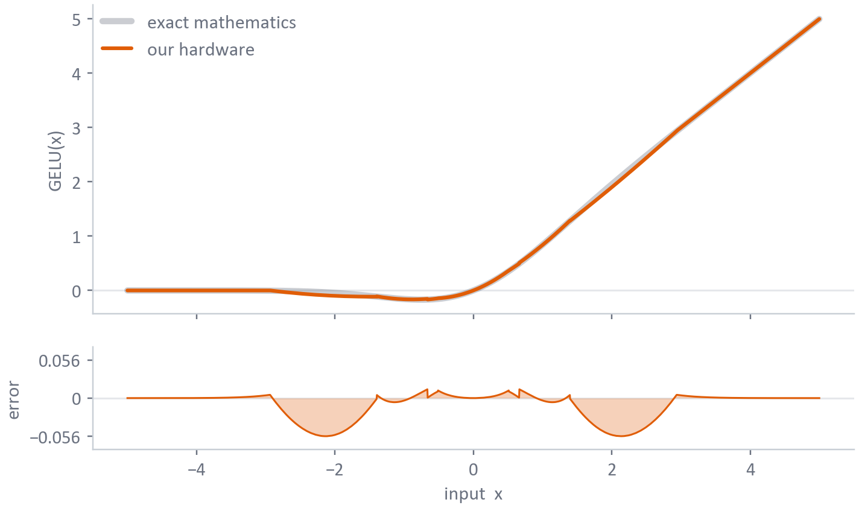
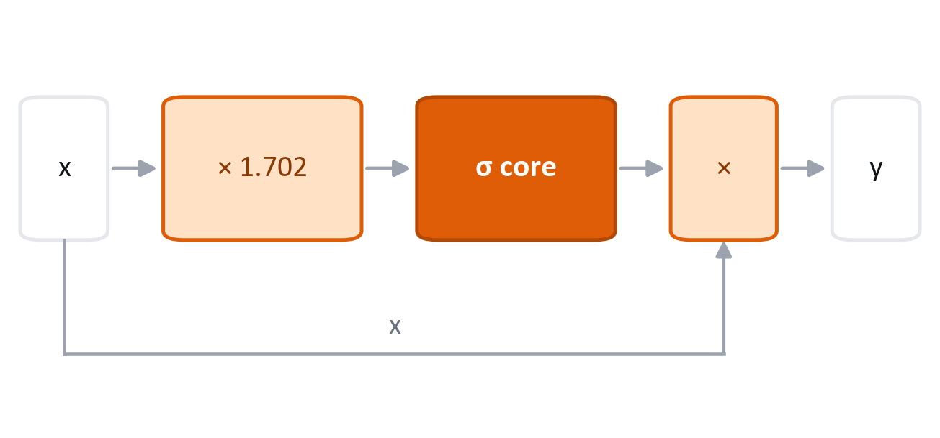
GELU: the same block again, scaled
ACTIVATION FUNCTION 3 OF 5
HOW OUR HARDWARE DOES IT
GELU(x) ≈ x · σ(1.702x)
The sigmoid block again, input scaled by 1.702. The only one that also needs the multiplier.
ACCURACY
4.92e−4
mean squared error over [-5, 5] requirement ≤ 0.025 · PASS
8
Notes:
GELU is the activation used inside modern transformer models. It behaves like a
soft version of ReLU — notice the small dip below zero just left of the origin,
where GELU actually returns a slightly negative value.
The standard cheap approximation is x times sigmoid of 1.702 x. So for the third
time we reuse the same sigmoid block. Scale the input by the constant 1.702,
run it through sigmoid, then multiply by the original x.
This is the one activation that genuinely needs a multiplier, for the input
scaling and the final product. Everything else in the engine is shift-only.
That is the resource-sharing story of this project in one sentence: sigmoid,
tanh and GELU are three instructions, but only one sigmoid core exists on the
chip. Three separate units would have cost roughly three times the area.
Mean squared error, 4.9 times ten to the minus four. Fifty times inside the
requirement.
SOURCE: results/DLX-NN_Project_Targets.xlsx, sheet '1. Accuracy'; curve plotted from the RTL in design/

Slide 9
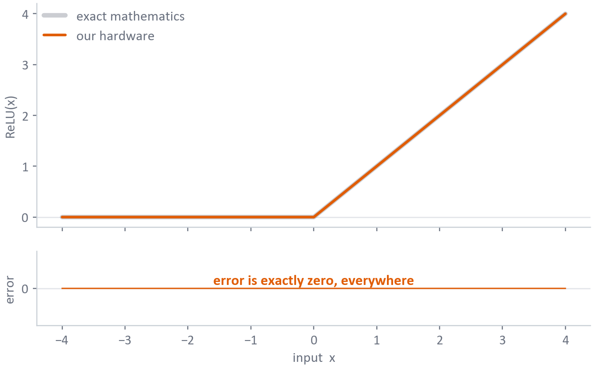
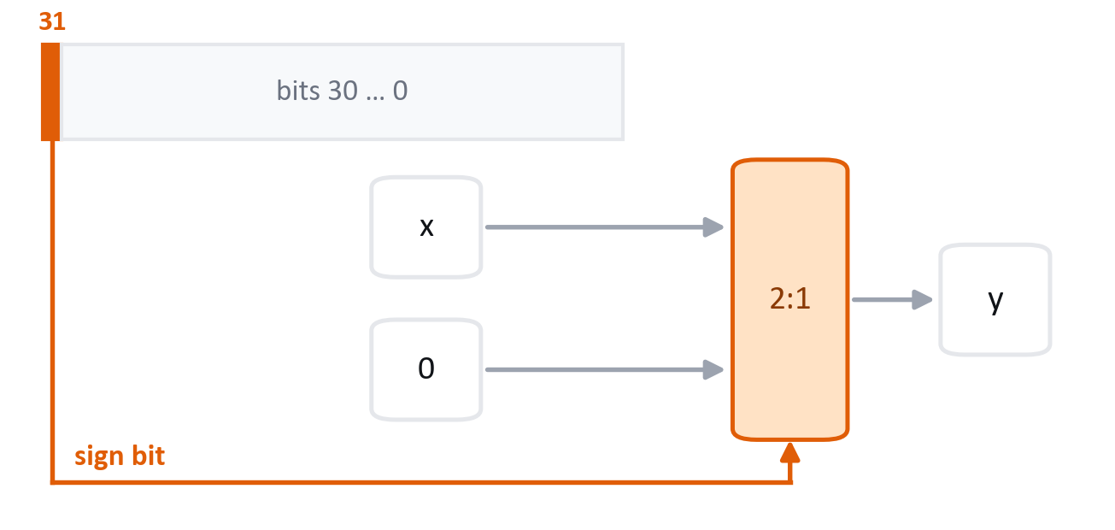
ReLU: one look at the sign bit
ACTIVATION FUNCTION 4 OF 5
HOW OUR HARDWARE DOES IT
ReLU(x) = max(0, x)
Sign bit set, the answer is zero. Otherwise the input passes straight through. Exact, not approximate.
ACCURACY
0
mean squared error over [-10, 10] requirement ≤ 0.025 · PASS
9
Notes:
ReLU is the easy one, and I want to be honest about that.
ReLU keeps positive numbers and replaces negatives with zero. In two's complement
the sign is a single bit — bit thirty-one. So the entire unit is: look at bit
thirty-one; if it is one, output zero; otherwise output the input unchanged.
That is one multiplexer. No arithmetic at all.
Because there is no approximation, the error is not small — it is exactly zero
for every input. That is the flat line at the bottom, and the zero in the
results sheet.
Remember this slide when we get to the speed results, because ReLU is also the
one function where the hardware wins least. When the software version is already
only three instructions, there is not much left to remove.
SOURCE: results/DLX-NN_Project_Targets.xlsx, sheet '1. Accuracy'; curve plotted from the RTL in design/

Slide 10
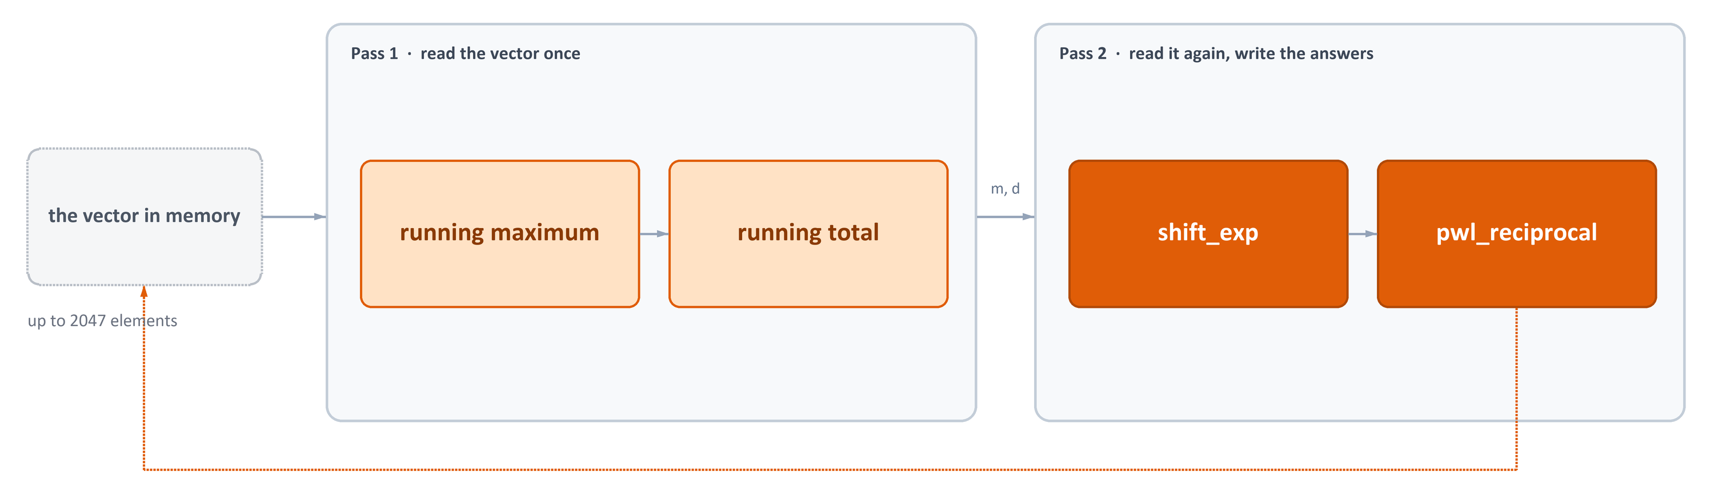
Softmax: a whole vector, in two passes
ACTIVATION FUNCTION 5 OF 5
THE EXPONENT
THE DIVISION
THE ACCURACY
becomes a shift
becomes eight lines
1.03e−4
shift_exp: multiply by 1.5, then shift right — no exp()
1/d as eight straight segments — no divider
mean squared error over 1,050 vectors · PASS
10
Notes:
Softmax is the odd one out, because it is not a curve — it turns a whole vector
of scores into probabilities that add up to one. Every output depends on every
input, so the hardware has to see the entire vector.
Textbook softmax is the exponential of each score divided by the sum of the
exponentials. We have neither an exponential nor a divider, so we follow the
online-softmax algorithm from the ICECS 2025 paper by Hirayae and colleagues and
replace both.
Pass one walks the vector once, keeping the largest score so far and a running
denominator, rescaling that denominator whenever a new maximum appears —
subtracting the maximum is what stops the numbers overflowing. Pass two walks
the vector again and writes each output.
The exponential becomes shift-exp: multiply by one and a half, split into whole
and fractional parts, and shift. Right shifts only, because after subtracting
the maximum every argument is negative. The division becomes a piecewise-linear
reciprocal: eight straight segments over powers of two.
Over 1,050 test vectors, up to five hundred elements long, mean squared error is
one times ten to the minus four.
SOURCE: results/DLX-NN_Project_Targets.xlsx, sheet '1. Accuracy'; README.md 'Softmax Instruction'; papers/ (ICECS 2025, Hirayae et al.)

Slide 11
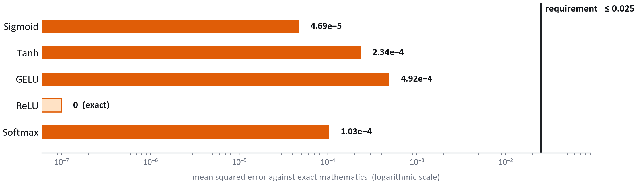
All five, against the accuracy requirement
RESULT 1 OF 3 · ACCURACY
5 / 5
≤ 0.025
4.92e−4
functions inside the requirement
the requirement
our worst case (GELU)
11
Notes:
This is the first of the three requirements, closed out.
The scale is logarithmic, so each gridline is a factor of ten. The black line on
the right is the requirement: mean squared error no worse than 0.025.
Every bar is far to the left of it. GELU is our worst function at five ten-thousandths,
and that is still fifty times better than required. Sigmoid is five hundred times
better. ReLU is exact, so it has no bar at all — I have drawn it at the floor of
the scale so you can see the label.
Softmax was measured differently from the others: not by sweeping one input, but
by running 1,050 complete vectors of up to five hundred elements each.
Requirement one: met, with a very large margin. Now the harder question — how
much faster is it, and what did it cost.
SOURCE: results/DLX-NN_Project_Targets.xlsx, sheet '1. Accuracy'

Slide 12
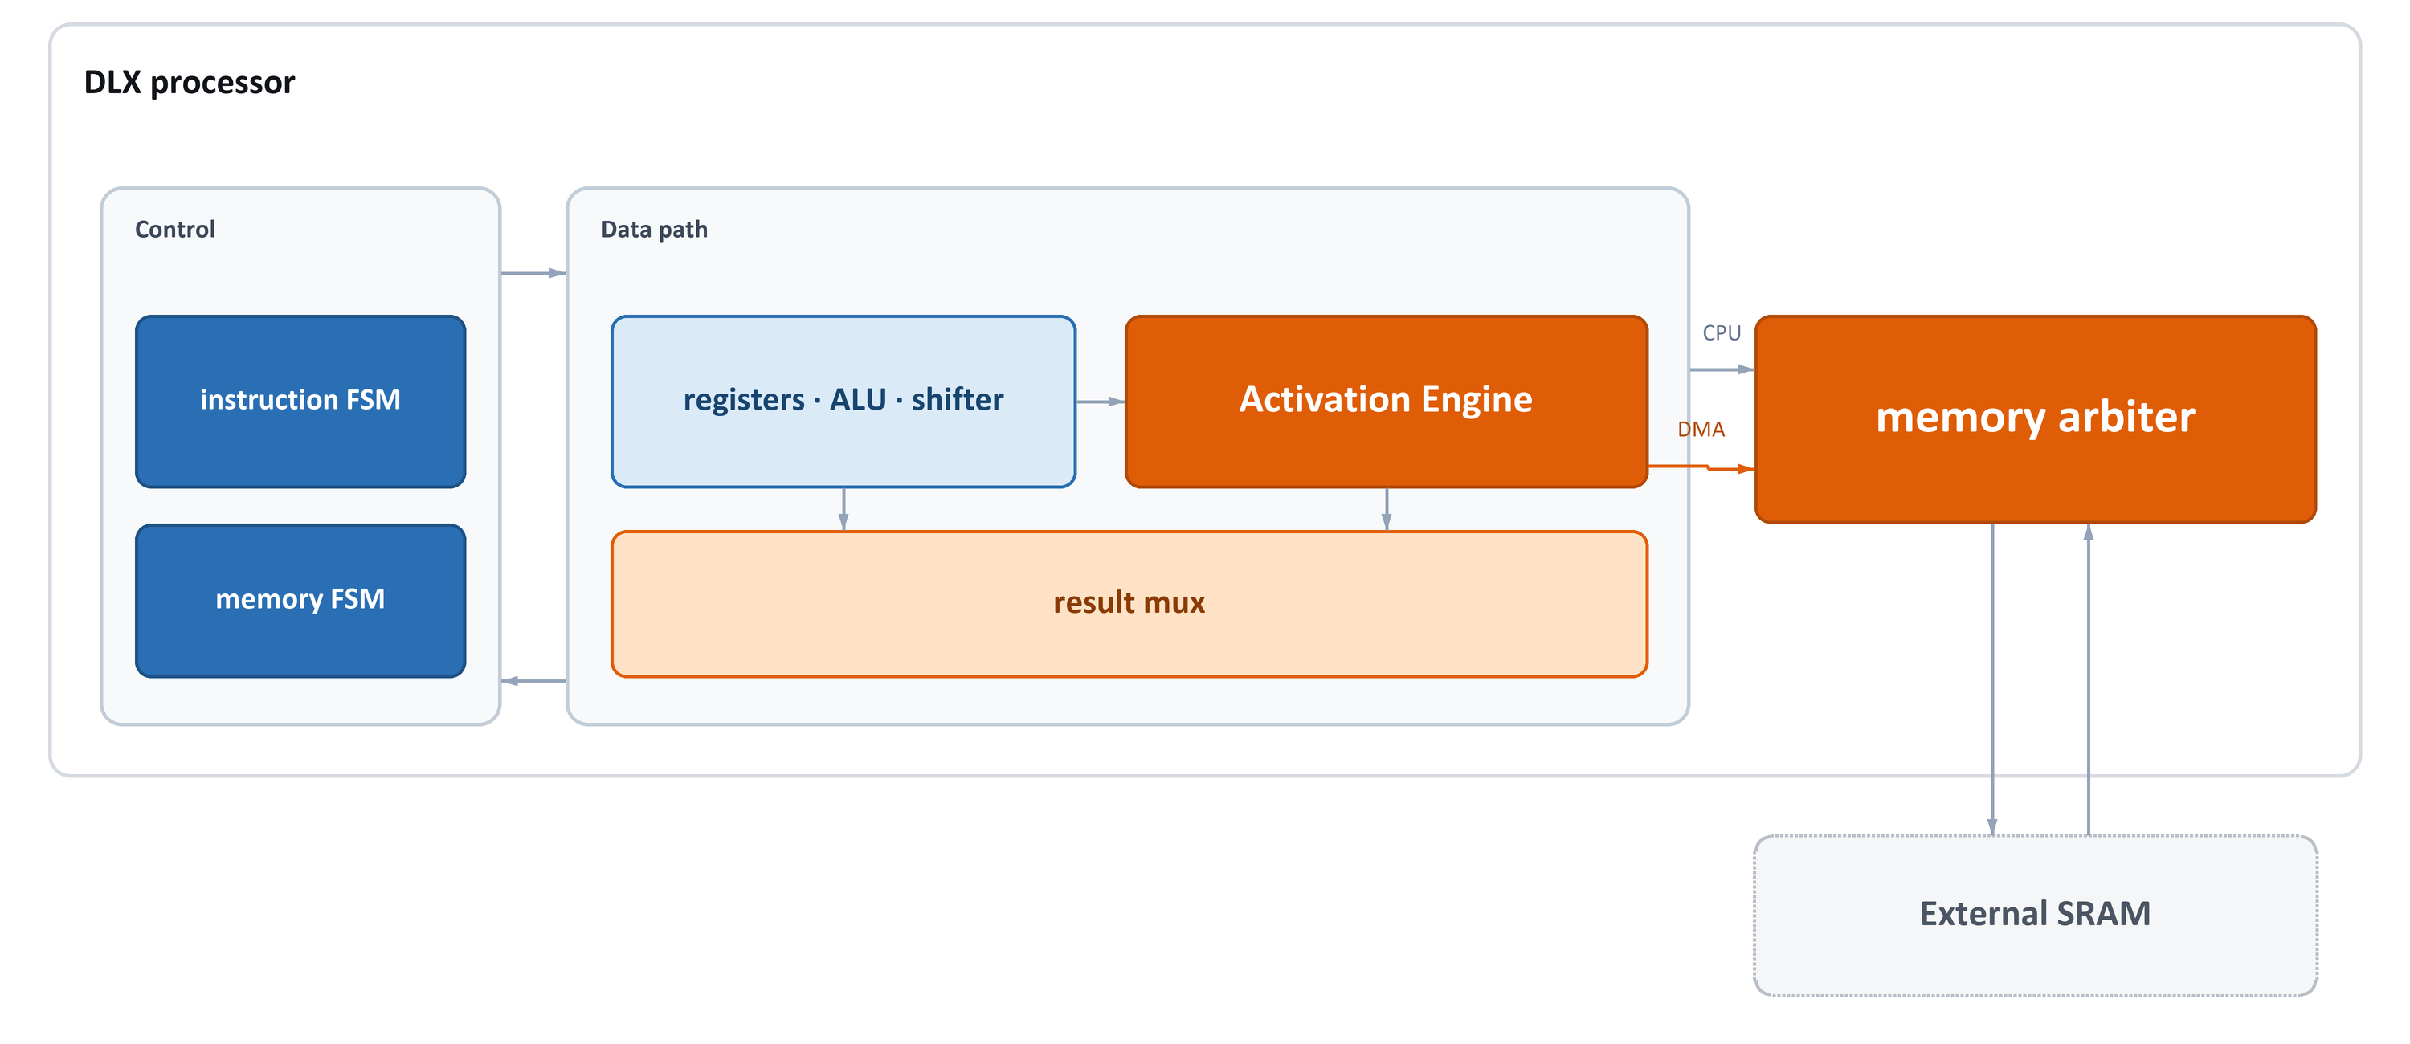
What we added, at the top level
BUILDING IT IN · STEP 1 OF 7
Everything orange is new. Everything else is the processor you saw two slides ago.
12
Notes:
This is the same picture as the baseline slide, with everything we added shown
in orange. There are only three additions, and I want to stress how small that
list is.
One: the Activation Engine, inside the data path. That is the block that
computes all five functions.
Two: a new multiplexer that lets an instruction's result come from the
activation engine instead of the ALU.
Three: a memory arbiter between the processor and the SRAM, because the softmax
engine needs the memory bus for itself.
Plus four new states in the instruction FSM.
Everything else — the register file, the ALU, the shifter, the memory FSM, the
SRAM — is untouched. We did not redesign the processor. We attached to it.
The next six slides walk through each of those pieces.
SOURCE: docs/architecture_block_diagrams.md (BEFORE / AFTER); README.md 'Architecture Overview'

Slide 13
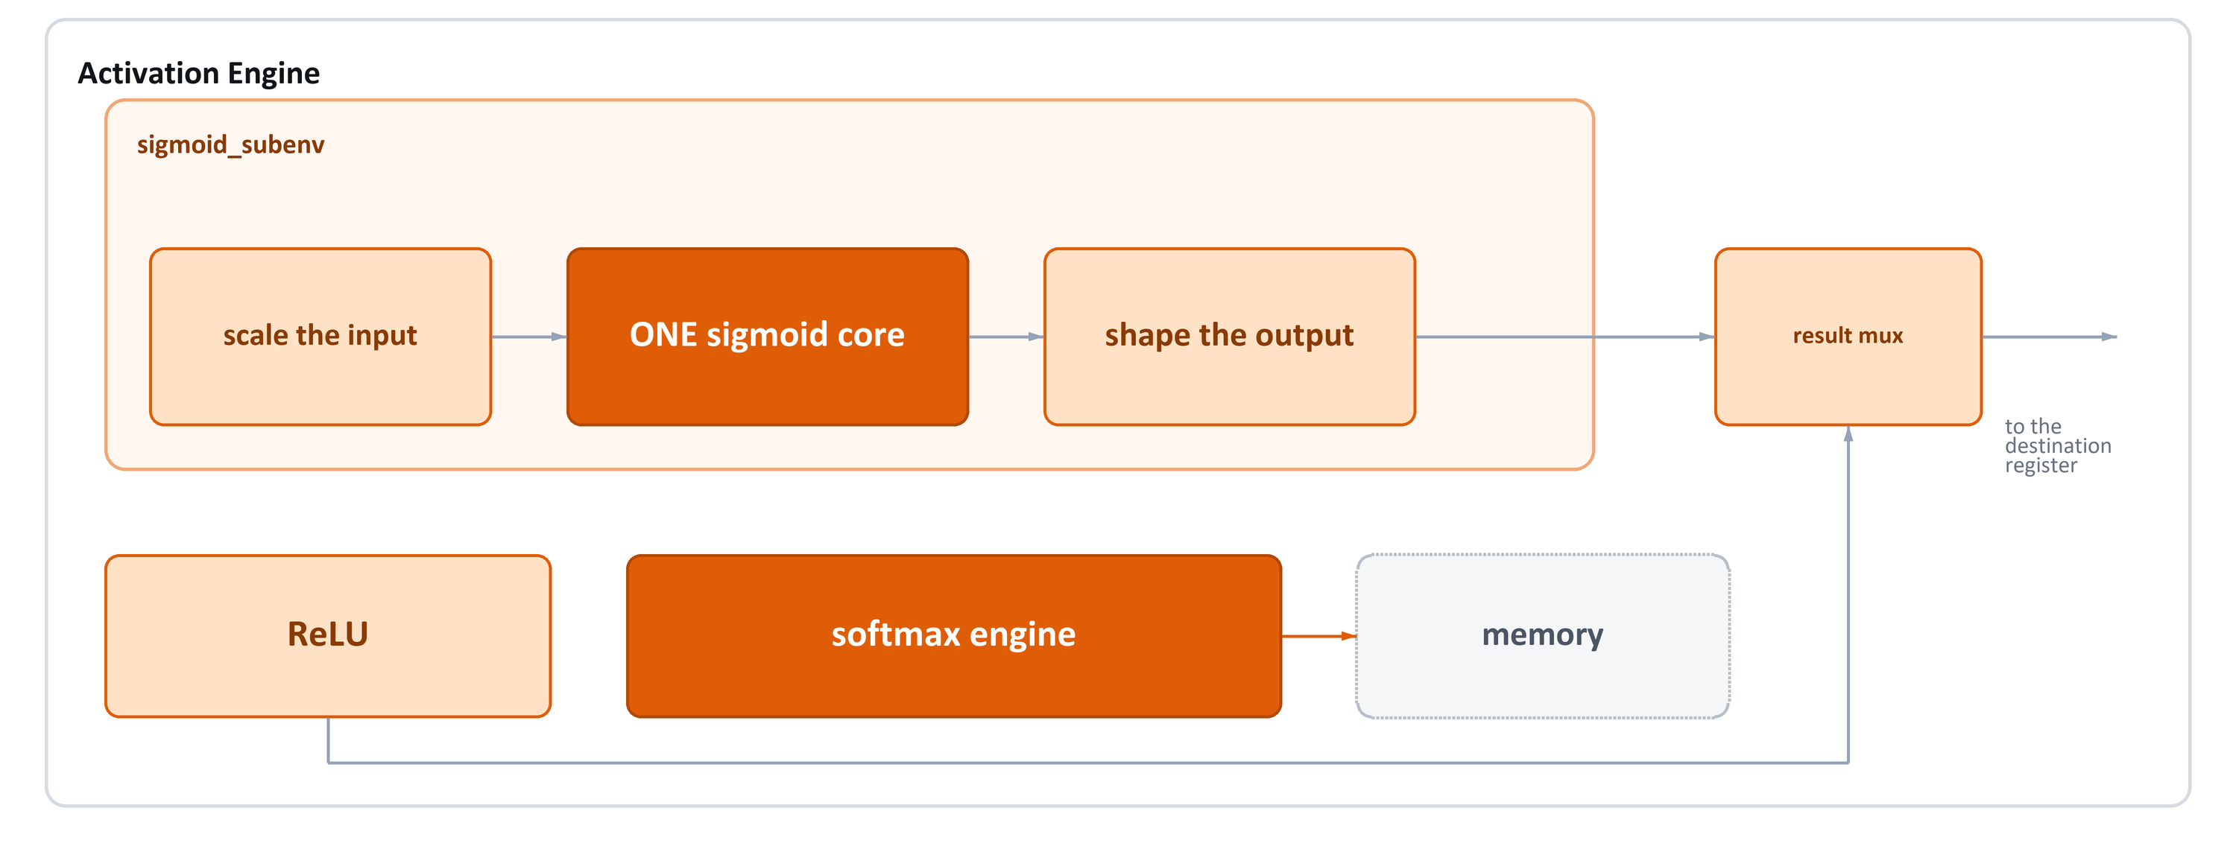
One core, three instructions
BUILDING IT IN · STEP 2 OF 7
Three separate sigmoid units would have cost roughly three times the area. We build one and mux around it.
13
Notes:
Inside the engine — this is where the area saving lives.
Look at the top row. Sigmoid, tanh and GELU are three instructions taking one
route: scale the input, run it through one sigmoid core, shape the output. The
scaling and shaping are just multiplexers — x, 2x or 1.702x going in; y, 2y
minus one, or x times y coming out.
So the expensive part — the sigmoid core with its comparators, adders and
shifters — exists exactly once on the chip. Building three separate units would
have cost roughly three times the area for no extra capability.
ReLU sits outside that path — it shares nothing with sigmoid, it is one sign-bit
test. And the softmax engine sits apart from everything, because it does not
take a value from a register and give one back; it reads and writes memory
itself. More on that shortly.
At the right, a multiplexer picks whichever result was asked for.
SOURCE: README.md 'sigmoid_subenv - Shared Sigmoid Core'; design/sigmoid_subenv/sigmoid_subenv.v

Slide 14
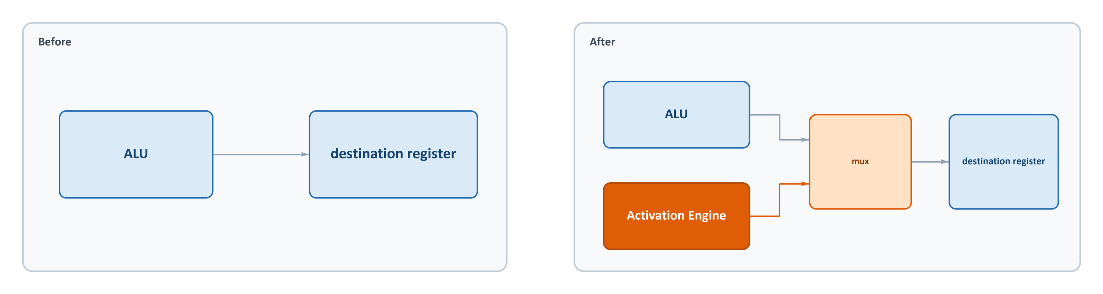
The data path barely changed
BUILDING IT IN · STEP 3 OF 7
That is the whole change to the data path: one extra input on one multiplexer.
14
Notes:
People often expect that adding a hardware unit to a processor means rewiring
the data path. It did not.
Before, the result that gets written into a destination register always came
from the ALU. One wire.
After, there is a two-to-one multiplexer in front of that same wire. If the
instruction's opcode starts with the three bits one-one-one, the result comes
from the activation engine. Otherwise it comes from the ALU, exactly as before.
We chose the opcodes deliberately so that this test is three bits, not a full
comparison against five separate opcodes. All five activation instructions live
in the one-one-one block: sigmoid, tanh, GELU, ReLU, softmax.
No new register-file port. No second write-back path. No change to the timing of
any existing instruction. That is the whole modification.
SOURCE: docs/architecture_block_diagrams.md, 'Changed: DINT_0_IN mux'; opcode map from RESA_ENV/OPCODES.md

Slide 15
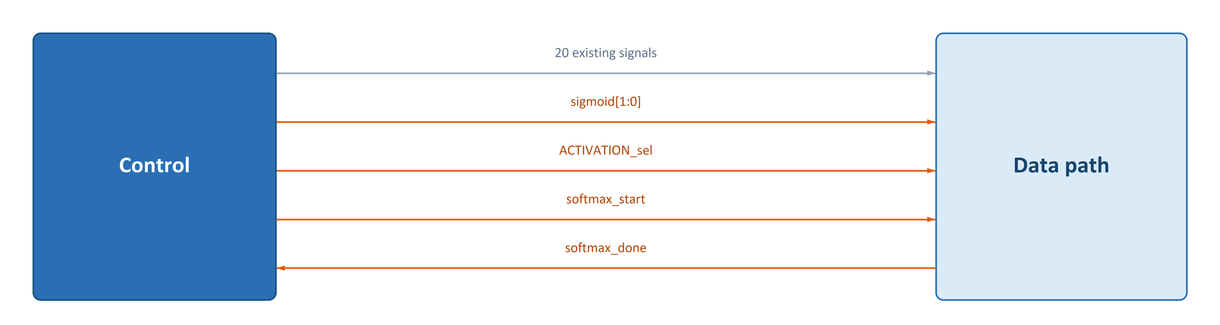
Three new control signals
BUILDING IT IN · STEP 4 OF 7
Three new signals out, one new signal back. Nothing that was already there had to change.
15
Notes:
The control unit talks to the data path over a bundle of wires. Before this
project there were twenty of them — enable this register, select that
multiplexer, and so on.
We added three going out.
sigmoid, two bits, says which of the three sigmoid-family functions is wanted:
sigmoid, tanh or GELU. That is what drives the input and output multiplexers you
saw two slides ago.
ACTIVATION_sel picks between the sigmoid path and the ReLU path.
softmax_start is a single-cycle pulse. It tells the softmax engine to begin, and
then the control unit lets go.
And one signal comes back: softmax_done. Because softmax takes many cycles and
the number depends on the length of the vector, the control unit cannot simply
count. It waits for the engine to say it has finished.
None of the twenty original signals changed meaning. That matters — it means
every existing instruction still executes exactly as it did before.
SOURCE: docs/architecture_block_diagrams.md, 'NEW outputs' / 'NEW input'

Slide 16
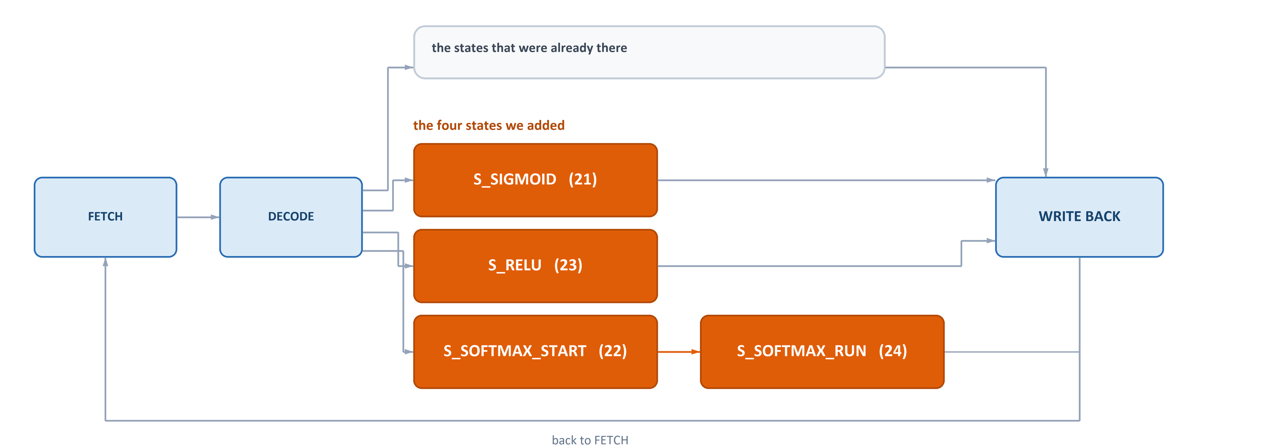
Four new states in the instruction FSM
BUILDING IT IN · STEP 5 OF 7
Four new states. The scalar ones finish in one or two clocks; the last just waits for the softmax engine.
16
Notes:
The control unit is a state machine. Every instruction walks a path through it:
fetch, decode, then whichever states that instruction needs, then write back.
Decode now has four more destinations.
S_SIGMOID, state twenty-one, handles sigmoid, tanh and GELU. Sigmoid and tanh
finish in a single clock. GELU takes two, because its path is pipelined — the
state waits on a ready signal from the engine rather than assuming a fixed
length.
S_RELU, state twenty-three, does the same for ReLU, in one cycle.
The two softmax states are different. S_SOFTMAX_START, state twenty-two, pulses
the start signal and moves on. S_SOFTMAX_RUN, state twenty-four, is a waiting
state: it sits there until softmax_done comes back. That is how a multi-cycle,
data-dependent operation is handled in a machine that otherwise knows exactly
how long everything takes.
Notice that softmax does not go to write back. Its results are already in
memory, so it returns straight to fetch.
SOURCE: docs/architecture_block_diagrams.md; state numbers from CLAUDE.md (S_SIGMOID 21, S_SOFTMAX_START 22, S_RELU 23, S_SOFTMAX_RUN 24)

Slide 17
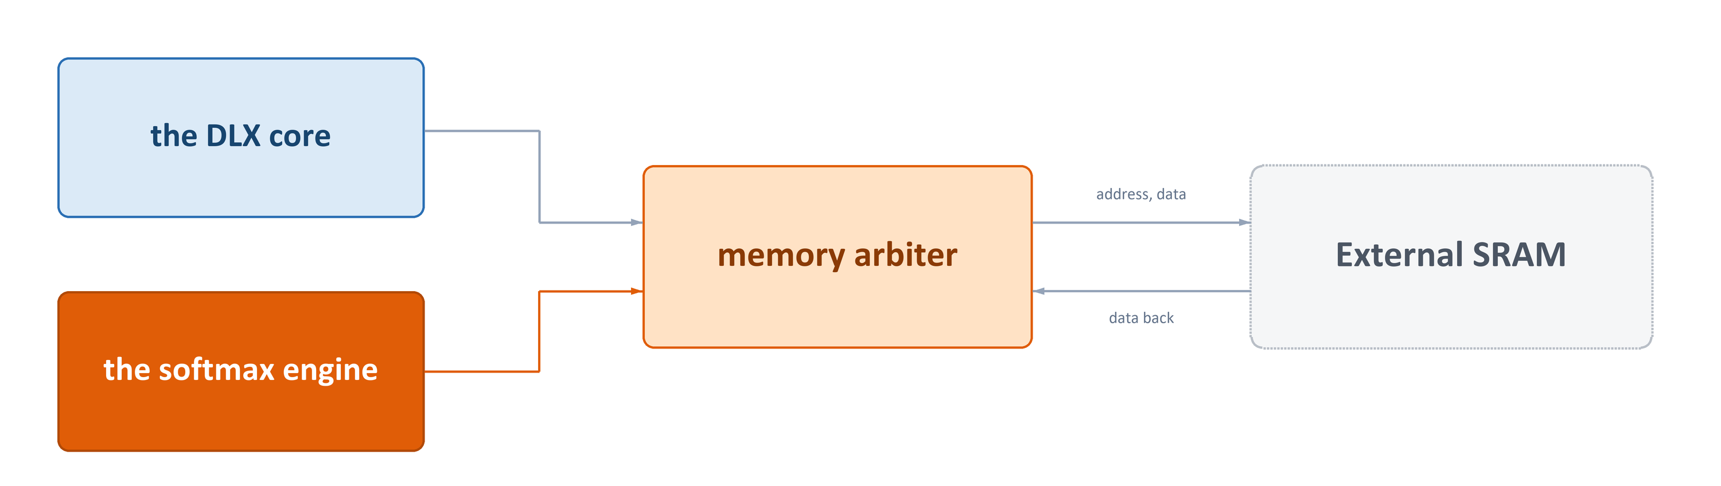
Two masters, one memory bus
BUILDING IT IN · STEP 6 OF 7
The processor was never designed to share its memory. The arbiter is what makes that safe.
17
Notes:
Here is the problem the arbiter solves.
The DLX was built on the assumption that it is the only thing touching memory.
Its loads and stores drive the address lines, the data lines and the handshake
signals directly.
The softmax engine also needs memory — it streams a whole vector in and a whole
vector out. If both drove the bus at once you would get corrupted data, or two
drivers fighting on the same wires.
So we put a two-to-one switch in between, controlled by one signal: is the
softmax engine active? If yes, the engine owns the bus and the processor's
requests are held off. If no, the processor owns it, exactly as before.
Because the DLX is stopped in the waiting state while softmax runs, it is not
actually trying to use memory during that window. So in practice nothing is ever
delayed — but the arbiter guarantees it, rather than relying on that being true.
SOURCE: docs/architecture_block_diagrams.md, 'mem_arbiter'; final_simple_DLX/.../mem_arbiter.v

Slide 18
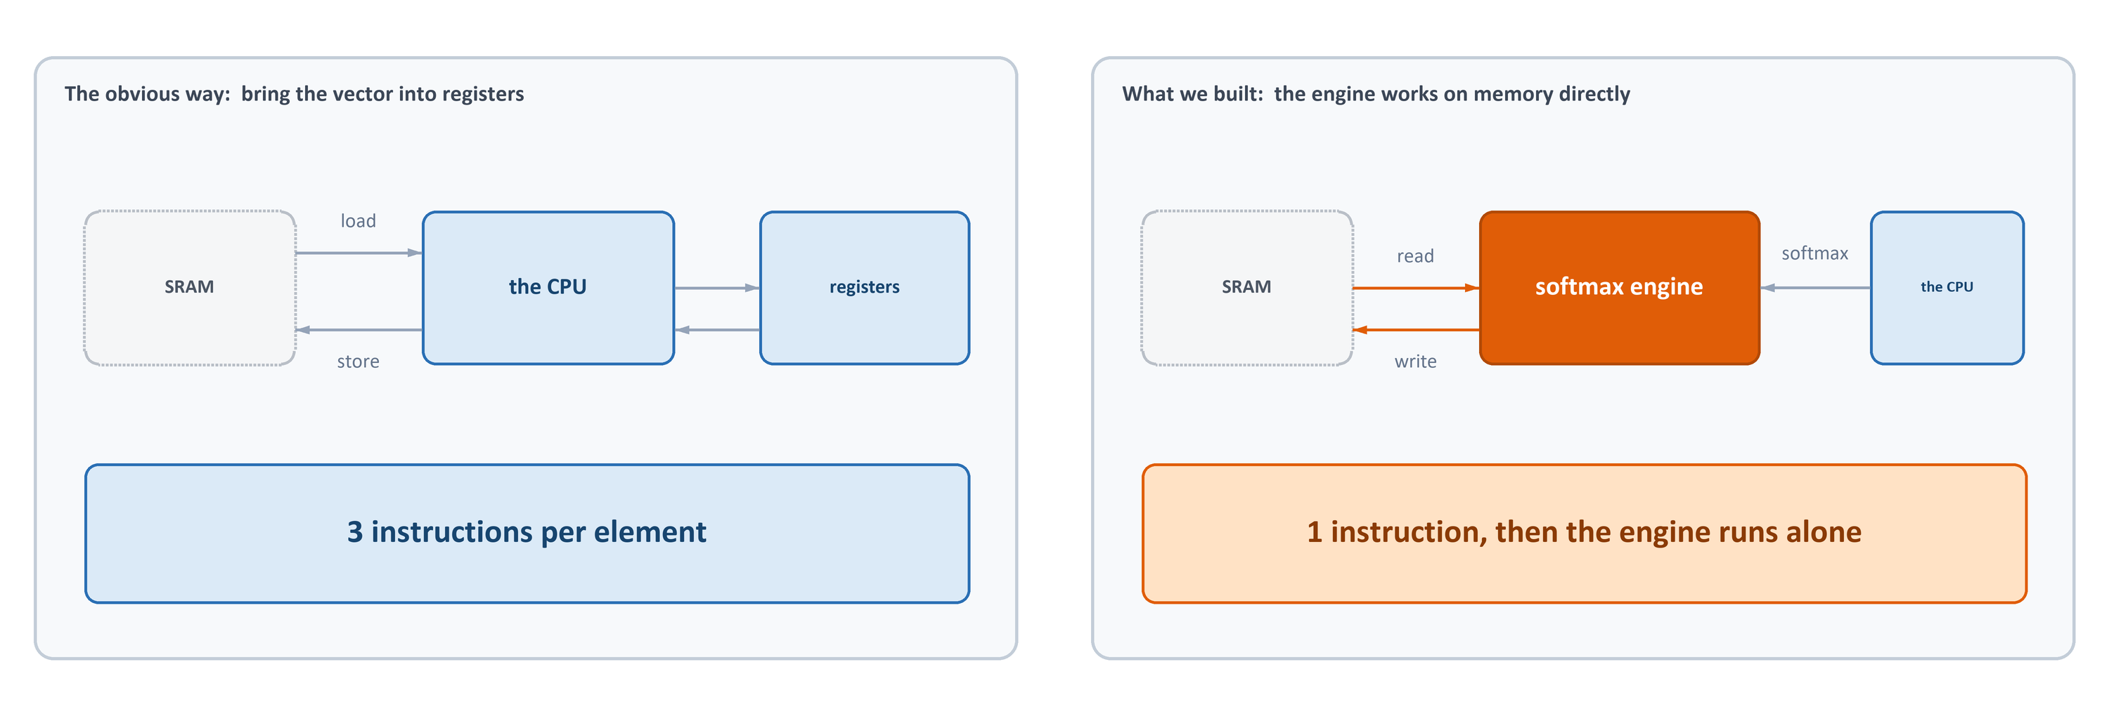
Why softmax could not live in registers
BUILDING IT IN · STEP 7 OF 7
Softmax needs the whole vector — so it is the one function that could not stay inside the register file.
18
Notes:
This is the design decision I most want you to take away.
The other four functions take one number and give one back — that fits the
processor perfectly. Softmax cannot, because it needs the whole vector before it
can produce any single output: every answer depends on the maximum and on the
sum over all elements.
On the left is the obvious approach: pull the vector through the register file.
Every element costs a load, the computation, and a store — and a load or a store
is fourteen clock cycles by itself. For a five-hundred-element vector that is
tens of thousands of cycles just moving data.
On the right is what we built. The softmax instruction hands the engine two
addresses and a length; the engine generates its own addresses and reads and
writes memory directly. The vector never enters a register.
That is why the memory arbiter had to exist, and it is why softmax shows the
biggest speed-up of all five functions, which you will see in a moment.
SOURCE: README.md 'Softmax Instruction'; design/Softmax/softmax_dma.v; load/store latency 14 clk from results/timing results/*.txt

Slide 19
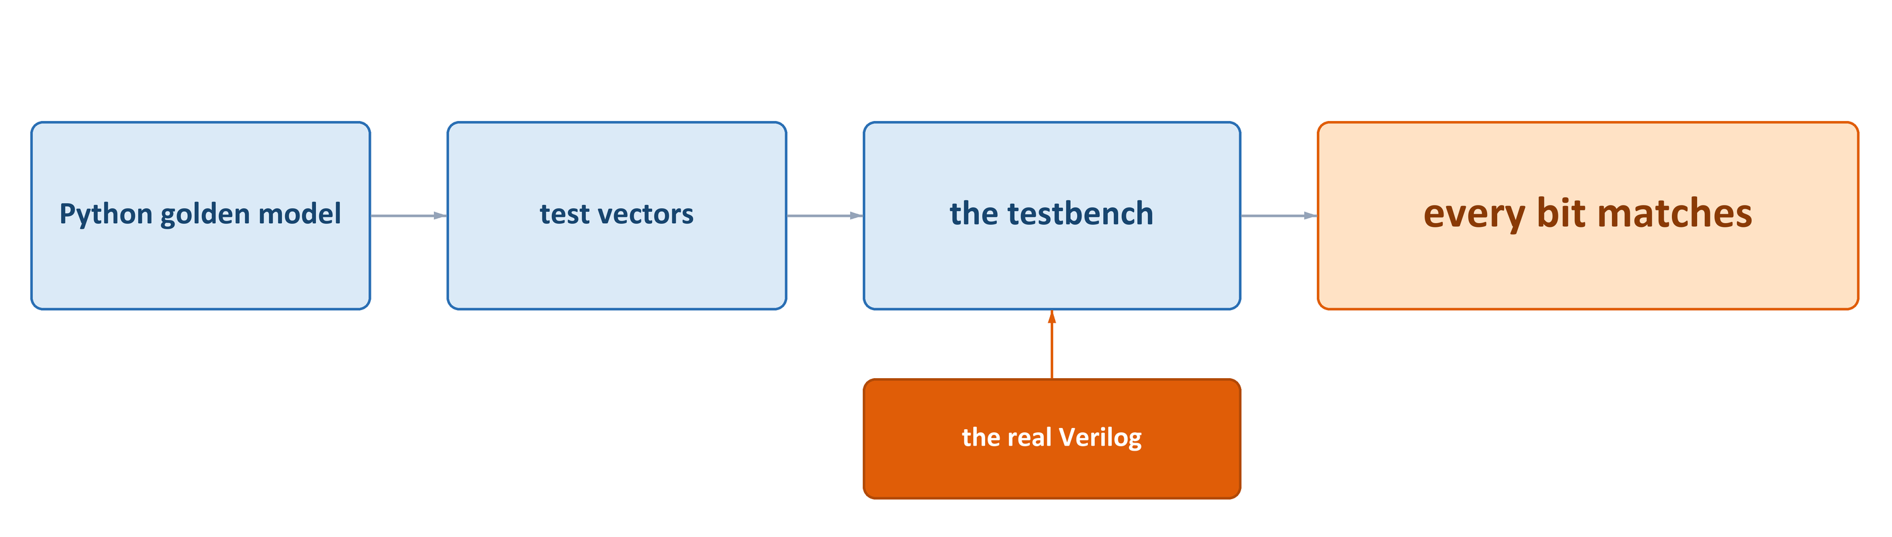
How we know it is right
VERIFICATION
1,835,012
1,050
0
input values swept through sigmoid, tanh and GELU
softmax vectors, up to 500 elements each
mismatches in the final suite after two real bugs were found
19
Notes:
Before the measurements, the obvious question: how do you know any of this is
actually correct?
The answer is that nothing in this project was checked by looking at a waveform
and deciding it seemed reasonable. For every unit we wrote a Python golden model
first — the same arithmetic, in Q16.16, worked out independently. That model
then generates the test vectors: each one is an input plus the exact 32-bit word
the hardware must produce. The testbench feeds those into the real Verilog, the
same module that gets synthesised onto the chip, and compares thirty-two bits
against thirty-two bits. Not approximately equal — identical.
The scale is the point. Sigmoid was swept with 655,362 inputs, GELU with
655,361, tanh with 524,289. That is not a sample; for those ranges it is
effectively every representable input, at the full Q16.16 step of two to the
minus sixteen. Softmax cannot be swept that way because its input is a whole
vector, so it gets 1,050 complete test vectors of up to five hundred elements,
checked element by element, with a coverage collector confirming every class of
vector was actually exercised.
And it did find real bugs. Early softmax runs failed on extreme-spread vectors —
the outputs summed to about 1.35 instead of 1. We root-caused and fixed those,
and re-ran the whole suite after every change.
The last piece is on the right, and it is the one a processor designer should
care about most. We re-run the entire original instruction set — ALU, shifts,
compares, loads, stores, branches, jumps — on the extended control unit. It all
still passes, which is the evidence that adding five instructions did not
quietly break the machine we started from.
SOURCE: project_book/sections/simulation.tex 'RTL Testbench Results'; vector counts from design/sigmoid_subenv/*_vectors.sv and design/Softmax/softmax_vectors.sv (SOFTMAX_NUM_TESTS = 1050)

Slide 20
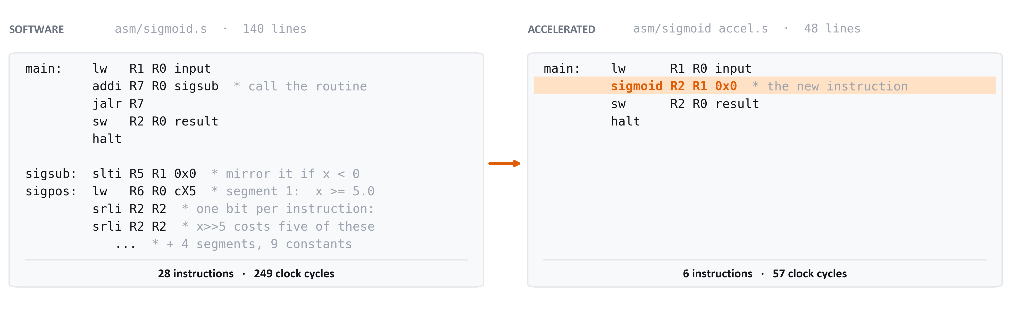
The same computation, written two ways
HOW THE SPEED WAS MEASURED
10
1
bit-exact
programs — a software and an accelerated version of each of the five functions
instruction replaces the whole routine what is left is load, store and halt
both programs return the same 32-bit word, so the comparison is honest
20
Notes:
Before the speed numbers, how they were produced, because a speed-up claim is
only worth what the comparison behind it is worth.
Every one of the five functions was written twice, as two complete DLX programs
that compute the same thing. Ten programs in total, and they all live in the
asm folder of the repository.
On the left is the software version. No new instructions — only what the
original DLX already had. For sigmoid that is the five-segment piecewise-linear
approximation done by hand: mirror the input if it is negative, compare against
each segment threshold, and shift. And notice the two srli lines, because this
is the detail people miss: our shifter moves exactly one bit per instruction,
so a divide-by-thirty-two is five instructions, not one. That is a hundred and
forty lines of assembly, twenty-eight instructions actually executed, two
hundred and forty-nine clock cycles.
On the right is the accelerated version. Load the input, one sigmoid
instruction, store the result, halt. The whole approximation moved out of the
program and into the Activation Engine. Six instructions, fifty-seven cycles.
Three things make this a fair fight. Same processor, same clock, same memory
system — the only difference is which instructions the program is allowed to
use. Same input word going in. And the same thirty-two-bit word coming out:
the software routine implements exactly the algorithm the hardware implements,
so both return 0x0000_EC00 for 0x0002_8000. If they disagreed, the comparison
would be meaningless, so bit-exactness is not a bonus here, it is what makes
the measurement valid.
ReLU is the honest exception. Its software version is only eight instructions
to begin with, so there is very little for the hardware to remove — and that
shows up in the next slide as the smallest gap of the five.
The counts on the next slide come from the simulator, not from an estimate:
every program was run to completion and the cycles counted.
SOURCE: asm/*.s and asm/*_accel.s (five pairs); results/DLX-NN_Project_Targets.xlsx, sheet '2. Cycle Count' (raw simulator logs: results/timing results/*.txt)

Slide 21
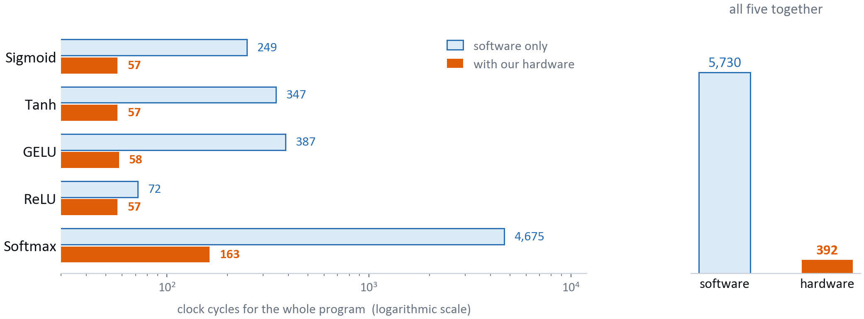
How much work the processor stops doing
RESULT 2 OF 3 · SPEED
5,730 → 392
14.6×
29×
clock cycles, all five programs
faster overall
faster on softmax alone
21
Notes:
Now the numbers those ten programs produced. The scale is logarithmic, because
the range is enormous.
Sigmoid: 249 cycles down to 57. Tanh: 347 down to 57. GELU: 387 down to 58. The
hardware numbers are almost identical because the work is now one instruction
finishing in one clock — what is left is the fetch, the load and the store.
ReLU: 72 down to 57. A much smaller gap, and I will come back to that.
Softmax: 4,675 cycles down to 163. That is the DMA design paying off.
Added together, the five programs went from 5,730 clock cycles to 392. Fourteen
and a half times faster overall; twenty-nine times faster on softmax alone.
SOURCE: results/DLX-NN_Project_Targets.xlsx, sheet '2. Cycle Count' (raw simulator logs: results/timing results/*.txt)

Slide 22
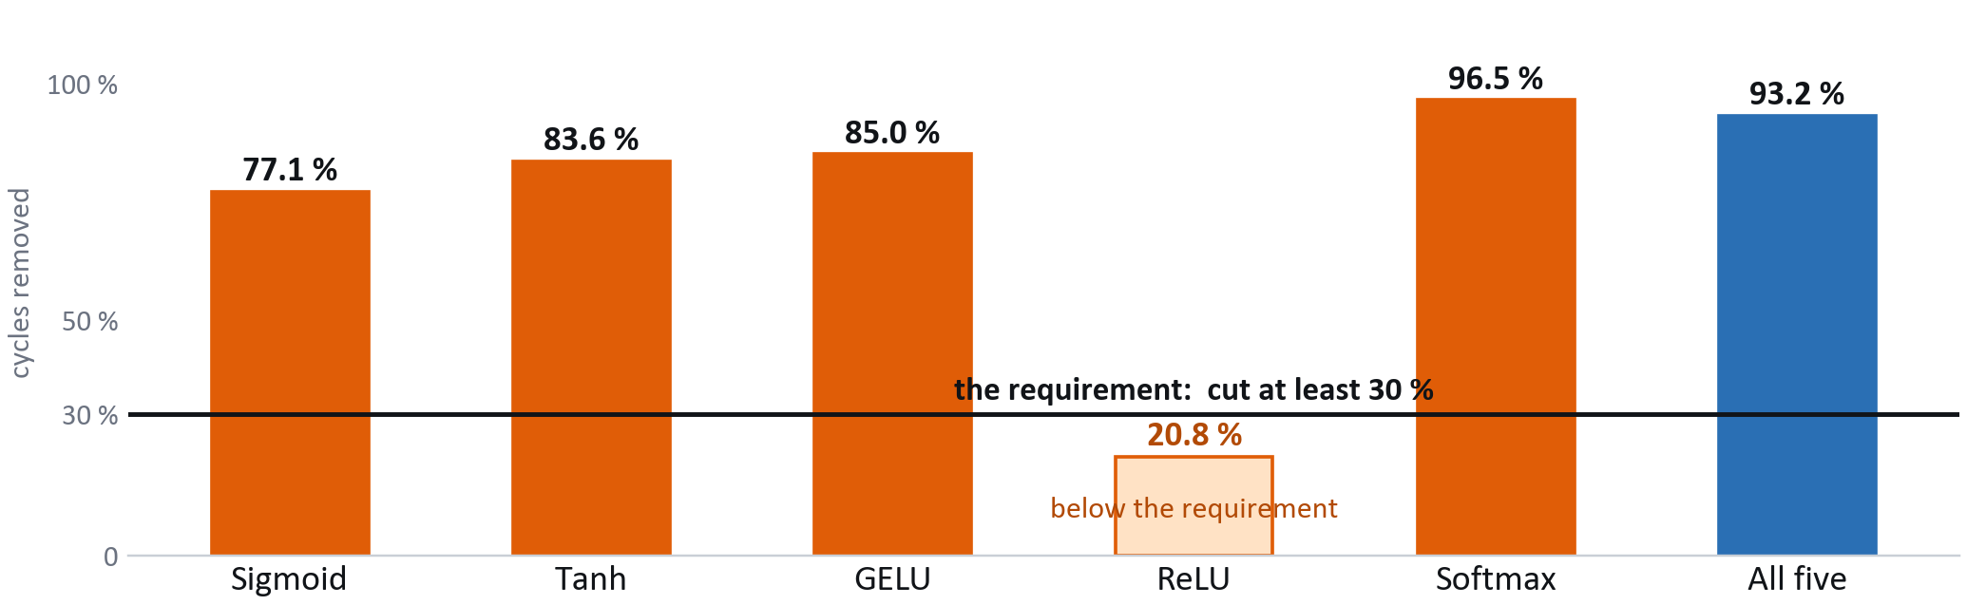
Against requirement R1: cut at least 30 % of the cycles
RESULT 2 OF 3 · SPEED
Four of the five clear it, 77 % to 96 %. ReLU cuts 20.8 % — its software version was already only eight instructions. Over all five programs together: 93.2 %.
22
Notes:
Here is the same data as a percentage, against the requirement.
Sigmoid removes 77 percent of the cycles. Tanh, 84. GELU, 85. Softmax, 96.5 —
all far above the line.
ReLU is at 20.8 percent and does not reach 30. I want to be straight about that
rather than hide it in an average.
The reason is the one from the ReLU slide. In software ReLU is a compare and a
branch — eight instructions, 72 cycles. Ours is six instructions, 57 cycles.
Most of what remains in both is not ReLU at all: it is the load and the store,
fourteen cycles each. You cannot accelerate away work the accelerator never
does.
Across all five programs together — which is how the requirement is stated, as
the cost of the activation workload — the reduction is 93.2 percent. So R1 is
met, and met with a large margin on the four functions that actually cost
something.
If ReLU alone had to clear 30 percent, the fix would not be a faster ReLU; it
would be a faster memory interface.
SOURCE: results/DLX-NN_Project_Targets.xlsx, sheet '2. Cycle Count' (raw simulator logs: results/timing results/*.txt); requirement R1 from CLAUDE.md and the 'Meets >= 30%?' column of the same sheet

Slide 23
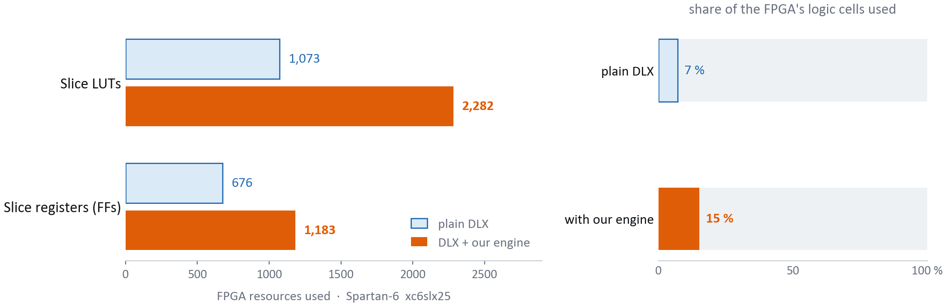
What it cost: area
RESULT 3 OF 3 · AREA
+113 %
6.9×
15 %
more logic cells budget was ≤ 20 % · over budget
better area × time the engine still pays for itself
of the FPGA used in total 85 % of the chip still free
23
Notes:
The third requirement, and the one we did not meet as stated — I would rather
put that on the slide than bury it.
The plain DLX uses 1,073 logic cells and 676 flip-flops; with the engine, 2,282
and 1,183. That is 113 percent more logic and 75 percent more registers, against
a 20 percent budget. We are well over it.
Two things to say, and neither is an excuse.
First: a 20 percent budget was realistic for a small arithmetic unit, not for
what we actually built — a piecewise-linear evaluator, a reciprocal unit, a
two-pass state machine and a DMA engine with its own address generator. The
softmax engine alone is a large share of that growth. The budget should have
been set per function, not for the whole extension.
Second, the number that decides whether it was worth doing: area multiplied by
time. Across all five functions that improves 6.9 times; for softmax alone,
13.5. The only bad trade is ReLU, the same story as the previous slide.
And in absolute terms it is not large: the whole extended processor uses fifteen
percent of this Spartan-6.
SOURCE: results/DLX-NN_Project_Targets.xlsx, sheet '3. Area' (raw: results/Utilization_Summary/*.pdf); results/DLX-NN_Project_Targets.xlsx, sheet '4. Worth It (Area x Delay)'

Slide 24
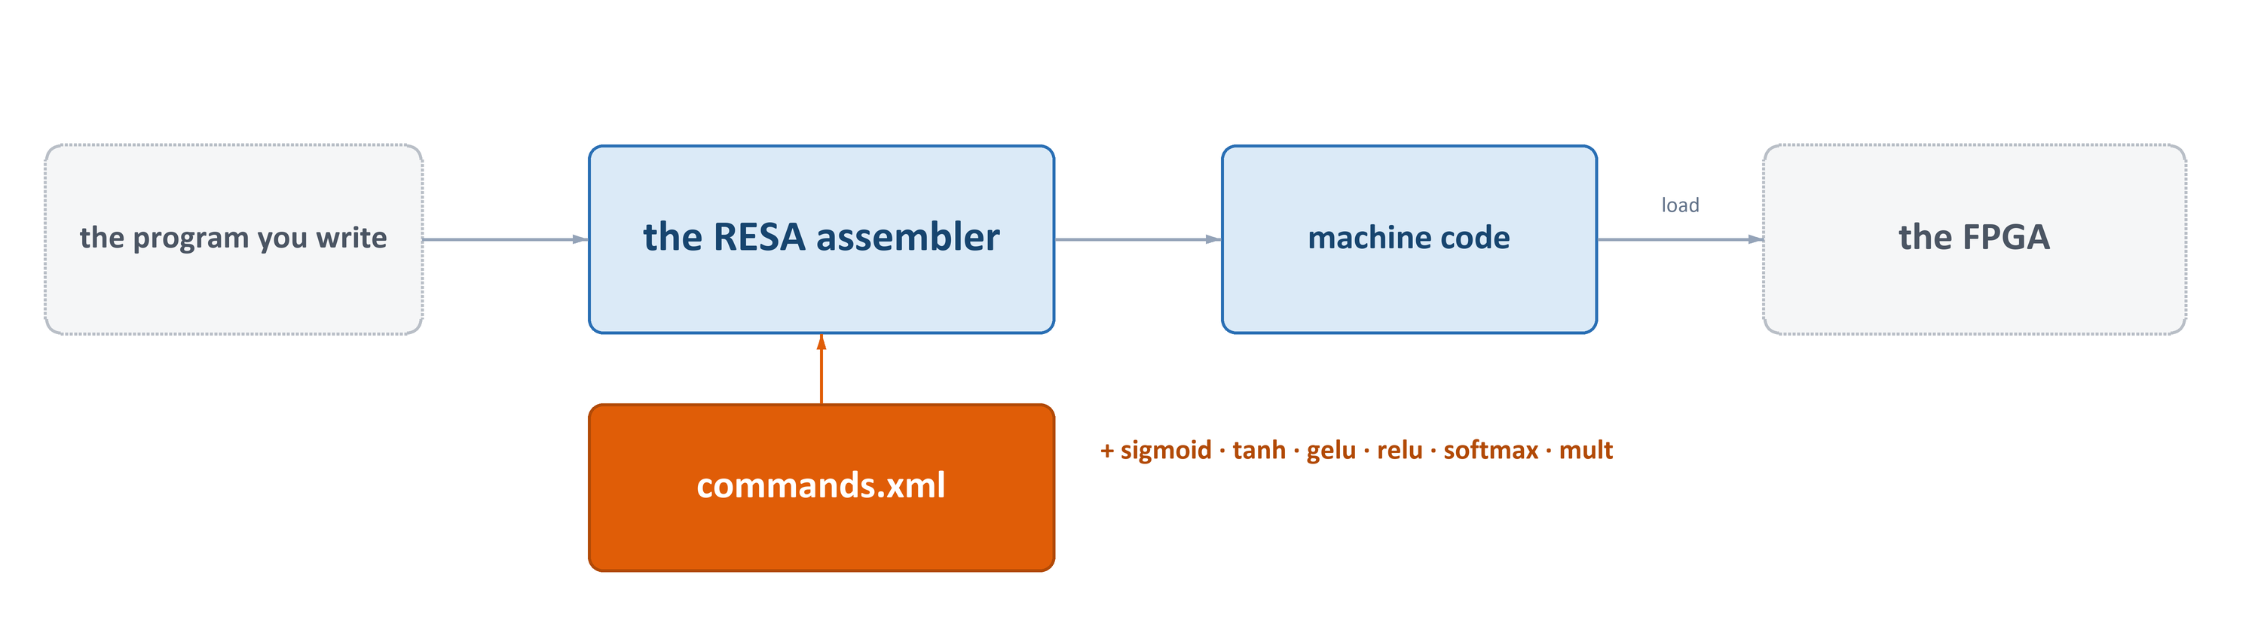
Teaching the assembler the new instructions
MAKING IT PROGRAMMABLE
BEFORE · the assembler had never heard of it
AFTER · one line, checked as you compile
dc 0xE0220000
sigmoid R2 R1 0x0
a raw word, typed by hand
the assembler emits the same word
All six are declared I-type on purpose — RESA's R-type encoder forces the opcode to zero and would emit the wrong word.
24
Notes:
One piece of this project is neither hardware nor mathematics, and it is what
makes the rest usable.
We put five instructions in the silicon, but the lab's assembler knew nothing
about them: writing "sigmoid R2 R1 0x0" was a syntax error. The only way to
reach our own hardware was to hand-compute the 32-bit word and paste it in as a
raw constant — the line on the left.
RESA does not have its instruction set compiled in; it reads it at start-up from
commands.xml. So we added six entries to that file — the five activations plus
the Q16.16 multiply — each declaring the mnemonic, the operands and the opcode
bits. Now the line on the right assembles to exactly the same word, and the
operands get checked for us.
One trap. All six are declared I-type, even softmax and mult, whose hardware
format is really R-type — because RESA's R-type encoder forces the opcode field
to zero and ignores what you declare, so a type-R entry emitted a completely
different instruction. The I-type layout happens to produce the exact hardware
word.
And one instruction had to go: pushi used opcode 111001, which now belongs to
tanh.
SOURCE: RESA_ENV/commands.xml (the table the RESA compiler reads); RESA_ENV/OPCODES.md; hand-encoding 0xE0220000 from README.md

Slide 25
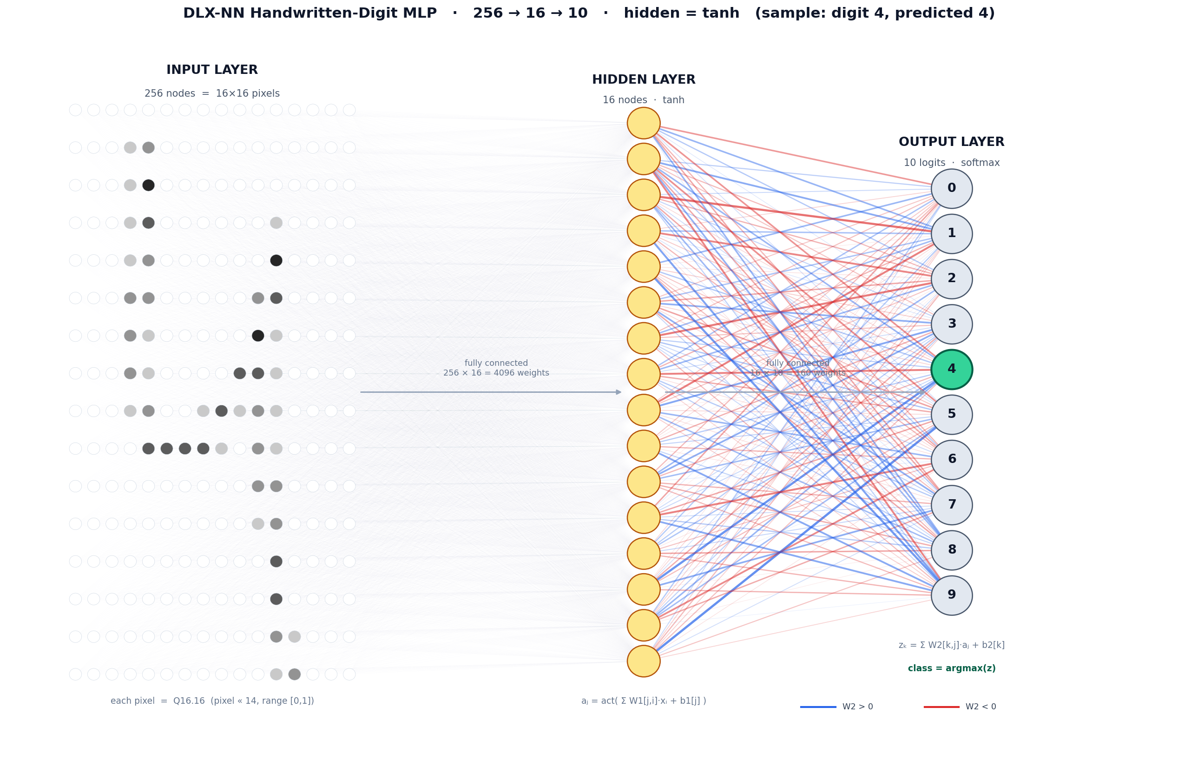
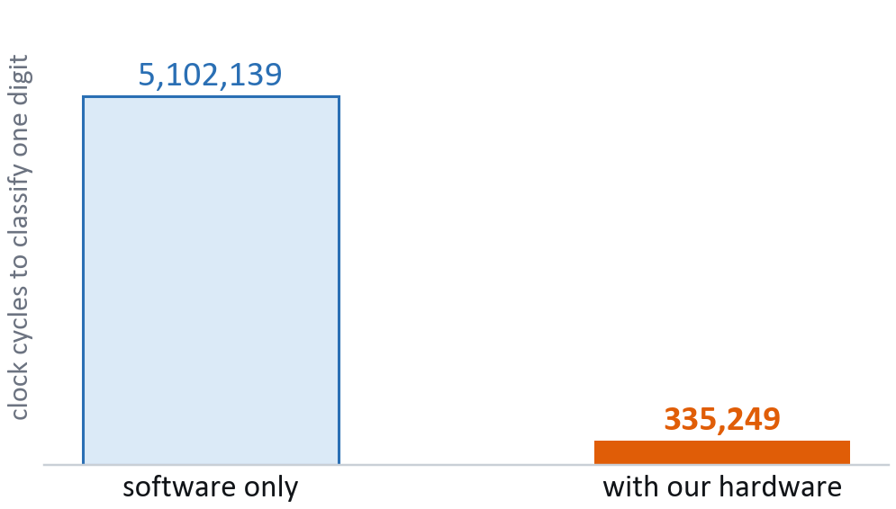
The demonstration: reading handwritten digits
IT ACTUALLY RUNS
THE NETWORK
256 pixels → 16 hidden neurons → 10 scores → softmax → the digit.
15× fewer clock cycles, same prediction. 95.33 % correct on the standard test set.
25
Notes:
Finally, the whole thing doing a real job.
A small network that reads handwritten digits. The image is sixteen by sixteen —
that grid on the left is all 256 pixels. They feed sixteen hidden neurons, which
feed ten scores, one per digit. Softmax turns those into probabilities and the
largest wins. Here it reads a zero; the green node is the answer.
Every activation in that picture is one of ours: ReLU in the hidden layer,
softmax at the output.
We wrote the network twice in DLX assembly — once with the original instruction
set, once with ours — and check the output scores are bit-for-bit identical
before trusting anything.
The software version takes about 635,000 steps. The hardware version takes about
34,400. Eighteen times fewer.
On the standard test set the network is 95.6 percent accurate with ReLU, 95.3
with tanh. On ten digits we drew and photographed ourselves it gets nine out of
ten — the miss is a four read as a nine, a genuinely ambiguous shape at sixteen
by sixteen rather than a bug.
SOURCE: nn/asm-nn/generated/README.md and nn/asm-nn/diagram/NN_EXPLAINED.md

Slide 26
What we set out to do, and where we landed
SUMMARY
Accuracy
worst case 4.9 × 10⁻⁴
MET
mean squared error ≤ 0.025
Speed (R1)
93.2 % over the five programs four of five clear it; ReLU is 20.8 %
MET
cut at least 30 % of the clock cycles
Area
+113 % logic — but area × time improves 6.9×, and it still fits in 15 % of the FPGA
MISSED
no more than 20 % extra logic
Five activation functions, multiplier-free except GELU, and a real classifier running on them.
26
Notes:
To summarise against the three requirements we set at the start.
Accuracy: required no worse than 0.025 mean squared error. Our worst function is
GELU at 4.9 ten-thousandths, fifty times inside the requirement, and ReLU is
exact. Met.
Speed, requirement R1: required a 30 percent cut. Over the five programs
together we removed 93.2 percent. Four of the five clear the line individually;
ReLU is at 20.8 percent because its software version was already almost free.
Area: required no more than 20 percent extra logic. We used 113 percent more.
Missed, and I will not argue otherwise — only that area multiplied by time still
improves 6.9 times, and the finished processor occupies fifteen percent of the
FPGA, so nothing about it is impractical.
What exists at the end: a DLX processor with five new instructions, one shared
sigmoid core serving three of them, a DMA softmax engine that works directly on
memory, and a handwritten-digit classifier that runs on the result.
SOURCE: results/DLX-NN_Project_Targets.xlsx, sheet '1. Accuracy'; results/DLX-NN_Project_Targets.xlsx, sheet '2. Cycle Count' (raw simulator logs: results/timing results/*.txt); results/DLX-NN_Project_Targets.xlsx, sheet '3. Area' (raw: results/Utilization_Summary/*.pdf); results/DLX-NN_Project_Targets.xlsx, sheet '4. Worth It (Area x Delay)'

Slide 27
Thank you
Questions?
Saed Abu Fool · Saleh Khalil Supervisor: Oren Ganon
Notes:
Thank you. We are happy to take questions.
Things we are ready for: why piecewise-linear instead of a lookup table; why
Q16.16 rather than floating point; what the softmax engine does when the vector
is longer than the 2047-element limit; how the area would change if softmax were
dropped; and what would have to change to pipeline the processor.

