Slide 1
MEMORY
AND
FORGETTING

Slide 2
Memory is storage and retrieval of information
In psychology, memory is an organism's mental ability to store, retain and recall information.
Memory is the retention of, and ability to recall, information, personal experiences, and procedures (skills and habits).
‘Memory’ is a label for a diverse set of cognitive capacities by which humans and perhaps other animals retain information and reconstruct past experiences, usually for present purposes.

Slide 3
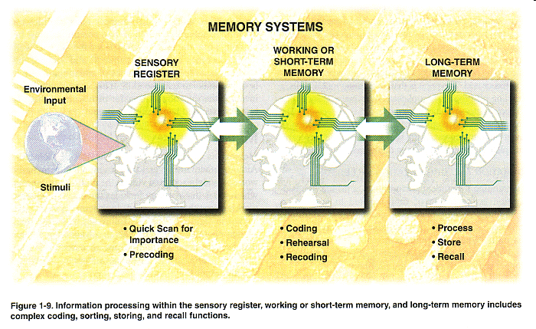

Slide 4
Brain Areas Included in Memory
The hippocampus, a primitive structure deep in the brain, plays the single largest role in processing information as memory.
The amygdala, an almond-shaped area near the hippocampus, processes emotion and helps imprint memories that involve emotion.
The cerebral cortex, the outer layer of the brain, stores most long-term memory in different zones, depending on what kind of processing the information involves: language, sensory input, problem-solving, and so forth.
In addition, memory involves communication among the brain’s network of neurons, millions of cells activated by brain chemicals called neurotransmitters.

Slide 5
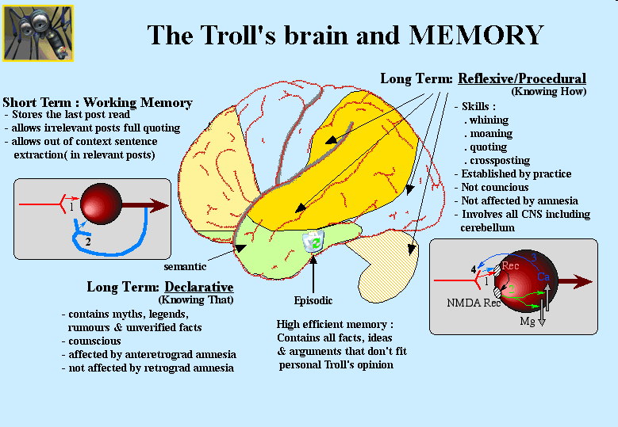

Slide 6
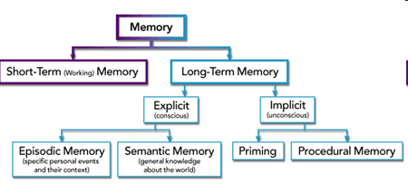
Types Of Memory

Slide 7
Short term Memory
Short-term memory—closely related to “working” memory—is the very short time that you keep something in mind before either dismissing it or transferring it to long-term memory. Short-term memory is shorter than you might think, lasting less than a minute. It’s what allows you to remember the first half of a sentence you hear or read long enough to make sense of the end of the sentence. But in order to store that sentence (or thought, fact, idea, word, impression, sight, or whatever else) for longer than a minute or so, it has to be transferred to long-term memory.

Slide 8
Long term Memory
long-term memory is anything you remember that happened more than a few minutes ago. Long-term memories aren’t all of equal strength. Stronger memories enable you to recall an event, procedure, or fact on demand—for example, that Paris is the capital of France. Weaker memories often come to mind only through prompting or reminding.

Slide 9
Sensory Memory
Sensory memory is the ability to retain impressions of sensory information after the original stimulus has ceased. It refers to items detected by the sensory receptors which are retained temporarily in the sensory registers and which have a large capacity for unprocessed information but are only able to hold accurate images of sensory information momentarily. The two types of sensory memory that have been most explored are iconic memory and echoic memory.

Slide 10
Declarative Memory
Declarative memory is the aspect of human memory that stores facts. It is so called because it refers to memories that can be consciously discussed, or declared. It applies to standard textbook learning and knowledge, as well as memories that can be 'travelled back to' in one's 'mind's eye'.

Slide 11
Procedural Memory
Procedural memory is the long-term memory of skills and procedures, or "how to" knowledge (procedural knowledge).
It is considered a form of implicit memory.

Slide 12
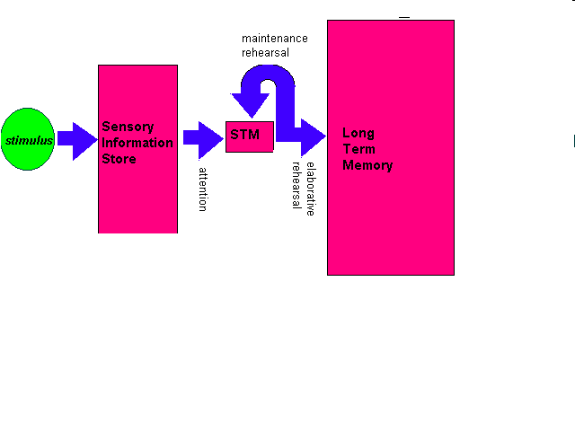
Models of Memory

Slide 13
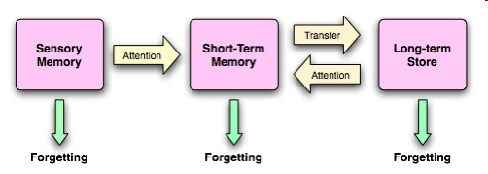

Slide 14
The Atkinson-Shiffrin model (also known as the Multi-store model, Multi-memory model and the Modal model) is a psychological model proposed in 1968 by Richard Atkinson and Richard Shiffrin as a proposal for the structure of memory. It proposed that human memory involves a sequence of three stages:
Sensory memory (SM)
Short-term memory (STM)
Long-term memory (LTM)

Slide 15
Memory Span
Memory span: The number of items, usually words or numbers, that a person can retain and recall. Memory span is a test of working memory (short-term memory). In a typical test of memory span, an examiner reads a list of random numbers aloud at about the rate of one number per second. At the end of a sequence, the person being tested is asked to recall the items in order. The average span for normal adults is seven to nine.

Slide 16
Memory Process
Human memory, like memory in a computer, allows us to store information for later use. In order to do this, however, both the computer and we need to master three processes involved in memory.
Encoding
Storage
Retrieval

Slide 17
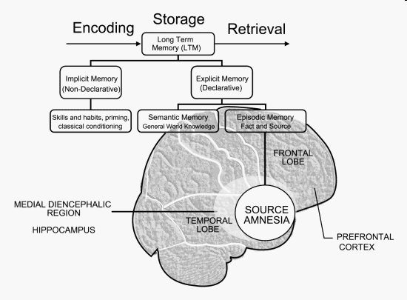

Slide 18
Encoding:
The process we use to transform information so that it can be stores.
Storage:
It simply means holding onto the information.
Retrieval:
It is bringing the memory out of storage and reversing the process of encoding. In other words, return the information to a form similar to what we stored.

Slide 19
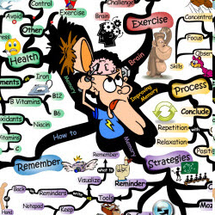
Methods of Improving Memory

Slide 20
RECALL:
This involves digging into the memory and bringing back information on a stimulus/response basis, e.g., "What is the capital of New Zealand?" Answer: "Wellington". Recall often needs prompting with cues to help us retrieve what we are looking for. It is not a reliable form of memory and many of us experience the feeling that we know the answer but simply can't dig the information out. This is the technique we use to remember people's names, hence we often forget them. There are three types of recall:
Free recall: when no cues are given to assist retrieval
Serial recall: when items are recalled in a particular order
Cued recall: when some cues are given to assist retrieval

Slide 21
Recognition (re+cognition) is a process that occurs in thinking when some event, process, pattern, or object recurs. Coming from the base cognition; cognition has various uses in different fields of study and has generally accepted to be used for the process of awareness or thought.

Slide 22
RELEARNING:
Another means of remembering is through relearning. Relearned information may return quickly, even if it hasn't been used for many years.

Slide 23
Tips for memory improvements
Brain exercises
Memory, like muscular strength, is a “use it or lose it” proposition. The more you work out your brain, the better you’ll be able to process and remember information.
Aerobics:
The best way to improve our memories seems to be to increase the supply of oxygen to the brain, which we can do by aerobic exercising. Walking for three hours each week suffices, as does swimming or bicycle riding.

Slide 24
General guidelines to improve memory
Pay attention:
You can’t remember something if you never learned it, and you can’t learn something — that is, encode it into your brain — if you don’t pay enough attention to it.
Involve as many senses as possible.
Relate information to what you already know.
Organize information.

Slide 25
Understand and be able to interpret complex material.
Rehearse information frequently and “over-learn”.
Be motivated and keep a positive attitude.

Slide 26
Healthy habits to improve memory
Regular exercise
Reduces the risk for disorders that lead to memory loss, such as diabetes and cardiovascular disease.
Increases oxygen to your brain.
3. May enhance the effects of helpful brain chemicals and protect brain cells.
Managing stress
Cortisol, the stress hormone, can damage the hippocampus if the stress is unrelieved.
Stress makes it difficult to concentrate.
Good sleep habits
Sleep is necessary for memory consolidation.
Sleep disorders like insomnia and sleep apnea leave you tired and unable to concentrate during the day.
Not smoking
Smoking heightens the risk of vascular disorders that can cause stroke and constrict arteries that deliver oxygen to the brain.

Slide 27
Memory and aging
Several factors cause aging brains to experience changes in the ability to retain and retrieve memories:
The hippocampus is especially vulnerable to age-related deterioration, and that can affect how well you retain information.
There’s a relative loss of neurons with age, which can affect the activity of brain chemicals called neurotransmitters and their receptors.
An older person often experiences decreased blood flow to the brain and processes nutrients that enhance brain activity less efficiently than a younger person.

Slide 28

FORGETTING

Slide 29
Forgetting (retention loss) refers to apparent loss of information already encoded and stored in an individual's long term memory. It is a spontaneous or gradual process in which old memories are unable to be recalled from memory storage.

Slide 30
AMNESIA
“Amnesia is loss of ability to memorize information or to recall information stored in memory.”

Slide 31
WHAT CAUSES
AMNESIA?
Amnesia is most commonly associated with either brain damage through injury or degeneration of brain cells in dementia.

Slide 32
FORMS OF AMNESIA
ANTEROGRADE AMNESIA:
In Anterograde amnesia patient cannot retain any new memory.
RETROGRADE AMNESIA:
In Retrograde amnesia the patient cannot recall the past events.

Slide 33
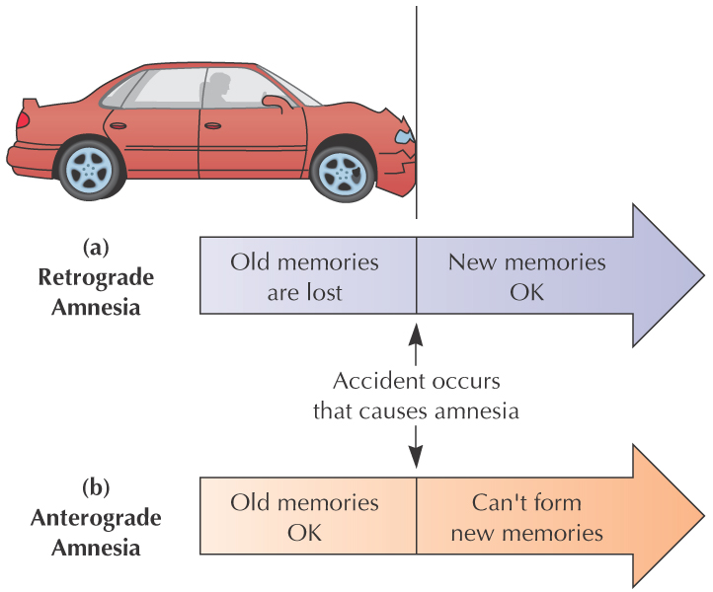
FORMS OF AMNESIA
(cont.)

Slide 34
Repression:
Refers to the inability to recall information, usually about stressful or traumatic events in persons' lives, such as a violent attack or rape. The memory is stored in long term memory, but access to it is impaired because of psychological defense mechanisms. Persons retain the capacity to learn new information and there may be some later partial or complete recovery of memory. This contrasts with e.g. anterograde amnesia caused by amnestics such as benzodiazepines or alcohol, where an experience was prevented from being transferred from temporary to permanent memory storage: it will never be recovered, because it was never stored in the first place. Formerly known as "Psychogenic Amnesia"

Slide 35
Memory impairments
Alzheimer disease: Initially starts with simple forgetting resulting in language and physical deterioration.Cuase can be defect in production of protein amyloid.
Korsakoff syndrome amnesia due chronic alcohol.

Slide 36
Interference theory
Interference theory (also known as retrieval interference (Roediger & Karpicke, 2006)) refers to the idea that forgetting occurs because the recall of certain items interferes with the recall of other items. In nature, the interfering items are said to originate from an over stimulating environment.

Slide 37
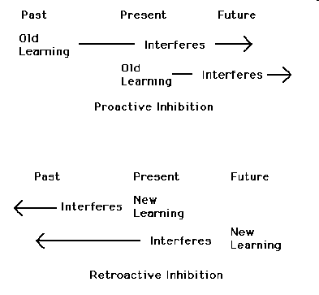
TYPES OF INTERFERENCE

Slide 38
Proactive interference
Underwood (1957) provided early evidence that things you've learned before encoding a target item can worsen recall of that target item. In a meta-analysis of multiple experiments, he showed that the more lists one had already learned, the more trouble one had in recalling the most recent one. This is proactive interference, where the prior existence of old memories makes it harder to recall newer memories.
e.g Psy----phil----problem in recalling philosophy

Slide 39
Retroactive interference
Retroactive interference occurs when later learning interferes with previous learning; i.e., learning new things somehow overwrites or obscures existing knowledge.
e.g Psy---phil----problem in recalling psychology

Slide 40
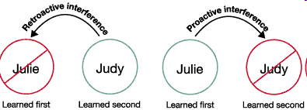

Slide 41
Output interference
Output interference occurs when the act of retrieving interferes with the retrieval of the actual information needed in the first place. Primarily, this is caused by the limited capacity of the short-term memory.

Slide 42
Cue-dependent forgetting:
It is the failure to recall a memory due to missing stimuli or cues that were present at the time the memory was encoded. It is one of five cognitive psychology theories of forgetting. It states that a memory is sometimes temporarily forgotten purely because it cannot be retrieved, but the proper cue can bring it to mind. A good metaphor for this is searching for a book in a library without the reference number, title, author or even subject. The information still exists, but without these cues retrieval is unlikely. Furthermore, a good retrieval cue must be consistent with the original encoding of the information. If the sound of the word is emphasized during the encoding process, the cue that should be used should also put emphasis on the phonetic quality of the word

